Slide 1





















Unit 4
My house
Lesson 1 – Task 1,2,3
Notes:
Để nguyên trang bìa như này, chỉ thay đổi tên bài trong quá trình làm. Logo của sách Wonderful World

Slide 2

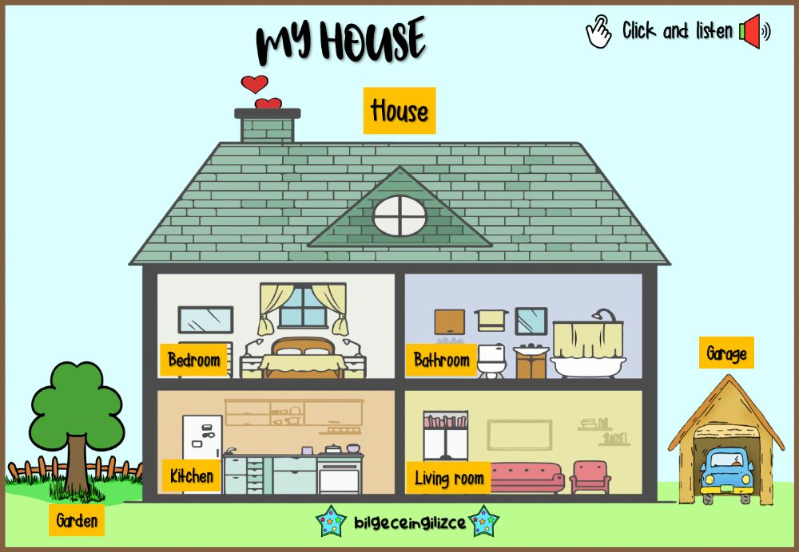
LEAD IN
Notes:
Lead in: Teacher introduces your house

Slide 3
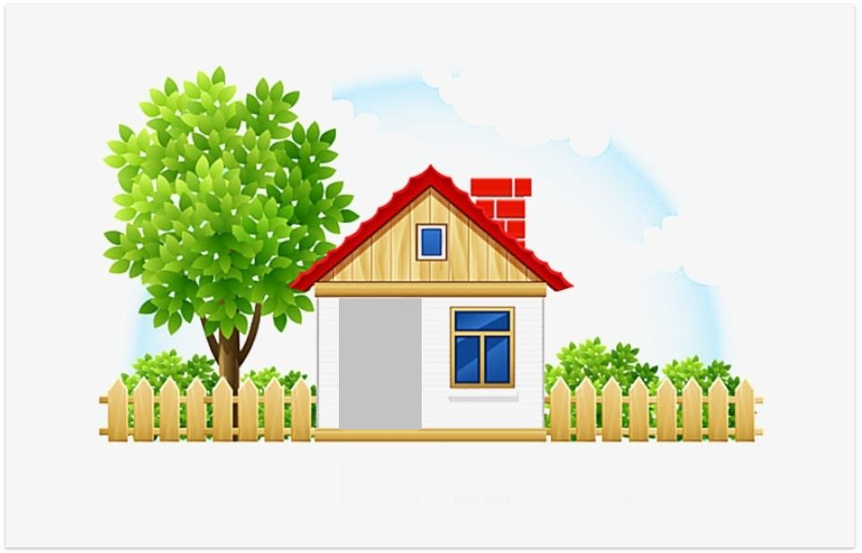


Presentation

Slide 4
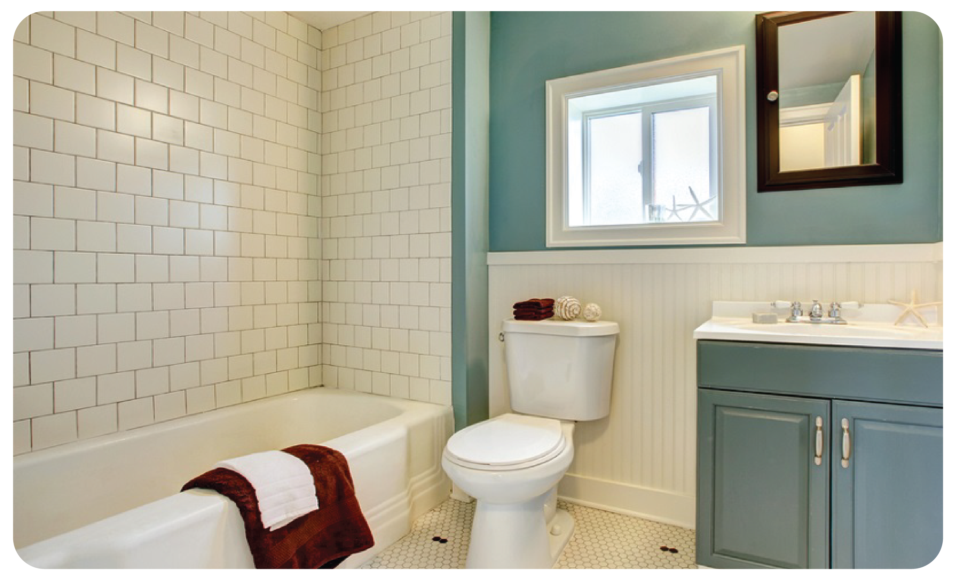
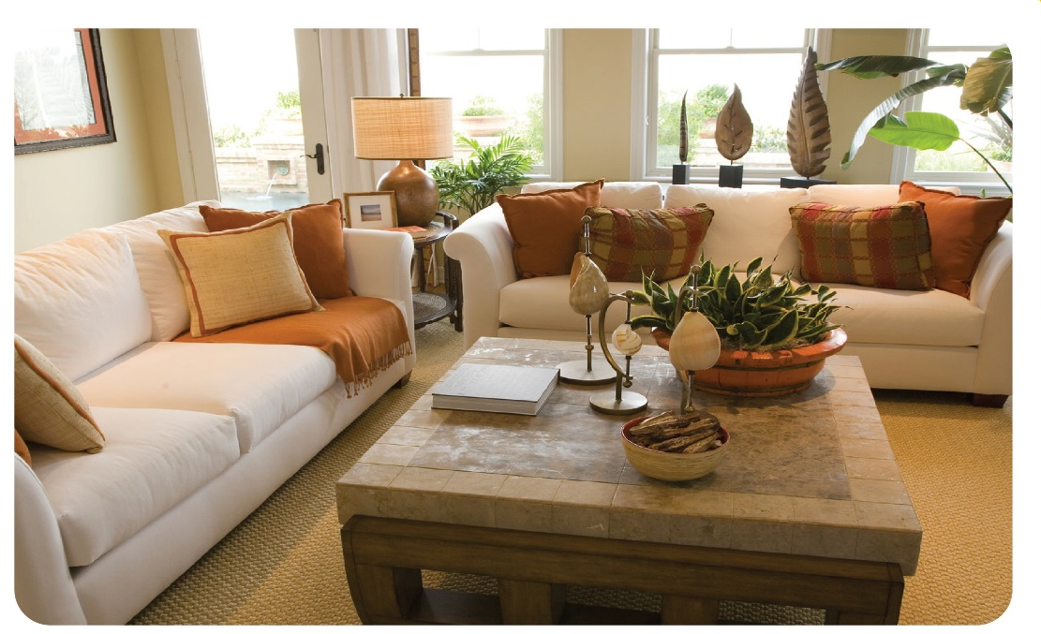
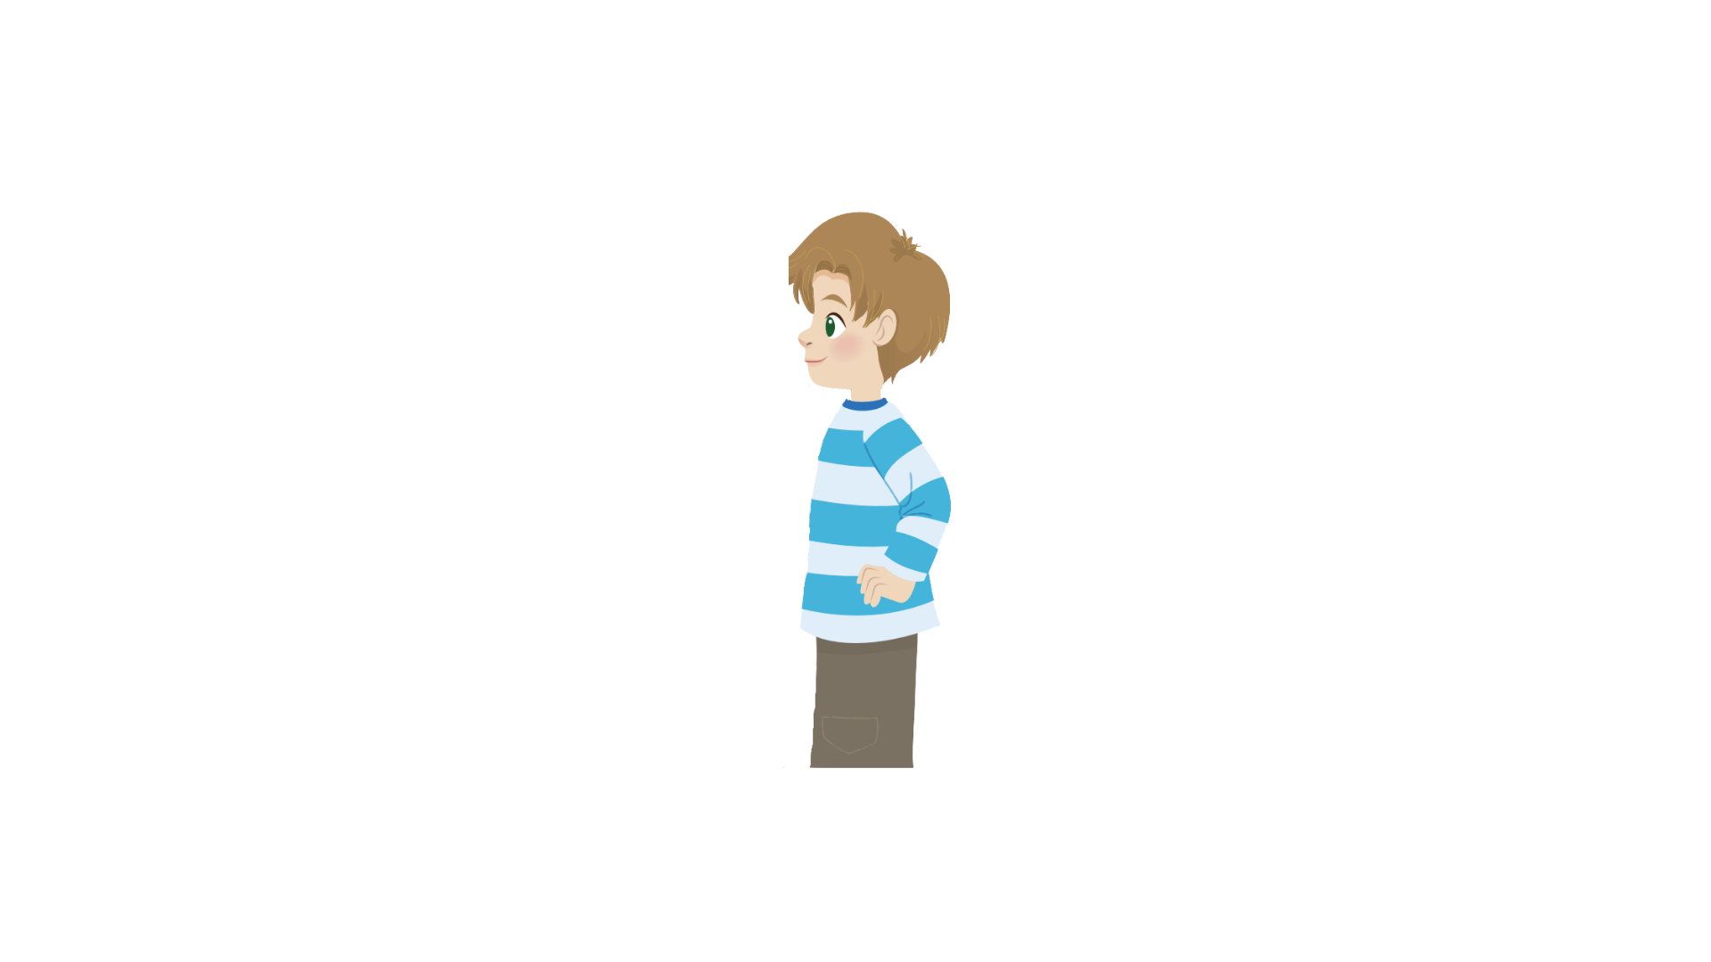

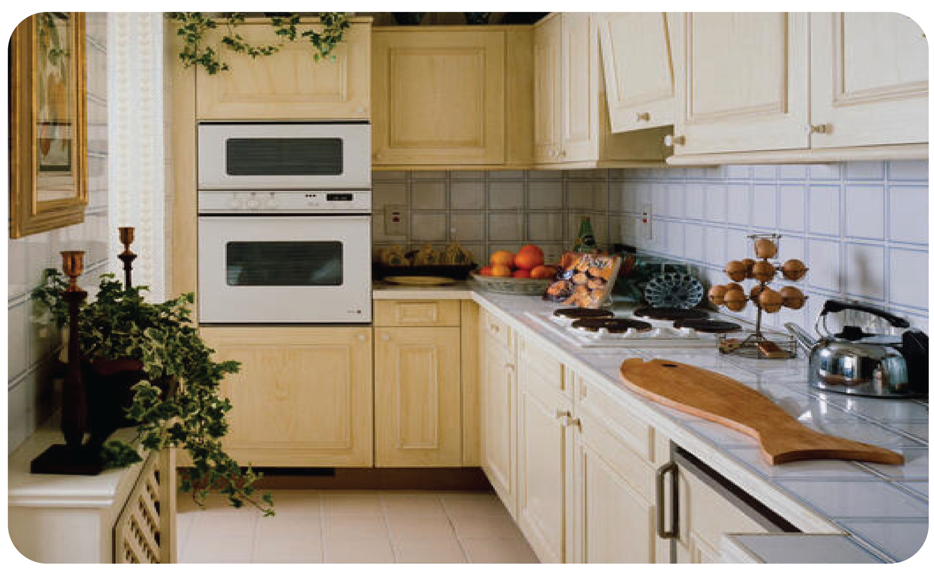
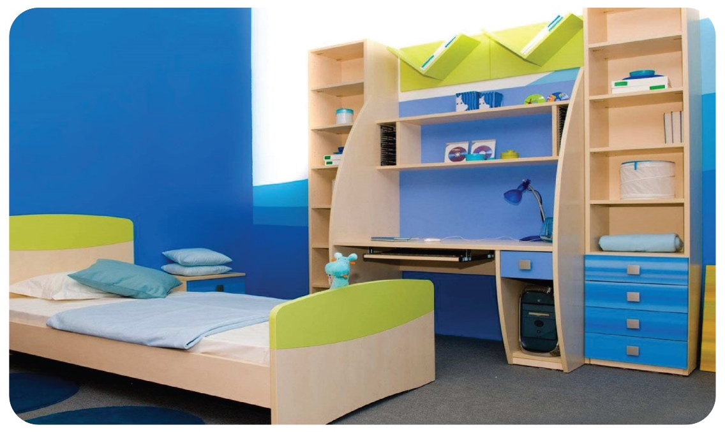
1 Listen and point. Repeat.
bathroom
living room
kitchen
bedroom

Slide 5
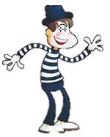
bathroom
living room
kitchen
bedroom

Slide 6

Practice

Slide 7

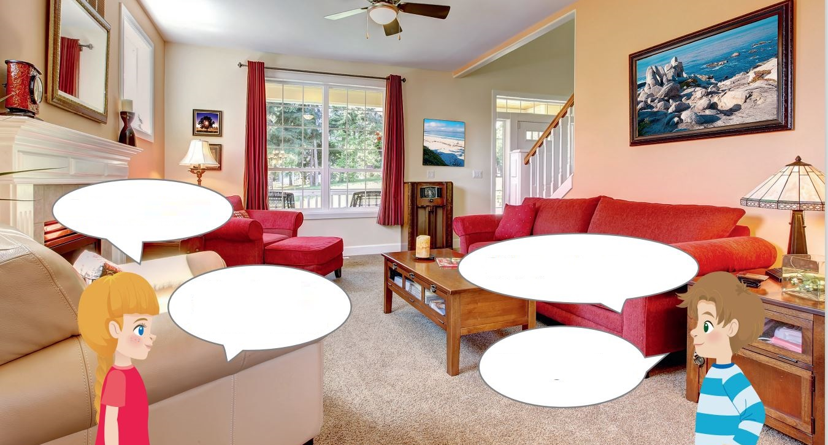
2
Listen and tick.
What’s this?
It’s a living room.
It’s nice.
What’s that?
It’s a garden.
The living room garden is nice.
✓
Notes:
HOẠT ĐỘNG TƯƠNG TÁC: chèn file nghe
Listen and tick:
The ______ is nice.
living room
garden

Slide 8
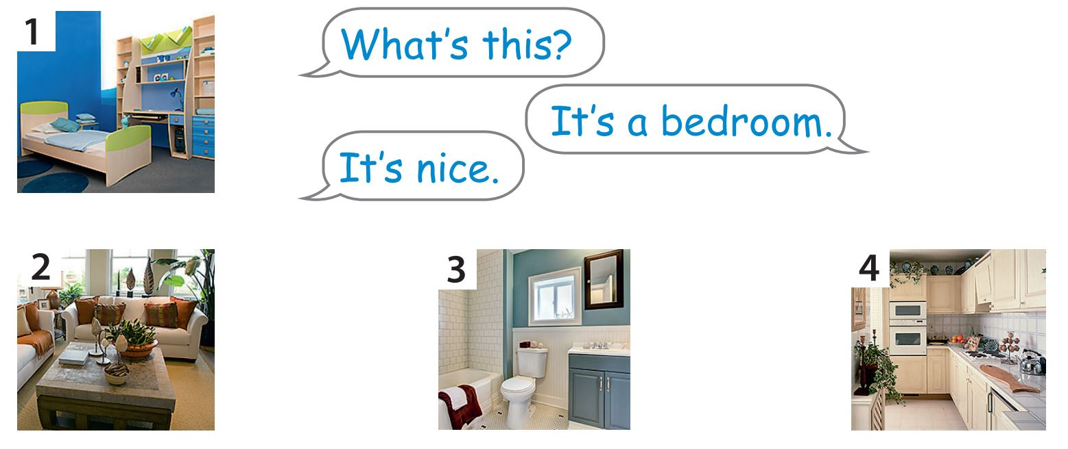
3
Look. Ask and answer.

Slide 9
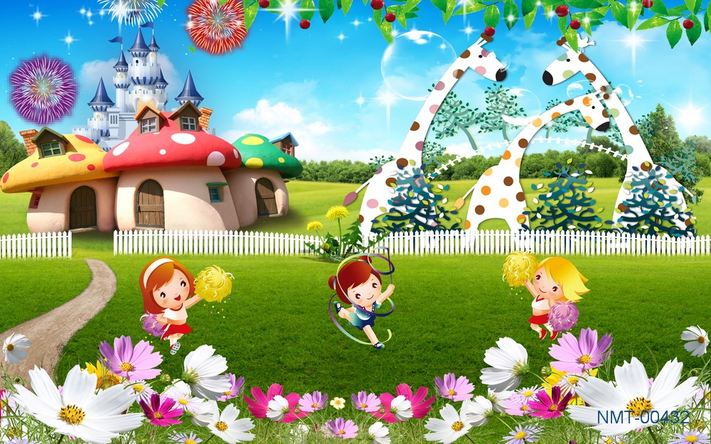

Slide 10





What’s this?
It’s a bedroom.
It’s nice.
bedroom

Slide 11
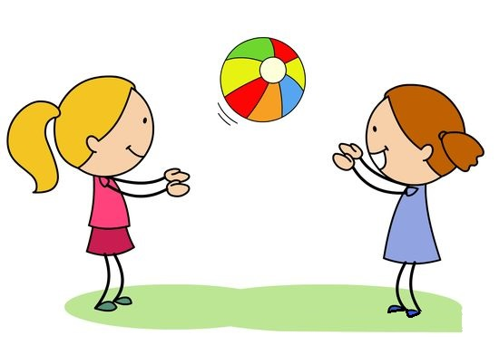
Pass the ball Game
Start

Slide 13
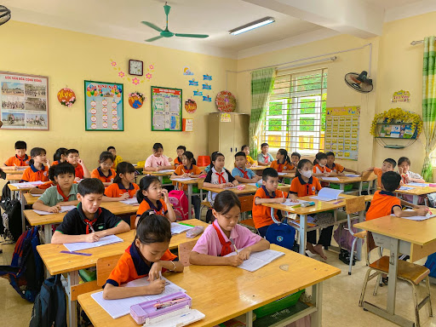

Slide 14
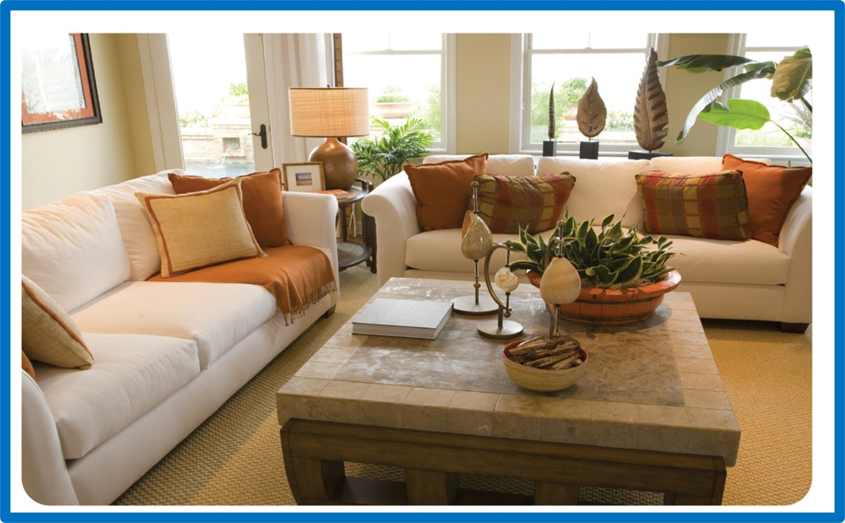
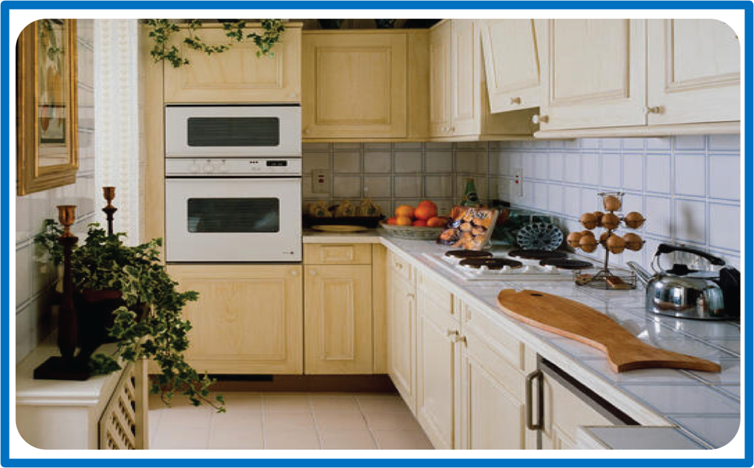
1
2
3
Next

Slide 15


What’s this?
It’s a bathroom.
It’s nice.
1

Slide 16
What’s this?
It’s a living room.
It’s nice.
2

Slide 17
What’s this?
It’s a kitchen.
It’s nice.
3

Slide 18

Production

