Slide 1



















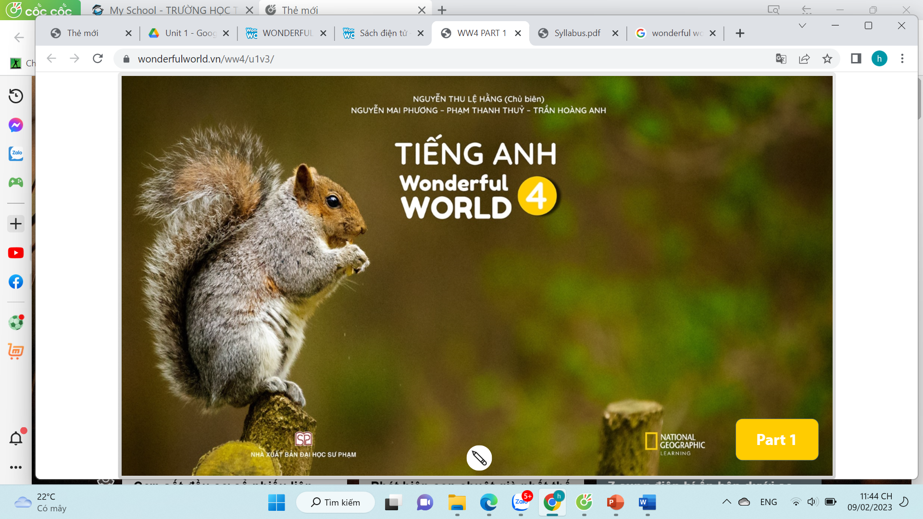

Notes:
Để nguyên trang bìa như này, chỉ thay đổi tên bài trong quá trình làm. Logo của sách Wonderful World

Slide 2













Unit 1:
My family and friends
Lesson 2. Task 1 2 3

Slide 3
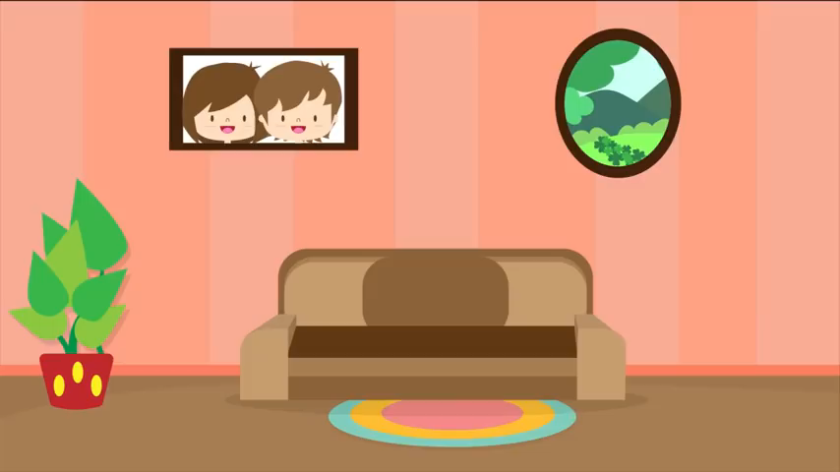

Slide 4

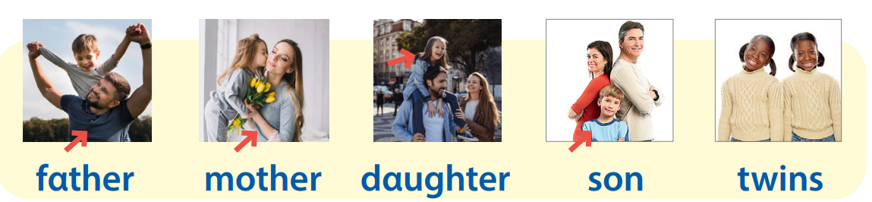


Warm up:
Review
Notes:
- Revise the words from Lesson 1 with the flashcards.

Slide 5
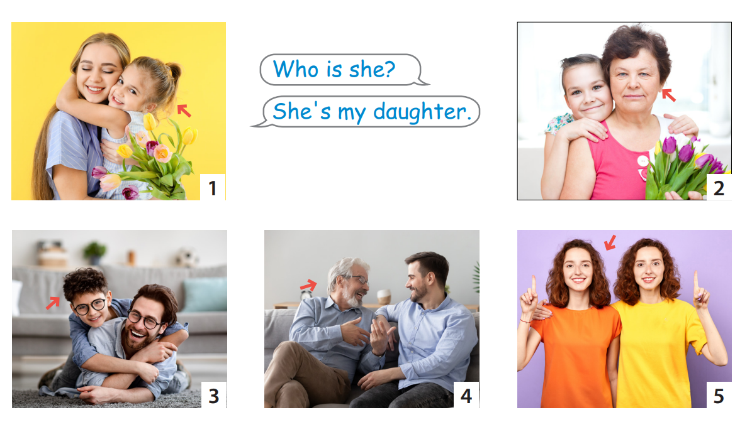
Review

Slide 6



GIRLS
0
1
2
3
4
5
6
7
8
0
9
1
2
3
4
5
6
7
8
0
9
1
2
3
4
5
6
7
8
9
BOYS
0
1
2
3
4
5
6
7
8
0
9
1
2
3
4
5
6
7
8
0
9
1
2
3
4
5
6
7
8
9
A
B
C
D
E
F
G
H
Notes:
- Each team choose a letter to go to the question.
- Have pupils look, read and answer the questions.
- Back to the menu for pupils another question.
- Pupils continue their turns until there are no letters left.
- The team with the most points wins.

Slide 7


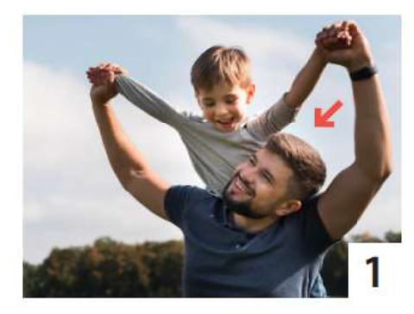


Who’s he?
10
He’s my father.
home
Notes:
Click the answer box to show how many points the students get.
- Click the flower on top left to go back.

Slide 8
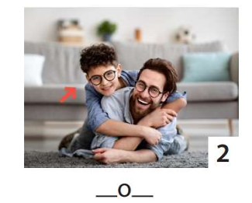
Who’s he?
20
He’s my son.
home
Notes:
Click the answer box to show how many points the students get.
- Click the flower on top left to go back.

Slide 9
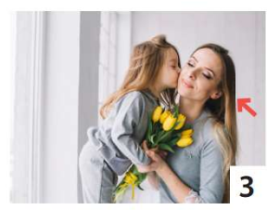
Who’s she?
home
10
She’s my mother.
Notes:
Click the answer box to show how many points the students get.
- Click the flower on top left to go back.

Slide 10
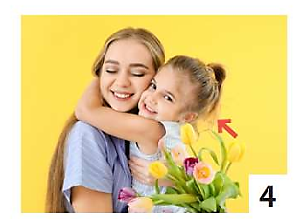
Who’s she?
home
20
She’s my sister.
Notes:
Click the answer box to show how many points the students get.
- Click the flower on top left to go back.

Slide 11
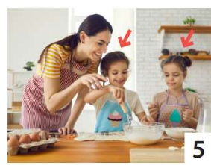
Who are they?
home
30
They are twins.
Notes:
Click the answer box to show how many points the students get.
- Click the flower on top left to go back.

Slide 12

Who’s she?
home
20
She’s my mother.
Notes:
Click the answer box to show how many points the students get.
- Click the flower on top left to go back.

Slide 13

Who’s he?
home
30
He’s my father.
Notes:
Click the answer box to show how many points the students get.
- Click the flower on top left to go back.

Slide 14

Who’s he?
home
20
He’s my brother.
Notes:
Click the answer box to show how many points the students get.
- Click the flower on top left to go back.

Slide 15


2 Presentatation

Slide 16

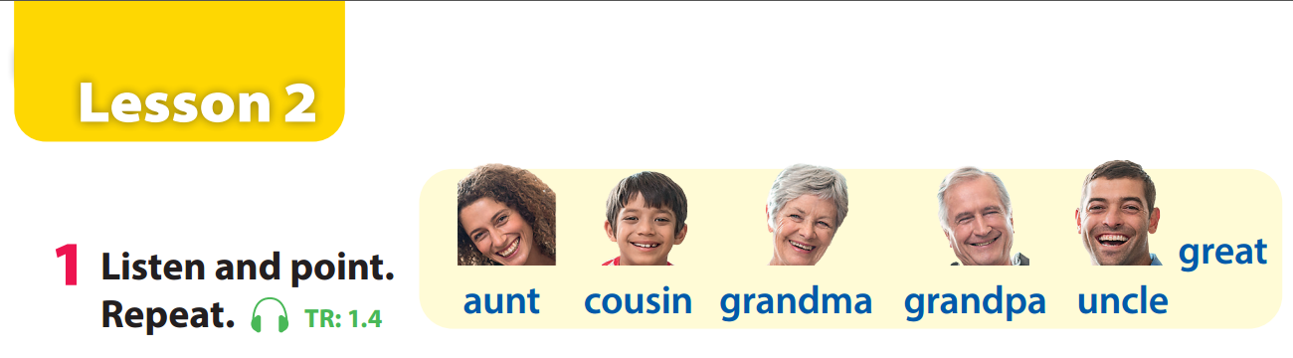

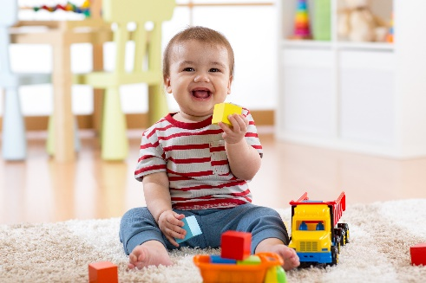
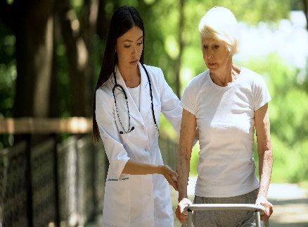
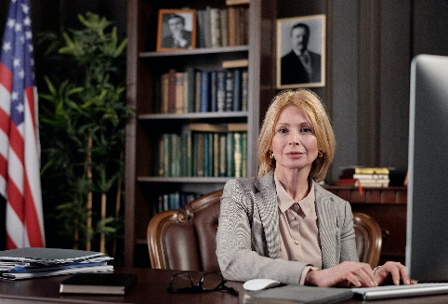
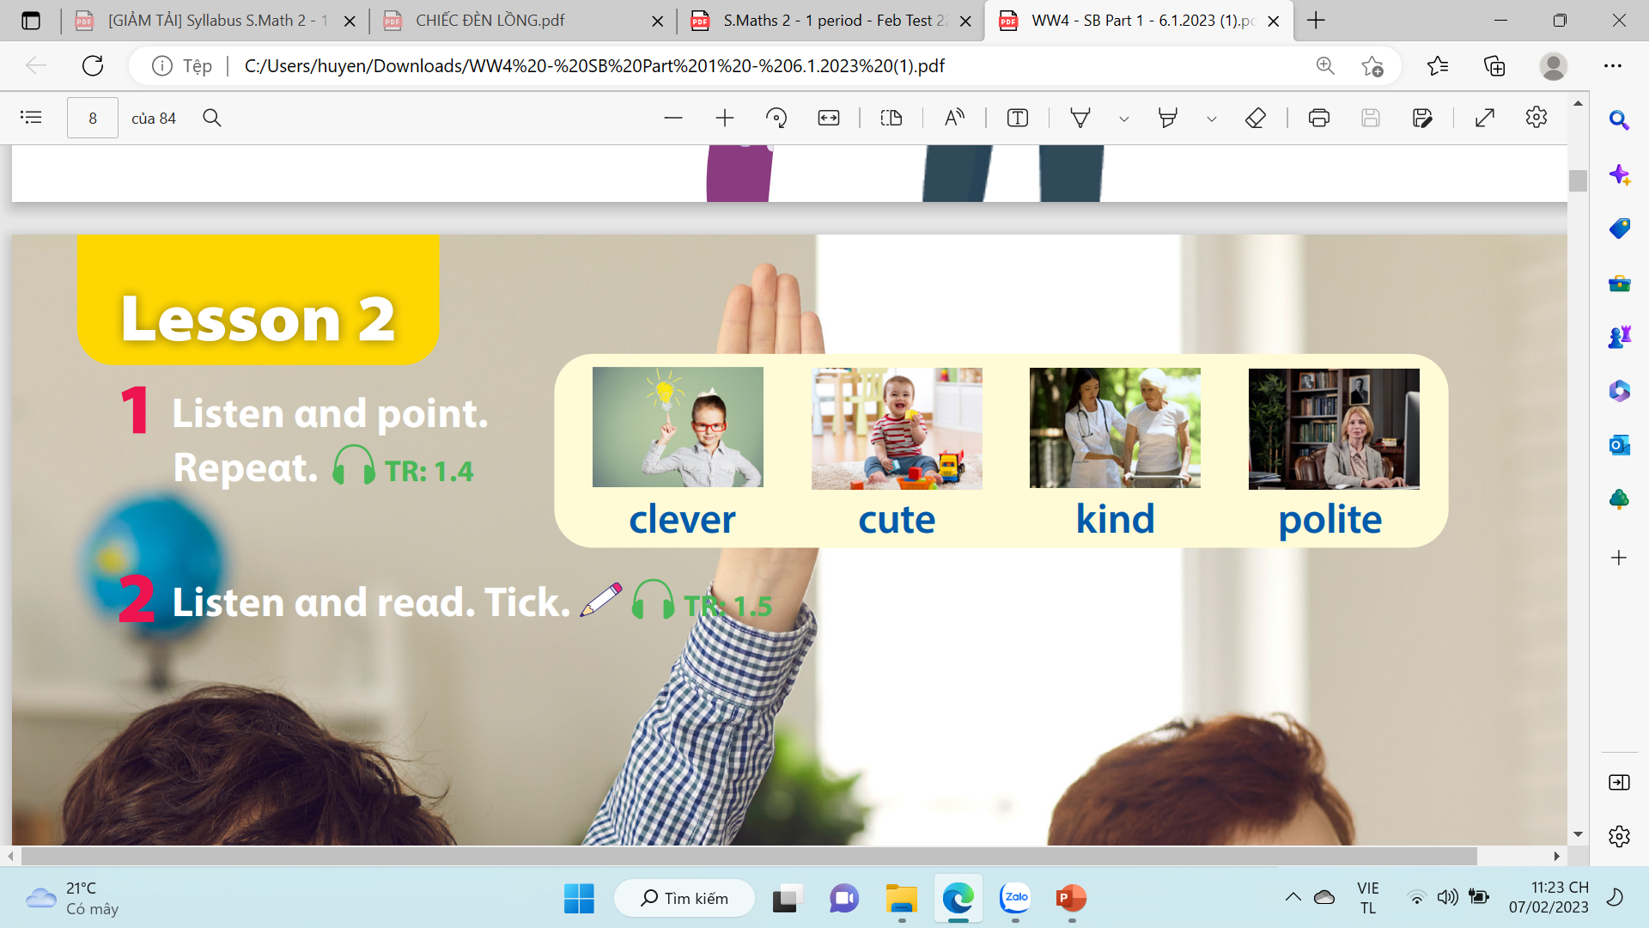

Notes:
Task 1: Listen and point. Repeat. (Track 1.4)
- Use flashcards to introduce the vocabulary and structure of lesson.
- Say the words for students to repeat in chorus.
- Play the recording for the students to listen to, point to, and repeat the words.
- Read out the new picture words in the vocabulary box in random order and ask students to point to the correct pictures.
- Read out the word clever. Explain the meaning. Then say a student’s name, e.g. Lan’s clever! and ask students to repeat. Ask volunteers to stand at the front and do the same with any name they like.

Slide 18


Slide 19


Touch the board
Notes:
Mini game: Touch the board
- Have 4 -5 students come to the board.
- Teacher calls out a word. Once the word has been called, have the students turn around and touch the correct picture.

Slide 20


3 Practice

Slide 21

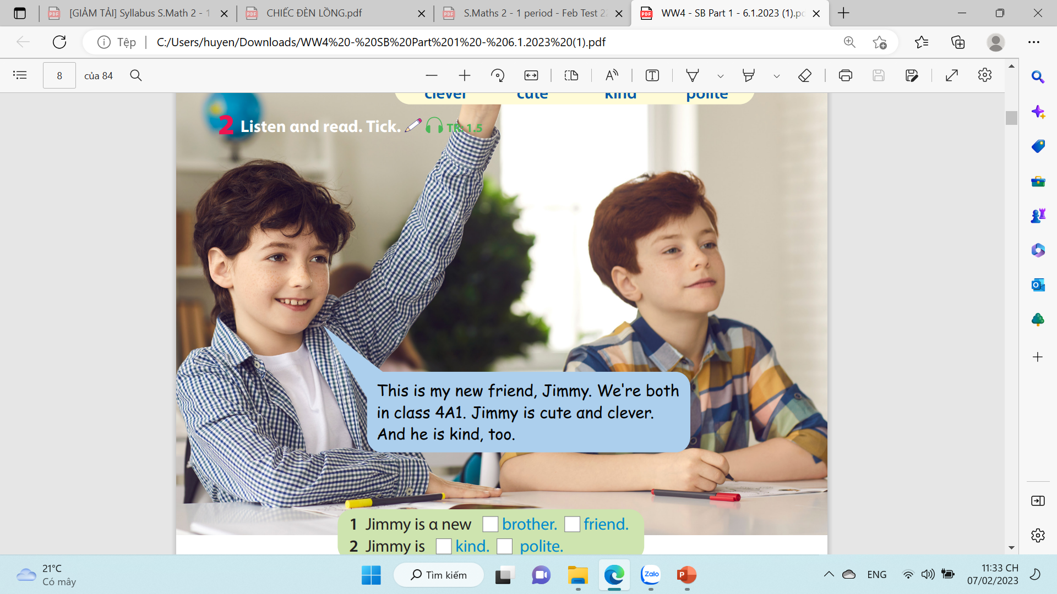
read.
Notes:
Task 2: Listen and tick. (Track 1.5)
- Ask students to look at the photo of 2 friends
- Point to the name in the text. Read them out and ask students to repeat.
- Play the recording. Tell students to look at the picture and follow the text with their fingers.
- Play the recording again, pause after each sentence and ask students to repeat.
- Ask students to practice reading out the text individually and in pairs. Ask some volunteers to read it out in front of the whole class.
- Tell students to look at the photo and ask them tick the right answer in the box.Ask students to read the text again to find out information to make sure that they have the right answer.
Check answers as the whole class.

Slide 22


tick.
✔
✔
Notes:
T asks Ss to listen and look at the text. Then, Ss listen again and tick.

Slide 23
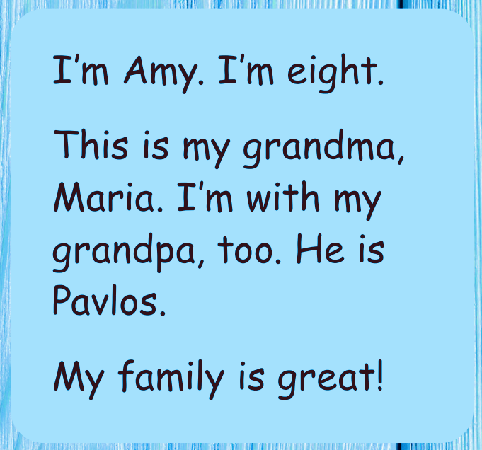
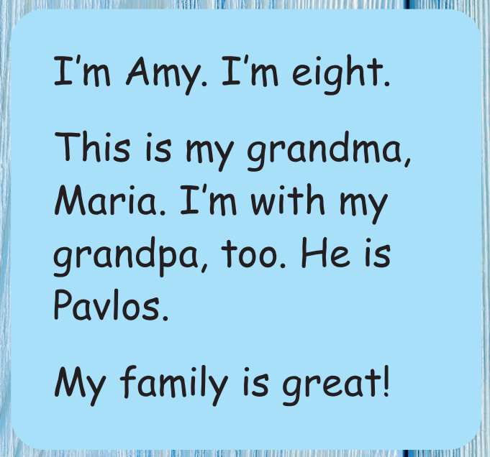
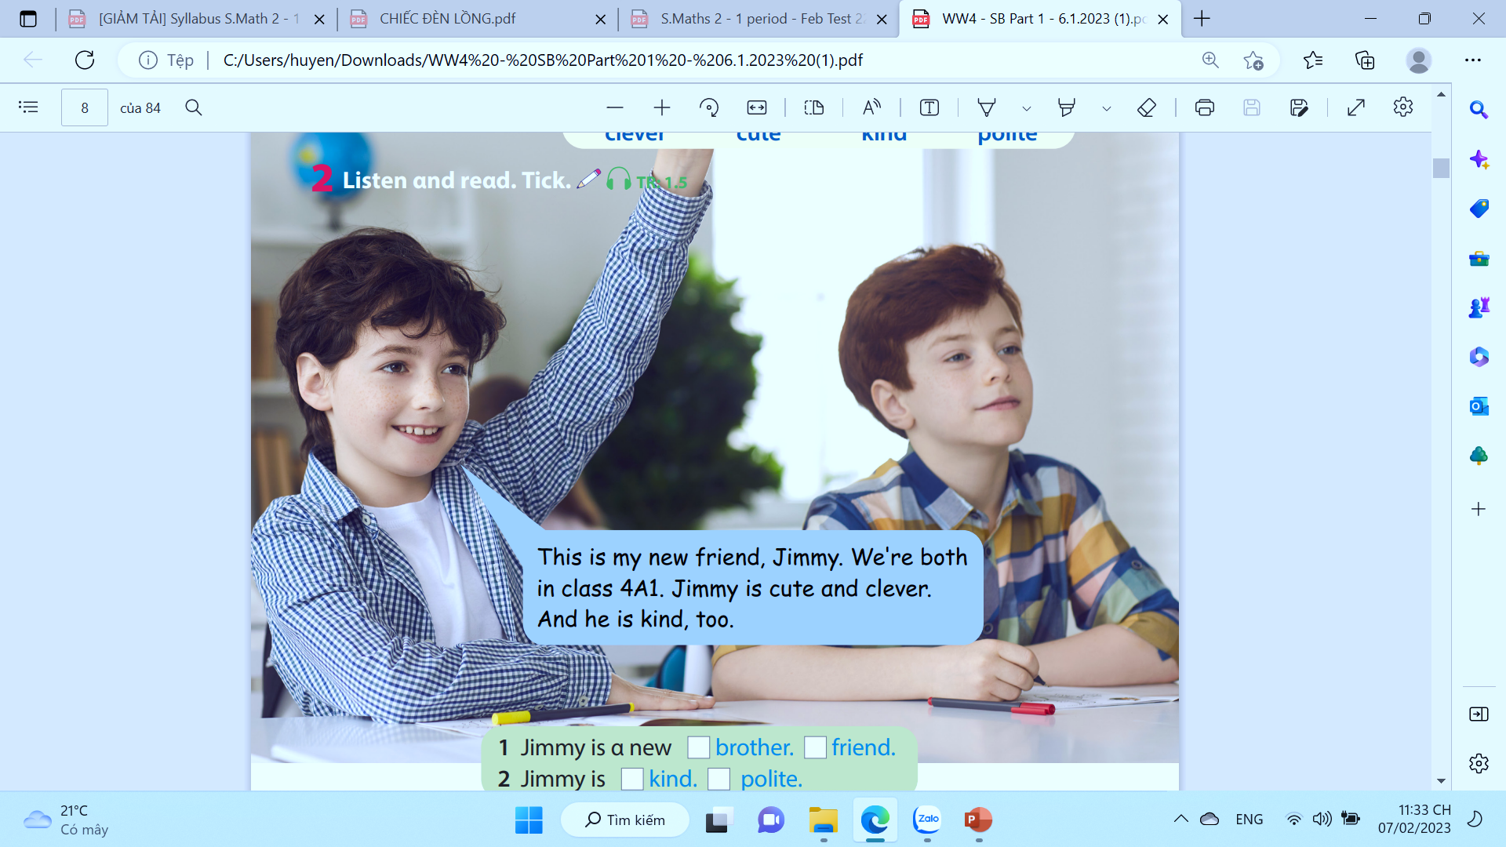
Notes:
T asks Ss to listen and look at the text. Then, Ss listen again and write.

Slide 24
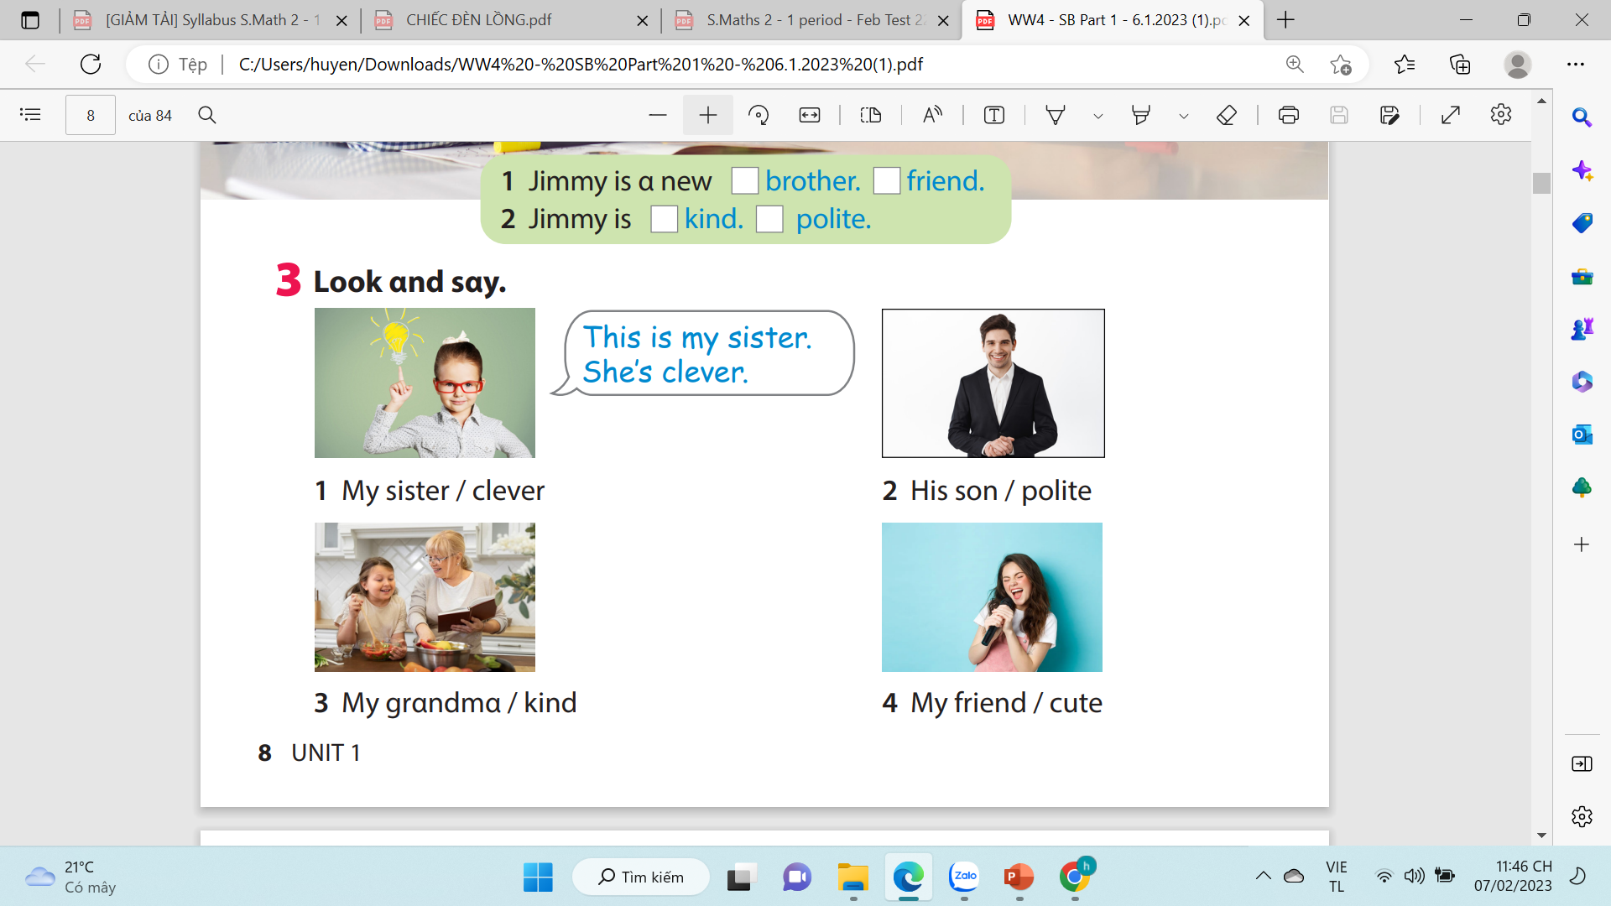
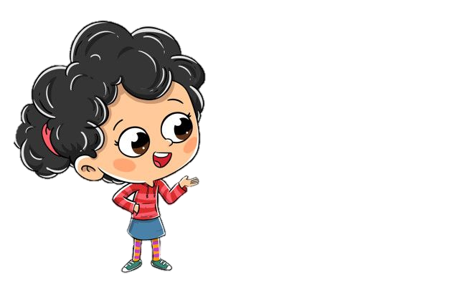
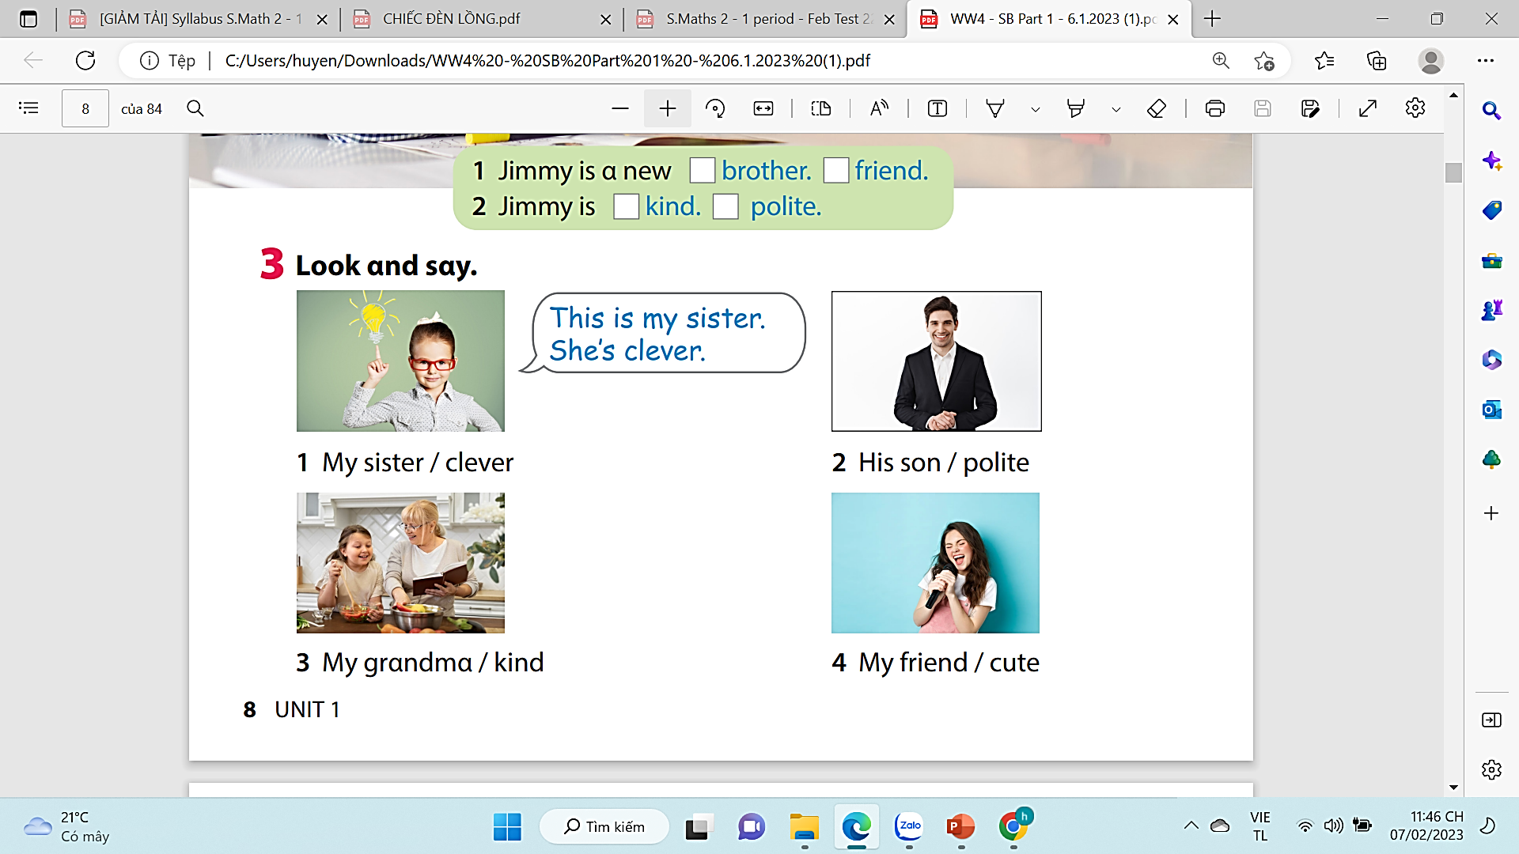
Notes:
Task 3: Point and say.
- Ask students to work pairs. Tell them they are going to say sentences based on the photo in Activity 2.
- Ask students to look back at the photo in Activity 2 and the sample sentences in Activity 3.

Slide 25








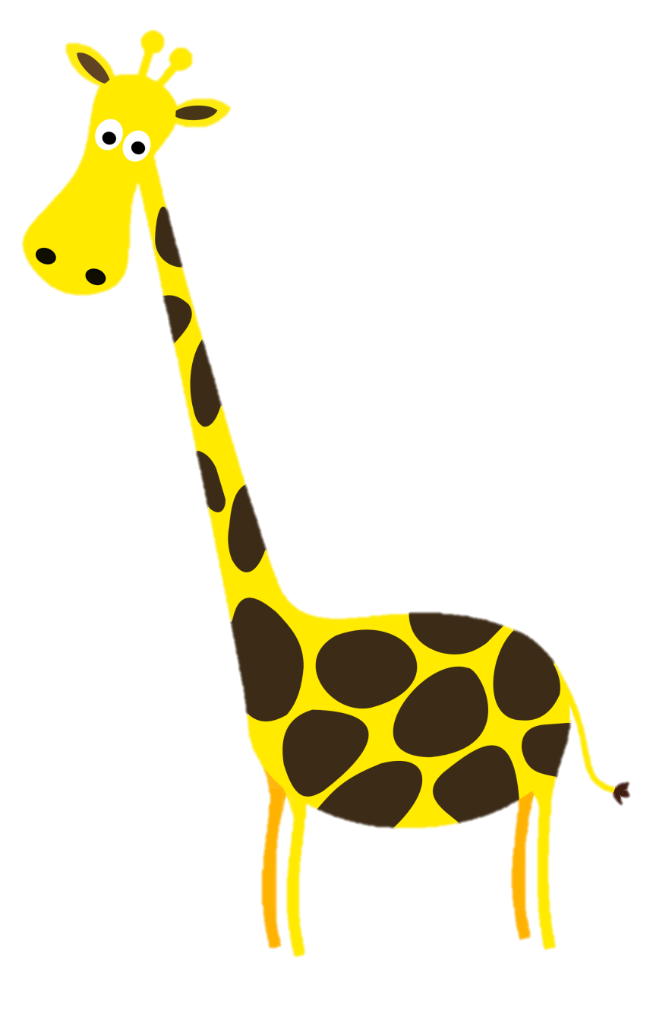









Picking apples

Slide 26




This is my sister.
She’s clever.

Slide 27
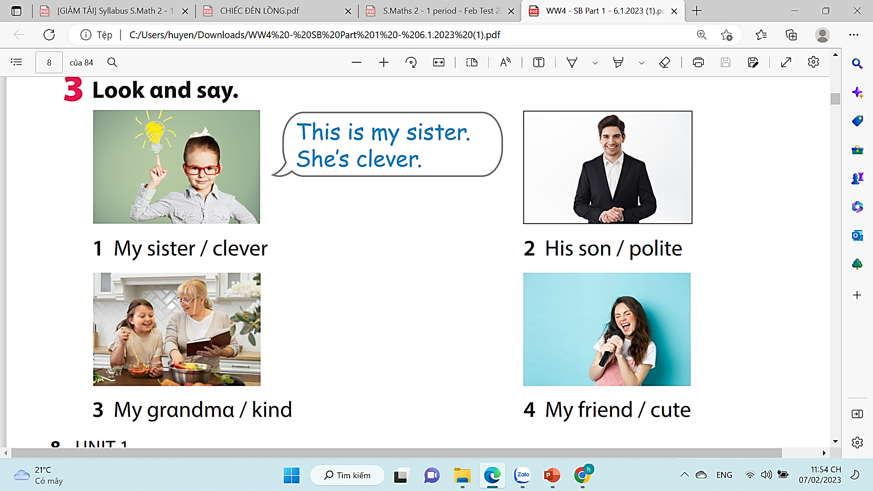
This is his son. He’s polite.

Slide 28
This is my grandma. She’s kind.

Slide 29
This is my friend. She’s cute.

Slide 30

5. her baby/ cute.
This is her baby. He’s cute.

Slide 31

6. her daughter/ polite.
This is her daughter. She’s polite.

Slide 32



4 Production
Draw a picture and write a text about family

Slide 33

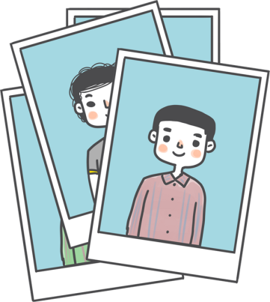


draw
1
2
say

Slide 34
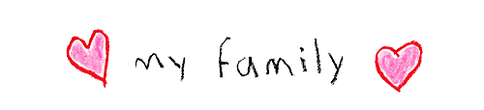

Example: This is my family. My father is polite. My mother is kind. This is my brother . He’s clever. I’m a daughter. I’m cute.
I love my family.
Notes:
-Let the sts draw a picture of members in their family and write a text about them using adjectives. (read the example on the board)
-Call some sts to present their own work

Slide 35



5 Assessment

Slide 36
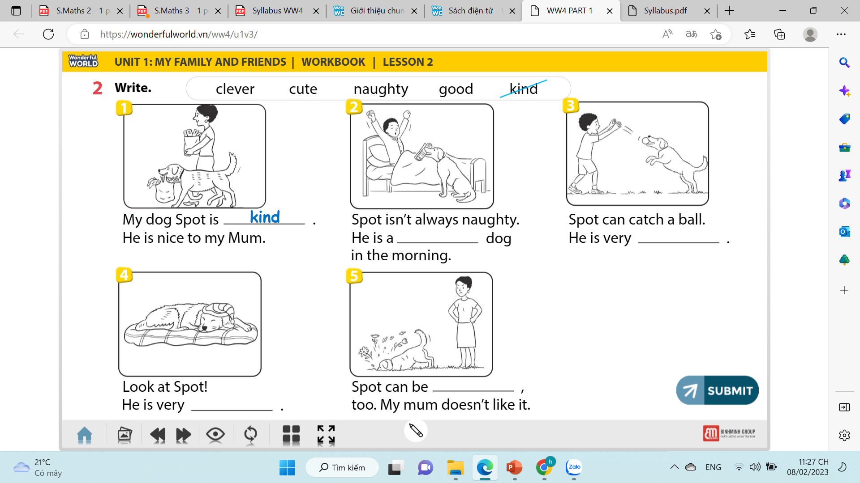
Notes:
THIẾT KẾ HOẠT ĐỘNG TƯƠNG TÁC CHO 5 CÂU NÀY. Điền từ thích hợp vào chỗ trống.
Sts look at the picture and key word in the box. Try to fill the key word to the right blank.

Slide 37
good
clever
naughty
cute
Notes:
Sts look at the picture and given words. Fill in the blank with the sentences on the board or on their notebooks.

Slide 38

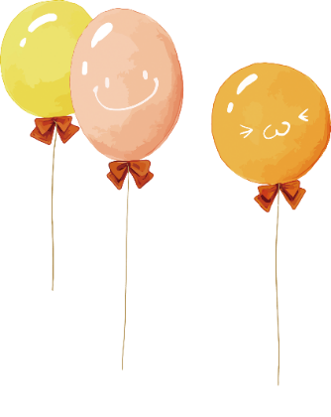
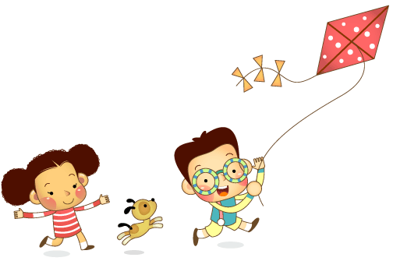
Remember
Vocabulary:
- clever, cute, kite, polite.
Structure:
- This is my____________.
- She is_______________.
- He is _______________.

Slide 39


Slide 40




Thank you & goodbye!

