Slide 1








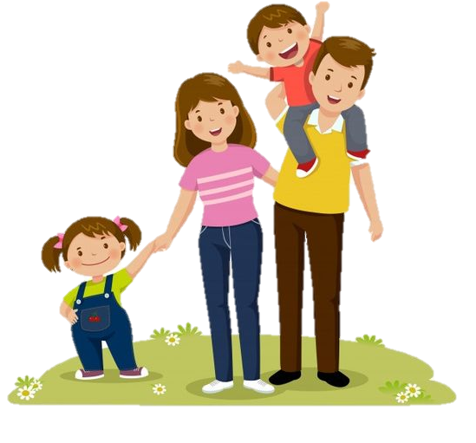
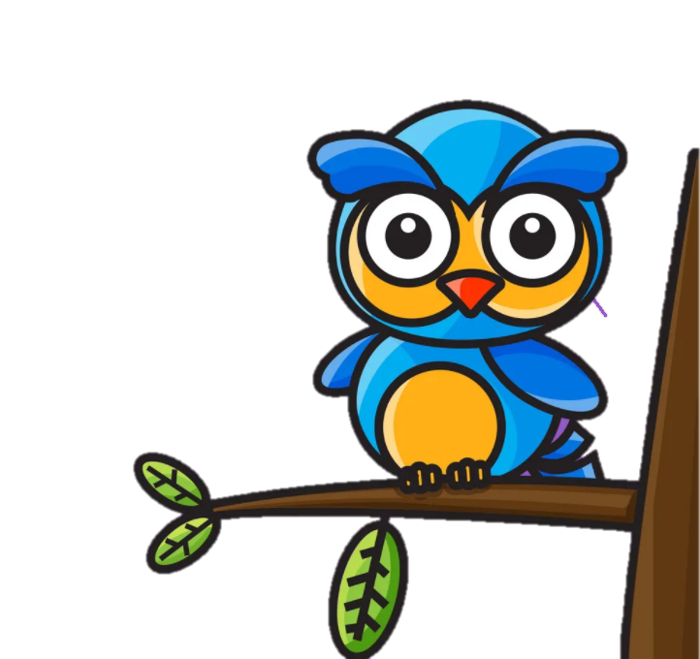





Unit 1:
My family and friends
Lesson 3- Period 2- Task 4 5 6

Slide 2


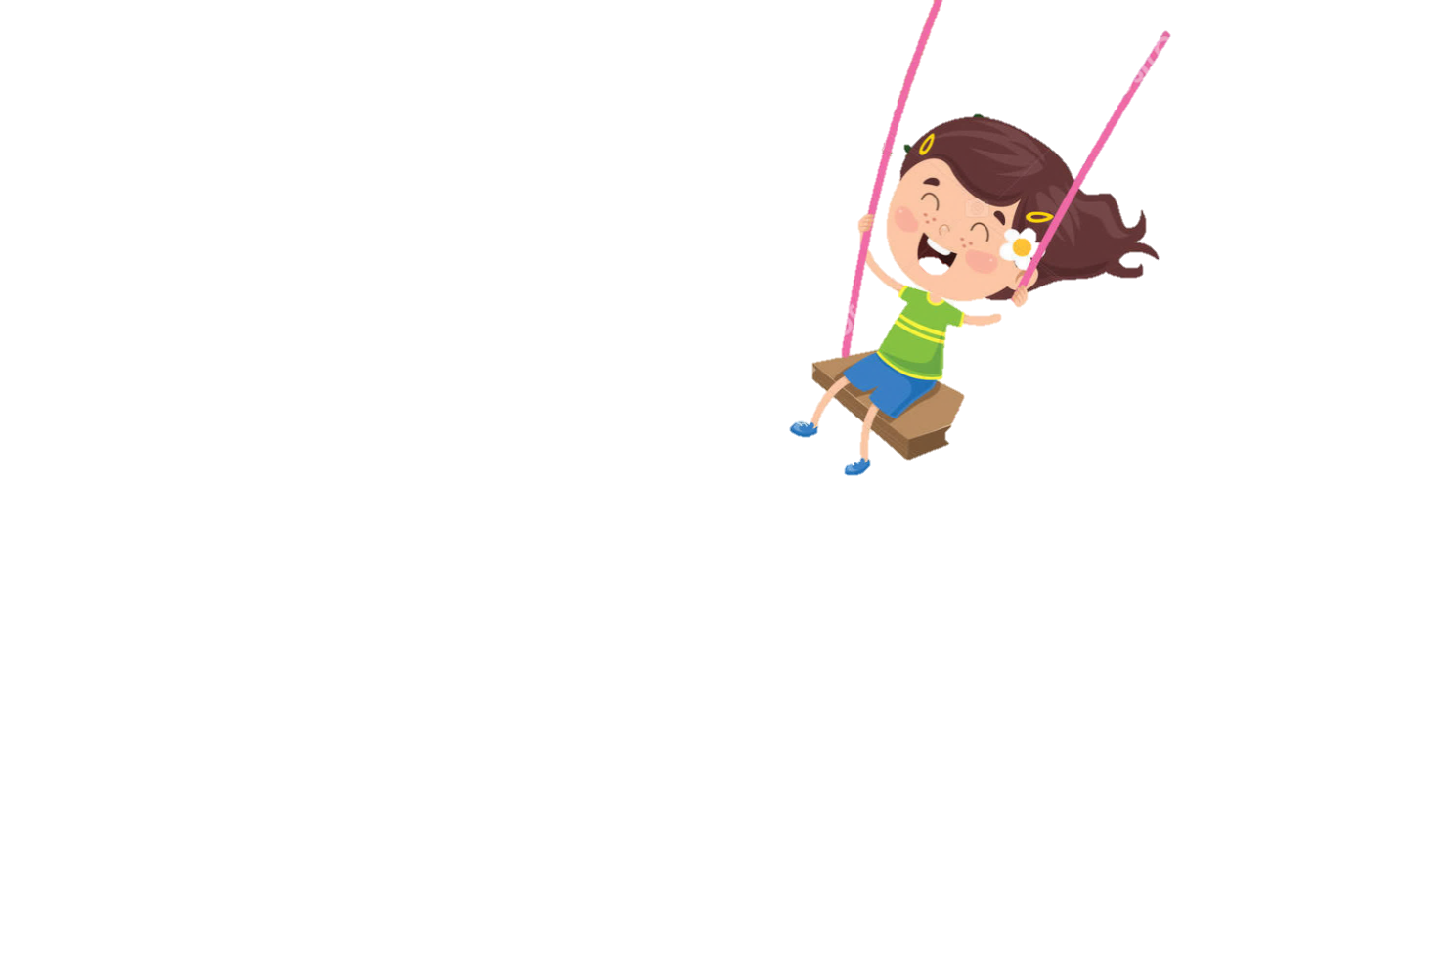
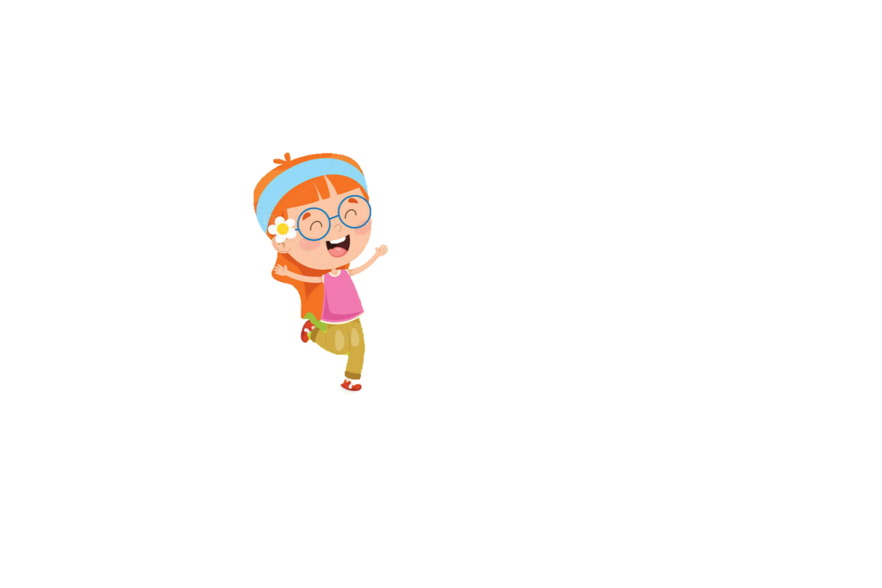
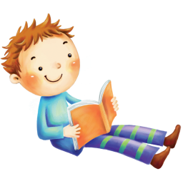

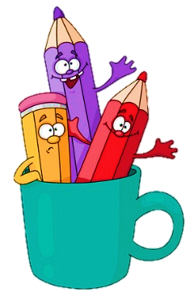
2
Review

Slide 3
3
Presentation

Slide 4
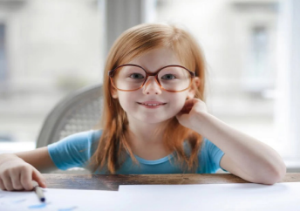
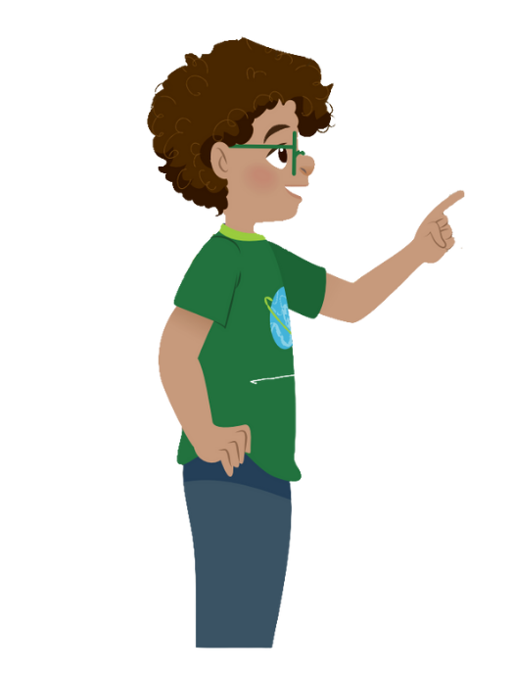
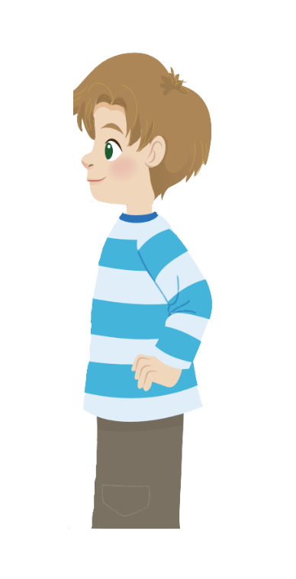
What is your sister like?
She’s hardworking.

Slide 5
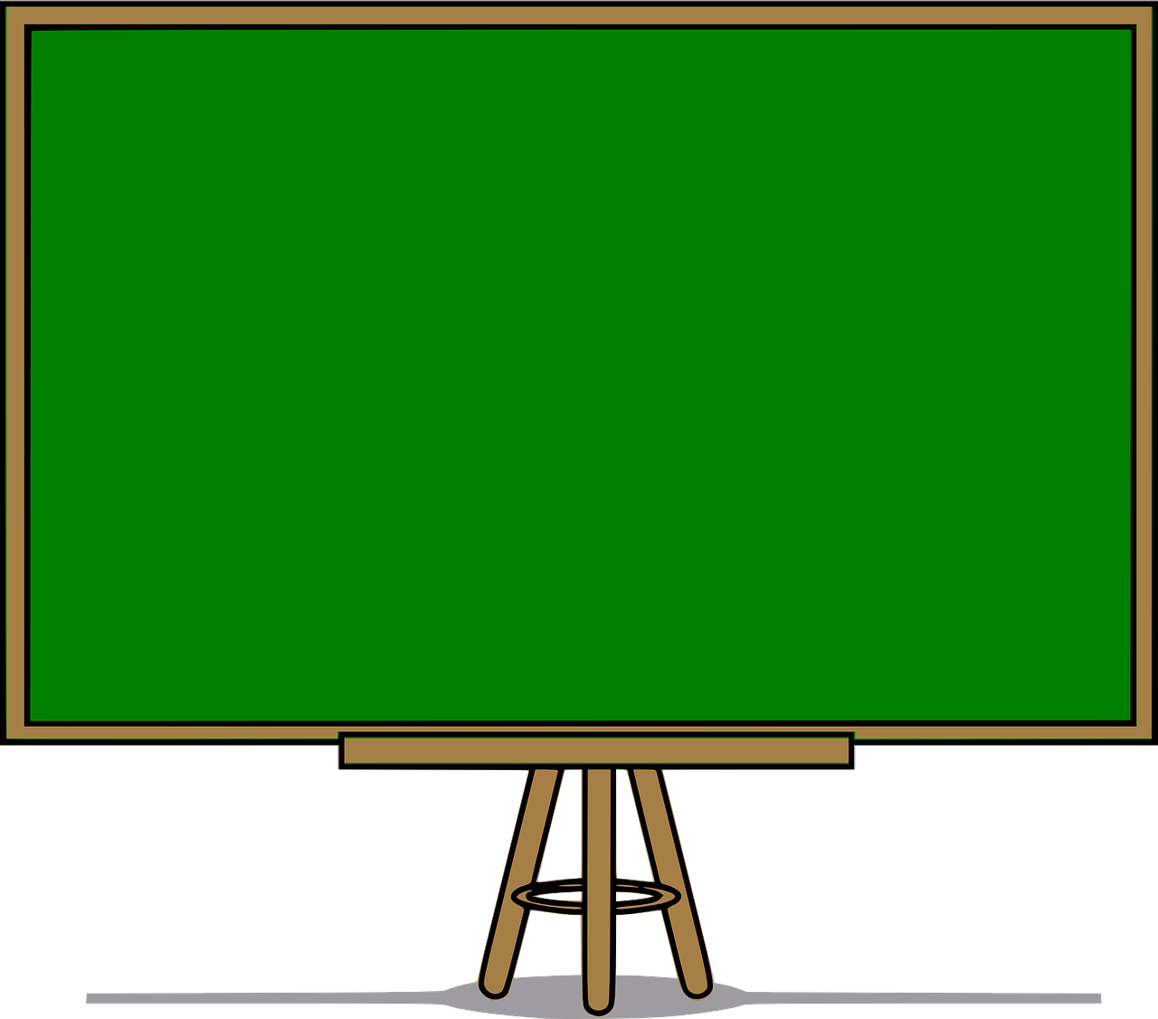
Structure
What is ………………like?
- She’s/ He’s ……… .

Slide 6
4
Practice

Slide 7
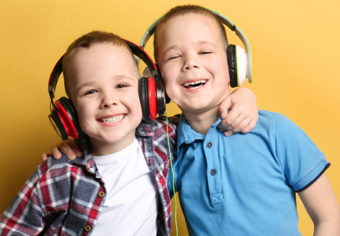
4. Listen and repeat.
1. Whαt is your sister like? - She's hαrdworking αnd pleαsαnt.
2. Whαt is his twin brother like?
- He's clever αnd friendly.

Slide 8

5. Look. Ask and answer.
1. Your cousin / hαrdworking / clever
What is your cousin like?
She’s hardworking
and clever.

Slide 9
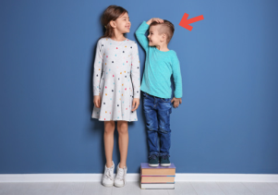
2. Her brother / short / cute
What is her brother
like?
He’s short
and cute.

Slide 10
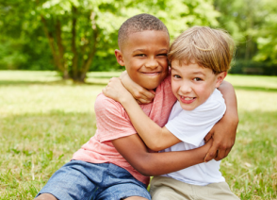
3. His friend / cheerful / friendly
What is his friend
like?
He’s cheerful
and friendly.

Slide 11
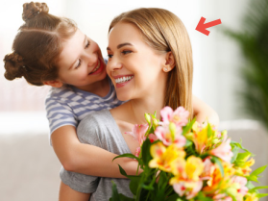
4. Her mother / pleαsαnt / kind
What is her mother
like?
She’s pleasant
and kind.

Slide 12

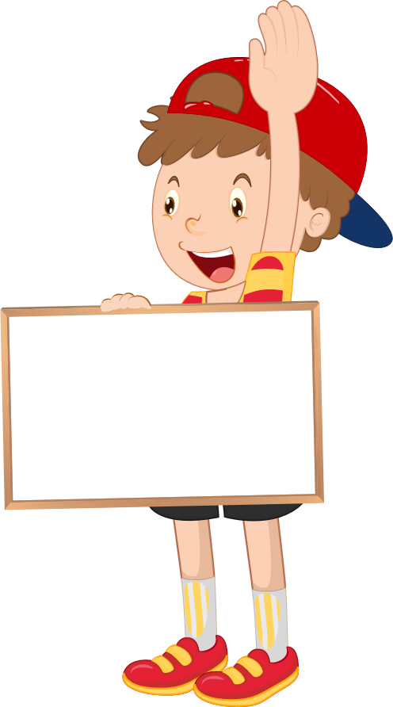
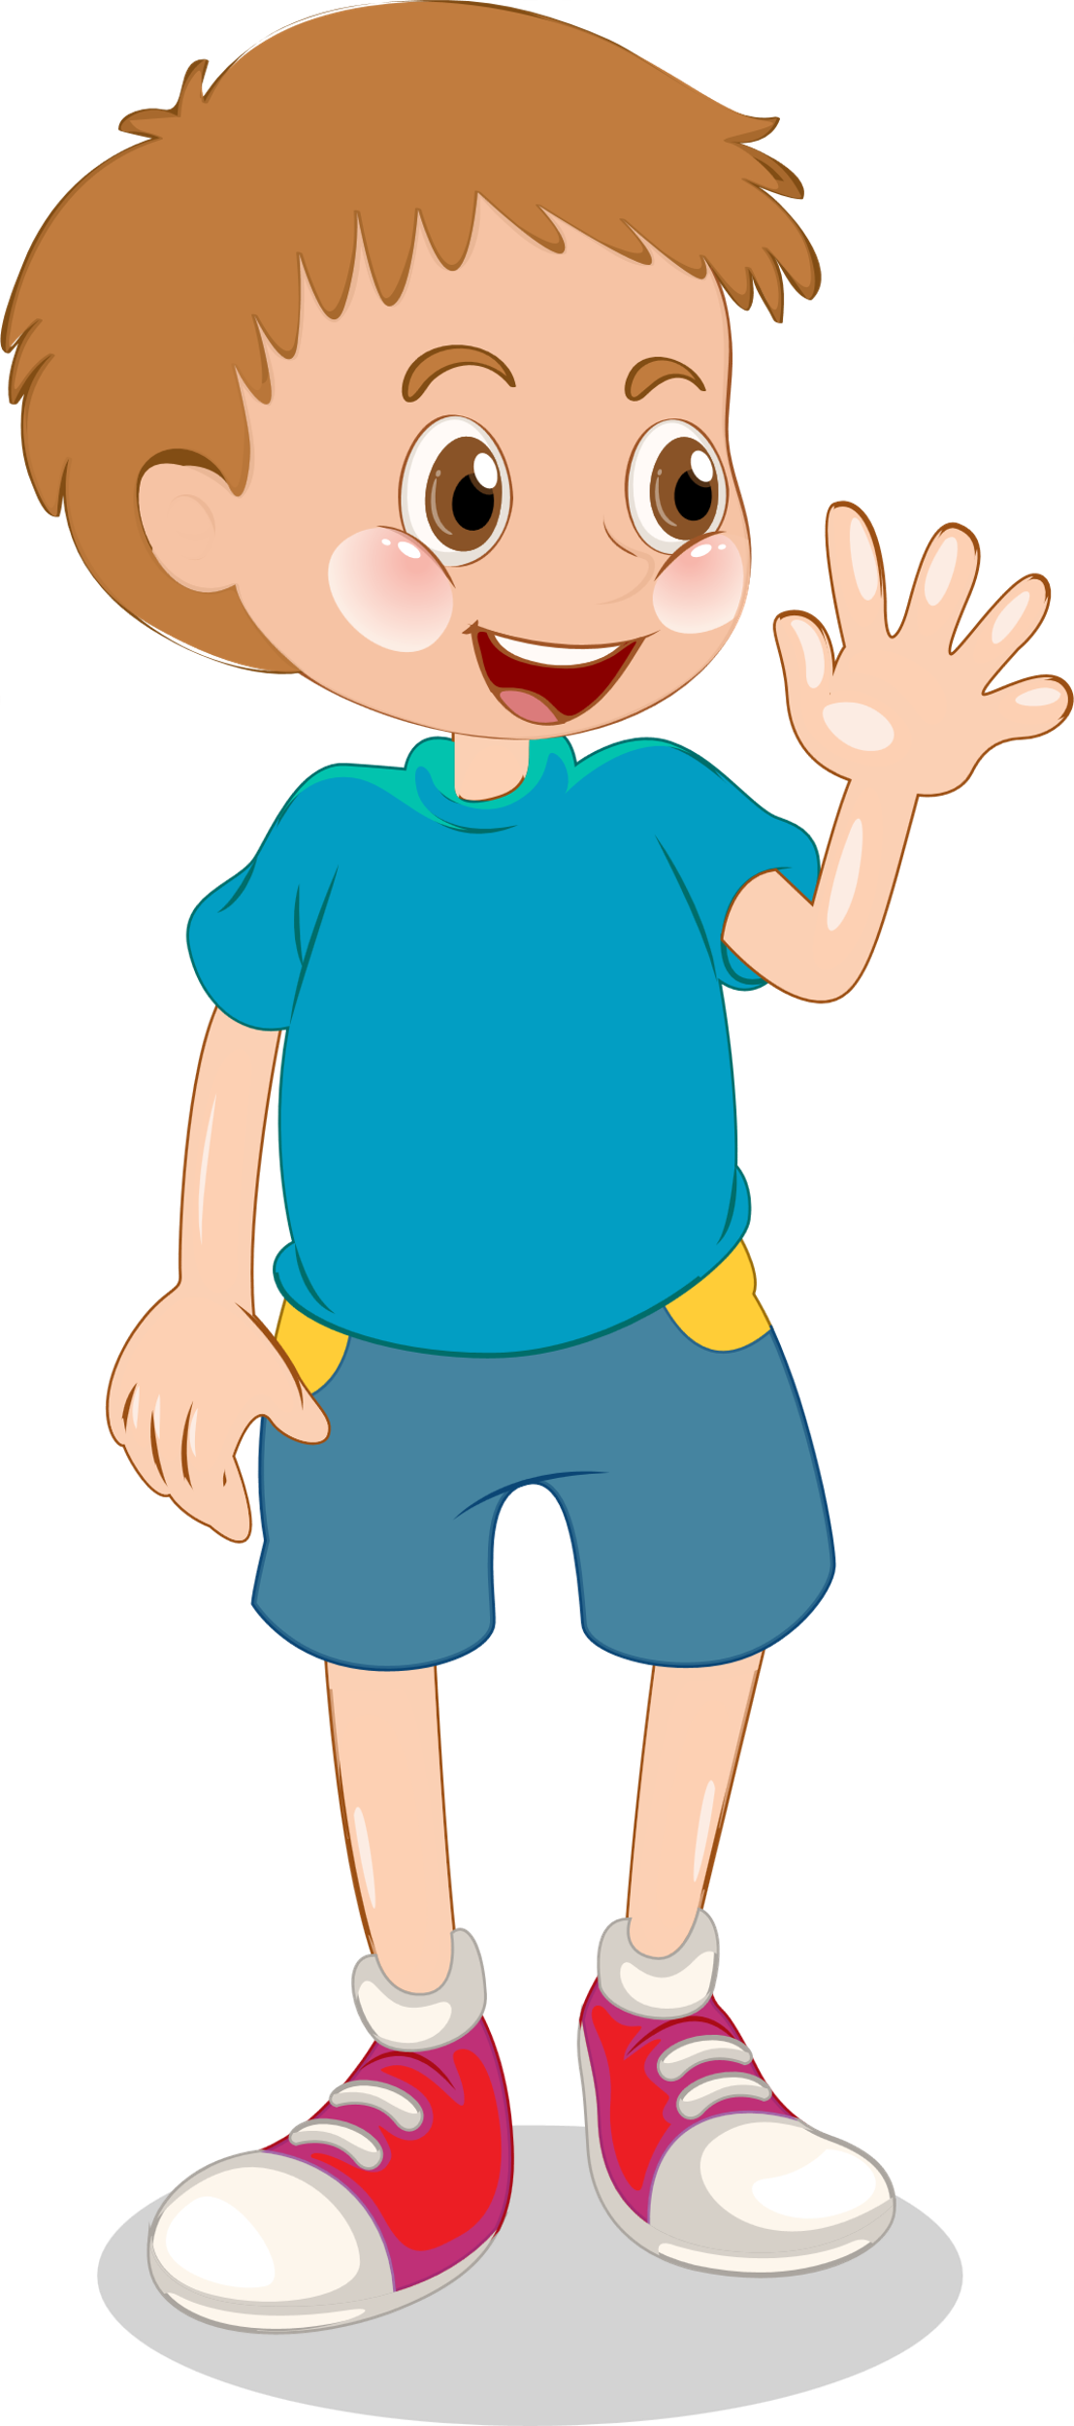
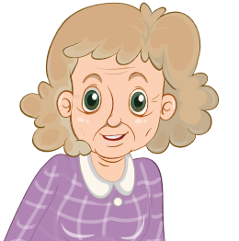
6 Drαw. Αsk αnd αnswer.
Who is she?
She’s my grandma.
What is your
grandmother like?
She’s old
and kind.

Slide 13
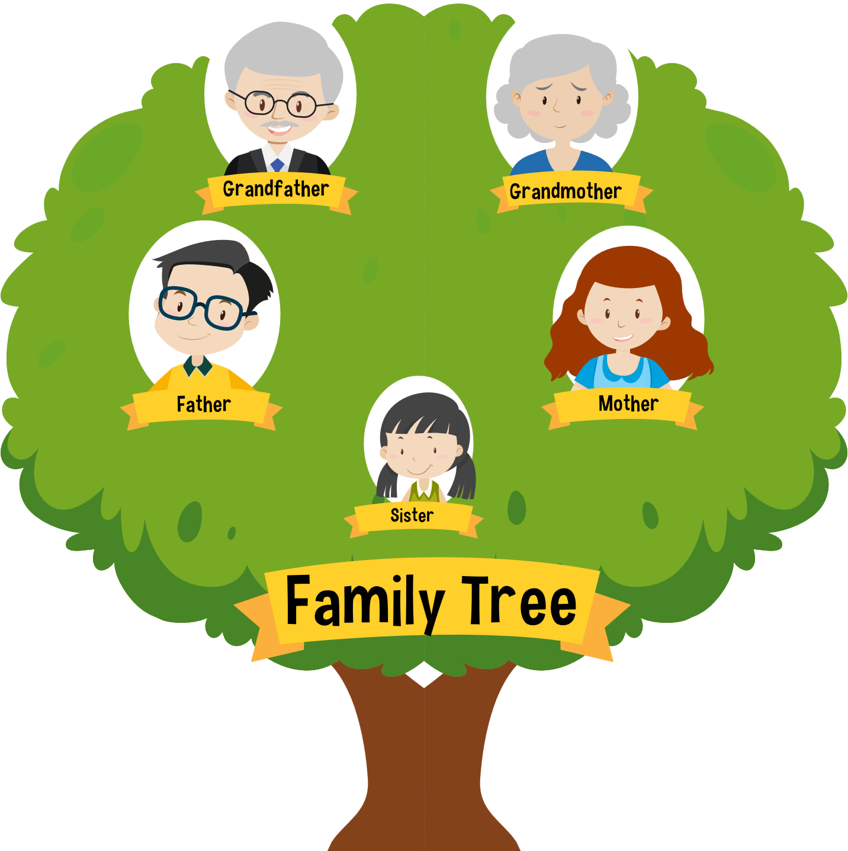
5
Production
Game :Family Tree
Look and answer
PLAY

Slide 14
Look and match.
1. Who is this?
a. He’s nine years old.
2. How old is he?
b. They are friendly.
3. What is your aunt like?
c. She’s my sister.
4. What is your brother like?
d. He’s cheerful.
5. What are your cousins like?
e. She’s pleasant.

Slide 15
UNIT 1: Family and Friends
LESSON 3 – PERIOD 2- TASK 4,5,6
What we learnt today
Vocabulary
cheerful
friendly
hardworking
pleasant
Structure
My fαther is kind αnd cool.

