Slide 1









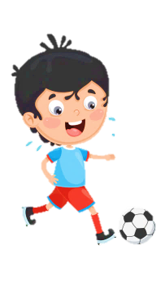













Slide 2

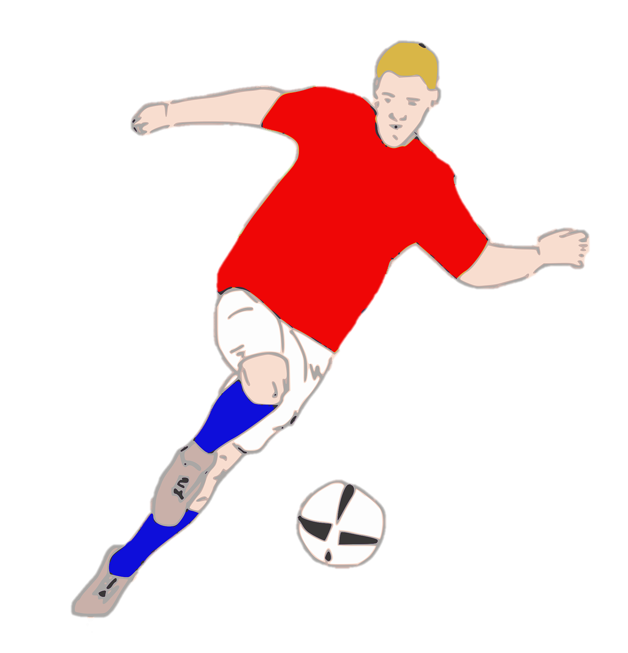
Unit 7:
SPORTS
Lesson 3 – Part 4, 5, 6

Slide 3





Table of contents
01
02
Warm-up
Presentation
04
05
Wrap-up &
Assessment
Production
03
Practice

Slide 4



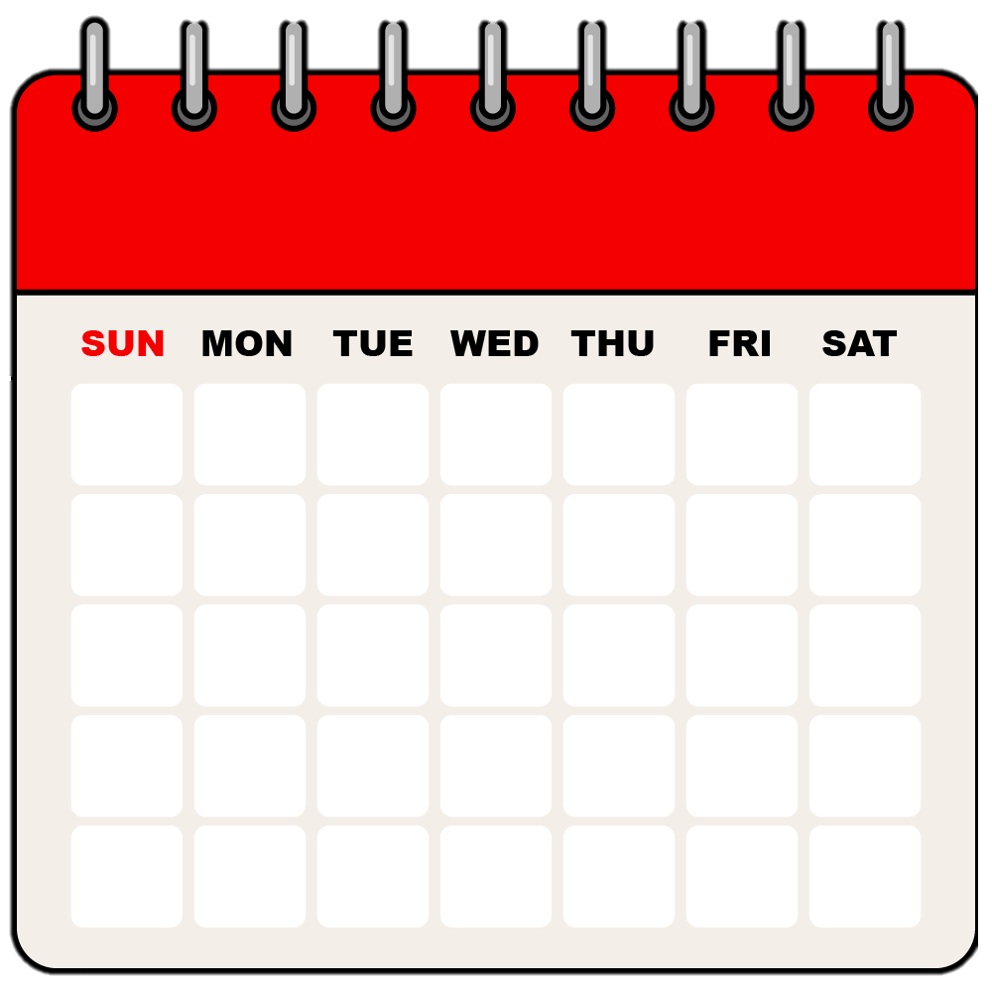
1
Warm-up

Slide 5



Slide 6
2
Presentation

Slide 7

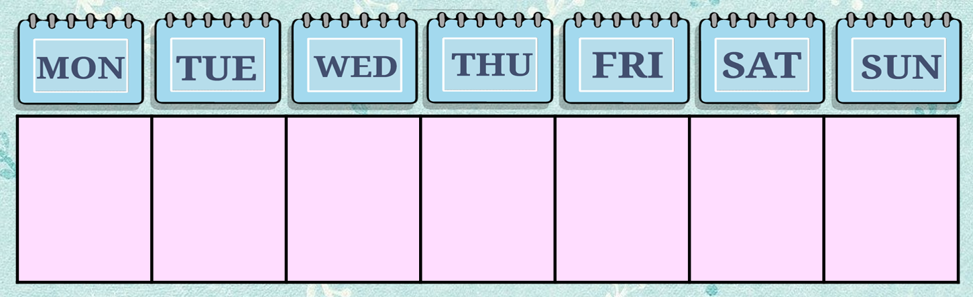
once a week
✓

Slide 8
twice a week
✓
✓

Slide 9
three times a week
✓
✓
✓

Slide 10
four times a week
✓
✓
✓
✓

Slide 11
Match
1
2
a. once
a week
✓
✓
✓
✓
✓
b. twice
a week
3
4
c. three times
a week
✓
d. four times
a week
✓
✓
✓
✓

Slide 12
3
Practice

Slide 13



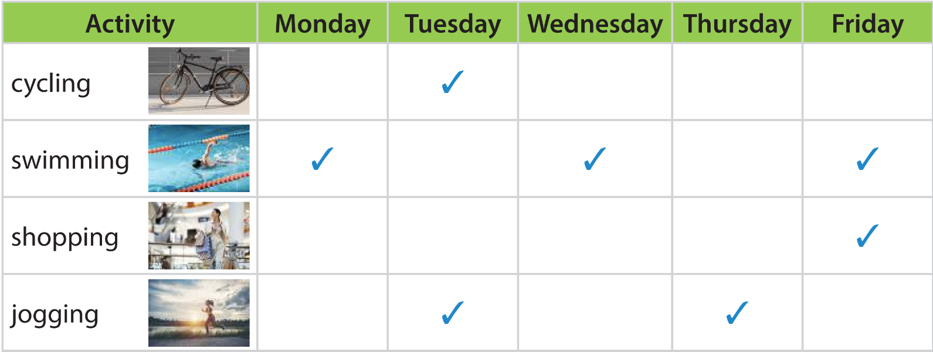
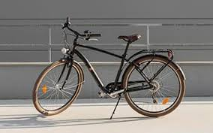
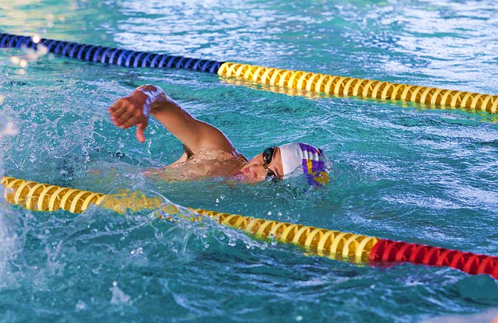
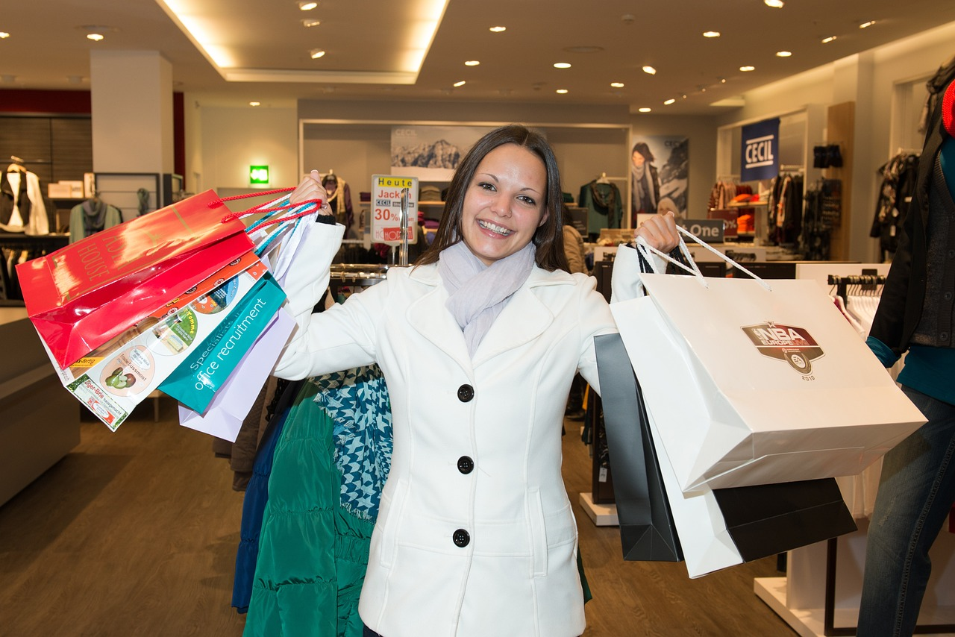


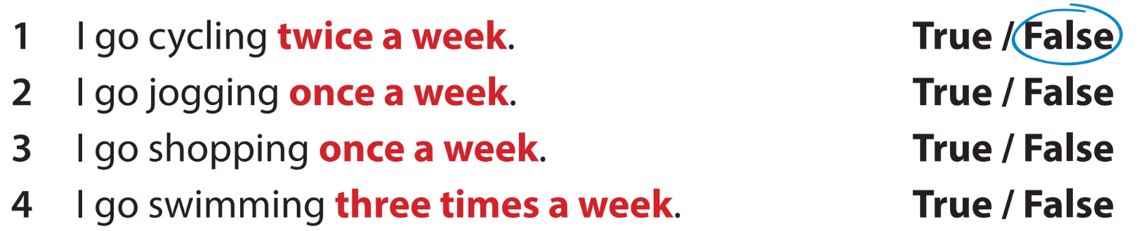


Slide 14
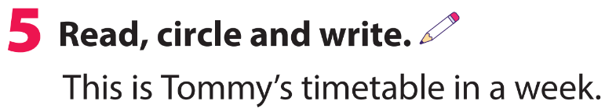
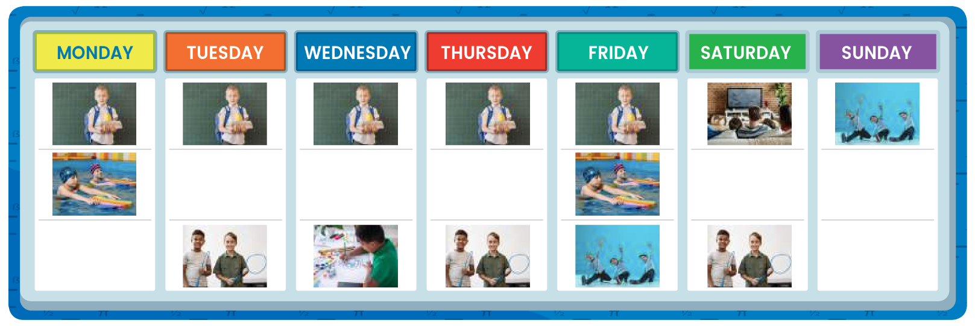
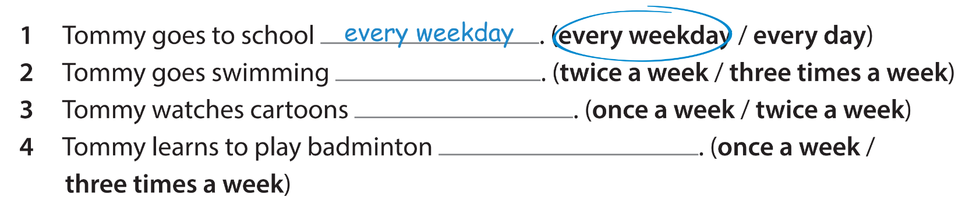
twice a week
once a week
three times a week

Slide 15
4
Production

Slide 16
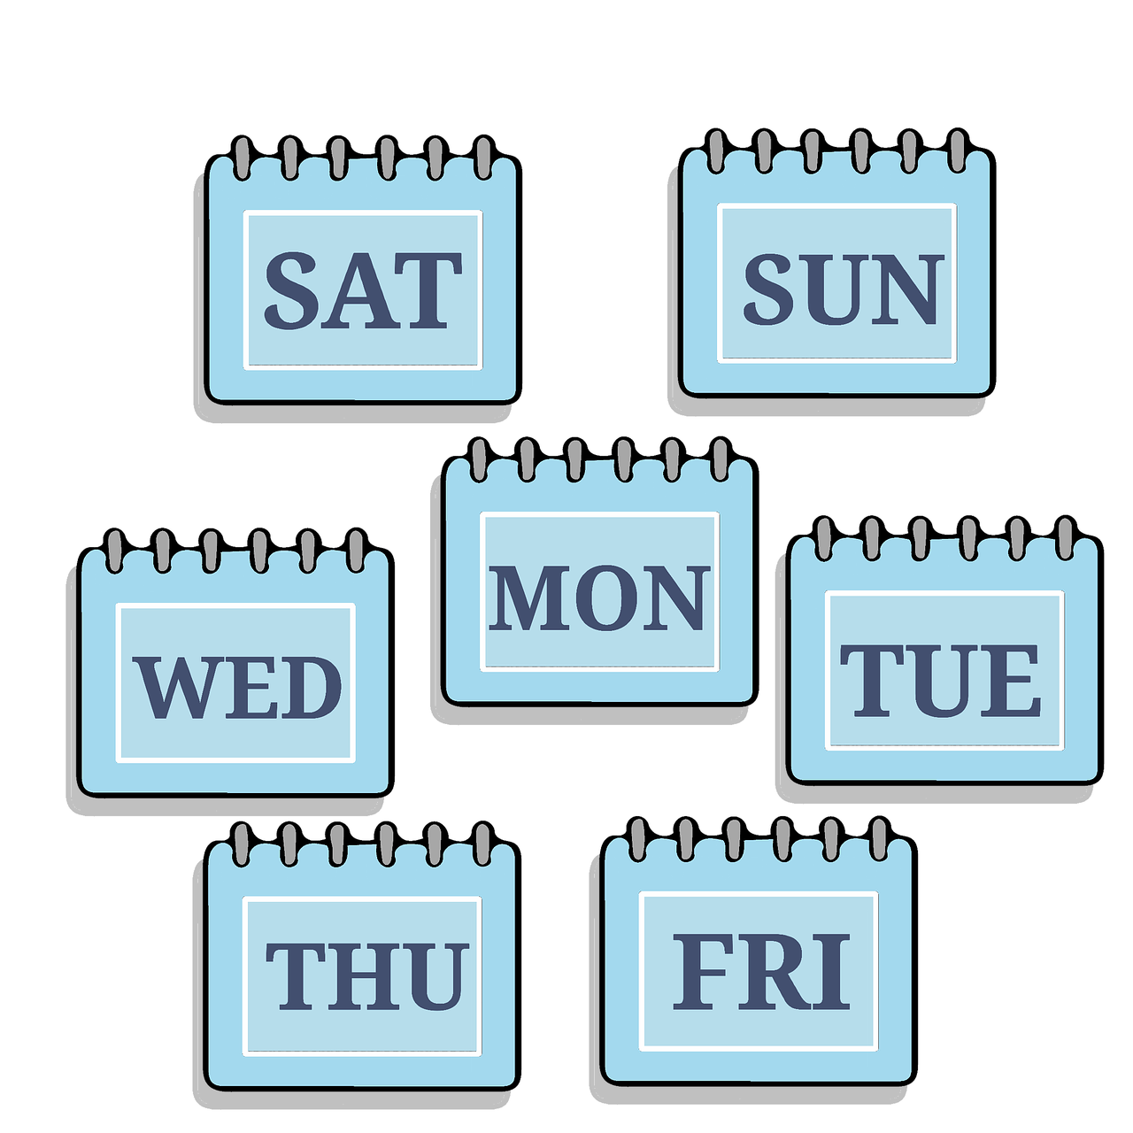



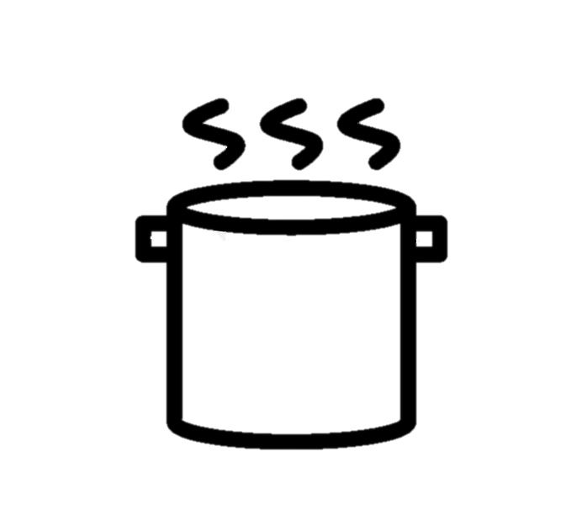
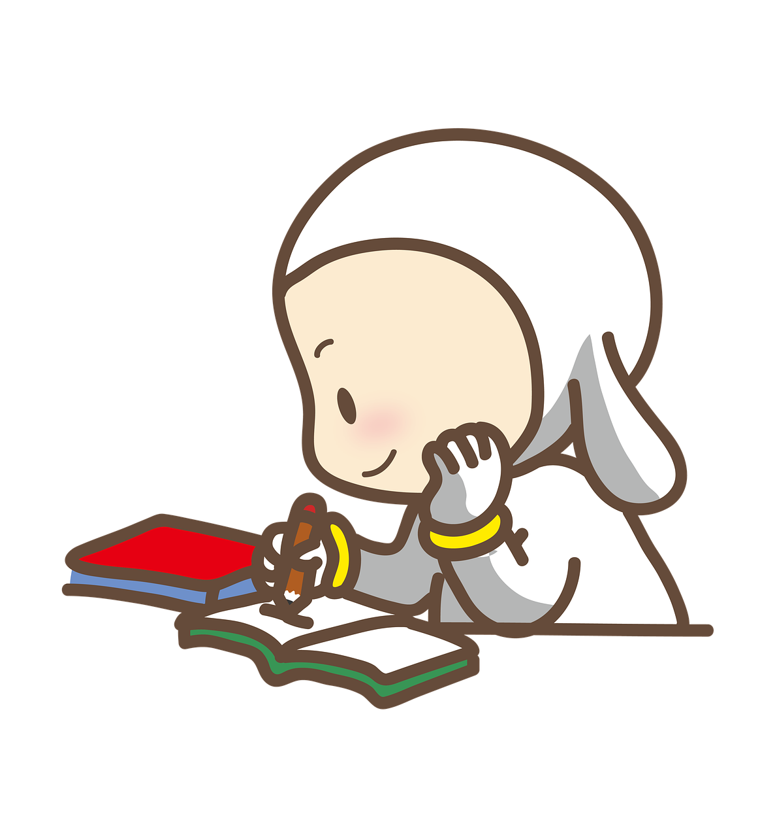
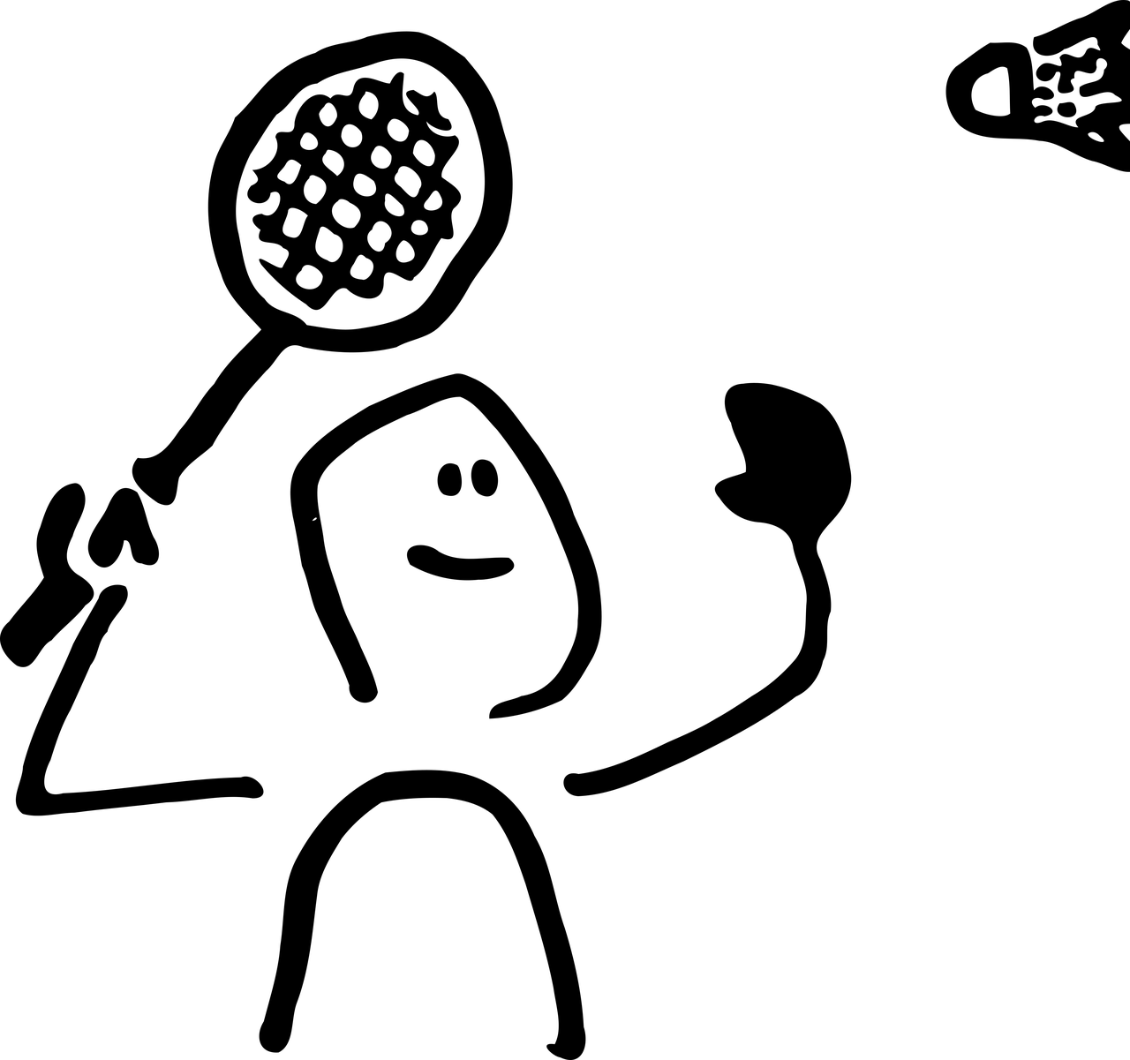

Slide 17

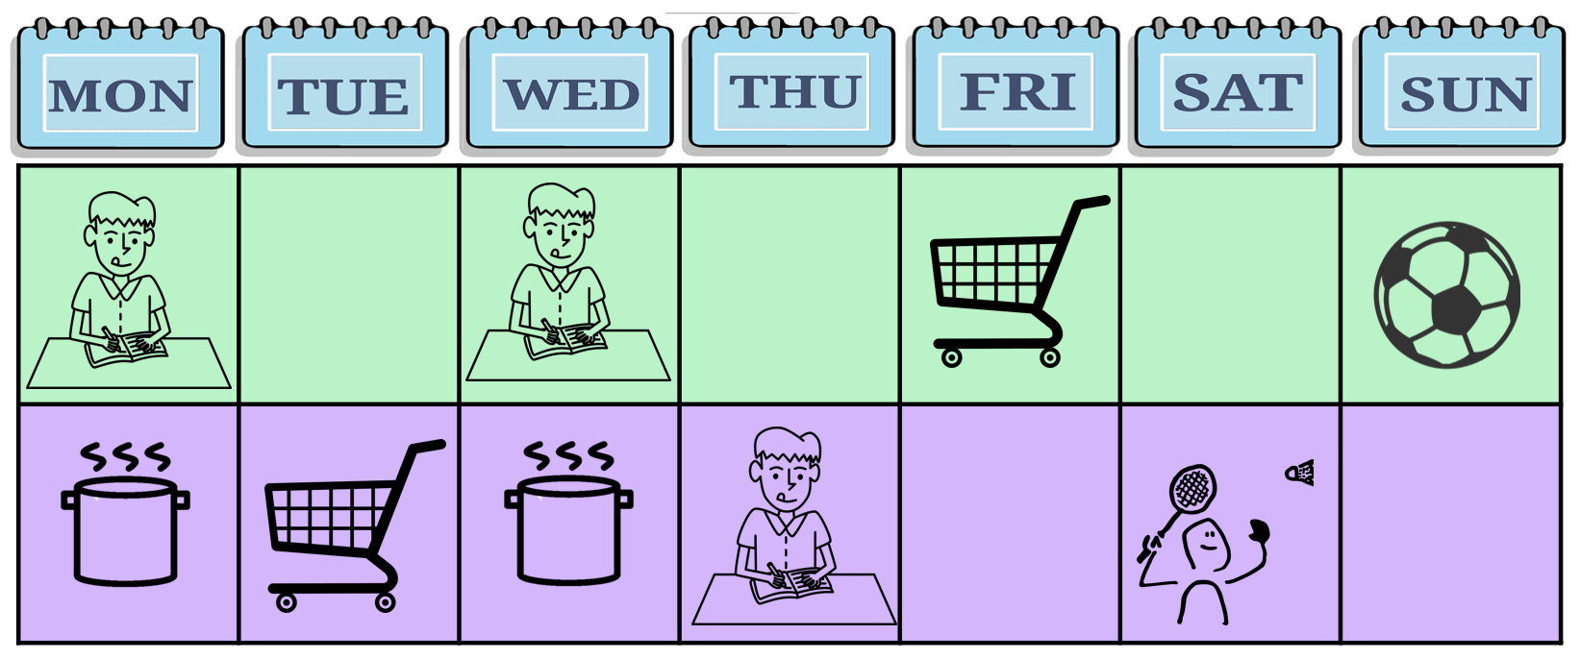

My timetable
This is my timetable.
I have English three times a week. I go shopping and cook twice a week. I play badminton and play football once a week.

Slide 18
5
Wrap-up &
Assessment

Slide 19
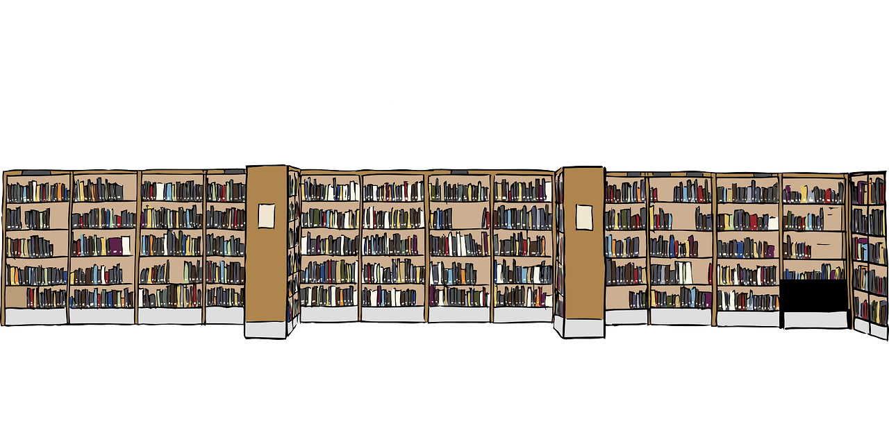
Listen and write
three times a week
I go to the library ______________.

Slide 20

Listen and write
I play video games with my friend ______________.
twice a week

Slide 21

Listen and write
My family eats at this restaurant ______________.
once a week

Slide 22

Listen and write
My father works in the factory ______________.
every weekday

Slide 23
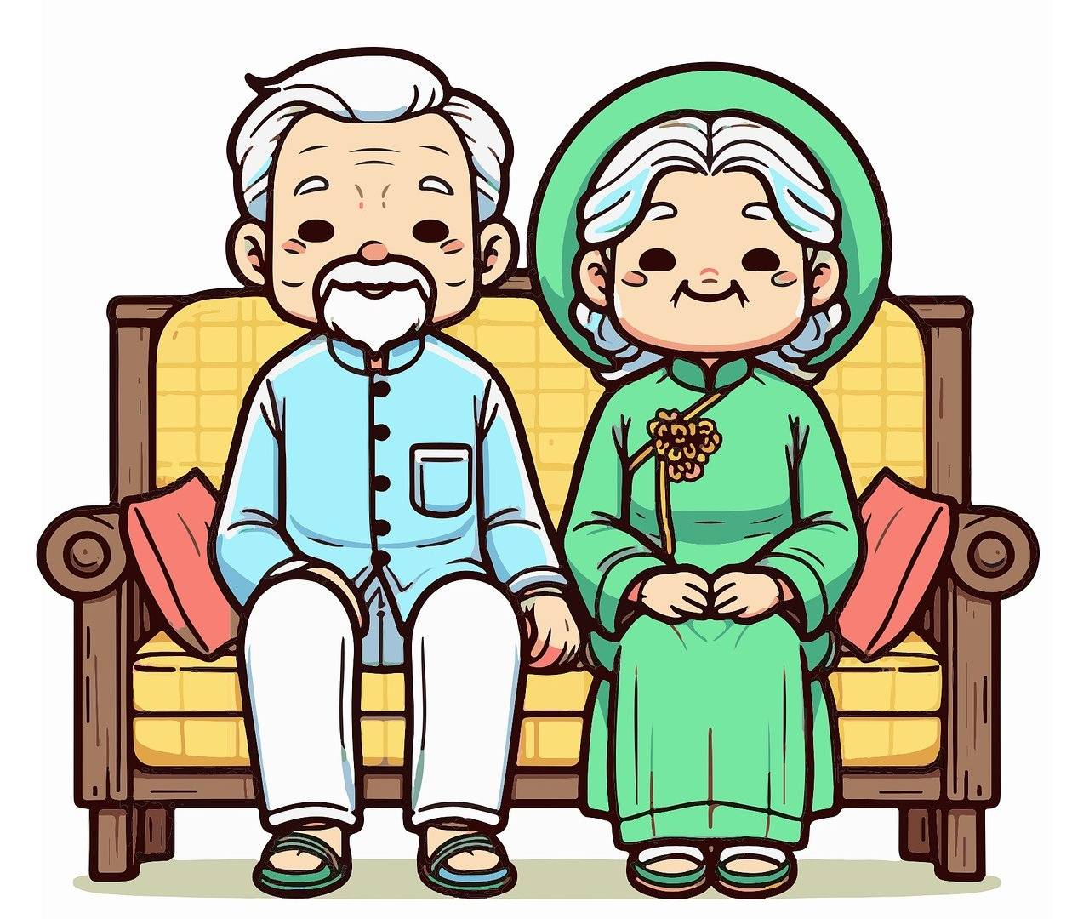
Listen and write
Sam visits her grandparents ______________.
four times a month

Slide 24


Wrap-up
Unit 7: Sports
Lesson 3 – Part 4,5,6
What have we learnt today?
once a week, twice a week,
three times a week, four times a week

Slide 25

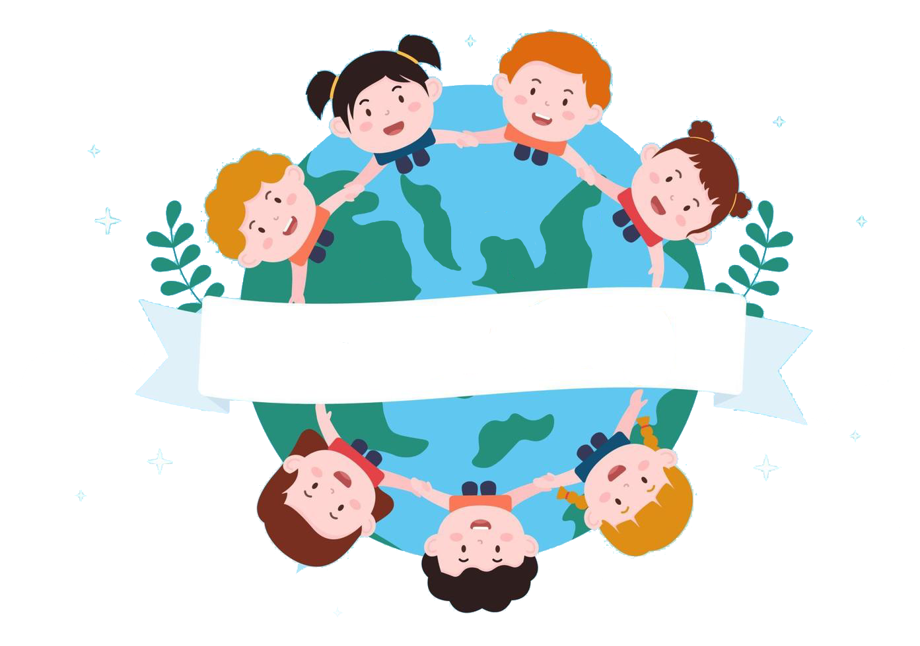
Thank you
& goodbye!

