Slide 1


Slide 2



Slide 3

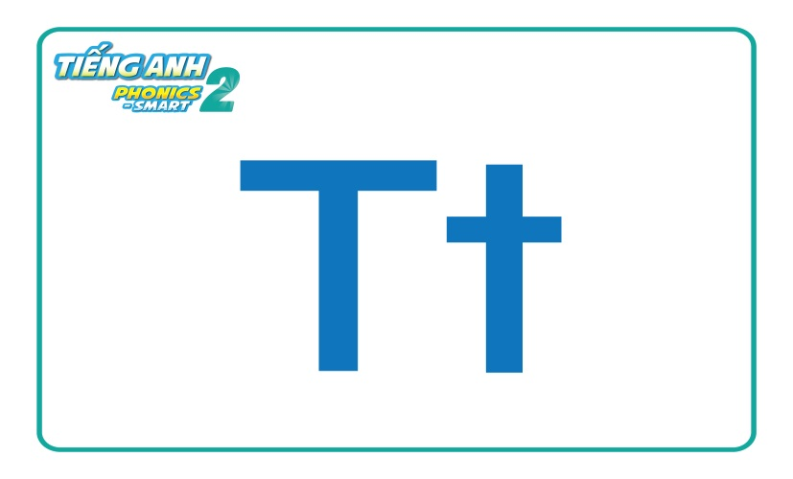


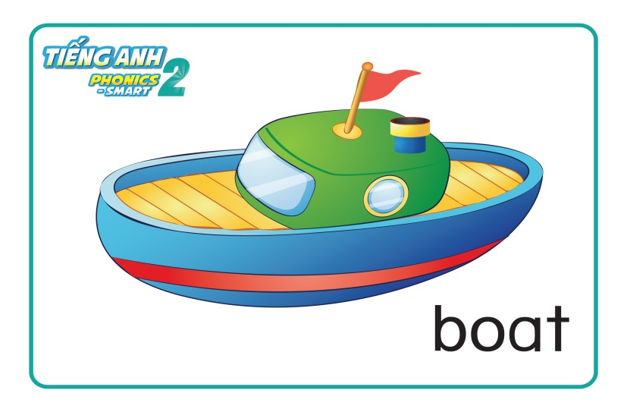
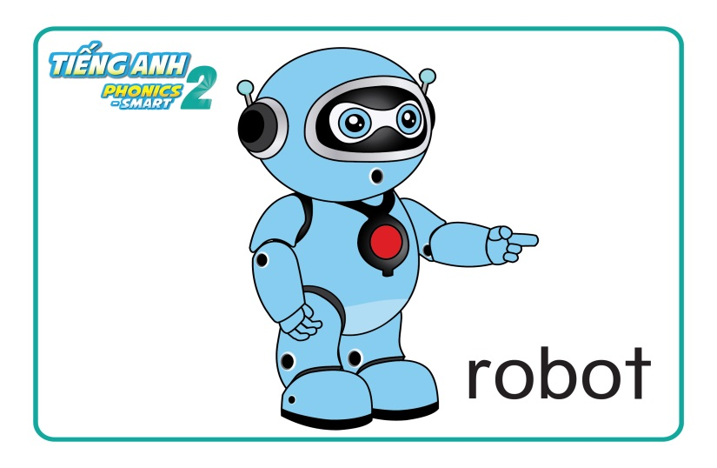
REVISION & WARM UP

Slide 4
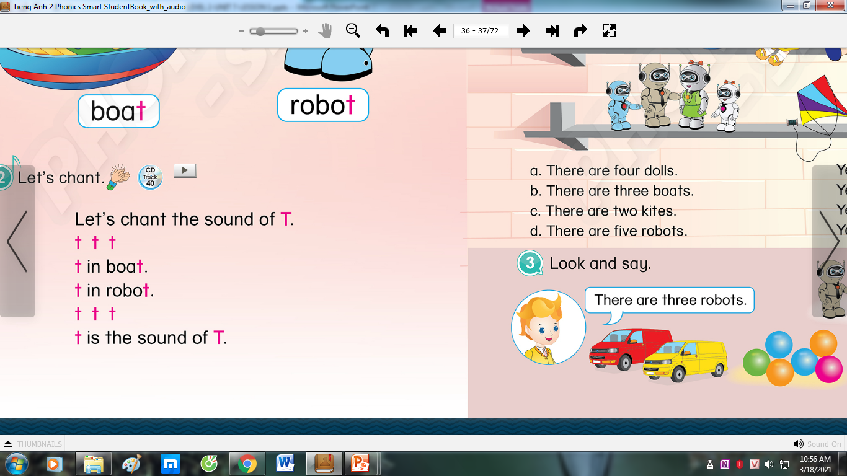
REVISION & WARM UP
Let’s sing and do the actions

Slide 5

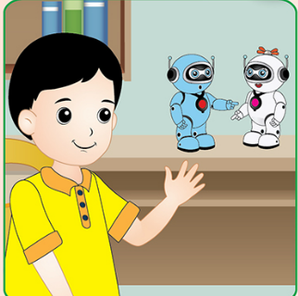


Unit 7:
Lesson 2
Tt
1. Listen and repeat.
There are two robots.
There are three boats.
We can share them.

Slide 6

Unit 7:
Lesson 2
Tt
1. Listen and repeat.
two robots

Slide 7
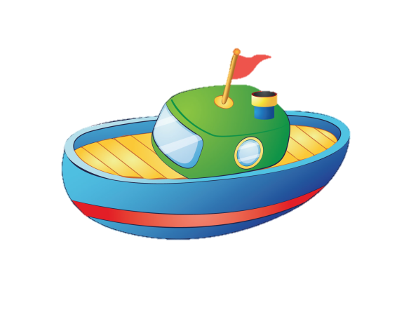
Unit 7:
Lesson 2
Tt
1. Listen and repeat.
three boats

Slide 8
Unit 7:
Lesson 2
Tt
1. Listen and repeat.
There are two robots.
There are three boats.

Slide 9

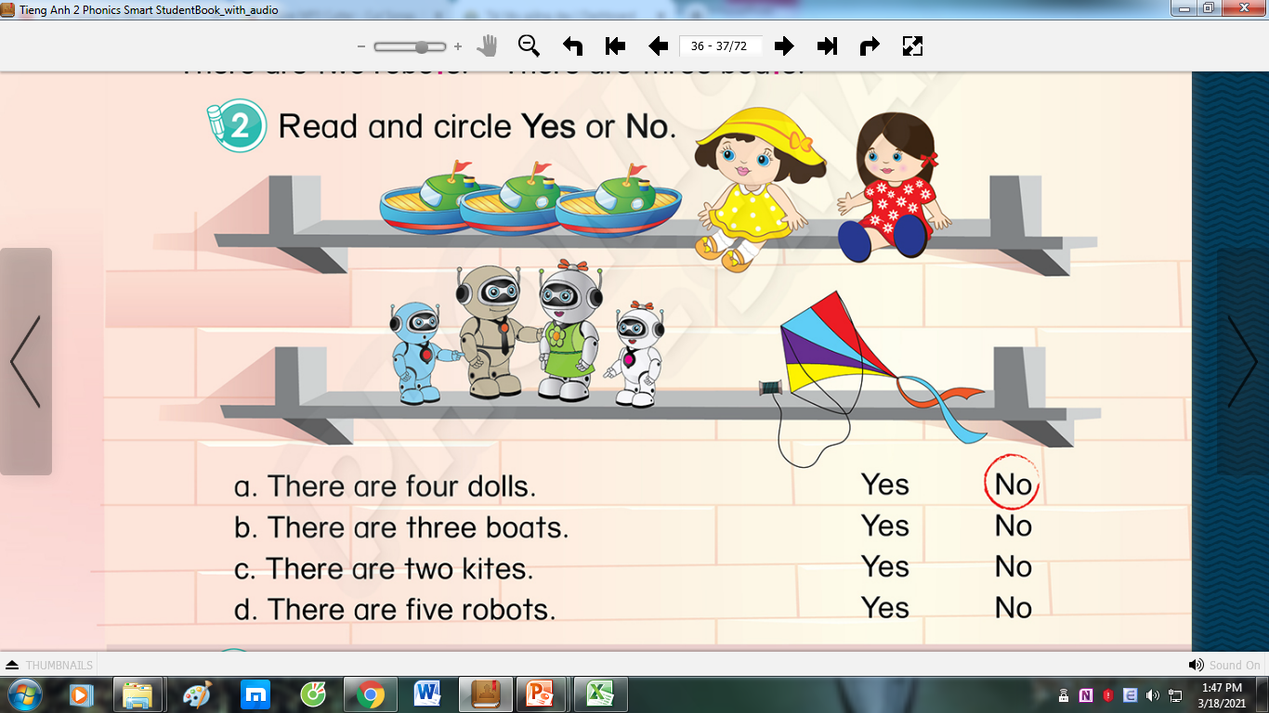
Unit 7:
Lesson 2
Tt
1. Listen and repeat.
2. Read and circle Yes or No
There are five dolls.
Yes / No

Slide 10
Unit 7:
Lesson 2
Tt
2. Read and circle Yes or No
There are three boats.
Yes / No

Slide 11
Unit 7:
Lesson 2
Tt
2. Read and circle Yes or No
There are two kites.
Yes / No

Slide 12
Unit 7:
Lesson 2
Tt
2. Read and circle Yes or No
There are five robots.
Yes / No

Slide 13
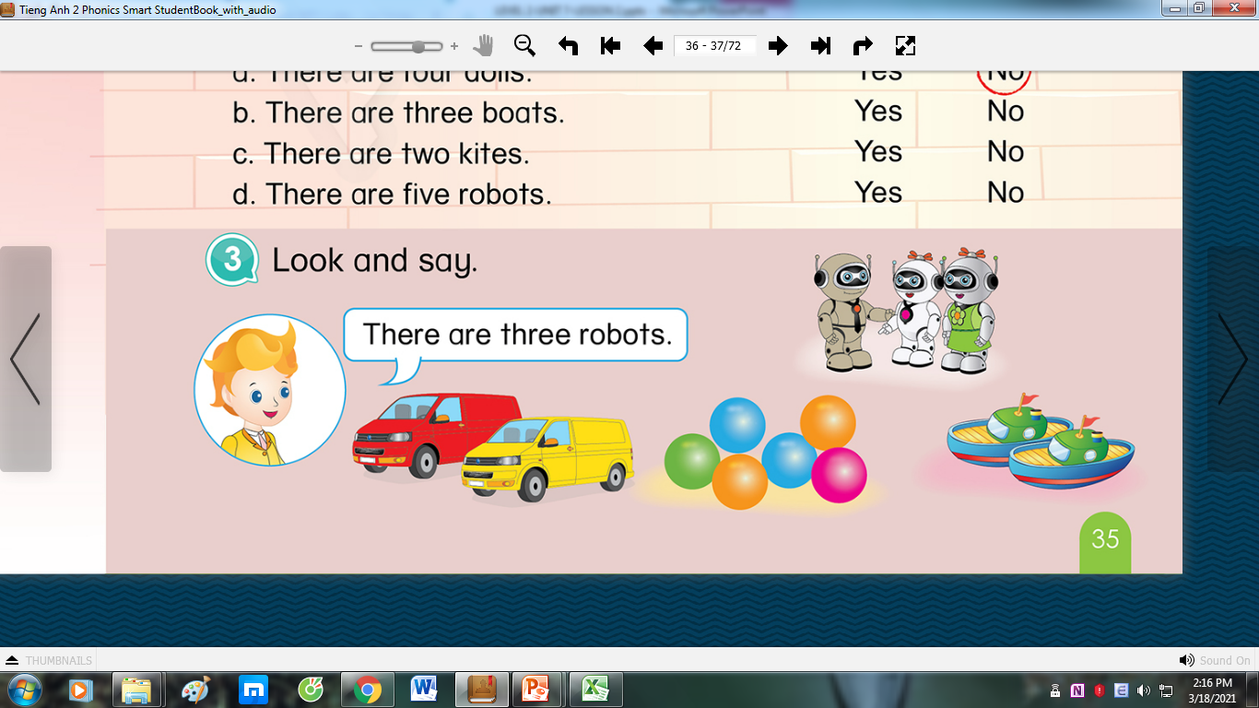

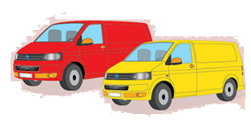
Unit 7:
Lesson 2
T t
3. Look and say.
There are three robots.
There are two cars.

Slide 14

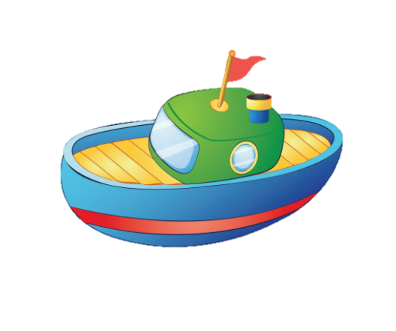

Unit 7:
Lesson 2:
T t
3. Look and say.
There are six balls.
There are two boats.

Slide 15




Unit 7: Lesson 2
T t
Who is faster?
Next
Notes:
Who is faster? game
T says “Let’s play with these magic numbers.”
Work in groups
Each group chooses 1 number – “Group 1/Group 2, what number do you like?”
T clicks on the number, shows the picture and asks “How many..?”
With a correct answer, each group will have 1 flower.

Slide 16

Unit 7: Lesson 2
T t
How many robots?
back
two robots
Notes:
How many robots?

Slide 17
Unit 7: Lesson 2:
T t
How many boats?
three boats
back
Notes:
How many boats?

Slide 18
Unit 7: Lesson 2:
T t
How many kites?
one kite
back
Notes:
How many kites?

Slide 19
Unit 7: Lesson 2:
T t
How many balls?
six balls
back
Notes:
How many boats?

Slide 20


CÔNG TY CỔ PHẦN PHÁT TRIỂN GIÁO DỤC
VIỆT NAM VPBOX
Hà Nội
Biệt thự G2&G28, Làng Quốc Tế Thăng Long,
Quận Cầu Giấy, Hà Nội.
ĐT: (024) 3 3793 2405
phonics.hanoi@vpbox.edu.vn
Thành Phố Hồ Chí Minh
Số 29 Mai Thị Lựu, Quận 1, TP. HCM.
ĐT: (028) 3 820 5934
phonics.hcm@vpbox.edu.vn
www.vpbox.edu.vn

