Slide 1


Slide 2



Slide 3


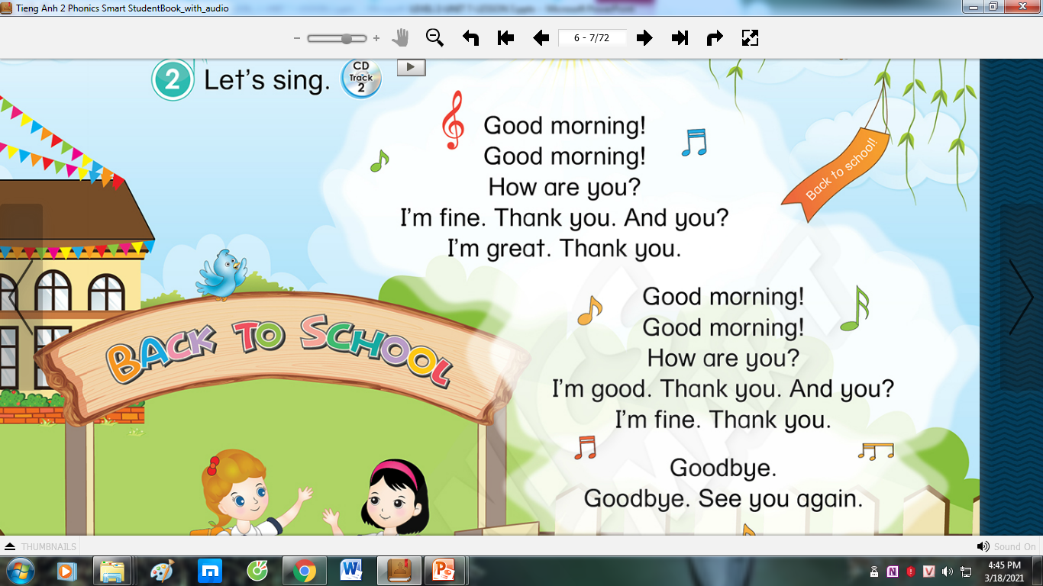


LET’S SING!

Slide 4



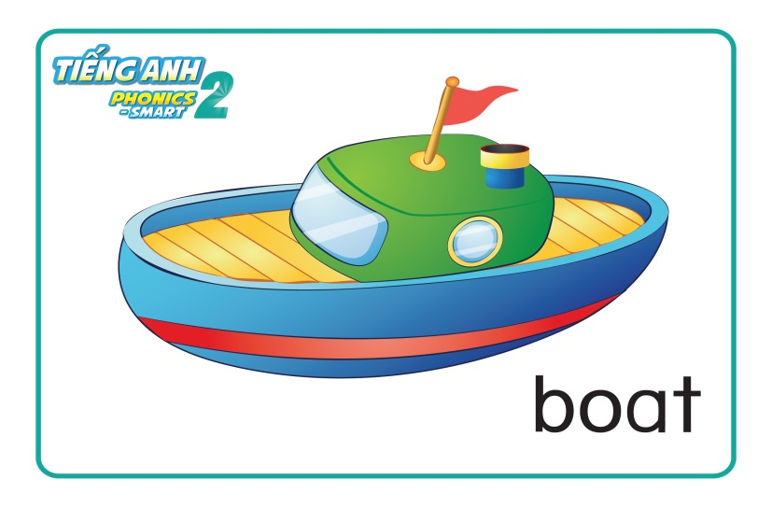
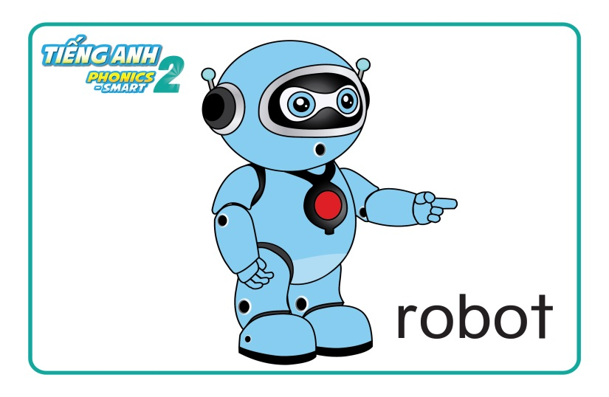
REVISION

Slide 5

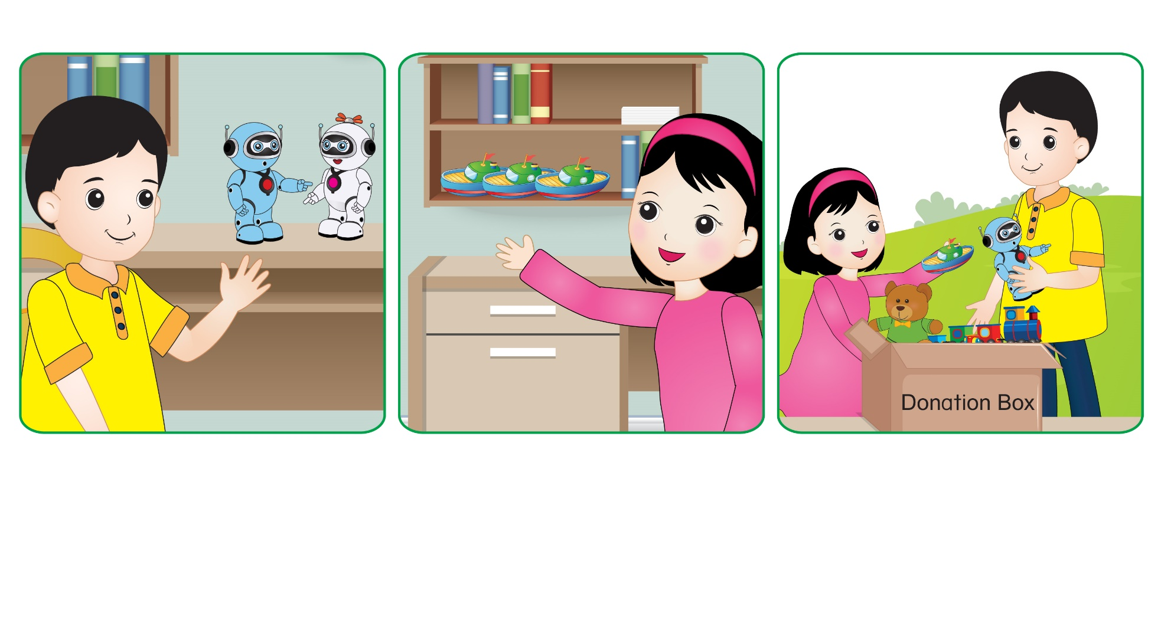
Unit 7: Lesson 3

Slide 6
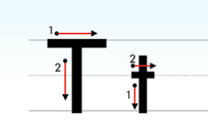
Unit 7: Lesson 3 Tt
1. Trace the letters.

Slide 7

Unit 7: Lesson 3 Tt
1. Trace the letters.
Let’s write letter Tt on your board.
T
t
T
T
t

Slide 8


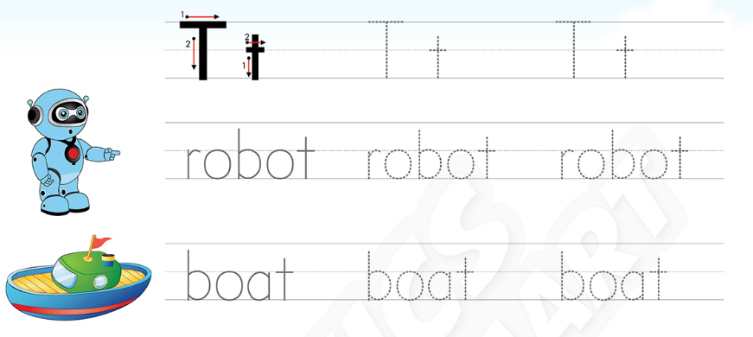

Unit 7: Lesson 3 Tt
1. Trace the letters.
36

Slide 9
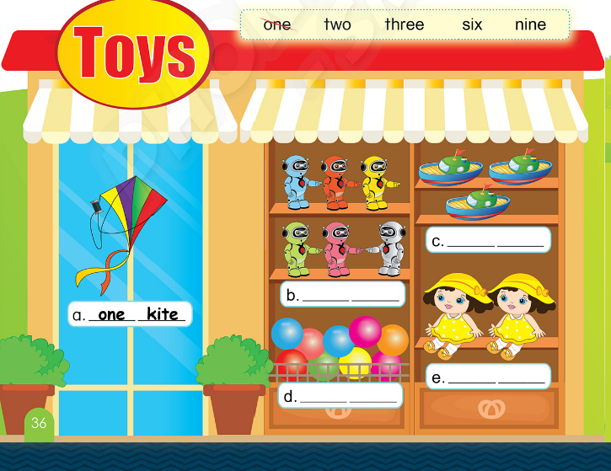
Unit 7: Lesson 3 Tt
1. Trace the letters.
36
2. Choose, write and say.

Slide 10
Unit 7: Lesson 3 Tt
1. Trace the letters.
2. Choose, write and say.
three
boats
six
robots
nine
two
dolls
balls

Slide 11
BIG WHEEL GAME
1
2
3
4
5
6
SPIN
STOP
Notes:
- HS chọn câu hỏi, trả lời và quay lấy sao.

Slide 12
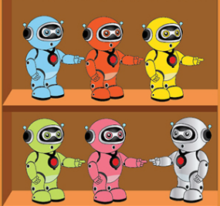

How many robots?
There are …
six robots
back

Slide 13

How many boats?
There are …
three boats
back

Slide 14

How many balls?
There are …
nine balls
back

Slide 15

How many dolls?
There are …
two dolls
back

Slide 16
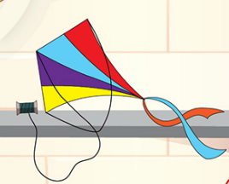
How many kites?
There is …
one kite
back

Slide 17

How many cars?
There are …
two cars
back

Slide 18


CÔNG TY CỔ PHẦN PHÁT TRIỂN GIÁO DỤC
VIỆT NAM VPBOX
Hà Nội
Biệt thự G2&G28, Làng Quốc Tế Thăng Long,
Quận Cầu Giấy, Hà Nội.
ĐT: (024) 3 3793 2405
phonics.hanoi@vpbox.edu.vn
Thành Phố Hồ Chí Minh
Số 29 Mai Thị Lựu, Quận 1, TP. HCM.
ĐT: (028) 3 820 5934
phonics.hcm@vpbox.edu.vn
www.vpbox.edu.vn

