Slide 1
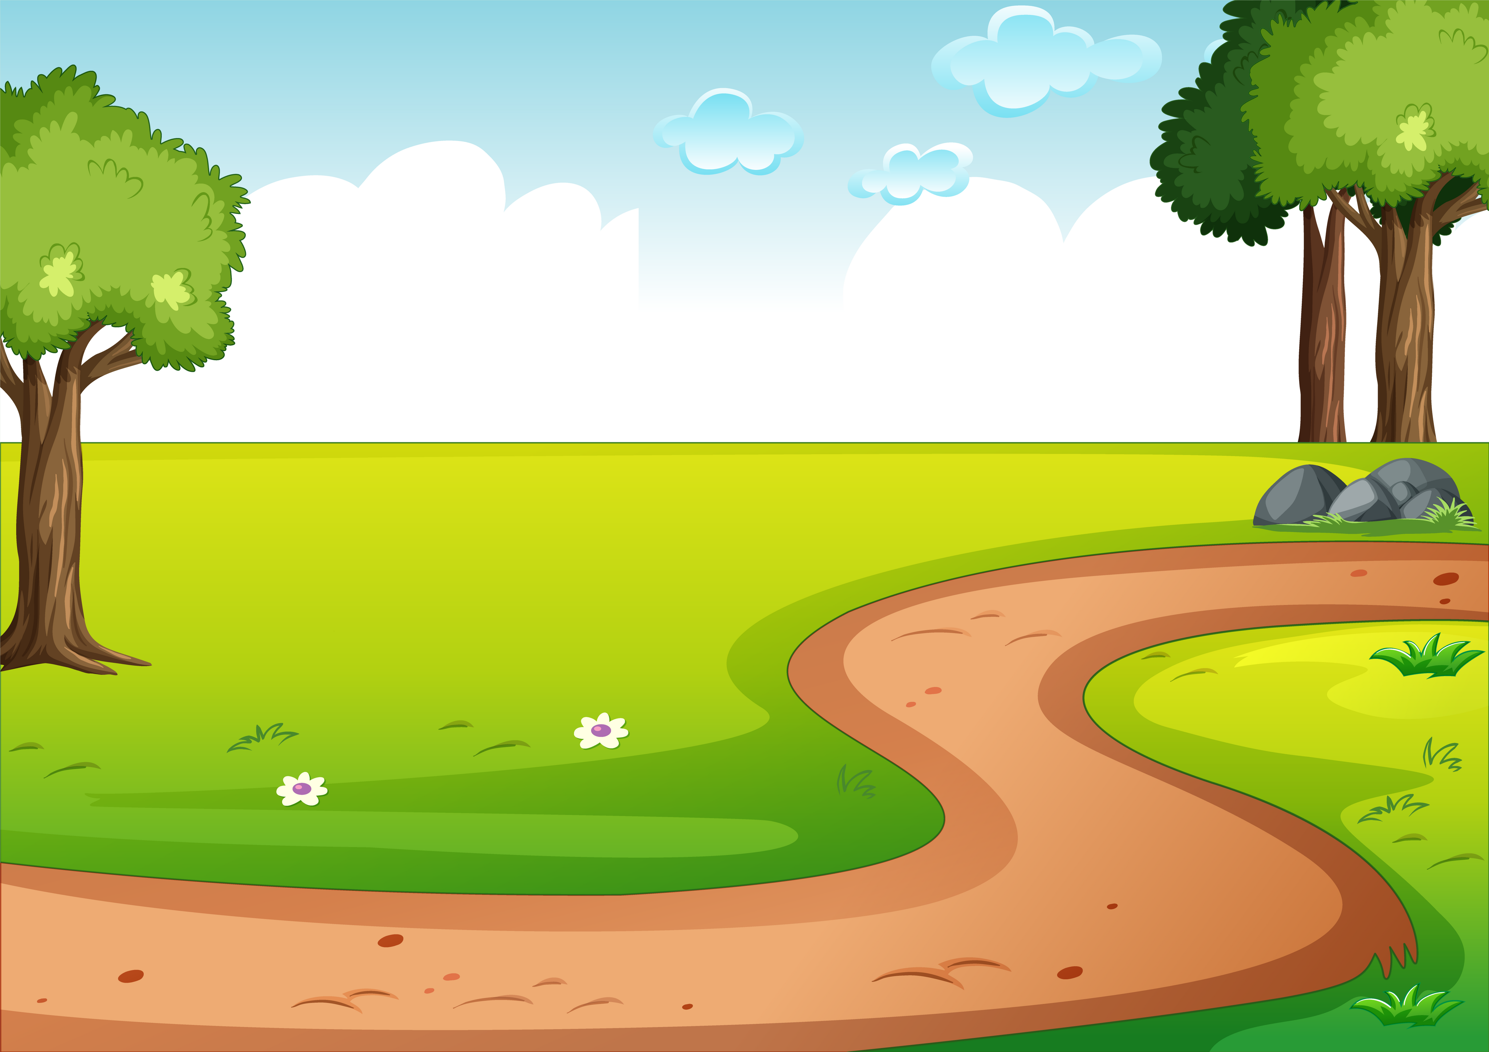

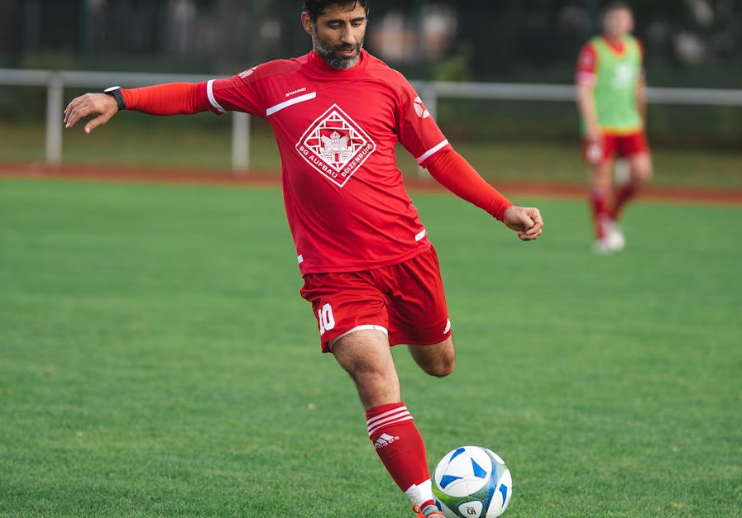

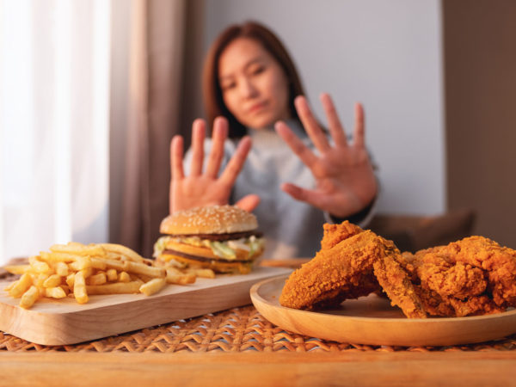
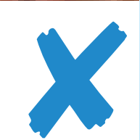
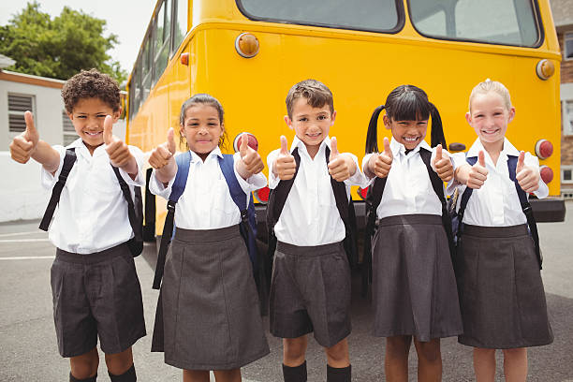
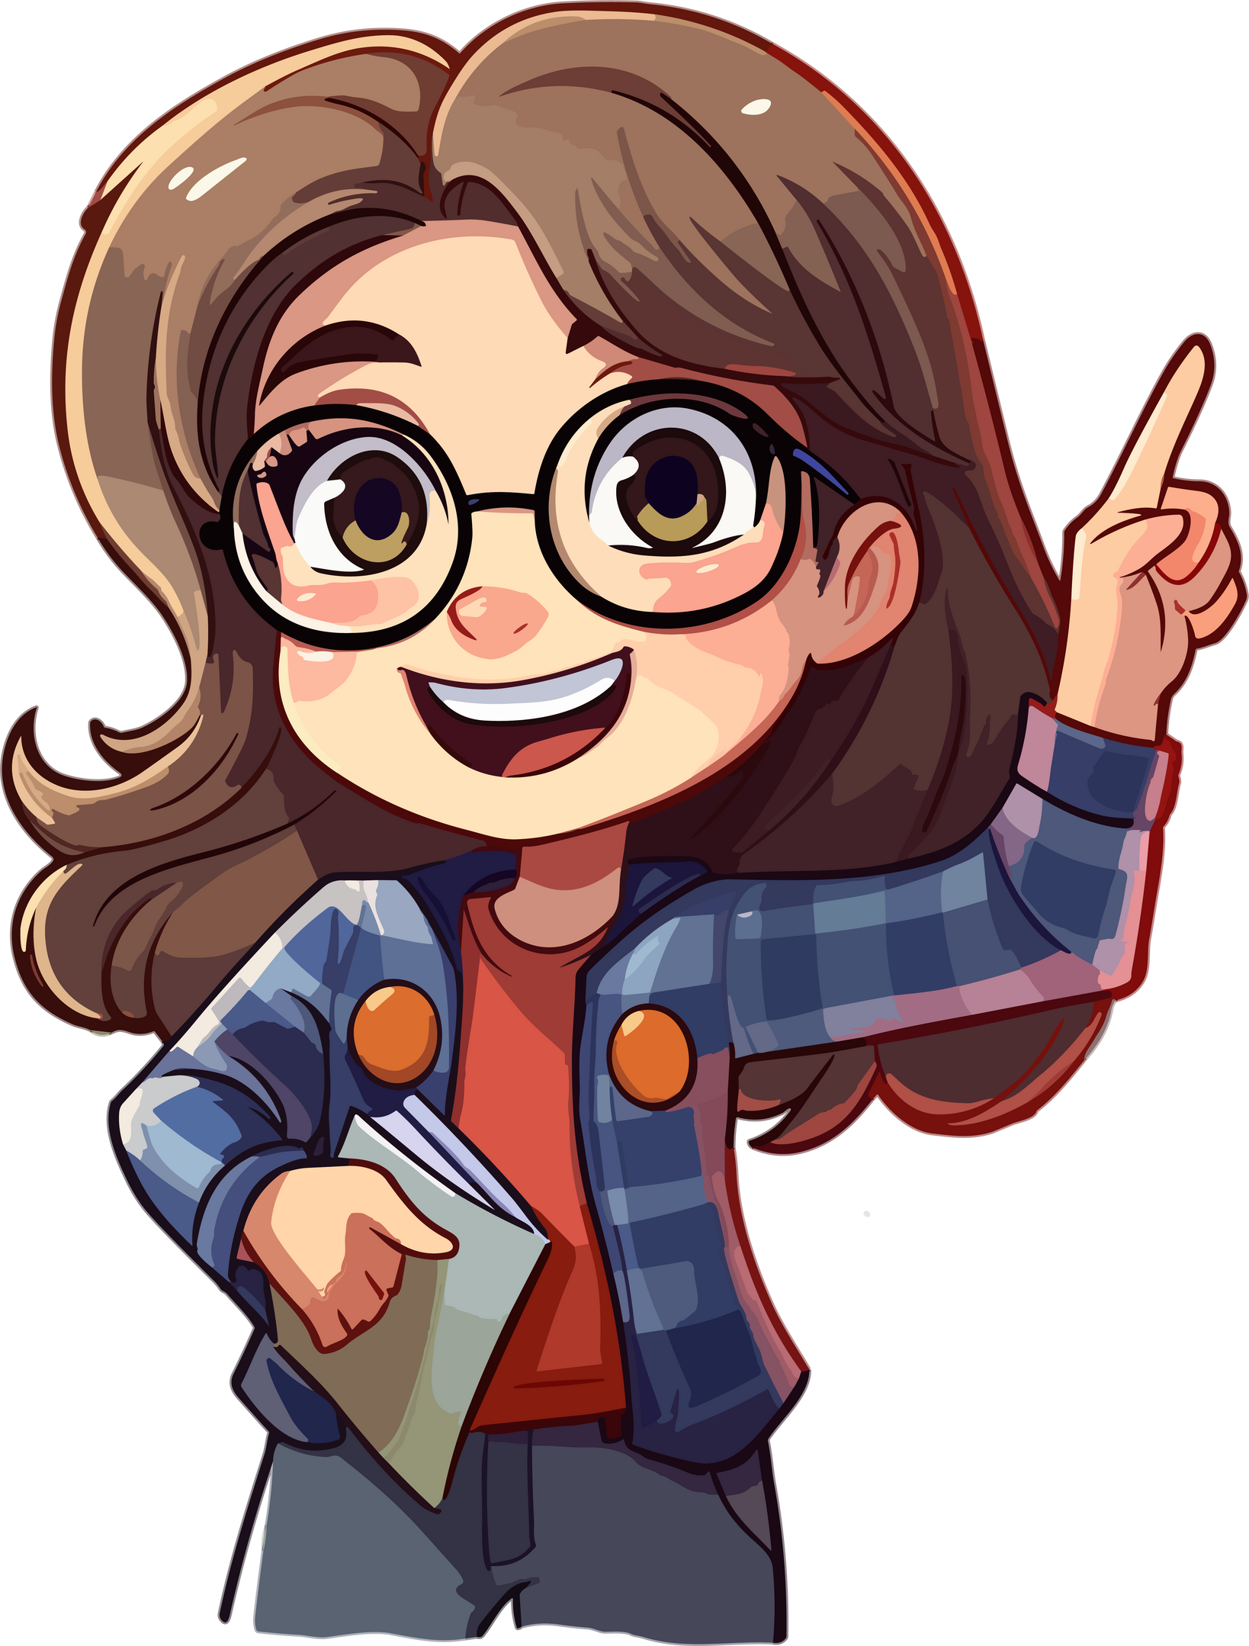
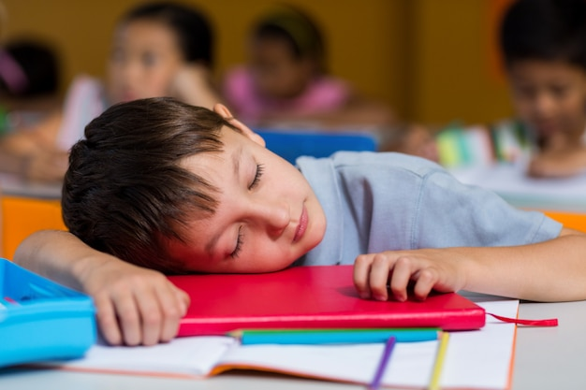
4. Look at the picture and complete the sentences with must or mustn’t.
1. You ______ kick the ball.
You ______ touch the ball with your hands.
must
mustn’t
2. You ______ eat a lot of junk food.
You ______ eat more fruit.
mustn’t
must
3. They ______ wear white shirts to school.
Girls ______ wear grey skirts.
must
must
4. He ______ pay attention.
He ______ fall asleep at school.
must
mustn’t

Slide 2

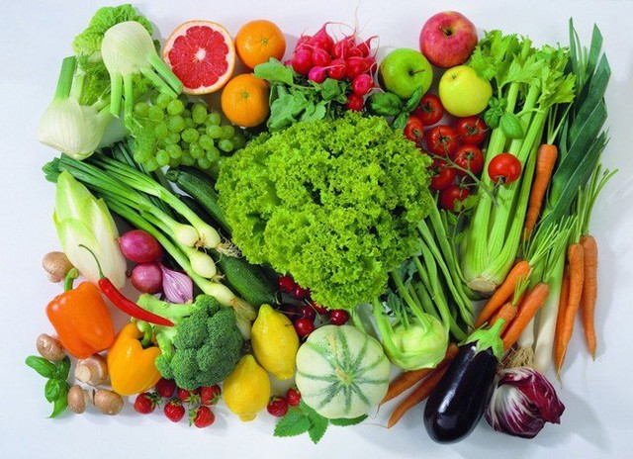
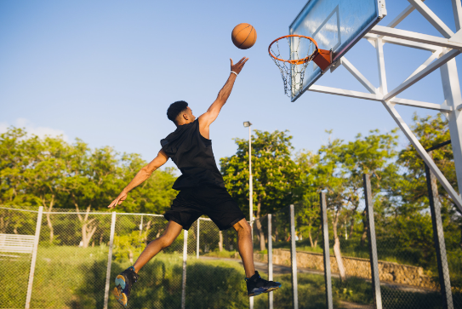
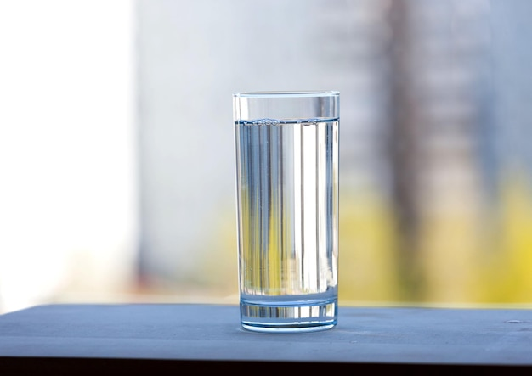
5. Look, write, and say.
What must a basketball player do? What mustn’t they do?
1. eat a lot of vegetable
________________________.
They must eat a lot of vegetables
2. practice every day
________________________.
They must practice every day
3. drink lots of water
________________________.
They must drink lots of water

Slide 3
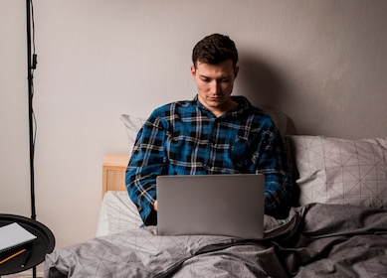
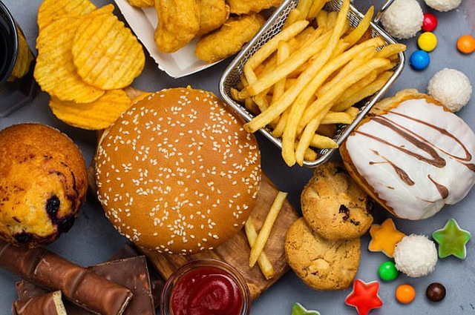
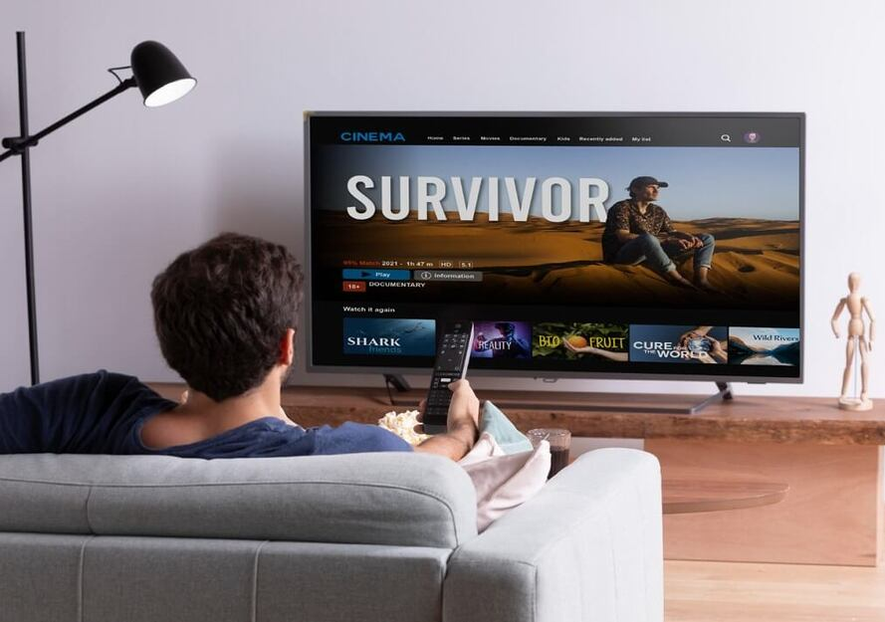
5. Look, write, and say.
What must a basketball player do? What mustn’t they do?
4. go to bed late
________________________.
They mustn’t go to bed late
5. eat junk food
________________________.
They mustn’t eat junk food
6. watch TV all day
________________________.
They mustn’t watch TV all day

Slide 4

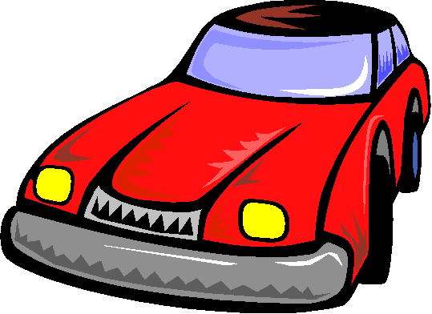
DRIVING TEST
must or mustn’t ?

Slide 5


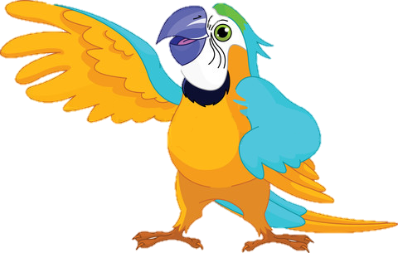
If you see this traffic sight, you _________ turn right.
must
mustn’t

Slide 6

If you see this traffic sight, you _________ turn left.
must
mustn’t

Slide 7
If you see this traffic sight, you _________ turn left.
must
mustn’t

Slide 8

If you see this traffic sight, you _________ stop here.
must
mustn’t

Slide 9

If you see this traffic sight, you _________ park here.
must
mustn’t

Slide 10
If you see this traffic sight, you _________ turn right.
must
mustn’t

Slide 11
If you see this traffic sight, you _________ enter.
must
mustn’t

Slide 12

If you see this traffic sight, you _________ go straight.
must
mustn’t

Slide 13

If you see this traffic sight, you _________ stop here.
must
mustn’t

Slide 14


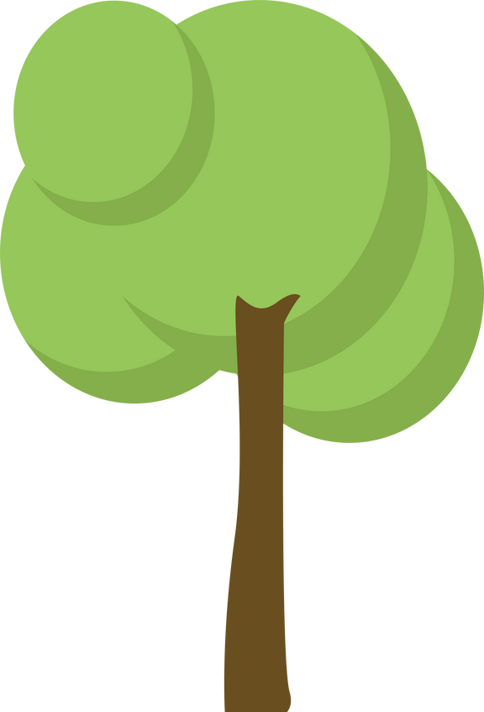
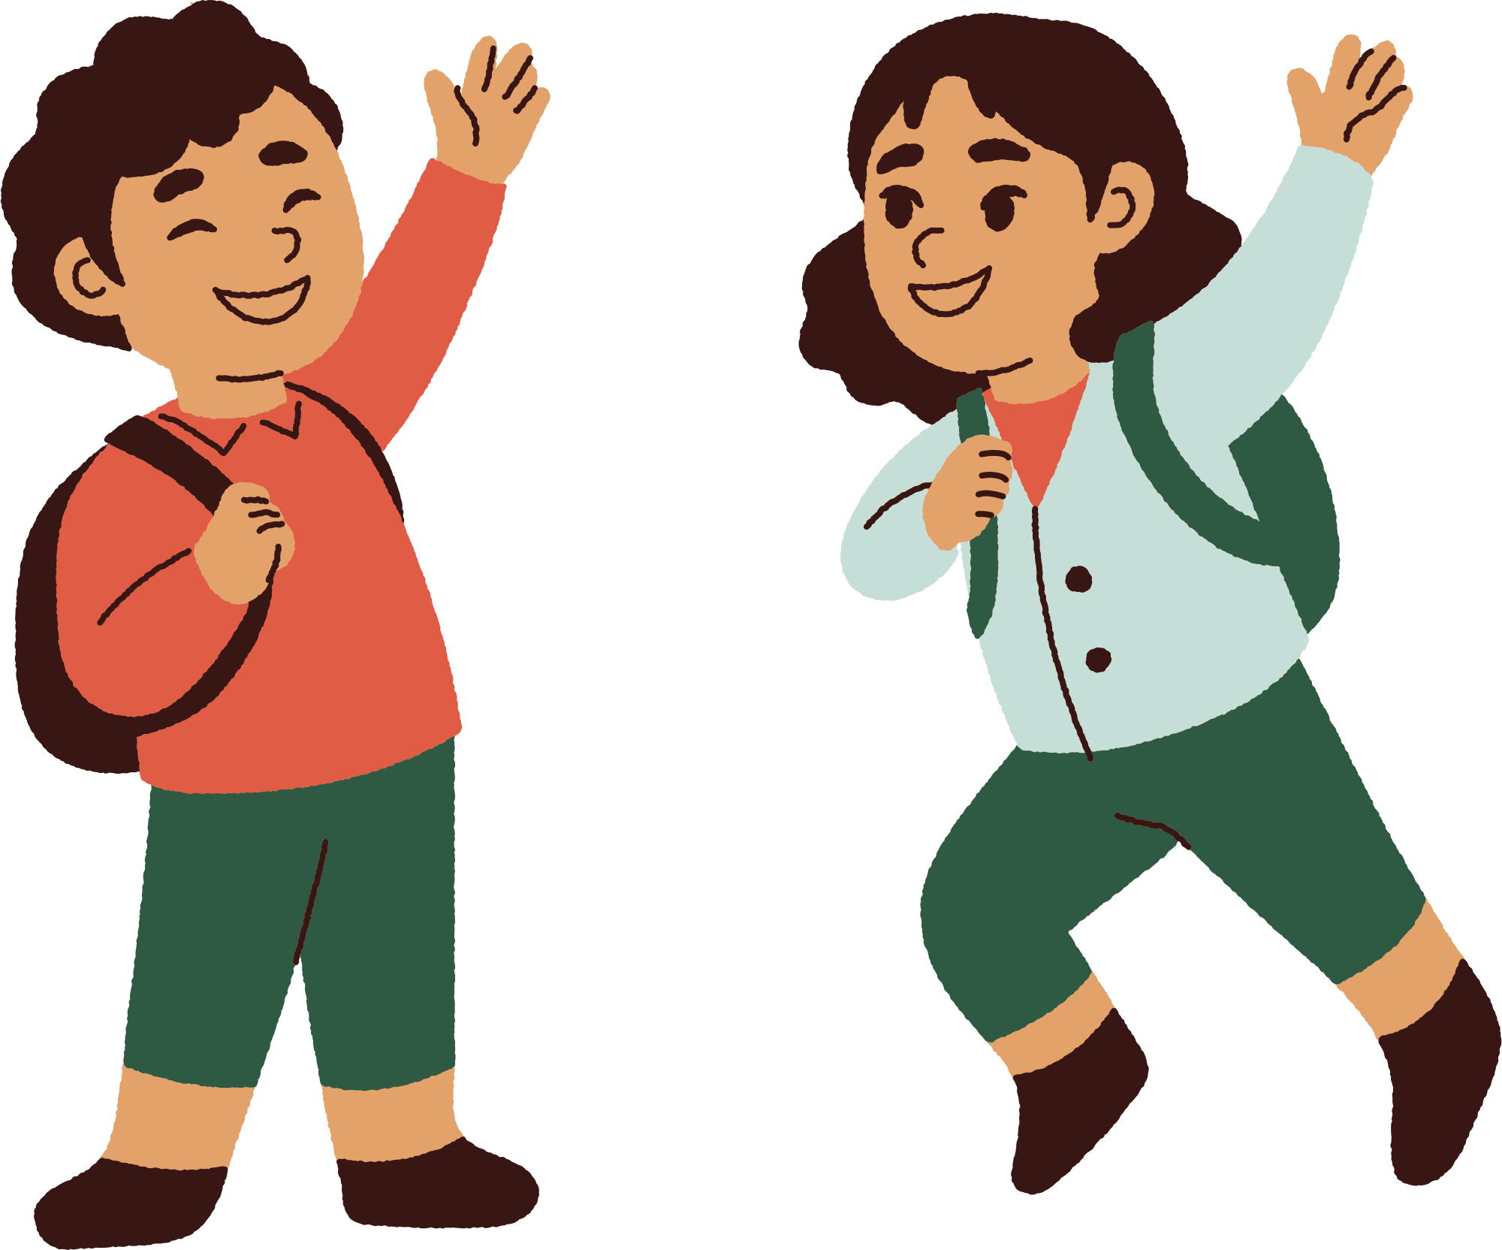

04
Production

Slide 15
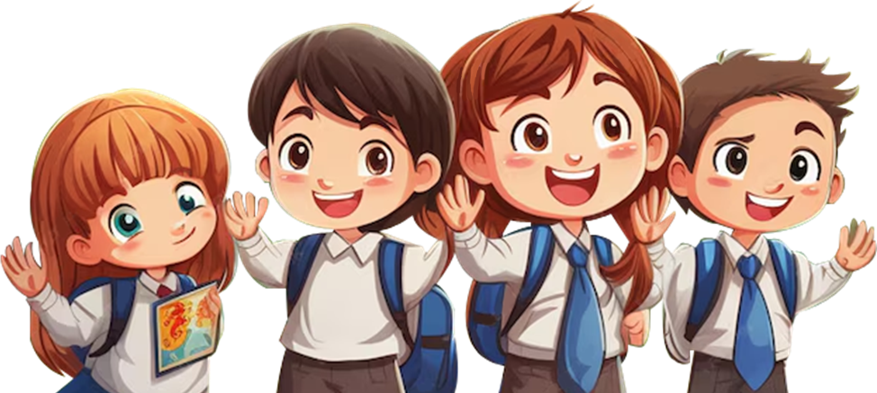
6. Write and say. What must or mustn’t we do at school?
Use the verb in the box to help you.
eat run play clean sleep write climb do use
must
mustn’t
We must clean the board.
We must ____
We mustn’t climb the trees.
We mustn’t ___

