Slide 1









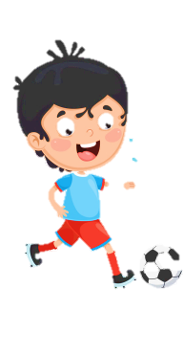












Slide 2










Unit 12: WEATHER AND NATURE
Lesson 1 – Task 4, 5, 6

Slide 3






Table of contents
01
05
Warm - up
02
04
Presentation
Production
03
Practice
Wrap-up & Assessment

Slide 4

01
Warm - up
Crossword

Slide 5


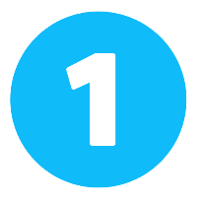





CROSSWORD GAME
B | O | I | L | I | N | G
E | N | V | I | R | O | N | M | E | N | T
U | N | D | E | R | G | R | O | U | N | D
G | E | O | T | H | E | R | M | A | L |  | E | N | E | R | G | Y
R | A | I | N | F | O | R | E | S | T
Notes:
Click các số để chuyển tới slide tương ứng.
Click vào phần điền ở câu đã chọn để hiện đáp án.
Đáp án: 1. boiling; 2. environment; 3. underground; 4. geothermal energy; 5. rainforest

Slide 6
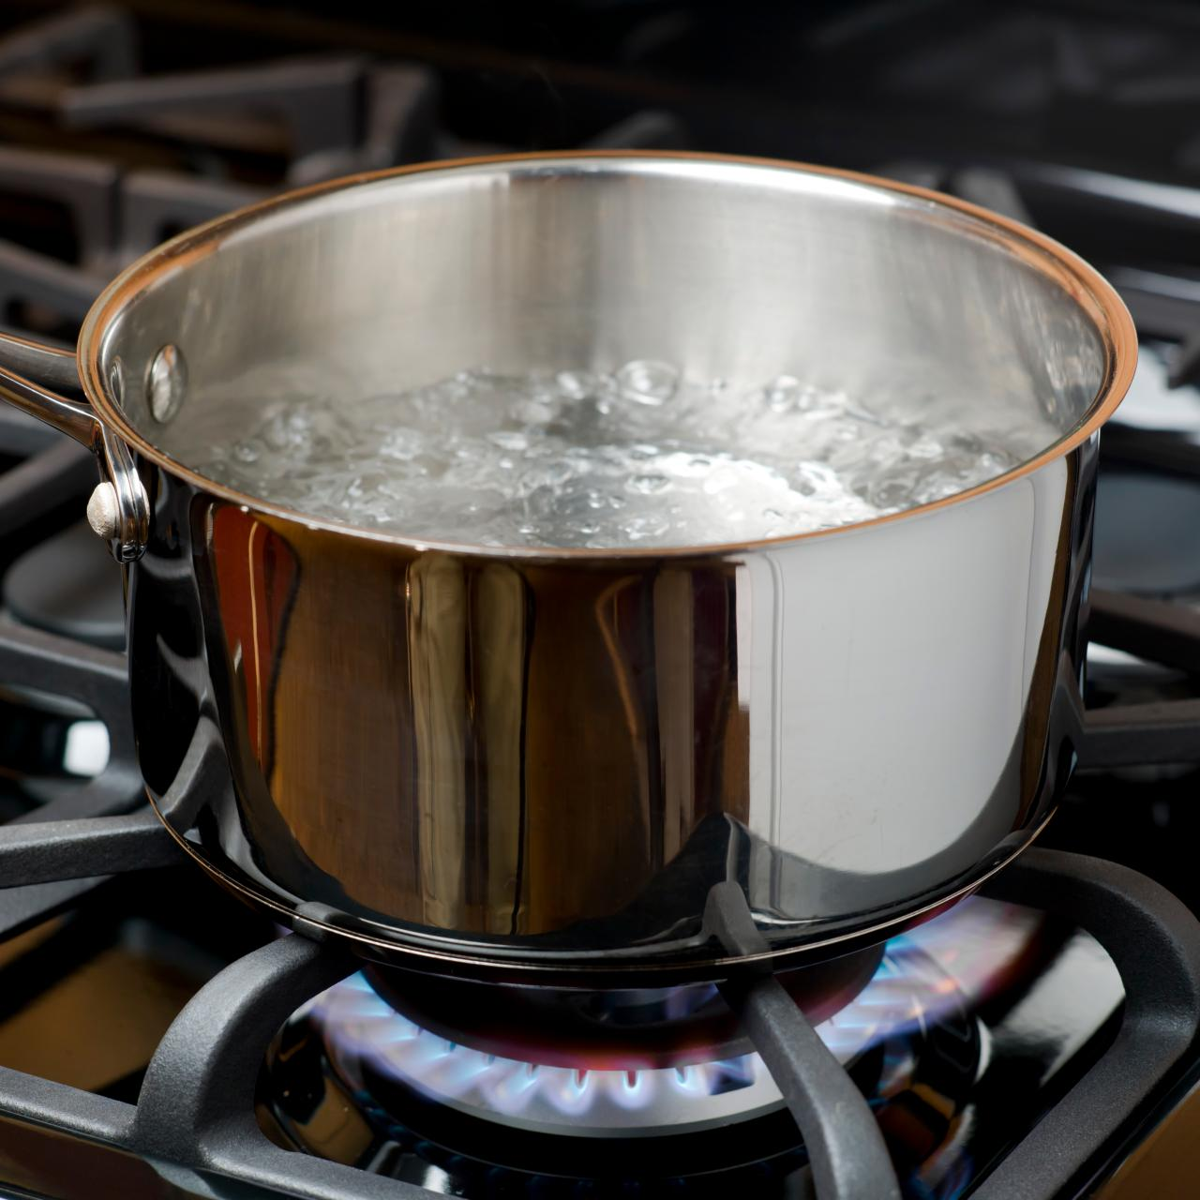

Slide 7

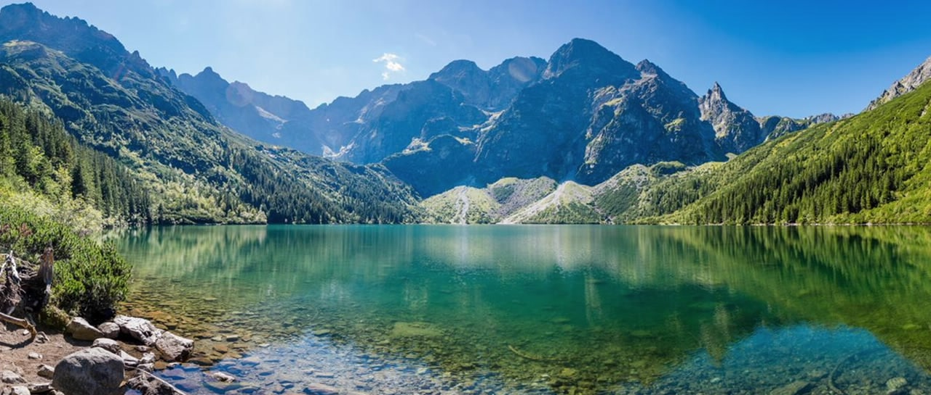

Slide 8

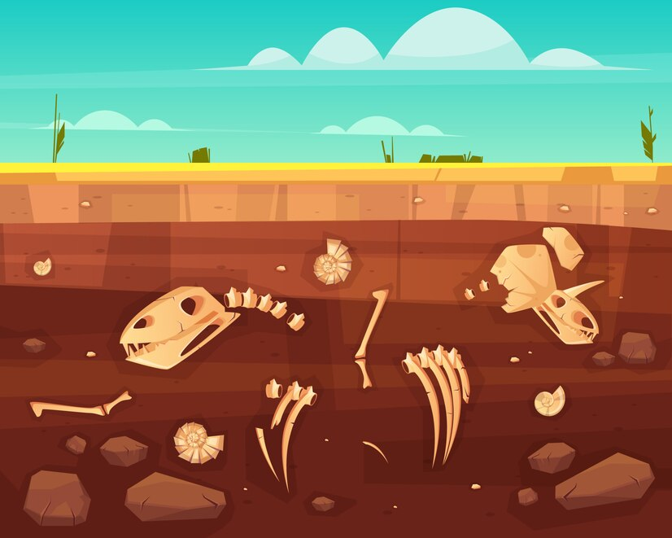

Slide 9

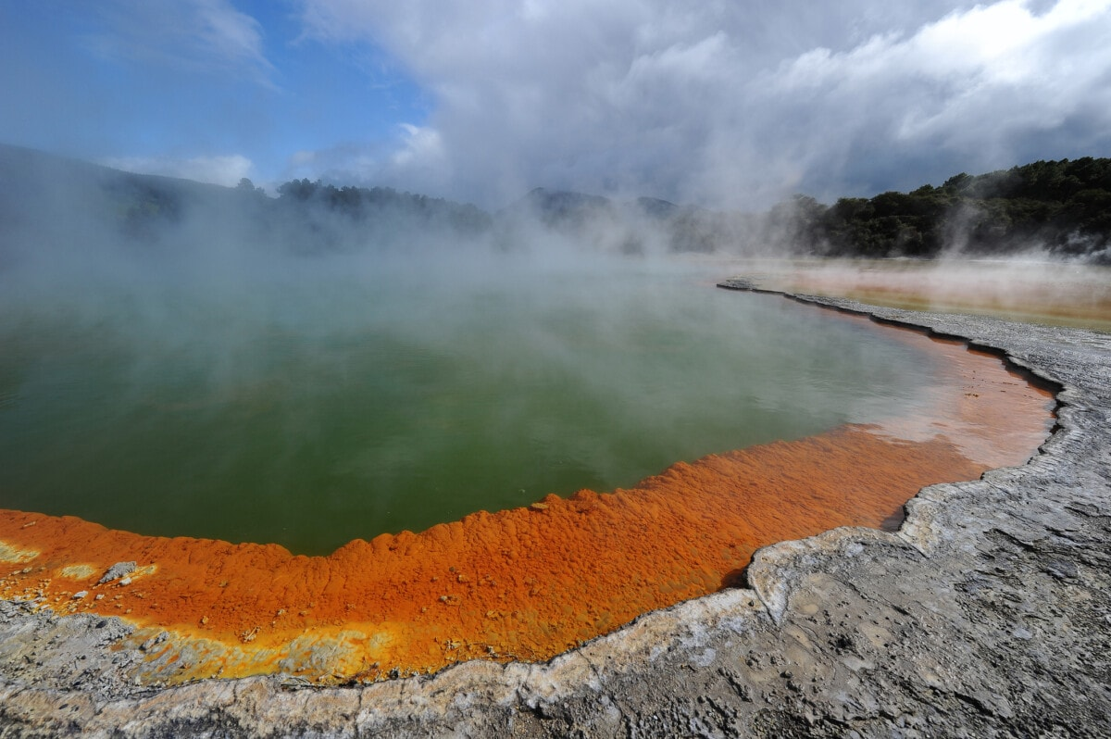

Slide 10

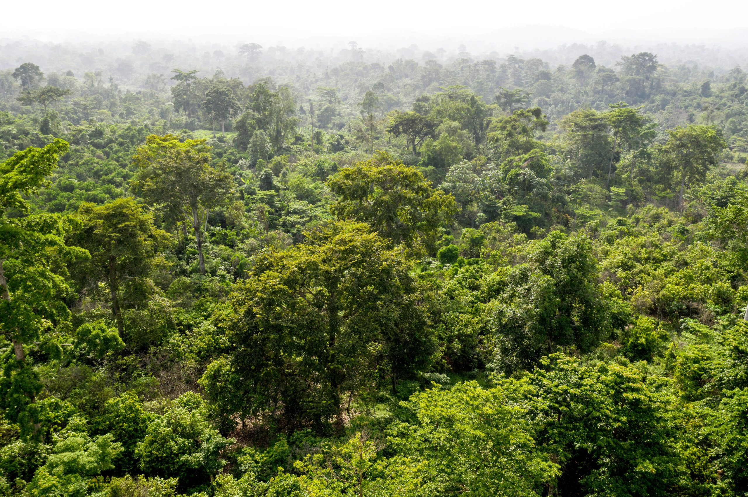

Slide 11

02
PRESENTATION

Slide 12





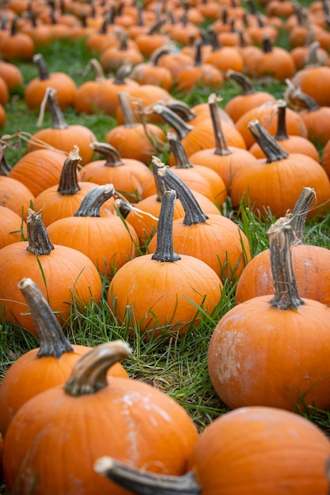








4 Role play
1. A: We don’t have any pumpkins at home.
B: Oh, I’ll get one from the supermarket.
2. A: Why won’t these vegetables grow there?
B: There’s no sunlight there.
3. A: It’s a lovely morning.
B: John and I will walk to school.
4. A: I’m going to a party today.
B: I’m sure you’ll have a great time.

Slide 13







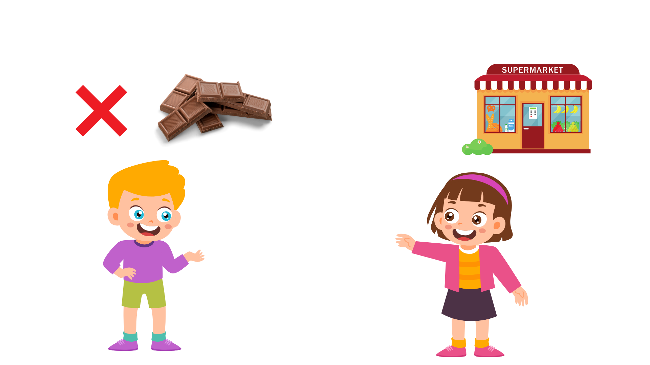
Future simple: Decision
I’ll buy some at the supermarket.
We don’t have any chocolate left.

Slide 14
Future simple: Form
Long form
Short form
will
‘ll
will go
‘ll go

Slide 15
Future simple: Form
Long form
Short form
will not
won’t
will not go
won’t go

Slide 16
4 Role play
1. A: We don’t have any pumpkins at home.
B: Oh, I’ll get one from the supermarket.
2. A: Why won’t these vegetables grow there?
B: There’s no sunlight there.
3. A: It’s a lovely morning.
B: John and I will walk to school.
4. A: I’m going to a party today.
B: I’m sure you’ll have a great time.

Slide 17
03
PRACTICE

Slide 18













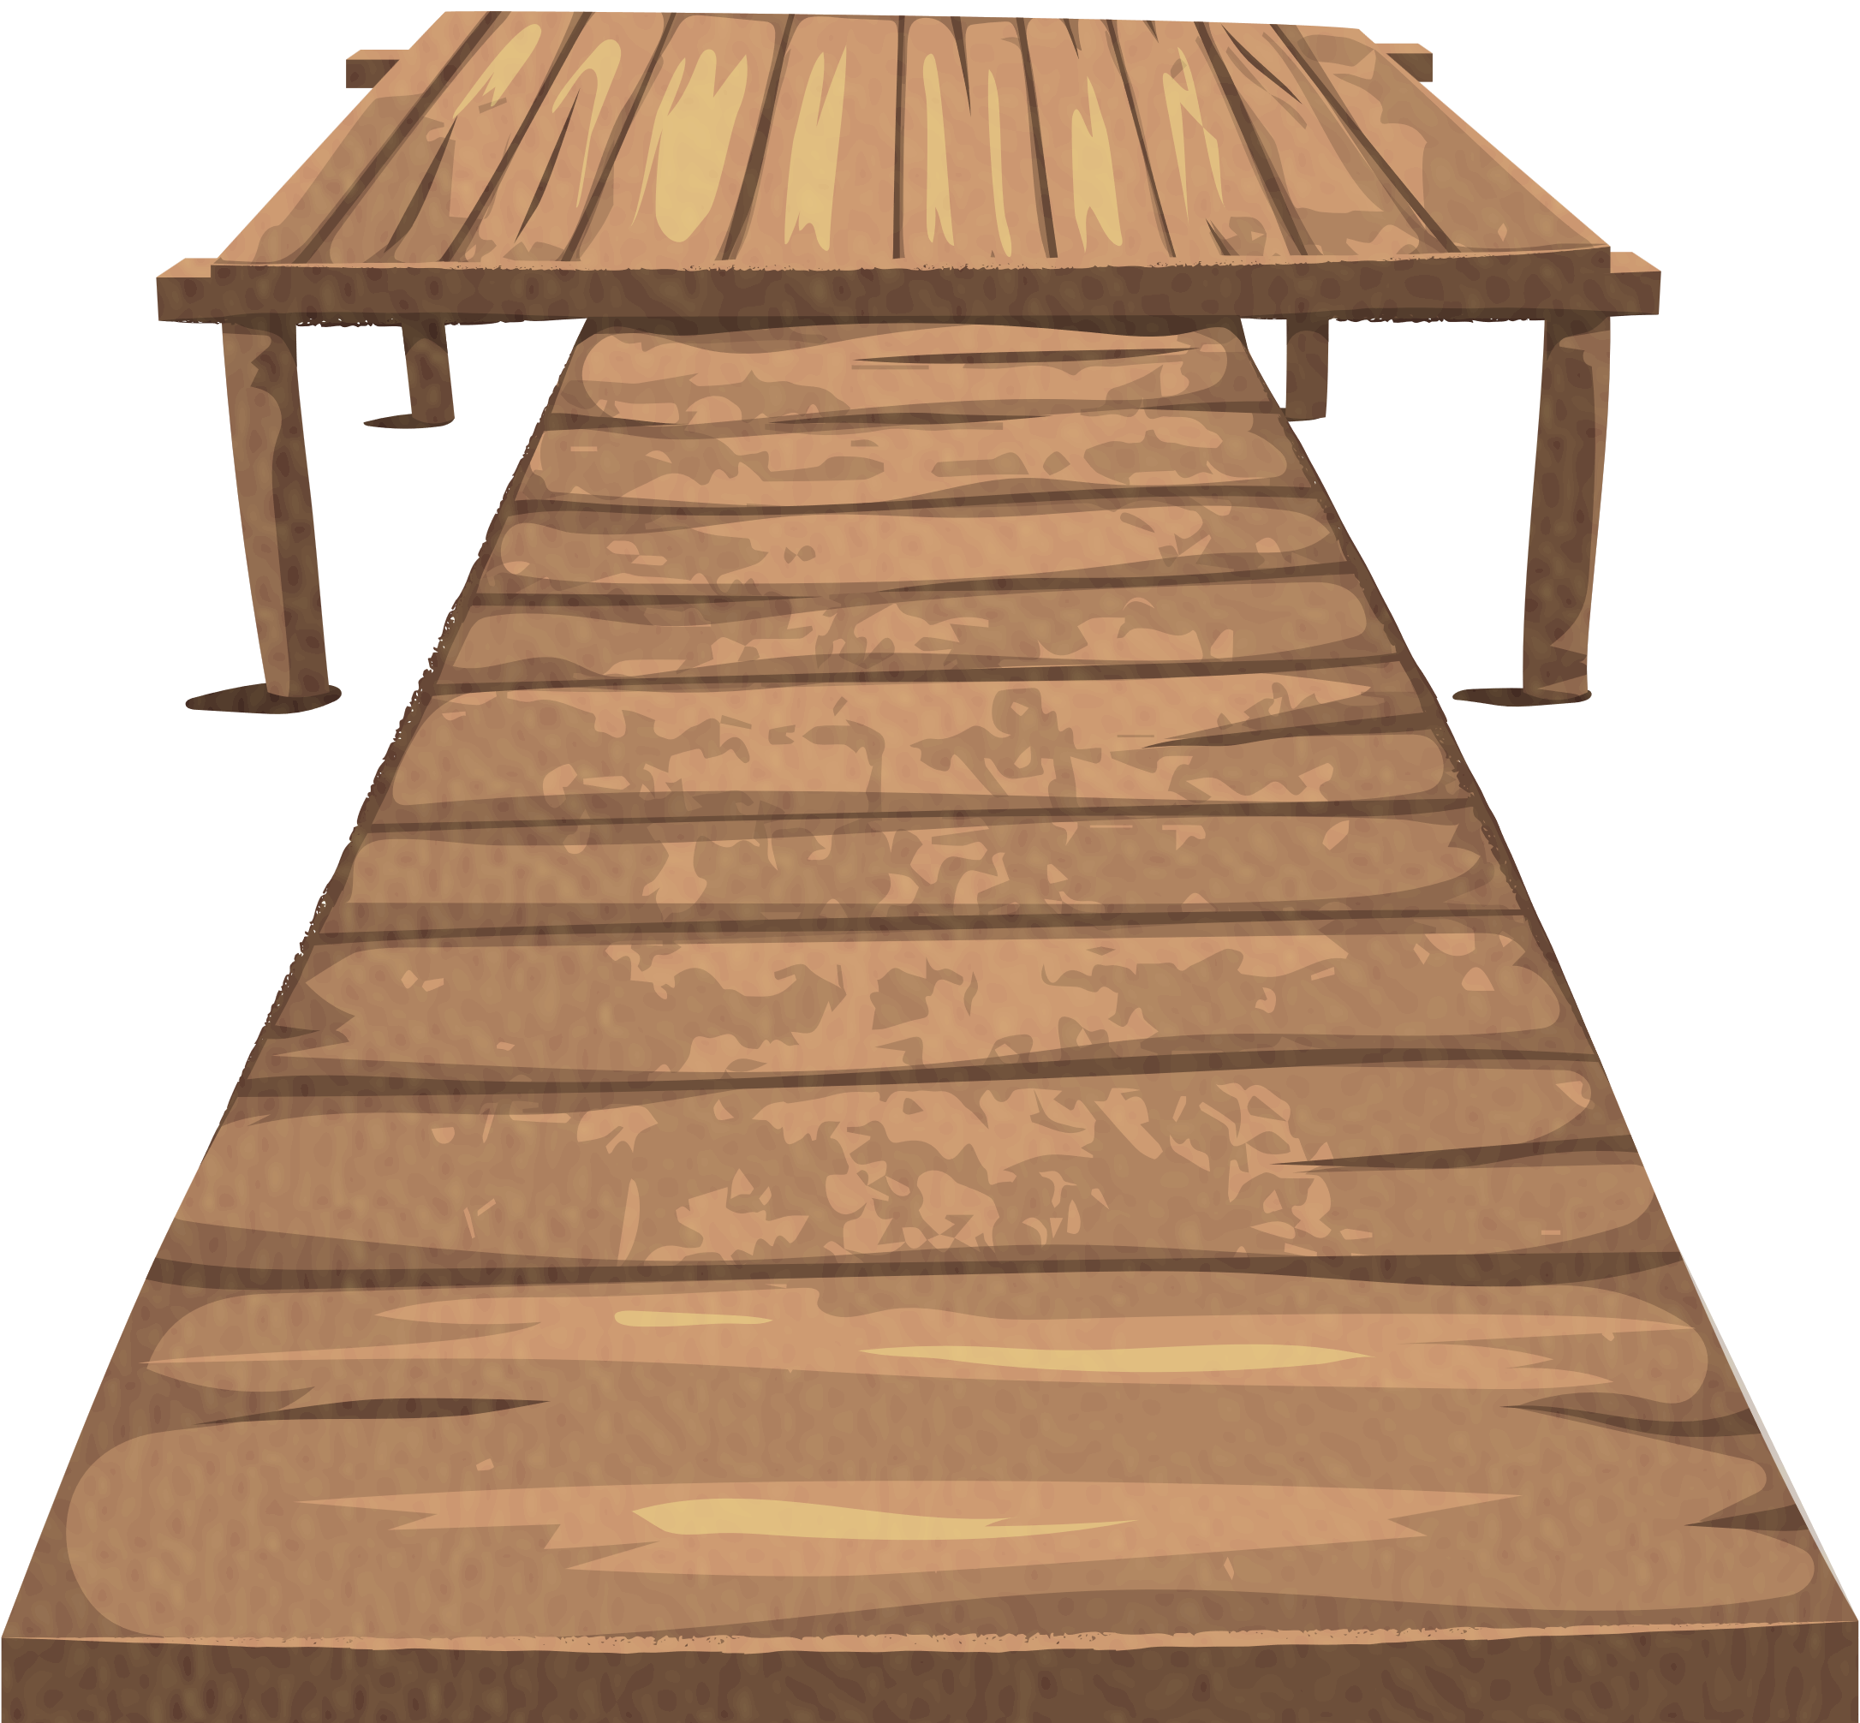


5 Read and match
1. It’s a lovely morning.
a. Don’t worry, I’ll help you with it.
2. Let’s plan a party for her birthday.
b. She will enjoy it.
3. It’s really hot.
c. John and I will walk to school.
4. Don’t cut down any more trees.
d. I think I’ll have a cold drink.
5. I can’t do my science homework!
e. You’ll destroy the park.

Slide 19

A: There is no orange juice left.
B:
I
go to
the supermarket
yesterday.
They
will go to
the hospital
tomorrow.

Slide 20
A: I’m so hungry. I want something to eat.
B:
She
‘ll make
you
some juice.
We
won’t make
I
a sandwich.

Slide 21
A: The weather is very bad today.
B:
He
won’t
have lunch
at school.
I
will
go camping
at the park.

Slide 22
They
exercises
is
too difficult.
This
exercise
will be
too easy.
A:
B: I’ll help you.

Slide 23
04
PRODUCTION
Let’s talk!

Slide 24
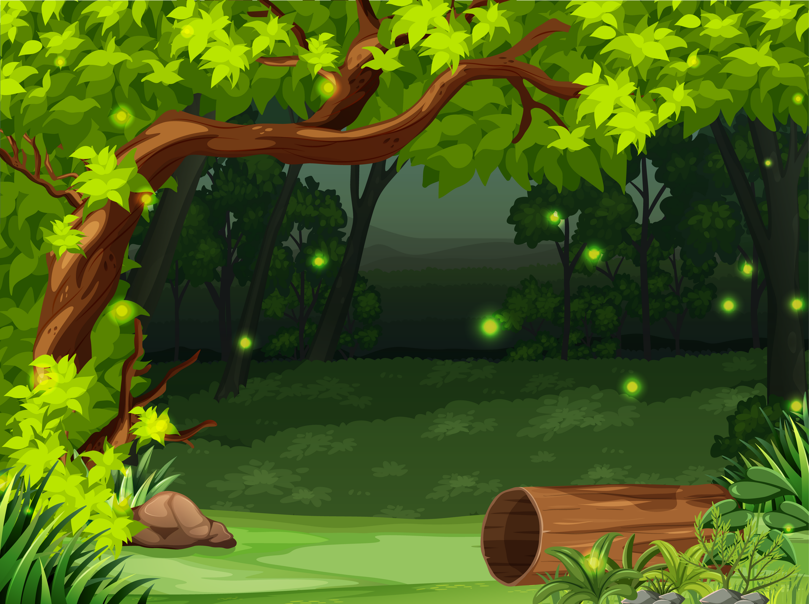

Work in group.
What will you say in these situations?
1. The door is open, and it’s cold outside.
2. You meet your friend at the train station, and he is carrying two big bags.
3. Your sister wrote a letter, and you can go past the post office today.
4. Your brother bought a cat yesterday, but it doesn’t have a name

Slide 25
05
WRAP-UP & ASSESSMENT

Slide 26

Fill in the blanks with the correct form of the verbs.
01
Wait here. I ________ (get) some help.
will get
I forgot to call my boyfriend. I _______ (do) it after dinner.
02
will do

Slide 27
Fill in the blanks with the correct form of the verbs.
This blue T-shirt looks good on me. I think I ________ (buy) it.
03
‘ll buy
04
I ________ (help) the old lady cross the street.
‘ll help

Slide 28













Unit 12: Weather and nature
Lesson 1 – Part 4,5,6
What have we learnt today?
Review vocabulary: boiling, geothermal energy, environment, rainforest, underground.
Grammar: will / won’t (decision)
● John and I will walk to school.
● These vegetables won’t grow here.

Slide 29


Thank you
& goodbye!

