Slide 1









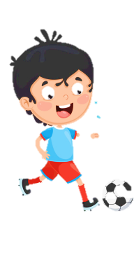












Slide 2










Unit 12: WEATHER AND NATURE
Lesson 2 – Task 4, 5, 6

Slide 3



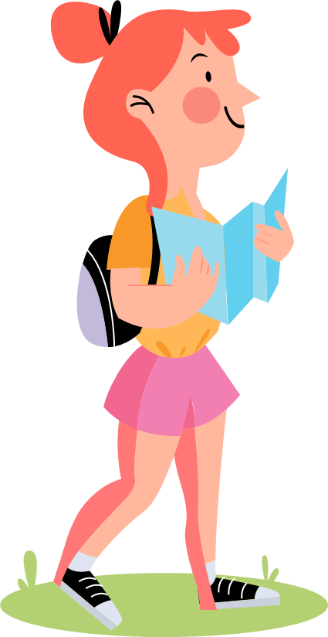


Table of contents
01
05
Warm - up
02
04
Presentation
Production
03
Practice
Wrap-up & Assessment

Slide 4
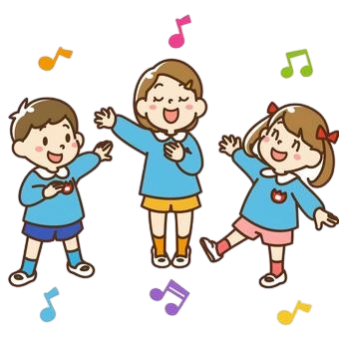
01
Warm - up
Multiple choice

Slide 5


Slide 6





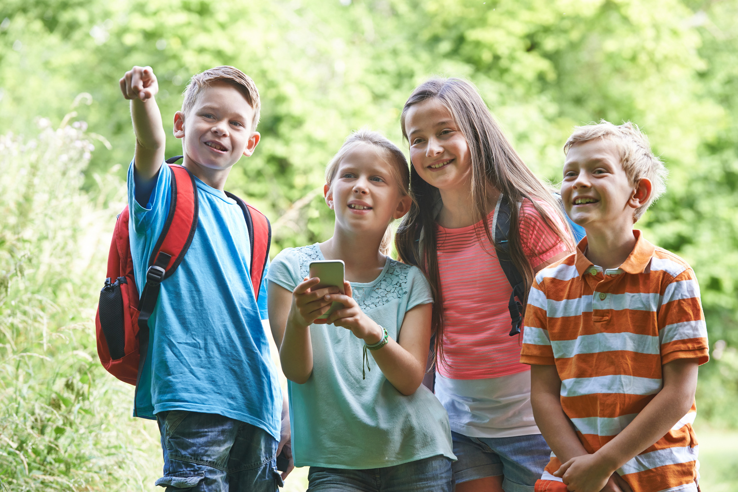



QUESTION 1
A. GPS
B. treasure
C. geocaching
D. geothermal energy

Slide 7
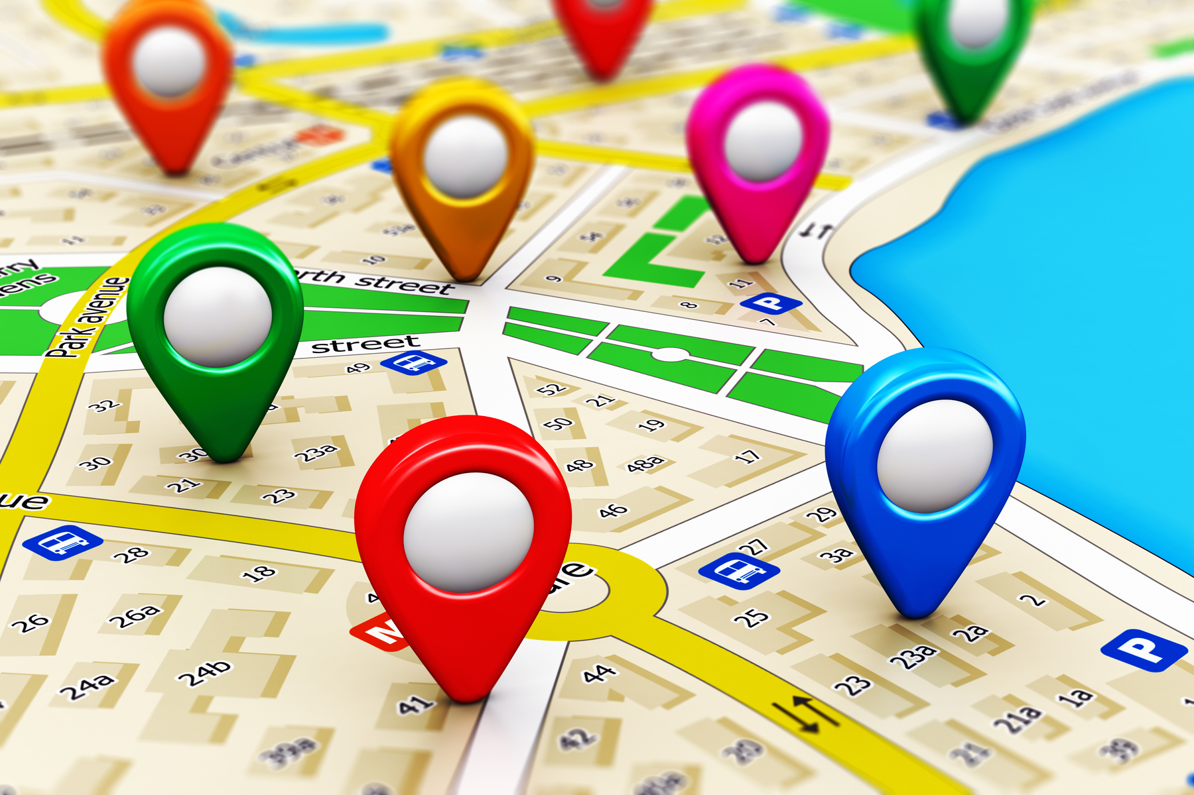
QUESTION 2
A. app
B. GPS
C. underground
D. geocaching

Slide 8
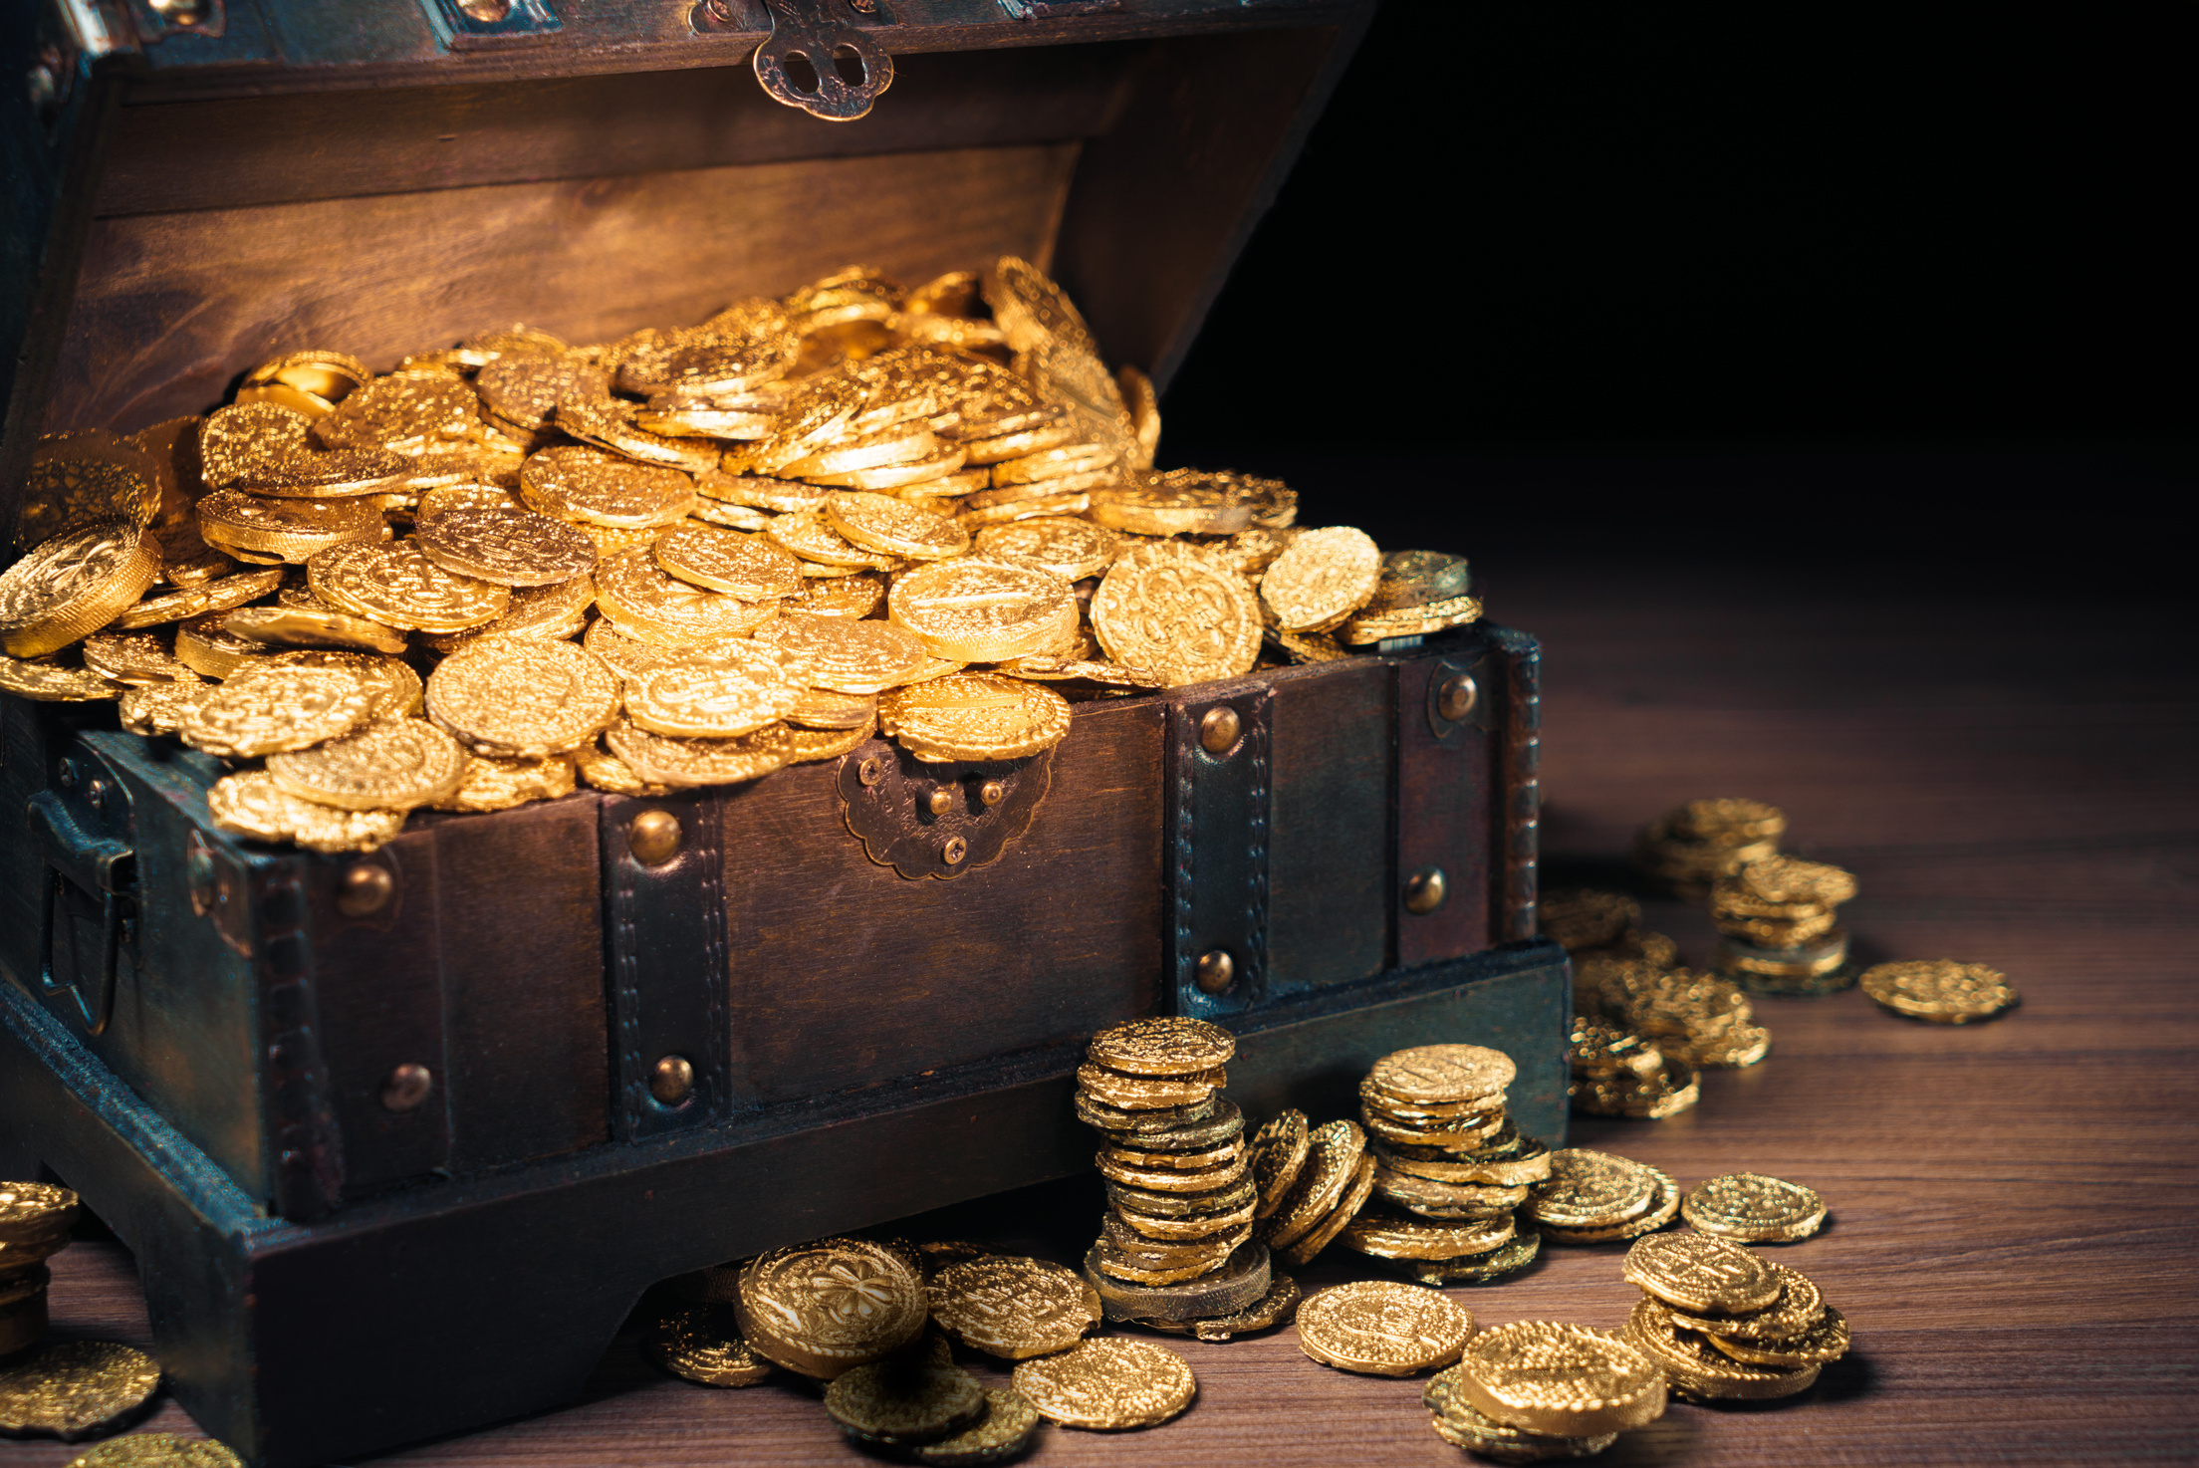
QUESTION 3
A. boiling
B. rainforest
C. app
D. treasure

Slide 9

QUESTION 4
A. app
B. underground
C. telephone
D. geothermal energy

Slide 10
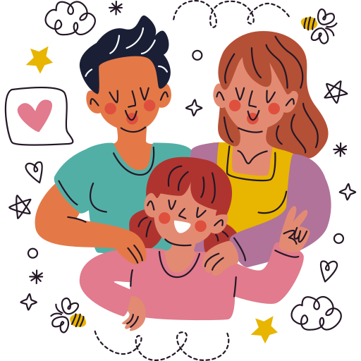
02
PRESENTATION

Slide 11

will: negative and interrogative forms
Positive
Negative
Interrogative
I will go to school tomorrow.
I won’t go to school tomorrow.
Will you go to school tomorrow?
will go
won’t go
Will go
.
.
?

Slide 12
will: negative and interrogative forms
Positive
Negative
Interrogative
He will go on a picnic next week.
He won’t go on a picnic next week.
Will he go on a picnic next week?

Slide 13

will: time expressions for future
tomorrow
next week
next year
in 2050
in the future

Slide 14
03
PRACTICE

Slide 15
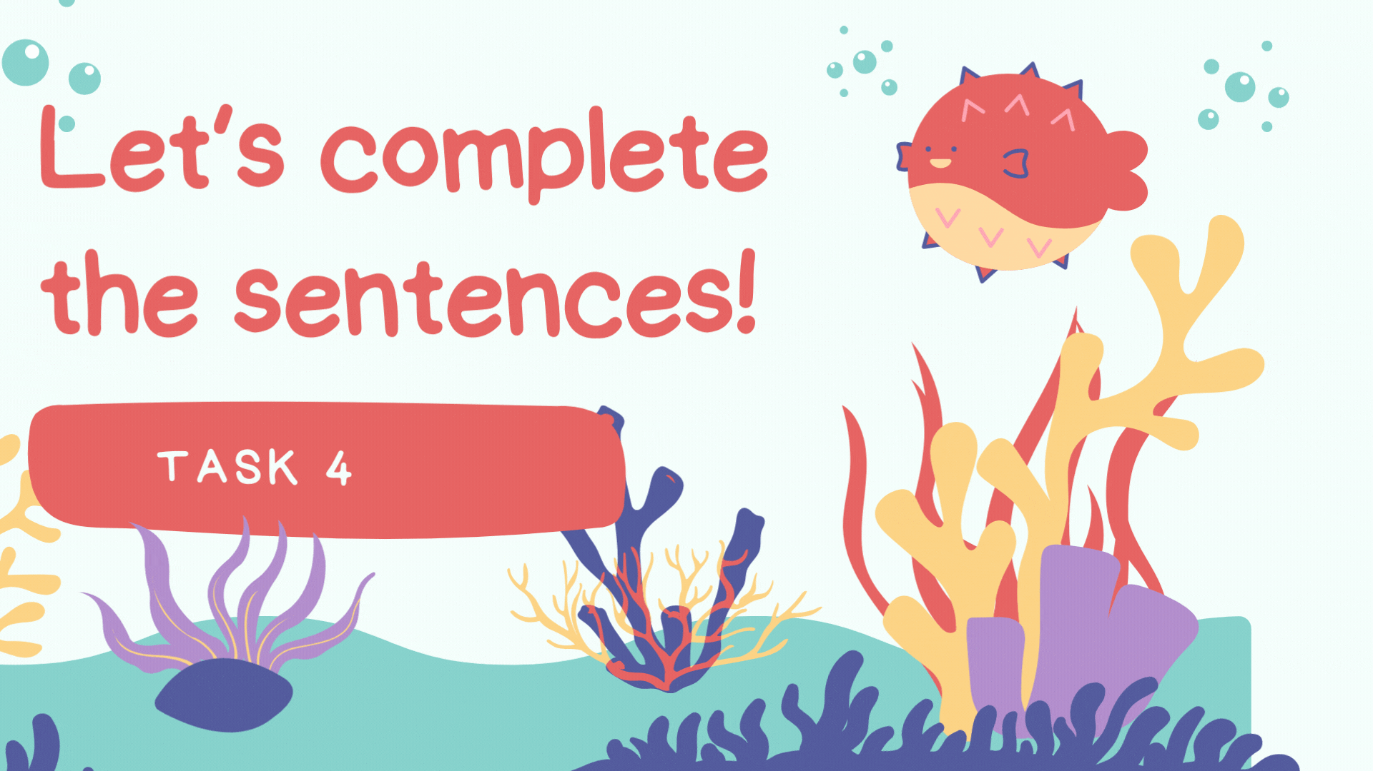

Slide 16







1. The scientists (follow) the river next year. (✔)
SEAHORSE
will follows
won’t follow
will follow
won’t follows
will follow

Slide 17




2. We (drive) to the forest next Sunday. (✘)
will drive
don’t drive
won’t drive
won’t drive
drive

Slide 18


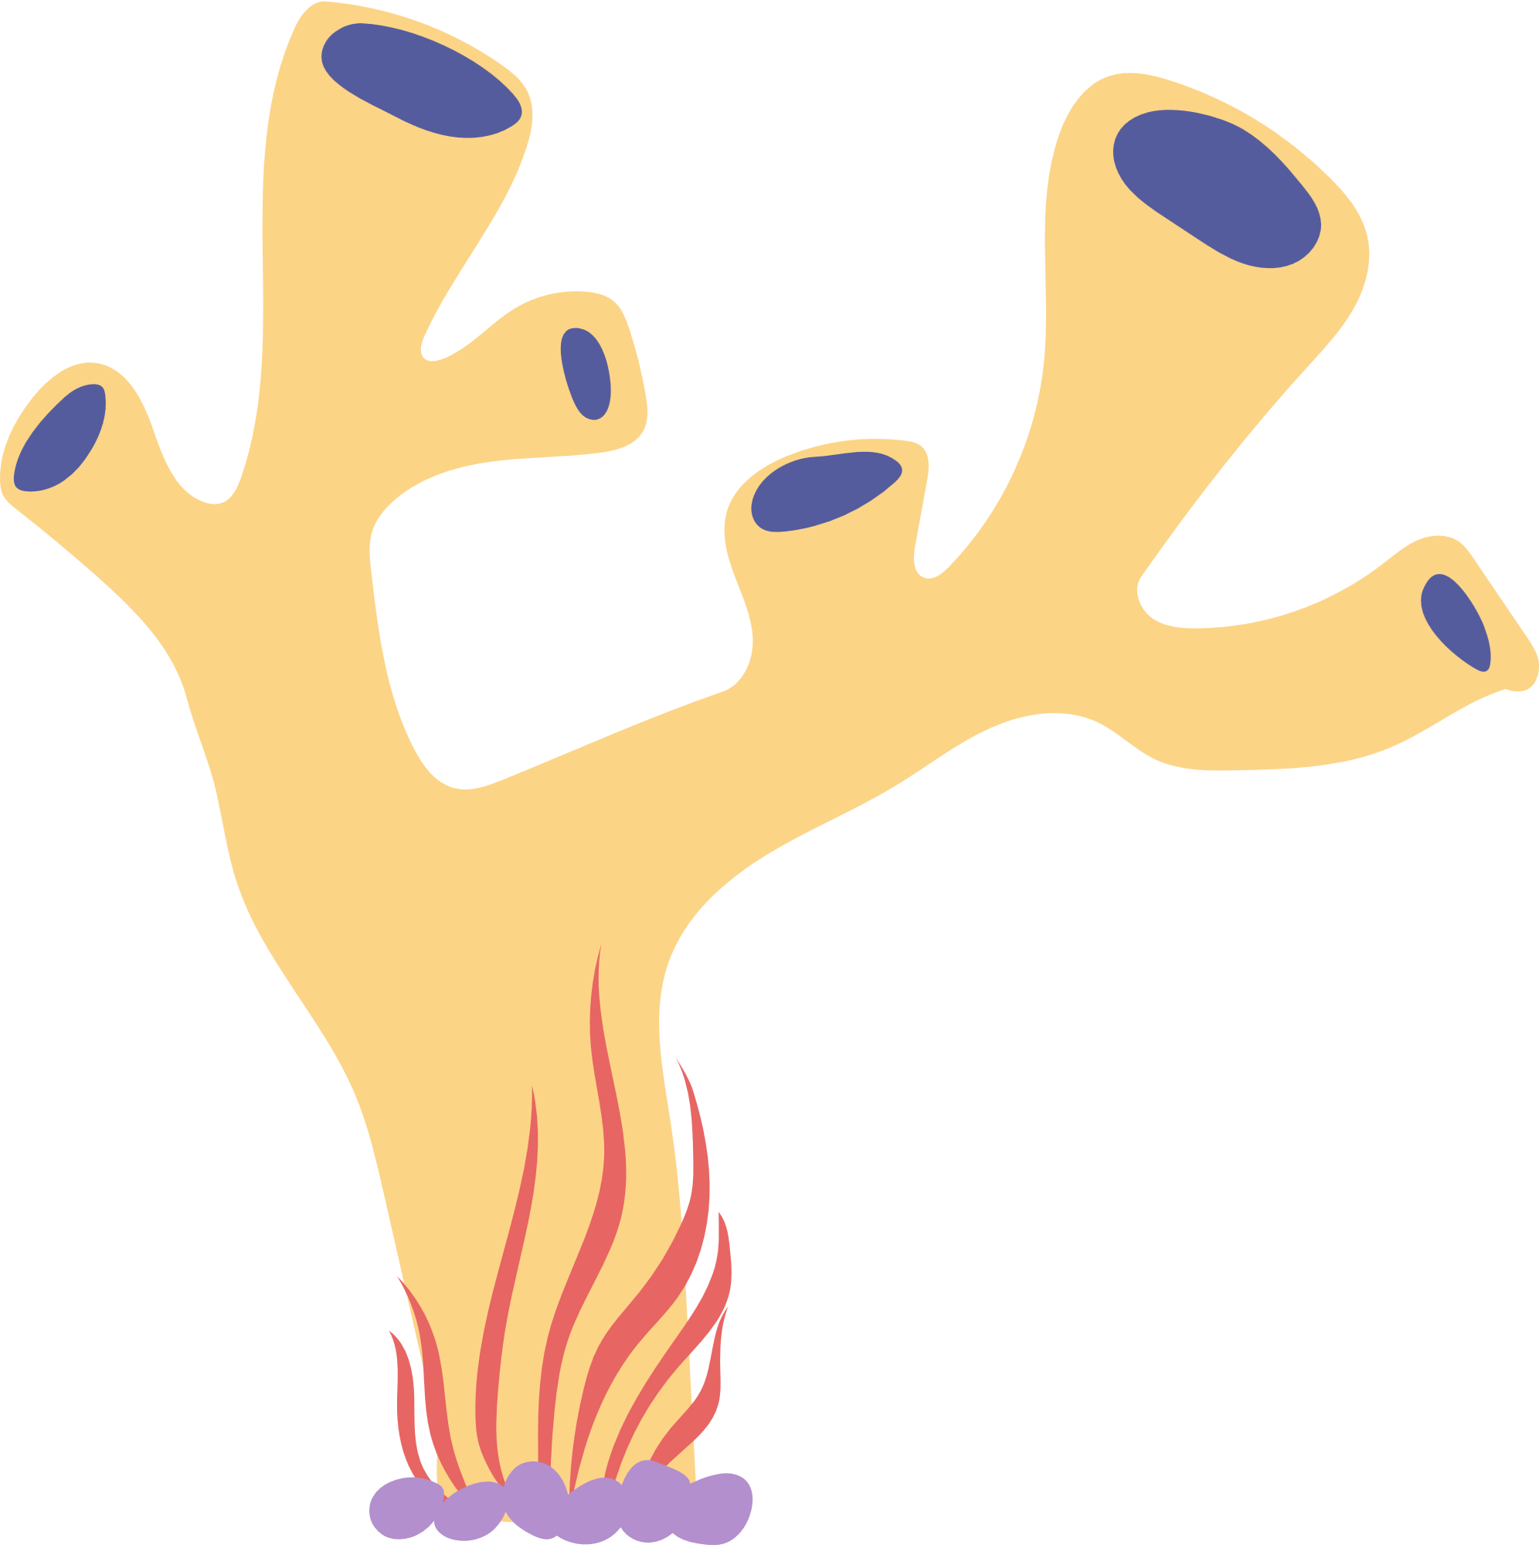




3. You and I (be) here next week. (✔)
will
were
are
will be
will be

Slide 19
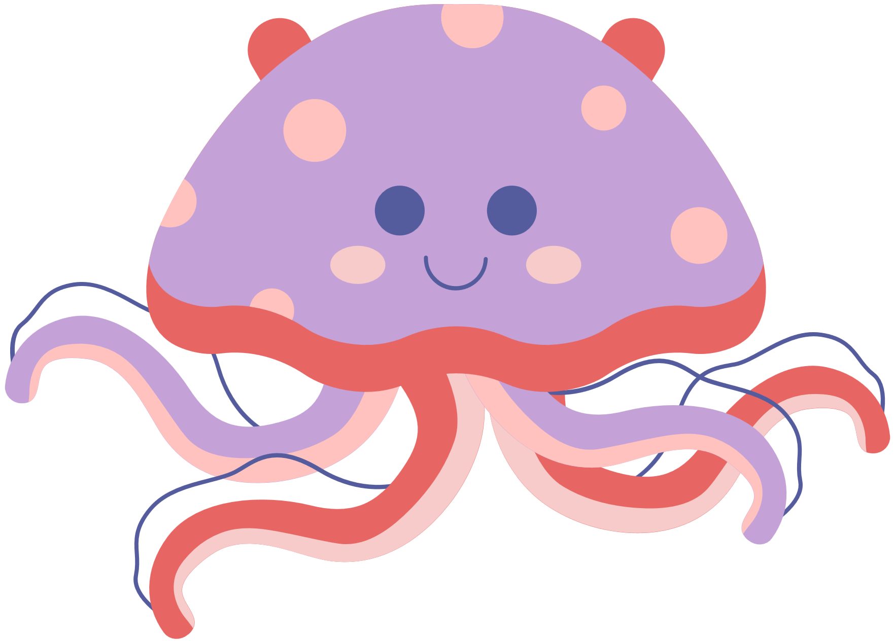



4. It (rain) tomorrow morning. (✘)
won’t rain
won’t rain
didn’t rain
doesn’t rain
isn’t raining

Slide 20
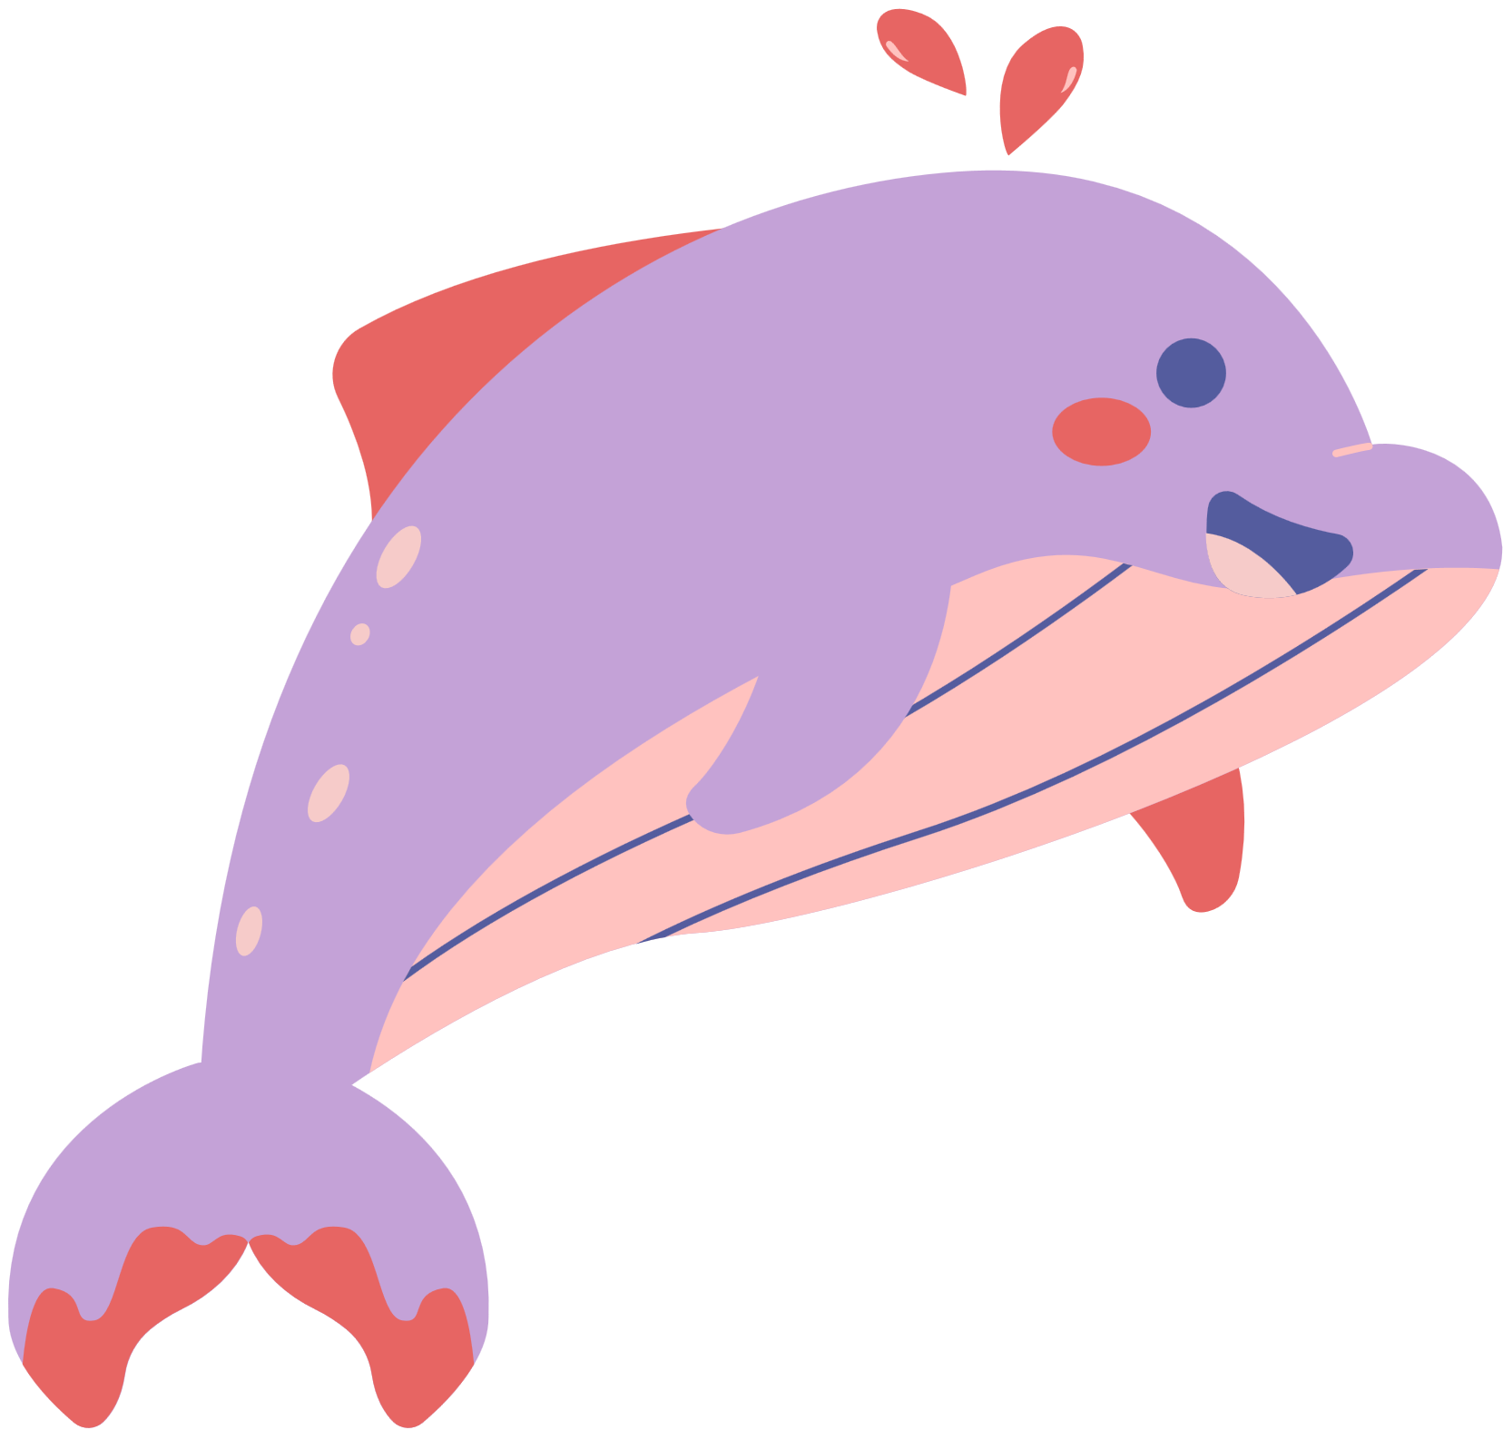
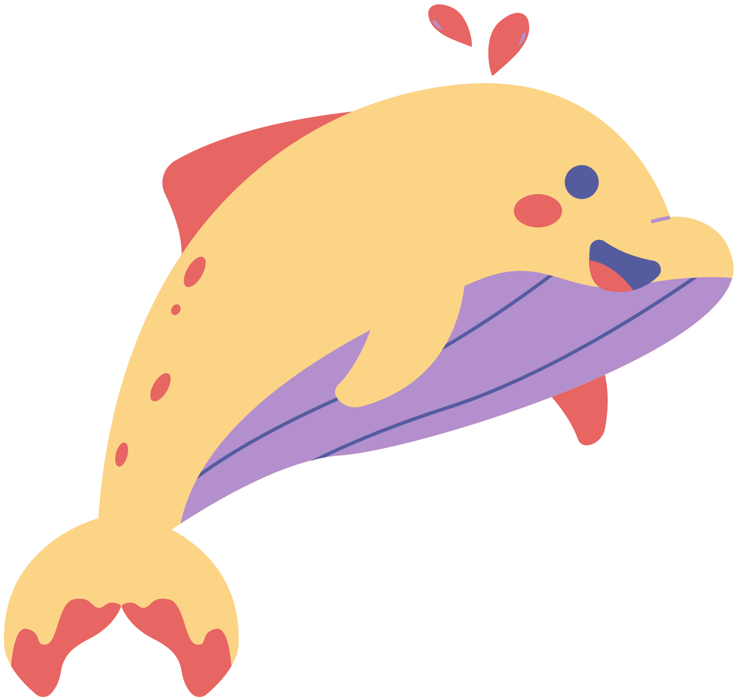


5. There (be) any clouds tomorrow. (✘)
weren’t
won’t be
won’t be
aren’t
didn’t be

Slide 21

5 Complete the sentences.
1. Amy / talk about / rainforests / tomorrow morning?
________________________________________________
Yes, ____________________________________________.
2. Juan and Cata / bring / photos / of waterfalls / this weekend?
________________________________________________
No, _____________________________________________.
Will Amy talk about rainforests tomorrow morning?
she will
Will Juan and Cata bring photos of waterfalls this weekend?
they won’t

Slide 22

5 Complete the sentences.
3. Susie and I / talk about / our holiday / next Monday?
________________________________________________
No, _____________________________________________.
4. Roberto / give / me / a book / about wild animals / tomorrow?
________________________________________________
Yes, ____________________________________________.
Will Susie and I talk about our holiday next Monday?
you won’t
Will Roberto give me a book about wild animals tomorrow?
he will

Slide 23

5 Complete the sentences.
5. Mum / walk / in the forest / with me / next Saturday?
______________________________________________
Yes, __________________________________________.
6. you / show us / pictures of the canyon / tomorrow night?
______________________________________________
No, __________________________________________.
Will Mum walk in the forest with me next Saturday?
she will
Will you show us pictures of the canyon tomorrow night?
I won’t

Slide 24
04
PRODUCTION
Let’s talk!

Slide 25
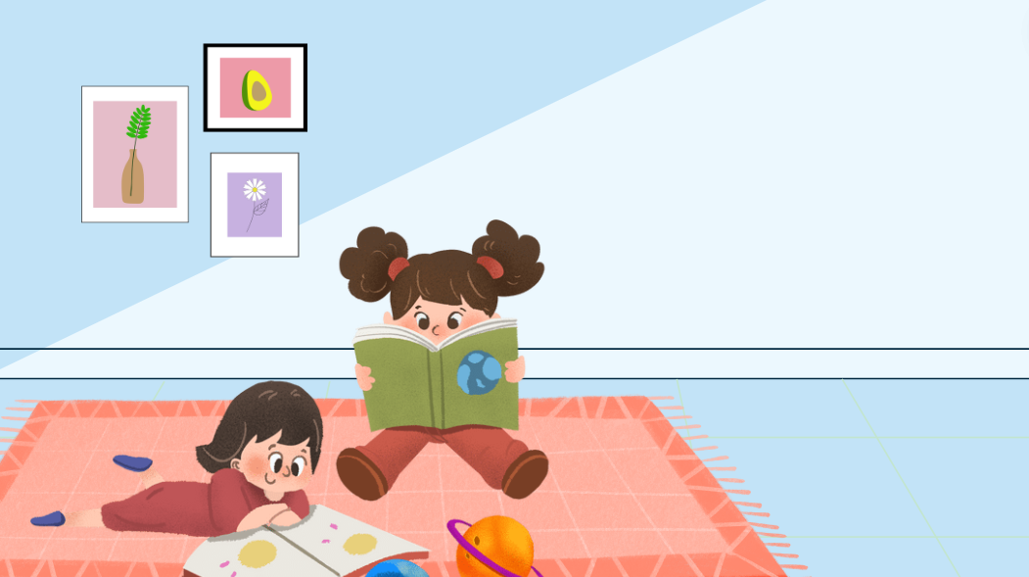
I will clean my house.
6 Let’s talk.
Work in pairs. Ask and answer about what you will do today and tomorrow.
What will you do tomorrow?

Slide 26
05
WRAP-UP & ASSESSMENT

Slide 27

Say aloud these sentences in positive, negative and interrogative forms.
01
My teacher will talk about rainforests tomorrow afternoon.
02
His friend will give him a book about wild animals next week.
03
Will Amy talk about her holiday tomorrow?

Slide 28













Unit 12: Weather and nature Lesson 2 – Part 4,5,6
What have we learnt today?
Review vocabulary: app, geocaching, GPS, treasure
Grammar: will
Time expressions for future: next week/ tomorrow/ next year/ in 2050/ in the future
Negative: I won’t go to school tomorrow.
Interrogative: Will you go to school tomorrow?

Slide 29

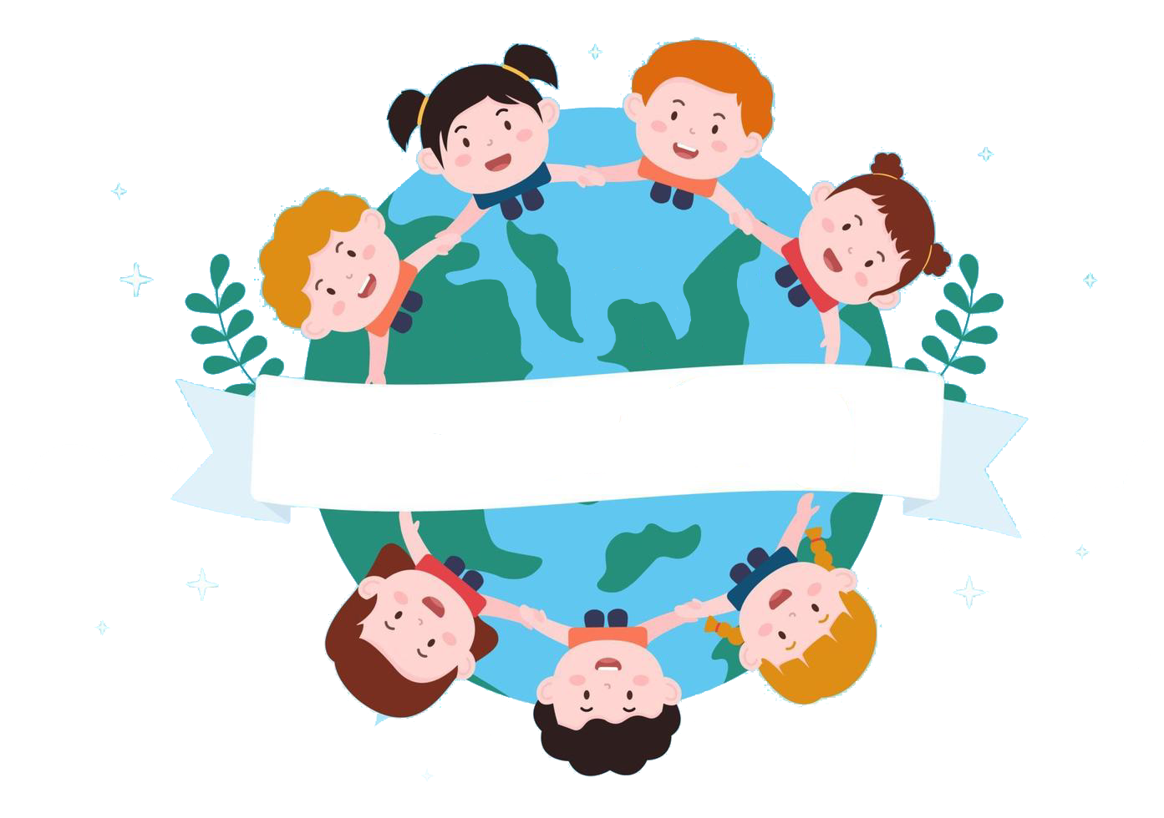
Thank you
& goodbye!

