Slide 1










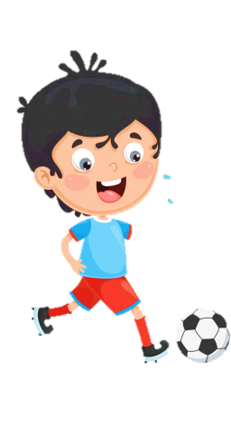
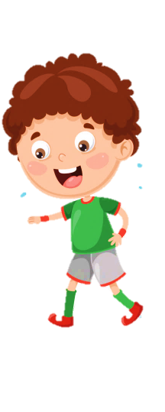
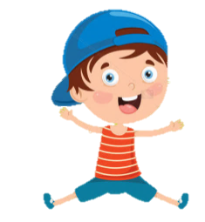
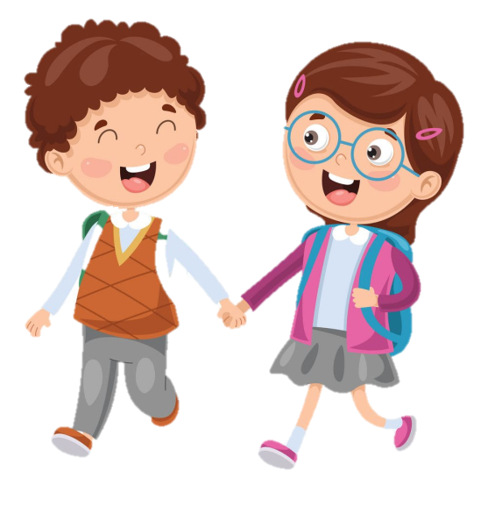



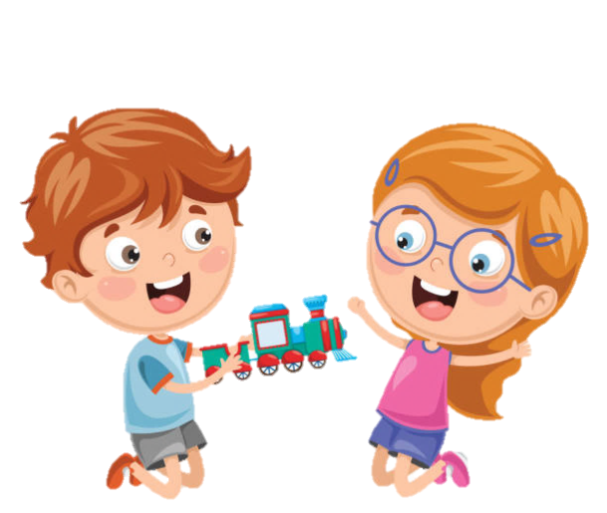




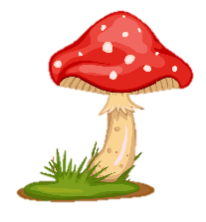
SCHOOL

Slide 2
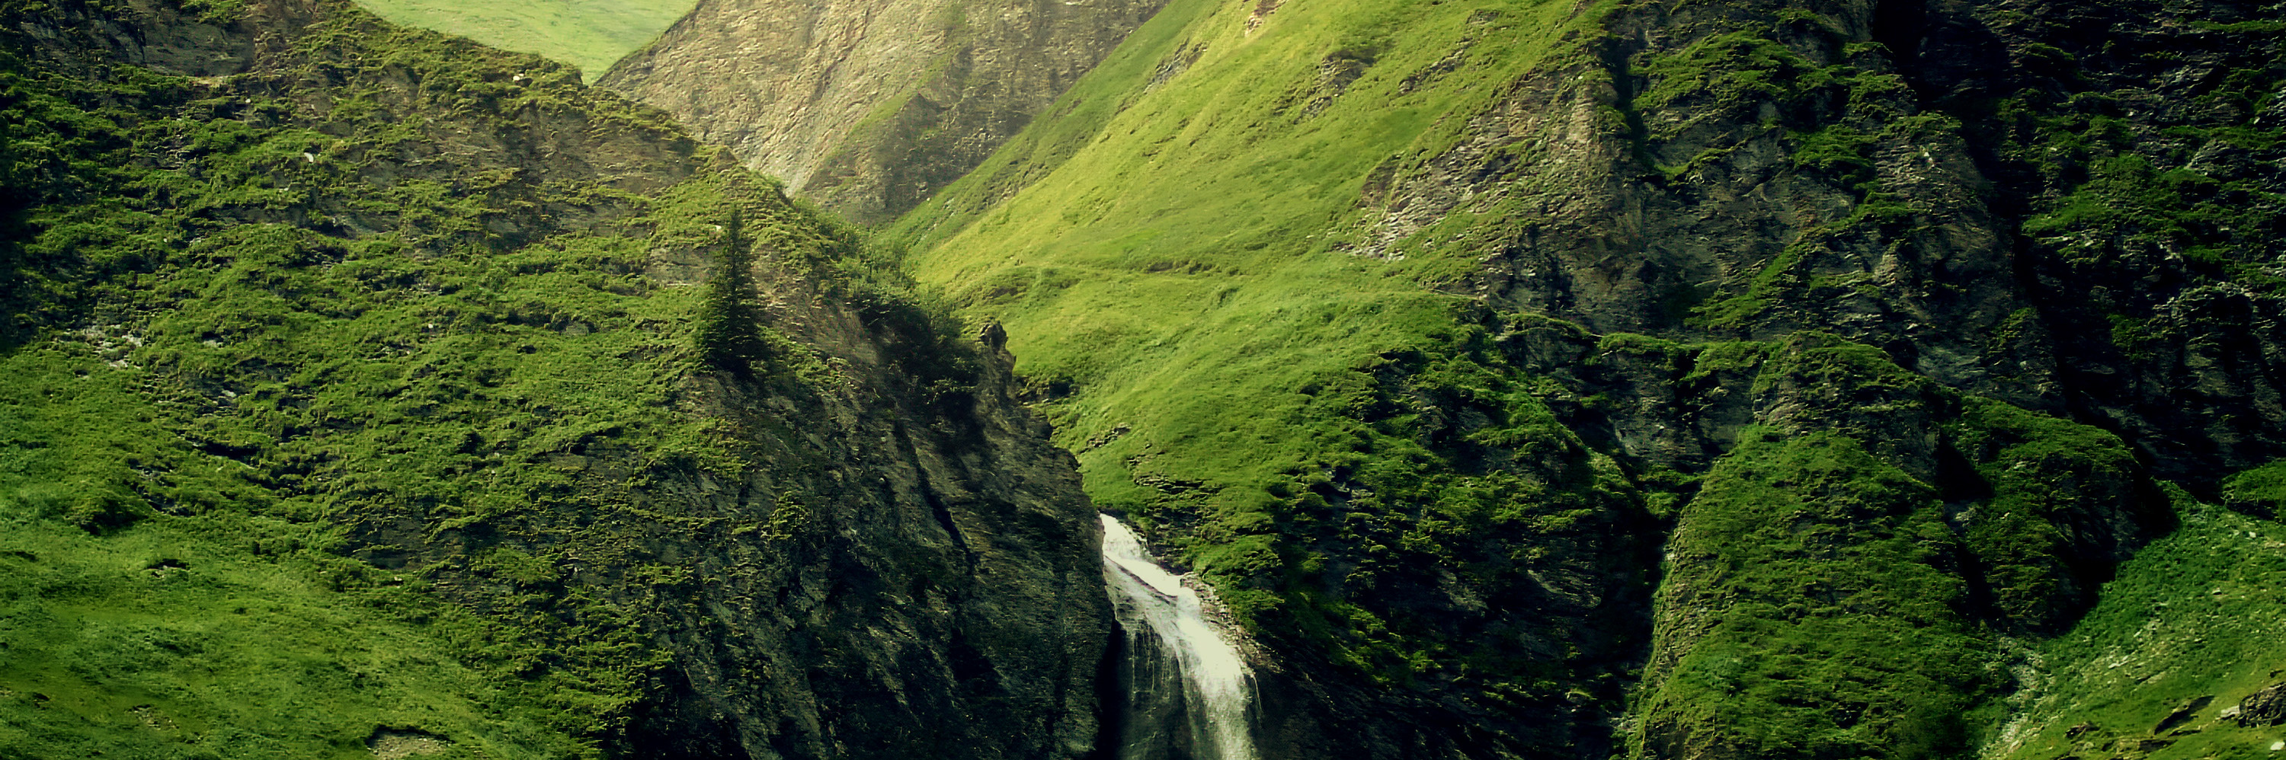


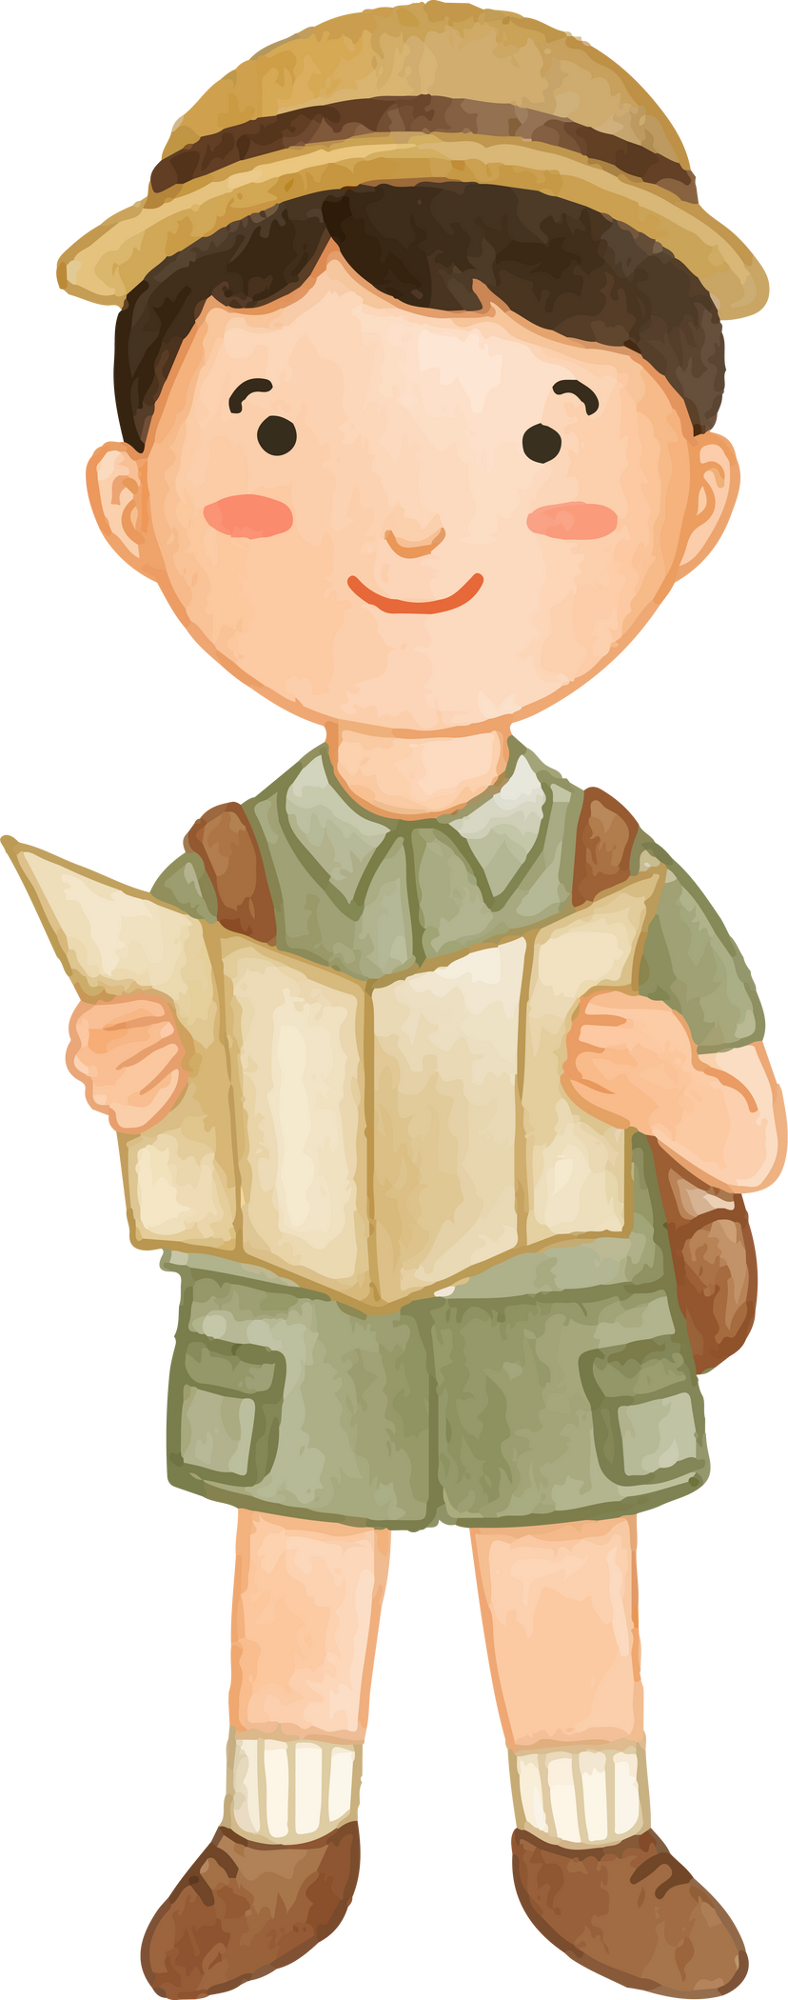
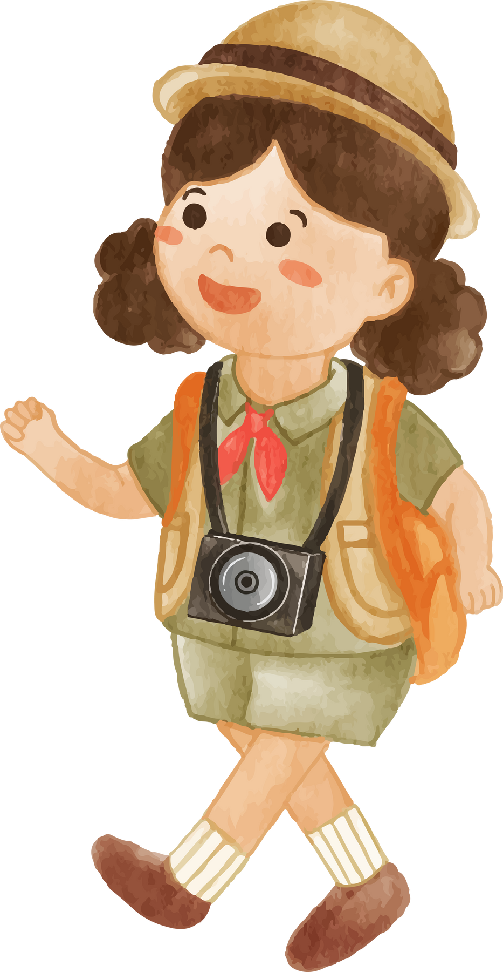

Unit 12
Weather and nature
Lesson 3 Part 2

Slide 3





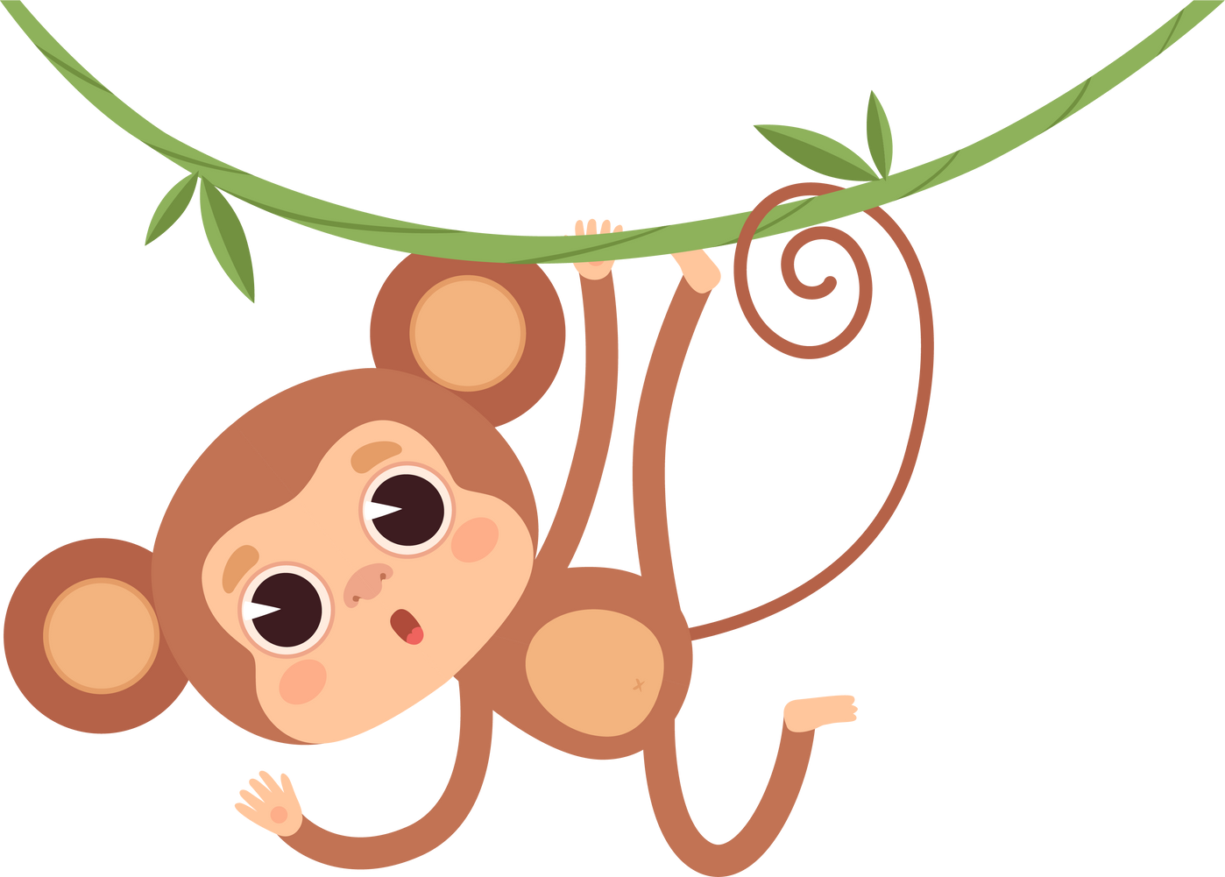











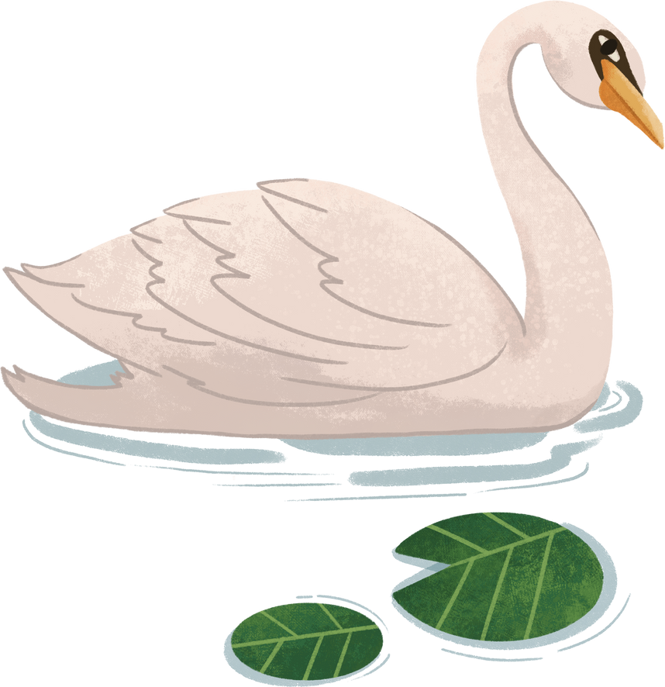

Table of contents
02
04
Presentation
Production
03
01
05
Practice
Warm - up
Wrap – up & Assessment

Slide 4
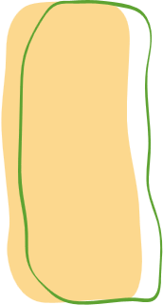

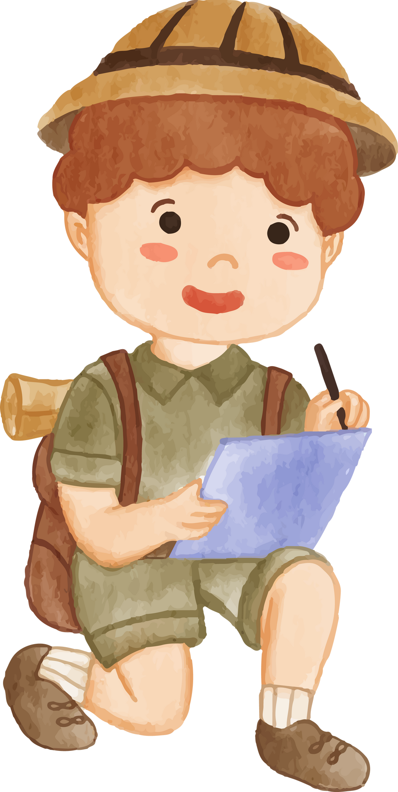
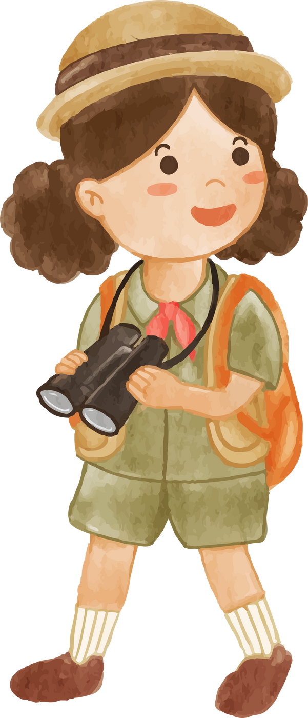



1
Warm-up

Slide 5




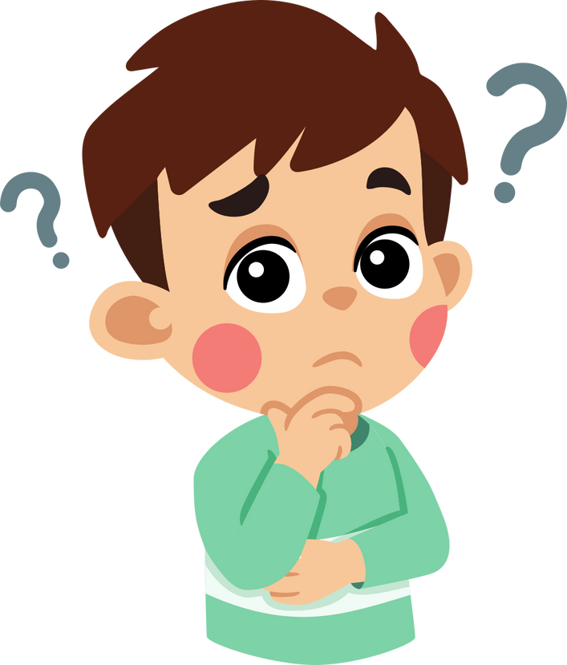

NATURE

Slide 6






QUESTION 1
Where does geothermal energy come from?
A. The sun
C. Hot rocks and steam inside the Earth
B. The wind
D. The sea

Slide 7

QUESTION 2
Where can you find lots of trees, animals, and rain?
a) Desert
c) Rainforest
b) Ocean
d) Mountain

Slide 8

QUESTION 3
Which of these is related to exploring and finding hidden items with an app?
a) Cooking
c) Reading
b) Geocaching
d) Gardening

Slide 9
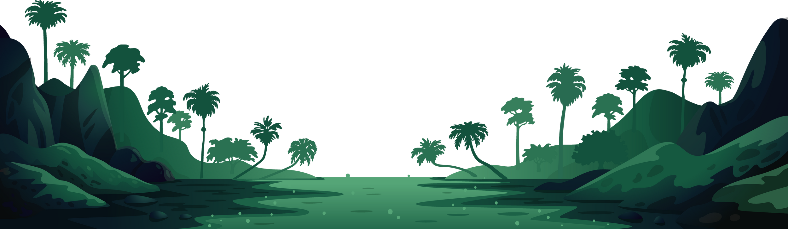
QUESTION 4
What helps you find your location using satellites?
a) GPS
c) TV
b) Radio
d) Lamp

Slide 10
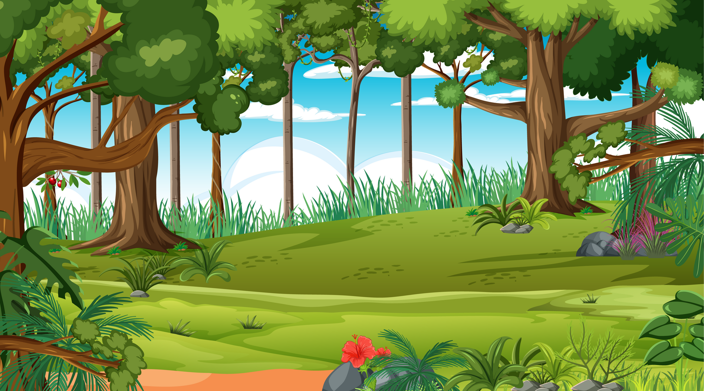
QUESTION 5
I am going to go hiking in the_______.
a) beach
b) rainforest

Slide 11
GREAT JOB!
One point for one correct answer !

Slide 12
2
Presentation

Slide 13
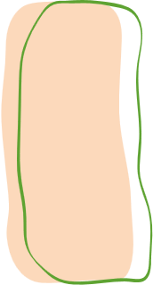


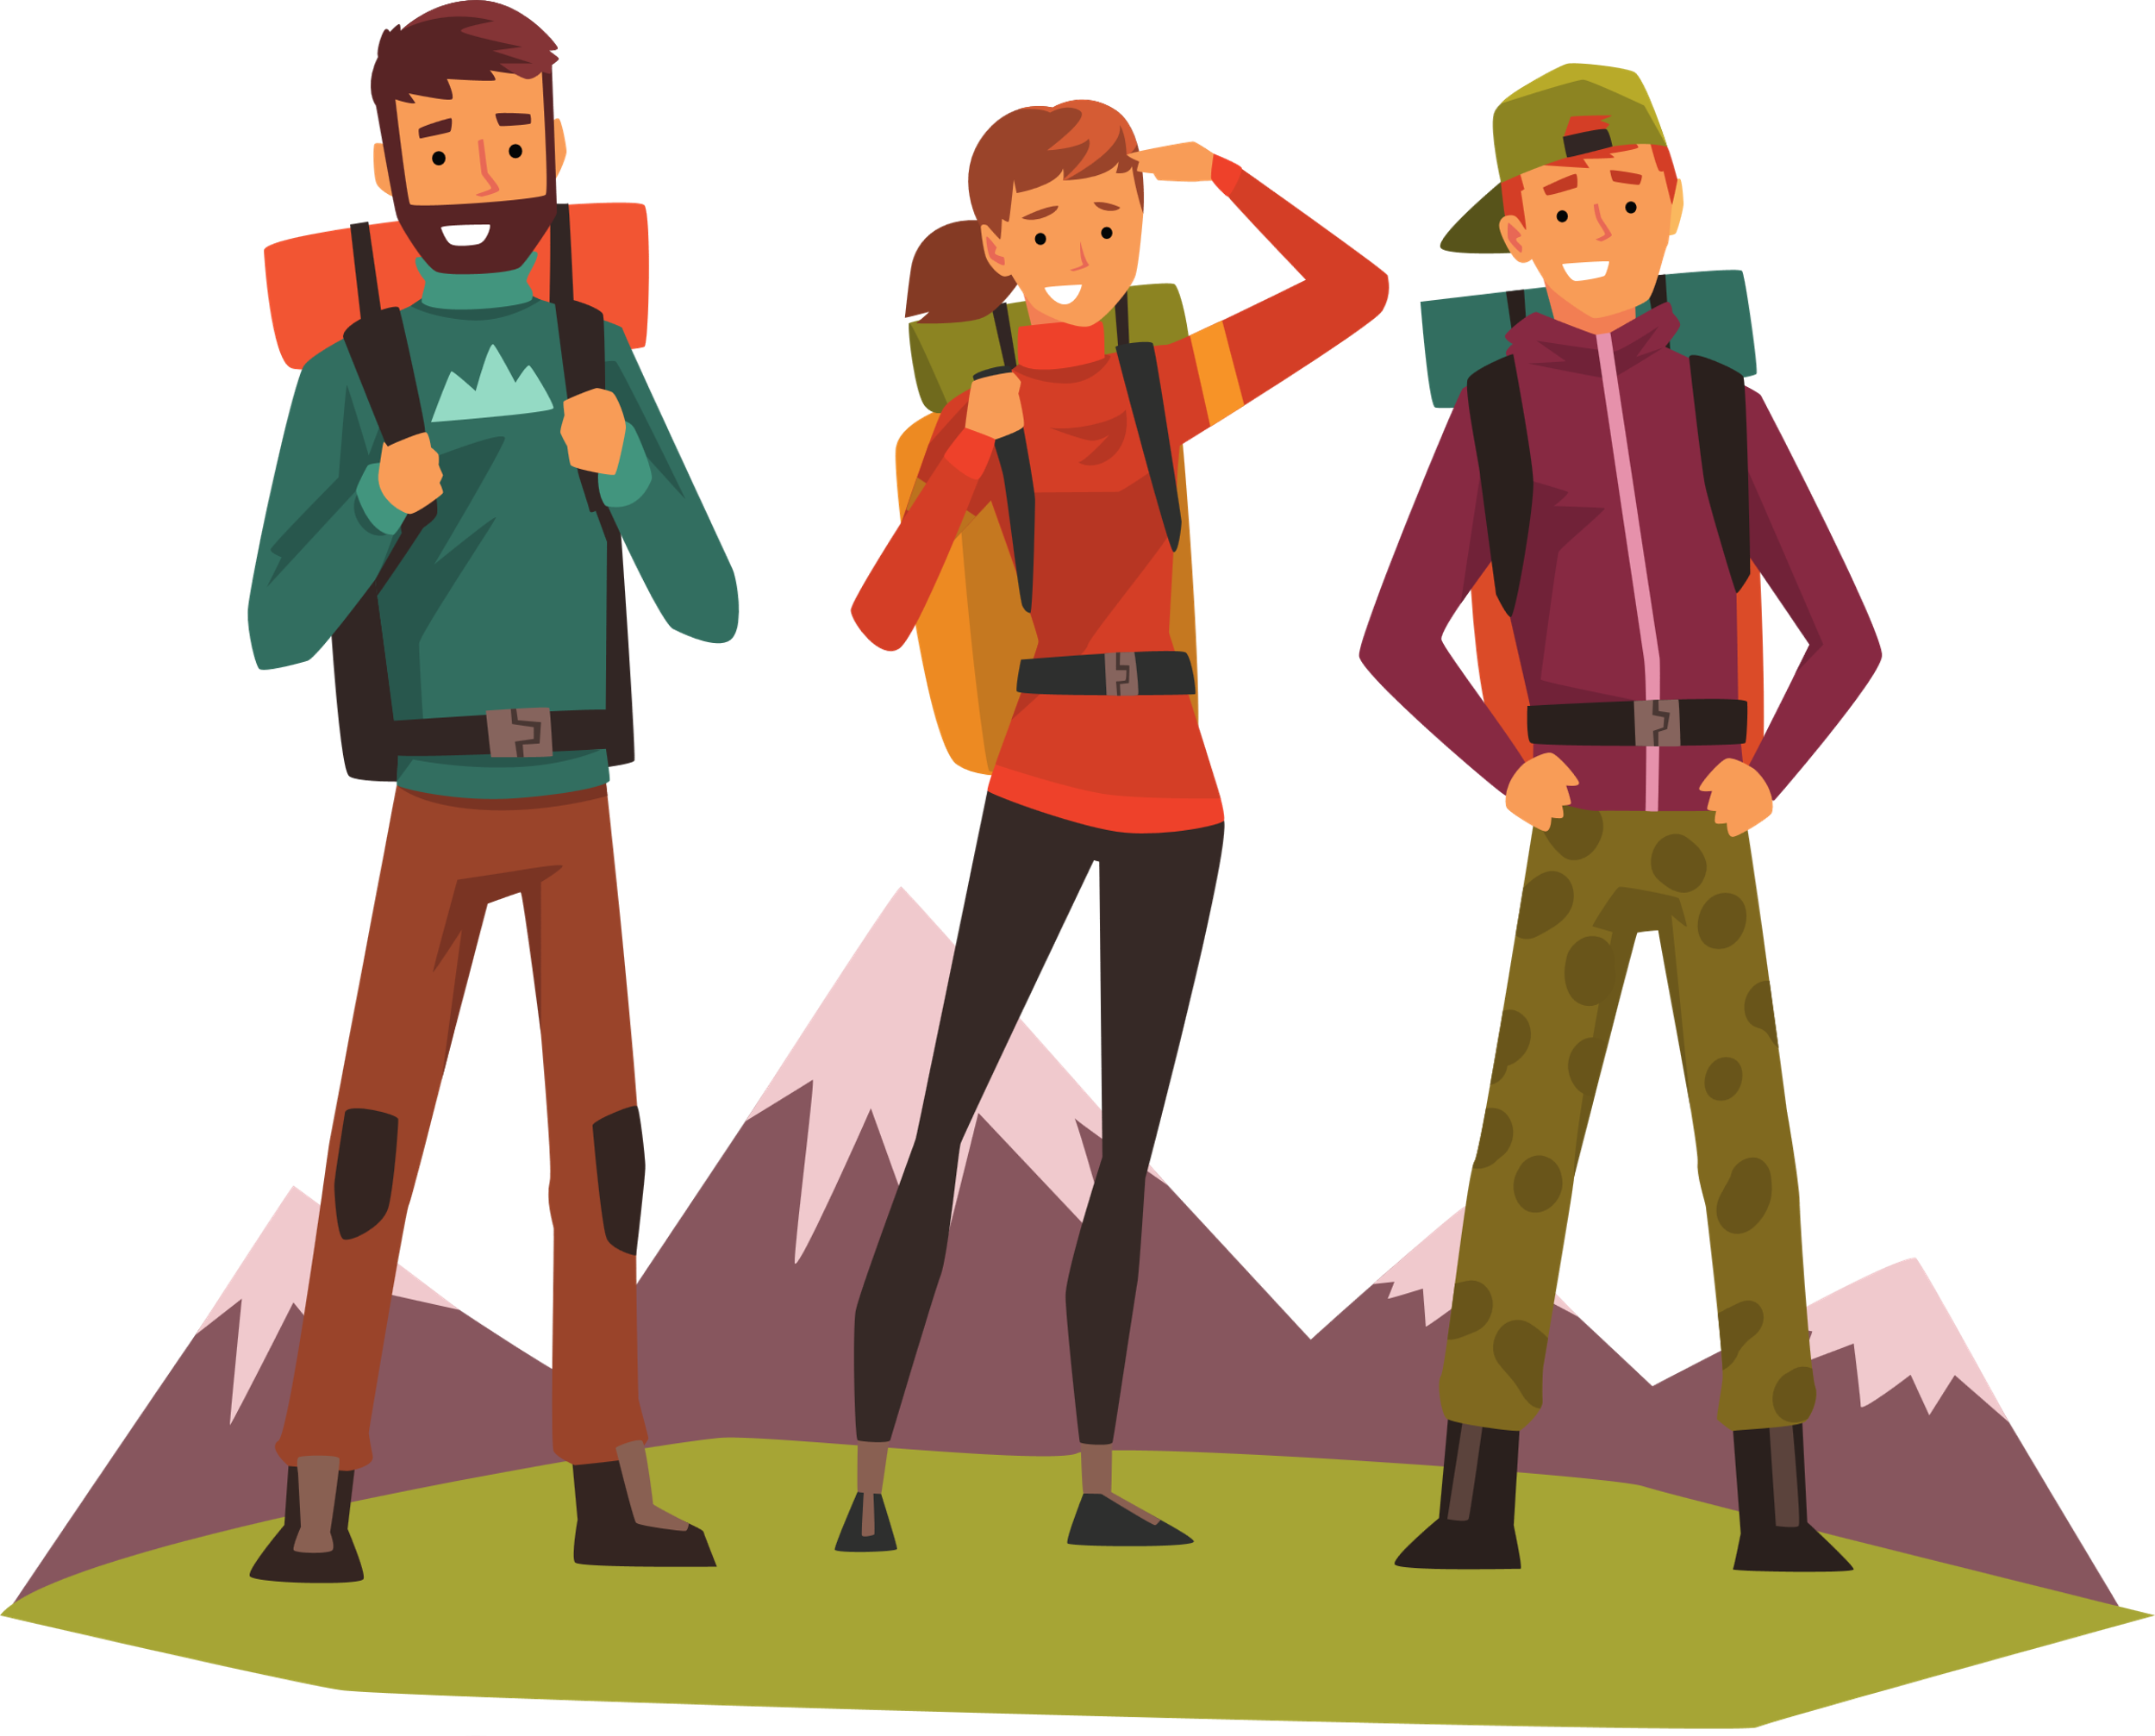
be going to
GRAMMAR
We can use be going to in making plan.
This summer holiday, I am going to go camping.

Slide 14

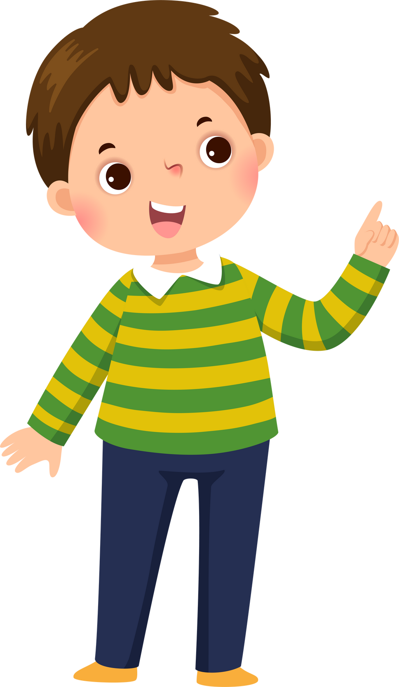

I am going to _______________.
I am not going to _______________.

Slide 15
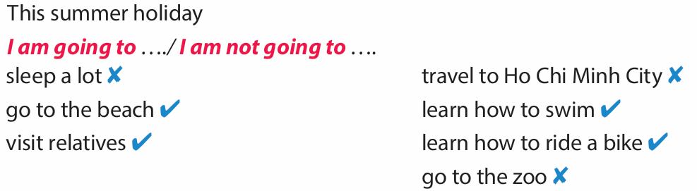



Look and read. Write T for True or F for False.
This summer holiday, I am going to learn how to swim.

Slide 16
Look and read. Write T for True or F for False.
This summer holiday, I am not going to sleep a lot.

Slide 17
Look and read. Write T for True or F for False.
This summer holiday, I am going to visit my relatives.

Slide 18
Look and read. Write T for True or F for False.
This summer holiday, I am not going to travel to Ho Chi Minh City.

Slide 19
Look and read. Write T for True or F for False.
This summer holiday, I am going to learn how to ride a bike.

Slide 20
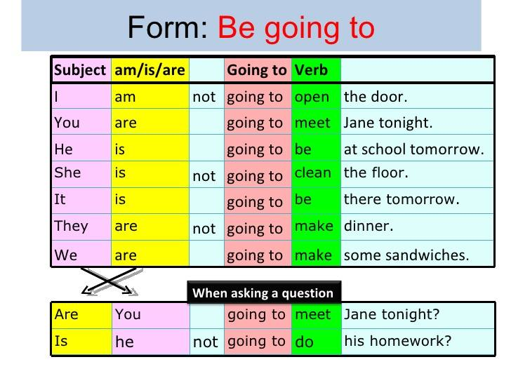
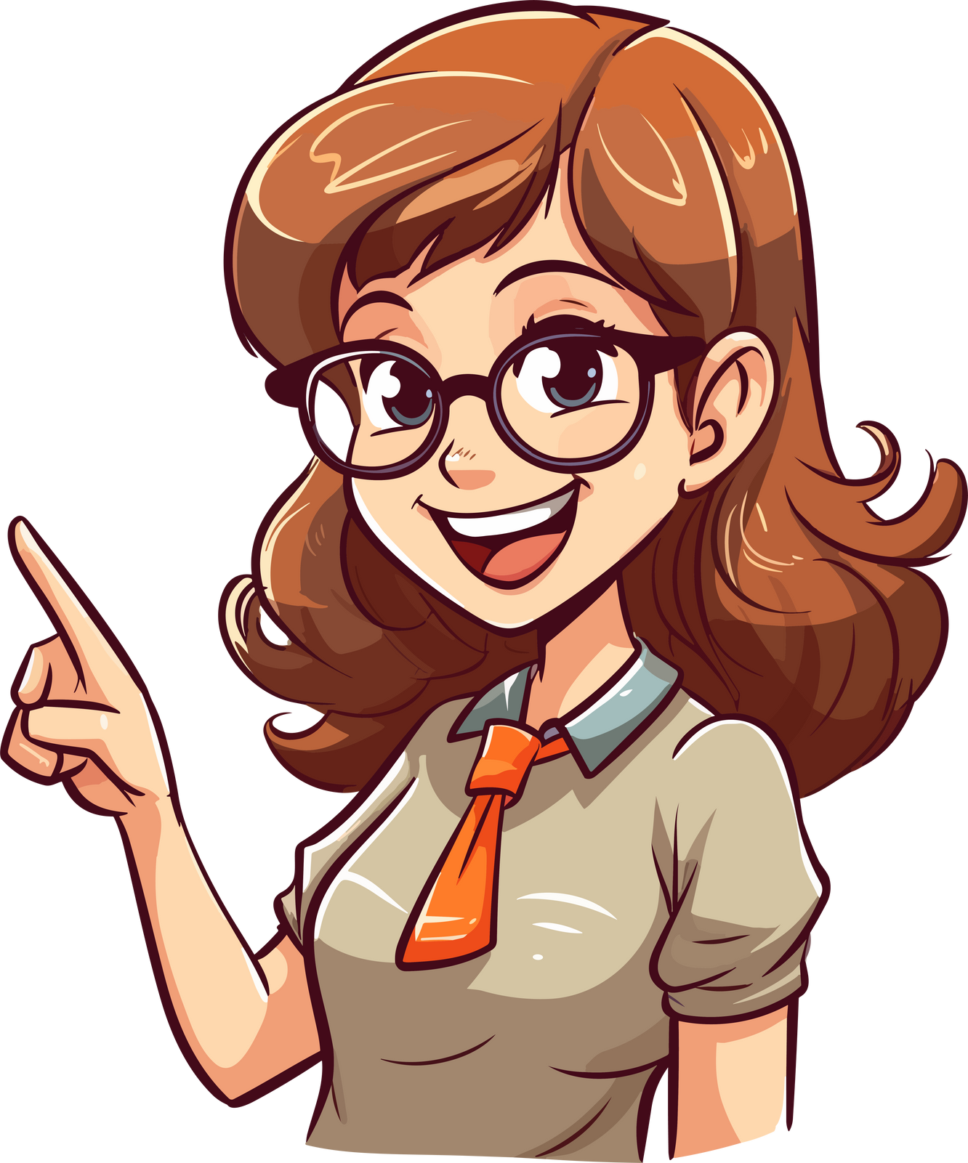

Slide 21
3
Practice

Slide 22


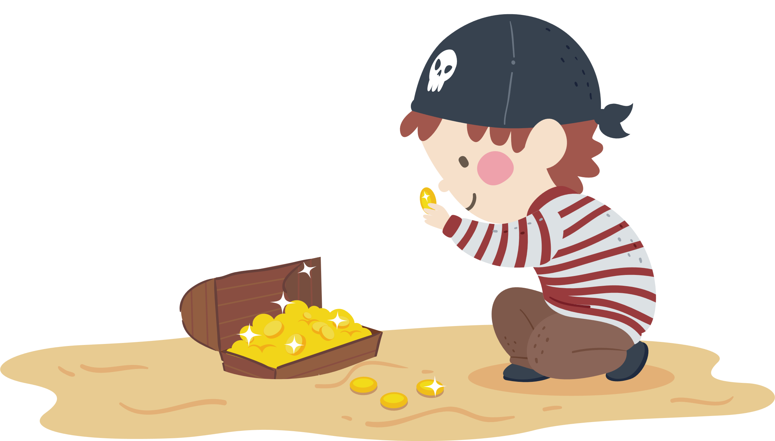


TREASURE HUNT
GAME

Slide 23

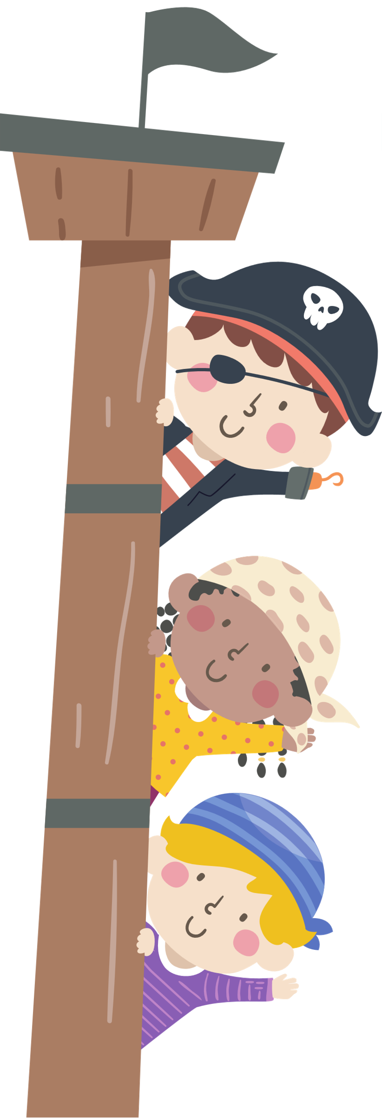


“Hello Treasure Hunters! I will be your captain today.”

Slide 24
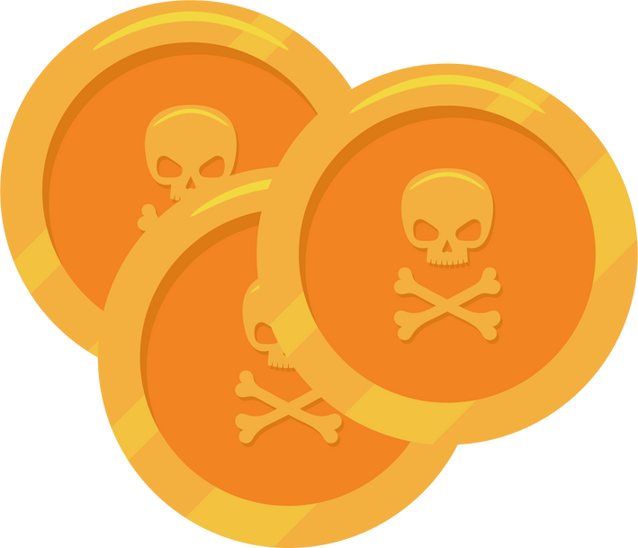

Instructions
  Split the class into four groups.
  Discuss the riddle within the group.
  The first one to find the correct answer will get points!

Slide 25

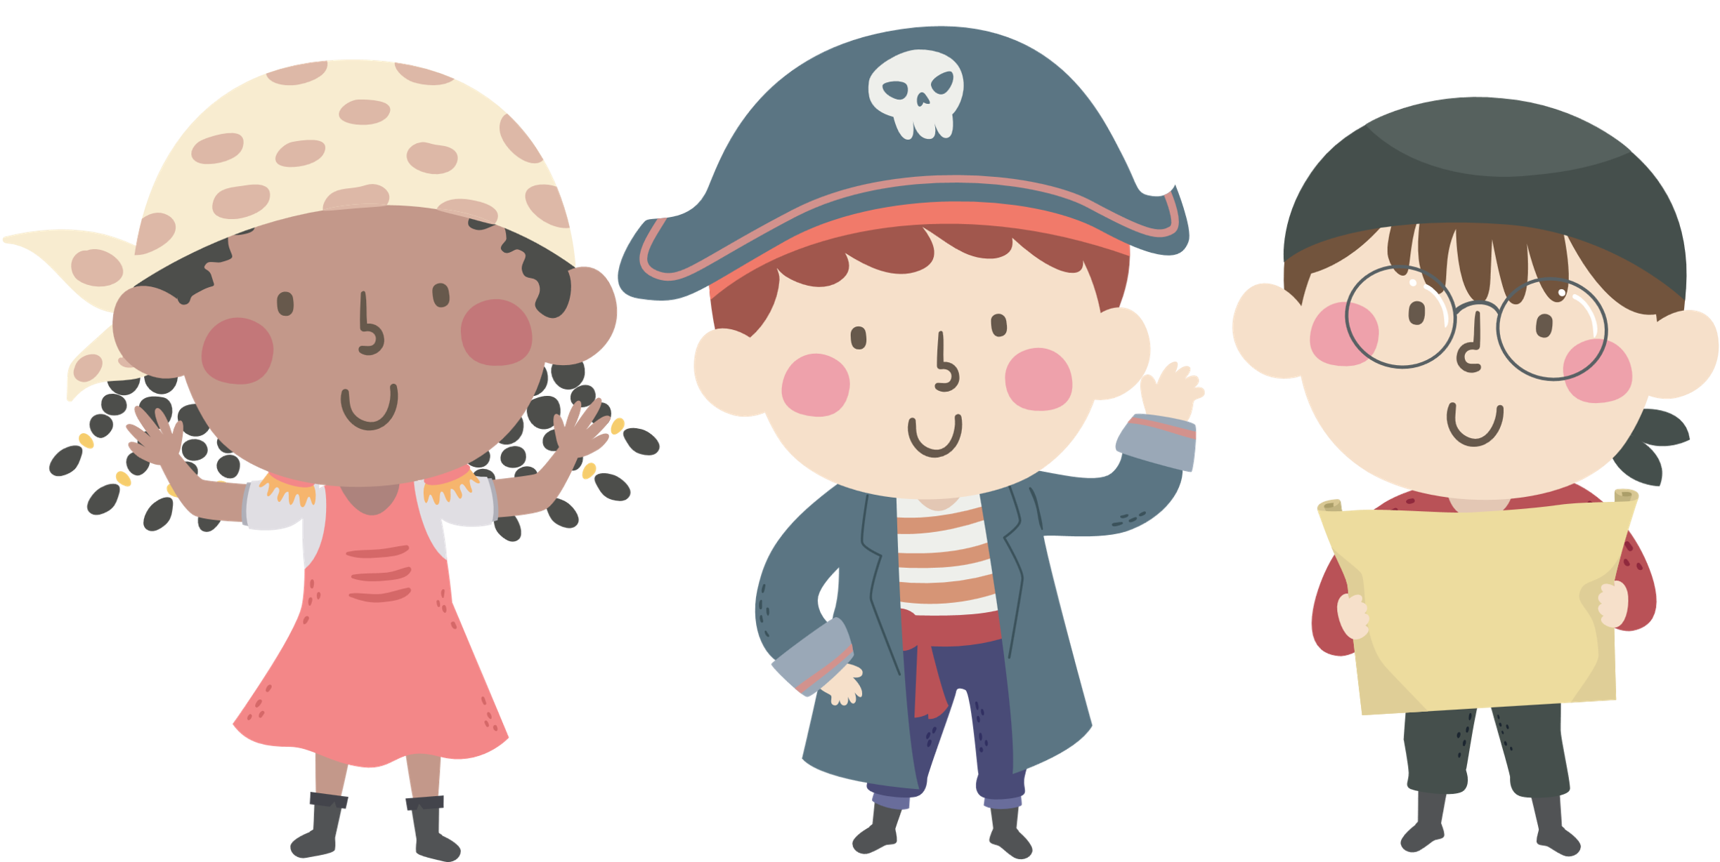

Slide 26
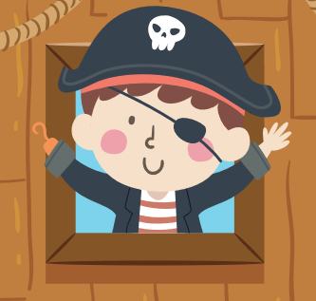

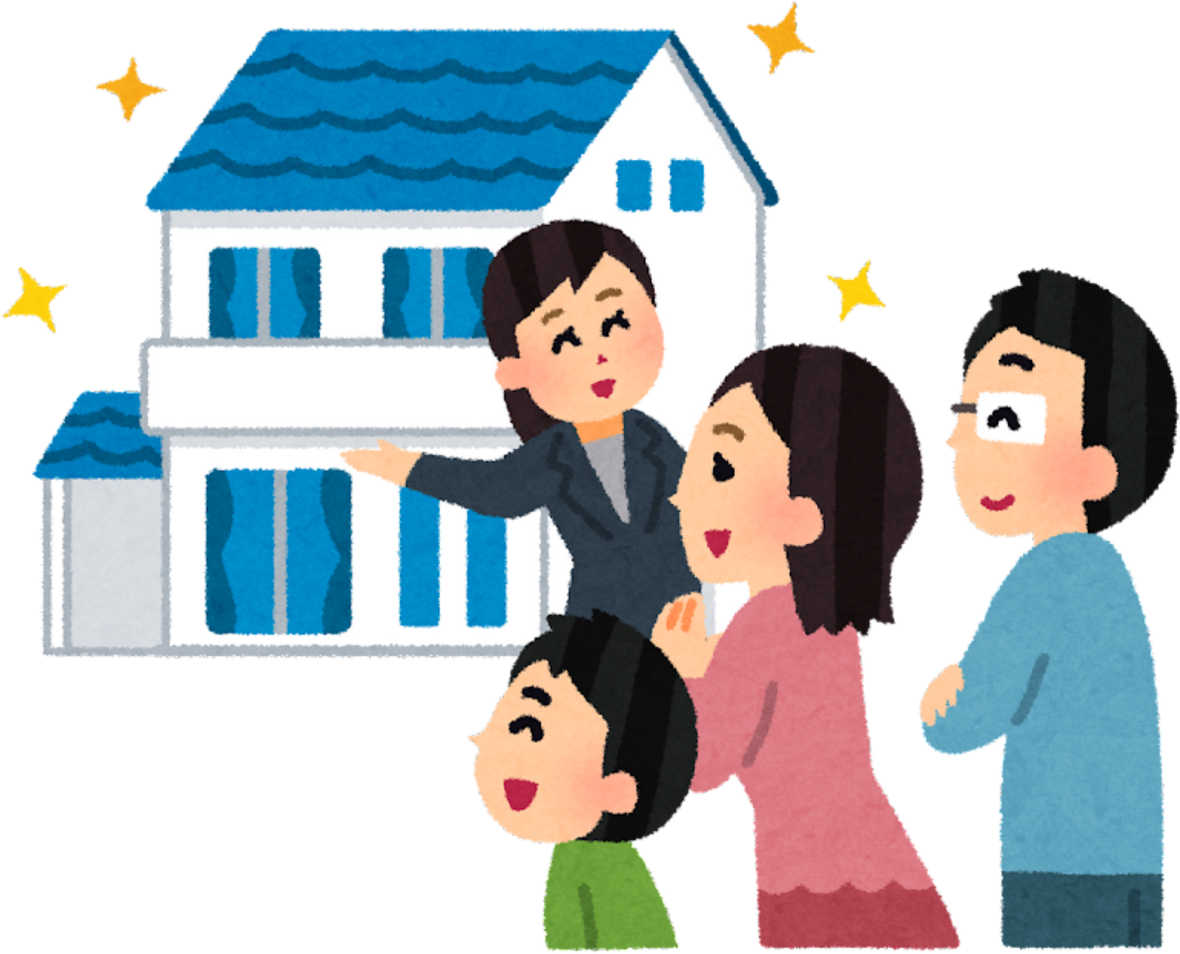
Riddle #
Make sentences using be going to.
What is Minh going to do?
- Minh / visit / aunt.
A. Minh are going to visit his aunt.
B. Minh are going to visit his aunt.
C. Minh is going to visit his aunt.
. .

Slide 27
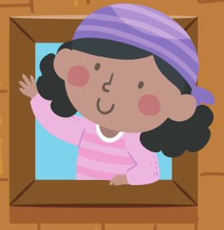


Riddle #
Make sentences using be going to.
What are Juliet and John going to do?
- Juliet and John / see / movie / cinema.
A. Juliet and John is going to see a movie at the cinema.
B. Juliet and John am going to see a movie at the cinema.
C. Juliet and John are going to see a movie at the cinema. .

Slide 28

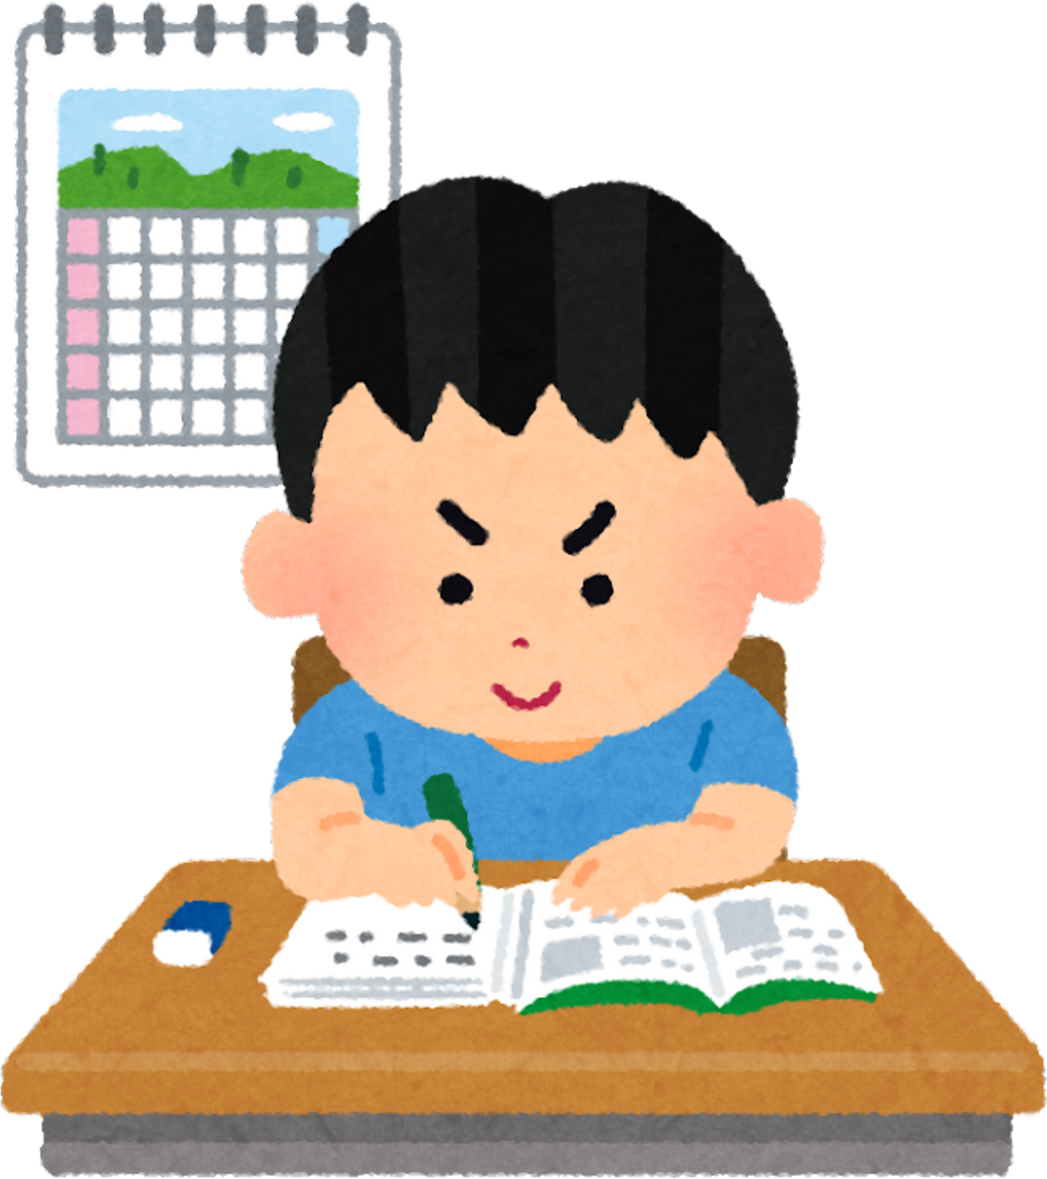
Riddle #
Make sentences using be going to.
What is Henry going to do?
- Henry / do / all / homework.
A. Henry am going to do all the homework.
B. Henry is going to do all the homework.
C. Henry are going to do all the homework.

Slide 29

Riddle #
Make sentences using be going to.
What is Melissa going to do?
- Melissa / have / a shower.
A. Melissa are going to have a shower.
B. Melissa am going to have a shower.
C. Melissa is going to have a shower.

Slide 30

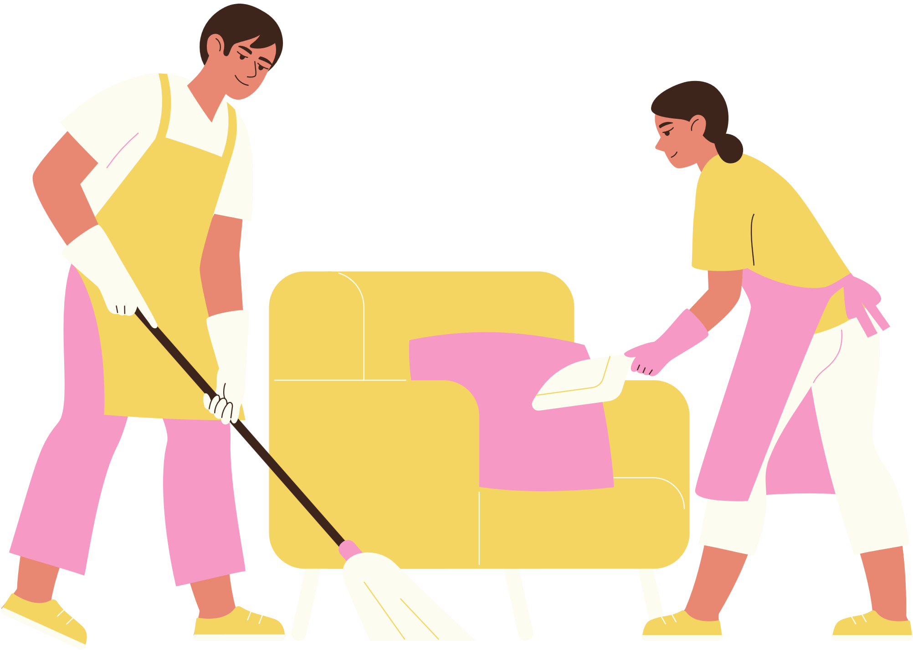
Riddle #
Make sentences using be going to.
What are your parents going to do?
- My parents / clean / house.
A. My parents is going to clean the house.
B. My parents are going to clean the house.
C. My parents am going to clean the house.

Slide 31
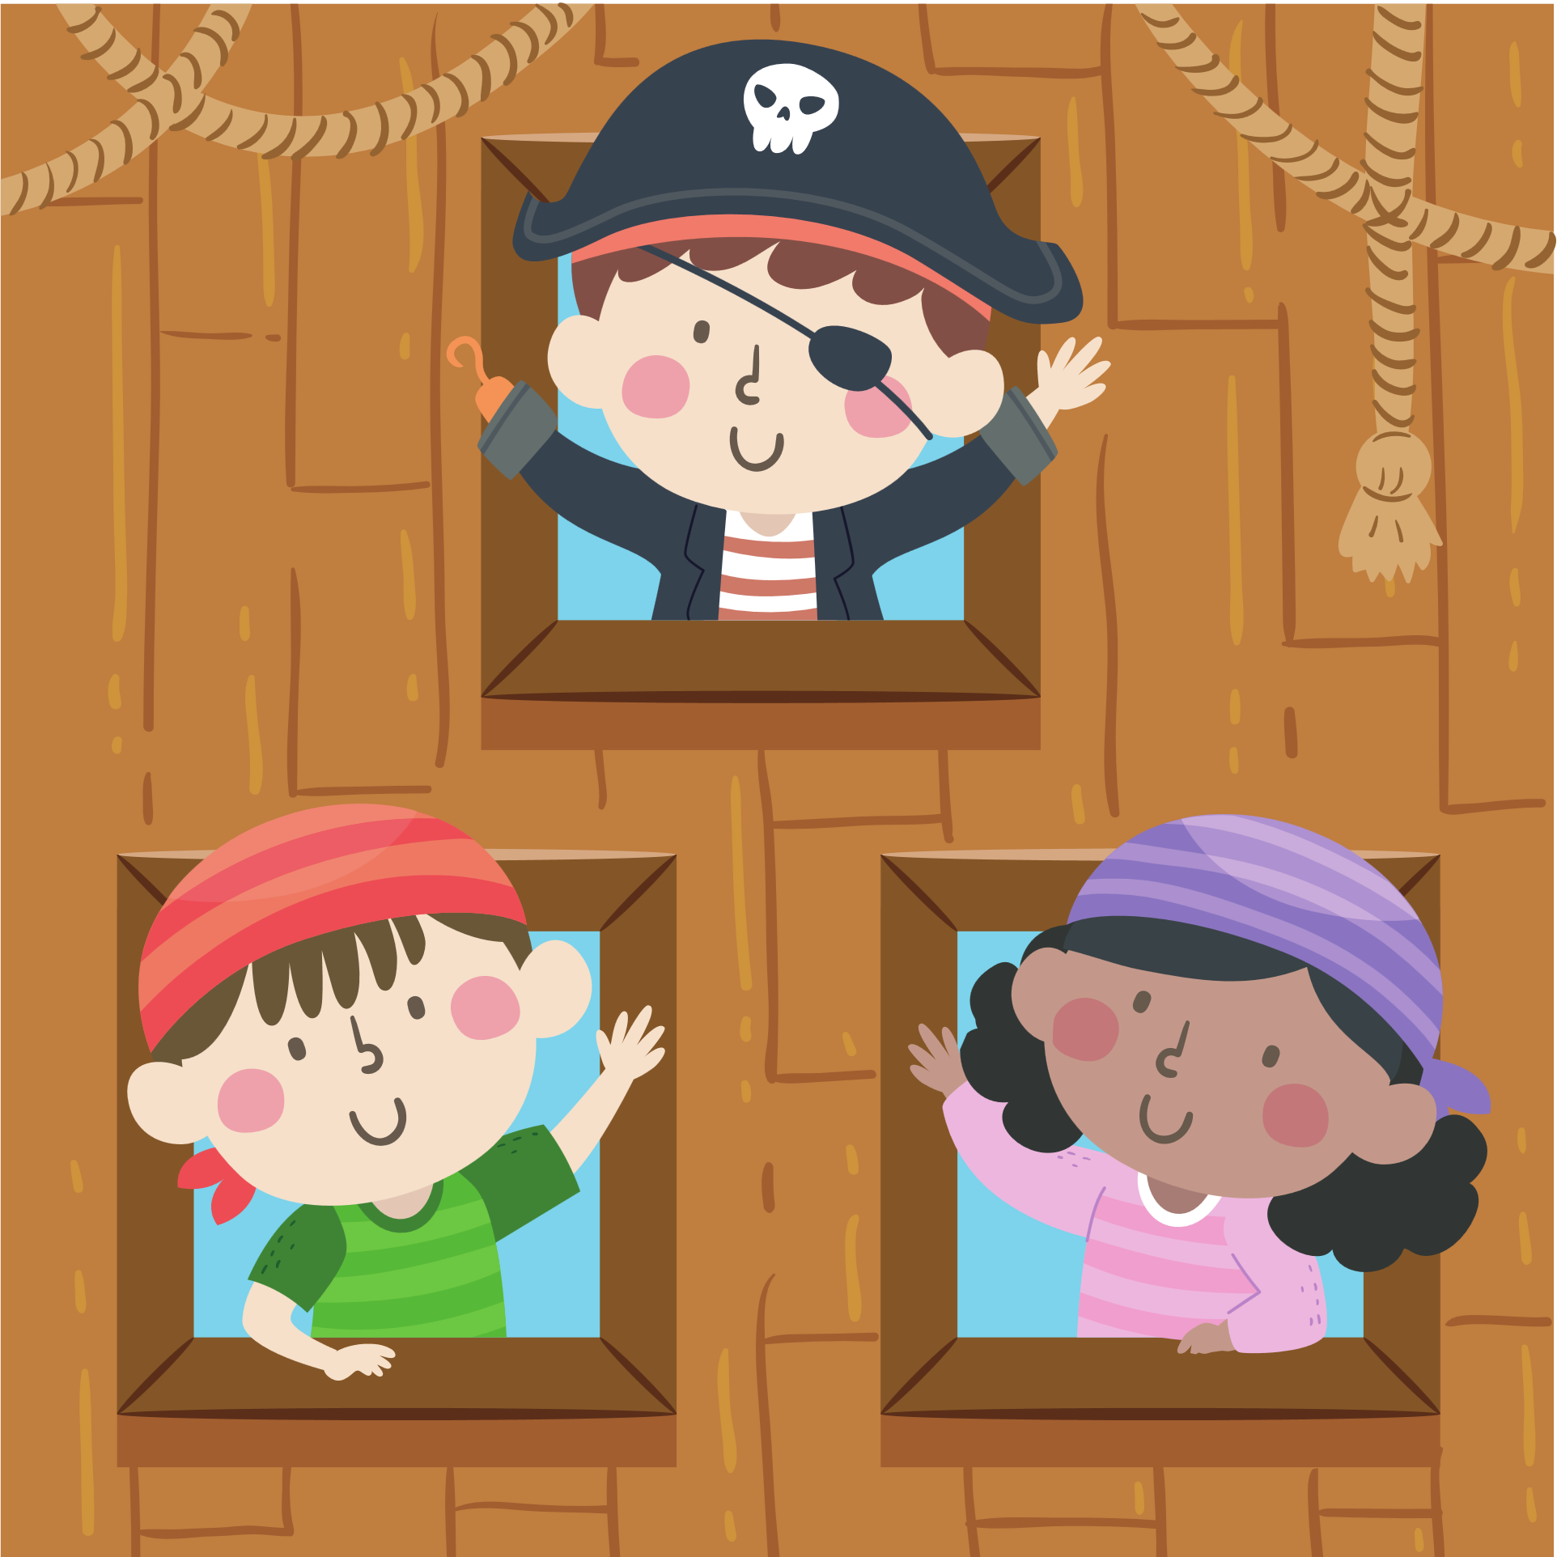
Break Time

Slide 32
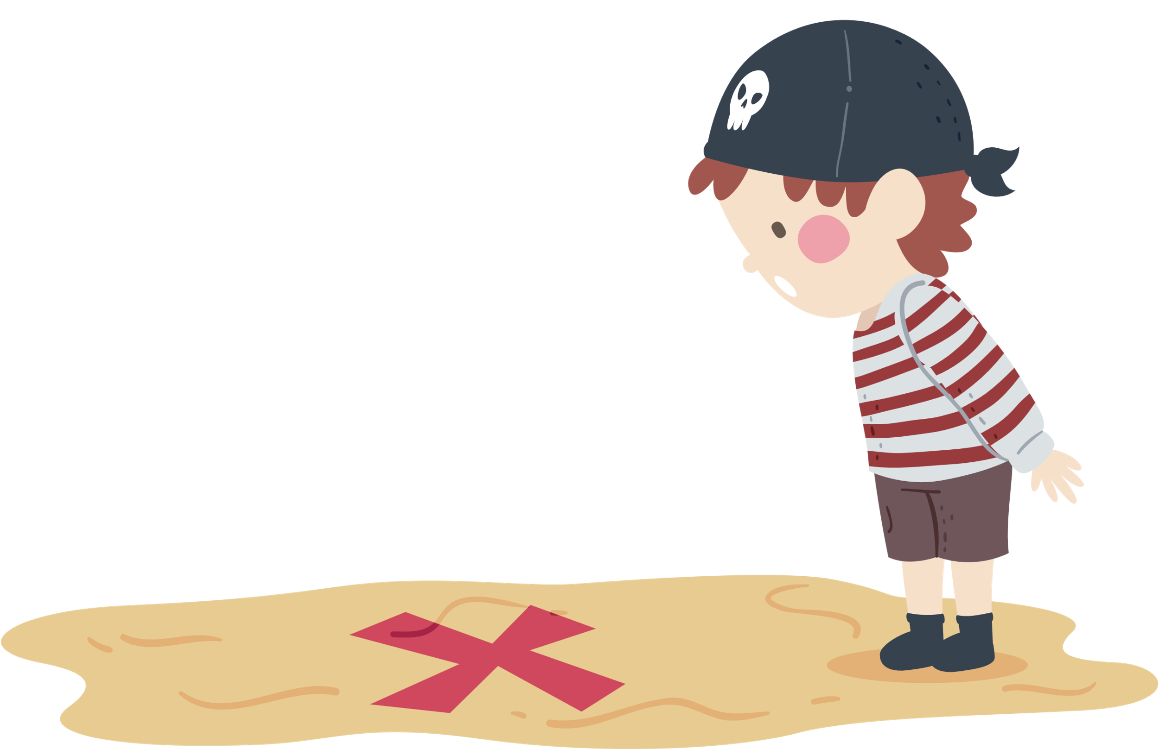
and the group that found the most treasures is...

Slide 33
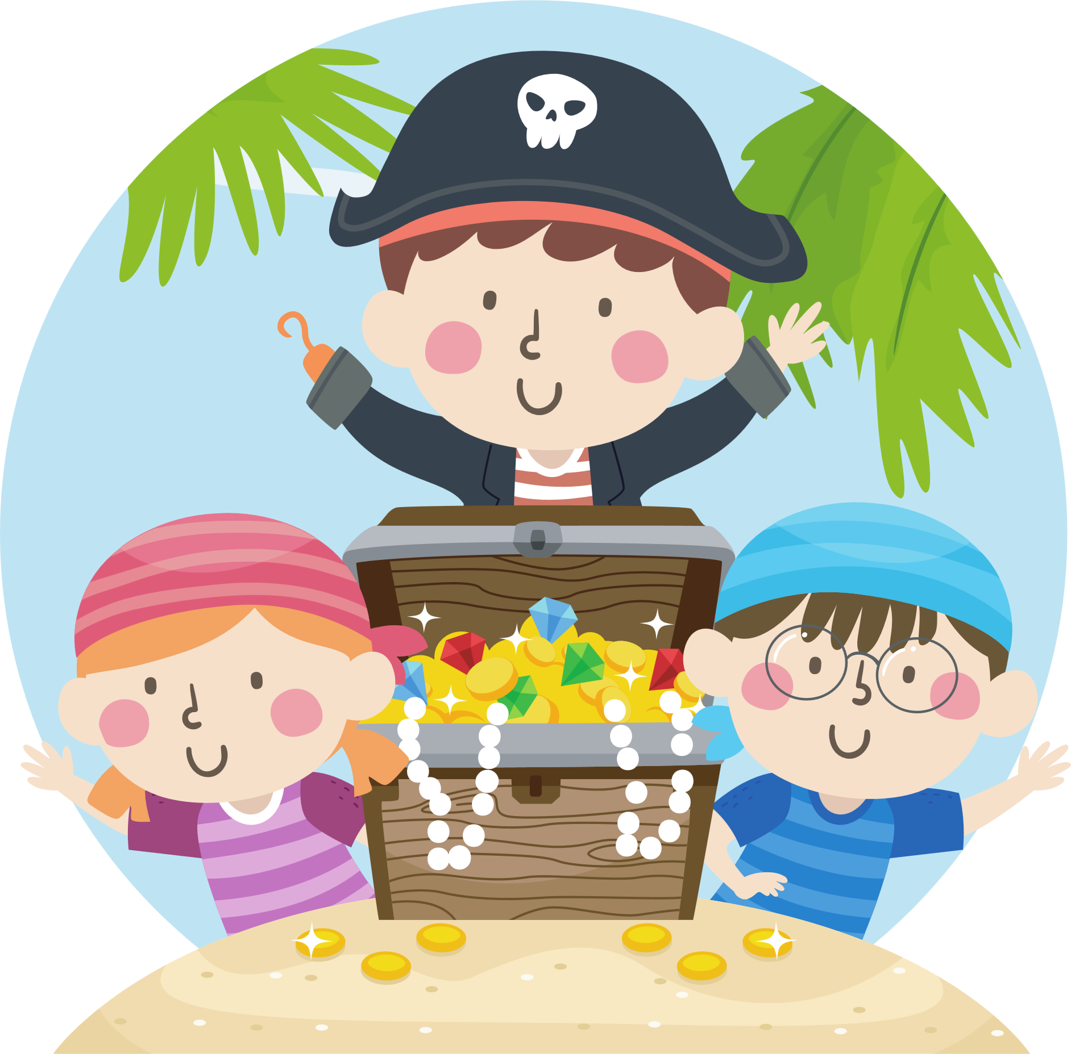
Group ?

Slide 34
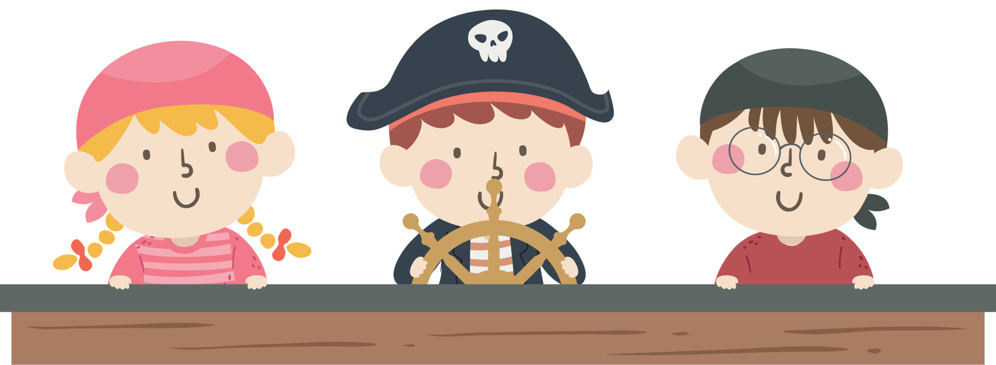
See you again!

Slide 35
4
Production

Slide 36
Write
Make a plan for your weekend. Then write four sentences using be going to.
Saturday Sunday
- watch a movie with my mum - ................................................
- .................................................. - ................................................
  I am going to watch a movie with my mum this Saturday.
  ........................................................................................................
  ........................................................................................................
  ........................................................................................................

Slide 37
5
Wrap-up &
Assessment

Slide 38
Correct the following sentences. There is ONE mistake in each sentence.
I am going to doing my homework after school today.
_________________________________________
2. She goes to play football on Saturday.
_________________________________________
3. Look at the sky! It going to rain.
_________________________________________
4. They are going to visit the museum this afternoon?
_________________________________________
5. He doesn't going to travel to Argentina this summer. ?
_________________________________________
I am going to do my homework after school today.
She is going to play football on Saturday.
Look at the sky! It is going to rain.
Are they going to visit the museum this afternoon?
Is he going to visit travel to Argentina this summer?

Slide 39





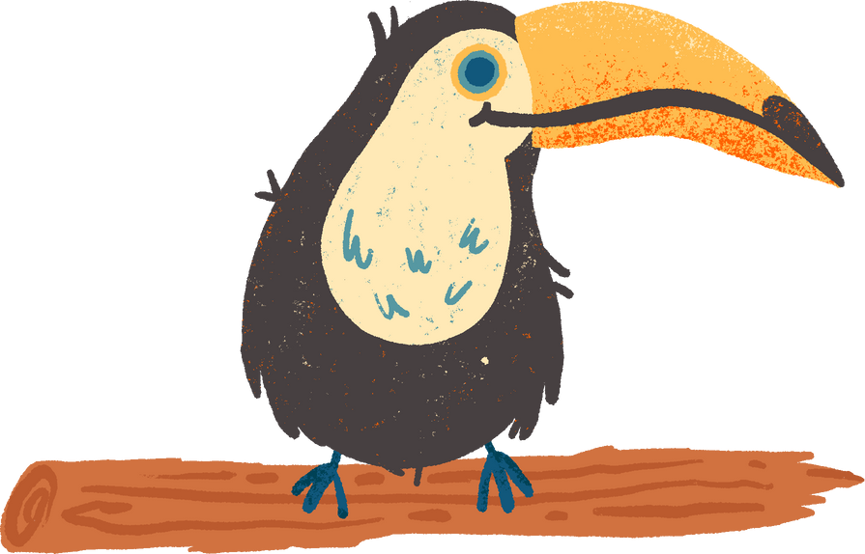
What have we learnt today ?
Review Vocabulary:
boiling, geothermal energy, environment, rainforest, underground, app, geocaching, GPS, treasure
Grammar: Be going to (making plan)
● This summer holiday, I am going to go camping.

Slide 40
THANK YOU

