Slide 1









Slide 2



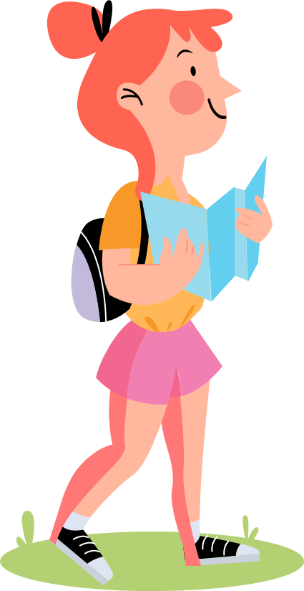




Table of contents
02
04
Review
Production
03
05
Wrap–up & Assessment
Practice
01
Warm-up

Slide 3


Unit 12:
WEATHER AND NATURE
Lesson 3 – Part 7,8,9

Slide 4
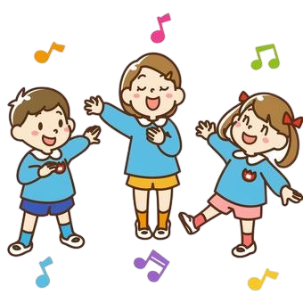
01
WARM-UP
Play the Race game!

Slide 5
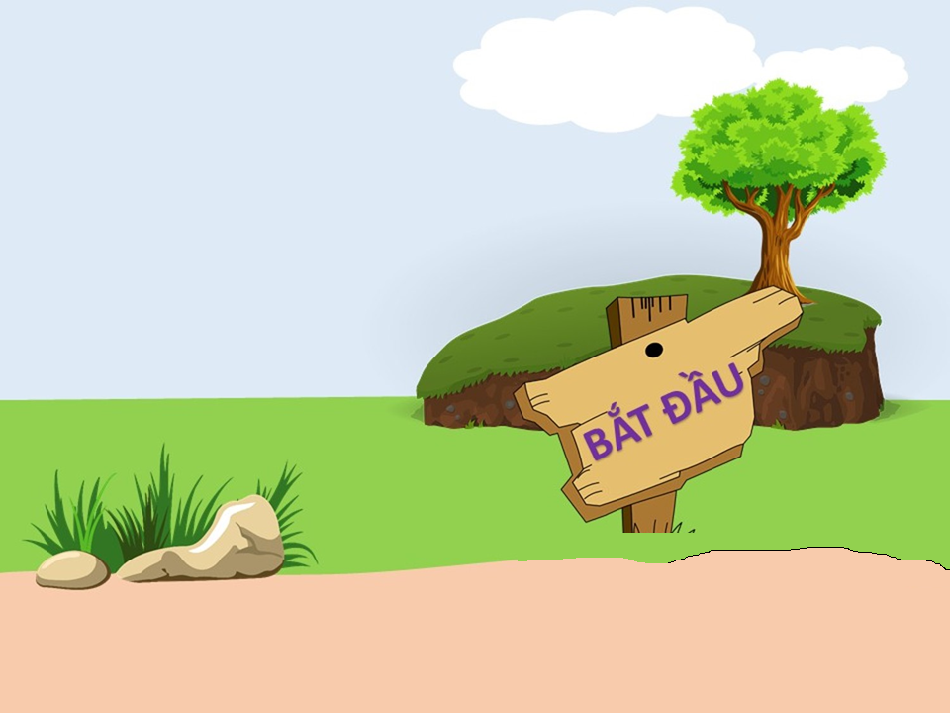
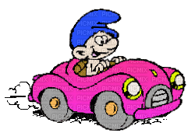

Obstacle Race
Start

Slide 6
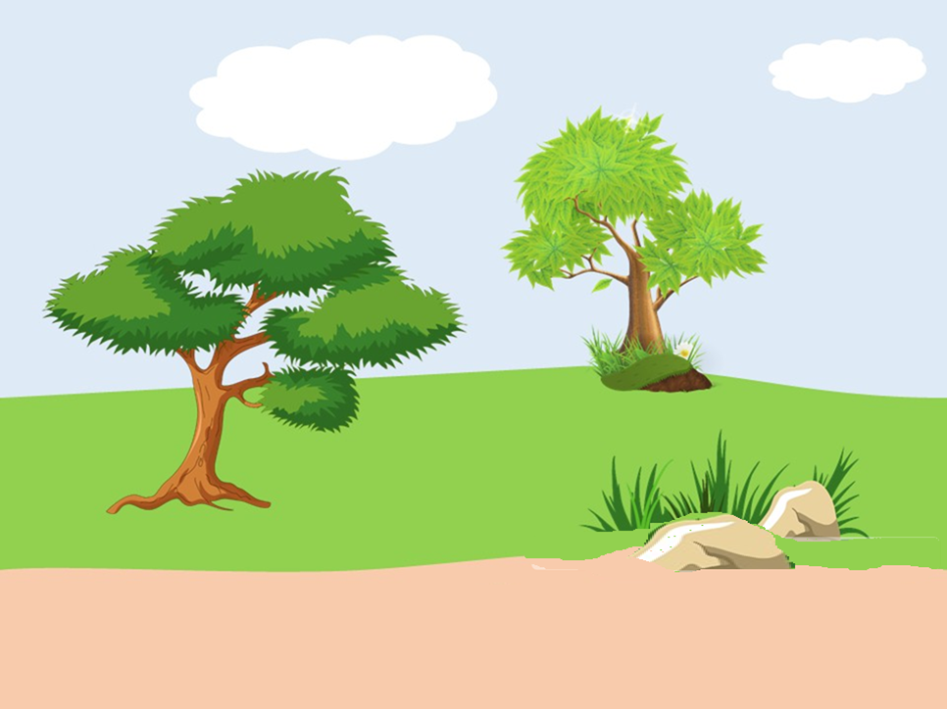
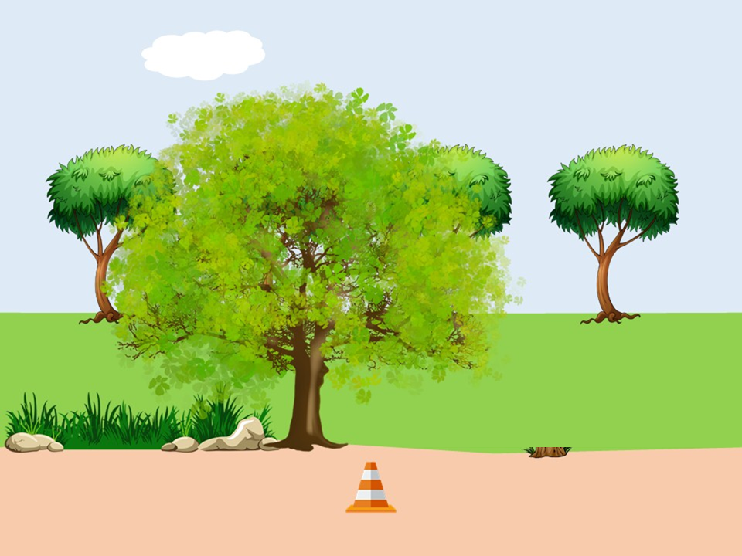
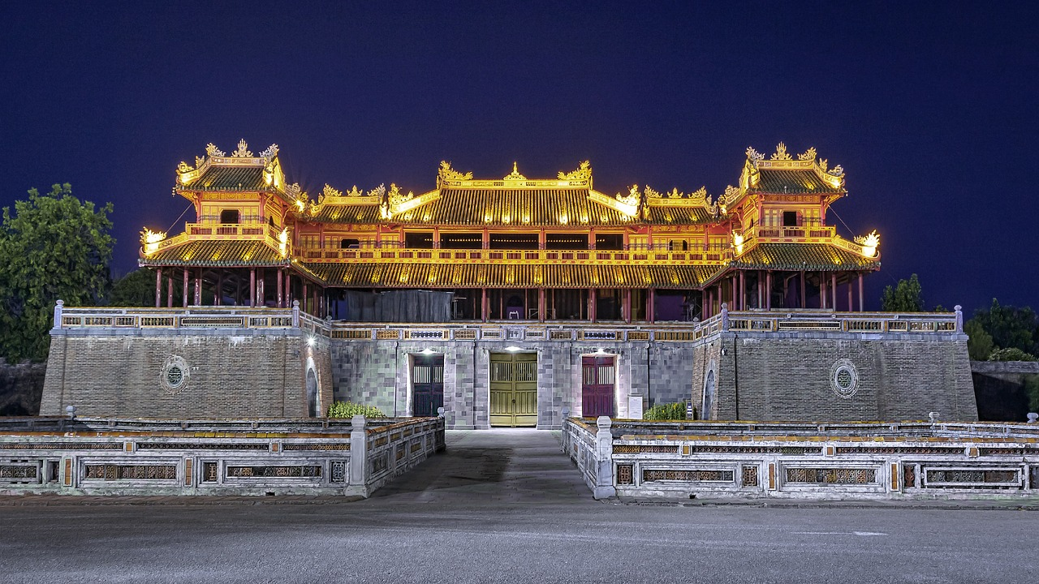


1. Where are you going to this summer?
I’m going to travel Hue City.

Slide 7
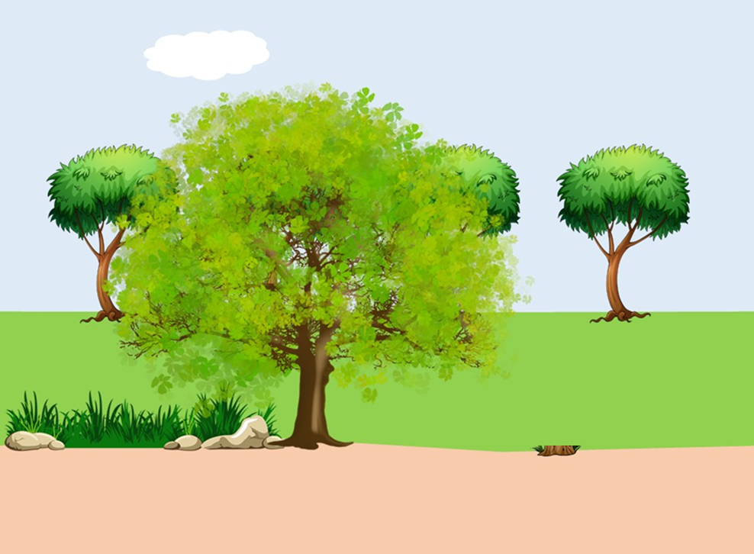
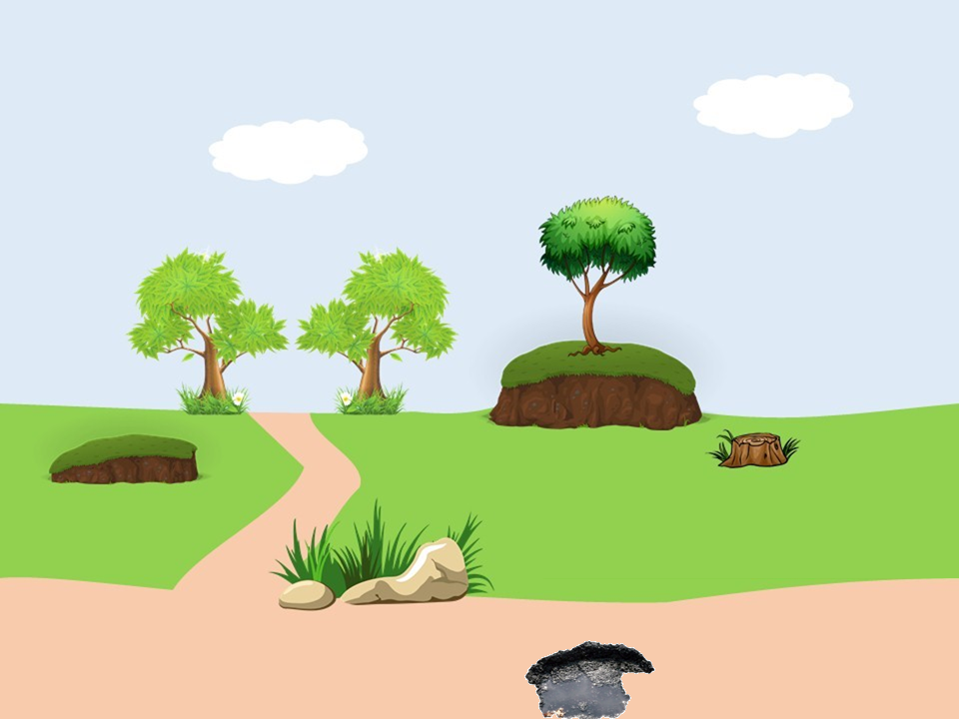
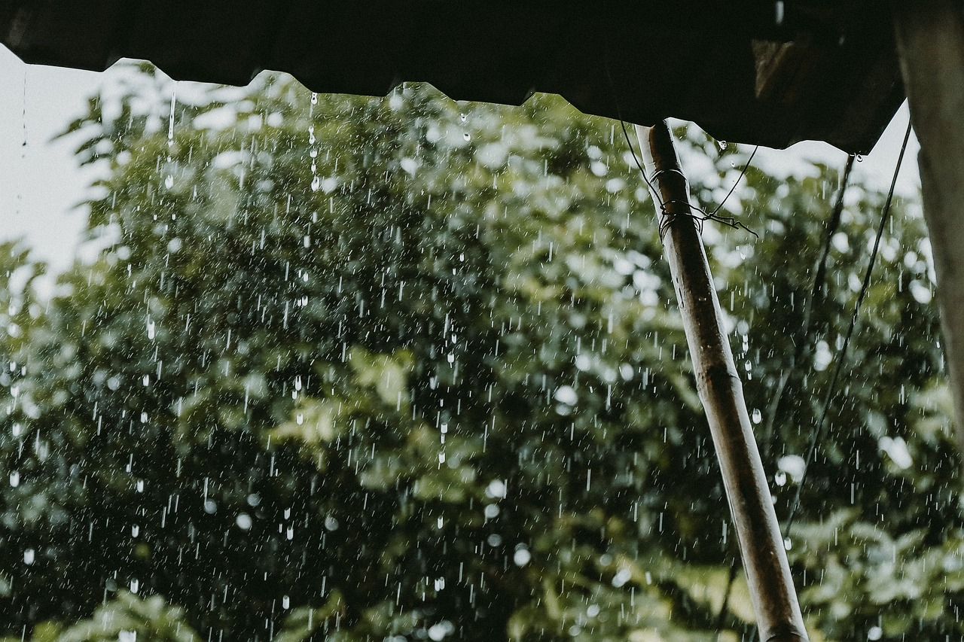

2. It’s _____ rain tomorrow.
It’s going to rain tomorrow.

Slide 8
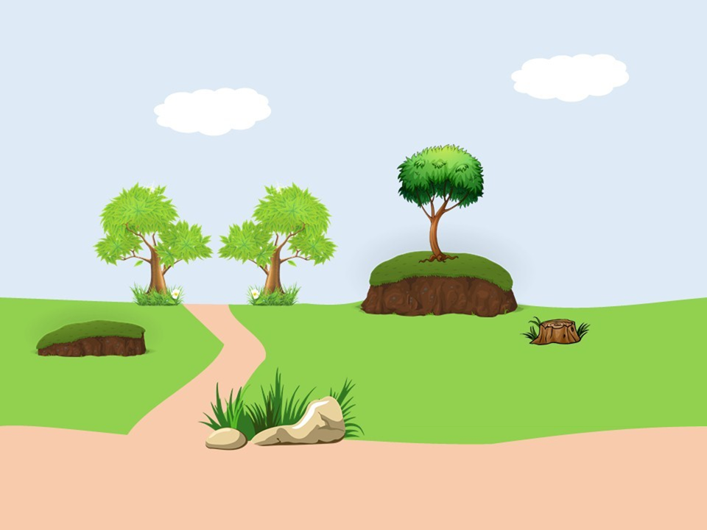
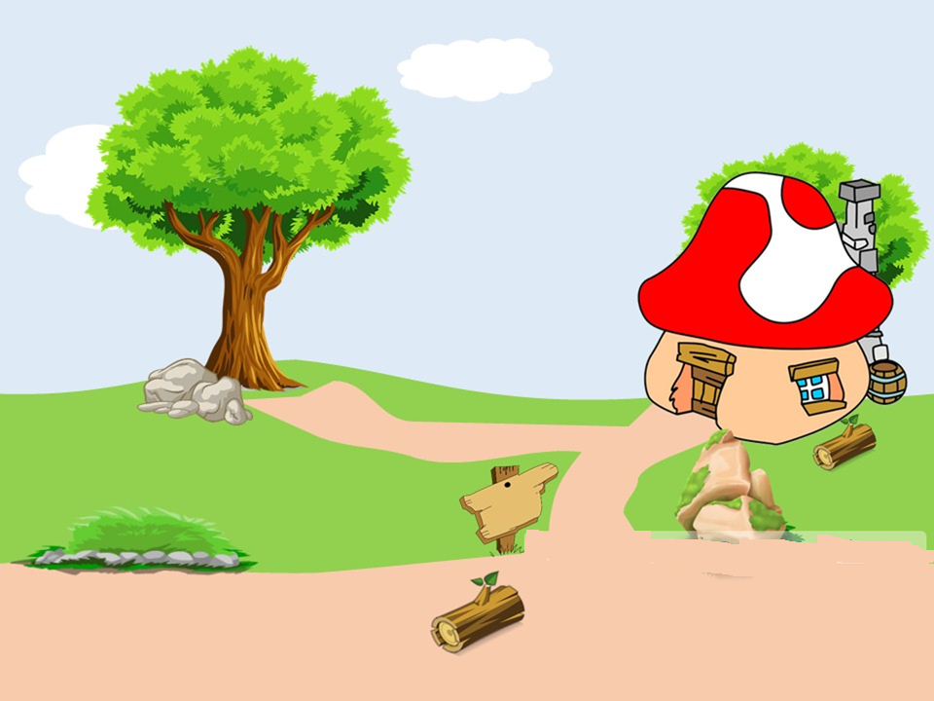
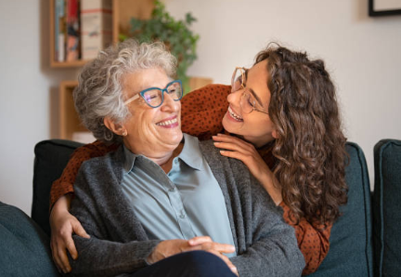

3. She/ going/ is/ to/ visit/ grandma/ her/.
She is going to visit her grandma.

Slide 9
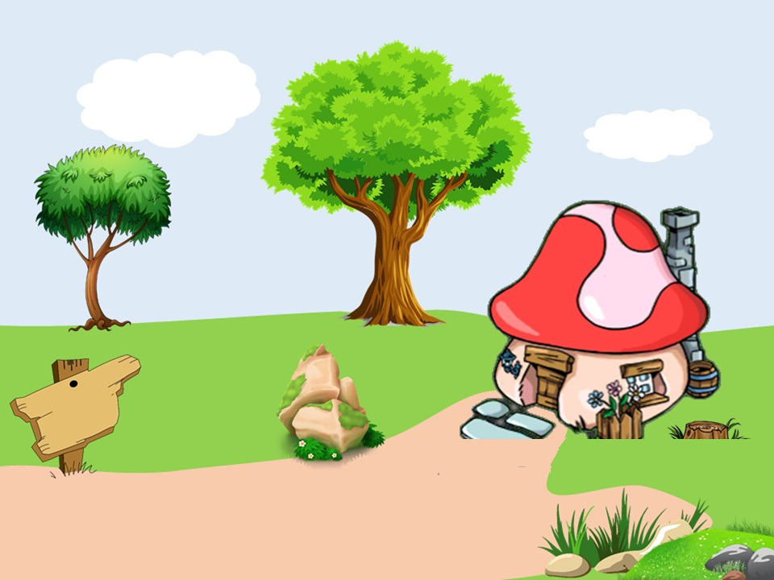
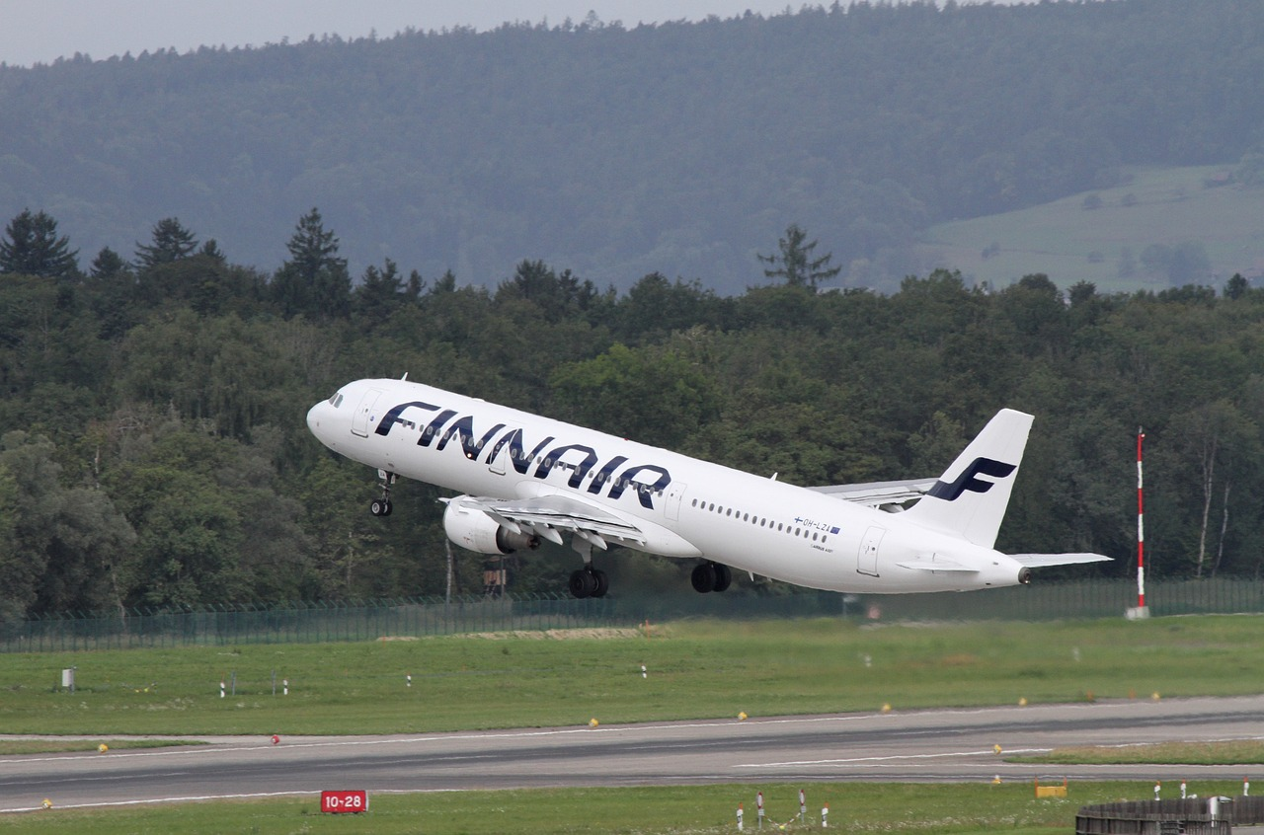





4. Are they going to travel by plane?
Yes, they are going to travel by plane.

Slide 10

02
PRESENTATION
Listen and repeat.

Slide 11


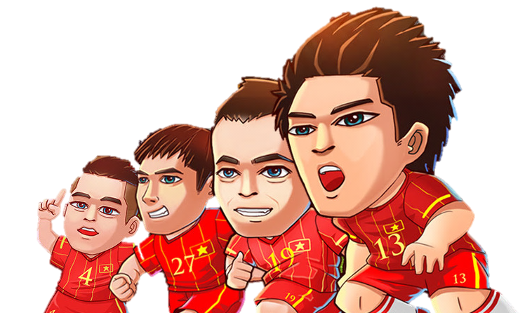
Goalkeeper game

Slide 12
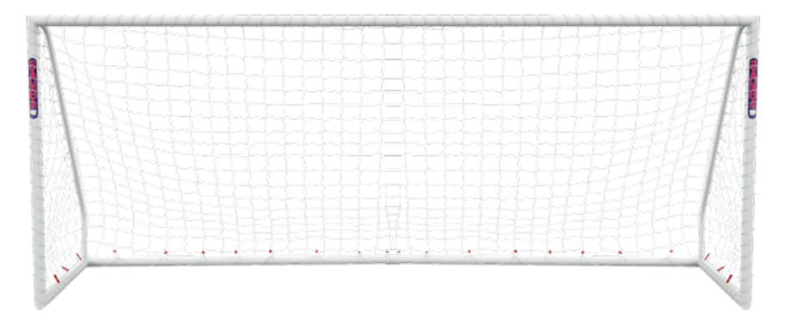
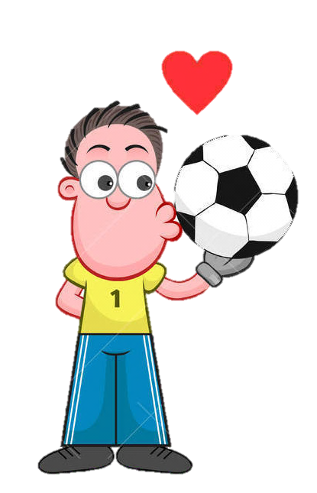
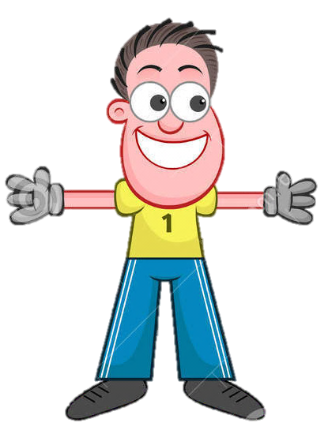
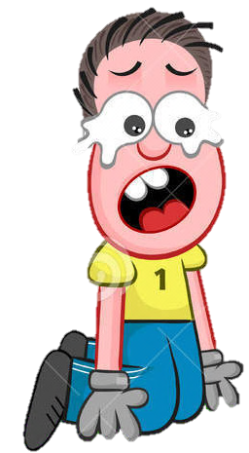


Question 1:
What are ____ going to do this summer?
A. he
B. you

Slide 13
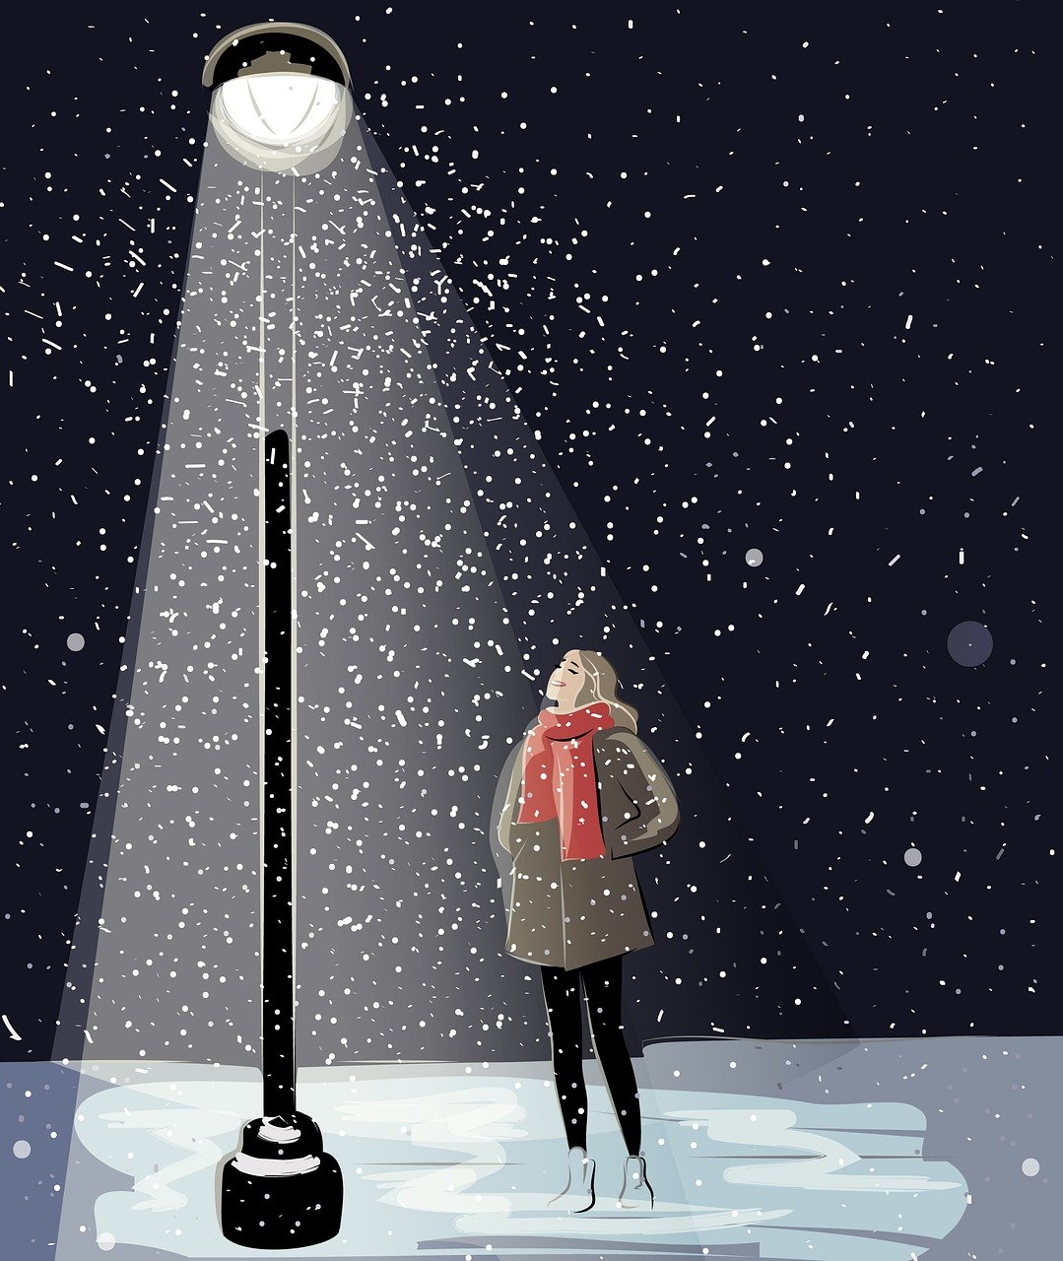
Question 2: Why do you like ____?
A. winter
B. spring

Slide 14
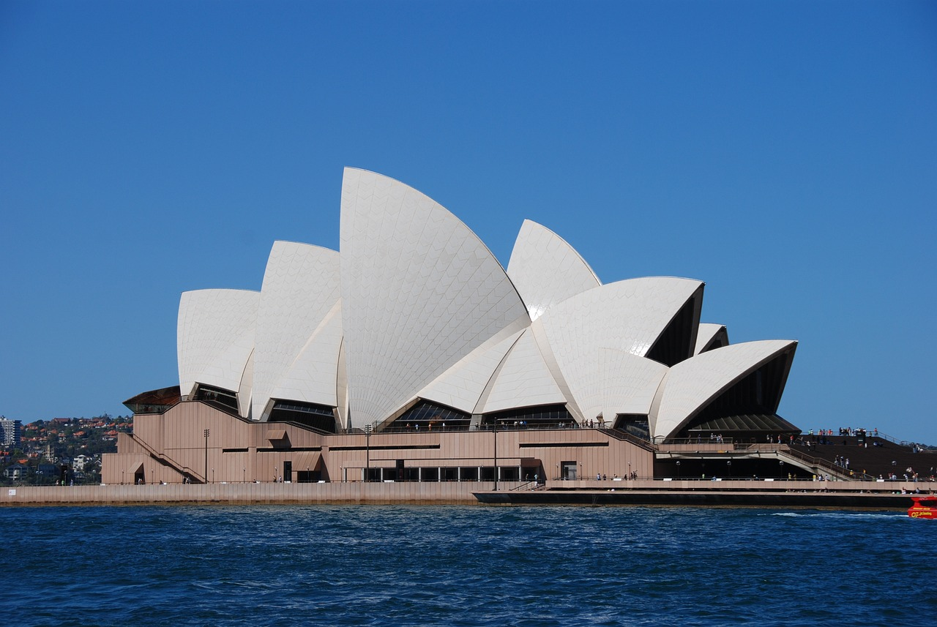
Question 3:
I’m going to visit my mother in _____.
A. Tokyo
B. Sydney

Slide 15
Question 4: He’s/tennis/playing
A. He’s playing tennis
B.He’s tennis playing

Slide 16
Question 5:
______ is going to join with you in the trip?
A. Where
B. Who

Slide 17
Question 6:
I ____ go to school on Sunday.
A. won’t
B. will

Slide 18

7 Listen and repeat.
1 What are you going to do during this summer?
2 Where are you going to go on your summer vacation?
3 Why do you like summer?
4 How are you going to stay cool during the hot weather?
5 Who is going to join you for a nature hike?

Slide 19


Pronounciation: Falling intonation
* Describe how to voice goes down at the end of the sentences.
* Usually use in wh-questions.
1 Where are you going to go this summer?
2 Who is going to join you for the picnic?

Slide 20
03
PRACTICE
Let’s play

Slide 21
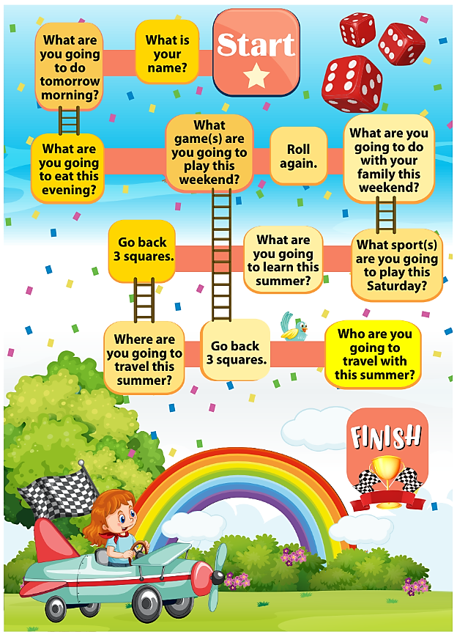

Slide 22



YOU WIN
5
4
3
2
1
A
YOU WIN
2
1
4
5
B
3
Notes:
Chia 2 đội, lần lượt từng câu, mỗi hình trái tim tương ứng 1 câu hỏi
Ấn hình trái tim để di chuyển, hs trả lời đúng sẽ ấn cộng để hiện số câu đúng

Slide 23
Team A
Question 1: What are ___ going to do?
A. he
B. she
C. they
D. I
Back
Notes:
Chọn đáp án đúng sẽ đổi màu, sai chuyển câu

Slide 24

Team A
Question 2: What are you going to eat this evening?
A. candy
B. meat
C. hotdog
D. beef
Back

Slide 25

Team A
Question 3: What are you going to do tomorrow?
A. I’m swim.
B. I swam.
C. I will swim.
D. I’m going to swim.
Back

Slide 26
Team A : Question 4: Reorder the words
She/ going/ is/ to/ go/ a/ picnic/ for/ this/ weekend.
A. She is going to go for a picnic this weekend.
B. She going to go for a picnic is this weekend.
C. She is going this weekend for picnic a go.
Back

Slide 27
Team A
Question 5: Where are you going to visit this summer vacation?
A. America
B. Australia
C. Japan
D. France
Back

Slide 28
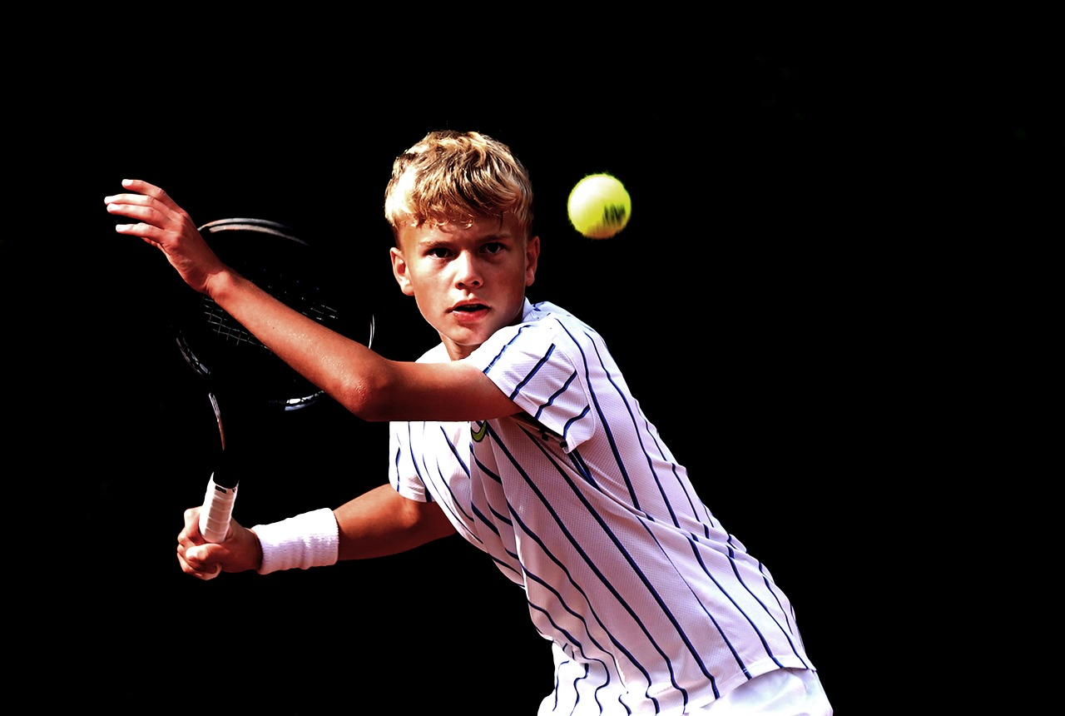
Team B
Question 1: What sport are you going to play this Saturday?
A. tennis
B. swimming
C. football
D. running
Back

Slide 29
Team B
Question 2:What are you going to learn this summer?
A. I’m going learning English this summer.
B. I are going to learn English this summer.
C. I’m going to learn English this summer.
Back

Slide 30
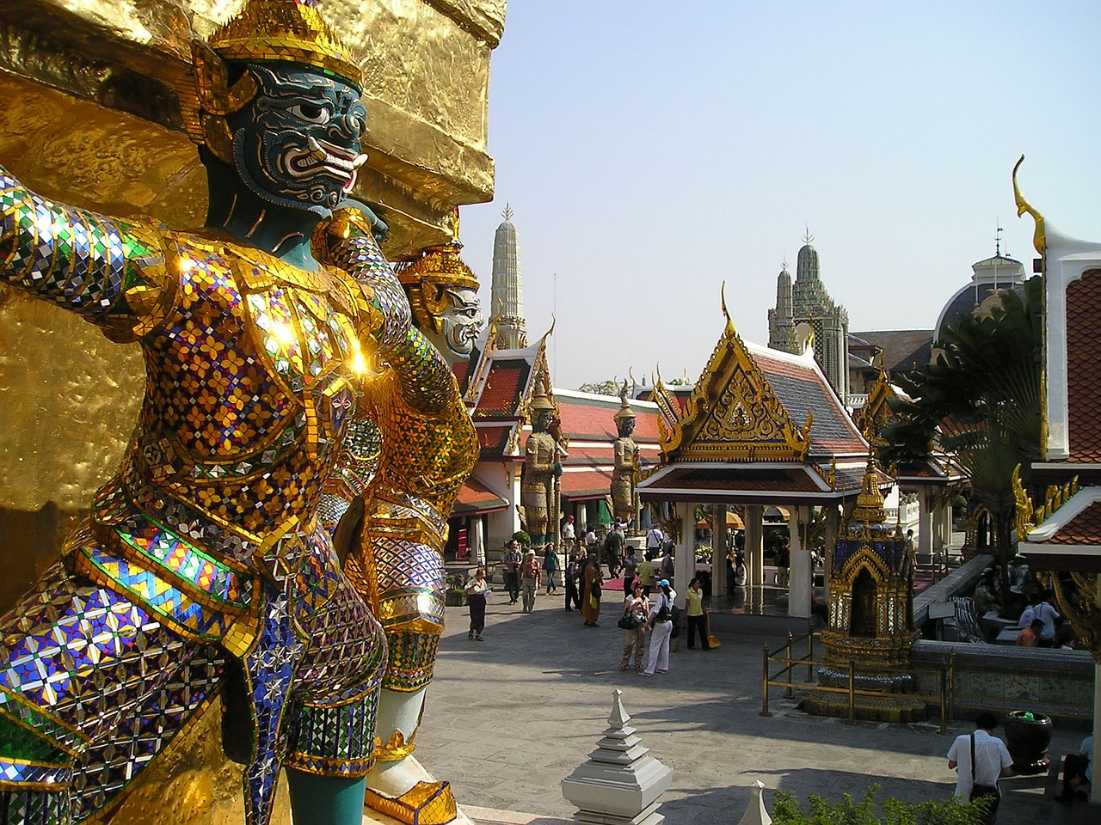
Team B
Question 3: Where are they going to travel this summer?
A. London
B. Bangkok
C. Tokyo
D. New York
Back

Slide 31
Team B
Question 4: Reorder the sentence:
Nam/Trang/ and/ going/ to/ dance/ are/ tomorrow.
A. Nam and Trang going to dance are tomorrow.
B. Nam and Trang are to going dance tomorrow.
C. Nam and Trang are going to dance tomorrow.
Back

Slide 32
Team B
Question 5: ____ are you going to travel with this summer?
A. How
B. What
C. Where
D. Who
Back

Slide 33
04
PRODUCTION
Listen a story!

Slide 34
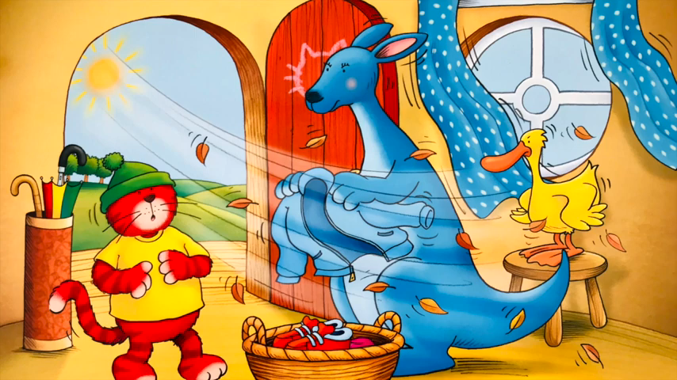

Slide 35
05
ASSESSMENT

Slide 36


Fill the missing words in the blanks:
are warm spring lots fun sunny
Tomorrow, we _____ going to visit London. It is _____ there. Day becomes ____ so people spend a lot of time outdoors. Most days it will be ______, but the rains can come sometimes. We will have ____ of activities there. Hope that our trip will be ____.
are
spring
warm
sunny
lots
fun

Slide 37
05
WRAP-UP

Slide 38

Unit 12: Weather and Nature
LESSON 3 – PERIOD 3
What have we learnt today?
Pronounciation:
Falling intonation
1 Where are you going to go this summer?
2 Who is going to join you for the picnic?

Slide 39




Thank you & goodbye!

