Slide 1










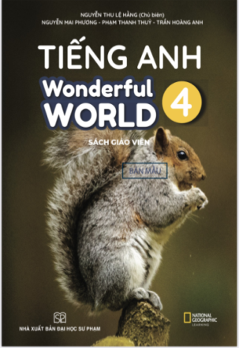








Slide 2


Slide 3



Unit 2 - My Home
Lesson 2 – Period 1

Slide 4


Warm up
Guessing Game

Slide 5
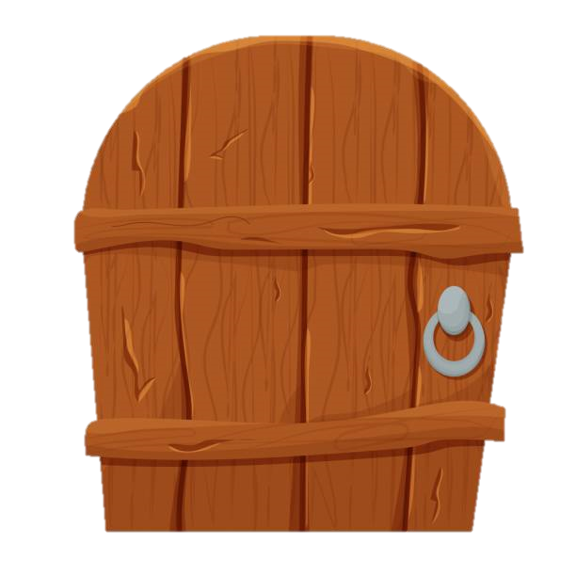

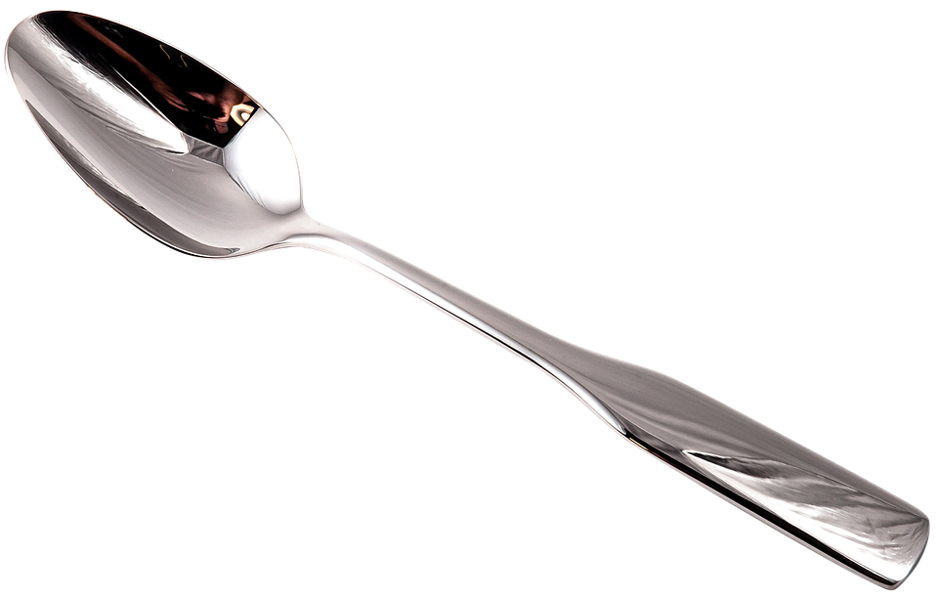
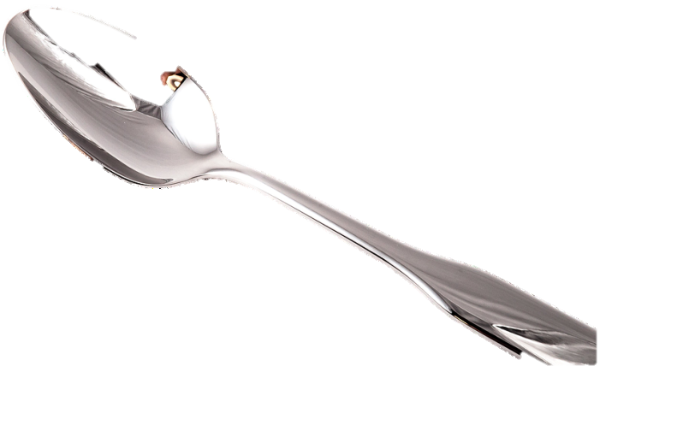
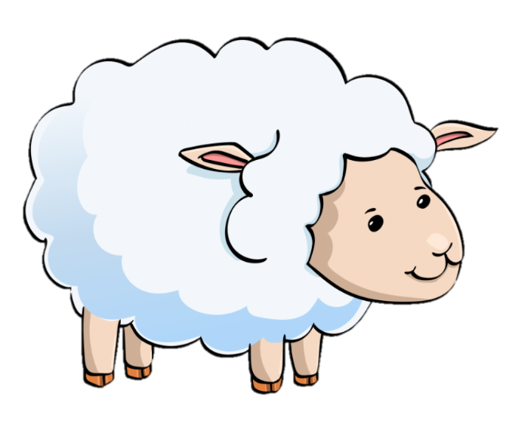
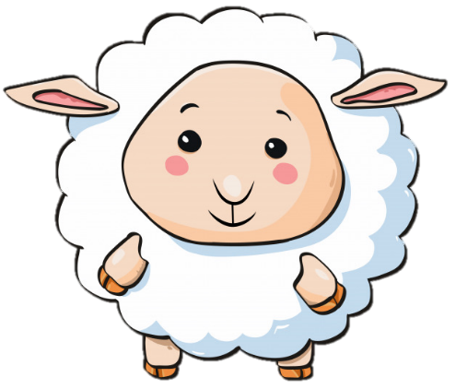
5 stars
What is it?
It’s a spoon.

Slide 6
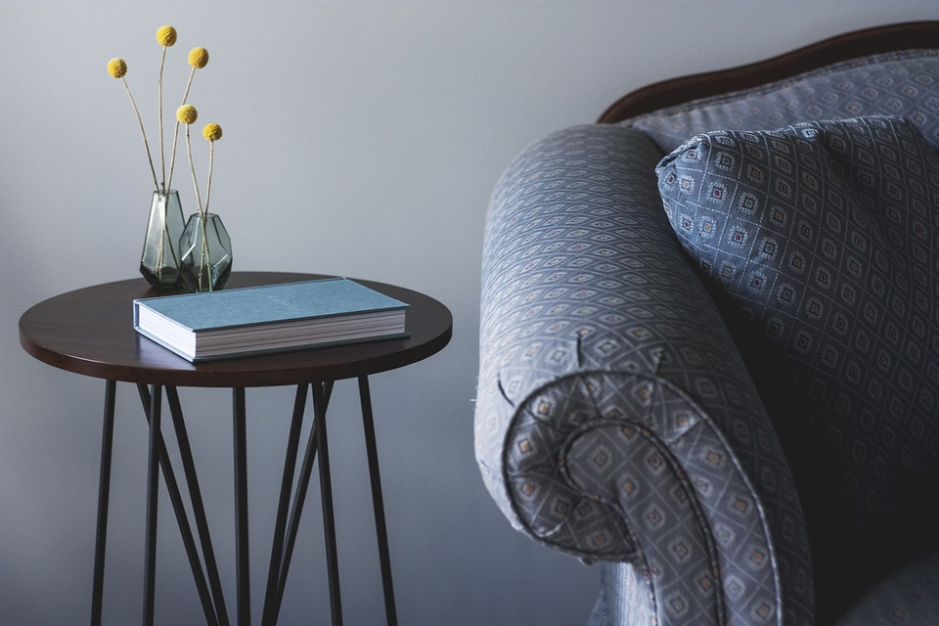
3 stars
It’s their ____.
It’s their table.
Notes:
Dấu chấm câu

Slide 7
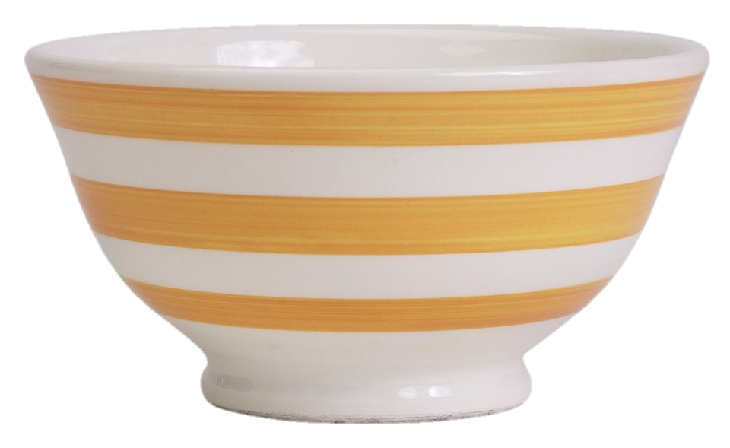
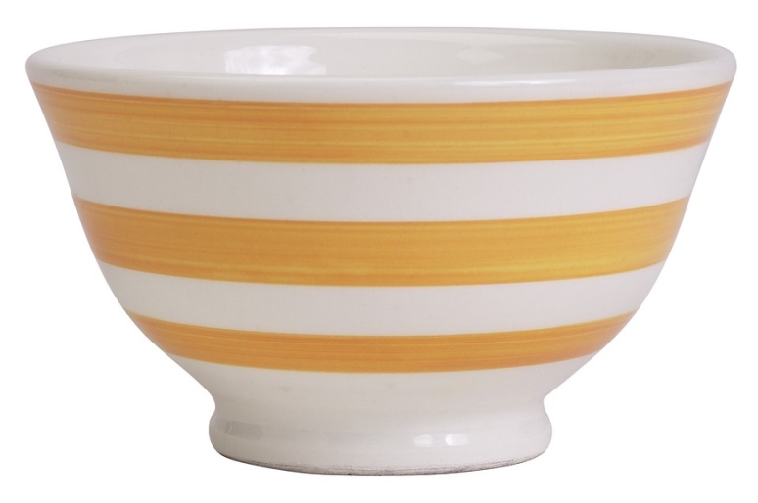
4 stars
It’s her _____.
It’s her bowl.

Slide 8
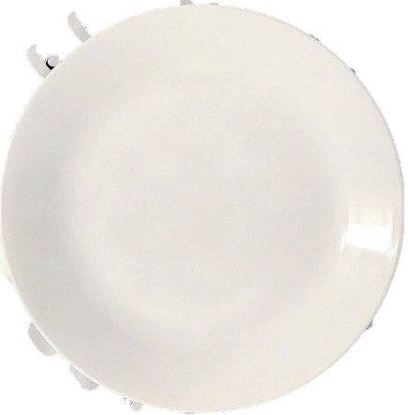
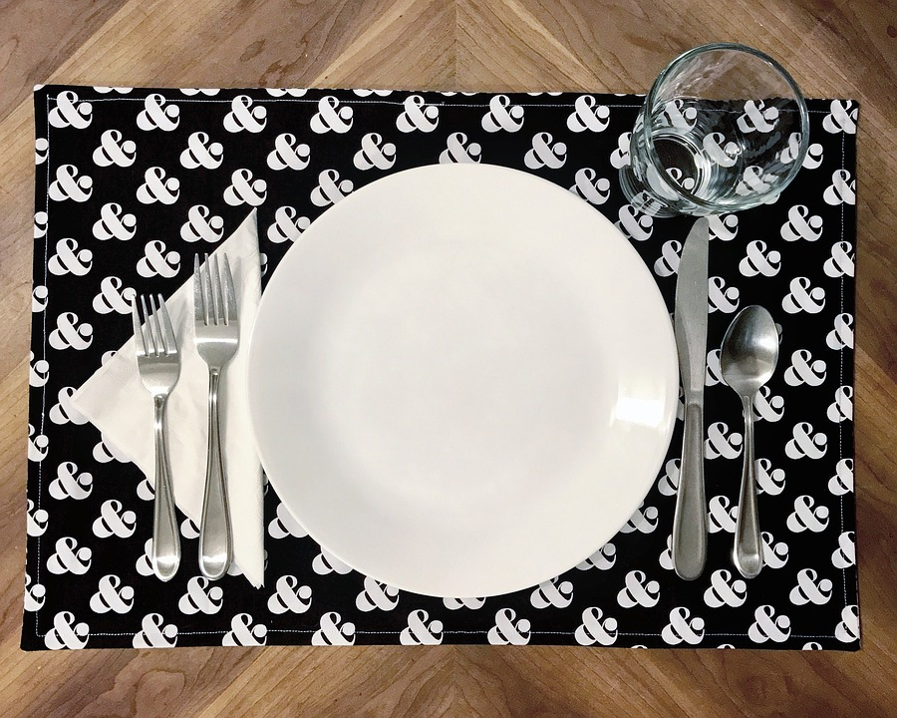

5 stars
Look at my ____.
Look at my plate.

Slide 9

Presentation
1
Listen and point. Repeat.

Slide 10


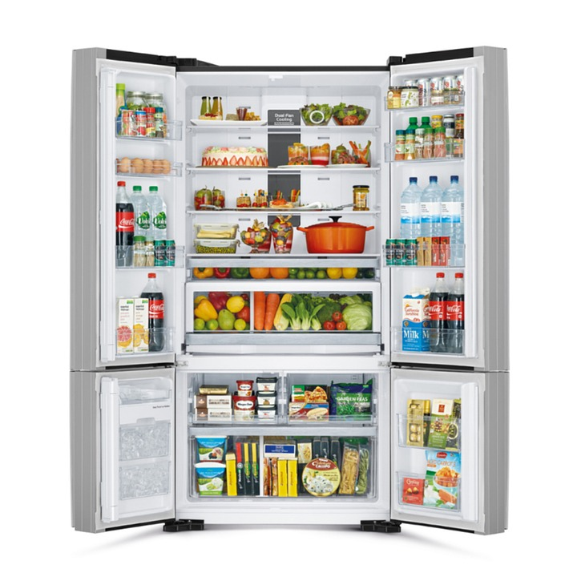
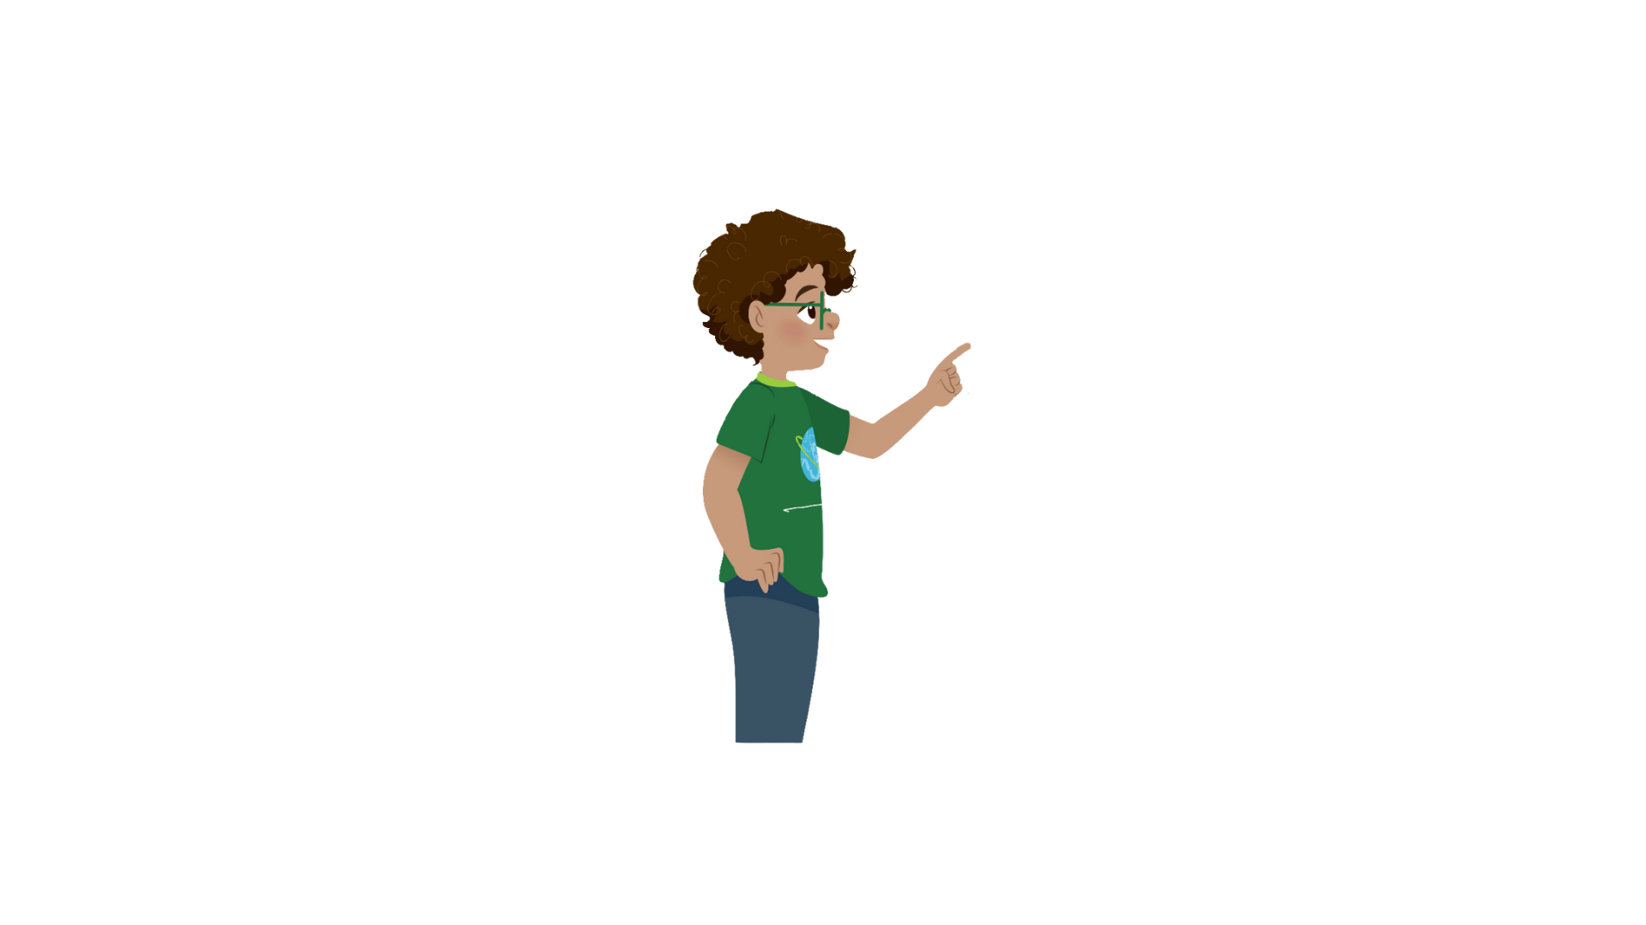

1
Listen and point. Repeat.
fridge

Slide 11
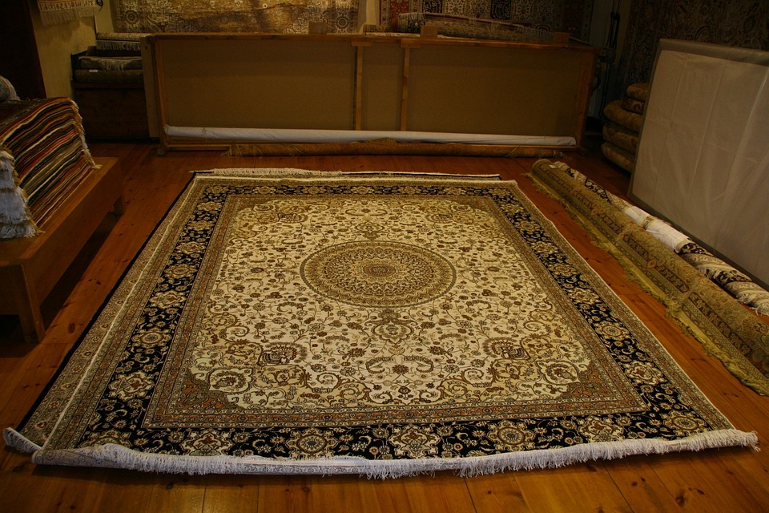

rug

Slide 12
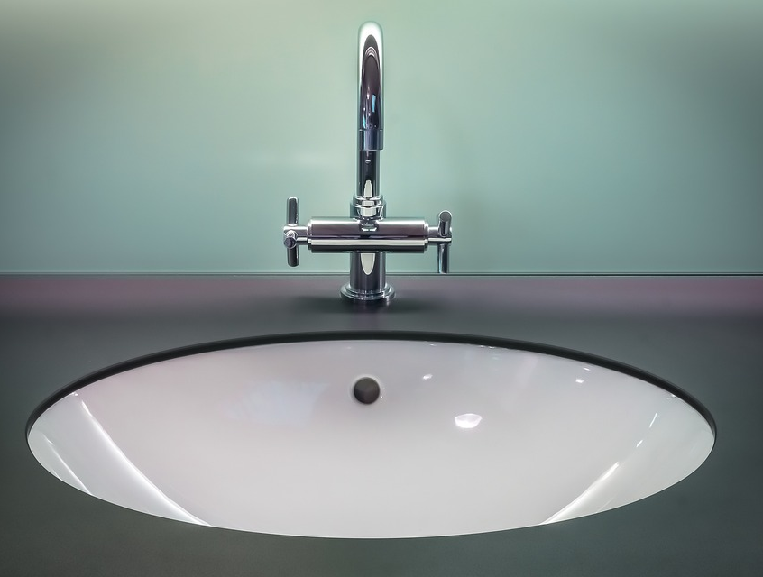

sink

Slide 13
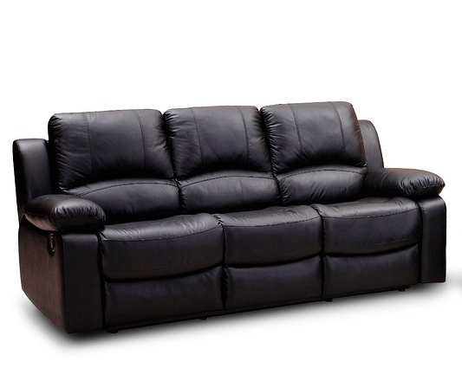

sofa

Slide 14
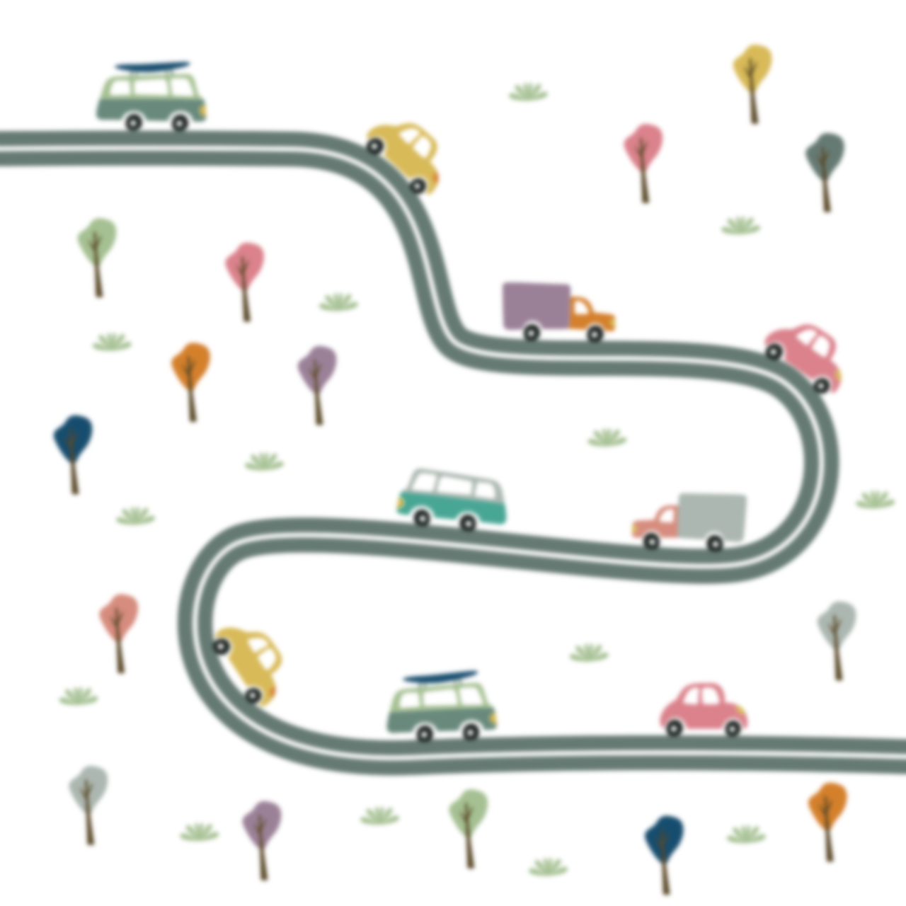
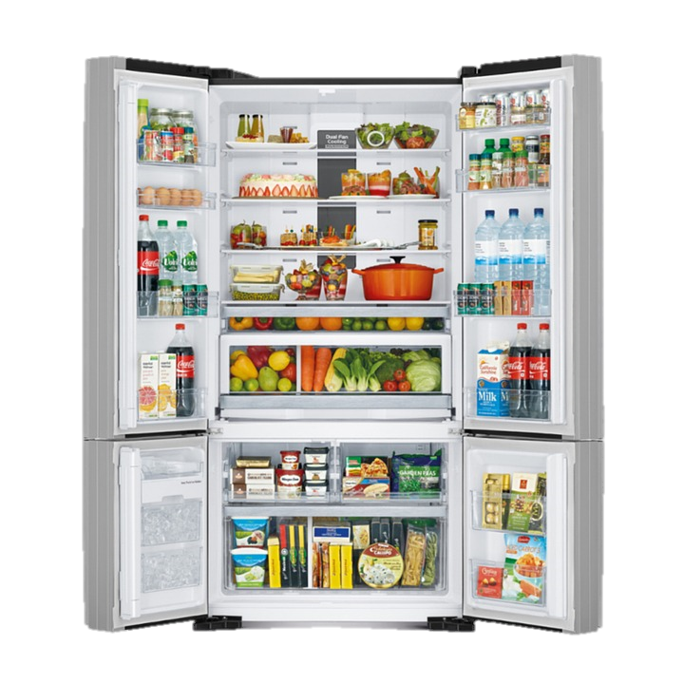
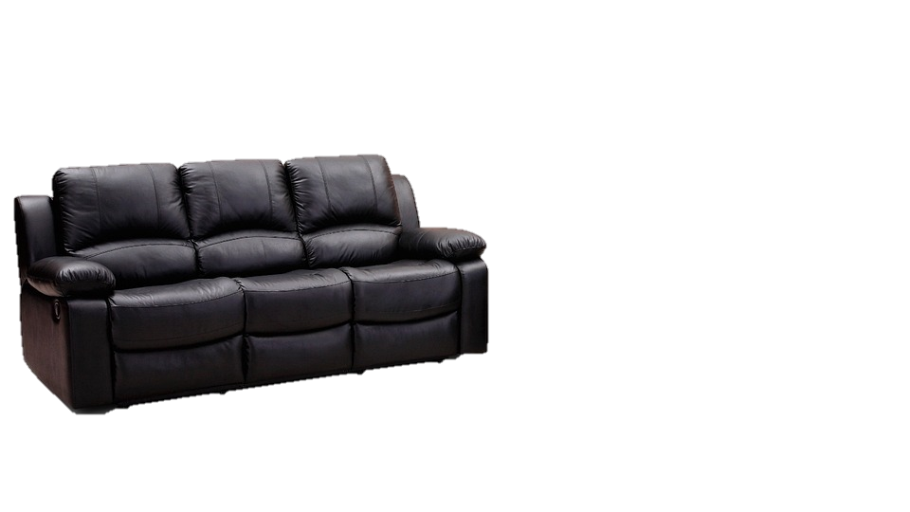
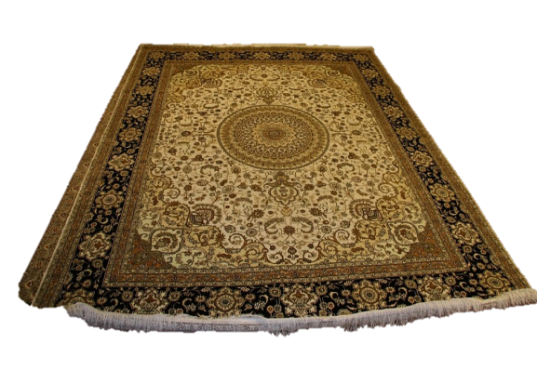

1
Listen and point. Repeat.
fridge
rug
sink
sofa

Slide 15
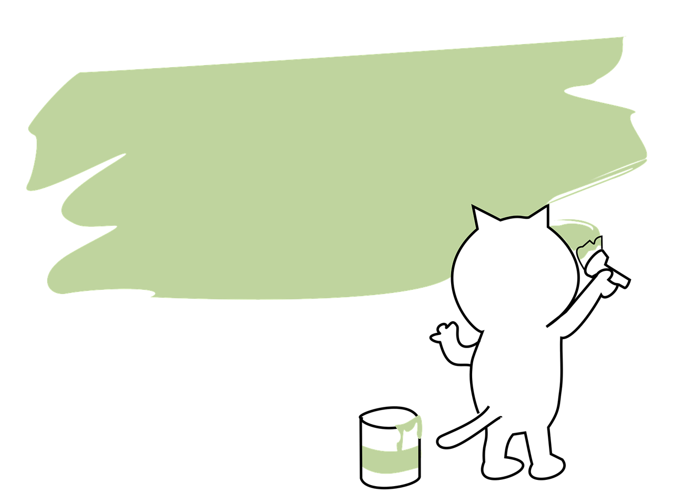
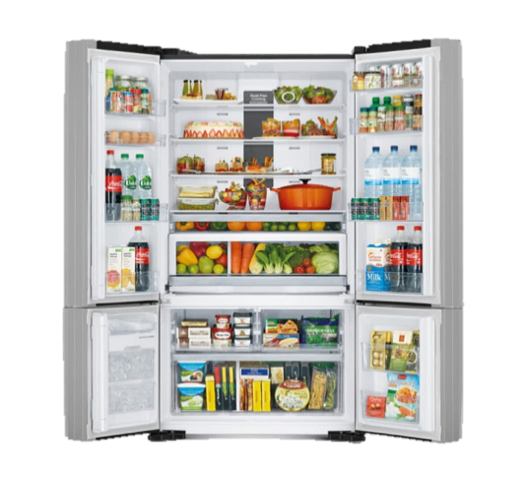

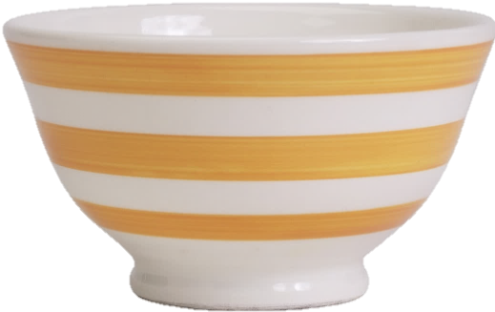

SLAP THE BOARD GAME
Notes:
- T asks some pairs to come to the board
- T reads the words and asks ss to slap the correct pictures

Slide 16

Practice
2
Listen and read. Tick

Slide 17


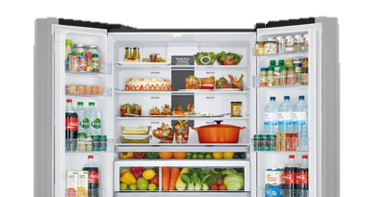
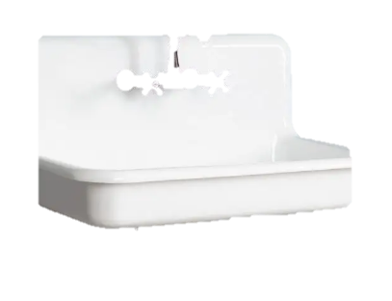
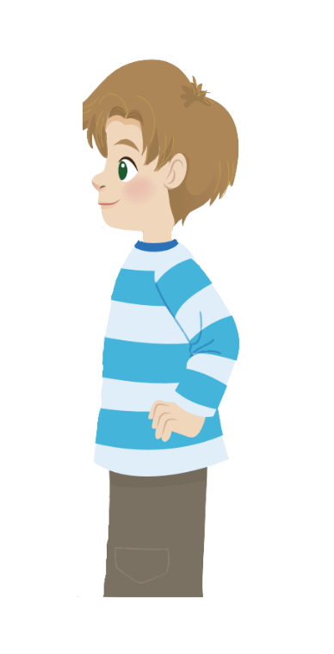
2
Listen and read.Tick.
This is our new house.
Great!
Dad
Jack
This is our living room.
Look! There’s a big rug under the table.
There is a in the living room.
chair
✓
table

Slide 18
2
Listen and repeat.Tick.
2. There is a in the kitchen.
✓
fridge
sofa
Dad
Jack
And is that our kitchen?
Yes, it is.
Where is the fridge?
Over there. It’s
next to the sink.
Cool!

Slide 19

Production

Slide 20
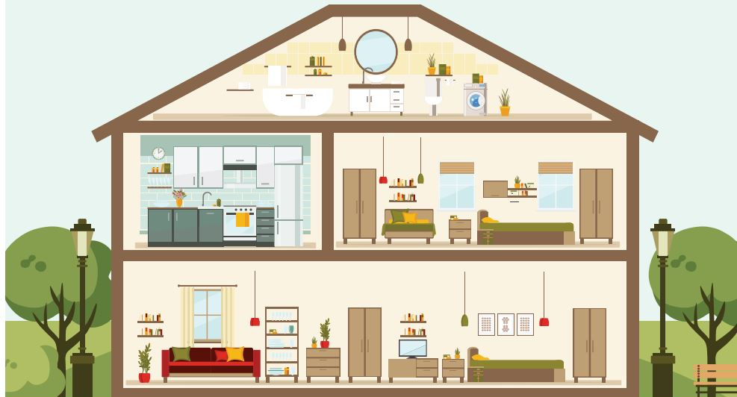


3
Look and say.
What room is it?
It’s a living room.

Slide 21
3
Look and say.
No, it isn’t.
It’s a kitchen.
Is it the bedroom?

Slide 22
1
2
3
4
Next

Slide 23
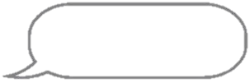
3
Look and say.
There’s a sofa in our living room.
BACK
Living room

Slide 24
There is a fridge in our kitchen.
Kitchen
BACK

Slide 25

There’s a rug in our living room.
Living room
BACK

Slide 26
There’s a sink in our kitchen.
Kitchen
BACK

Slide 27

Assessment

Slide 28
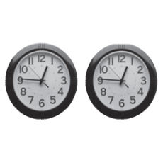
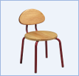
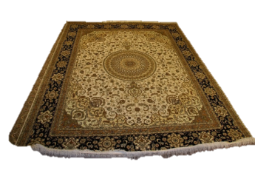


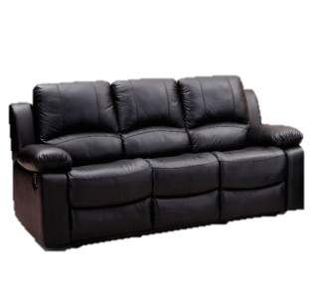


Look and read. Put tick (✓) or cross (✗) in the box.
Ex:
There are two pens.
✗
This is a chair.
✓
1. There is a rug.
3. A sink is in the kitchen.
2. There is a sofa.
4. A fridge is in the bedroom.
Notes:
HOẠT ĐỘNG TƯƠNG TÁC

Slide 29
Wrap up
Notes:
Đây k phải là extra, đây là hđ 3 của bài

Slide 30
REMEMBER
VOCABULARY:
Sink
Sofa
Rug
Fridge
STRUCTURE:
Where is the sofa?
- It’s in the living room.
30

Slide 31



