Slide 1

TEAM DIVISION
Team 1
Team 2
Team 3
Team 4
Unit 13- Lesson 2
Notes:
Divide class into 4 teams

Slide 2
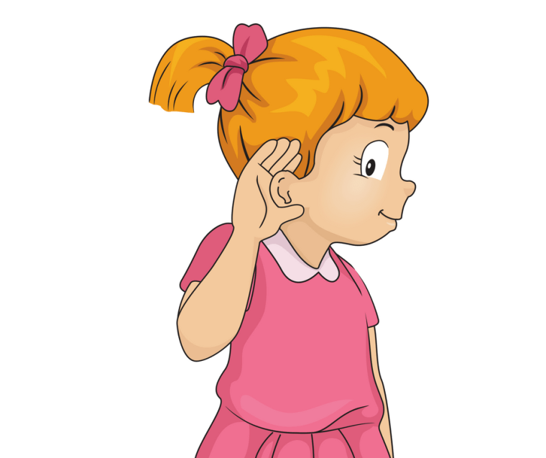

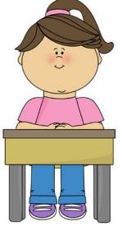

CLASSROOM RULES
1. Be quiet!
2. Listen!
3. Sit nicely!
4. Raise your hand to speak!
Unit 13- Lesson 2

Slide 3

WARM UP: Memorable game.
Notes:
Memorable game.
Teacher shows a picture which has many kinds of animals in it. Students try to remember all the animals in the picture. After 3 minutes, teacher hides that pictue. Students play in groups, take turns name the animals. With each correct answer, teacher gives this group one point.

Slide 4
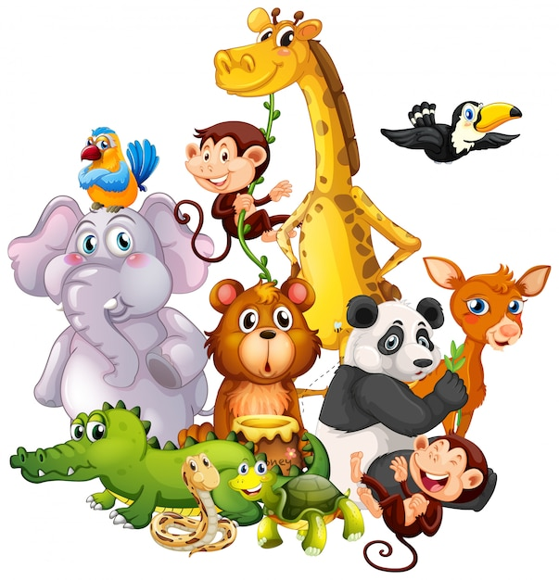
WARM UP: Memorable game.
Notes:
Memorable game.
Teacher shows a picture which has many kinds of animals in it. Students try to remember all the animals in the picture. After 3 minutes, teacher hides that picture. Students play in groups, take turns name the animals. With each correct answer, teacher gives this group one point.

Slide 5
WARM UP: Memorable game.
Notes:
Memorable game.
Teacher shows a picture which has many kinds of animals in it. Students try to remember all the animals in the picture. After 3 minutes, teacher hides that pictue. Students play in groups, take turns name the animals. With each correct answer, teacher gives this group one point.

Slide 6
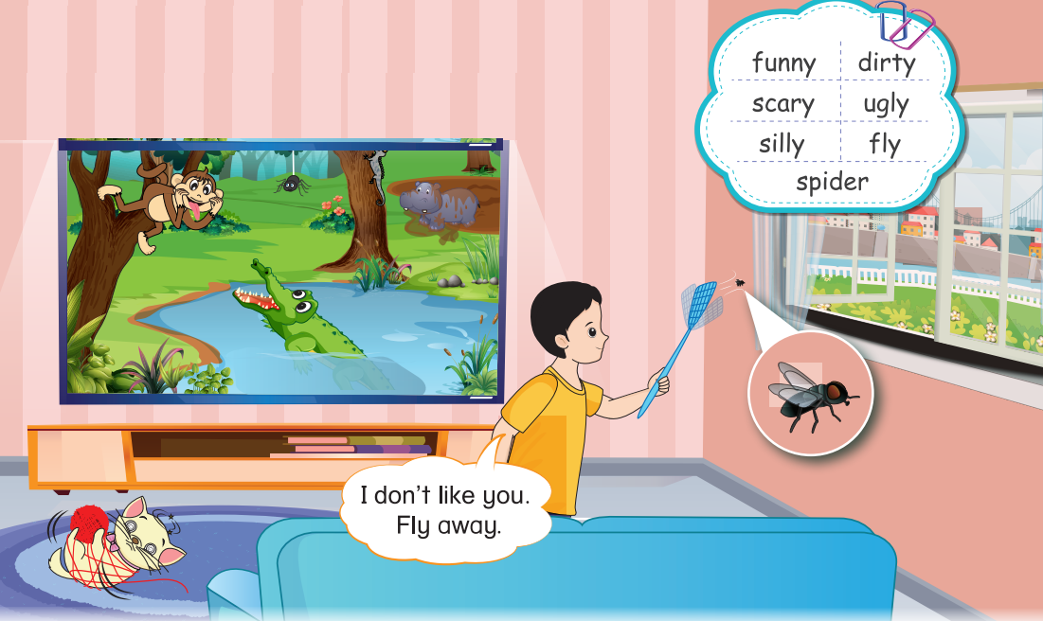

UNIT 13 – ANIMALS
Period 1

Slide 7

1
Listen and repeat.
Notes:
Ask students to look at the picture in the book (or show it on the screen) and elicit the animals in the picture.
Focus students on Ha Linh’s brother and ask them what he is doing? (He making the small animal fly away through the window.)

Slide 8
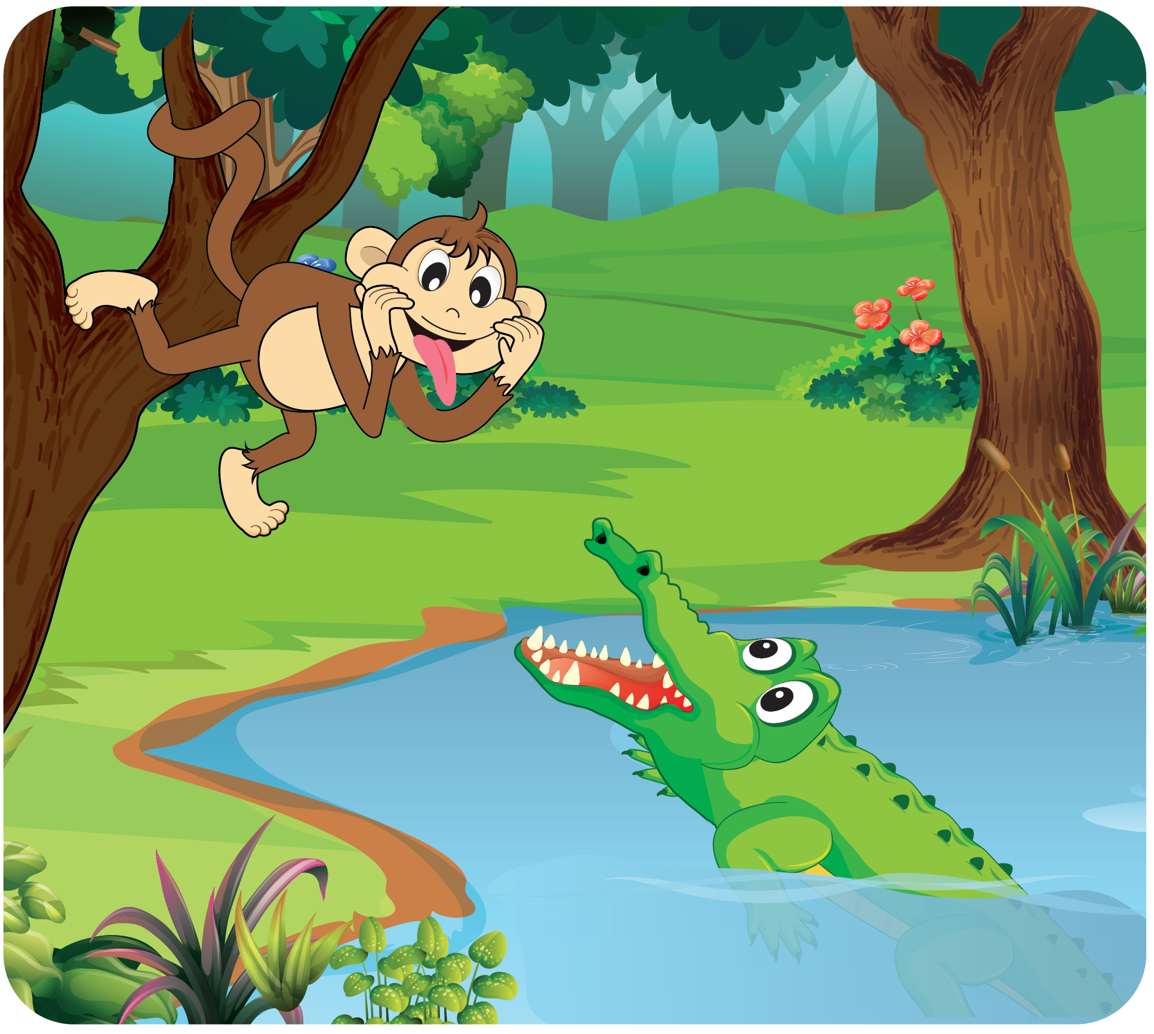

1
Listen and repeat.
Notes:
Ask students to talk about each animal by asking: Is the monkey funny?/…
Play the audio CD (CD2 Track 75) twice.
Teach the new words.
Ask students listen to the audio and repeat.

Slide 9
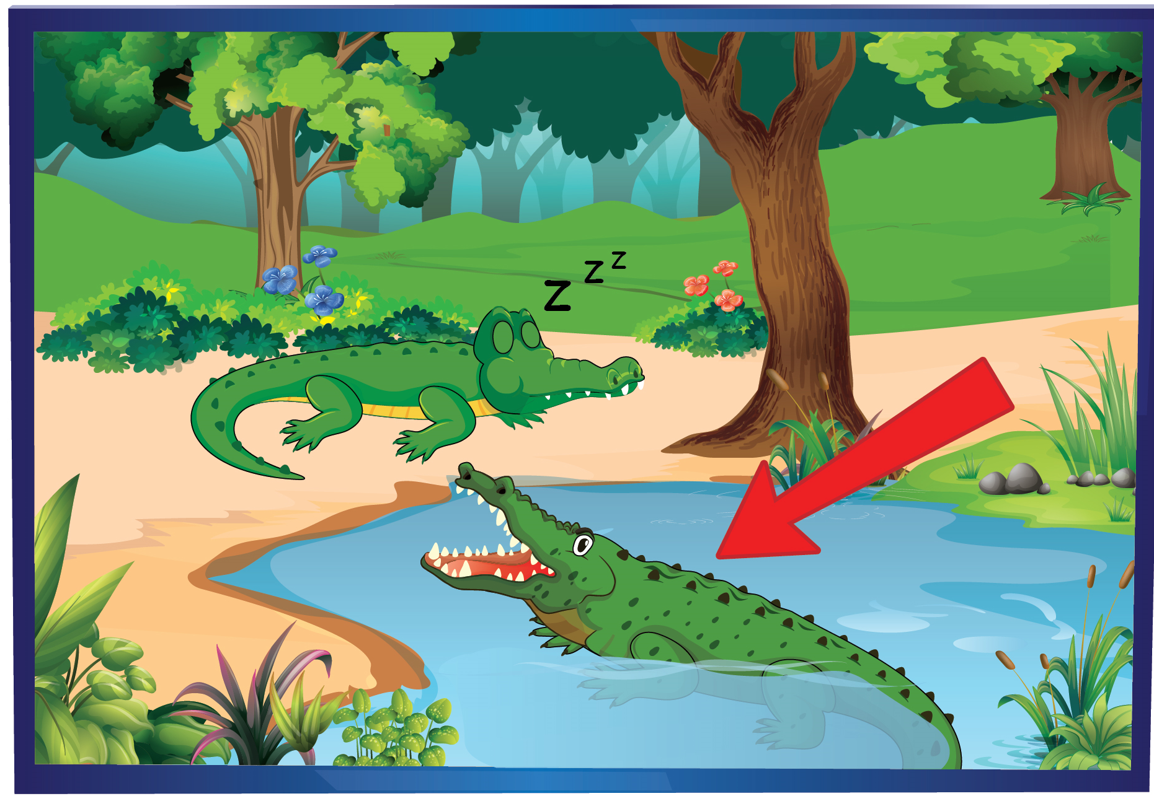

1
Listen and repeat.
Notes:
Ask students to talk about each animal by asking: Is the monkey funny?/…
Play the audio CD (CD2 Track 75) twice.
Teach the new words.
Ask students listen to the audio and repeat.

Slide 10
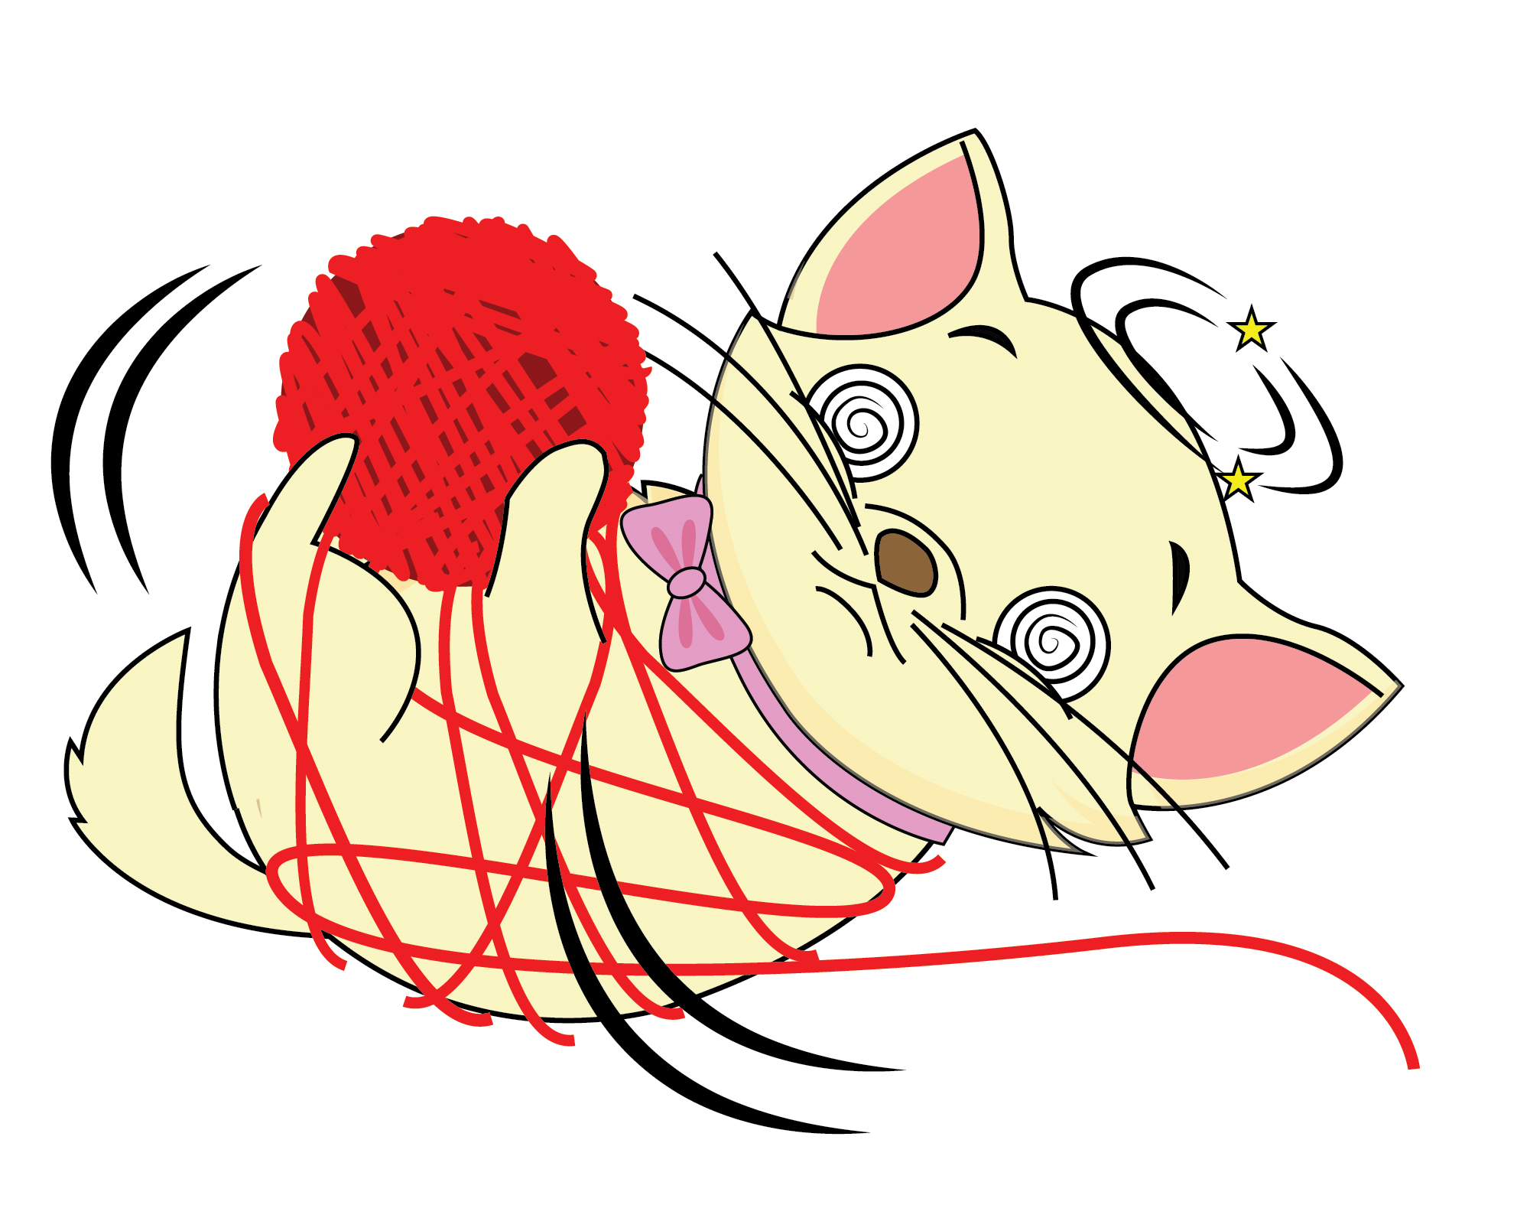

1
Listen and repeat.
Notes:
Ask students to talk about each animal by asking: Is the monkey funny?/…
Play the audio CD (CD2 Track 75) twice.
Teach the new words.
Ask students listen to the audio and repeat.

Slide 11
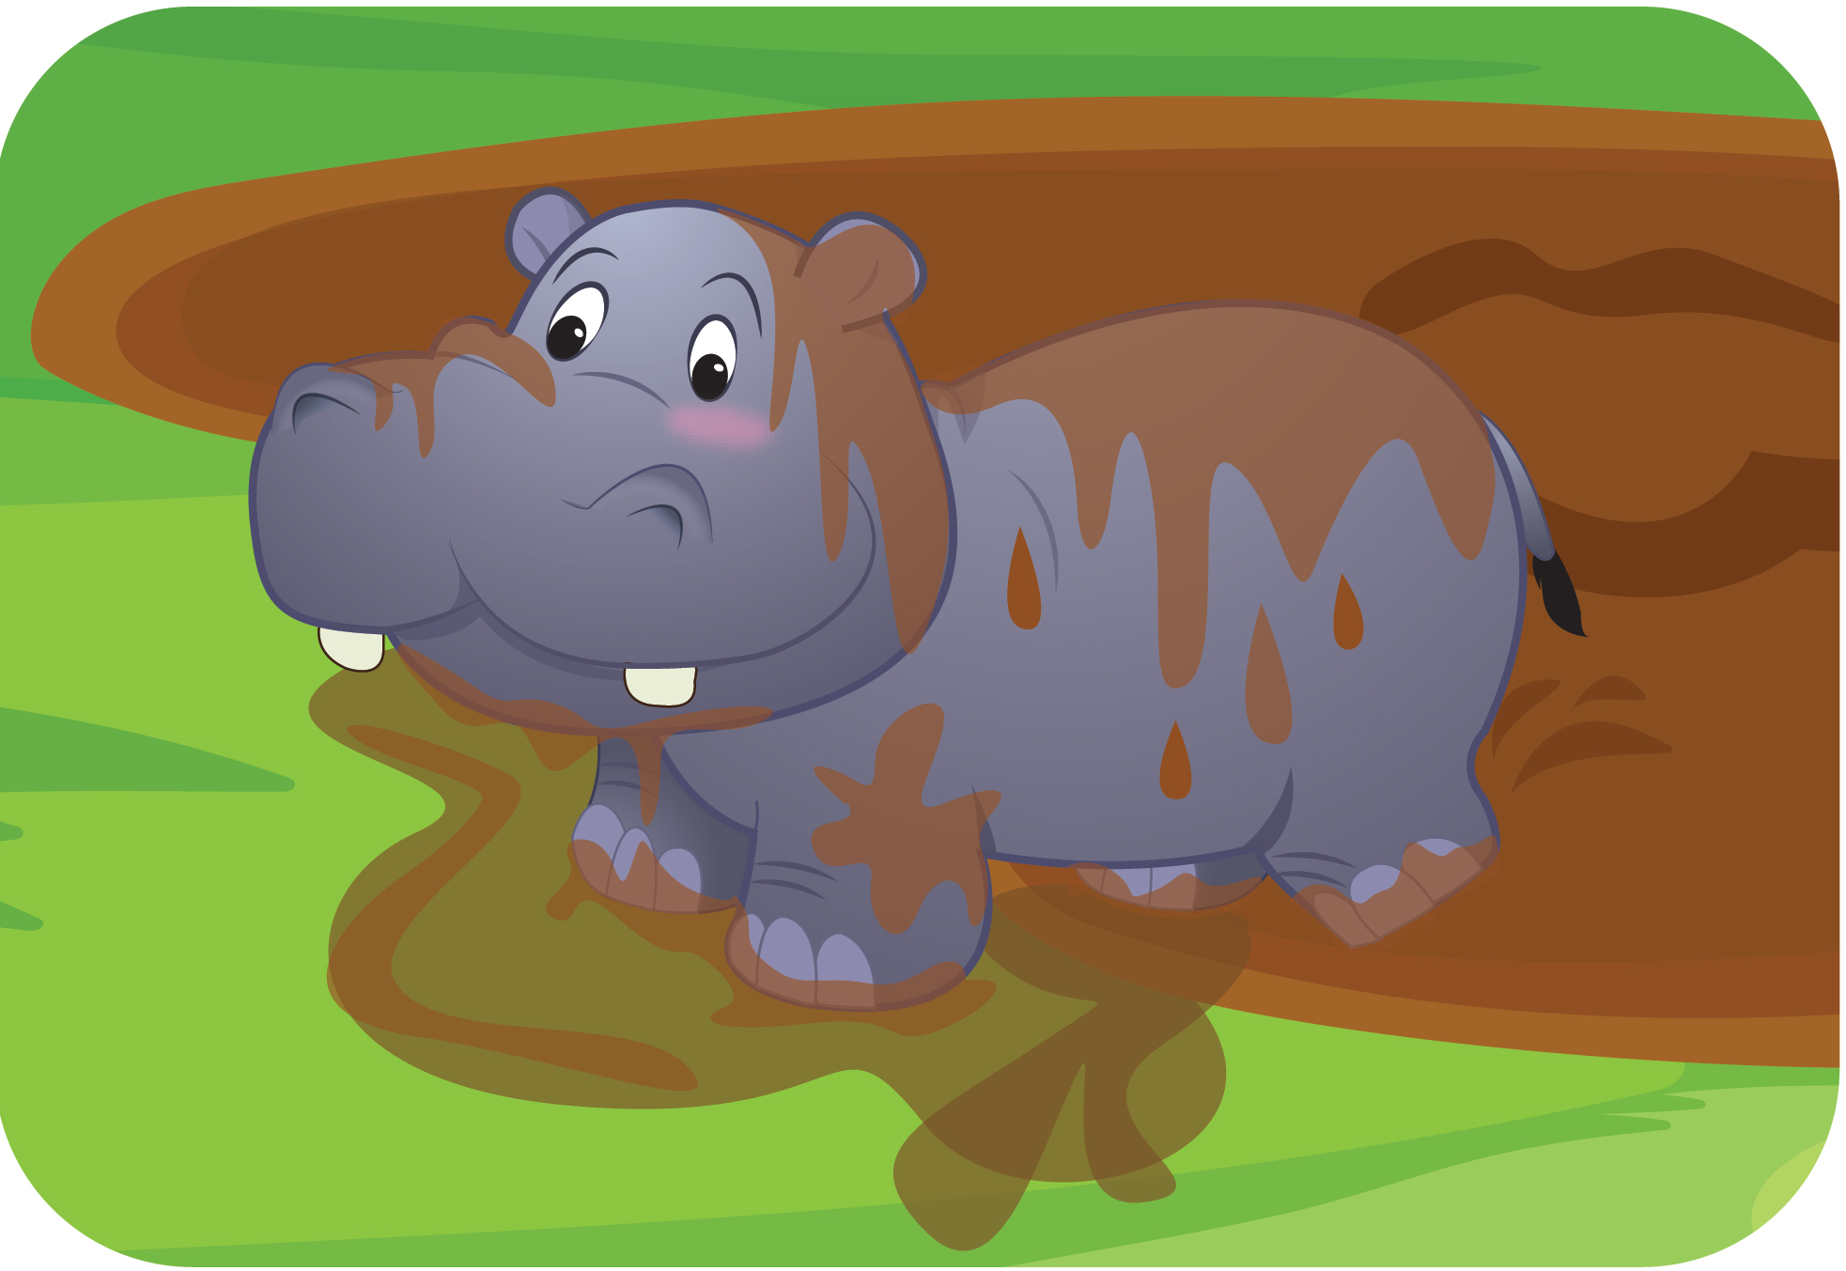

1
Listen and repeat.
Notes:
Ask students to talk about each animal by asking: Is the monkey funny?/…
Play the audio CD (CD2 Track 75) twice.
Teach the new words.
Ask students listen to the audio and repeat.

Slide 12
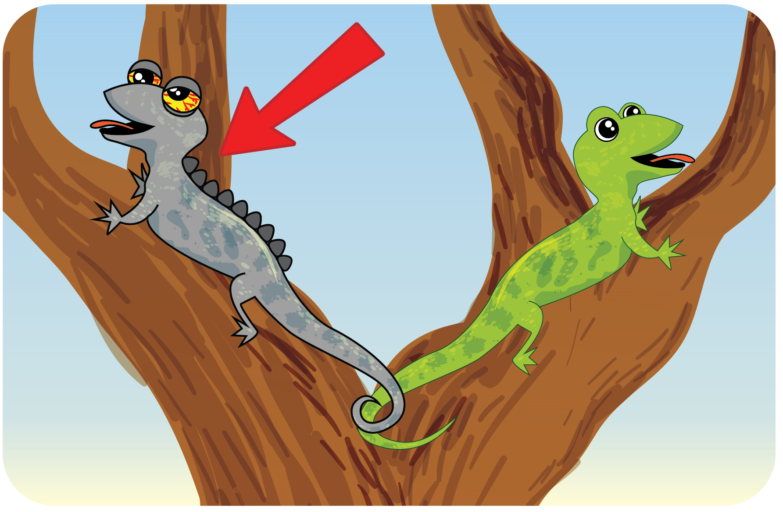

1
Listen and repeat.
Notes:
Ask students to talk about each animal by asking: Is the monkey funny?/…
Play the audio CD (CD2 Track 75) twice.
Teach the new words.
Ask students listen to the audio and repeat.

Slide 13


1
Listen and repeat.
Notes:
Ask students to talk about each animal by asking: Is the monkey funny?/…
Play the audio CD (CD2 Track 75) twice.
Teach the new words.
Ask students listen to the audio and repeat.

Slide 14
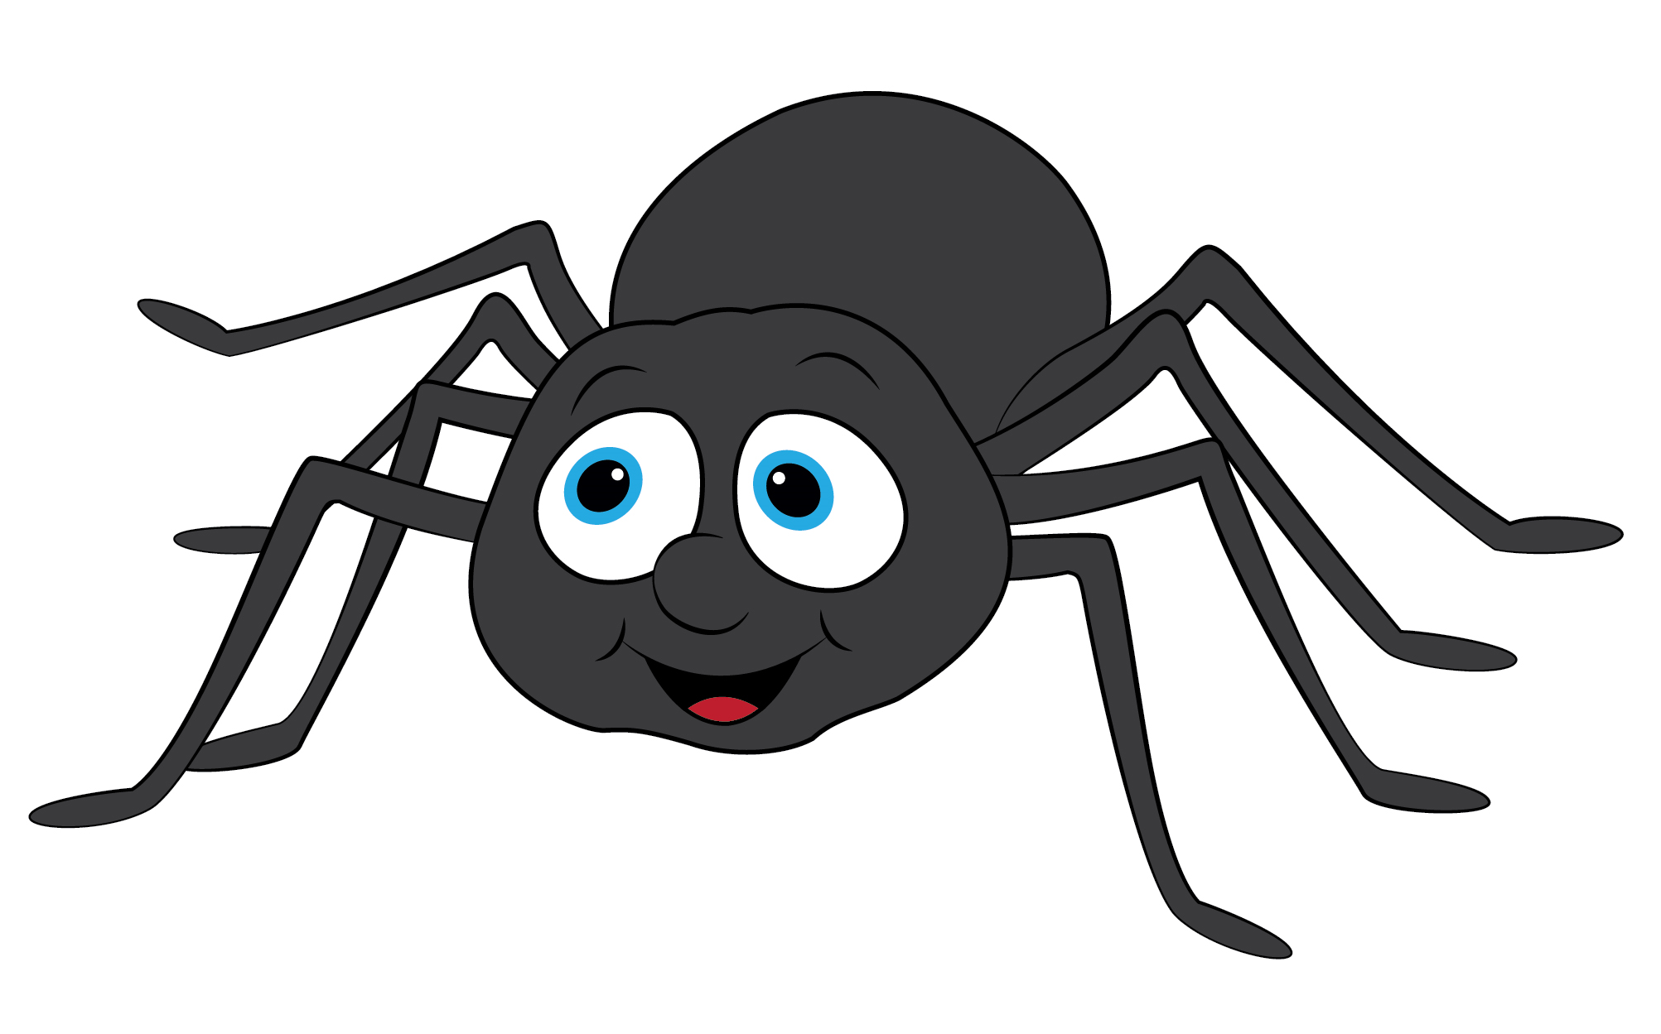

1
Listen and repeat.
Notes:
Ask students to talk about each animal by asking: Is the monkey funny?/…
Play the audio CD (CD2 Track 75) twice.
Teach the new words.
Ask students listen to the audio and repeat.

Slide 15
1
Listen and repeat.
Notes:
Ask students practice in pairs, one point and one say aloud the words.

Slide 16

GAME: Challenging!
Notes:
Challenging!
Teacher uses the flascards of the new words they have leant. Students play in groups. Teacher goes first with any flashcard. Then the teacher calls one student from group 1 and shows another flascard, in 10 seconds, this student have to make a sentence with this word. If the student can make a correct sentence, his/her group get one point.

Slide 17
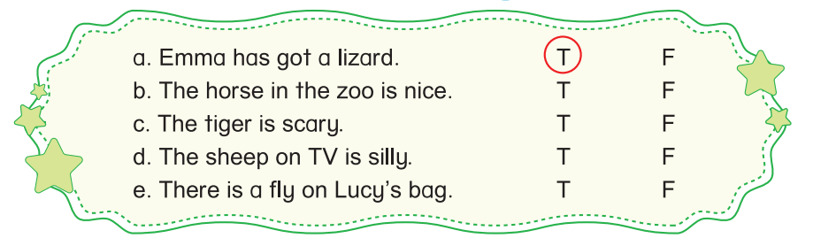
2
Listen and circle T (True) or F (False).
T
Notes:
Ask students to focus on Activity 2, look at the sentences.
Guide students to read and understand the sentences.
Tell students that they are going to listen and circle T if the sentences describe correctly compared to the dialogues. Otherwise, they circle F.
Model the task with sentence a.
Explain the example.
Play the audio twice for students to complete the task individually.
Ask students to work in pairs and share their answers with their partners.
Check the answers in whole class and have the class to say their positions.

Slide 18
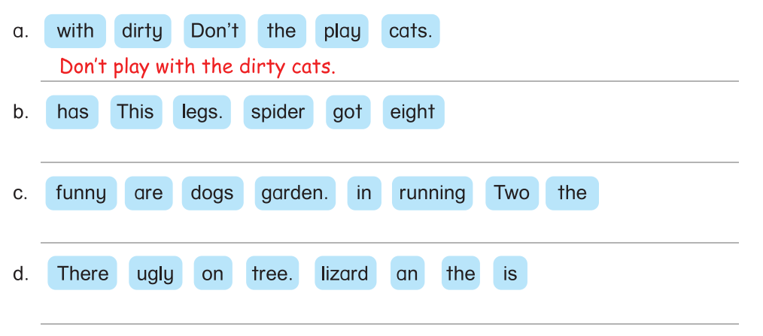
3
Unscramble the sentences.
This spider has got eight legs.
Two funny dogs are running in the garden.
There is an ugly lizard on the tree.
Notes:
Focus students on Activity 3.
Tell students that they are going to look at the given words then put them into the correct order.
Model the task with sentence a. Explain.
Give students time to do the task individually.
Ask students to check their answers in pairs before checking as in class.
Correct the answers with the whole class.

Slide 19


… Day … Month …. Date … Year
Unit 9: ANIMALS
Lesson 2. Period 1
Vocabulary
Funny
Scary
Silly
Dirty
Ugly
Spider
fly
Notes:
Review all the words they have learned by using flashcards.
Count the stars.
Give compliments.

Slide 20
WRAP UP
Notes:
Ask students practice in pairs, one point and one say aloud the words.

