Slide 1

Date : 4 April 2025
“Một số phương pháp gây hứng thú cho học sinh tiểu học thông qua bài hát tiếng Anh ngắn”
Cat Bi Primary School
Class : 3A5
Giáo viên: KHOA THỊ MAI ANH
1

Slide 2
Warm-up and review

Slide 3




Our toys
17
LESSON 2
Period 3

Slide 4
Look, listen and repeat.
1
1

Slide 5
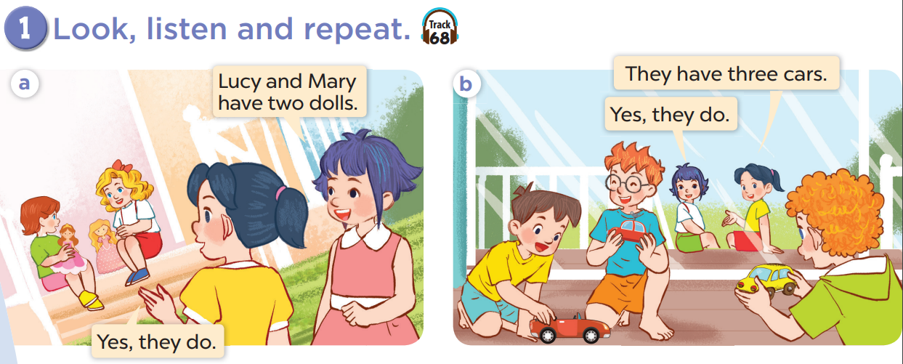

Slide 7
Listen, point and say.
2
2

Slide 8
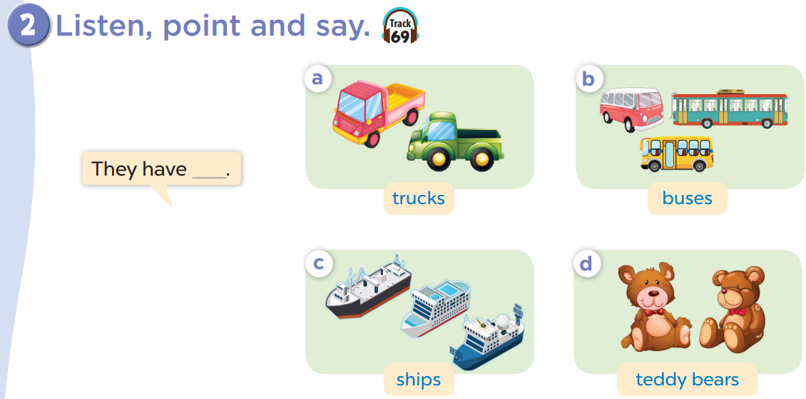

E-Flash card
Link: https://wordwall.net/resource/81107202

Slide 9




Guessing game

Slide 10
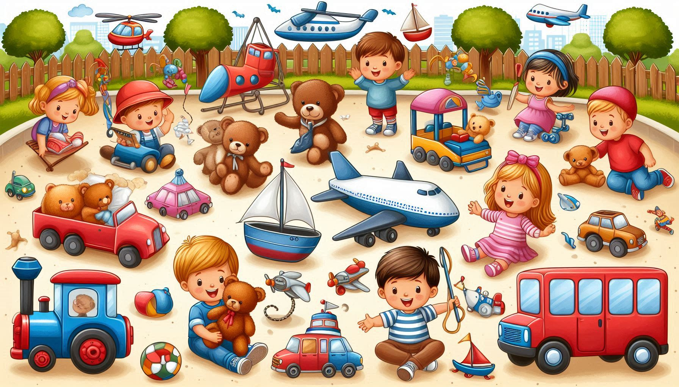
Their toys
Two trucks and three buses.
They have two trucks.
They have three buses.
Two teddy bears and three ships.
They have two teddy bears.
They have three ships.
Toys, toys.
They love toys. (Suno.com)

Slide 11
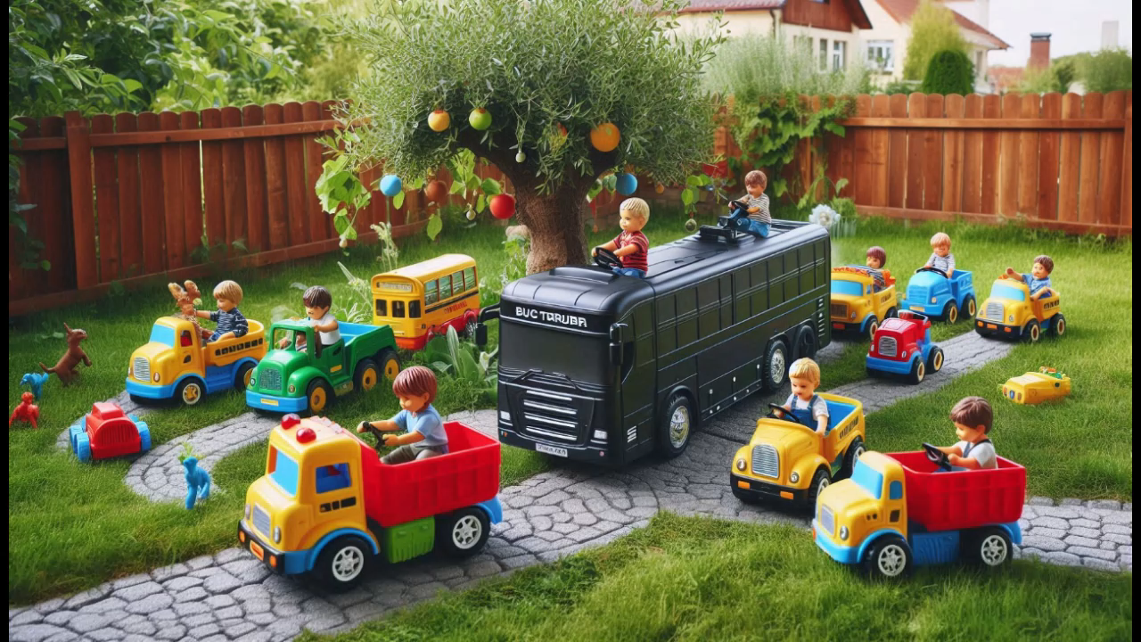

Slide 12
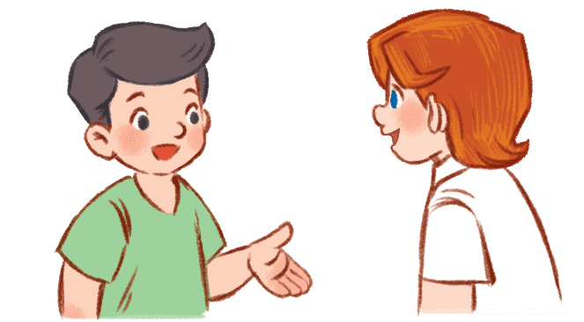
Let’s talk
4
4

Slide 13
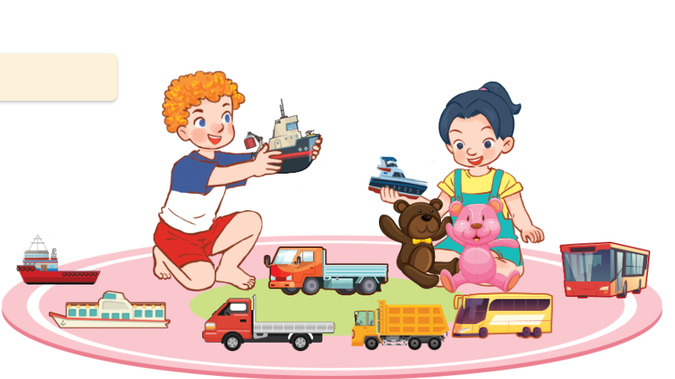
Talk about toys
Hello, I’m Bill. I love toys.
Look! I have a ship. It’s new. It’s slow.

Slide 14
Fun corner and wrap-up
5
5

Slide 15
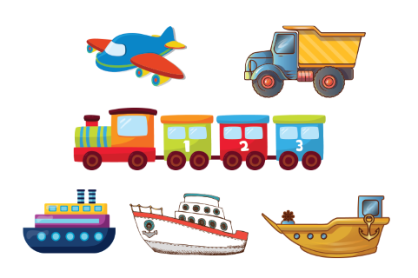
QUIZ time!!!
Link: https://www.plickers.com/classes/67e1153cc38bbc98a97c9399
Notes:
Step 1: Divide the class into 4 teams.
Step 2: Invite 1 pupil from each team to come to the board, look and choose the correct answer. If it is correct, give points for the teams.
Step 3: Encourage pupils to practice speaking English.
Step 4: Give points for pupils.

