Slide 2
1. Lan asked Hoang, “ Why don’t you come here to do project with me?”
A. Lan asked Hoang why didn’t he come there to do project with her
B. Lan asked Hoang why she didn’t come there to do project with her.
C. Lan asked Hoang why he didn’t come there to do project with her.
D. Lan asked Hoang why he didn’t come there to do project with me
2. She said: “What should I give my new neighbour at his house-warming party?”
A. She wondered what should she give her new neighbour at his house-warming party.
B. She wonders what to give my new neighbour at his house-warming party.
C. She wondered what gave her new neighbour at his house-warming party.
D. She wondered what to give her new neighbour at his house-warming party.

Slide 3
3: “Where can I borrow those reference books?” Trang asked.
A. Trang was not sure where can she borrow those reference books.
B. Trang was not sure where borrow those reference books.
C. Trang was not sure where can borrow those reference books.
D. Trang was not sure where to borrow those reference books

Slide 4



Unit
1
LOCAL COMMUNITY
LESSON 3: A CLOSER LOOK 2
1

Slide 5
She said: “What should I give my new neighbour at his house-warming party?”
->………………………………………………………………………
->………………………………………………………………………
3: “Where can I borrow those reference books?” Trang asked.
->
->
She wondered what she should give her new neighbour at his house-warming party
She wondered what to give her new neighbour at his house-warming party.
Trang was not sure where she could borrow those reference books.
. Trang was not sure where to borrow those reference books

Slide 6
ask, wonder, + who, what, where, when, or how + to-V……
(not) decide,
S + (not) tell,
(not) know
be (not) sure + whether +to-V….(or not.)
We use a question word such as who, what, where, when, or how before a to-infinitive to express an indirect question about what we should do. (When the both Subjects are the same)

Slide 7
PRACTICE
1
Fill in each blank with a suitable question word.
how
1. I don’t know ______ to deal with this problem.
2. My sister wondered ______ to buy the best cakes.
3. Could you tell me ______ to do to get on well with my new neighbours?
4. They asked ______ to take out the rubbish, at 5 or 6 p.m.
5. He can’t decide ______ to give his books to.
where
what
when
who

Slide 8
PRACTICE
2
Rewrite the sentences using question words + to-infinitives.
1. I don’t know how I can get to the swimming pool.
2. They are wondering where they can buy traditional handicrafts.
3. She asked what she should give to her new neighbour at his house-warming party?
I don’t know how to get to the swimming pool.
They are wondering where to buy traditional handicrafts.
She asked what to give to her new neighbour at his house-warming party.

Slide 9
PRACTICE
2
Rewrite the sentences using question words + to-infinitives.
4. I can’t decide who I should ask for advice.
5. Could you tell me when I have to pay the water bill?
I can’t decide who to ask for advice.
Could you tell me when to pay the water bill?

Slide 10
PHRASAL VERBS
– A phrasal verb consists of a verb and one or two particles, such as up, down, back, on, round, …
– A phrasal verb usually has a special meaning.
Example:
go out = leave your house to go to a social event
pass down = give or teach something to your children
cut down on = reduce the amount or number of something
run out of = have no more of

Slide 11
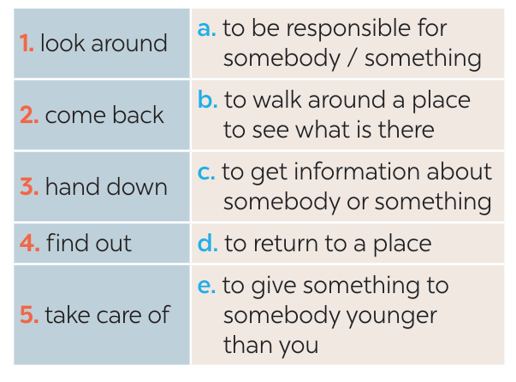
PRACTICE
3
Match each phrasal verb with its meaning.
1-b
2-d
3-e
4-c
5-a

Slide 12
PRACTICE
4
Complete each sentence using the correct form of a phrasal verb in 3.
came back
1. We _______________ from our home town last Saturday.
2. The artisans in my village usually _______________ their skills to their eldest children.
3. If you want to ______________ about our community, you can go to the local museum.
4. When we aren’t at home, our neighbour _____________ our cats.
5. Whenever I go to a new place, I spend time _____________.
hand down
find out
takes care of
looking around

Slide 13
1: Jimmy said: “How should we find a support center for the homeless?”
A. Jimmy wondered how we find a support center for the homeless.
B. Jimmy said how they found a support center for the homeless.
C. Jimmy wondered how to find a support center for the homeless.
D. Jimmy wondered how finding a support center for the homeless
2. “What should I do to stop arguing with my sister?” Linh wondered.
A. Linh wondered what doing to stop arguing with her sister.
B. Linh wondered what to do to stop arguing with her sister.
C. Linh wondered what she to do to stop arguing with her sister.
D. Linh wondered what should she do to stop arguing with her sister.
3:“What should I do to stop arguing with my sister?” Linh wondered.
A. Linh wondered what doing to stop arguing with her sister.
B. Linh wondered what she to do to stop arguing with her sister.
C. Linh wondered what to do to stop arguing with her sister.
D. Linh wondered what should she do to stop arguing with her sister.

Slide 14
4. “Should I tell my parents what I really think?” Peter asked.
Peter wondered whether to tell his parents what he really thinks.
B. Peter wondered whether should he tell his parents what he really thought.
C. Peter wondered if to tell his parents what he really thought.
D. Peter wondered whether to tell his parents what he really thought.
5. “Can we enter Angkor Wat after sunrise?”, they asked
A. They wanted to know whether we enter Angkor Wat after sunrise.
B. They wanted to know whether to enter Angkor Wat after sunrise.
C. They asked if they can enter Angkor Wat after sunrise.
D. They wanted to know could they enter Angkor Wat after sunrise.

Slide 15
1. Production methods in the village are normally passed ______ from ancestors to the younger generations.
A. up B. down C. away D. out
2. When we went to Sydney, we only had a couple of hours to look ______ the city.
around B. back C. out D. down
3. They need to ______ salt and sugary foods in their diets. They’re not good for their health.
cut down on B. keep up with C. speed up D. carry out
4. My sister will _______ a job in Ha Noi as soon as she graduates from university.
A. put up B. look after C. put on D. look for
6. She suggested eating out because they ________ rice and cooking ingredients.
A. found out B. passed down C. came down with D. ran out of

Slide 16
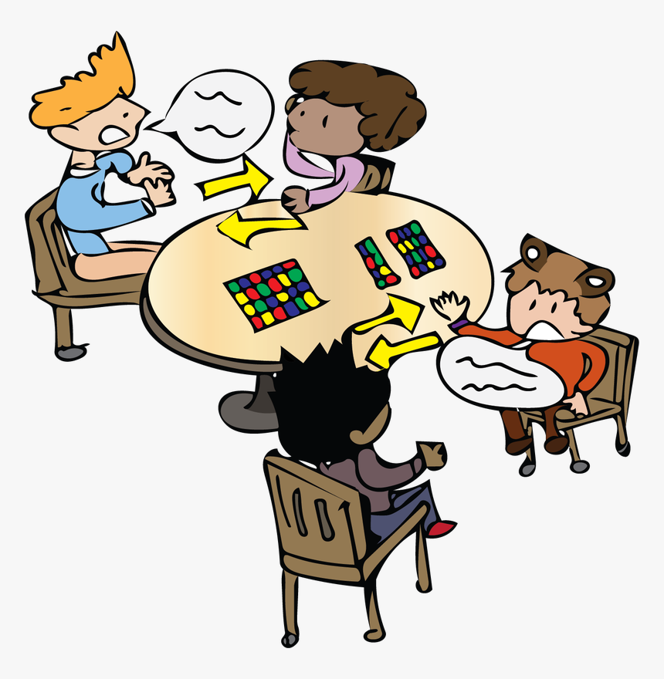
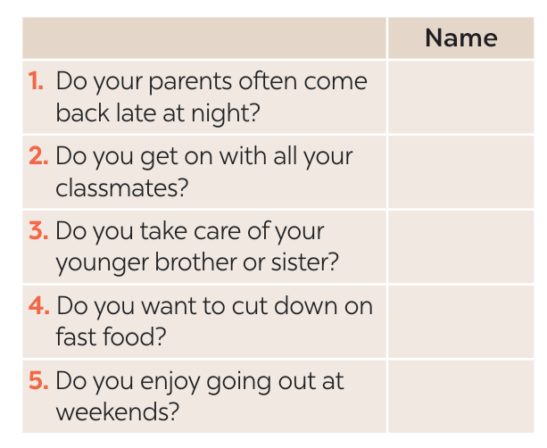
PRACTICE
5
Find someone who … Ask as many friends as you can the following questions. Then write their names in the table if they say “yes”.

