Slide 1
PGD & ĐT HUYỆN TIÊN LÃNG TRƯỜNG THCS ĐẠI THẮNG | CỘNG HOÀ XÃ HỘI CHỦ NGHĨA VIỆT NAM Độc lập - Tự do - Hạnh phúc
TIẾT THỰC HÀNH
MÔN: TIẾNG ANH
TIẾNG ANH 7 UNIT 8 LESSON 5 SKILLS 1 TIẾT 64
Giáo viên thực hiện : Nguyễn Trần Minh

Slide 2



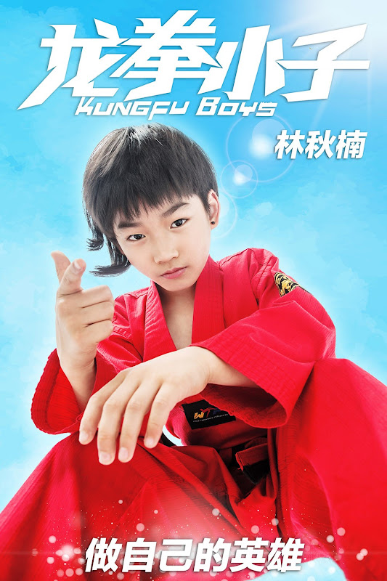
Unit
8
FILMS
LESSON 5: SKILLS 1
READING
SPEAKING

Slide 3


LESSON 5: SKILLS 1
WARM-UP
Game: Who is faster?

Slide 4

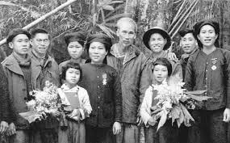
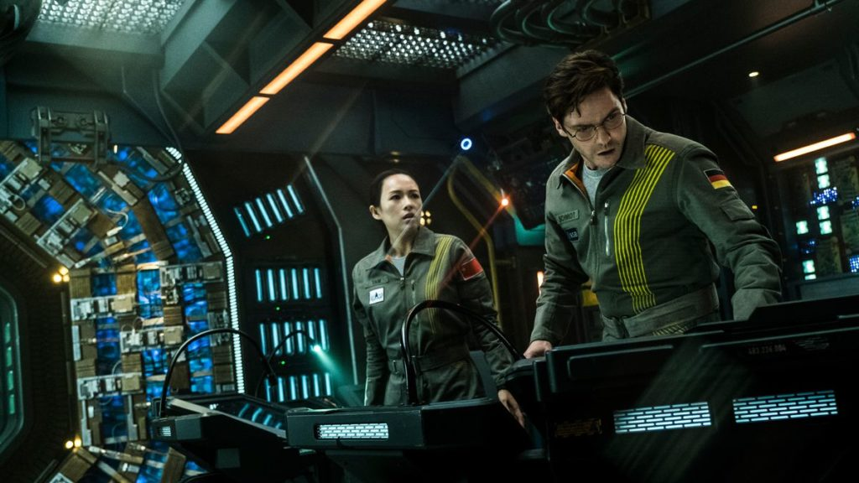
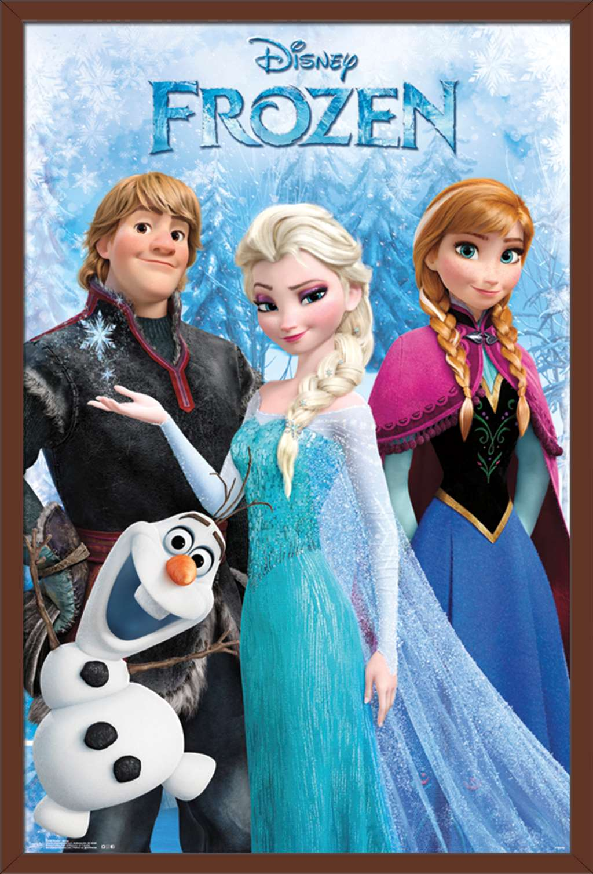
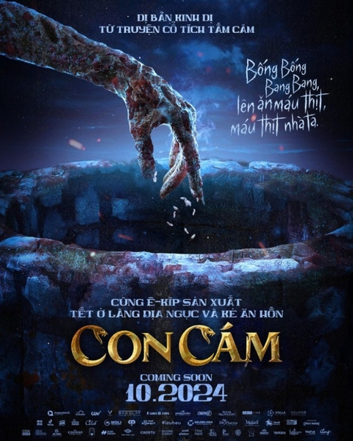
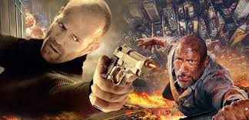
WARM-UP
Look at the posters, say the correct types of films.
1
documentary
4
Science fiction
6
fantasy
2
Animation/cartoon
3
Horror
5
Action

Slide 5

PRE-READING
1
Work in pairs. Discuss the following questions.
Do you like fantasies?
Why or why not?
fantasy

Slide 6
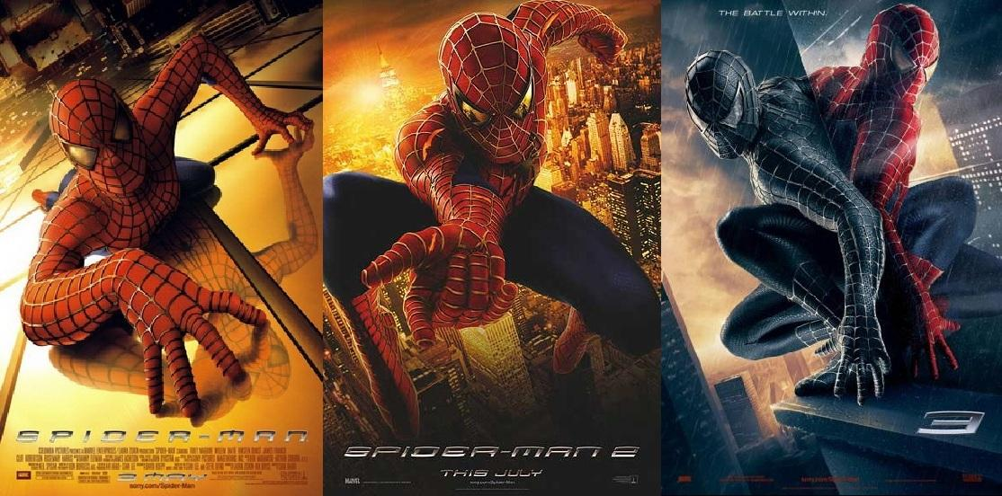
PRE-READING - VOCABULARY
series (n)
/'siəri:z/
chuỗi, loạt (phim dài tập)
Spiderman 1(2002)
Spiderman 3 (2007)
Spiderman 2(2004)

Slide 7
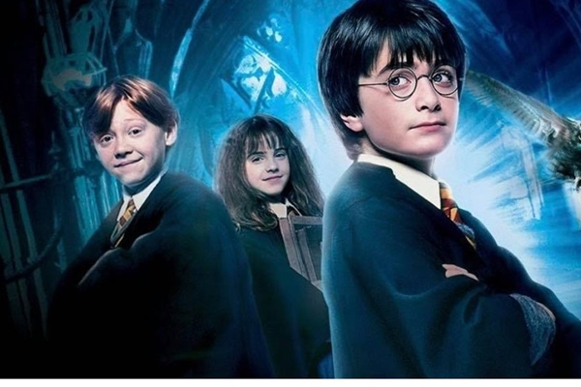
PRE-READING - VOCABULARY
wizard (n)
/'wizəd/
phù thủy, người có tài năng phi thường

Slide 8

PRE-READING - VOCABULARY
must-see (n)
/ˈmʌstˈsiː/
bộ phim đáng xem, nên xem

Slide 9
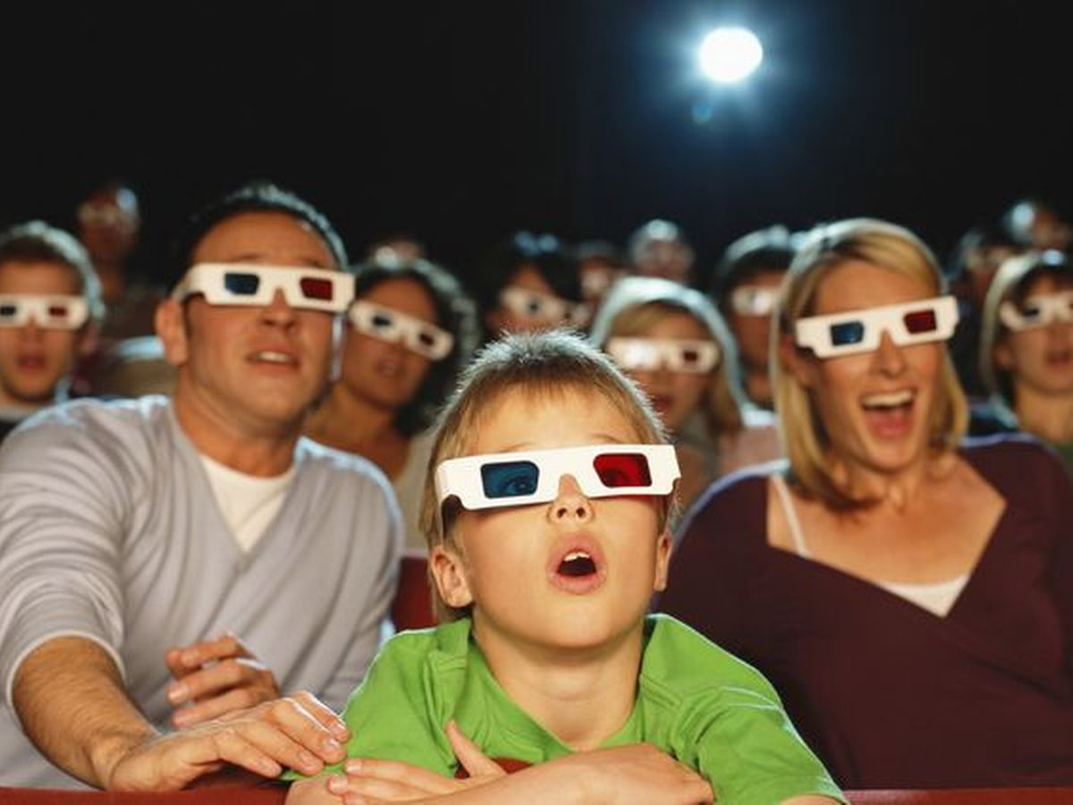
PRE-READING - VOCABULARY
gripping (adj)
/'gripiη/
cuốn hút, hấp dẫn

Slide 10
PRE-READING - VOCABULARY
 | Pronunciation | Meaning
series | /'siəri:z/ | chuỗi, loạt (phim dài tập)
wizard | /'wizəd/ | phù thủy, người có tài phi thường
must-see | /ˈmʌstˈsiː/ | bộ phim đáng xem, nên xem
gripping | /'gripiη/ | cuốn hút, hấp dẫn

Slide 11
2. Read the film review of Harry Potter and the Sorcerer's Stone on Mark's blog.
Match the words with their meanings.
Mon, Apr 20th
Harry Potter and the Sorcerer's Stone is a fantasy. Its director is Chris Columbus. It is the first of the Harry Potter film series.
Daniel Radcliffe is one of the stars in the film.
The film tells the story of Harry Potter. He's a powerful wizard. He is a student at a school for wizards and learns about himself, his family, and the bad things happening around him.
The film received a lot of good reviews. People say it's a must-see for teens. I agree because the story is gripping and the acting is excellent. The music is also amazing…
Words | Meanings
1. series | a. something that is so good that you think others should see it
2. wizard | b. related films that tell stories about the same characters
3. must-see | c. very exciting or interesting
4. gripping | d. a man who has magical powers

Slide 12

WHILE-READING
2
Match the words or phrases with their meanings.
Words | Meanings
1. series | a. something that is so good that you think others should see it
2. wizard | b. related films that tell stories about the same characters
3. must-see | c. very exciting or interesting
4. gripping | d. a man who has magical powers
1. b
2. d
3. a
4. c

Slide 13
WHILE-READING
3
Read Mark’s blog and answer the questions.
1. What kind of film is Harry Potter and the Sorcerer’s Stone?
2. Who is Daniel Radcliffe?
3. What is the film about?
4. What do people say about the film?

Slide 14
WHILE-READING
3
Read Mark’s blog and answer the questions.
1. What kind of film is Harry Potter and the Sorcerer’s Stone?
- Harry Potter and the Sorcerer’s Stone is a fantasy.

Slide 15
WHILE-READING
3
Read Mark’s blog and answer the questions.
2. Who is Daniel Radcliffe?
- Daniel Radcliffe is one of the stars in the film.

Slide 16
WHILE-READING
3
Read Mark’s blog and answer the questions.
3. What is the film about?
- The film tells the story of Harry Potter. He’s a powerful wizard. He is a student at a school for wizards and learns about himself, his family, and the bad things happening around him.

Slide 17
WHILE-READING
3
Read Mark’s blog and answer the questions.
4. What do people say about the film?
- People say it’s a must-see for teens.

Slide 18
SPEAKING
4
Look at the table. Work in pairs. Ask and answer questions about the film Kungfu Boy.
Film’s name | Kungfu Boy
Director | John Stevenson
Type of film | Comedy
Main actor / actress | Bruce Wane
Main content | About a very big boy who saves his town and becomes a hero
Reviews | Funny and interesting
Time | 4.30 p.m and 8.30 p.m daily
Place | Ngoc Khanh Cinema
Example:
A: How about seeing a film this evening?
B: That’s a great idea. What film shall we see?
A: Kungfu Boy.
B: What kind of film is it?
A: __________________

Slide 19
Marking criteria ( 10 points)
PRODUCTION (Post-Read & Speak)
5.
Work in groups. Take turns to talk about the film Kungfu Boy.
Film’s name | Kungfu Boy
Director | John Stevenson
Type of film | Comedy
Main actor / actress | Bruce Wane
Main content | About a very big boy who saves his town and becomes a hero
Reviews | Funny and interesting
Time | 4.30 p.m and 8.30 p.m daily
Place | Ngoc Khanh Cinema
1. Vocabulary accuracy: 2
2. Pronunciation accuracy : 2
3.Grammar accuracy : 2
4. speaking fluency : 2
5. Performance : 2

Slide 20
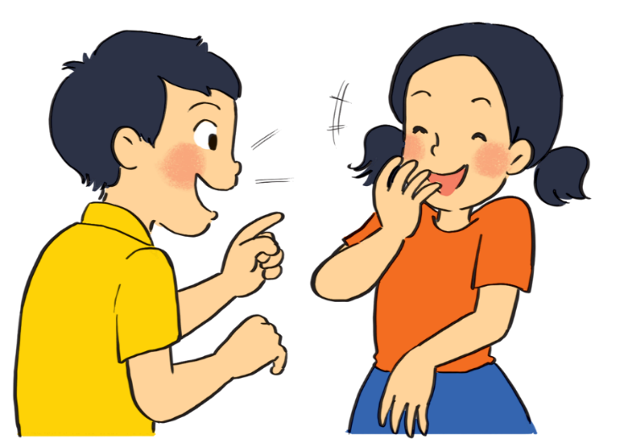
PRODUCTION (Post-Read & Speak)
5
Work in groups. Take turns to talk about the film Kungfu Boy.
Eg:
Kungfu Boy is on at … at … p.m.
It’s (an) … about …
Kungfu Boy is on at ………Cinema at ….. p.m and ….. p.m. It's a ……… about a very …….who ……. his town and …….. a hero. It …….. Bruce Wane and was directed by ………. People ….. that it is very ………………and ……………...

Slide 21
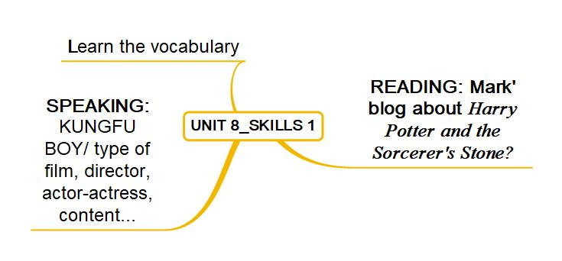

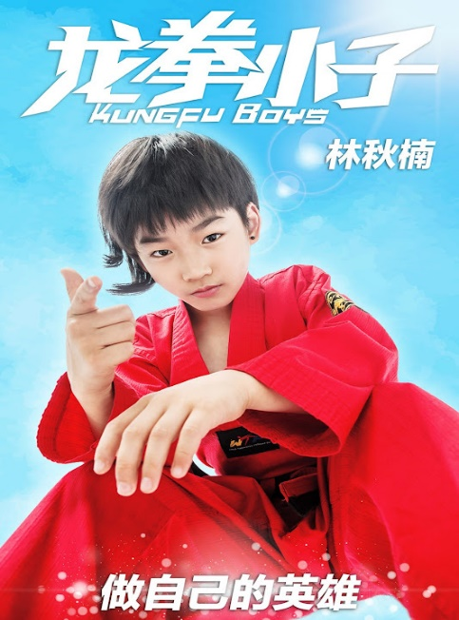
CONSOLIDATION
1
Wrap-up
s

Slide 22

CONSOLIDATION
2
Homework
Prepare for the next : UNIT 8_SKILLS 2
Choose one of your favourite films:
– name of the film
– type of film
– its director and main actors / actresses
– a short summary
– your overall opinion about the film
– the showtime and cinema
– pictures or photos to illustrate the film

