Slide 1

Warmly welcome all the teachers and students
Teacher: Nguyen Thi Phuong Thao
Doan Lap Lower Secondary School

Slide 2

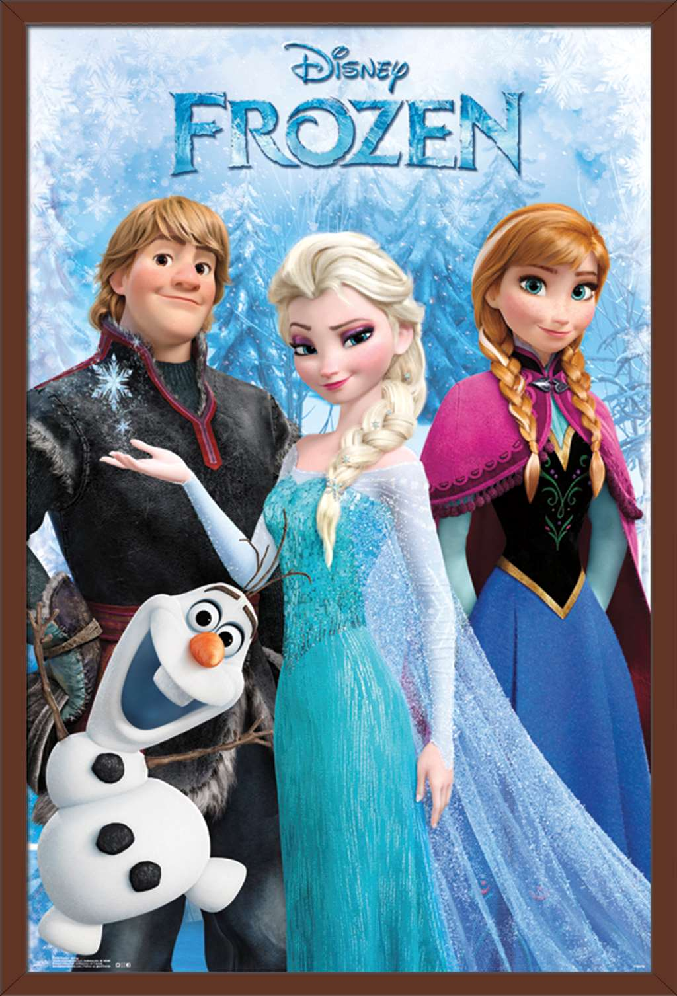
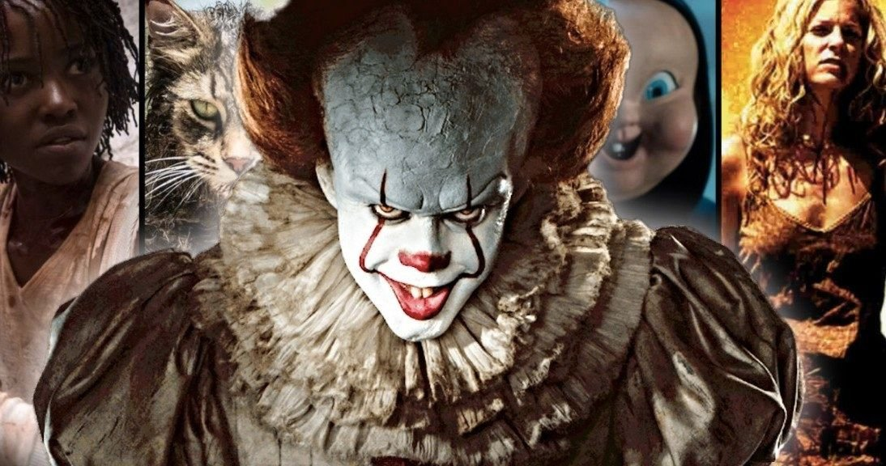
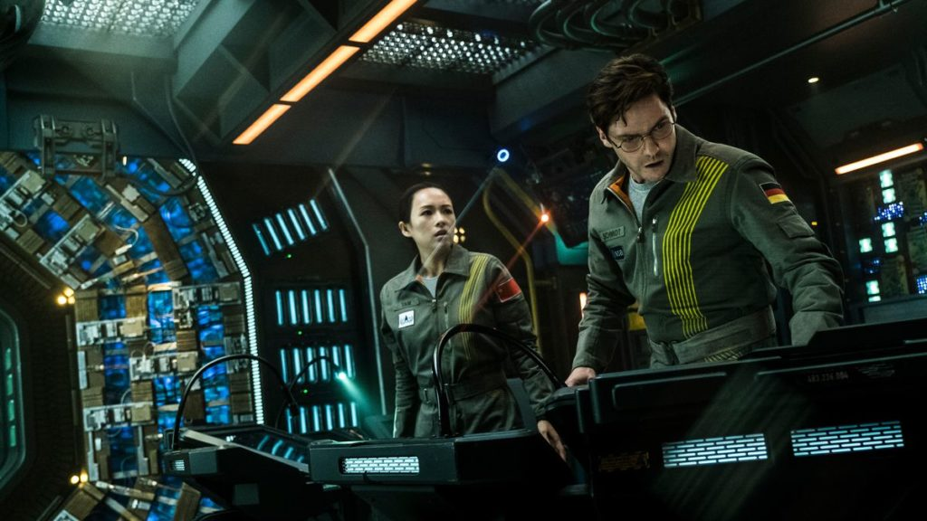
Look at the pictures, say the correct types of films.
1
2
3
animation
horror film
science fiction film

Slide 3

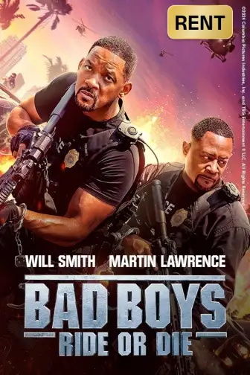
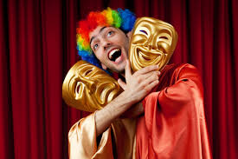

Look at the pictures, say the correct types of films.
4
5
6
comedy
fantasy
action film

Slide 4

Do you like fantasies?
Why or why not?

Slide 5



UNIT 8: films
Period 66 - Lesson 5: Skills 1

Slide 6
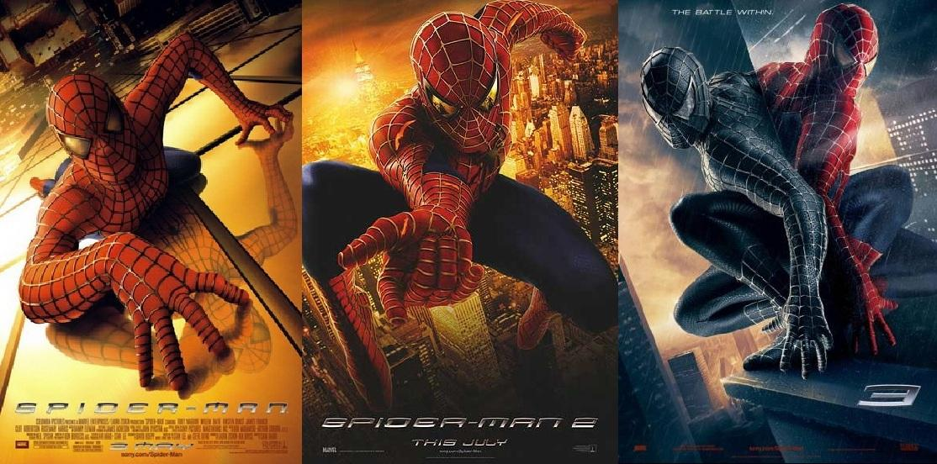

series (n)
/'siəri:z/
chuỗi, loạt (phim dài tập)

Slide 7
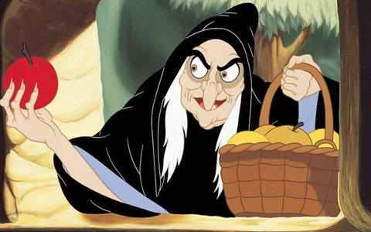
wizard (n)
/'wizəd/
phù thủy, người có tài phi thường

Slide 8

must-see (adj)
/ˈmʌstˈsiː/
đáng xem, nên xem

Slide 9
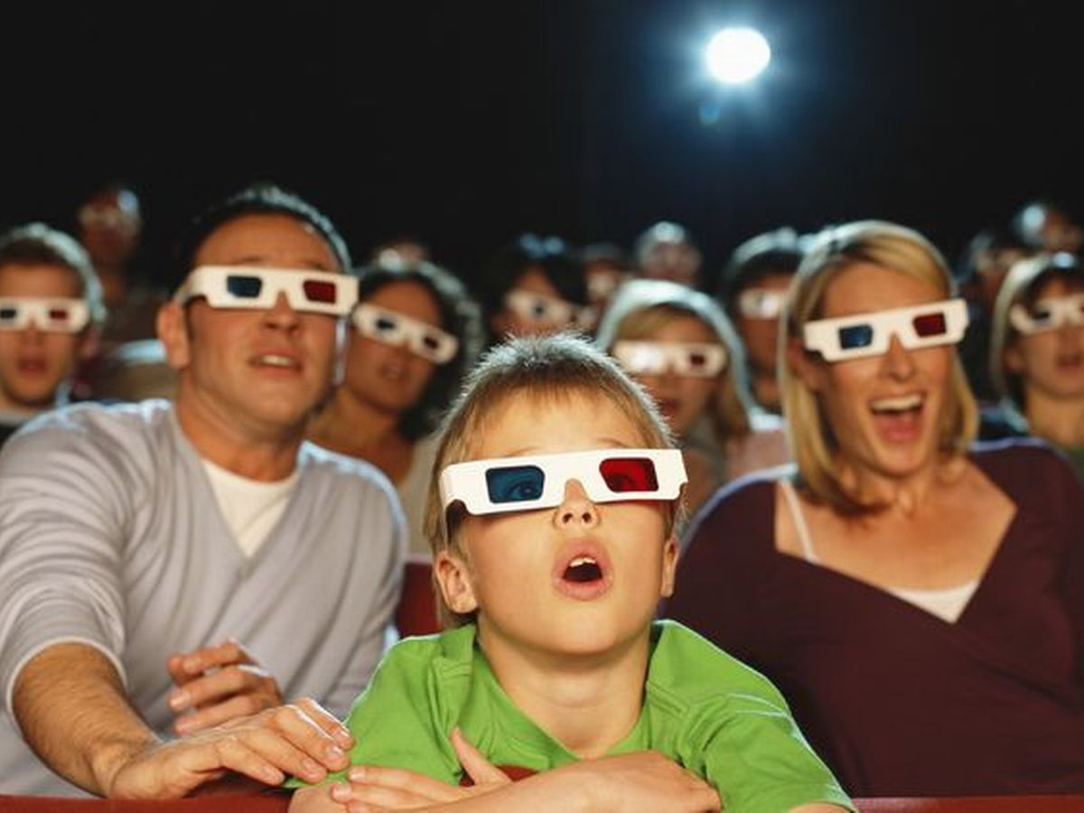
gripping (adj)
/'gripiη/
cuốn hút, hấp dẫn

Slide 10
VOCABULARY
series /'siəri:z/ (n): chuỗi, loạt (phim dài tập)
wizard /'wizəd/ (n): phù thuỷ/ người có tài phi thường
must-see /ˈmʌst-siː/: bộ phim đáng xem/ nên xem
gripping /'gripiη/: cuốn hút, hấp dẫn

Slide 11
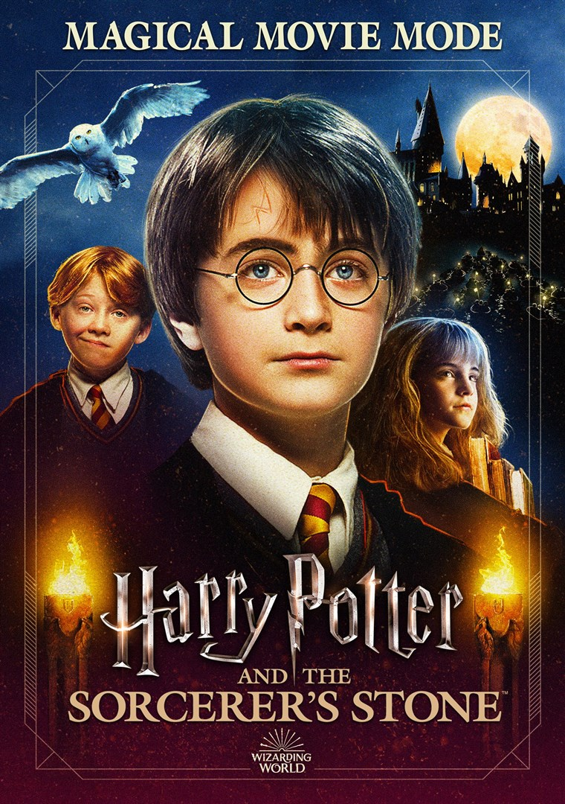
Match the words with their meanings.
Words | Meanings
1. series | a. something that is so good that you think others should see it
2. wizard | b. related films that tell stories about the same characters
3. must-see | c. very exciting or interesting
4. gripping | d. a man who has magical powers
1. b
2. d
3. a
4. c

Slide 12

Task 3: Read Mark's blog and answer the questions.
Mon, Apr 20th
Harry Potter and the Sorcerer's Stone is a fantasy. Its director is Chris Columbus. It is the first of the Harry Potter film series.
Daniel Radcliffe is one of the stars in the film.
The film tells the story of Harry Potter. He's a powerful wizard. He is a student at a school for wizards and learns about himself, his family, and the bad things happening around him.
The film received a lot of good reviews. People say it's a must-see for teens. I agree because the story is gripping and the acting is excellent. The music is also amazing.
Although Harry Potter and the Sorcerer's Stone is a little frightening at times, it is very interesting and full of action. Go and see it if you can.
Posted by Mark at 5.30 p.m.
1. What kind of film is Harry Potter and the Sorcerer’s Stone?
2. Who is Daniel Radcliffe?
3. What is the film about?
4. What do people say about the film?

Slide 13
Task 3: Read Mark’s blog and answer the questions.
What kind of film is Harry Potter and the Sorcerer’s Stone?
2. Who is Daniel Radcliffe?
3. What is the film about?
4. What do people say about the film?

Slide 14
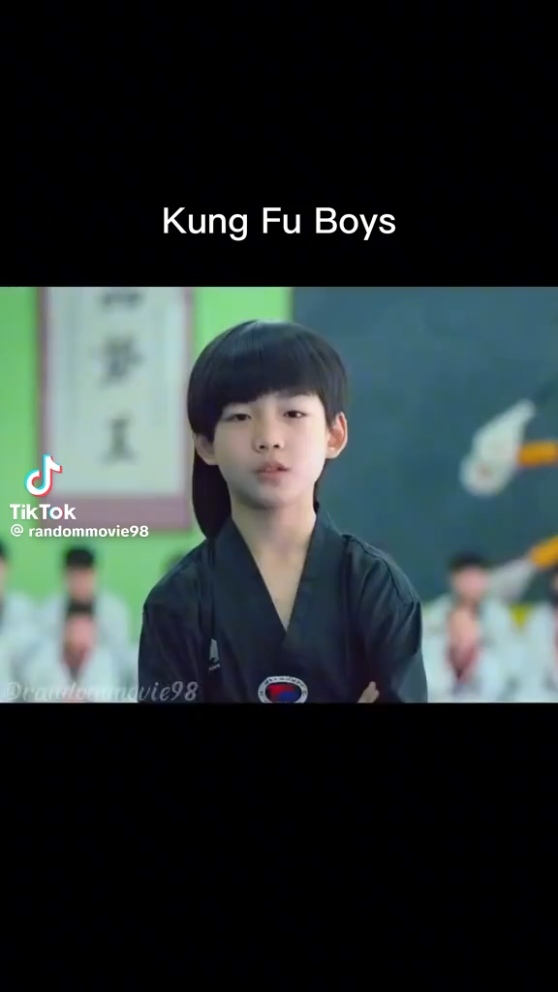

Slide 15

SPEAKING

Slide 16
Task 4: Look at the table. Work in pairs. Ask and answer questions about the film Kungfu Boy.
Example: A: How about seeing a film this evening? B: That’s a great idea. What film shall we see? A: Kungfu Boy. B: What kind of film is it?
A: __________________
B: Who stars in it?
A: __________________
B: What’s it about?
A: __________________
B: What are the reviews like?
A: __________________
B: What time is the film on?
A: __________________
B: Where shall we see?
A: __________________
Film’s name | Kungfu Boy
Director | John Stevenson
Type of film | Comedy
Main actor / actress | Bruce Wane
Main content | About a very big boy who saves his town and becomes a hero
Reviews | Funny and interesting
Time | 4.30 p.m and 8.30 p.m daily
Place | Ngoc Khanh Cinema

Slide 17
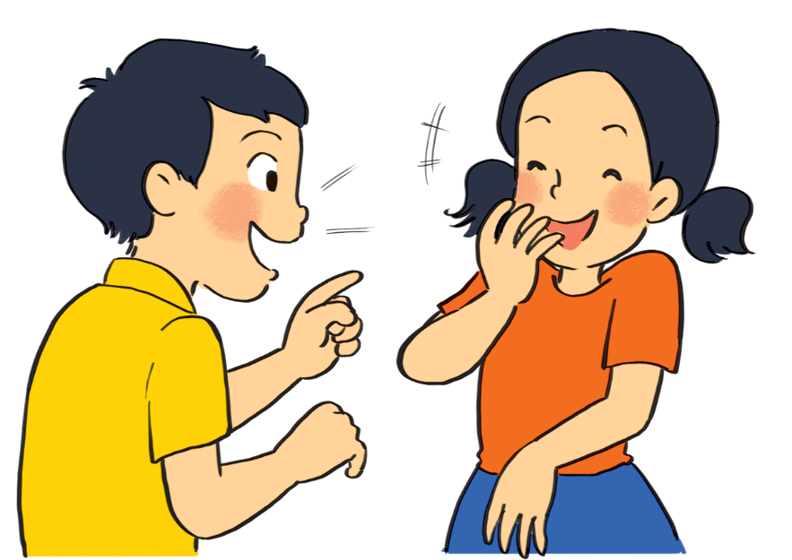
Task 5: Work in groups. Take turns to talk about the film Kungfu Boy.
Film’s name | Kungfu Boy
Director | John Stevenson
Type of film | Comedy
Main actor / actress | Bruce Wane
Main content | About a very big boy who saves his town and becomes a hero
Reviews | Funny and interesting
Time | 4.30 p.m and 8.30 p.m daily
Place | Ngoc Khanh Cinema
Example: Kungfu Boy is on at … at … p.m.
It’s (an) … about …

Slide 18
CRITERIA FOR SPEAKING
Criteria |  | Point(s)
Content | His/her name | 1
 | The sport he/she plays | 1
 | Why he/she is famous | 2
 | You like him/her or not Explain why ... | 2
Pronunciation | Pronunciation Intonation | 2
Grammar | Use present simple and past simple tense | 2
Total |  | 10

Slide 19
Task 5: Work in groups. Take turns to talk about the film Kungfu Boy.
Film’s name | Kungfu Boy
Director | John Stevenson
Type of film | Comedy
Main actor / actress | Bruce Wane
Main content | About a very big boy who saves his town and becomes a hero
Reviews | Funny and interesting
Time | 4.30 p.m and 8.30 p.m daily
Place | Ngoc Khanh Cinema
Example: Kungfu Boy is on at … at … p.m.
It’s (an) … about …

Slide 20

Choose one of your favourite films:
– name of the film – type of film – its director and main actors/ actresses – a short summary – your overall opinion about the film – the showtime and cinema – pictures or photos to illustrate the film

Slide 21
Home assignment:
- Learn by heart the new words.
- Do exercise part D – Task 1,2,3 in workbook.

Slide 22


