Slide 2
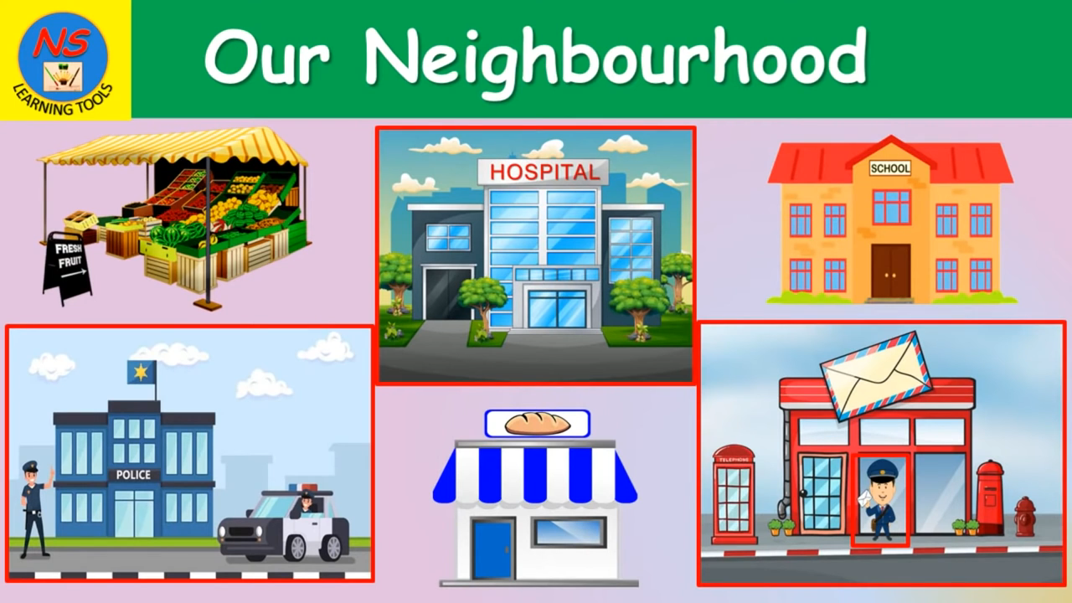
Watch a video and write down the places and the activities to go there.

Slide 3
1. supermarket
Answer:
8. bakery
2. hospital
9. Fruit and vegetables shop
3. market
4. hospital
10. Fire station
11. library
5. school
12. park
6. Police station
13. pharmacy
7. bank
14. cinema

Slide 4
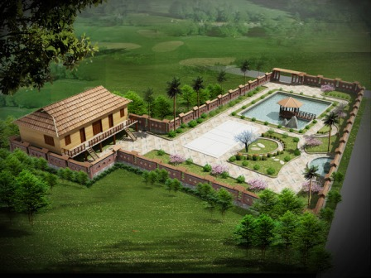
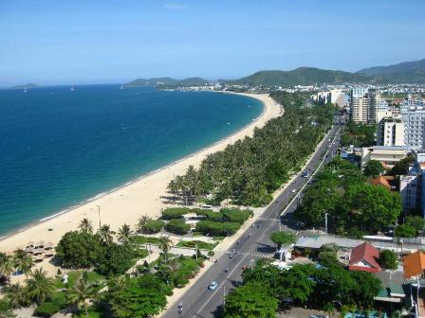
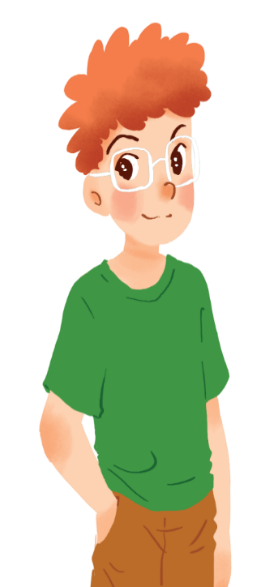
Khang
1.Where is Khang’s neighbourhood ?
2.What do you think about it? Is it beautiful?
3.Does Khang like his neighborhood?

Slide 5

Read Khang’s blog. Look at the words in the box, then find them in the text and underline them. What do they mean?
suburbs
dislike
outdoor

Slide 6





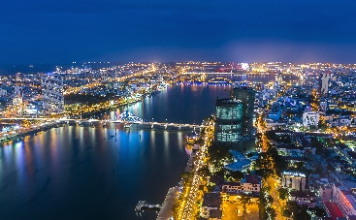
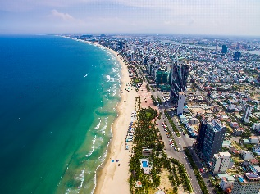
http://www.myblog.com.vn/Khang
KHANG’S BLOG
Friday, December 23rd ...
MY NEIGHBOURHOOD
I live in the suburbs of Da Nang City. There are many things I like about my neighbourhood.
It’s great for outdoor activities because it has beautiful parks, sandy beaches and fine weather. There’s almost everything I need here: shops, restaurants, and markets. The people here are friendlier, and the food is better than in other places.
However, there are two things I dislike about it: there are many modern buildings and offices; and the streets are busy and crowded.
suburbs
outdoor
dislike
Posted by Khang at 4:55 PM

Slide 7
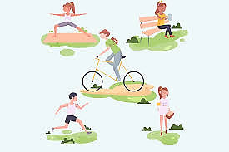

Outdoor activities:
hoạt động ngoài trời
/ ˈaʊtdɔː/
/ ækˈtɪvəti /

Slide 8
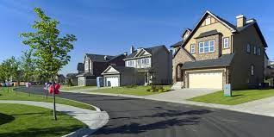
Suburb (n):
ngoại ô thành phố
/ ˈsʌbɜːb /

Slide 9

dislike (n):
không thích
/ dɪsˈlaɪk /

Slide 10
Read Khang’s blog again. Then answer the questions.
1.
Where is Khang’s neighbourhood?
It is in the suburbs of Da Nang City.
2.
Why is his neighbourhood great for outdoor activities?
Because it has beautiful parks, sandy beaches and fine weather.
3.
What are the people in his neighbourhood like?
They are very friendly.
4.
How are the streets in his neighbourhood?
They are busy and crowed.

Slide 11
http://www.myblog.com.vn/Khang
KHANG’S BLOG
Friday, December 23rd ...
MY NEIGHBOURHOOD
I live in the suburbs of Da Nang City. There are many things I like about my neighbourhood.
It’s great for outdoor activities because it has beautiful parks, sandy beaches and fine weather. There’s almost everything I need here: shops, restaurants, and markets. The people here are friendlier, and the food is better than in other places.
However, there are two things I dislike about it: there are many modern buildings and offices; and the streets are busy and crowded.
Posted by Khang at 4:55 PM

Slide 12
http://www.myblog.com.vn/Khang
KHANG’S BLOG
Friday, December 23rd ...
MY NEIGHBOURHOOD
I live in the suburbs of Da Nang City. There are many things I like about my neighbourhood.
It’s great for outdoor activities because it has beautiful parks, sandy beaches and fine weather. There’s almost everything I need here: shops, restaurants, and markets. The people here are friendlier, and the food is better than in other places.
However, there are two things I dislike about it: there are many modern buildings and offices; and the streets are busy and crowded.
Posted by Khang at 4:55 PM

Slide 13
http://www.myblog.com.vn/Khang
KHANG’S BLOG
Friday, December 23rd ...
MY NEIGHBOURHOOD
I live in the suburbs of Da Nang City. There are many things I like about my neighbourhood.
It’s great for outdoor activities because it has beautiful parks, sandy beaches and fine weather. There’s almost everything I need here: shops, restaurants, and markets. The people here are friendlier, and the food is better than in other places.
However, there are two things I dislike about it: there are many modern buildings and offices; and the streets are busy and crowded.
Posted by Khang at 4:55 PM

Slide 14
http://www.myblog.com.vn/Khang
KHANG’S BLOG
Friday, December 23rd ...
MY NEIGHBOURHOOD
I live in the suburbs of Da Nang City. There are many things I like about my neighbourhood.
It’s great for outdoor activities because it has beautiful parks, sandy beaches and fine weather. There’s almost everything I need here: shops, restaurants, and markets. The people here are friendlier, and the food is better than in other places.
However, there are two things I dislike about it: there are many modern buildings and offices; and the streets are busy and crowded.
Posted by Khang at 4:55 PM

Slide 15
http://www.myblog.com.vn/Khang
KHANG’S BLOG
Friday, December 23rd ...
MY NEIGHBOURHOOD
I live in the suburbs of Da Nang City. There are many things I like about my neighbourhood.
It’s great for outdoor activities because it has beautiful parks, sandy beaches and fine weather. There’s almost everything I need here: shops, restaurants, and markets. The people here are friendlier, and the food is better than in other places.
However, there are two things I dislike about it: there are many modern buildings and offices; and the streets are busy and crowded.
Posted by Khang at 4:55 PM

Slide 16
Read Khang’s blog again and fill the table with the information.
LIKES | DISLIKES
beautiful parks
modern buildings and offices
sandy beaches
busy and crowed streets
fine weather
shops, restaurant, markets
friendly people
good food

Slide 17
There are many things that Khang likes about his neighborhood:
The parks __________________________________________
The people _________________________________________
The weather ________________________________________
The beaches ________________________________________
The food ___________________________________________
__________________________________________________
There are two things that Khang dislikes about his neighborhood:
The streets __________________________________________
The buildings and offices_______________________________

Slide 18
Make notes about your neighbourhood.
Think about what you like / dislike about it.
LIKES | DISLIKES

Slide 19
Work in pairs. Ask and answer about what you like and dislike about your neighbourhood.
Example:
A: Where do you live?
the suburbs of Da Nang City.
B: I live in ________________________
A: What do you like about it?
The weather is fine. The people are friendly
and the food is good.
B: ________________________________
A: What do you dislike about it?
B: _______________________________
The streets are busy and crowded.

Slide 20
There are many things that I like about my neighborhood:
The parks __________________________________________
The people _________________________________________
The weather ________________________________________
The beaches ________________________________________
The food ___________________________________________
__________________________________________________
There are two things that I dislike about my neighborhood:
The streets __________________________________________
The buildings and offices_______________________________

Slide 21

AT HOME
-Write your blog talk about what you like and don’t like about your neighbourhood.
- Do exercise part D1,2,3 in workbook.
- Prepare Unit 4 Lesson 5 Skills 2.

