Slide 1

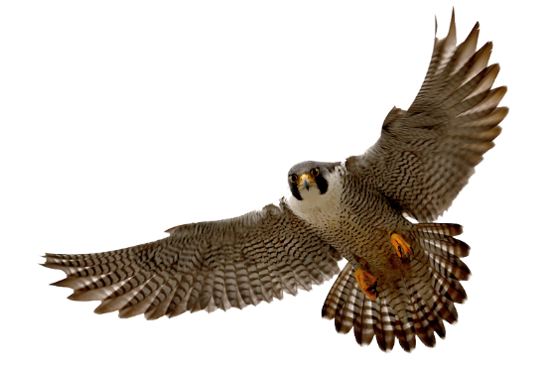
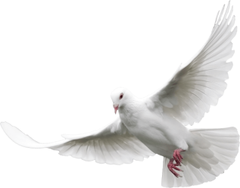


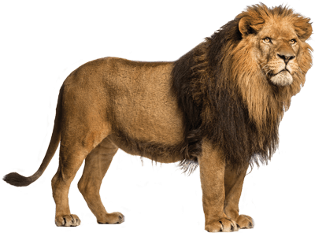
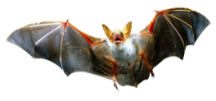
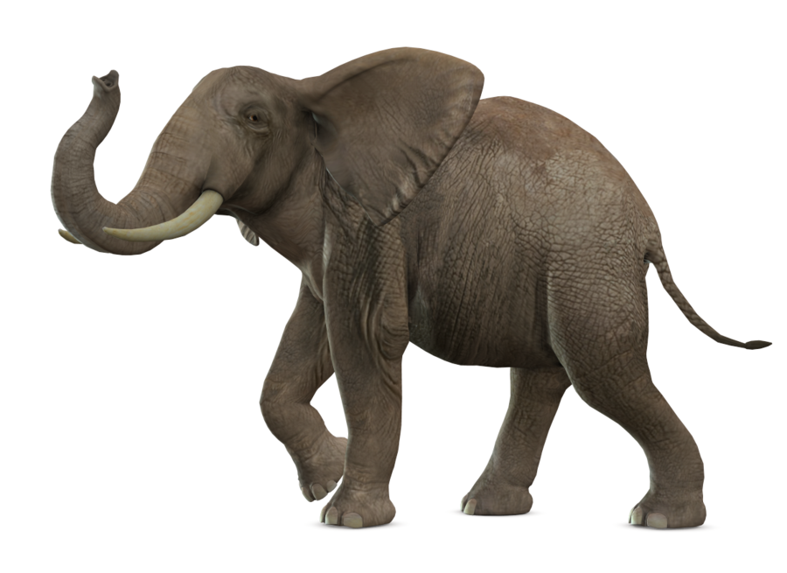
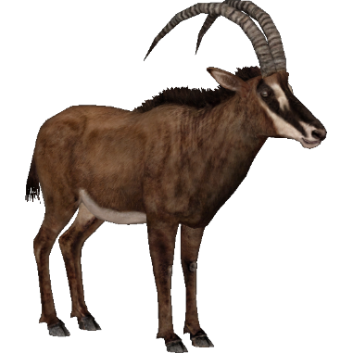
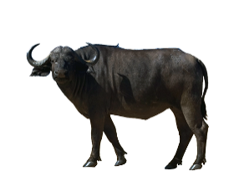
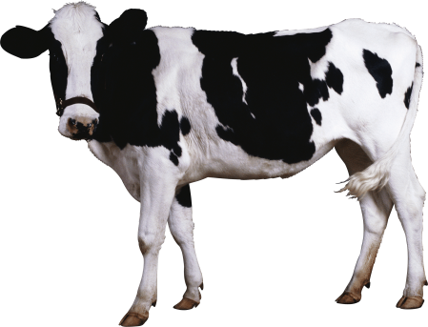
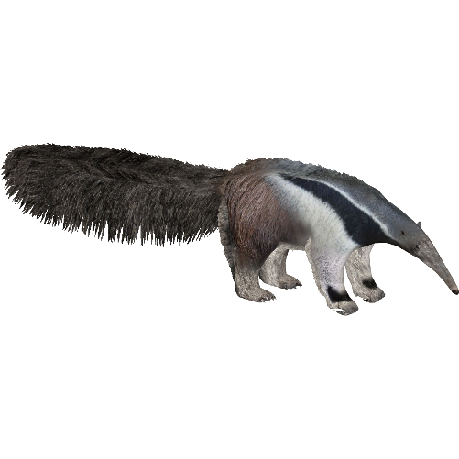
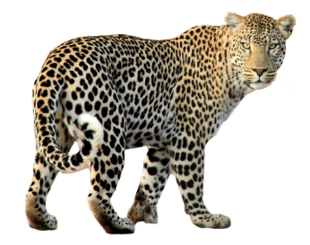

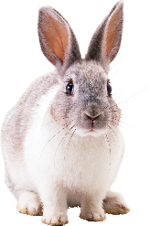
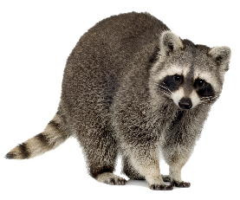

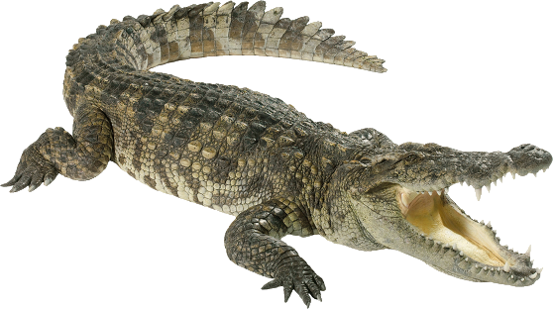
Animal ?
For ESL

Slide 2

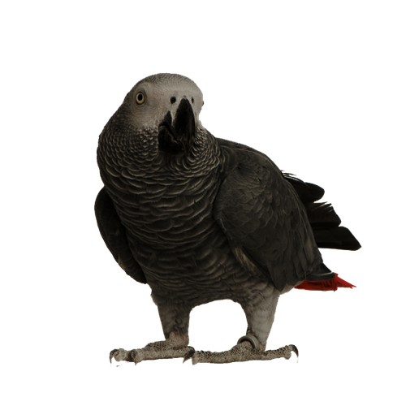
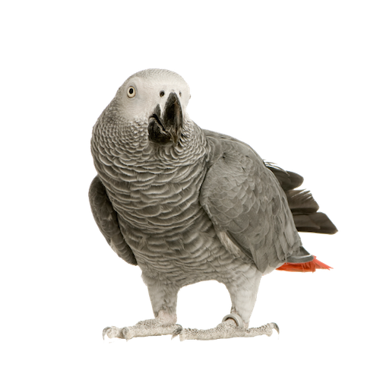
PRE
NEXT
African grey parrot
Alligator
Duck
Rooster

Slide 3
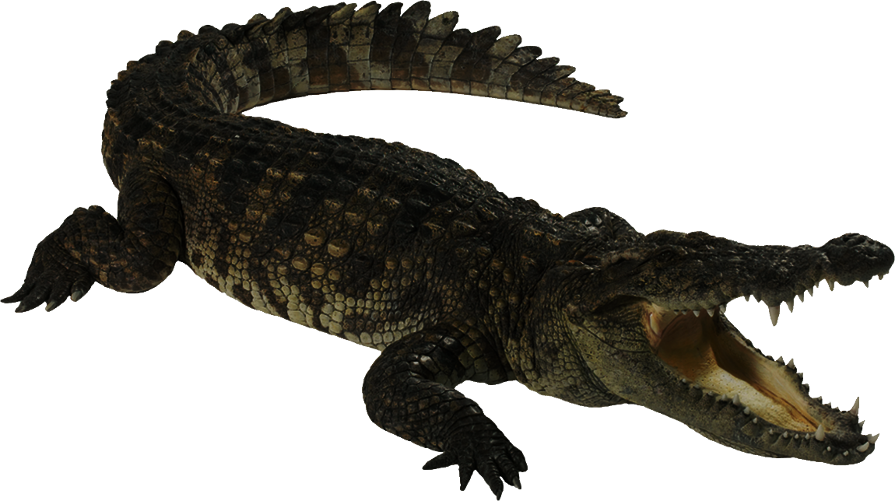

PRE
NEXT
Lizard
Alligator
Anteater
Humpback whale

Slide 4
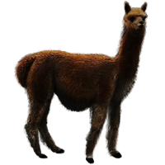
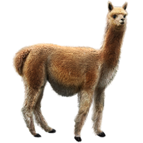
PRE
NEXT
Moose
Leopard
Alpaca
Sheep

Slide 5
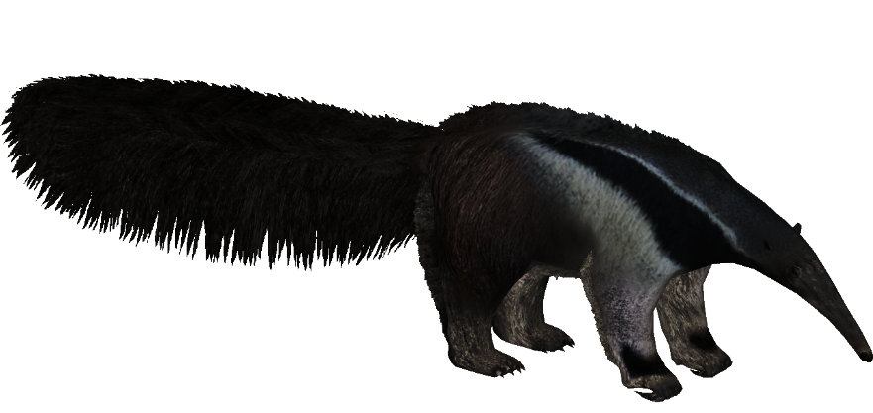

PRE
NEXT
Lizard
Alligator
Humpback whale
Anteater

Slide 6
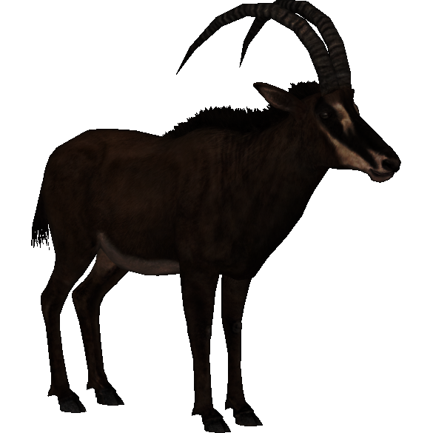
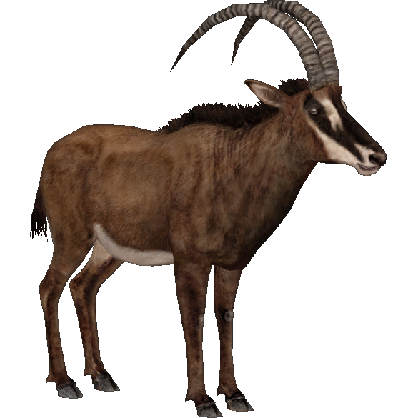
PRE
NEXT
Lizard
Antelope
Anteater
Humpback whale

Slide 7
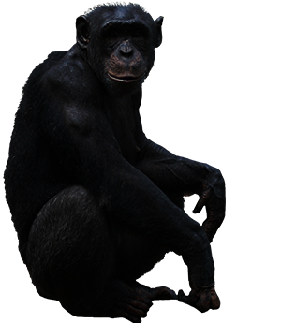
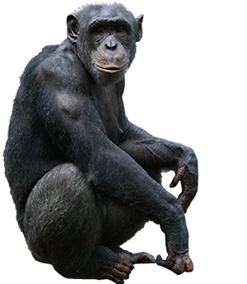
PRE
NEXT
Ape
Panda
Sheep
Raccoon

Slide 8
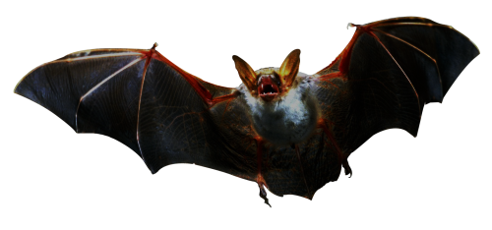
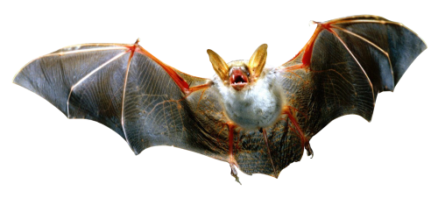
PRE
NEXT
Dove
Turkey
Falcon
Bat

Slide 9
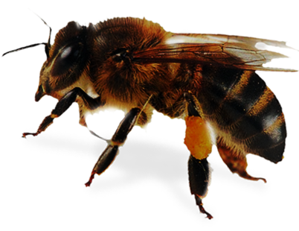
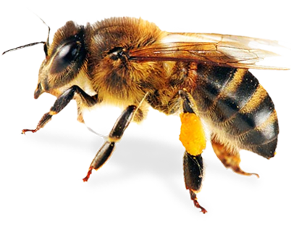
PRE
NEXT
Duck
Dove
Bee
Owl

Slide 10
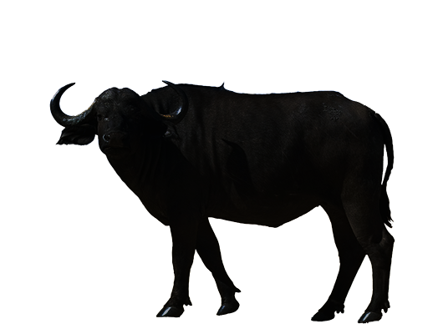
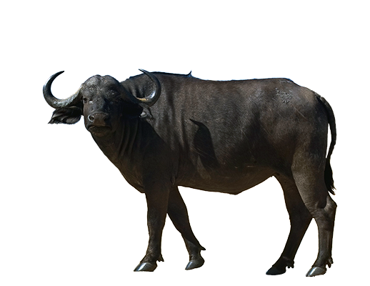
PRE
NEXT
Buffalo
Antelope
Cow
Zebra

Slide 11
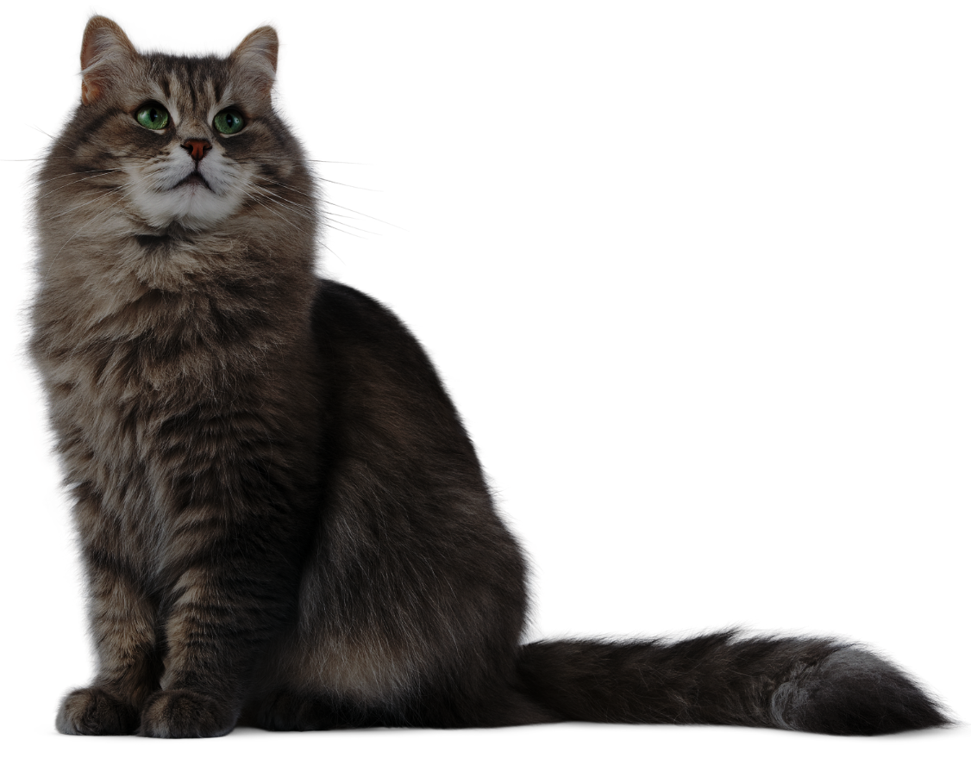
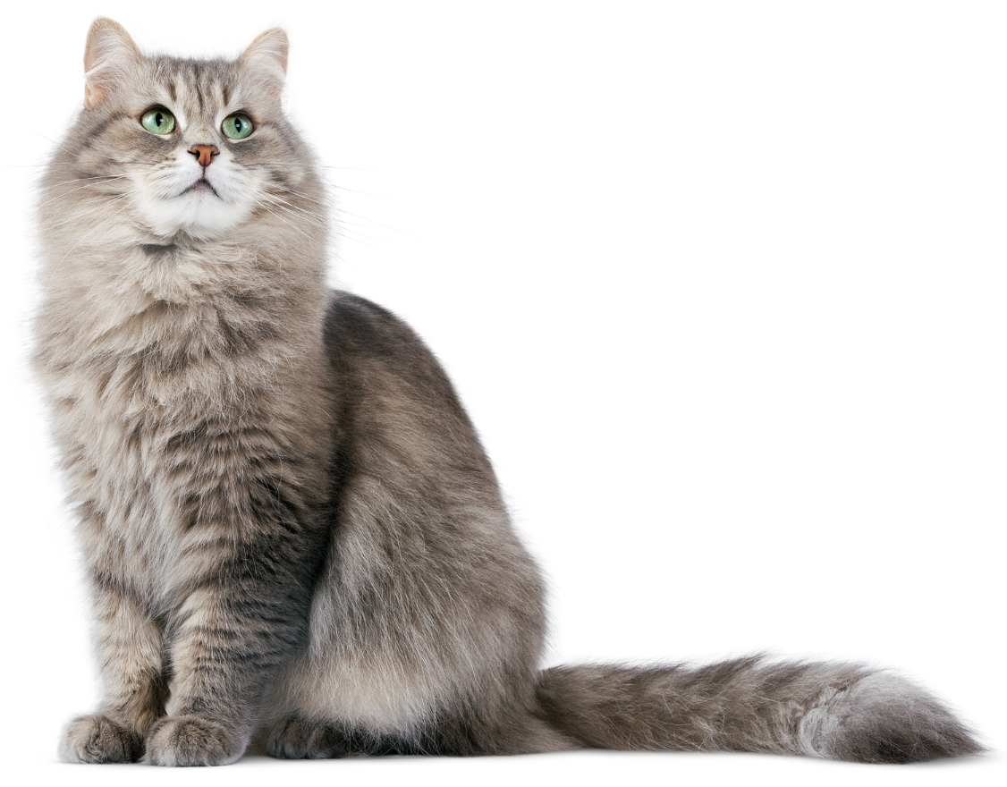
PRE
NEXT
Raccoon
Tiger
Cat
Rabbit

Slide 12
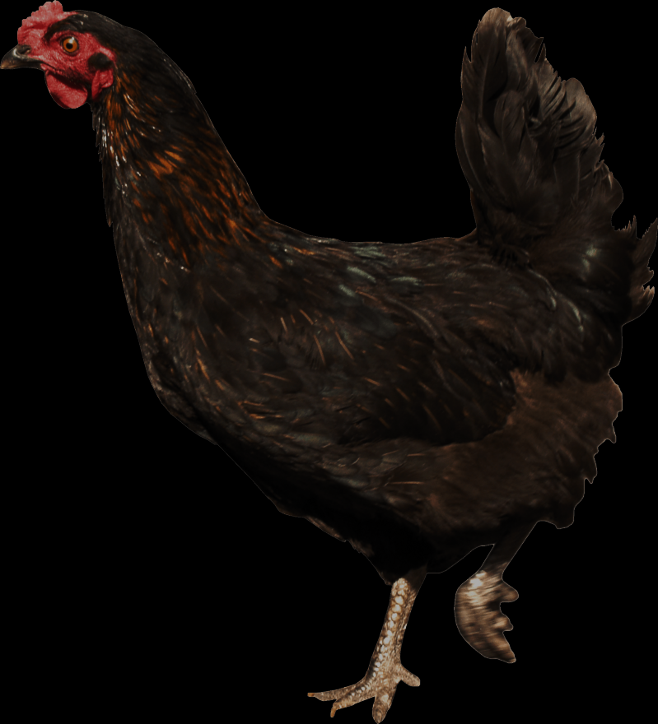
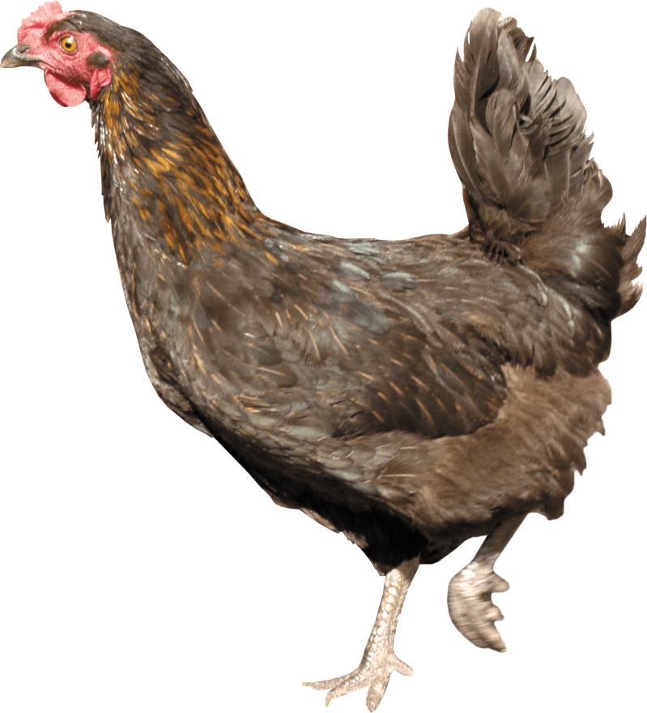
PRE
NEXT
Owl
Falcon
Turkey
Chicken

Slide 13
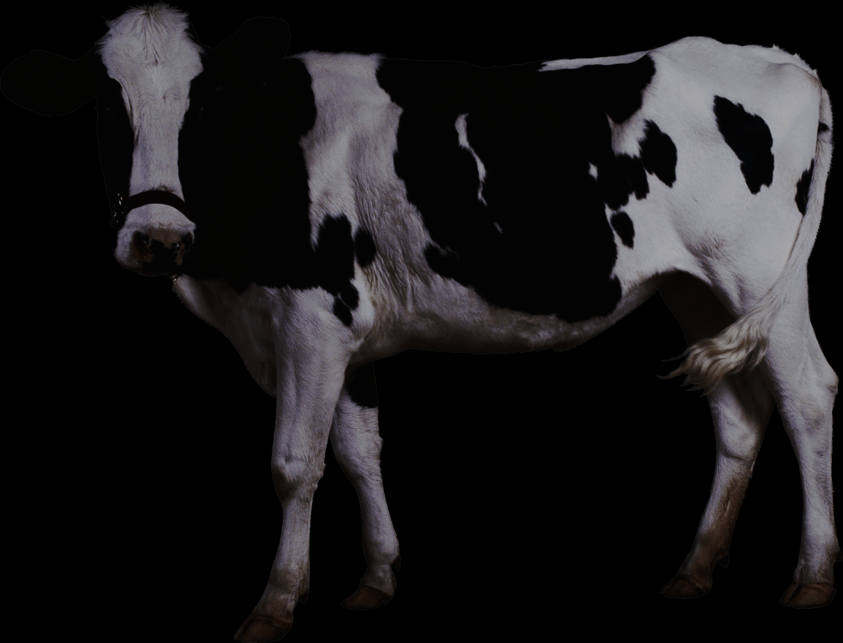
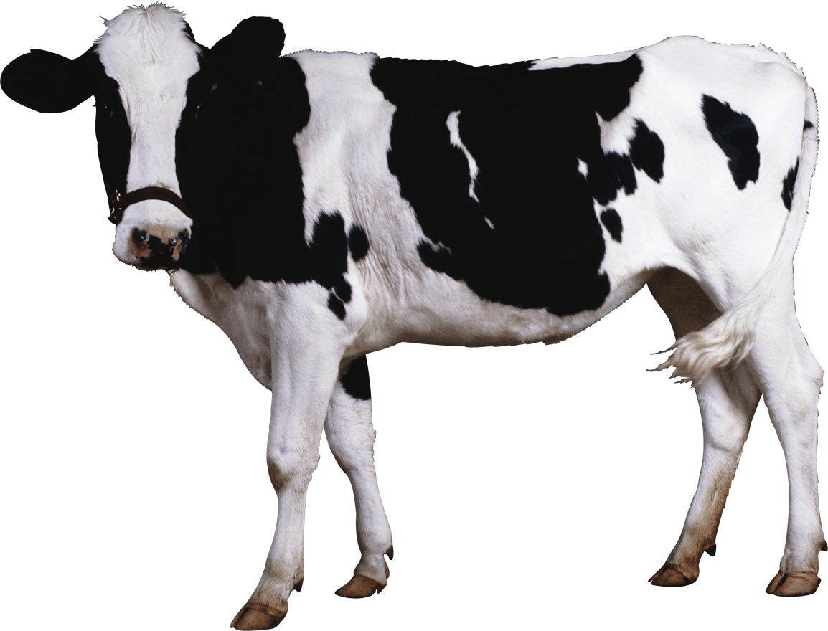
PRE
NEXT
Cow
Buffalo
Sheep
Rhinoceros

Slide 14
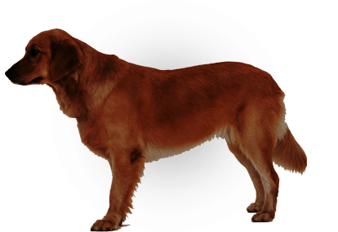
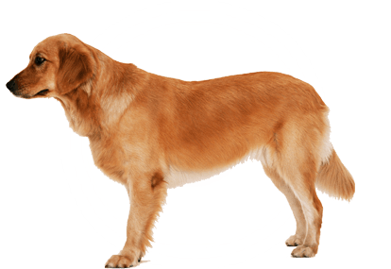
PRE
NEXT
Tiger
Leopard
Dog
Zebra

Slide 15
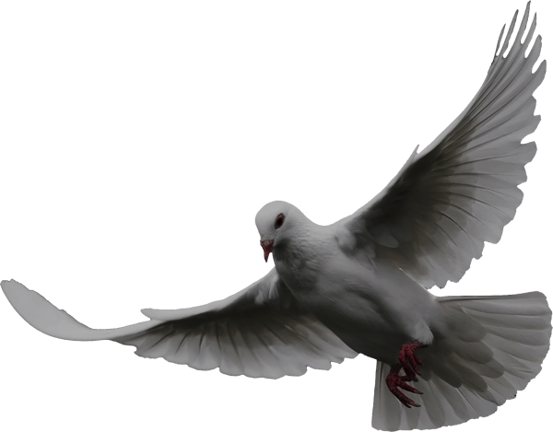

PRE
NEXT
Dove
Bat
Falcon
Rooster

Slide 16
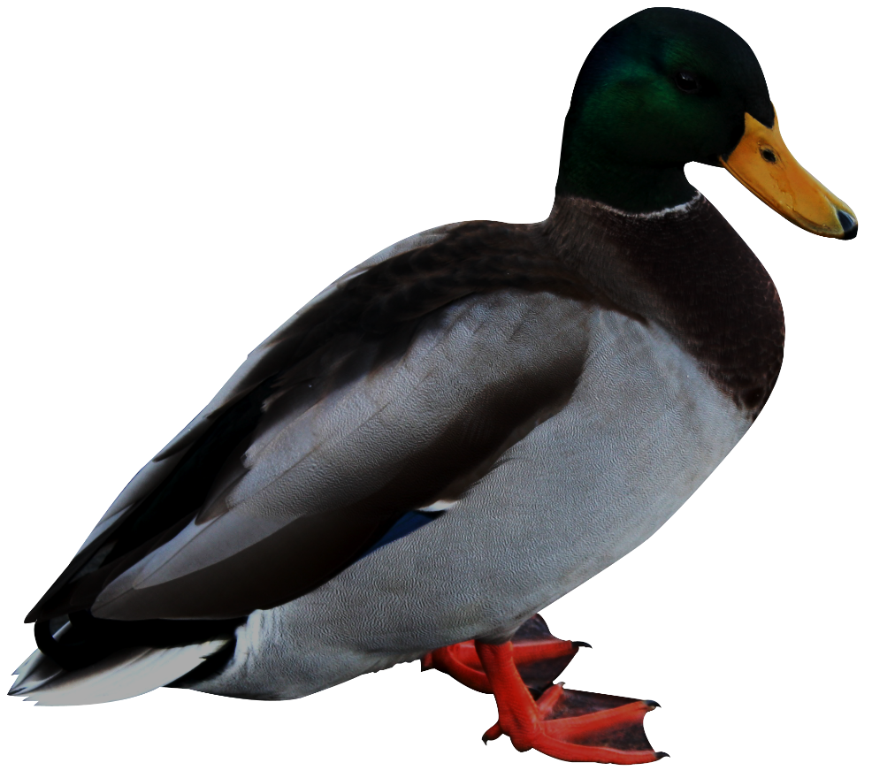
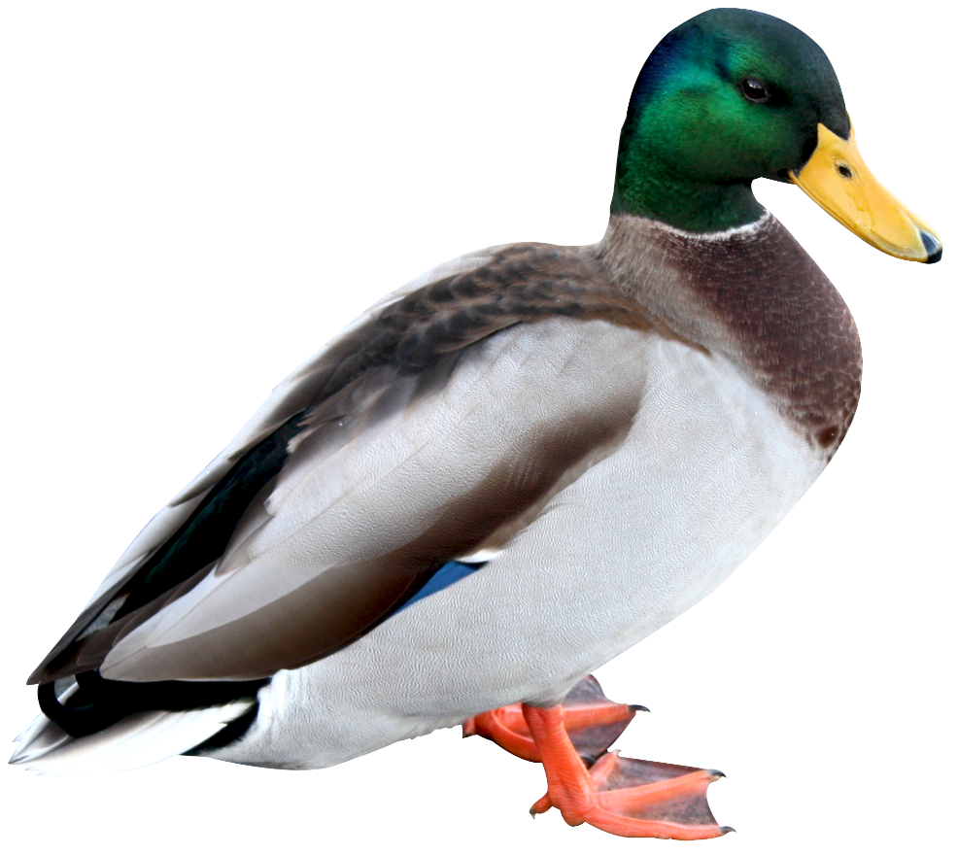
PRE
NEXT
Owl
Duck
Turkey
Chicken

Slide 17
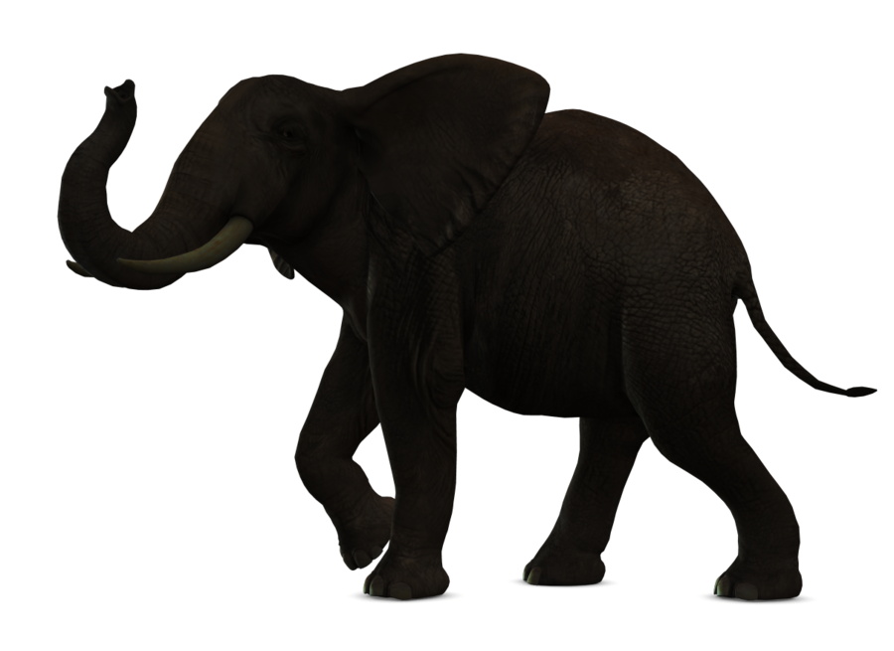
PRE
NEXT
Humpback whale
Rhinoceros
Raccoon
Elephant

Slide 18
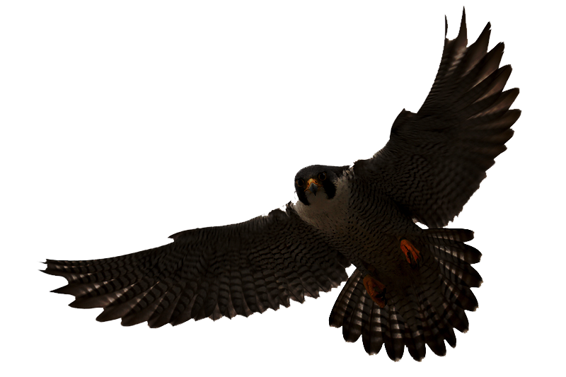
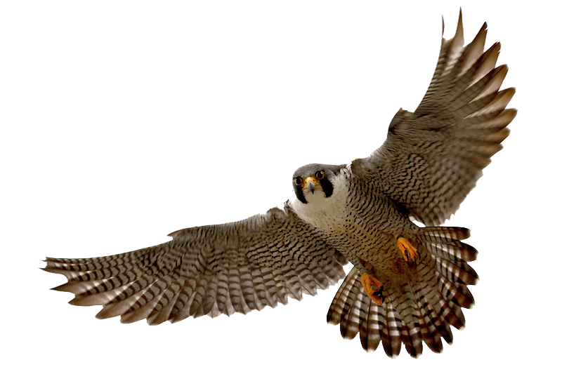
PRE
NEXT
Falcon
Bat
Dove
Rooster

Slide 19
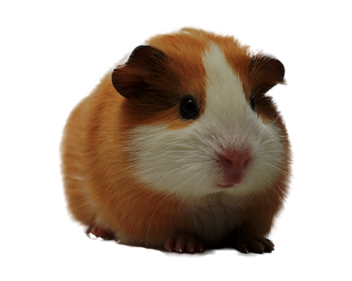
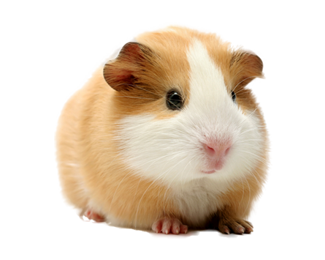
PRE
NEXT
Rabbit
Raccoon
Guinea pig
Panda

Slide 20
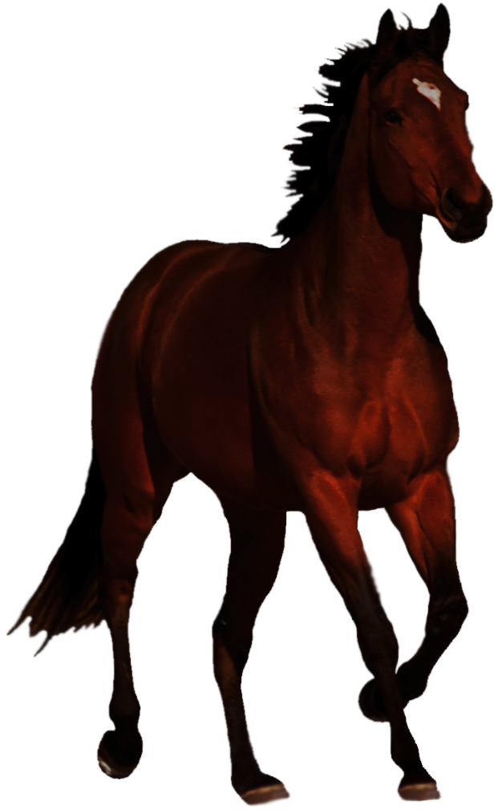
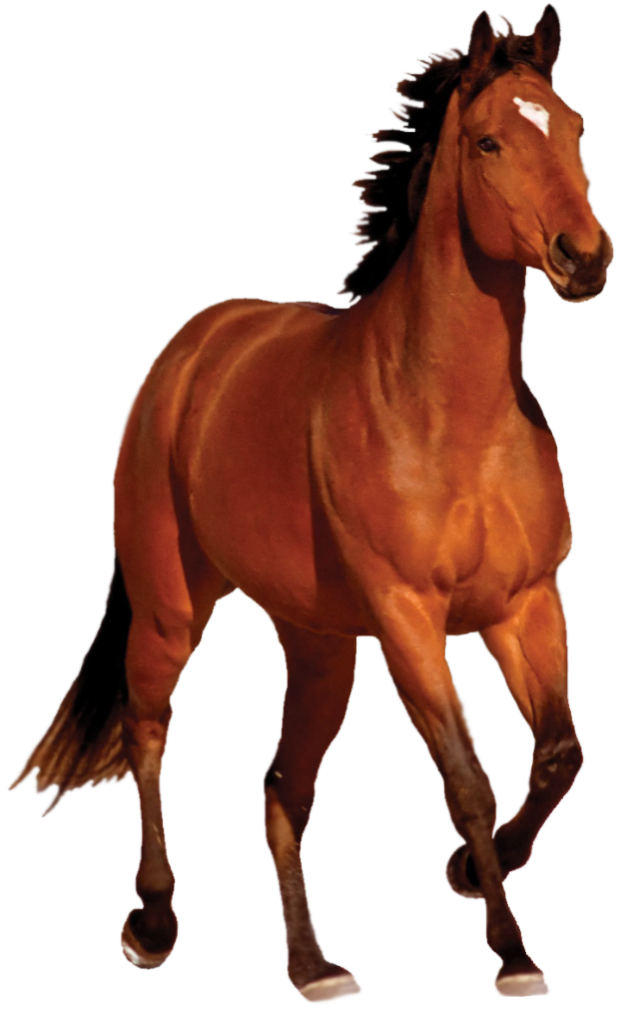
PRE
NEXT
Horse
Buffalo
Sheep
Rhinoceros

Slide 21
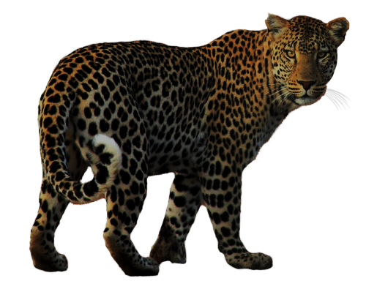
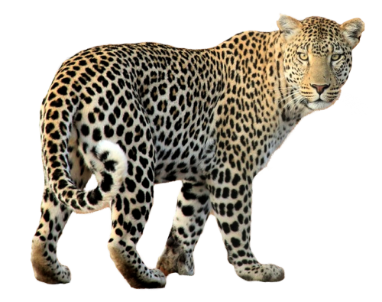
PRE
NEXT
Lion
Dog
Leopard
Tiger

Slide 22
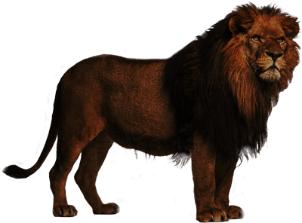
PRE
NEXT
Panda
Sheep
Tiger
Lion

Slide 23


PRE
NEXT
Alligator
Lizard
Anteater
Raccoon

Slide 24


PRE
NEXT
Antelope
Buffalo
Rhinoceros
Moose

Slide 25


PRE
NEXT
Owl
Penguin
Turkey
Cat

Slide 26


PRE
NEXT
Raccoon
Pig
Panda
Dog

Slide 27


PRE
NEXT
Penguin
Owl
Duck
Turkey

Slide 28


PRE
NEXT
Guinea pig
Panda
Sheep
Pig

Slide 29


PRE
NEXT
Cat
Rabbit
Raccoon
Guinea pig

Slide 30


PRE
NEXT
Antelope
Cow
Rhinoceros
Sheep

Slide 31


PRE
NEXT
Leopard
Pig
Raccoon
Panda

Slide 32


PRE
NEXT
Rooster
Owl
Duck
Turkey

Slide 33


PRE
NEXT
Moose
Cow
Zebra
Sheep

Slide 34


PRE
NEXT
Leopard
Alpaca
Tiger
Raccoon

Slide 35


PRE
NEXT
Rooster
Turkey
Duck
Chicken

Slide 36


PRE
NEXT
Zebra
Alpaca
Cow
Buffalo

Slide 37
Continue to update

