Slide 1







PHÒNG GD & ĐT HUYỆN TIÊN LÃNG
TRƯỜNG THCS HÙNG THẮNG
CHUYÊN ĐỀ
ÔN THI VÀO LỚP 10 THPT
MÔN TIẾNG ANH

Slide 2


PART I: READING SKILL
PART II: TEST PRACTICE

Slide 3


PART I: READING SKILL
Type 1
Reading a passage and filling in blanks
Type 2
Reading a passage and answering questions

Slide 4


TYPE 1
READING A PASSAGE AND FILLING IN BLANKS

Slide 5
Ex1. Read the following passage and mark letter A, B, C or D to indicate the correct word that best completes each of the blanks
ANXIETY DURING PUBERTY
Many psychologists believe that boys and girls are prone to anxiety when they experience puberty for a number of reasons. Puberty often starts at the middle of (1) ______ (from 15 to 17 years old) when people experience rapid changes in their body as well as their brain. (2) ______ changes may cause a lot of anxiety if adolescents are not well- aware of what they are undergoing. For girls, acne is always a big crisis and for boys, changes in their voice sometimes bother them. Those teenagers may (3) ______ their confidence because they are ashamed of the changes of appearance. (4) ______, the surge in hormones also contributes to high level of anxiety of teenagers. During puberty mood swing happens very often and teenagers easily get
(5) ______at tiny problems. It is necessary that parents fully understand their children to help them deal with anxiety.
1. A. adolescence B. childhood C. adulthood D. youngster
2. A. So B. This C. That D. Such
3. A. have B. spend C. lose D. get
4. A. Besides B. Because C. Although D. And
5. A. excited B. interested C. keen D. frustrated

Slide 6


STEPS TO DO THE TASK
Step 1: Skim the passage to understand the main idea. Step 2: Analyze the blanks that need to be filled. Step 3: Analyze the given answer choices. Step 4: Choose the most suitable answer. Step 5: Reread the passage and check the answers.

Slide 7


Step 1: Skim the passage to understand the main idea
Đọc lướt để hiểu nội dung chính
Đọc nhanh cả bài từ đầu đến cuối, không dừng lại khi gặp từ mới hay thông tin chưa hiểu. Lần đọc này nhằm tìm nội dung, ý chính, cách tổ chức thông tin của bài.

Slide 8


Step 3: Analyze the given answer choices
Phân tích các đáp án cho sẵn
Đọc tất cả các đáp án và so sánh các đáp án trong mỗi câu.

Slide 9


Step 4: Choose the most suitable answer
Chọn đáp án phù hợp
- Dựa vào các dấu hiệu về vị trí, dấu câu, ngữ pháp, cụm từ cố định hoặc ý nghĩa để chọn đáp án đúng.
- Có thể dùng phương pháp loại trừ để loại ra các đáp án sai.
- Trong trường hợp điền từ vào chỗ trống phải dựa vào ý nghĩa, nếu trong 4 đáp án có các từ đồng nghĩa, hãy loại hết các từ đó vì một câu không thể có nhiều đáp án đúng.
- Trong trường hợp không xác định được câu trả lời, hãy ghép từng phương án vào chỗ trống để tìm ra phương án phù hợp nhất.

Slide 10
Ex1. Read the following passage and mark letter A, B, C or D to indicate the correct word that best completes each of the blanks
ANXIETY DURING PUBERTY
Many psychologists believe that boys and girls are prone to anxiety when they experience puberty for a number of reasons. Puberty often starts at the middle of (1) ______ (from 15 to 17 years old) when people experience rapid changes in their body as well as their brain. (2) ______ changes may cause a lot of anxiety if adolescents are not well- aware of what they are undergoing. For girls, acne is always a big crisis and for boys, changes in their voice sometimes bother them. Those teenagers may (3) ______ their confidence because they are ashamed of the changes of appearance. (4) ______, the surge in hormones also contributes to high level of anxiety of teenagers. During puberty mood swing happens very often and teenagers easily get
(5) ______at tiny problems. It is necessary that parents fully understand their children to help them deal with anxiety.
1. A. adolescence B. childhood C. adulthood D. youngster
2. A. So B. This C. That D. Such
3. A. have B. spend C. lose D. get
4. A. Besides B. Because C. Although D. And
5. A. excited B. interested C. keen D. frustrated

Slide 11



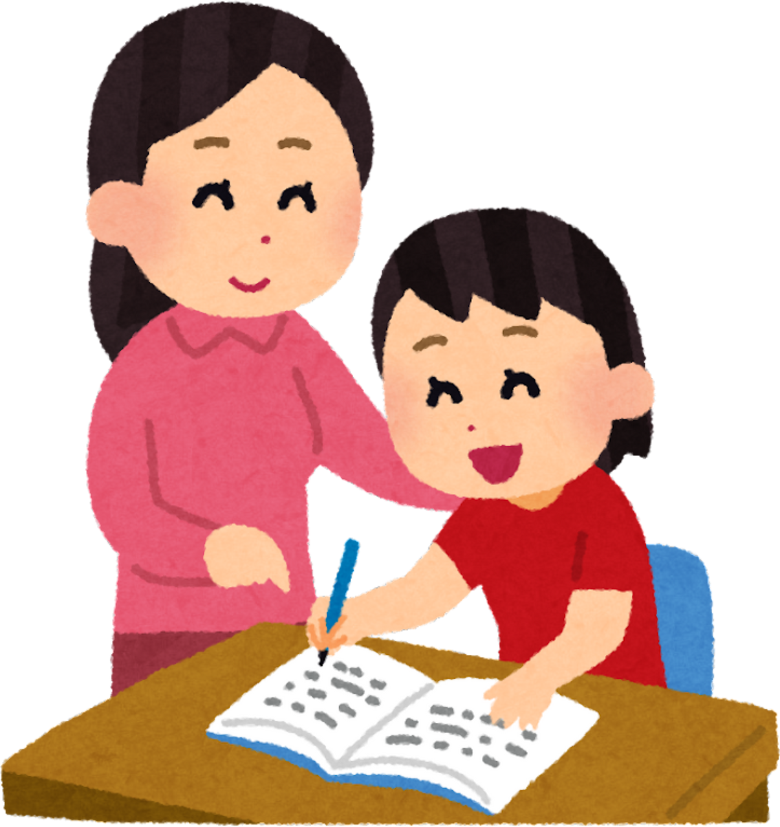
Type 2
Reading a passage and answering questions

Slide 12
Ex2. Read the following passage and mark the letter questions that follow.
Obviously, it is difficult to compare the life of ancient people and the life of the people living in the 21st century because so many changes have occurred. Even the changes that have occurred over the last ten years are amazing. To start with, in the past, people had to work harder as they did not have tools and machines to make their work easier. Today, most of the difficult and dangerous work is done by computers and other powerful machines. In the past, living conditions were not as comfortable as they are now. Besides, many people could not afford household appliances like a fridge or a vacuum cleaner because those used to be luxurious goods. Another difference between life now and in the past is the fact that nowadays education is accessible to everyone. In the past, men were mainly the only ones educated and women were not allowed into public or private schools. Besides, nowadays, it is much easier to find the educational materials and the information you need, thanks to the Internet. It is therefore an obvious conclusion that life has changed significantly during the course of history.
Questions:
1. What is the main idea of the passage?
A. Vietnam’s economy now and 100 years ago
B. Life in the past and life in the present
C. Economic changes in Vietnam
D. Significant changes in education
2. What does the word “they” in line 4 refer to?
A. people in the past B. people living in the 21st century
C. changes D. tools and machines
3. How is most of the difficult and dangerous work done today?
A. By all of the workers
B. By vacuum cleaners
C. By robots
D. By computers and other powerful machines
4. The word “significantly” is closest in meaning to ______.
A. slightly B. considerably C. gradually D. immediate
5. Which sentence is NOT true, according to the passage?
A. Education used to be available only to men.
B. People in the past lived less comfortably than they do now.
C. Women in the past were only accepted into public schools.
D. The Internet enables us to access educational materials more easily.
Give me a break.

Slide 13
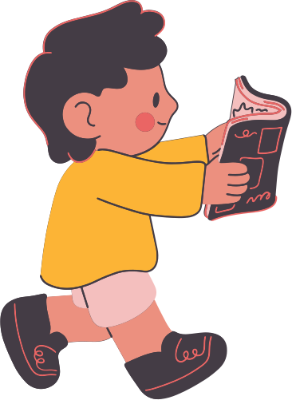
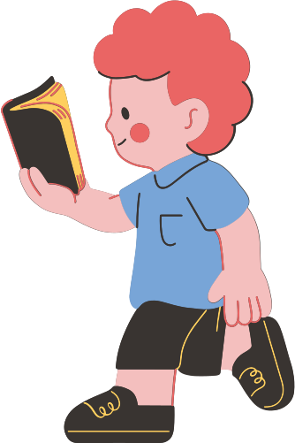
STEPS TO DO THE TASK
01
Read the questions first and find keywords
02
Skim the passage to know the main idea
03
Read carefully to find the answers
04
Eliminate incorrect answers
05
Review your answers

Slide 14


1. Main idea questions
What is the main idea of the passage?
2. Detail questions
How is most of the difficult and dangerous work done today?
3. Vocabulary questions
The word “significantly” is closest in meaning to ______.
4. Reference Questions
What does the word “they” in line 4 refer to?
5. True/ Not True questions
Which sentence is NOT TRUE according to the passage?

Slide 15
Main idea questions (Câu hỏi về ý chính)
What is the main idea of the passage?
- Nếu đoạn văn có tiêu đề thì chúng ta chọn đáp án gần nghĩa nhất với tiêu đề.
- Chú ý đến câu chủ đề topic sentence, thường nằm ở 1-2 câu đầu tiên của đoạn, cũng có thể là câu cuối cùng của đoạn.
- Kiểm tra các từ khóa quan trọng lặp lại trong bài.
- Loại bỏ đáp án chứa thông tin quá chi tiết hoặc không liên quan đến toàn bài.
- Chú ý hãy để dành câu hỏi này để trả lời cuối cùng. Sau khi hoàn thành các câu hỏi còn lại, chúng ta sẽ quay trở về trả lời câu này, như vậy sẽ giúp tiết kiệm được thời gian và hiệu quả hơn.

Slide 16
2. Detail questions (Câu hỏi chi tiết)
How is most of the difficult and dangerous work done today?
- Xác định từ khóa trong câu hỏi.
- Quay lại đoạn văn, tìm từ khóa và đọc câu chứa thông tin đó.
- Đối chiếu với các đáp án và chọn câu phù hợp nhất.
That's mine!

Slide 17
3. Vocabulary questions (Câu hỏi từ vựng)
The word “significantly” is closest in meaning to ______.
- Đọc câu chứa từ cần tìm nghĩa.
- Xem các từ xung quanh để đoán nghĩa dựa vào ngữ cảnh.
- Kiểm tra xem từ đó thuộc loại từ gì (danh từ, động từ, tính từ...) để loại bớt đáp án sai.

Slide 18
5. True/ Not True questions (Câu hỏi TRUE/NOT TRUE)
Which sentence is NOT TRUE according to the passage?
Đọc câu hỏi cẩn thận. Xác định xem câu hỏi yêu cầu tìm câu ĐÚNG (TRUE) hay KHÔNG ĐÚNG (NOT TRUE).
Đọc những nhận định đề bài đưa ra, gạch chân các từ khoá.
Xác định thông tin cần tìm nằm ở phần nào của văn bản.
So sánh thông tin trong bài đọc và thông tin trong đề bài cho để xác định đúng/ sai.
Give me a break.

Slide 19



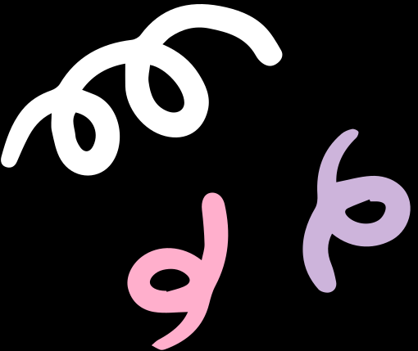

STATION 1
Pronunciation
Stress
Antonyms
Synonyms
STATION 2
Vocabulary
Grammar
Communication
STATION 3
Reading the passage and filling in the blanks
STATION 4
Reading the passage and answering the questions
STATION 5
Error Identification
Writing

Slide 20



V. Mark the letter A, B, C, or D to indicate the correct word or phrase that completes each of the sentences.
9. It is important to ______ the wonders of the world so that future generations can see them with their own eyes.
A. destroy B. ignore C. preserve D. remain
10. Many tourists choose _________ for convenience and to save time on planning.
trip itinerary B. package holiday C. self-guided tour D. package
11. If you want to join our excursion next weekend, you must get your parents’_________.
A. permit B. permissible C. permissive D. permission
12. It is necessary for students to listen to their teacher _________.
A. attentively B. attentive C. attend D. attention
13. A: Do you mind lending me your bike? - B: __________.
A. Yes, here it is B. Great C. Yes, let’s D. Not at all
14. Bill: Thank you for introducing me to the most memorable museum here, Nam.
Nam: __________.
A. Are you sure? B. It’s very convenient to get to it.
C. Sure. D. You’re welcome.

Slide 21
IX. Mark the letter A, B, C, or D on your answer sheet to indicate the sentence that is CLOSEST in meaning to the original one.
33. The teacher asked: “Do you enjoy your English club, Lan?”
A. The teacher asked Lan if she enjoyed her English club. B. The teacher asked Lan if she enjoys her English club.
C. The teacher asked Lan if did she enjoy her English club. D. The teacher asked Lan if she will enjoy her English club.
34. Although the weather was bad, the farmers kept on working in the fields.
A. In spite of the bad weather, but the farmers kept on working in the fields.
B. Despite the weather was bad, the farmers kept on working in the fields.
C. Because of the bad weather, the farmers kept on working in the fields.
D. In spite of the bad weather, the farmers kept on working in the fields.
35. The restaurant is expensive. The service is good.
A. The expensive the restaurant is, the good the service is.
B. The more expensive the restaurant is, the better the service is.
C. The more expensive the restaurant is, the more better the service.
D. The more expensive the restaurant is, the better the service are.
36. Study hard or you will fail the exam.
A. You don’t fail the exam unless you study hard. B. You don’t study hard, so you will fail the exam.
C. If you don’t study hard, you will fail the exam. D. Because you study hard, you don’t fail the exam.

