Slide 1


Welcome to our class!
Teacher: Pham Thi Phuong Nha
School: Hung Thang Secondary School

Slide 2
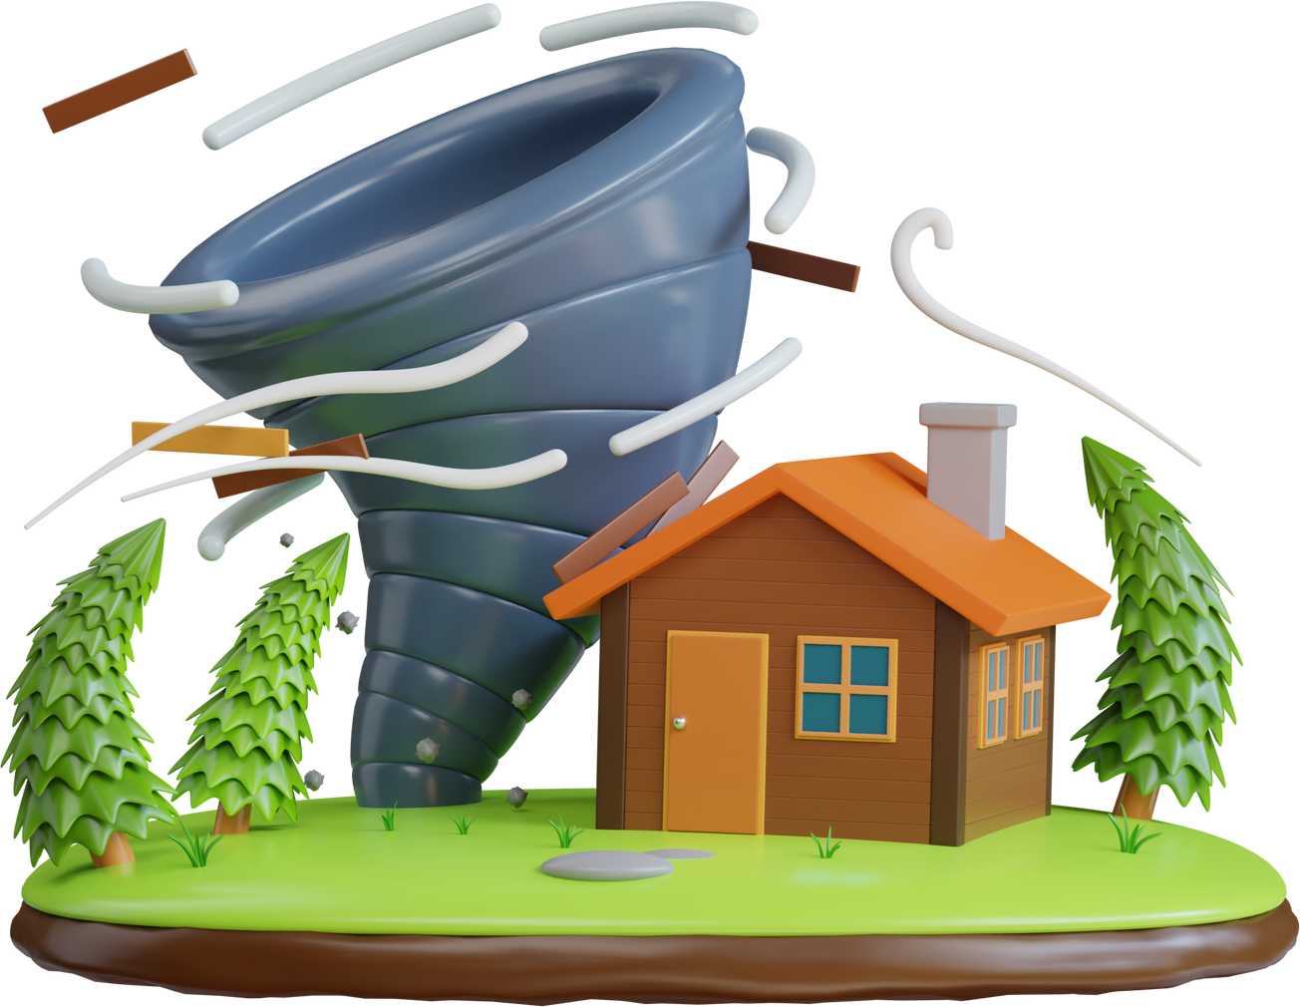
TYPHOON GAME

Slide 3


PICK A BOX
20
1
50
2
3
4
5
40
6
10

Slide 4
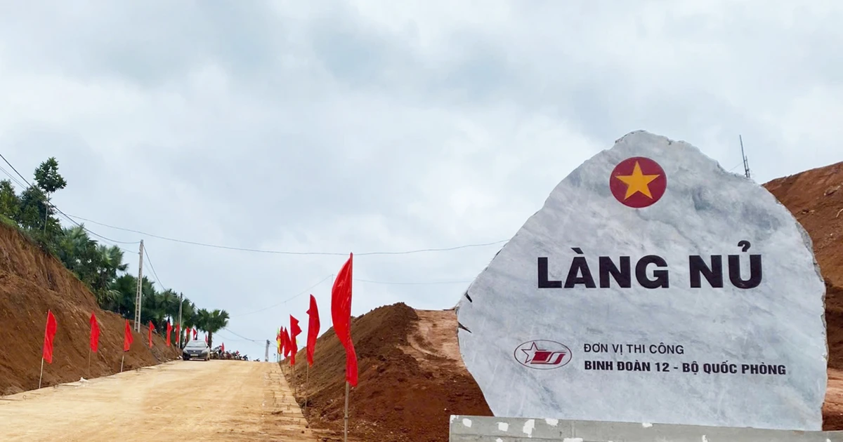

2. Choose A, B, or C to complete the sentence.
The flood _________ Nu Village in Lao Cai in September 2024.
A. went B. destroyed C. moved

Slide 5
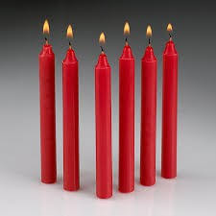
3. Choose A, B, or C to complete the sentence.
The power went out, so we used ________ for lighting.
A. clothing B. rope C. candles

Slide 6

4. Choose A, B, or C to complete the sentence.
The rescue team brought them instant _______, bread and drinking water.
A. noodles B. bag C. roof

Slide 7
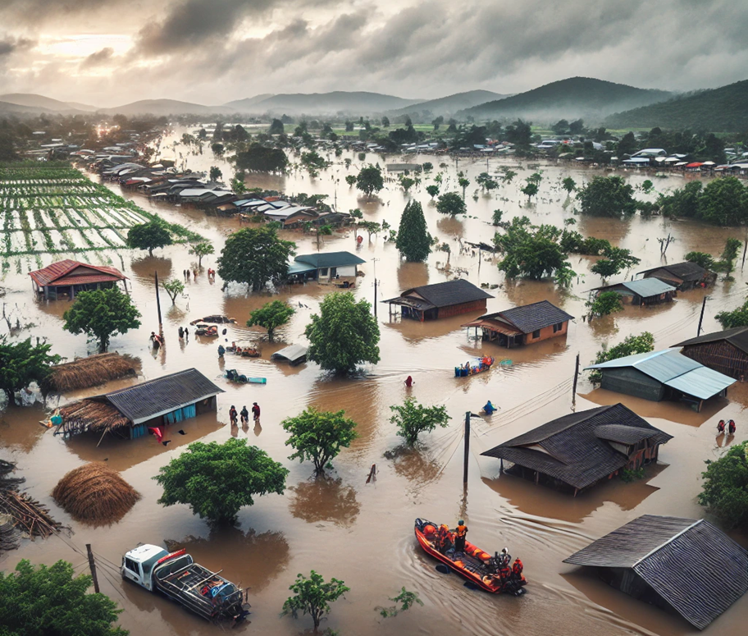
6. Look at the picture and choose A, B, or C to complete the sentence.
People all over Viet Nam donated money and essential items to those in _________ areas.
A. mountainous B. flooded C. coastal

Slide 8

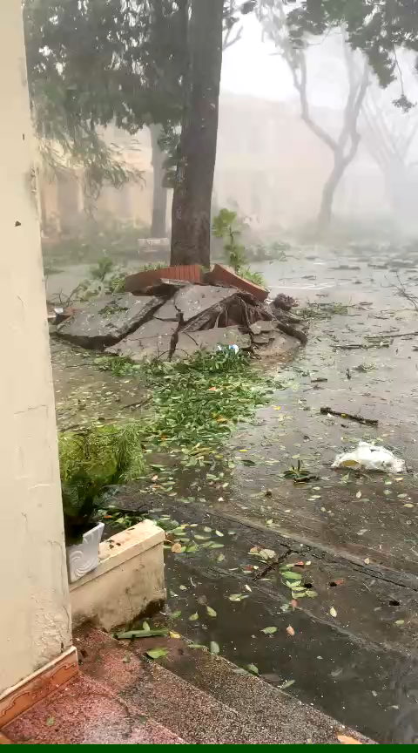


What do you think of when you see the pictures and video?

Slide 9
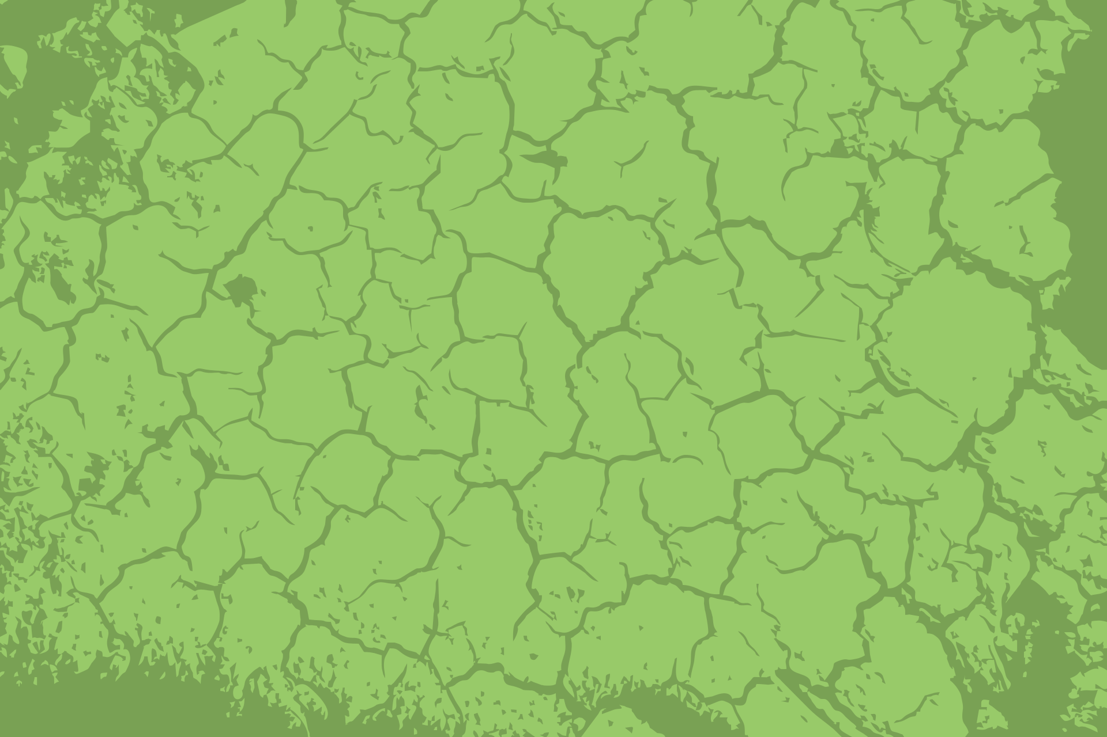



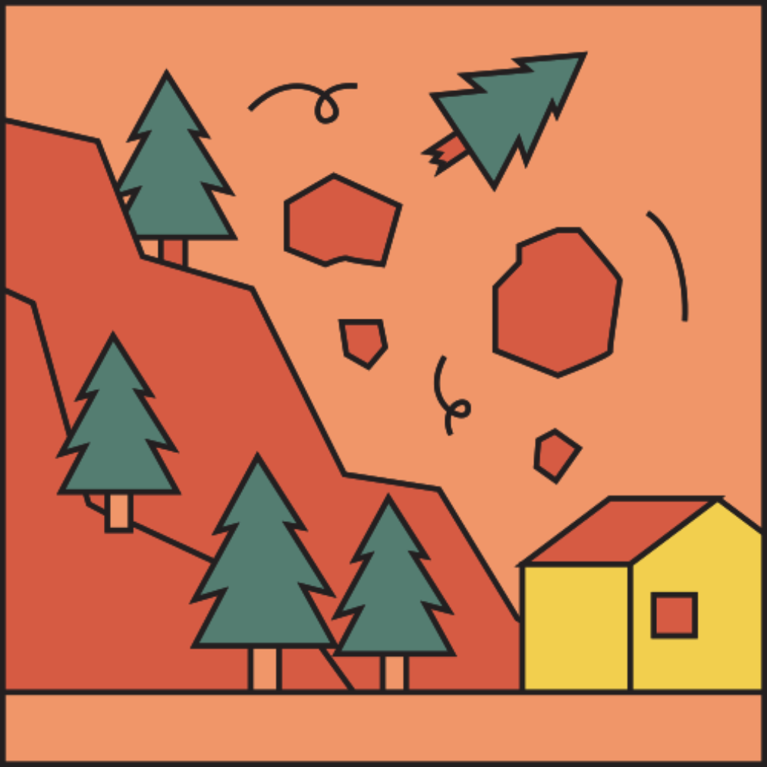
Period 69
UNIT 9: NATURAL DISASTERS Lesson 1: GETTING STARTED/ P. 92, 93

Slide 10
Vocabulary
Natural disasters

Slide 11
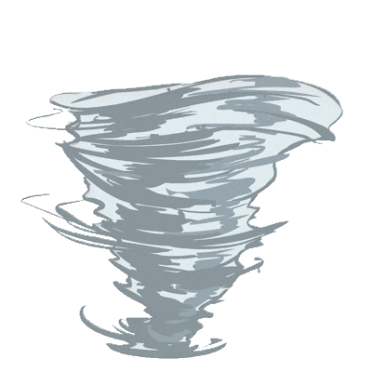
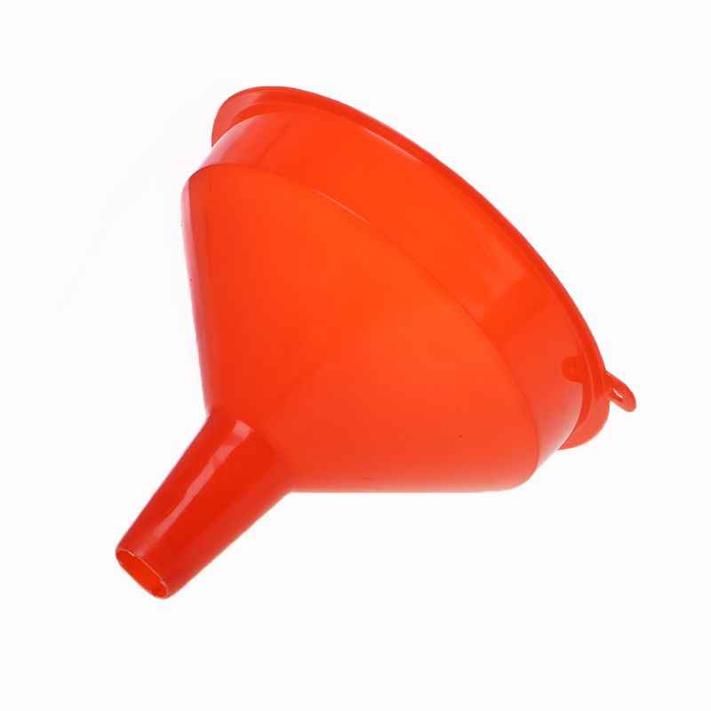
tornado
~ A funnel of wind
/tɔːˈneɪdəʊ/
funnel (n)
lốc xoáy
/ˈfʌnl/
cái phễu

Slide 12
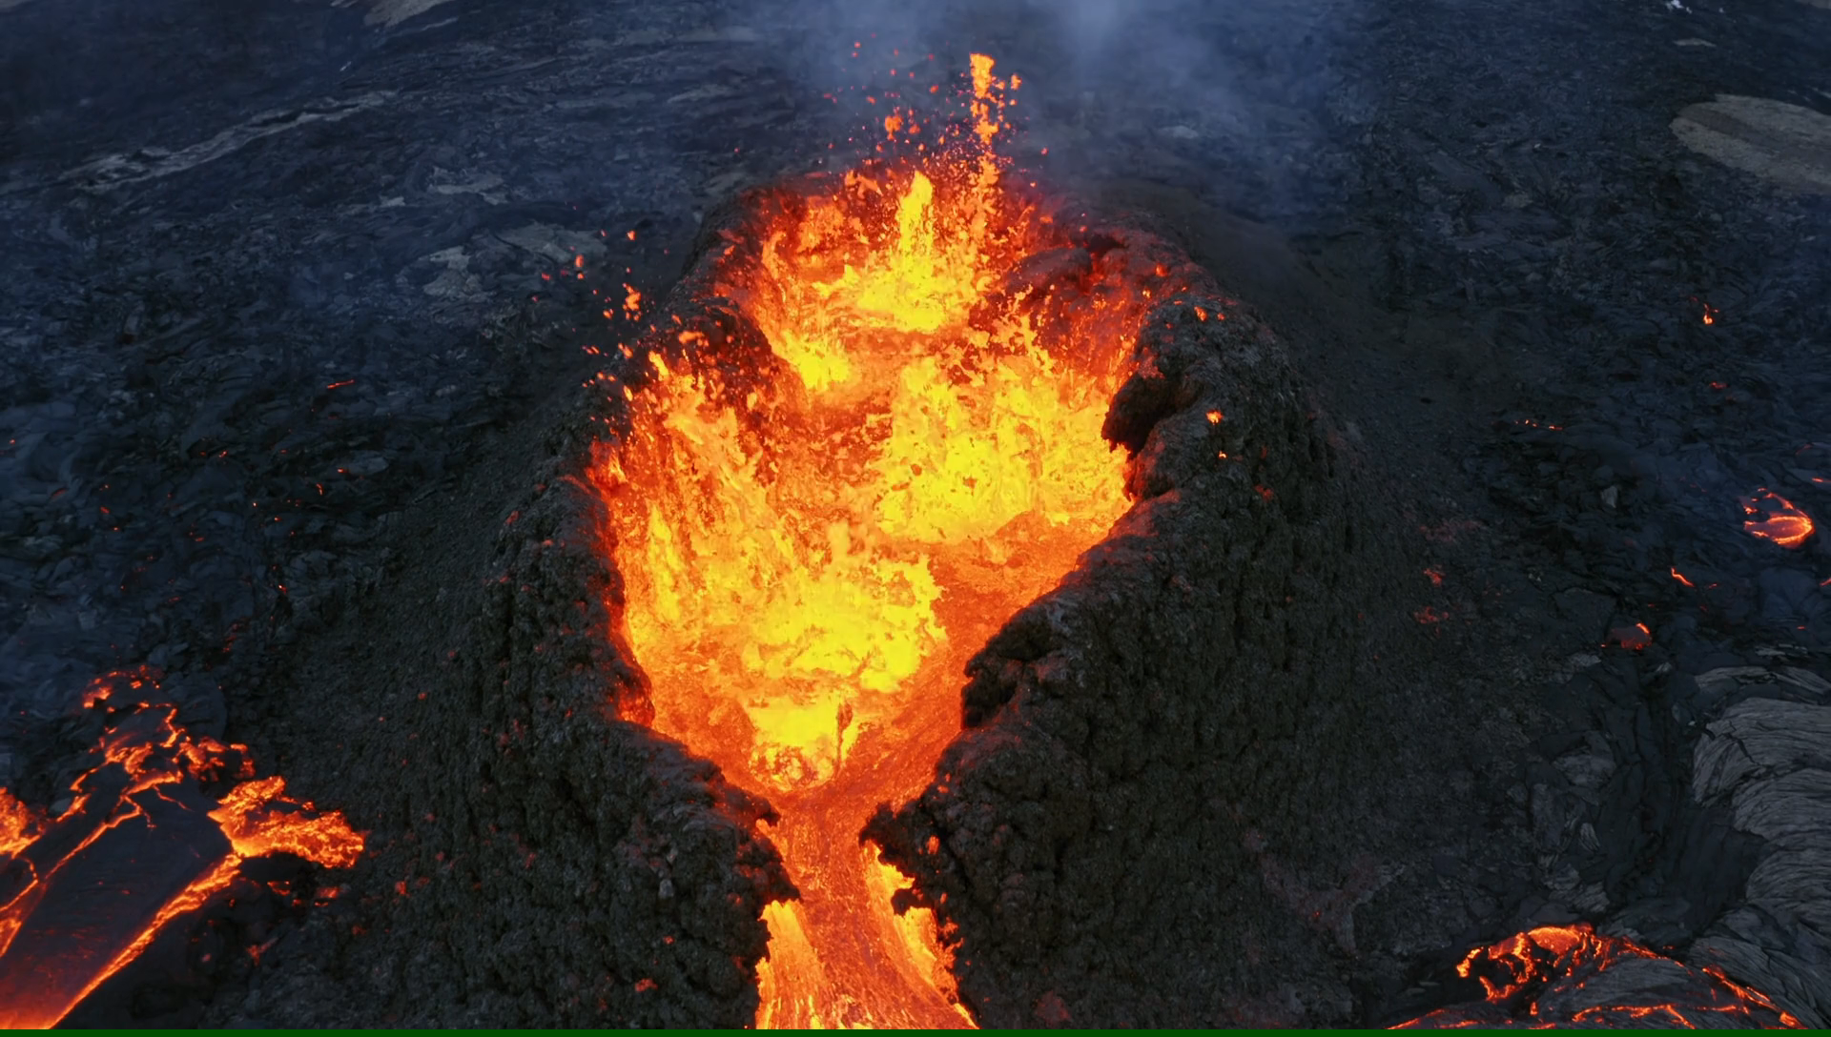
eruption (n)
/ɪˈrʌpʃn/
sự phun trào
=> volcanic eruption

Slide 13
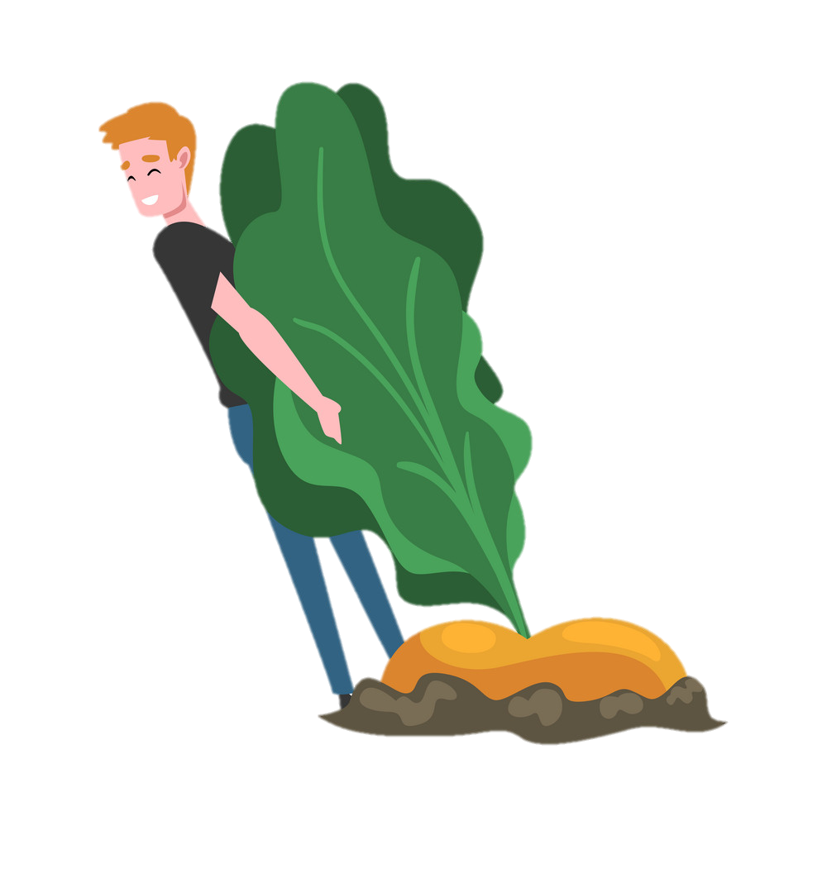
pull up
/pʊl ʌp/
kéo lên, nhổ lên, lôi lên

Slide 14
Match the words/ phrases with their meaning
Word |  | Meaning
1. funnel (n) |  | a. lốc xoáy
2. tornado (n) |  | b. sự phun trào
3. eruption (n) |  | c. cái phễu
4. pull up |  | d. vụ sạt lở
5. landslide (n) |  | e. kéo lên, nhổ lên, lôi lên

Slide 15
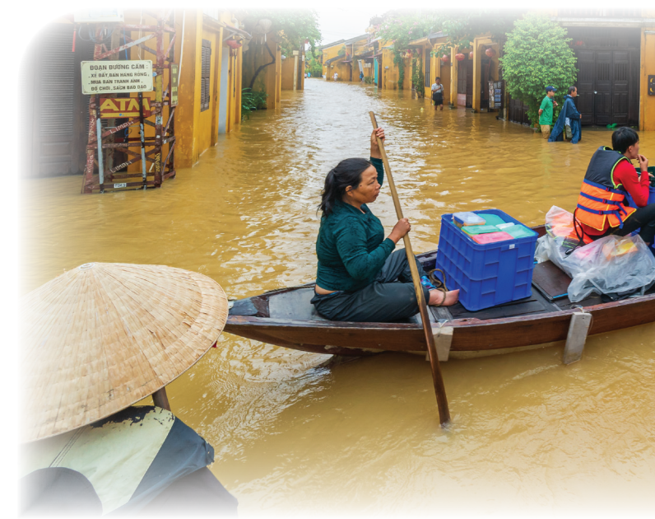
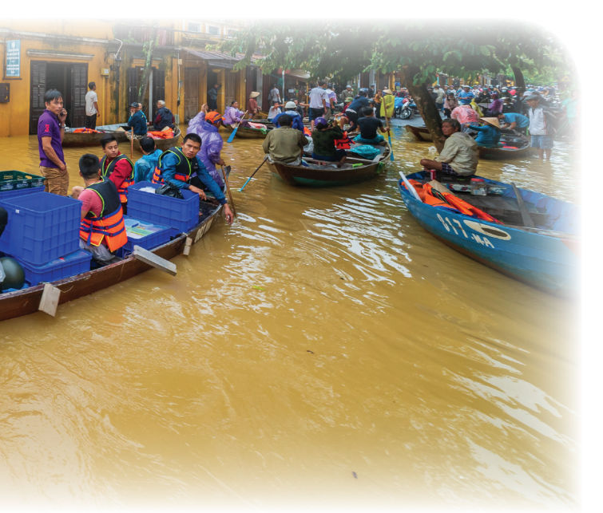
What can you see in the picture?
What natural disaster is it?

Slide 16
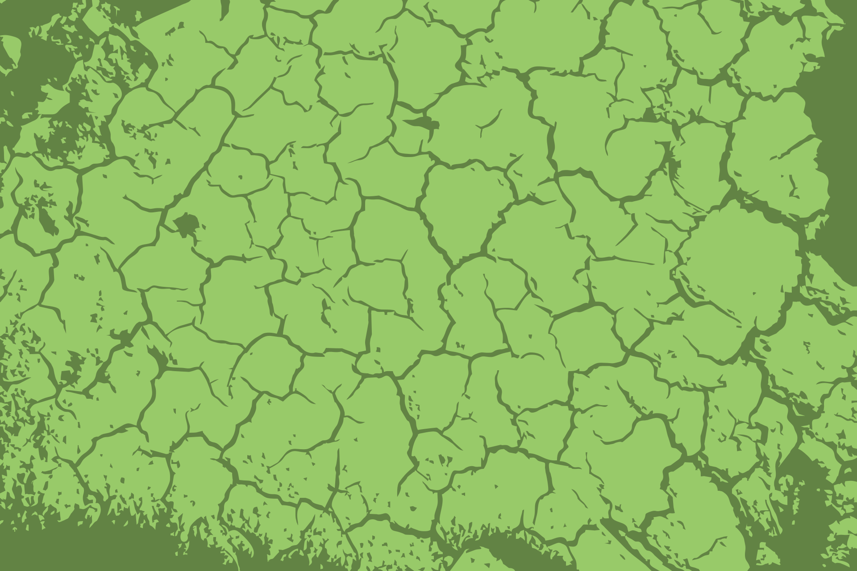


Slide 17

Task 1. Listen and read.
Tom: You look pretty sad, Mi. What’s the matter?
Mi: My uncle called us this morning. Our home town has been affected by a flood. It’s the second time this year.
Tom: I’m sorry to hear that. How are things there now?
Mi: My uncle, his wife, and his children are all safe. They moved everything to the second floor of their house last night. Are there natural disasters in your home town in the US?
Tom: Yes, we sometimes have tornadoes.
Mi: Tornadoes? Sounds strange. What’s a tornado?
Tom: It’s a violent storm that moves in a circle with very strong winds. I still remember the tornado we had last year.
Mi: What happened?
Tom: One evening my parents and I were having dinner. Suddenly we heard a very loud noise. When we looked out of the window, we saw a big funnel of wind moving towards us.
Mi: Did it cause any damage?
Tom: Yes, a lot. It damaged the roof of our house and pulled up some trees in our yard. Fortunately, no one was hurt.

Slide 18
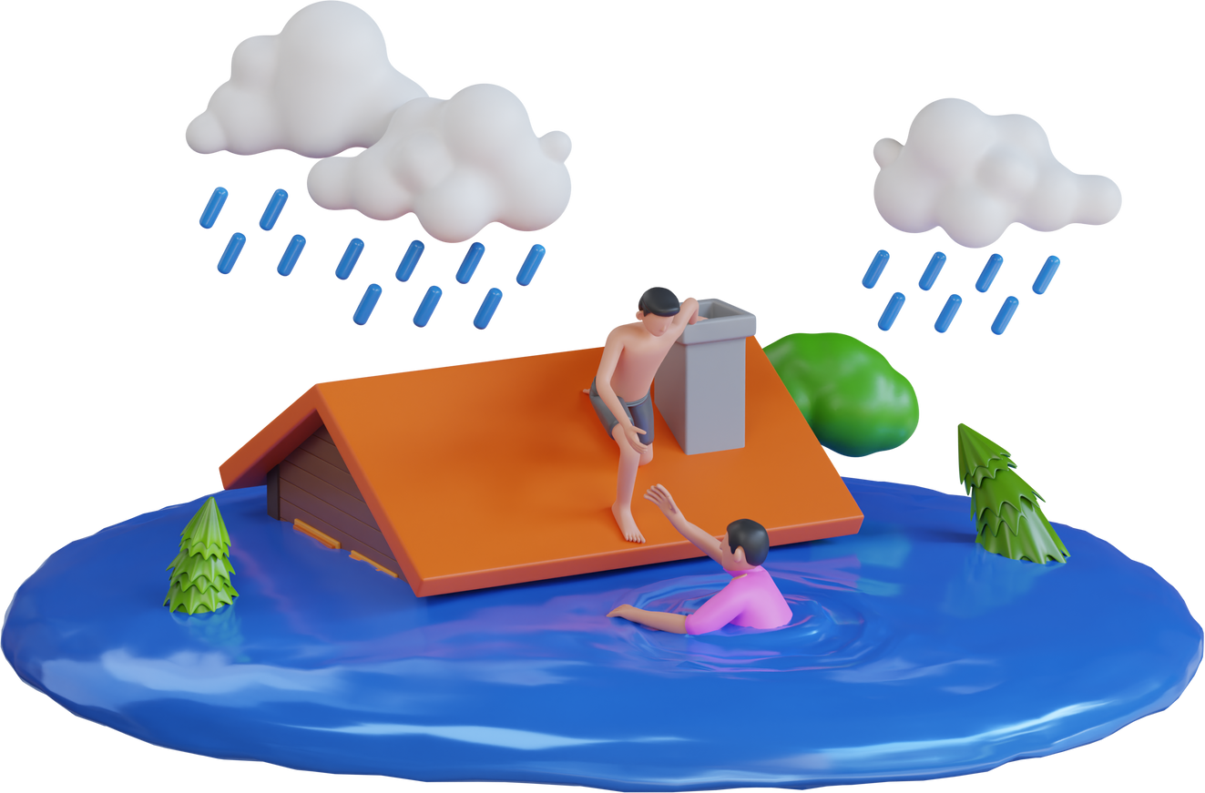
Task 2. Read the conversation again. Complete each sentence with no more than TWO words from it.
1. There is a _______ in Mi’s home town.
2. Her uncle’s family had to move everything to the ______________ last night.
3. A tornado is an example of a __________________.
4. Tom’s family ___________ dinner when the tornado came.
5. The tornado damaged their roof and _______ up some trees in their yard.

Slide 19
Task 2. Read the conversation again. Complete each sentence with no more than TWO words from it.
1. There is a _______ in Mi’s home town.
2. Her uncle’s family had to move everything to the ______________ last night.
3. A tornado is an example of a __________________.
flood
Mi: My uncle, his wife, and his children are all safe. They moved everything to the second floor of their house last night.
Mi: My uncle called us this morning. Our home town has been affected by a flood. It’s the second time this year.
Mi: Are there natural disasters in your home town in the US?
Tom: Yes, we sometimes have tornadoes.
second floor
natural disaster

Slide 20
Task 2. Read the conversation again. Complete each sentence with no more than TWO words from it.
4. Tom’s family ___________ dinner when the tornado came.
5. The tornado damaged their roof and _______ up some trees in their yard.
was having
Tom: Yes, a lot. It damaged the roof of our house and pulled up some trees in our yard. Fortunately, no one was hurt.
Tom: One evening my parents and I were having dinner. Suddenly we heard a very loud noise. When we looked out of the window, we saw a big funnel of wind moving towards us.
pulled

Slide 21

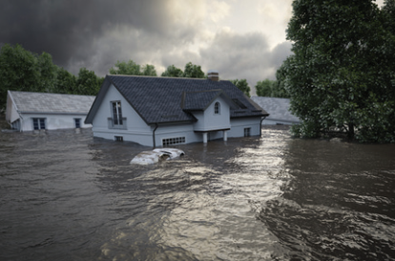
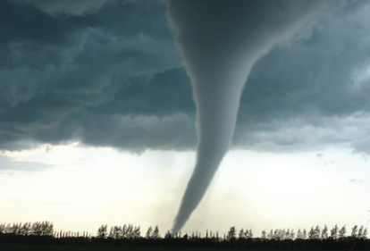
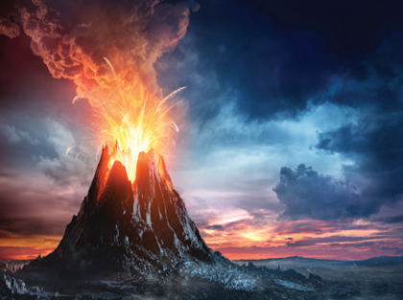
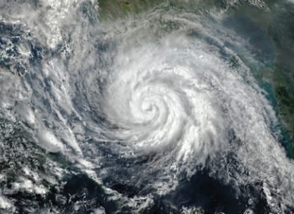
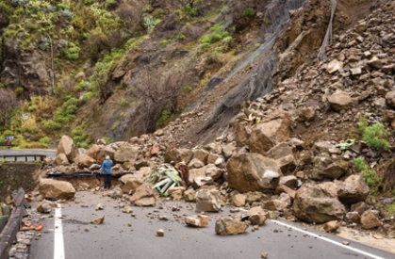
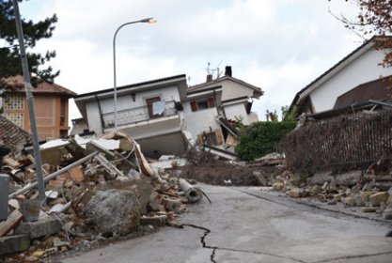

Task 3: Write the natural disasters from the box under the pictures. Then listen, check, and repeat.
volcanic eruption
earthquake
landslide
storm
tornado
flood
1. ………………
2. ………………
3. ……………...
4. ………………
5. ………………
6. …………………

Slide 22

Task 4: Choose the correct answer to complete each sentence.
1. When there is a(n) earthquake / volcanic eruption, hot gases and liquid
rock pour out from a mountain.
2. Oh, the house is shaking! I think we’re having a(n) earthquake / flood.
3. We wanted to travel to Ha Giang, but there was a tornado / landslide.
Some big rocks and mud came down the mountains.
4. Every year more than ten floods / storms with strong winds and
rain cause damage in our country.
5. A tornado / storm looks like a huge funnel and causes a lot of
damage. Its strong winds can reach 480 km per hour.

Slide 23
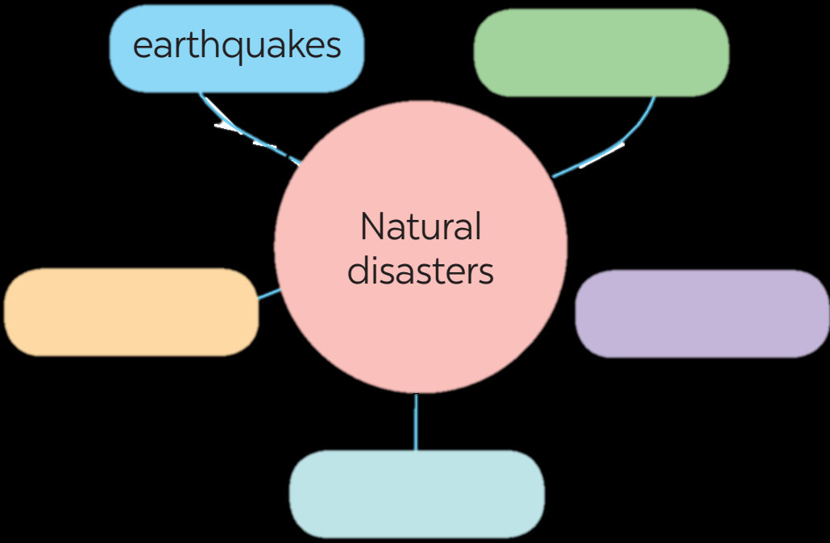
Task 5: Work in groups. Complete the web with all of the words and phrases related to natural disasters you know.

