Slide 1

Period UNIT 3: COMMUNITY SERVICE
Lesson 1: GETTING STARTED

Slide 2
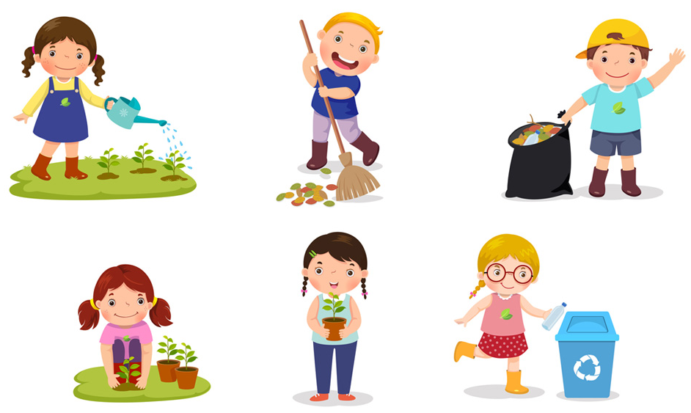

1. Vocabulary
- community activity (n)
/kəˈmjuːnɪti ækˈtɪvɪti/
hoạt động cộng đồng

Slide 3

- donate (v)
/dəʊˈneɪt/
quyên góp, ủng hộ

Slide 4
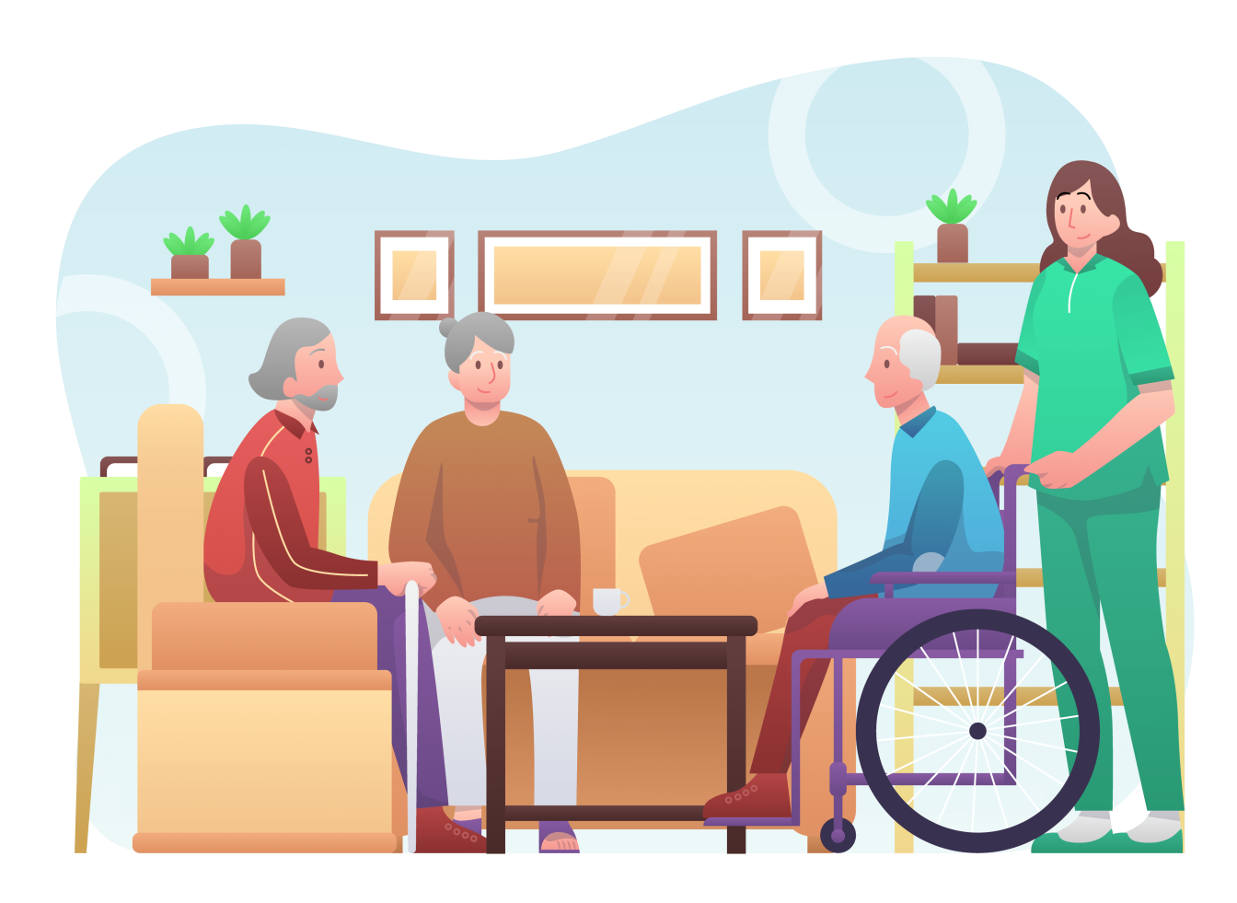
- nursing home (n.phr.)
/ˈnɜːsɪŋ həʊm/
viện dưỡng lão

Slide 5
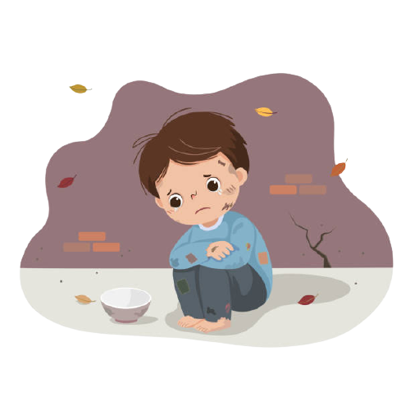
- homeless (adj)
/ˈhəʊmləs/
vô gia cư

Slide 6
- Board game (n): trò chơi trên bàn cờ

Slide 7
- pick up(v): Nhặt

Slide 8
New words | Pronunciation | Meaning
community activity | /kəˈmjuːnɪti ækˈtɪvɪti/ | hoạt động cộng đồng
donate | /dəʊˈneɪt/ | quyên góp, ủng hộ
nursing home | /ˈnɜːsɪŋ həʊm/ | viện dưỡng lão
homeless | /ˈhəʊmləs/ | vô gia cư
board game |  | trò chơi trên bàn cờ
pick up |  | nhặt

Slide 9
2. Practice
1
Listen and read.
Minh: Hi, Tom. Are you back in Ha Noi? Tom: Yes. I came back yesterday. Can we meet up this Sunday morning? I bought you a board game. Minh: Sure, I can’t wait! But our Green School Club will have some community activities on that morning. Tom: What activities does your club do? Minh: Well, we pick up litter around our school and plant vegetables in our school garden. Tom: School gardening? That’s fantastic! Minh: Yes. We donate the vegetables to a nursing home. Does your school have any activities like these? Tom: Yes. We donate books to homeless children. We also have English classes. Last summer, we taught English to 30 kids in the area. Minh: Sounds like great work! Tom: Thanks. Minh: ... So, let’s meet in the afternoon then.

Slide 10

2
Read the conversation again and tick the appropriate box.
Community activity | Minh’s club | Tom’s club
1. picking up litter
2. planting vegetables
3. donating books
4. donating vegetables
5. teaching English

Slide 11
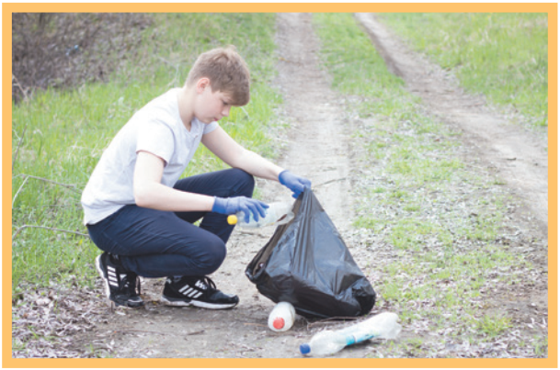
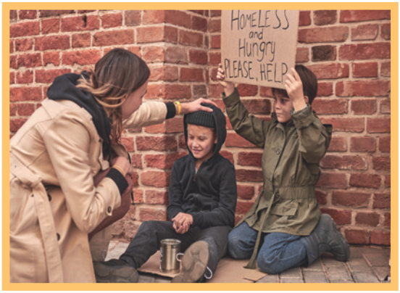
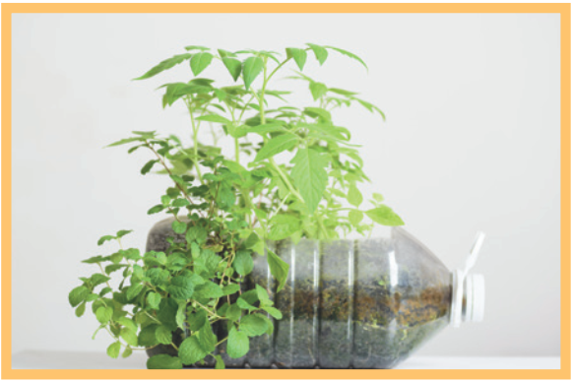
3
Complete the phrases under the pictures with the verbs below.
pick up clean donate recycle help
pick up
help
recycle
1. ________ litter
2. ______ homeless children
3. _______ plastic bottles

Slide 12

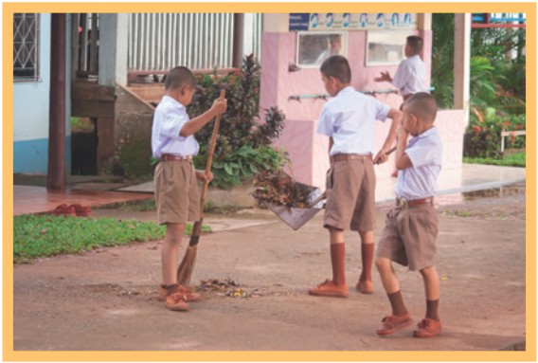
3
Complete the phrases under the pictures with the verbs below.
pick up clean donate recycle help
donate
clean
4. _________ clothes
5. ________ the playground

Slide 13
4
Complete the sentences with the correct words or phrases below.
old people homeless children planted litter taught
1. We collected clothes and gave them to _________________. 2. Those students picked up all the __________ on the street. 3. We helped ____________ in the nursing home last Sunday. 4. The club members ________ maths to primary students during school holidays. 5. We __________ a lot of trees in the park last summer.
homeless children
litter
old people
taught
planted

Slide 14
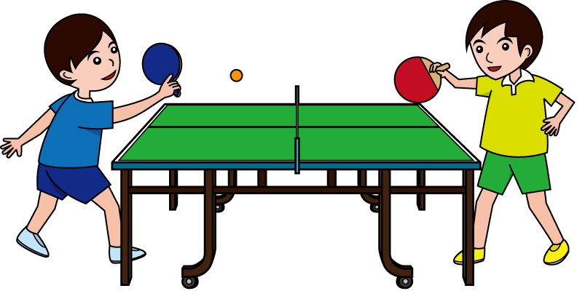
5
Game: Vocabulary Ping-pong
Work in two teams.
Team A provides a cue word.
Team B makes up a sentence with it.
Then switch roles.
Example: Team A: Litter Team B: We often pick up litter in the park. Trees Team A: We plant trees in our school every year. Book
Team A: …

Slide 15
HOME ASSIGNMENTS
Think about community activities that students can do (at least 3 activities)
Prepare for the Project lesson

Slide 16

Website: sachmem.vn
Fanpage: facebook.com/sachmem.vn/

