Slide 1


ENGLISH 9
Hello everyone !!!

Slide 2
* WARM -UP
The Adjectives related the cities and city life:
modern
…
busy
historical
Adjectives
fashionable
convenient
expensive
polluted
exciting

Slide 3
* WARM-UP
Do you like living in the city or in the countryside? Why?
I like living in the……………. Because …………..

Slide 4


Unit 2:
CITY LIFE
Lesson 3: A Closer Look 2

Slide 5
DOUBLE COMPARATIVES
(So sánh kép)
Look at the sentence:
The more expensive the rent in the city is, the fewer people can afford to live there.
You can use “the” with comparative adjectives to show that one thing or situation depends on another.
The + comparative adj 1 + clause 1, the + comparative adj 2 + clause 2.

Slide 6
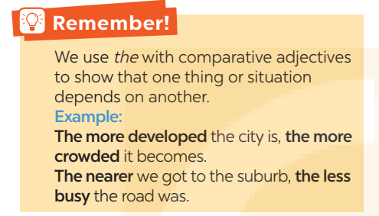
DOUBLE COMPARATIVES
(So sánh kép)
Chúng ta sử dụng the với tính từ so sánh hơn để chỉ ra rằng một sự việc hoặc tình huống này phụ thuộc vào một sự việc hoặc tình huống khác.
The + so sánh hơn + S + V, the + so sánh hơn + S + V
( càng ………, thì càng ……………)
The more developed the city is, the more crowded it becomes.
(Thành phố càng phát triển thì càng đông đúc.)
The nearer we got to the suburb, the less busy the road was.
(Càng đến gần vùng ngoại ô, con đường càng bớt nhộn nhịp.)

Slide 7
DOUBLE COMPARATIVES
1
Choose the correct option to complete each sentence.
1. Lan isn’t home yet. The later / more late it gets, the more worried I get about her.
2. He wants a new house. The larger the house is, the comfortable / more comfortable he feels.
3. She thinks the bigger the city is, higher / the higher the cost of living gets.

Slide 8
DOUBLE COMPARATIVES
1
Choose the correct option to complete each sentence.
4. The famouser / more famous the city is, the higher number of tourists it can attract.
5. The larger population the town has, more difficult / the more difficult it is to find a job.

Slide 9
DOUBLE COMPARATIVES
2
Find a mistake in the underlined parts in each sentence below and correct it.
The hotter
1. I love the spicy food in this city. The hottest the food is, the more I like it.
A
B
C
D
2. I got stuck in a traffic jam yesterday. The more congested the road, the tired I became.
A
B
more tired
C
D

Slide 10
DOUBLE COMPARATIVES
2
Find a mistake in the underlined parts in each sentence below and correct it.
more modern
3. The modern the library is, the more attractive it is to teenagers.
A
B
C
D
4. The streets are getting dirtier. The more crowded this city is,
more polluted it becomes.
A
B
C
the more polluted
D

Slide 11
DOUBLE COMPARATIVES
2
Find a mistake in the underlined parts in each sentence below and correct it.
uglier
5. The denser the buildings are, the more ugly the city becomes. It’ll soon look like a concrete jungle.
A
B
C
D

Slide 12
PHRASAL VERBS
PHRASAL VERBS | MEANING
get around
carry out
come down with
hang out with
cut down on
move from place to place
/ go to a lot of different places
conduct
catch (a disease)
spend time a lot of time with sb
reduce

Slide 13
PHRASAL VERBS
3
Match a phrasal verb in column A with a suitable word / phrase in column B.
A | B | Keys
1. get around | a. noise pollution | 1.
2. carry out | b. friends | 2.
3. come down with | c. a project | 3.
4. hang out with | d. the city | 4.
5. cut down on | e. the flu | 5.

Slide 14
PHRASAL VERBS
3
Match a phrasal verb in column A with a suitable word / phrase in column B.
A | B
1. get around | a. noise pollution | 1.
2. carry out | b. friends | 2.
3. come down with | c. a project | 3.
4. hang out with | d. the city | 4.
5. cut down on | e. the flu | 5.
d
c
e
b
a

Slide 15

4
Complete each sentence with a phrasal verb in 3. You can change the form of the verb when necessary.
1. I’m a cold. I have a runny nose and a sore throat.
2. We all need to using our cars and ride our bikes more to reduce air pollution.
3. When I was in town, I chose to by bus.
4. Where do teenagers in your neighbourhood often each other?
5. The authority is a plan to solve traffic congestion in the downtown area.

Slide 16


Lucky Star Game

Slide 17



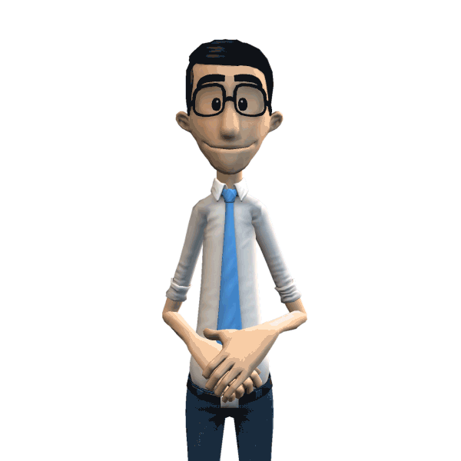

Vòng Quay
May Mắn
Hà Phương
Thuỷ
Đức Quang
Khánh linh
Khang
Ngọc Quang
Trang
Ngân
Nam Phong
Bảo Minh
Anh Đức
Phương Anh
Toàn Đức
Bảo An
Toàn
Xuân Mai
Phan Quân
Hiếu
Vũ Quân
Hiền
Phương Linh
Công
Gia Huy
Trúc
Bảo
Khánh
Dương
Minh ANh
Vinh
Ngọc Anh
Nam
Diệp
Tuệ Mimh
Trường
Nhật
Lê
Nhung
Nga
QUAY

Slide 18




1
2
3
4
5
6
7
8
Lucky Star Game

Slide 19
4
Complete each sentence with a phrasal verb in 3. You can change the form of the verb when necessary.
cut down on
get around
hang out with
coming down with
carrying out
1. I’m a cold. I have a runny nose and a sore throat.

Slide 20
4
Complete each sentence with a phrasal verb in 3. You can change the form of the verb when necessary.
cut down on
get around
hang out with
coming down with
carrying out
2. We all need to using our cars and ride our bikes more to reduce air pollution.

Slide 21
4
Complete each sentence with a phrasal verb in 3. You can change the form of the verb when necessary.
cut down on
get around
hang out with
coming down with
carrying out
3. When I was in town, I chose to by bus.

Slide 22
4
Complete each sentence with a phrasal verb in 3. You can change the form of the verb when necessary.
cut down on
get around
hang out with
coming down with
carrying out
4. Where do teenagers in your neighbourhood often each other?

Slide 23
4
Complete each sentence with a phrasal verb in 3. You can change the form of the verb when necessary.
cut down on
get around
hang out with
coming down with
carrying out
5. The authority is a plan to solve traffic congestion in the downtown area.

Slide 24

UNLUCKY NUMBER

Slide 25


Lucky number
Congratulation !

Slide 26
Lucky number
Congratulation !

Slide 27
4
Complete each sentence with a phrasal verb in 3. You can change the form of the verb when necessary.
1. I’m a cold. I have a runny nose and a sore throat.
coming down with
2. We all need to using our cars and ride our bikes more to reduce air pollution.
cut down on
get around
3. When I was in town, I chose to by bus.
4. Where do teenagers in your neighbourhood often each other?
hang out with
carrying out
5. The authority is a plan to solve traffic congestion in the downtown area.

Slide 28
5
Work in pairs. Tell each other whether you agree or disagree with the following ideas.
1. The busier the city is, the more unhappy its people are.
2. The older the city becomes, the less attractive it is to immigrants.
3. Your home town should cut down on noise pollution.

Slide 29

What have we learnt in this lesson?
Recognise and use comparison of adjectives and some phrasal verbs.

Slide 30

Home Assignment
- Do exercises in the workbook.
- Make 5 sentences by using double comparatives and phrasal verbs that you have learnt.
- Do the exercise on link: https://g.co/gemini/share/760b2759b6bd

Slide 31

Goodbye!
See you again
Thank you!
Have a nice day!

Slide 32


LESSON 3: A CLOSER LOOK 2
LESSON 1: GETTING STARTED
WARM-UP
Option 1: Think!
Grammar explanation
Task 1: Choose the correct option to complete each sentence.
Task 2: Find a mistake in the underlined parts in each sentence below and correct it.
DOUBLE COMPARATIVES
Task 3: Match a phrasal verb in column A with a suitable word / phrase in column B.
Task 4: Complete each sentence with a phrasal verb in 3. You can change the form of the verb when necessary.
PHRASAL VERBS
PRODUCTION
Task 5: Work in pairs. Tell each other whether you agree or disagree with the following ideas.
CONSOLIDATION
Wrap-up
Home Assignment

