Slide 1

CLASS 6D4
Welcome to our class
TEACHER: LÊ THU TRANG

Slide 2


GUESSING GAME

Slide 3

There are some food in the………

Slide 4

04
WRAP UP
There is a………..next to the bed

Slide 5

04
WRAP UP
This is my grandmother’s………………

Slide 6

Her mother’s………..is blue

Slide 7

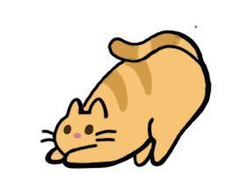
The cat is between the two…………..

Slide 8

Lian’s……………….is big

Slide 9
There are some food in the………
fridge

Slide 10
04
WRAP UP
There is a………..next to the bed
lamp

Slide 11
04
WRAP UP
This is my grandmother’s………………
dishwasher

Slide 12
Her mother’s………..is blue
sofa

Slide 13
The cat is between the two…………..
cupboard

Slide 14
Lian’s……………….is big
bedroom

Slide 15
Possessive case
Lian’s bedroom is big
Prepositions of place
The cat is between the two cupboard

Slide 16
CLASS 6D4
UNIT 2: MY HOUSE
LESSON 3: CLOSE LOOK 2

Slide 17

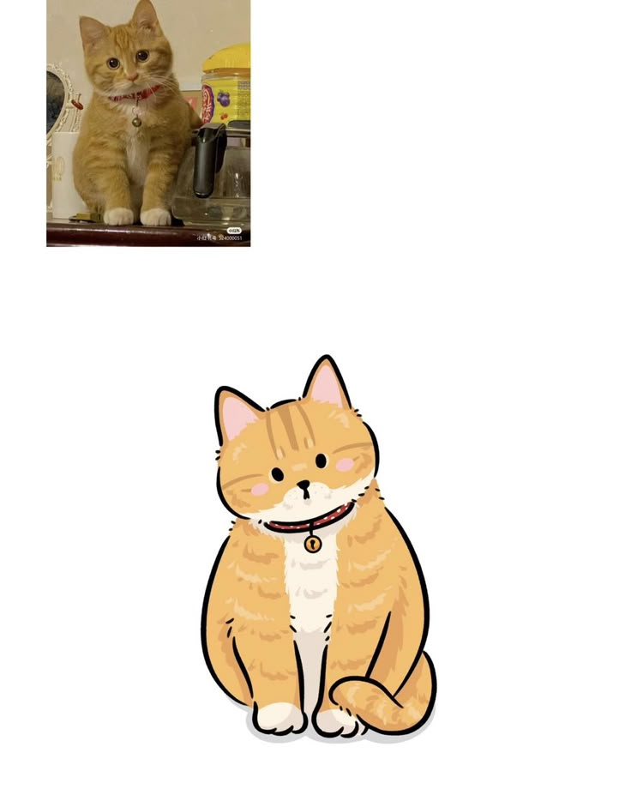
Possessive case
(sở hữu cách)
Lan and cat

Slide 18
GRAMMAR
Possessive case
Lan’s cat
=> the cat belong to Lan

Slide 19

GRAMMAR
Possessive case
- Use ‘s after a proper name (tên riêng)
Name’s + noun - Example: Lan’s cat
Use ‘s after a singular noun (danh từ số ít)
Singular noun’s + noun - Example: student’s book

Slide 20
TASK 1: Choose the correct answer .
1. My (grandmothers / grandmother’s) house is in Ha Noi.
2. This is my (sister’s / sister’) desk.
3. My (cousin’s / cousin) dad is my uncle.
4. (Nam’s / Nam’) house is small.
5. There are two bedrooms in (Ans / An’s) flat.

Slide 21
TASK 1: Choose the correct answer .
1. My (grandmothers / grandmother’s) house is in Ha Noi.
2. This is my (sister’s / sister’) desk.
3. My (cousin’s / cousin) dad is my uncle.
4. (Nam’s / Nam’) house is small.
5. There are two bedrooms in (Ans / An’s) flat.

Slide 22
TASK 2: Complete the sentences with the correct possessive forms.
1. Thuc Anh is ______ cousin. (Mi)
2. This is their _________ chair. (teacher)
3. Where is _______ computer? (Nick)
Mi’s
teacher’s
Nick’s

Slide 23
TASK 2: Complete the sentences with the correct possessive forms.
4. My _________ motorbikes is in the garden. (father)
5. My _________ bedroom is next to the living room. (brother)
father’s
brother’s

Slide 24
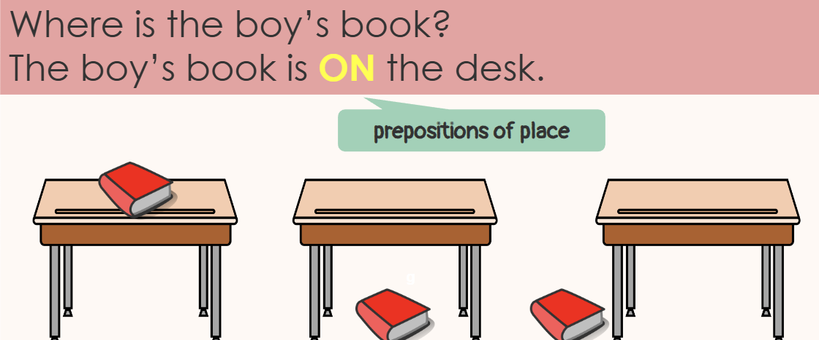
GRAMMAR
Preposition of place
Prepositions of place describe where people or things are

Slide 25


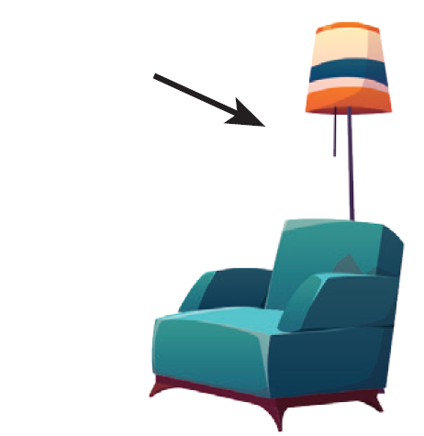


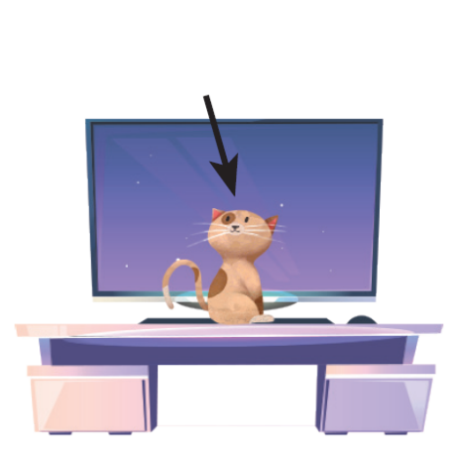
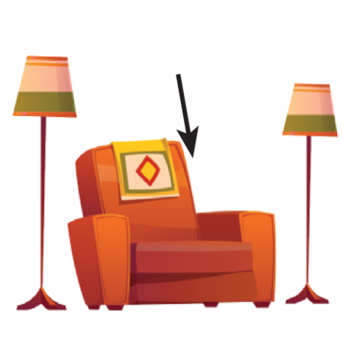
some prepositions of place
in
on
behind
under
next to
in front of
between

Slide 26
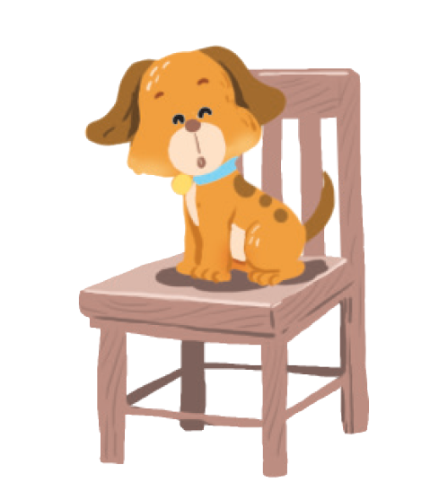
TASK 3: Write the correct preposition in the box under each picture. Say a sentence to describe the picture
Example:
1.
on
The dog is on the chair.

Slide 27
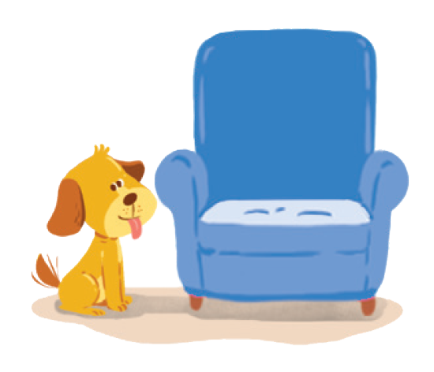

on
next to
behind
behind
in
on
next to
behind
in
next to
in front of
under
between
in front of
under
between
2.
next to
3.
behind
The dog is next to the armchair.
The cat is behind the TV.

Slide 28


in
on
next to
behind
in
in front of
under
between
in front of
4.
in
5.
in front of
The cat is in the wardrobe.
The dog is in front of the doghouse.

Slide 29
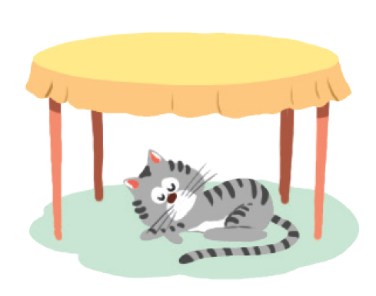

in
on
next to
behind
under
between
in front of
under
between
6.
between
7.
under
The cat is between
the lamp and the armchair.
The cat is under the table.

Slide 30
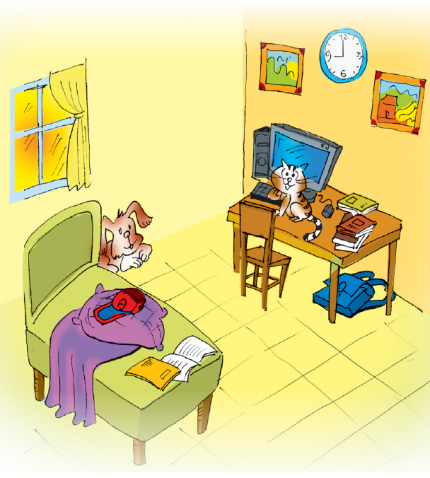

TASK 4: Look at the picture and write T (True) or F (False) for each sentence. Correct the false ones.
F
Example: The books are under the table. ______
→ The books are on the table.

Slide 31
TASK 4: Look at the picture and write T (True) or F (False) for each sentence. Correct the false ones.
1. The dog is behind the bed. ______
T
2. The school bag is on the table. ______
→ _________________________________
F
The school bag is under the table.

Slide 32
TASK 4: Look at the picture and write T (True) or F (False) for each sentence. Correct the false ones.
3. The picture is between the clocks. _____
→ _________________________________
F
The clock is between the two pictures.
4. The cat is in front of the computer. _____
T
5. The cap is under the pillow. _____
→ _________________________________
F
The cap is on the pillow.

Slide 33
04
WRAP UP
Whose and where GAME

Slide 34
04
WRAP UP
Exapmle: lamp / Nam / bedroom
-> The lamp is in Nam’s bedroom

Slide 35

Contents of this template
This is a slide structure based on a education presentation
You can delete this slide when you’re done editing the presentation
Fonts | To view this template correctly in PowerPoint, download and install the fonts we used
Used and alternative resources | An assortment of graphic resources that are suitable for use in this presentation
Thanks slide | You must keep it so that proper credits for our design are given
Colors | All the colors used in this presentation
Infographic resources | These can be used in the template, and their size and color can be edited
Customizable icons | They are sorted by theme so you can use them in all kinds of presentations
For more info:
SLIDESGO | SLIDESGO SCHOOL | FAQS
You can visit our sister projects:
FREEPIK | FLATICON | STORYSET | WEPIK | VIDFY

Slide 36

Thanks for your attention!

