Slide 1



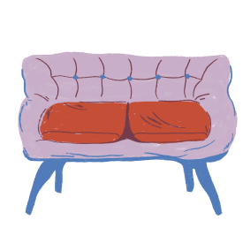
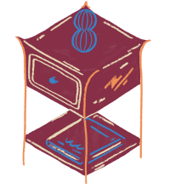
Welcome to our class!
Teacher: Nguyen Thi Thu Phuong
Class: 6D6

Slide 2
Unit 2: My house
Lesson 3: A Closer Look 2

Slide 3

Game: Pictionary

Slide 4
Rules
- 4 teams
- 1 member/team draws on the board
- The first team to say ‘Bingo‘ & give the correct answer will get 1 point

Slide 5
I. Possessive case

Slide 6
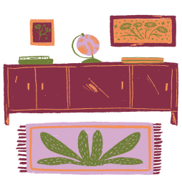

I. Possessive case (Sở hữu cách)
My sister has a book. This is my sister’s book.
Phương has a school bag. This is Phương’s school bag.
Sam has a picture. This is Sam’s picture.

Slide 7
I. Possessive case (Sở hữu cách)
→ To say “Who have/has...”, we use ‘s after:
A proper name: Phương’s, Anna’s, Peter’s, Khang’s…
A singular noun: my sister’s, my mother’s, my dad’s, my brother’s…

Slide 8




Task 1. Choose the correct answer. (p.18)
1. My grandmothers / grandmother's house is in Ha Noi.
2. This is my sister’s / sister’ desk.
3. My cousin’s / cousin dad is my uncle.
4. Nam’s / Nam’ house is small.
5. There are two bedrooms in Ans / An’s flat.

Slide 9
Task 2. Complete the sentences with the correct possessive forms. (p.19)
1. Thuc Anh is _________ cousin. (Mi)
2. This is their _________ chair. (teacher)
3. Where is _________ computer? (Nick)
Mi’s
teacher’s
Nick’s

Slide 10
Task 2. Complete the sentences with the correct possessive forms. (p.19)
4. My _________ motorbikes is in the garden. (father)
5. My _________ bedroom is next to the living room. (brother)
father’s
brother’s

Slide 11
II. Prepositions of place

Slide 12

Task 3. Write the correct preposition in the box under each picture. Say a sentence to describe the picture. (p.19)
next to on behind in between under in front of
Example:
The dog is on the chair.
on
____________

Slide 13

Task 3. Write the correct preposition in the box under each picture. Say a sentence to describe the picture. (p.19)
next to on behind in between under in front of
The dog is next to the armchair.
next to
1. ____________

Slide 14
Task 3. Write the correct preposition in the box under each picture. Say a sentence to describe the picture. (p.19)
next to on behind in between under in front of
The cat is behind the TV.
behind
2. ____________

Slide 15

Task 3. Write the correct preposition in the box under each picture. Say a sentence to describe the picture. (p.19)
next to on behind in between under in front of
The cat is in the wardrobe.
in
3. ____________

Slide 16
Task 3. Write the correct preposition in the box under each picture. Say a sentence to describe the picture. (p.19)
next to on behind in between under in front of
The dog is in front of the doghouse.
in front of
4. ____________

Slide 17
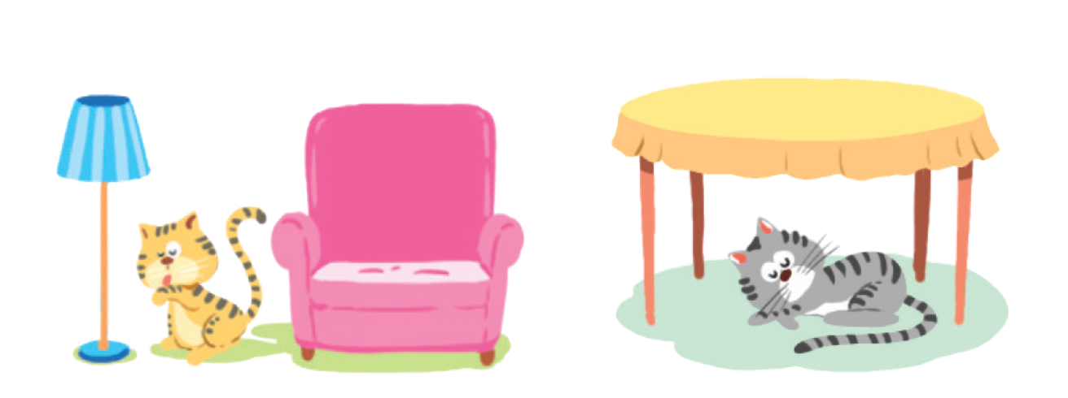
Task 3. Write the correct preposition in the box under each picture. Say a sentence to describe the picture. (p.19)
next to on behind in between under in front of
The cat is between
the lamp and the armchair.
between
5. ____________

Slide 18
Task 3. Write the correct preposition in the box under each picture. Say a sentence to describe the picture. (p.19)
next to on behind in between under in front of
The cat is under the table.
under
6. ____________

Slide 19
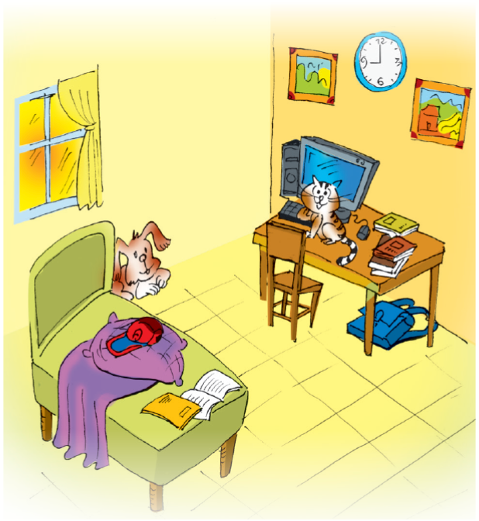
Task 4. Look at the picture and write T (True) or F (False) for each sentence. Correct the false ones. (p.20)
Example:
F
The books are under the table. ____
⟶ The books are on the table.

Slide 20
Task 4. Look at the picture and write T (True) or F (False) for each sentence. Correct the false ones. (p.20)
T
1. The dog is behind the bed. ____
F
2. The school bag is on the table. ____
⟶ The school bag is under the table.
F
3. The picture is between the clocks. __
⟶ The clock is between the pictures.

Slide 21
Task 4. Look at the picture and write T (True) or F (False) for each sentence. Correct the false ones. (p.20)
T
4. The cat is in front of the computer. __
F
5. The cap is under the pillow. ____
⟶ The cap is on the pillow.

Slide 22



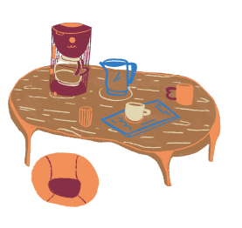
Game:
Flash

Slide 23
Rules
- I will show the picture very quickly
- You have to describe “Where is/are ...?”

Slide 24
Where is the lamp?

Slide 25


Slide 26
The lamp is next to the chair.

Slide 27
Where is the flower vase?

Slide 28
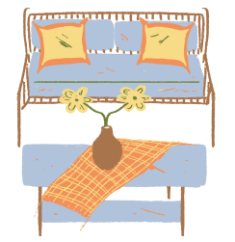

Slide 29
The flower vase is on the table.

Slide 30
Where is the cat?

Slide 31


Slide 32
The cat is in the box.

Slide 33
Where is the bed?

Slide 34
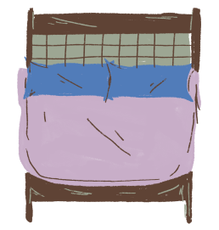
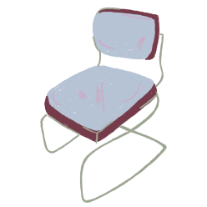

Slide 35
The bed is between the lamp and the chair.

Slide 36
Where is the window?

Slide 37
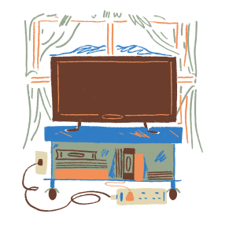

Slide 38
The window is behind the TV.

Slide 39
Where is the clock?

Slide 40



Slide 41
The clock is under the picture.

Slide 42
Where are the children?

Slide 43



Slide 44
The children are
in front of the house.

Slide 45
III. Homework
Ex 4, 5 – Part B – Unit 2 Workbook

Slide 46
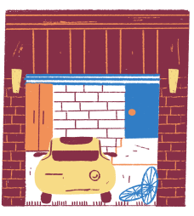
Great job! Thanks!

