Slide 1


  MINH DUC SECONDARY SCHOOL
WELCOME TO OUR CLASS!

Slide 2
WARM - UP
Put the words/ phrases into the correct order to make a sentence.

Slide 3
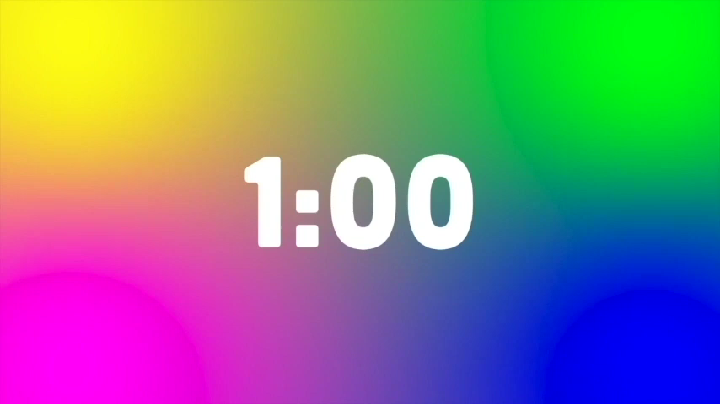

Put the words/ phrases into the correct order to make a sentence.
1. His/ mine./ color/ is/ car’s/ like/
2. photos/ is/ like/ painting./ Taking/ not/
3. not/ This painting/expensive/ is/ as/ as my painting.
4. /last week./ This show/ is/ from/ the show we saw/ different/
Notes:
2p cho hs làm việc nhóm để sắp xếp.
1p cho hs lên bảng sắp xếp các từ thành câu trả lời, để tiết kiệm tgian, GV có thể in giấy và cắt ra từng từ/ cụm từ cho hs dán lên bảng.

Slide 4
Check your answers
Comparison: like; different from; (not) as…as….
01
His car’s color is like mine.
02
Taking photos is not like painting.
03
This painting is not as expensive as my painting.
04
This show is different from the show we saw last week.

Slide 5
………….., November ….., 202…
Unit 4
MUSIC AND ARTS
Lesson 3: A Closer Look 2

Slide 6




Making comparisons
Robert
Mary
Bob
Robert’s pencil case
Mary’s
pencil case
Bob’s
pencil case

Slide 7

different from
Mary’s
pencil case
Bob’s
pencil case
Mary’s pencil case is different from Bob’s pencil case.
If two things are not similar, we use different from.
S
to be / verb
different from
N/ pronoun

Slide 8
like
Robert’s pencil case
Mary’s
pencil case
Robert’s pencil case is like Mary’s pencil case.
Robert’s pencil case is not like Bob’s pencil case.
Robert’s pencil case
Bob’s
pencil case
We can also use like to compare.
S
to be/ verb
like
N/ pronoun

Slide 9




(not) as…as
The red pencil is as long as the green pencil.
The red pencil is not as long as (shorter) the orange pencil.
The red pencil is not as long as (longer) the yellow pencil.
as + adjective + as to show that two things are similar.
not as + adjective + as to show that sth is "more" or "less" than sth else.
S
to be (not)
as adj as
N/ pronoun

Slide 10
Making comparisons
S
to be / verb
different from
N/ pronoun
S
to be/ verb
like
N/ pronoun
S
to be (not)
as adj as
N/ pronoun

Slide 11
1. Write like, as, or different in the gaps. (p.43)
1. This camera is not as expensive ______ I thought at first.
2. Her room is lovely. It is ______ a princess's room.
3. You like folk songs; I like pop music. Your taste is _________ from mine.
4. My dad is not always as busy ______ my mum.
5. Some of us think that Spiderman 2 is not too _________ from Spiderman 1.
as
like
different
as
different

Slide 12


Is it different?
1
ROCK MUSIC
2
COUNTRY MUSIC
Notes:
CLICK ô vuông 1-2 để nghe 2 âm thanh

Slide 13
2. Finish the second sentence in each pair, using like, as... as, or different from. (p.43)
1. Rock is very exciting. It is not like country music.
→ Rock is very ____________________ country music.
2. Composer Hoang Long wrote many good songs for children. Composer Pham Tuyen also wrote many good songs for children.
→ Composer Hoang Long, ____________________ Pham Tuyen, wrote many good songs for children.
3. The Vatican Museum has excellent works of art. The Louvre Museum has excellent works of art too.
→ The Vatican Museum's works of art are ______ excellent ______ the Louvre Museum's works of art.
4. A vacation on the beach is relaxing, while a vacation in a big city may not be.
→ A vacation on the beach is ____________________ a vacation in a big city.
5. City life is busy, but country life is peaceful.
→ City life is not _____ peaceful _____ country life.
different from
2022
2023

Slide 14
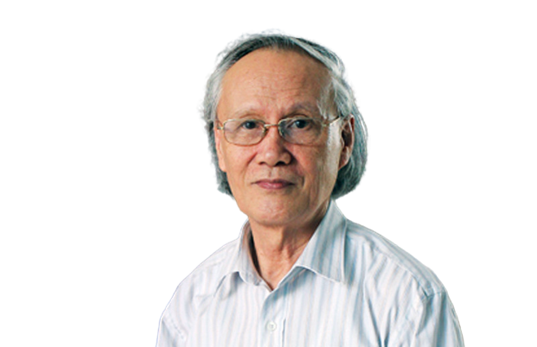
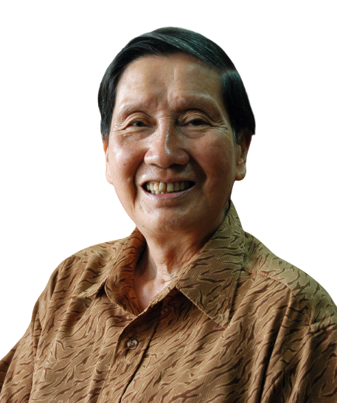
Check your answers
02
Composer Hoang Long wrote many good songs for children.
Composer Pham Tuyen also wrote many good songs for children.
like
→ Composer Hoang Long, _________ Pham Tuyen, wrote many good songs for children.

Slide 15
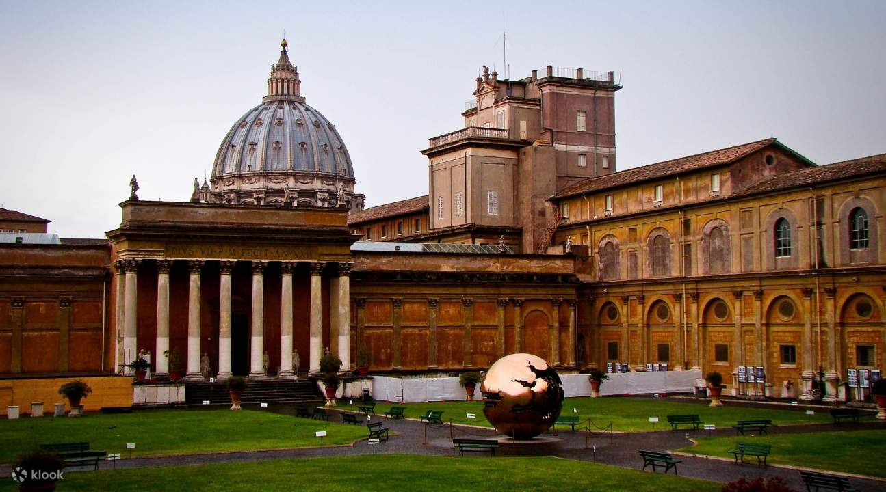
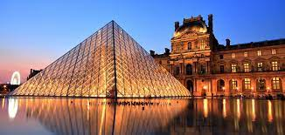
Check your answers
03
The Vatican Museum has excellent works of art.
The Louvre Museum has excellent works of art too.
as
→ The Vatican Museum's works of art are ______ excellent ______ the Louvre Museum's works of art.
as

Slide 16

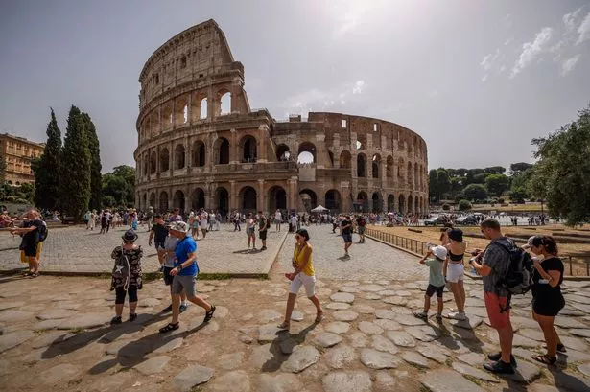
Check your answers
04
A vacation on the beach is relaxing
while a vacation in a big city may not be.
different from
→ A vacation on the beach is _________________ a vacation in a big city.

Slide 17
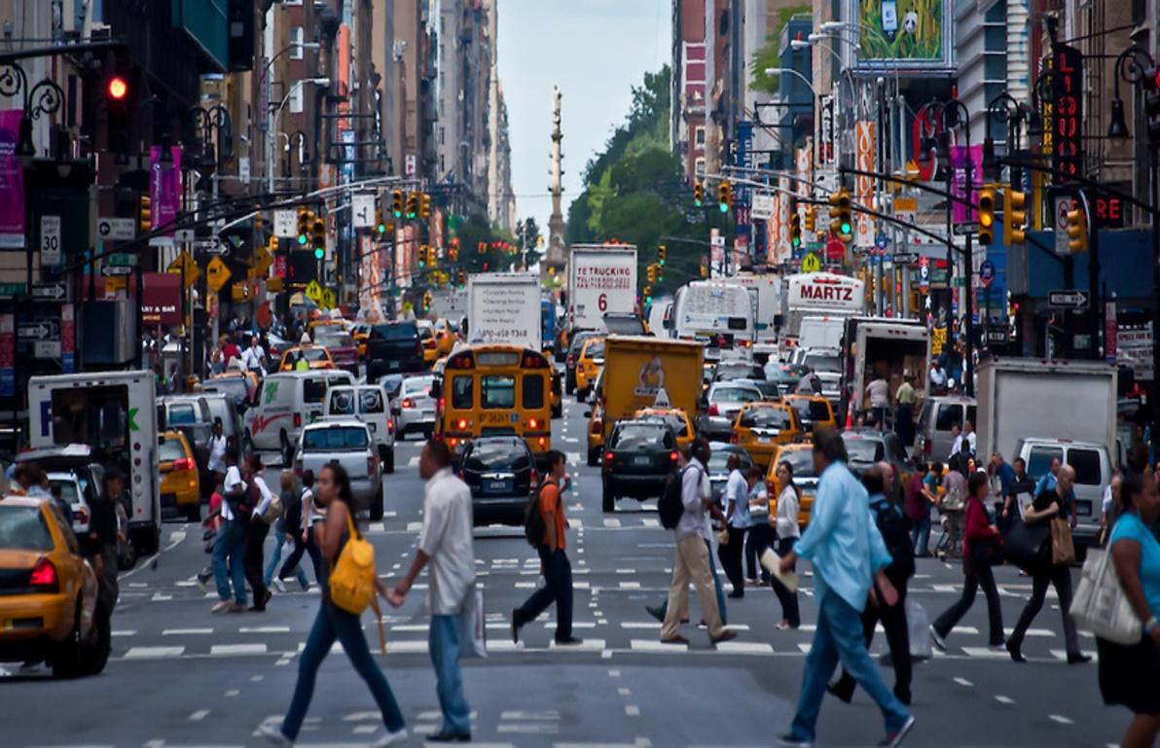
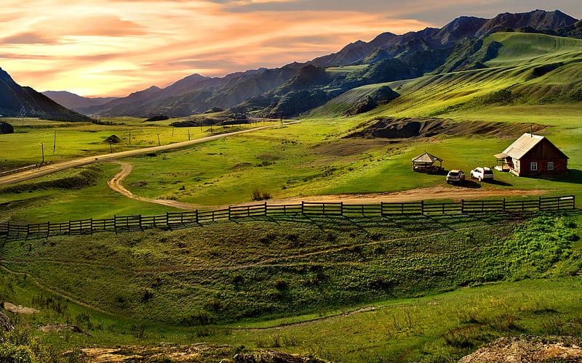
Check your answers
05
City life is busy
but country life is peaceful
as
as
→ City life is not _____ peaceful _____ country life.

Slide 18
Look at the answers again
1. Rock is very exciting. It is not like country music.
→ Rock is very ____________________ country music.
2. Composer Hoang Long wrote many good songs for children. Composer Pham Tuyen also wrote many good songs for children.
→ Composer Hoang Long, _____Pham Tuyen, wrote many good songs for children.
3. The Vatican Museum has excellent works of art. The Louvre Museum has excellent works of art too.
→ The Vatican Museum's works of art are ______ excellent ______ the Louvre Museum's works of art.
4. A vacation on the beach is relaxing, while a vacation in a big city may not be.
→ A vacation on the beach is ____________________ a vacation in a big city.
5. City life is busy, but country life is peaceful.
→ City life is not _____ peaceful _____ country life.
different from
like
2022
2023
as
as
different from
as
as

Slide 19
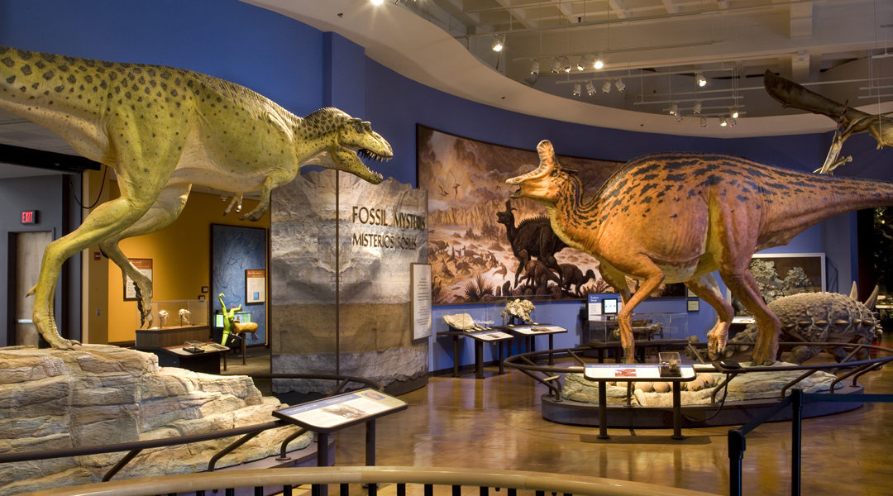

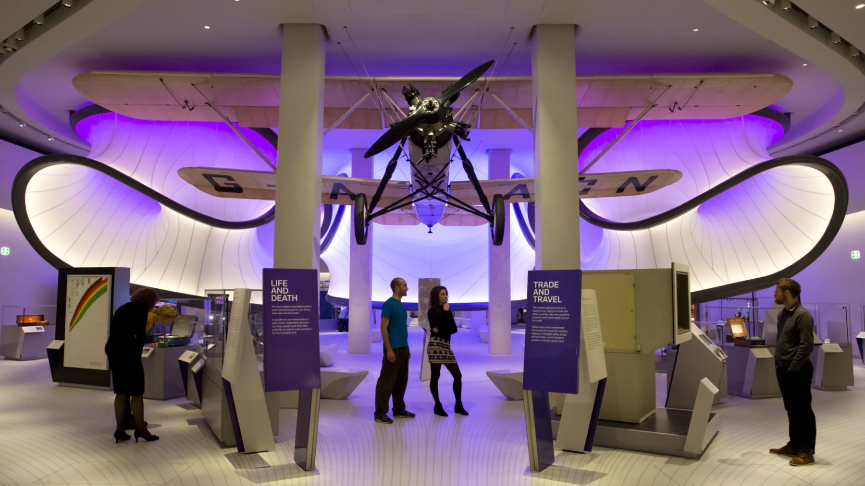
SCIENCE MUSEUM
HISTORY MUSEUM

Slide 20


3. Work in pairs. Compare the two museums: History and Science, using like, as..as, or different from.
Example: History is not as modern as Science.
HISTORY
SCIENCE
1. modern
2. friendly
3. interesting
4. expensive

Slide 21


Pick a box
Answer the question
Get a random prize below
The winning team has the most points
100
Blow friend’s point
Swap point
Your point

Slide 22

PICK A BOX
1
2
3
2
4
5
6
1
3
2

Slide 23

Making comparison
History museum Science museum
modern
History museum is
not as modern as Science museum.

Slide 24
Making comparison
History museum Science museum
friendly
History museum is as friendly as Science museum.

Slide 25
Making comparison
History museum Science museum
interesting
History museum is not as interesting as Science museum.

Slide 26
Making comparison
History museum Science museum
expensive
History museum is as expensive as Science museum.

Slide 27


Slide 29

4. Rewrite the sentences, using the words given at the beginning
Example: A play is usually longer than a film.
→ A film is usually not as long as a play.
1. I think action films are more interesting than comedies.
→ I think comedies are not _____________________________
2. Our Maths homework is more difficult than our history homework.
→ Our history homework is not _____________________________
3. This year's music contest is different from last year’s.
→ This year's music contest is not _____________________________
4. The characters in the film are not the same as the ones in the play.
→ The characters in the film are _____________________________.
5. This picture is brighter than that picture.
→ That picture is not _____________________________.

Slide 30
Check your answers
1. I think action films are more interesting than comedies.
→ I think comedies are not ________________________________
2. Our Maths homework is more difficult than our history homework.
→ Our history homework is not _____________________________________.
3. This year's music contest is different from last year’s.
→ This year's music contest is not _____________________________
4. The characters in the film are not the same as the ones in the play.
→ The characters in the film are _______________________________________.
5. This picture is brighter than that picture.
→ That picture is not _____________________________.
as interesting as action films.
as difficult as our Maths homework.
like last year’s.
different from the ones in the play
as bright as this one

Slide 31
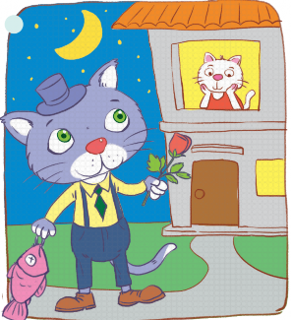
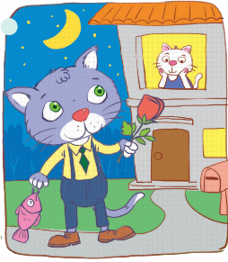
5. Work in groups. Look at the two pictures below.
Compare them, using like, as … as, or different from. (p.44)
A
Example:
- Picture A is not like / different from picture B.
- Picture A is not as big as picture B.
B

Slide 32
Recap
What structures have we learned today?
(not) as adj as
different from
the same as
like

Slide 33
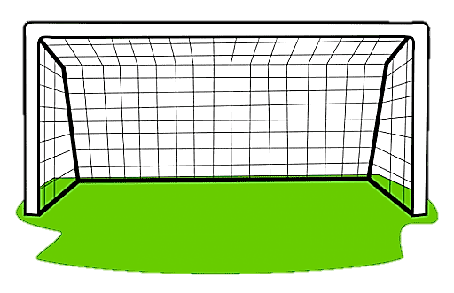


1. Our school uniform is _____ yours. Both are black and white.
A. like
B. different
C. more beautiful

Slide 34
2. English and Portuguese are _____ each other.
A. like
B. different from
C. the same to

Slide 35
3. Life in the big city is not _____ peaceful and interesting as life in the countryside.
A. as
B. than
C. more

Slide 36
4. The test is not _______ difficult _______ it was last year.
A. more - as
B. as - like
C. as - as

Slide 37
5. Hanoi is not _____ crowded as Ho Chi Minh City.
A. as
B. like
C. different

Slide 38

HOMEWORK
- Prepare for the next lesson
- Do Part B – Exercise 4,5,6,7 – p. 30

Slide 39
THANK YOU!

