Slide 1
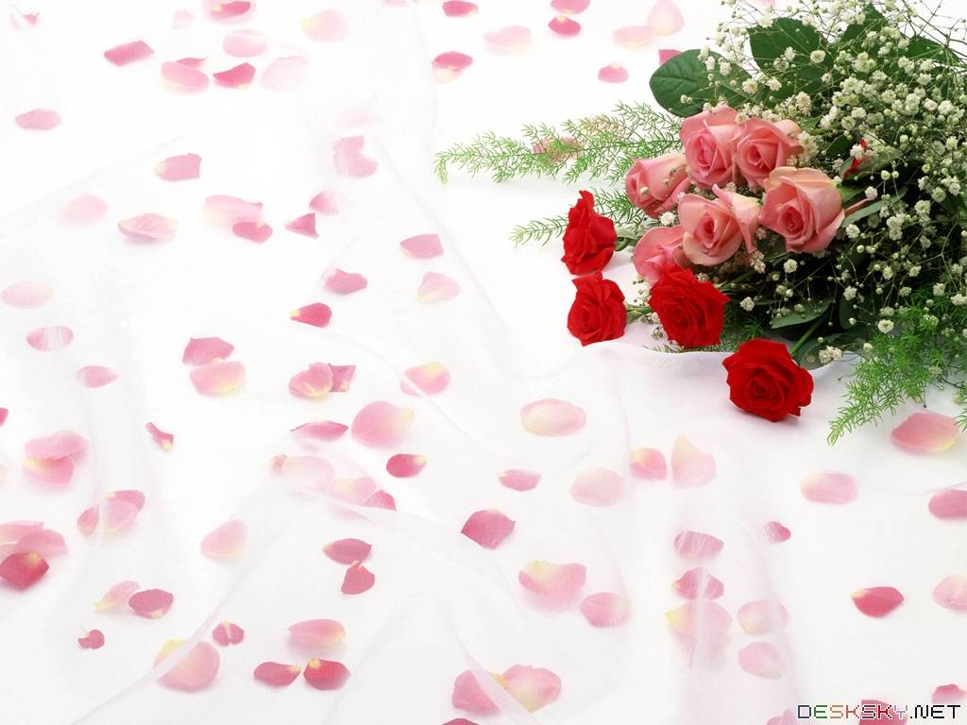
Warmly welcome to our class
English 6 A2

Slide 2
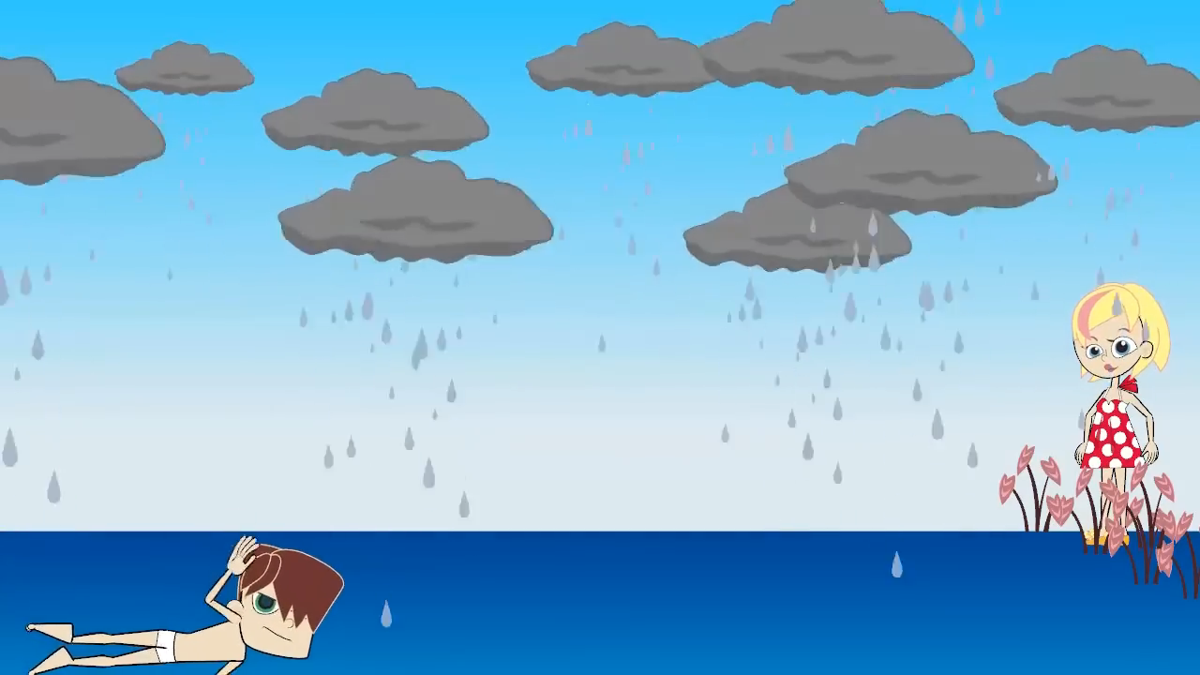
Watch and fill in the blank
1. You ___________ swim during the storm.
shouldn’t
2. You __________drive in the park.
shouldn’t
3. He shouldn’t ______ TV all day.
watch
4. You shouldn’t _____ on the table.
stand
5. You _______ run in the park.
should

Slide 3

UNIT 6: OUR TET HOLIDAY
LESSON 3. A CLOSER LOOK 2

Slide 4
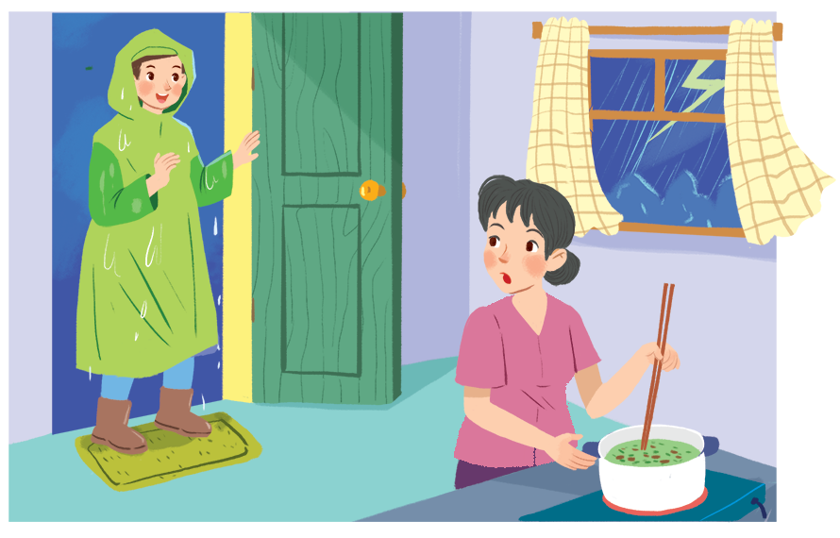
I. Grammar 1
Should / shouldn’t for advice
Nam, you shouldn't come in with your raincoat on.
When do you use should /shouldn’t?

Slide 5

Should / shouldn’t for advice
- should : nên, - shouldn’t : không nên
Ex: You shouldn't come in with your raincoat on.
* Form:
(+) S + should + V (BI) + ……….
(-) S + shouldn’t + V (BI) + ……….
should
We use ________ for things that are good to do.
We use ___________ for things that are not good to do.
shouldn’t

Slide 6


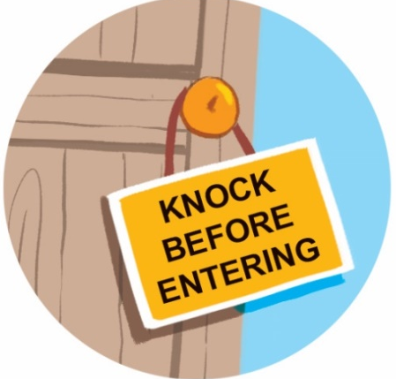
Ex1. Look at the signs at the library and complete the sentences with should or shouldn’t.
should
1. You. .……….keep quiet.
shouldn’t
2. You ………..…..eat or drink.
should
shouldn’t
3. You…..………. knock before you enter.
4. You……………....run

Slide 7
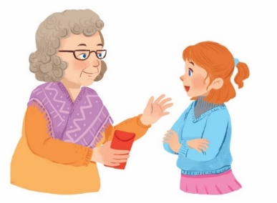
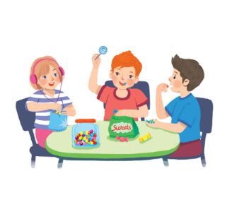
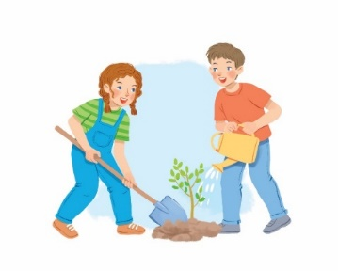
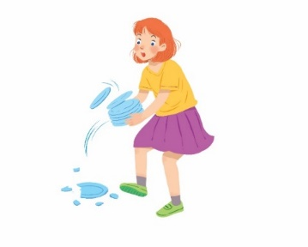
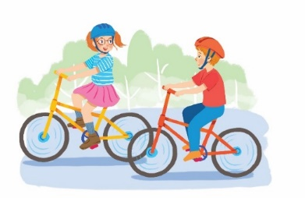
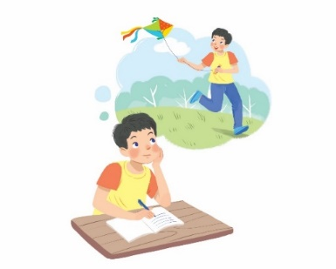
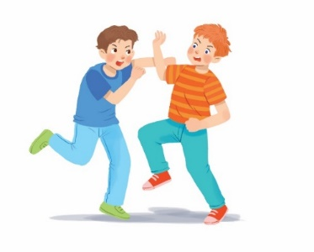
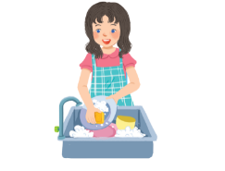
Ex2. Tick () the activities children should do at Tet and cross (×) the ones they shouldn’t.
Thank you.




1.
behave well
2.
eat lots of sweets
3.
plant trees
4.
break things




5.
go out with friends
6.
make a wish
7.
fight
8.
help with housework

Slide 8
Ex3. Work in pairs. Look at the activities in 2. Take turns to say what you think children should / shouldn’t do.
Thank you.




1.
behave well
2.
eat lots of sweets
3.
plant trees
4.
break things




5.
go out with friends
6.
make a wish
7.
fight
8.
help with housework
Example:
1. Children should behave well.
2. Children shouldn’t eat lots of sweets.

Slide 9
Questions: Lucky numbers
1
2
3
4
Team A
5
6
7
8
Team B
2
4
2
8
4
10
8
6
6
10

Slide 10
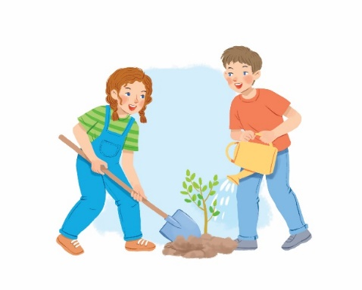

3. plant trees
Children should plant trees

Slide 11
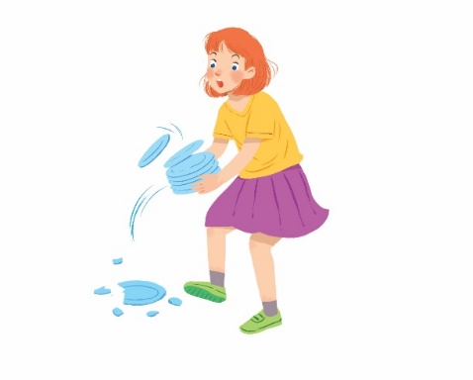

4. break things
Children shouldn’t break thing

Slide 12


5. go out with friends
Children should go out with friends

Slide 13

6. make a wish
Children should make a wish.

Slide 14
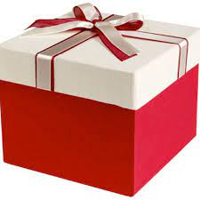
LUCKY NUMBER!

Slide 15

7. fight
Children shouldn’t fight

Slide 16

8. help with housework
Children should help with housework

Slide 17
LUCKY NUMBER!

Slide 18
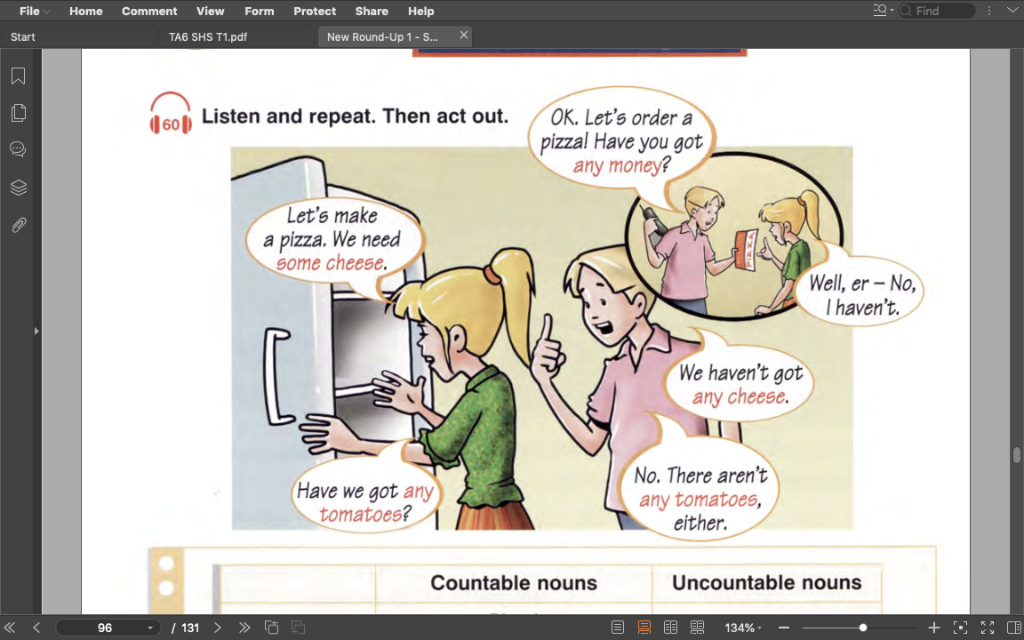

Listen and answer:
What are they talking about?
=> making and ordering pizza

Slide 19
Read and circle some or any
1. We use some / any for positive statements (+).
2. We use some / any for negative statements (-).
3. We use some / any for questions (?).

Slide 20
II. Grammar 2
Some / any for amount
Some / any: một vài, một ít
Some
any
(+) My mother bought some fruits.
(+) I need some milk for the cake.
(-) I can’t answer any questions.
(?) Do you have any sugar?
* Note:
- Some: Dùng trong câu khẳng định.
- Any: Dùng trong câu phủ định và câu hỏi.
* Ngoại lệ câu mời : Would you like some tea?

Slide 21
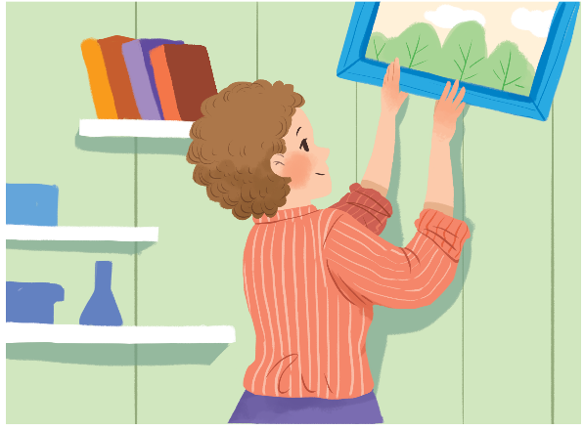
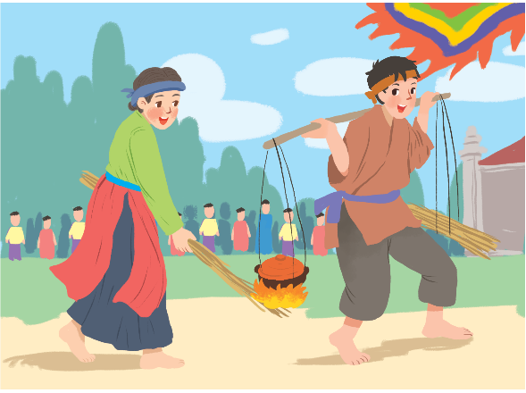
Ex4. Complete the sentences with some or any.
1. What do you need to decorate your room?
- I need colour paper and pictures.
2. Do you have free time for spotrs?
- Yes, I do.
3. Are there interesting activities here during Tet?
- Yes, there are traditional games like human chess, running and cooking.

Slide 22





1
What do you need to decorate your room?
I need ______ colour paper and _____ pictures.
some
some
any
NEXT

Slide 23
1
What do you need to decorate your room?
I need some colour paper and _____ pictures.
some
some
any
NEXT

Slide 24
2
any
Do you have _______ free time for sports?
Yes, I do.
some
any
NEXT

Slide 25
3
Are there ___ interesting activities here during Tet?
Yes, there are _____ traditional games like human chess, running and cooking.
any
some
any
NEXT

Slide 26
3
Are there any interesting activities here during Tet?
Yes, there are _____ traditional games like human chess, running and cooking.
some
some
any
NEXT

Slide 27
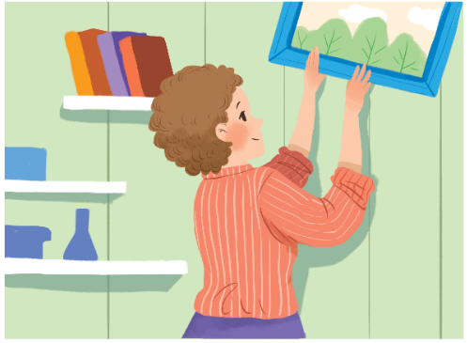
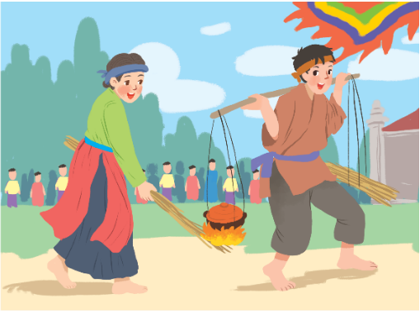
Look at the answers again
1. What do you need to decorate your room?
- I need colour paper and pictures.
some
some
any
2. Do you have free time for sports?
- Yes, I do.
any
3. Are there interesting activities here during Tet?
- Yes, there are traditional games like human chess, running and cooking.
some

Slide 28
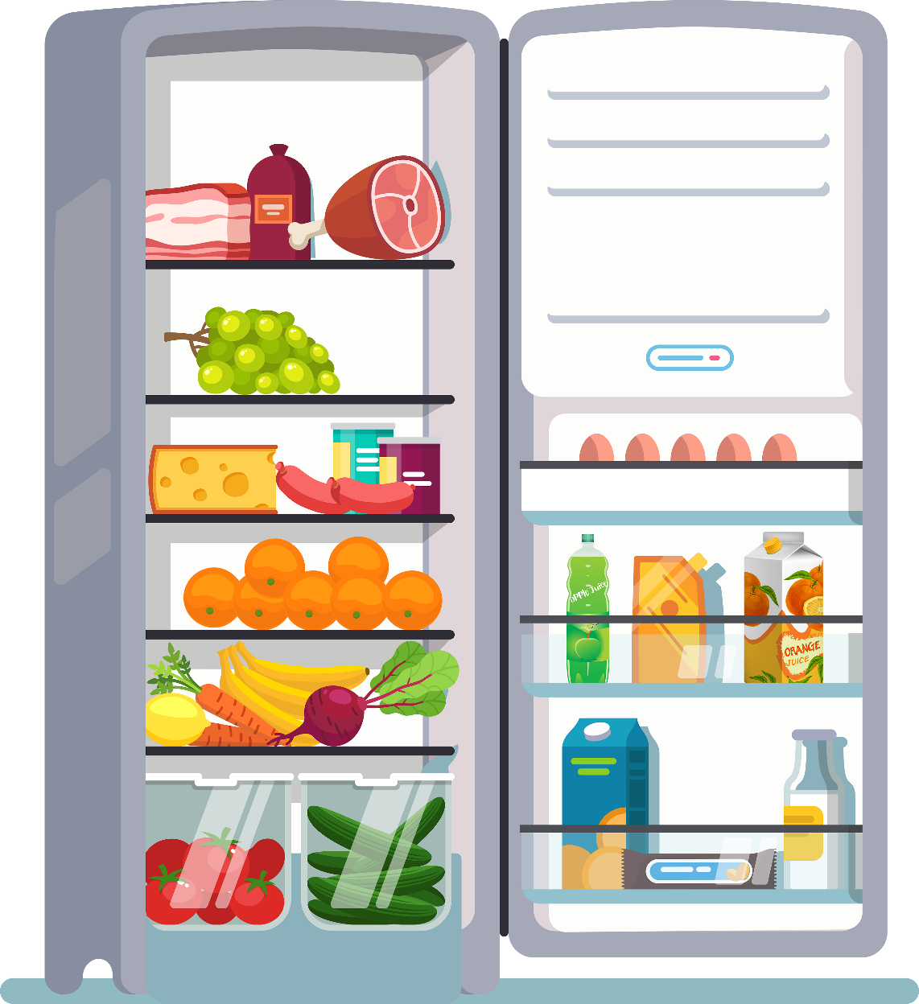
Ex5. Work in pairs. Look at the fridge. Make sentences with the words / phrases provided, using some or any.
Example:
- ice cream
There is not any ice cream.
- cucumbers
There are some cucumbers.

Slide 29

1.
eggs
There are some eggs (in the fridge).
2.
fruit juice
There is some fruit juice.
3.
apples
There aren’t any apples.
4.
bread
There isn’t any bread.
5.
bananas
There are some bananas.
6.
cheese
There is some cheese.

Slide 30
WRAP - UP
What have we learned today?
should / shouldn’t for advice
some / any for amount

Slide 31
CLICK THE LINK TO PRACTICE MORE:
https://english6unit5.my.canva.site/dagxdqyupio

Slide 32



Home ASSIGNMENTS
- Practice giving advice with should / shouldn’t.
- Practice saying the amount with some / any
- Prepare: Unit 6 - Communication

