Slide 1
JUMBLED SENTENCES
1.
is | Engish | She | learning | now.
→ She is learning English now.
2.
They | energy | not | are | solar | using | ?
→ They are not using solar energy.
3.
You | Are | your project | working | on | ?
→ Are you working on your Project?
4.
is | Where | studying. | brother | your
→ Where is your brother studying?

Slide 2
UNIT 10. ENERGY SOURCES
LESSON 3: A CLOSER LOOK 2

Slide 3
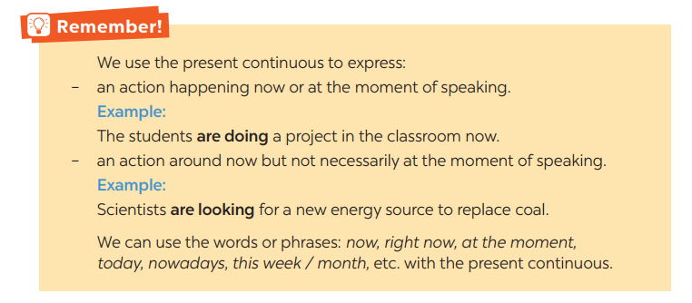
GRAMMAR: PRESENT CONTINUOUS

Slide 4
GRAMMAR: PRESENT CONTINUOUS
- Khẳng định: S + am / is / are + V-ing.
- Phủ định: S + am / is / are + not + V-ing.
- Nghi vấn: Am / Is / Are + S + V-ing?
- Câu hỏi với từ để hỏi: (wh - word) + Am / Is / Are + S + V-ing?

Slide 5
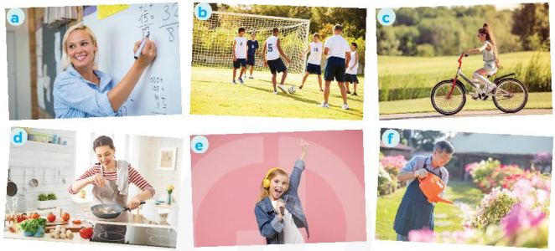
1
Work in pairs. Tell your partner what the people in the pictures are doing
Game

Slide 6
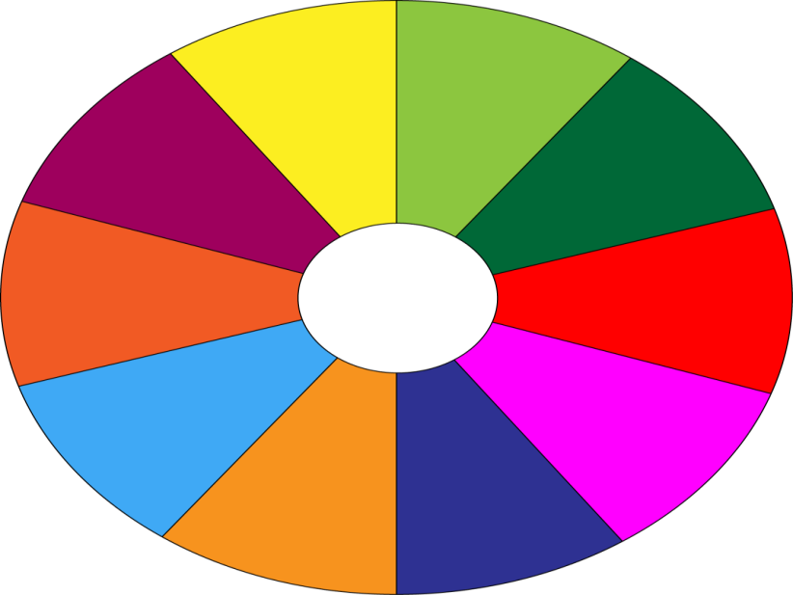
THE BIG WHEEL GAME
QUESTIONS
10
40
1
4
30
50
2
5
SPIN
20
10
3
6
-15
-20
05
60

Slide 7
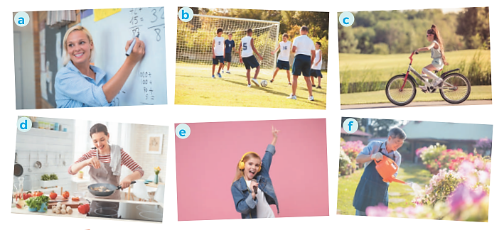
1
Work in pairs. Tell your partner what the people in the pictures are doing
She is teaching maths / is writing on the board.

Slide 8
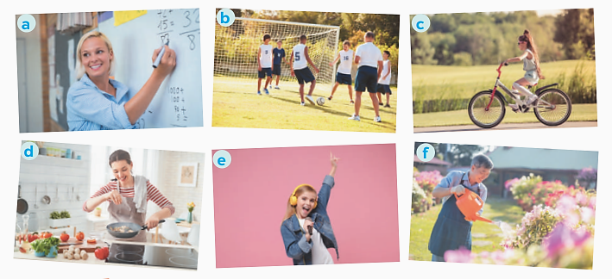
1
Work in pairs. Tell your partner what the people in the pictures are doing
They are play football/soccer.

Slide 9
1
Work in pairs. Tell your partner what the people in the pictures are doing
She is riding her bike/bicycle.

Slide 10
1
Work in pairs. Tell your partner what the people in the pictures are doing
She is cooking.

Slide 11

1
Work in pairs. Tell your partner what the people in the pictures are doing
She is singing.

Slide 12

1
Work in pairs. Tell your partner what the people in the pictures are doing
He is watering the flowers/plants/is doing gardening.

Slide 13
1
Work in pairs. Tell your partner what the people in the pictures are doing
* ANSWERS:
a- She is teaching maths / is writing on the board.
b- They are play football / soccer.
c- She is riding her bike / bicycle.
d- She is cooking.
c- She is singing.
f- He is watering the flowers / plants / is doing gardening.

Slide 14
2
Complete the sentences, using the present continuous form of the verbs in brackets.
is talking
1. Mai (talk) _________ about types of energy sources now.
2. We (use) ________ solar energy to replace energy from coal today.
3. Keep quiet! The students of Class 7C (take) _________ a test.
4. Scientists (develop) ____________ new energy sources to protect the environment.
5. We (reduce) ____________ the use of nuclear energy nowadays.
are using
are taking
are developing
are reducing

Slide 15
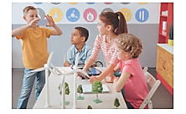
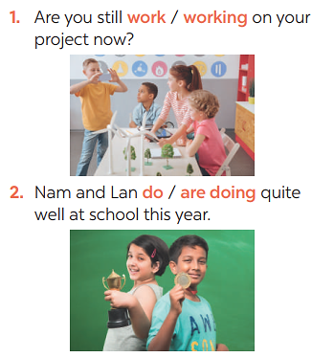
3
Circle the correct form of the verb in each sentence
2. Nam and Lan do / are doing quite well at school this year.
1. Are you still work / working on your project now?

Slide 16
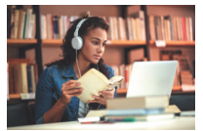
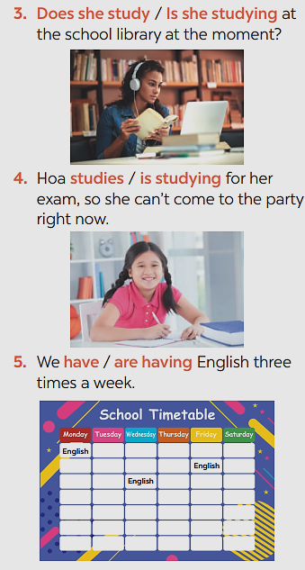
3
Circle the correct form of the verb in each sentence
Does she study / Is she studying at the school library at the moment?
Hoa studies / is studying for her exam, so she can't come to the party right now.

Slide 17
3
Circle the correct form of the verb in each sentence
We have / are having English three times a week.

Slide 18
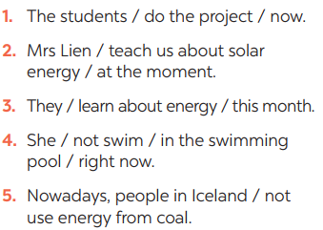
4
Write sentences about what the people are doing or not doing, using the suggestions.
* Answers:
1- The students are doing the project now.
2- Mrs. Lien is teaching us about solar energy at the moment.
3- They are learning about energy this month.
4- She isn’t swimming in the swimming pool right now.
5- Nowadays, people in Iceland aren’t using energy from coal.

Slide 19
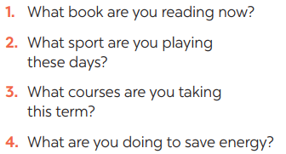
* PRODUCTION
5
Work in pairs. Ask and answer the following questions.
1. I’m reading a comic book now.
2. I’m playing chess.
3. I’m not taking any courses.
4. I’m walking to school.

Slide 20
* CONSOLIDATION
GRAMMAR: PRESENT CONTINUOUS

Slide 21
Home assignments
Exercises in the workbook.
Prepare lesson 4 ( communication)

