Slide 1
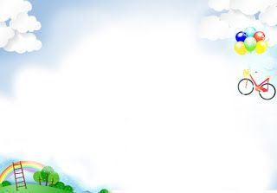
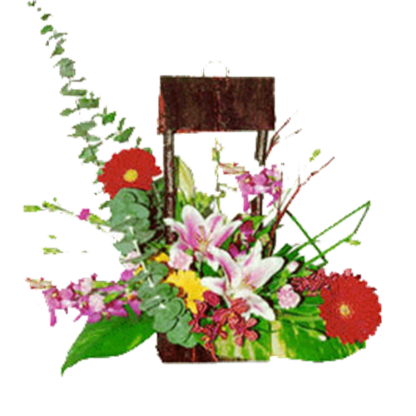
Hello every one !!!
love

Slide 2
WARM-UP
Write the names of the festivals
2 teams
*
Cannes Film Festival
Halloween
Types of festivals
Christmas
Mid-Autumn Festival
Tet holiday
Twins Day Festival
Thanksgiving
Easter
music festival
Buffalo – fighting Festival

Slide 3

Unit
9
FESTIVALS AROUND THE WORLD
LESSON 7: LOOKING BACK & PROJECT
Vocabulary review
Grammar review
Project: A new festival
Unit

Slide 4
* VOCABULARY REVIEW
1
Circle the correct words or phrases in brackets.
There wasn’t a (light / fireworks) display on New Year’s Eve last year.
She was the best actress at the (Cannes Film Festival / music festival) last year.
At Easter, children enjoy (painting / buying) Easter eggs.
People prepare (moon cakes / candy apples) for Halloween.
For (Thanksgiving / Tet), people have a feast with turkey, cornbread, and sweet potatoes.

Slide 5
2
Complete each sentence by filling in the blank with a word or phrase in the box.
floats Bunny lion dances costumes gathering
The best part of the Mid-Autumn Festival is the performance of __________.
There are flower ____________ in the Tulip Festival.
We like to wear traditional ____________ at Tet.
One of the symbols of Easter is the Easter ____________.
The Twins Day Festival is the largest ____________ for twins in the world.
Bunny : con Thỏ
Game

Slide 6
LUCKY NUMBERS
1
2
3
4
5
6
7
8
A
2
4
6
8
10
12
14
B
2
4
6
8
10
12
14

Slide 7
2
Complete each sentence by filling in the blank with a word or phrase in the box.
floats Bunny lion dances costumes gathering
The best part of the Mid-Autumn Festival is the performance of __________.
lion dances

Slide 8
2
Complete each sentence by filling in the blank with a word or phrase in the box.
floats Bunny lion dances costumes gathering
2. There are flower ____________ in the Tulip Festival.
floats

Slide 9
2
Complete each sentence by filling in the blank with a word or phrase in the box.
floats Bunny lion dances costumes gathering
3. We like to wear traditional ____________ at Tet.
costumes

Slide 10
2
Complete each sentence by filling in the blank with a word or phrase in the box.
floats Bunny lion dances costumes gathering
4. One of the symbols of Easter is the Easter ____________.
Bunny

Slide 11
2
Complete each sentence by filling in the blank with a word or phrase in the box.
floats Bunny lion dances costumes gathering
5. The Twins Day Festival is the largest ____________ for twins in the world.
gathering

Slide 12

LUCKY NUMBER!
you get 2 plus points

Slide 13
LUCKY NUMBER!
you get 2 plus points

Slide 14
LUCKY NUMBER!
you get 2 plus points

Slide 15
2
Complete each sentence by filling in the blank with a word or phrase in the box.
floats Bunny lion dances costumes gathering
The best part of the Mid-Autumn Festival is the performance of __________.
There are flower ____________ in the Tulip Festival.
We like to wear traditional ____________ at Tet.
One of the symbols of Easter is the Easter ____________.
The Twins Day Festival is the largest ____________ for twins in the world.
lion dances
floats
costumes
Bunny
gathering

Slide 16
* GRAMMAR REVIEW
3
Choose the correct question A or B.
1. A. Did you go to the Lim Festival yesterday?
B. Are you go to the Lim Festival yesterday?
2. A. Are they always celebrate the festival in May?
B. Do they always celebrate the festival in May?
3. A. Will you wear a costume for Halloween?
B. Will do you wear a costume for Halloween?
4. A. Does he interested in joining the festival?
B. Is he interested in joining the festival?
5. A. Do people listen to traditional songs at the Hoi Mua Festival last year?
B. Did people listen to traditional songs at the Hoi Mua Festival last year?

Slide 17
GRAMMAR REVIEW
4
Answer the following questions about yourself.
1. Are you interested in festivals?
2. Do you eat banh chung at Tet?
3. Can you cook any traditional food?
4. Did you see a fireworks display last year?
5. Does your family gather together at Tet?
Yes, I am. / No, I am not.
Yes, I do. / No, I don't
Yes, I can. / No, I can't.
Yes, I did. / No, I didn't
Yes, we do. / No, we don't.

Slide 18
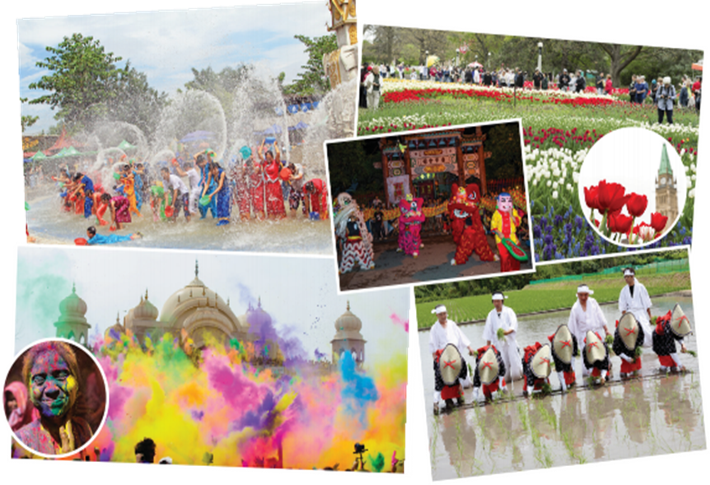
Each festival you can say about food and activities do in that festival.
Then make sure you can’t say the name of that festival.

Slide 19
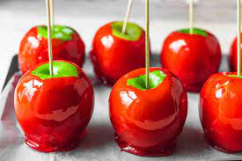
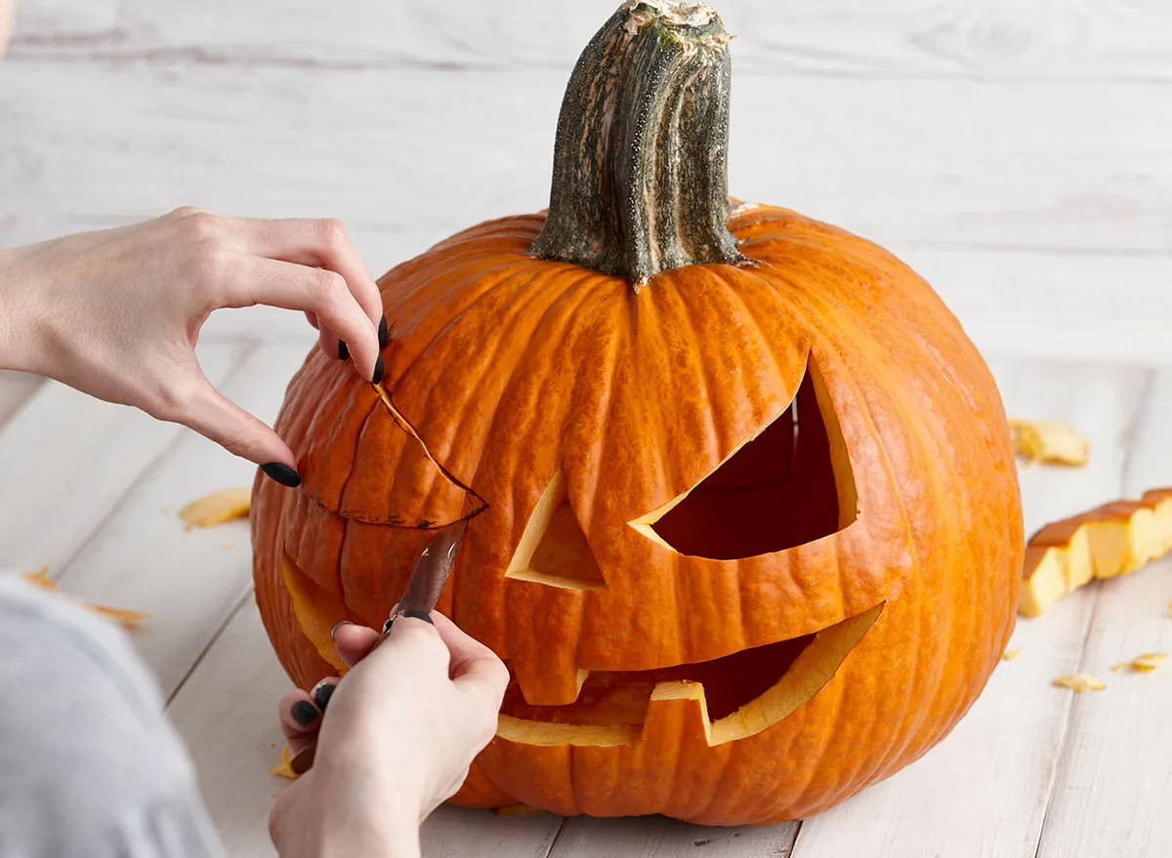
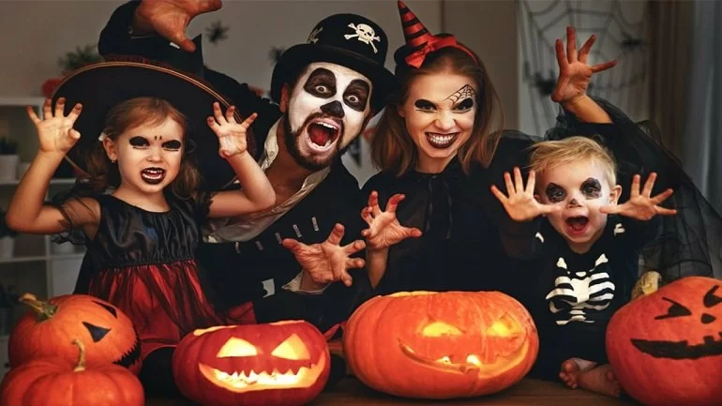
WARM-UP
carving pumpkins
candy apples
Halloween

Slide 20
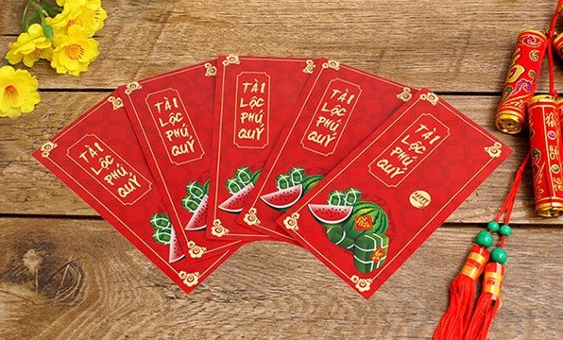
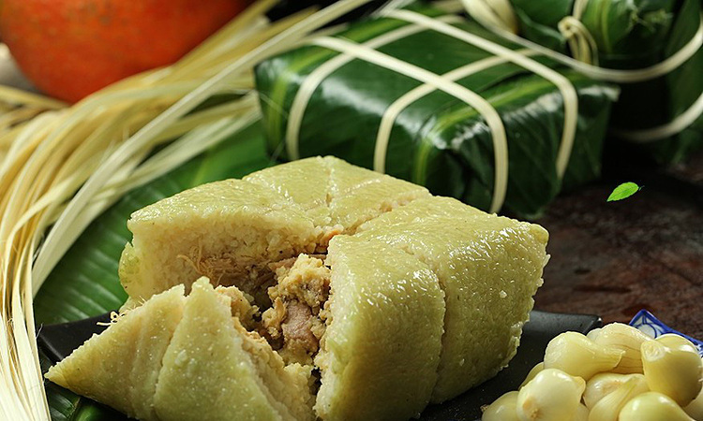
WARM-UP
Lucky money
Making “bánh chưng”
Tet

Slide 21
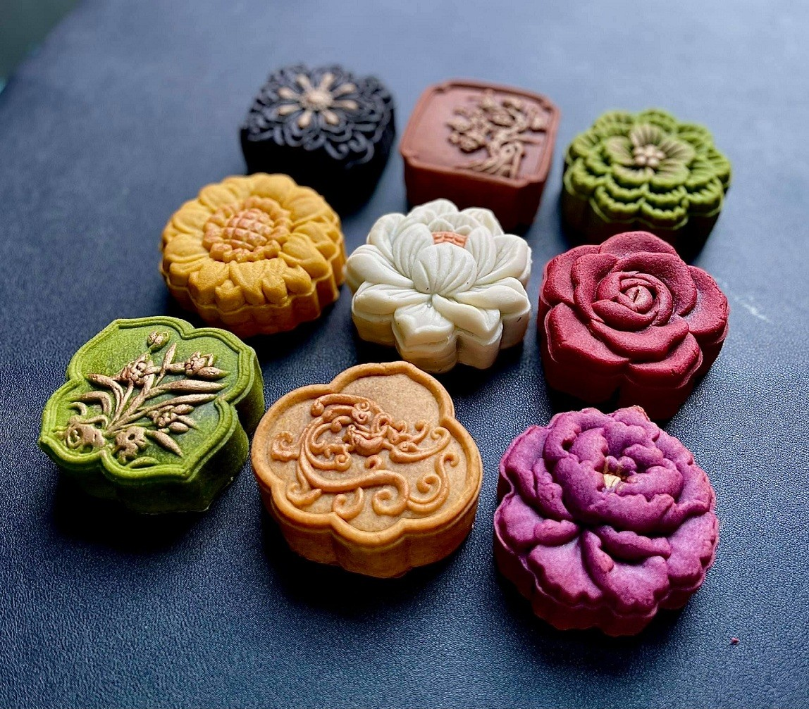
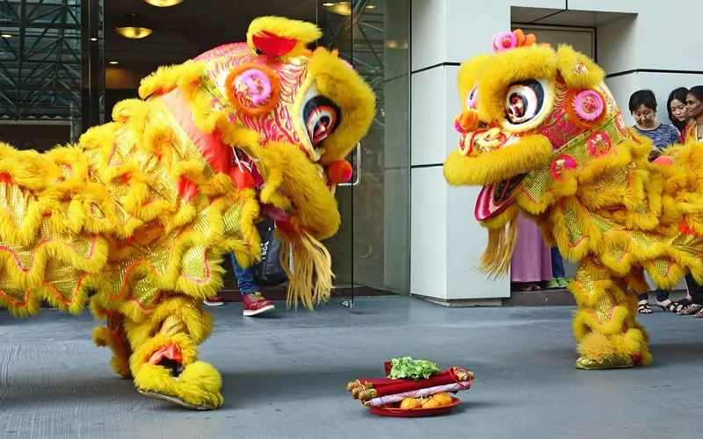
WARM-UP
Moon cakes
performing a lion dance
Mid-Autumn Festival

Slide 22
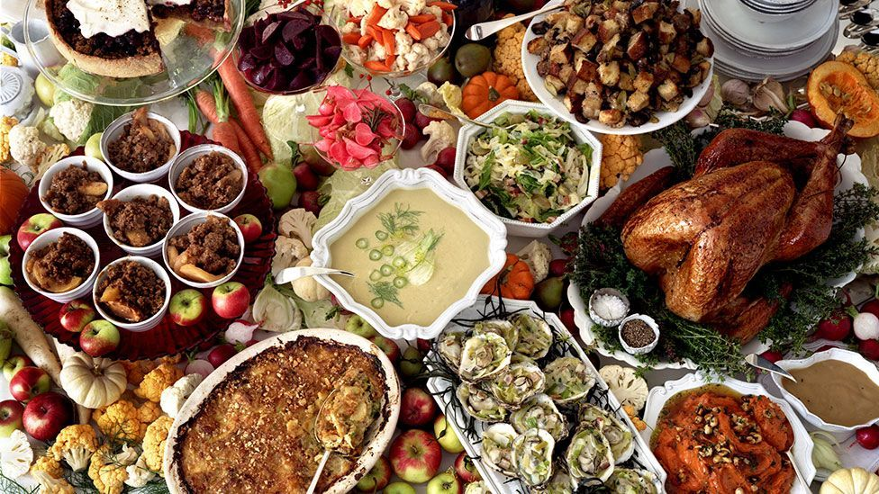
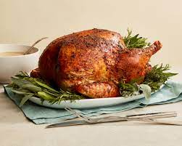
WARM-UP
Turkey
having a feast
Thanksgiving

Slide 23
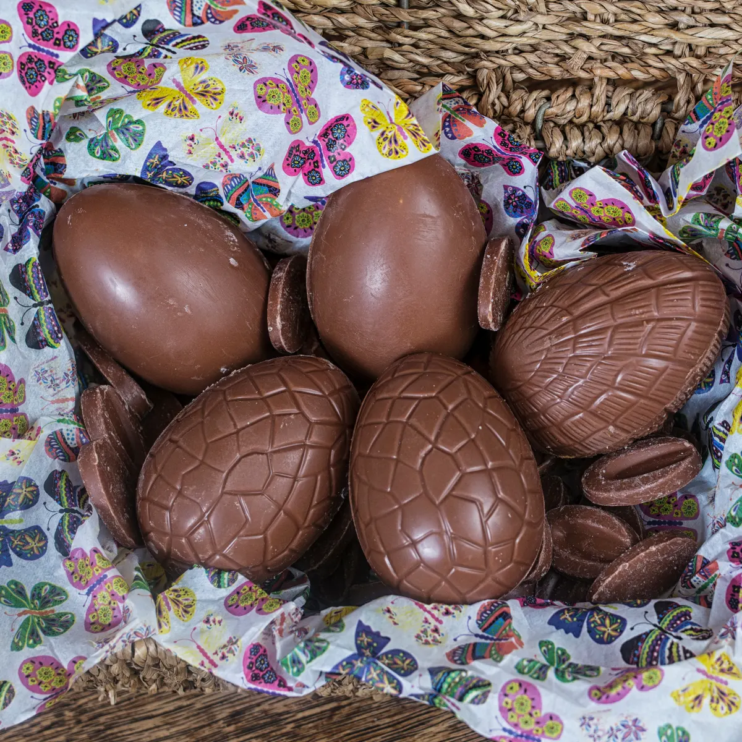
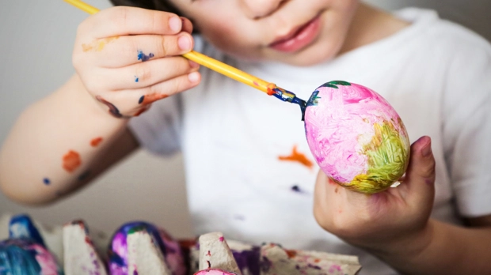
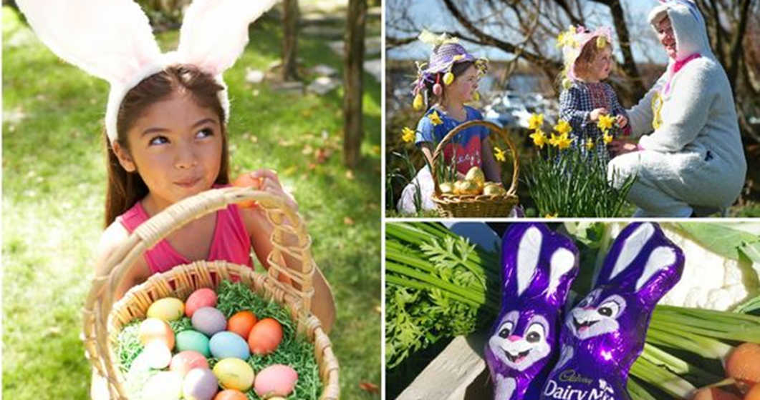
WARM-UP
Chocolate eggs
Painting eggs
Easter

Slide 24
PROJECT
A NEW FESTIVAL
5
1
Think of a new festival that you would like to celebrate. Discuss the following points:
- Name of the festival
- Time and place of the festival
- Festival activities
Draw pictures of the new festival or cut out pictures from magazines.
Present your festival to the class.
Vote for the best poster.
2
3
4

Slide 25

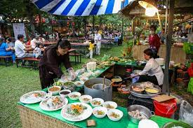
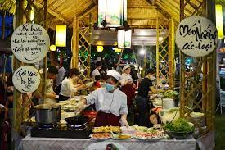
1
Think of a new festival that you would like to celebrate. Discuss the following points:
Name | Vietnamese food festival
Time | Every year in January
Place | In Ha Noi, Da Nang, and Ho Chi Minh City
Activities | - cook traditional dishes in Vietnam - decorate and give a presentation about a dish

Slide 26
2
Draw pictures of the new festival or cut out pictures from magazines.
Present your festival to the class.
3
Hello everyone, today I will tell you about a new festival in my country. That is a Vietnamese food festival. It is held in January and once a year in 3 big cities: Ha Noi, Da Nang and Ho Chi Minh City. All attendants will cook a traditional dish in Vietnam with available ingredients. Then, they will decorate and give a presentation about their dish. The winners are those ones who have the most creative dish and good presentation about their dish. It is held to promote the value of Vietnamese food and introduce it to international friends. It will interesting to join the festival.

Slide 27
* CONSOLIDATION
Vocabulary review
Grammar review
Project: A new festival

Slide 28

homework
- Revise grammars.
- Do exercises in the workbook.
- Prepare Review 3

