Slide 1

Hello every one!

Slide 2
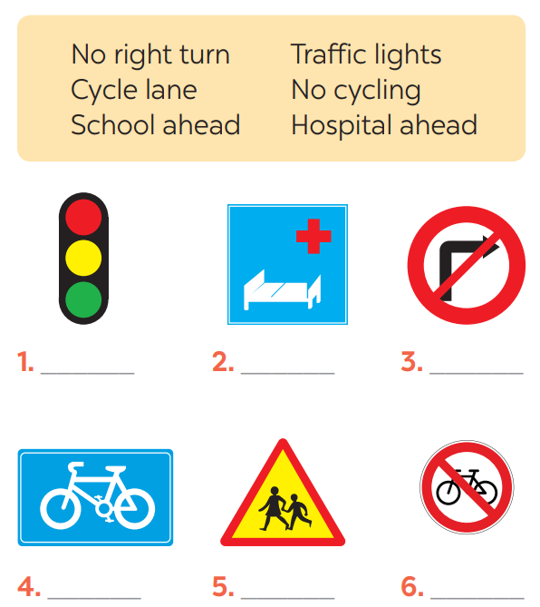
* Warm up:
Game:Pelmanism
1
2
3
4
5
6
7
Hospital ahead
No cycling
No right
turn
8
9
School ahead
Cycle lane
10

Slide 3
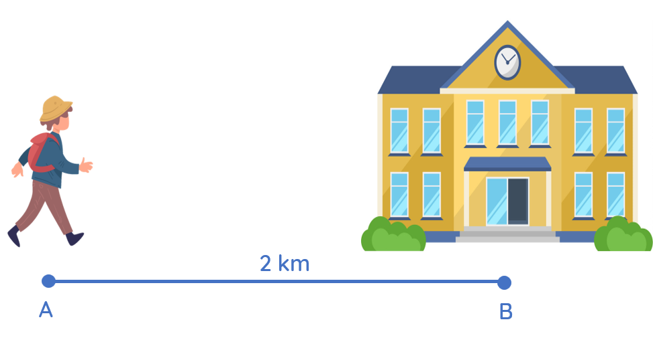
How far is it from your house to school?

Slide 4

Unit
7
TRAFFIC
LESSON 3: A CLOSER LOOK 2
GRAMMAR:
- It to indicate distance
- should and shouldn’t

Slide 5
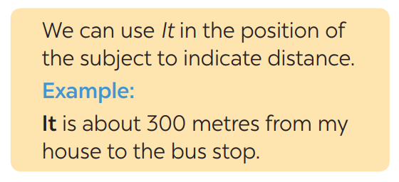
* GRAMMAR: It - INDICATING DISTANCE
What does the sentences tell us about?
→ Distance from his/her house to the bus stop
What is the structure using in the sentence?
It be (about) + distance from A to B.
- Chúng ta sử dụng đại từ “it” làm chủ ngữ của câu để chỉ khoảng cách.
- Cấu trúc: It is + (about) khoảng cách + from place 1 + to place 2.

Slide 6
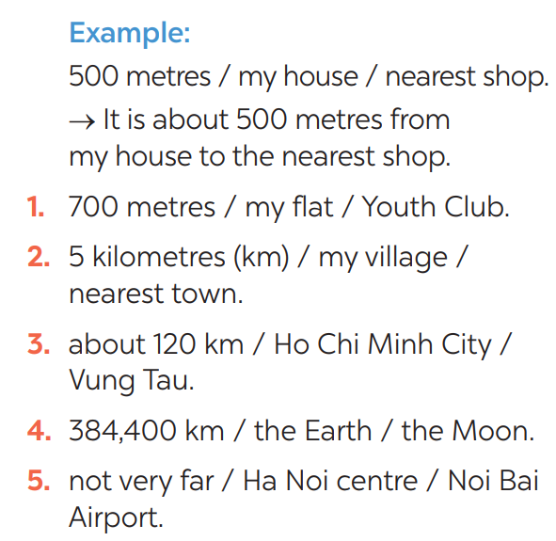

* PRACTICE
1
Write sentences with It. Use these cues.
* KEY
1- It is 700m from my house/home to the Youth club.
2- It is 5 kilometres from my village to the nearest town.
3- It is about 120 km from Ho Chi Minh city to Vung Tau.
4- It is 384,400 km from the Earth to the Moon.
5- It is not very far from Hanoi centre to Noi Bai airport.

Slide 8
1- It is 700m from my house to the Youth club.
2- It is 5 kilometres from my village to the nearest town.
3- It is about 120 km from Ho Chi Minh city to Vung Tau.
4- It is 384,400 km from the Earth to the Moon.
5- It is not very far from Hanoi centre to Noi Bai airport.

Slide 9
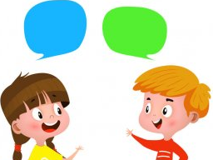
*PRACTICE
2
Work in pairs. Ask and answer questions about distances in your neighbourhood
EXample: Your home - gym
How far is it from your house to the gym?
It’s about 1 km.
- your home - open market / supermarket
- your home - playground
- your home - hospital
- your home - train station

Slide 10
1. your home - open market / supermarket
2. your home - playground
3. your home - hospital
4. your home - train station
Ex: Your home - gym
How far is it from your home to the gym?
It’s about 1 km.

Slide 11
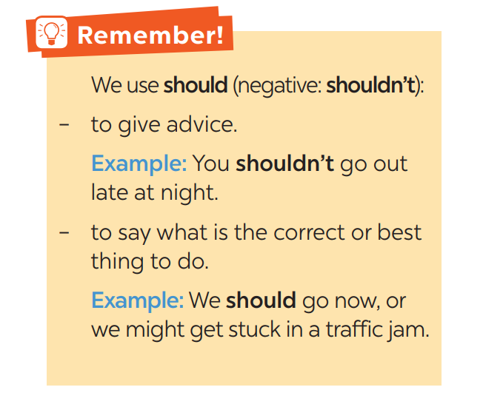

Slide 12
3
Choose the correct option in brackets.
1. That’s an interesting book. You (should / shouldn’t) read it.
2. You nearly fell off your bike! You really (should / shouldn’t) be more careful.
3. We (should / shouldn’t) go swimming right after eating.
4. I think that he (should / shouldn’t) eat less. He’s becoming overweight.
5. There are a lot of cars out today. He (should / shouldn’t) drive so fast.

Slide 13
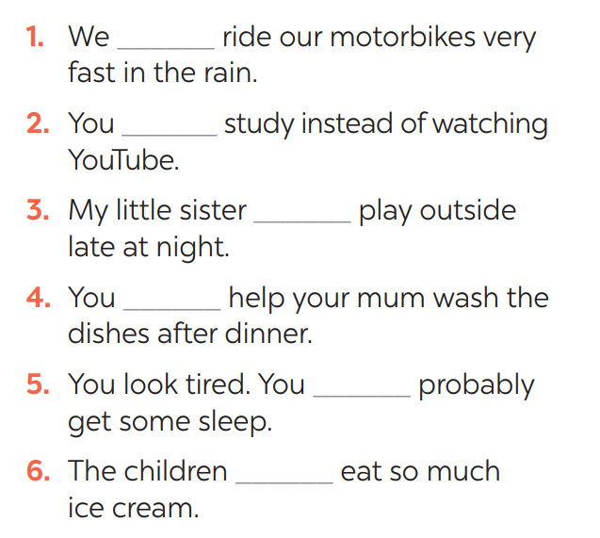
4
Complete each sentence, using should / shouldn’t.
shouldn’t
should
shouldn’t
should
should
shouldn’t

Slide 14
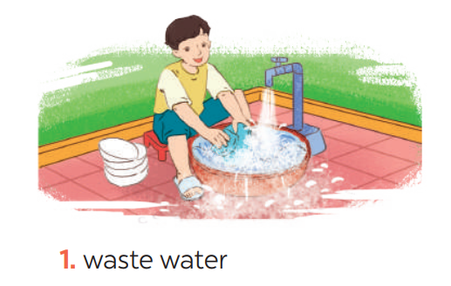
* PRODUCTION
5
Look at the pictures. Make sentences, using should / shouldn’t and the cues
He shouldn’t waste water.
GAME:

Slide 15
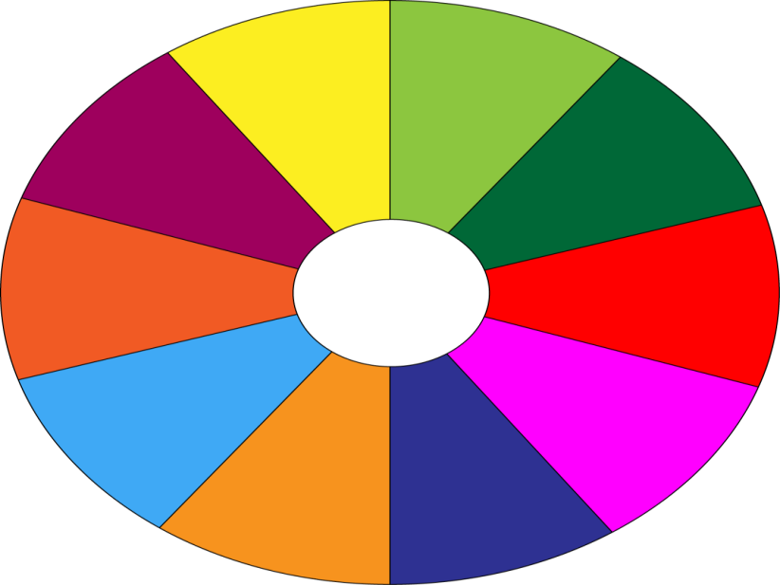
THE BIG WHEEL GAME
QUESTIONS
1
10
40
30
50
2
SPIN
20
10
3
-15
-20
05
60
4

Slide 16
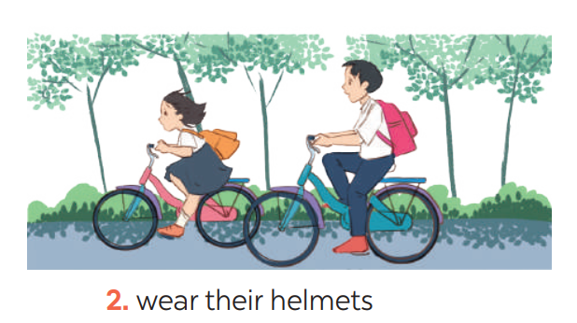
5
Look at the pictures. Make sentences, using should / shouldn’t and the cues
They should wear their helmets.

Slide 17
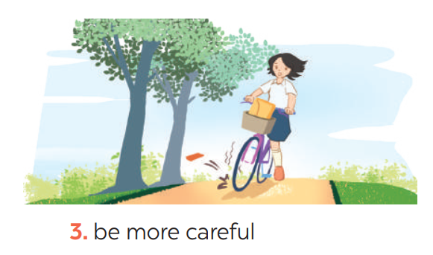
5
Look at the pictures. Make sentences, using should / shouldn’t and the cues
She should be more careful.

Slide 18
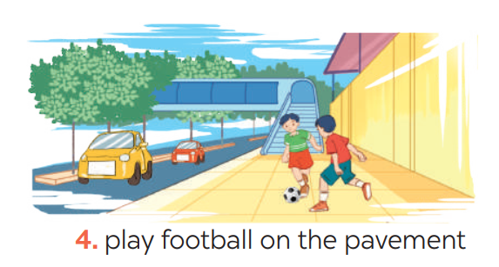
5
Look at the pictures. Make sentences, using should / shouldn’t and the cues
They shouldn’t play football on the pavement.

Slide 19
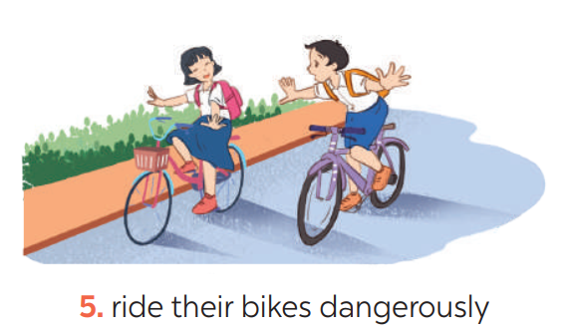
5
Look at the pictures. Make sentences, using should / shouldn’t and the cues
They shouldn’t ride their bikes dangerously.

Slide 20
* CONSOLIDATION
GRAMMAR:
- It to indicate distance
- should and shouldn’t

Slide 21
HOMEWORK
Do exercises in the workbook.
Prepare lesson 4 ( communication)

