Slide 1

WELCOME  TO  OUR  CLASS
ENGLISH 6
Unit 1:
MY NEW SCHOOL

Slide 2
UNIT 1: MY NEW SCHOOL
LESSON 1. GETTING STARTED
A special day

Slide 3
WARM - UP
book
School things

Slide 4
book
Eraser
ruler
School things
chalk
paper
pen
notebook
School bag

Slide 5
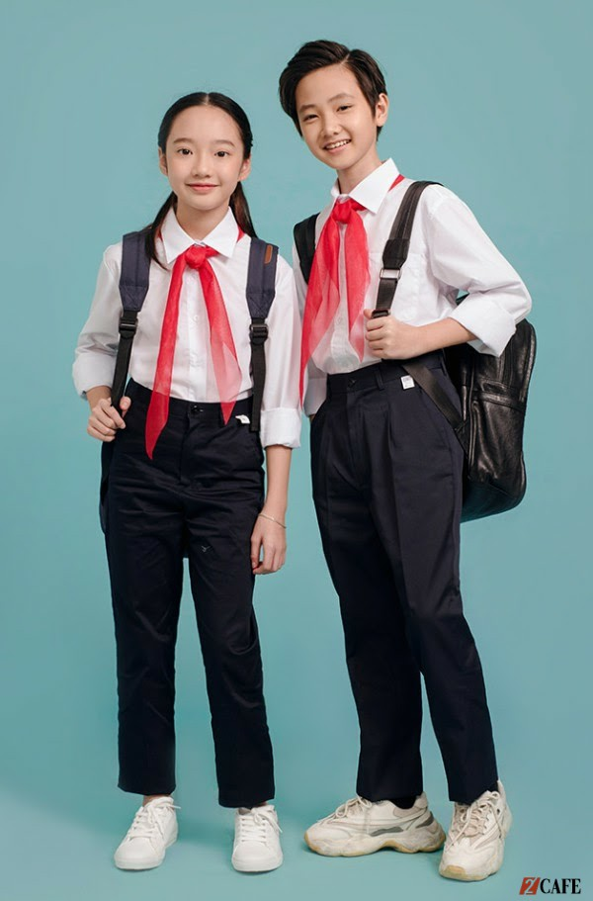
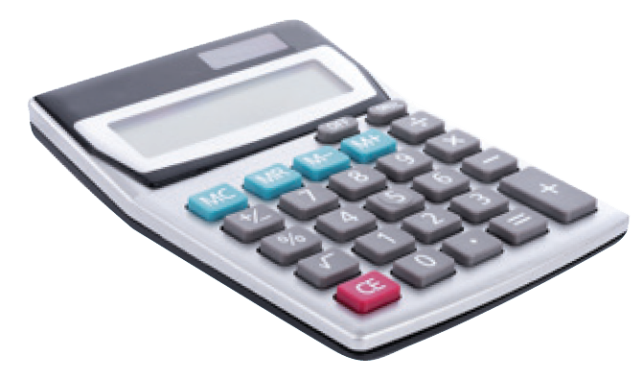
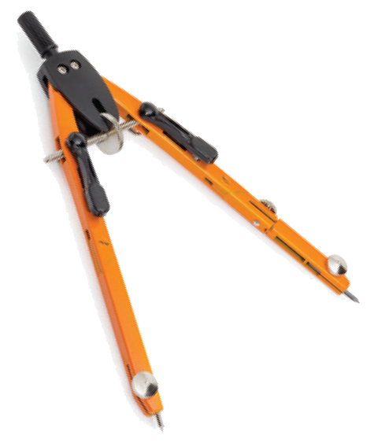
I. Vocabulary:
- calculator (n):
máy tính
- uniform (n):
đồng phục
- smart (a):
thanh nhã, lịch sự
put on (phr .v):
mặc (chuẩn bị mặc vào)
wear (v):
mặc (đang mặc)
- compass (n):
compa
- heavy (adj):
nặng

Slide 6
- calculator /ˈkælkjuleɪtə(r)/ (n):máy tính
- wear /weə(r), wer / (v)= - put on (phr v): mặc, đội
- 'uniform /ˈjuːnɪfɔːm/ (n): bộ đồng phục
- smart (adj): bảnh bao, nhanh trí
- 'compass /ˈkʌmpəs (n): com pa,la bàn
- 'heavy /ˈhevi /(adj): nặng
‘subject /ˈsʌbdʒɪkt, ˈsʌbdʒekt/ (n) môn học

Slide 7
* Checking words:
What and Where
calculator
compass
wear
uniform
Put on
heavy
smart

Slide 8
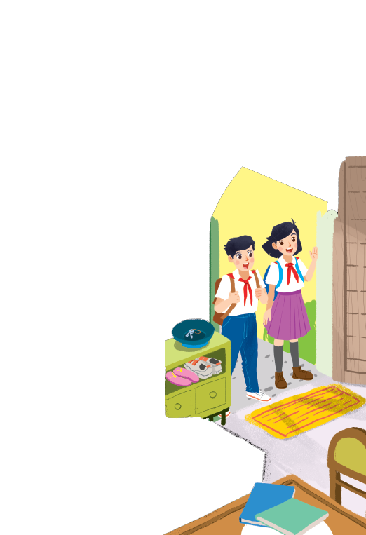
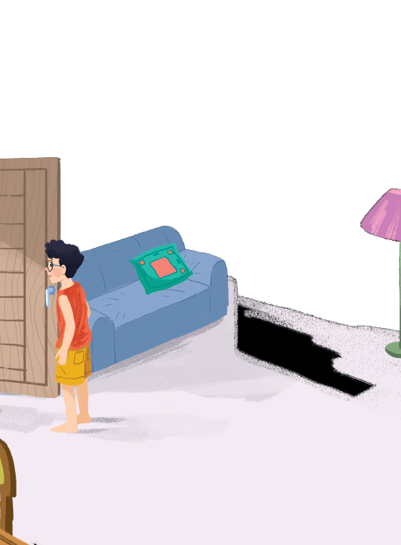

Slide 9


Listen and read.
A special day
(Loud knock)
Phong: Hi, Vy.
Vy: Hi, Phong. Are you ready?
Phong: Just a minute.
Vy: Oh, this is Duy, my new friend.
Phong: Hi, Duy. Nice to meet you.
Duy: Hi, Phong. I live near here, and we go to the same school!
Phong: Good. Hmm, your school bag looks heavy.
Duy: Yes! I have new books, and we have new subjects to study.
Phong: And a new uniform, Duy! You look smart!
Duy: Thanks, Phong. We always look smart in our uniforms.
Phong: Let me put on my uniform. Then we can go.

Slide 10

Read the conversation again and tick () T (True) or F (False).
 |  | T | F
1. | Vy, Phong, and Duy go to the same school.
2. | Duy is Phong’s friend.
3. | Phong says Duy looks smart in his uniform.
4. | They have new subjects to study
5. | Phong is wearing a school uniform.
✓
✓
✓
✓
✓

Slide 11

Write ONE word from the box in each gap.
go
subjects
has
wear
uniforms
wear
1.
Students their uniforms on Monday.
has
2.
Vy a new friend, Duy.
go
3.
- Do Phong, Vy, and Duy to the same school?
- Yes, they do.
uniforms
4.
Students always look smart in their .
5.
subjects
- What do you like to study?
- I like to study English and history.

Slide 12

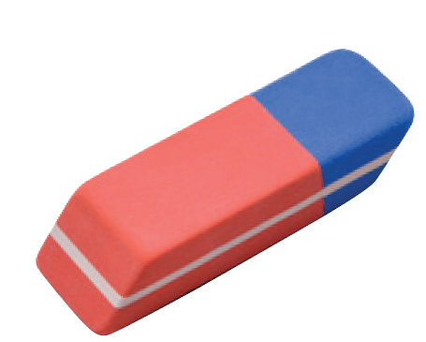
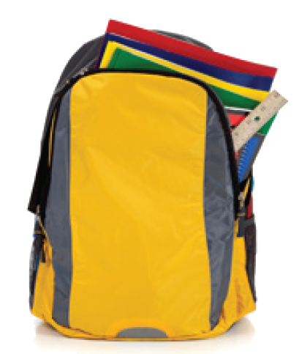
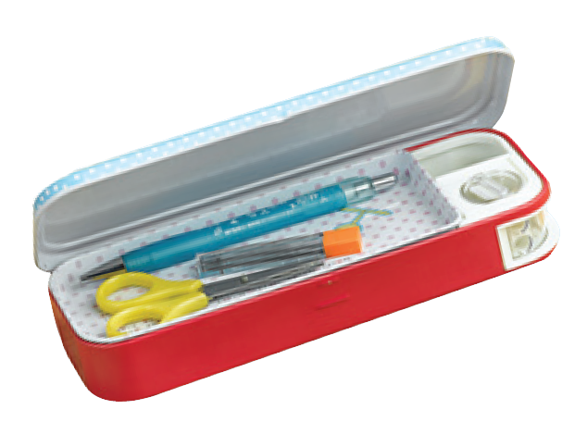
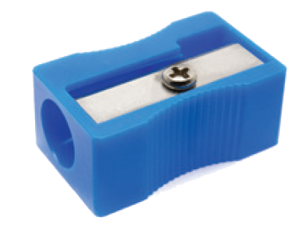
Match the word with the school things. Then listen and repeat.
pencil sharpener
4
compass
1
school bag
2
calculator
5
rubber
3
pencil case
6

Slide 13
Match the word with the school things. Then listen and repeat.
school bag
rubber
4
1
compass
pencil case
2
5
pencil sharpener
calculator
3
6

Slide 14

Look around the class. Write the names of the things you see in your notebook.
chairs, tables, clock, school bags, board, books, pen, flower pot, pencil,…

Slide 15


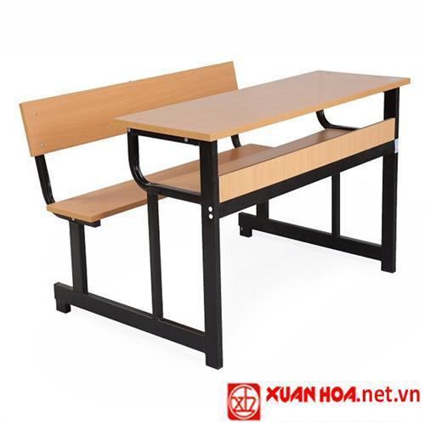
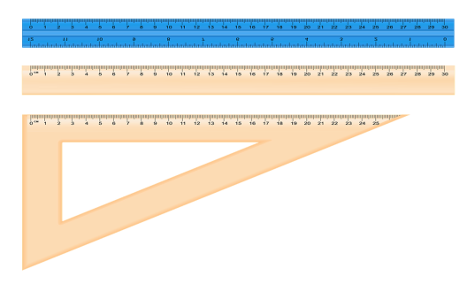
Consolidation
: Look at the pictures and say words in EL
School things

Slide 16
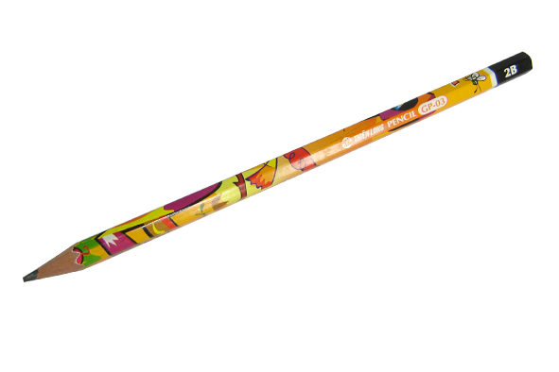
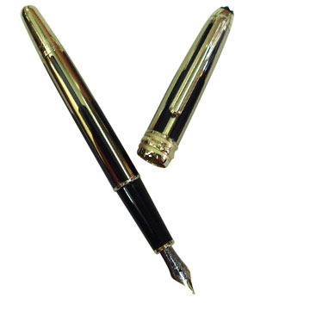
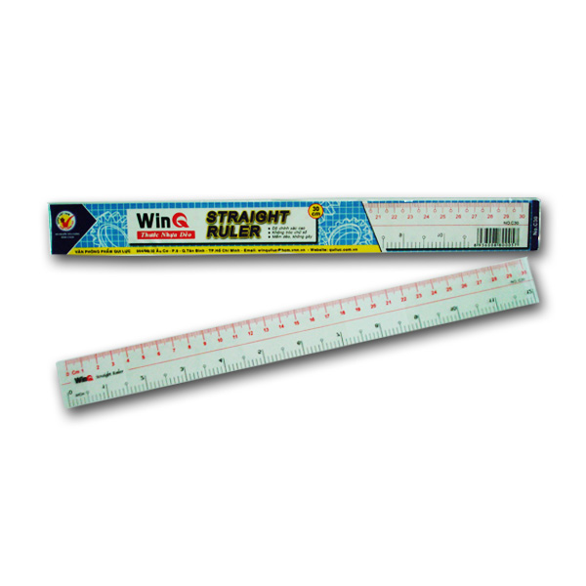

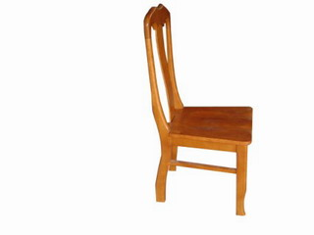


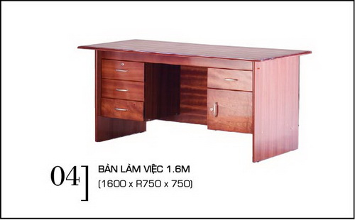
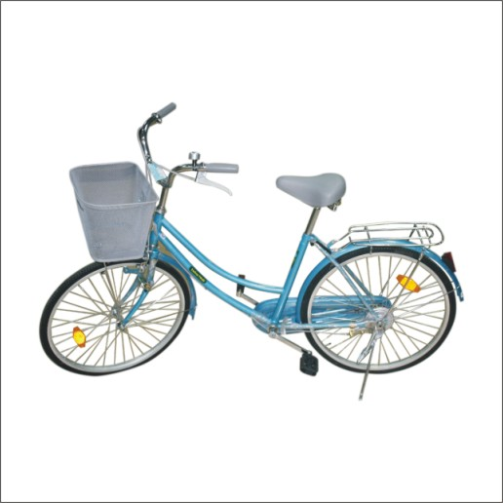
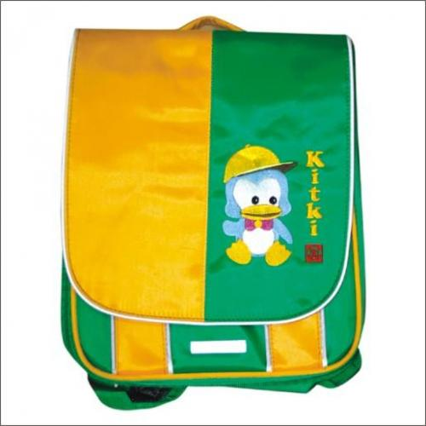
Remember and write the names of things
10
9
7
5
1
8
6
4
3
0
2

Slide 17

Remember and write the names of things
ruler
pencil
pen
chair
flower
eraser
school bag
books
desk
bike / bicycle
10
9
7
5
1
8
6
4
3
0
2

Slide 18
5. Homework - Learn by heart all the new words. - Prepare lesson 2 ( A closer look 1).

