Slide 1

Unit
4
ETHNIC GROUPS OF VIET NAM
LESSON 7: LOOKING BACK & PROJECT
LESSON 3: A CLOSER LOOK 2
Unit

Slide 2
* VOCABULARY
1
Match the words and phrases with the pictures.
1. weaving
2. folk dance
3. open fire
4. fishing
5. minority group
___________
___________
___________
___________
___________

Slide 3
2
Complete the sentences with the word and phrases from the box.
folk songs
staircase
sticky rice
communal house
musical instruments
1. Minority groups have their own _______________like the dan tinh, gong, t’rung.
2. The Kinh use __________ to make banh chung and banh tet.
3. For most minority groups like the Bahnar and Ede, the ________________, usually known as Rong house, is the heart of the village.
4. My grandmother taught me to sing many ___________.
5. The __________of a Muong’s stilt house has an odd number of steps: 5, 7, or 9.

Slide 4
GRAMMAR
3
Write questions from the clues.
1. you / attend / the Khmer’s Moon Worship Festival / last year / ?
→ Did you attend the Khmer’s Moon Worship Festival last year?
2. How many / ethnic minority groups / Viet Nam / ?
→ How many ethnic minority groups are there in Viet Nam?

Slide 5
* GRAMMAR
3
Write questions from the clues.
3. Where / the Hmong / live / ?
→ Where do the Hmong live?
4. What / you / do / the Ede’s Harvest Festival / last October / ?
→ What did you do at the Ede’s Harvest Festival last October?
5. How old / minority children / when / they / start helping / the family / ?
→ How old are the minority children when they start helping the family?

Slide 6
Những hs nào hoàn thành câu đúng gv cho nhận quà bằng cách chọn số.

Slide 7


4
2
3
5
1
7
6

Slide 8


LUCKY apple!
You get 5K

Slide 9

LUCKY apple!
You get 2 Lollipop Sticks

Slide 10

LUCKY apple!
You get 1 Lollipop Stick

Slide 11
LUCKY apple!
You get 3 Lollipop Sticks

Slide 12
LUCKY apple!
You get 4 Lollipop Sticks

Slide 13

LUCKY apple!
Your reward is a round of applause

Slide 14
* GRAMMAR
4
There is one incorrect underlined word in each sentence. Circle and correct it.
 | Correct word
1. A big stilt houses stands on high posts.
2. The Lahu build their houses from wood and wild banana leave.
3. Much people in remote areas travel on foot.
4. Most minority women weave clothes and do houseworks.
5. In the mountains, there is not many land for growing crops.
→ house
→ leaves
→ Many
→ housework
→ much

Slide 15
OUR ETHNIC GROUPS
* PROJECT
Choose an ethnic group in Viet Nam you are most interested in.

Slide 16
* PROJECT
OUR ETHNIC GROUPS
Do a little research about it, focusing on its:
living place (homes or villages).
economy.
traditional culture.

Slide 17
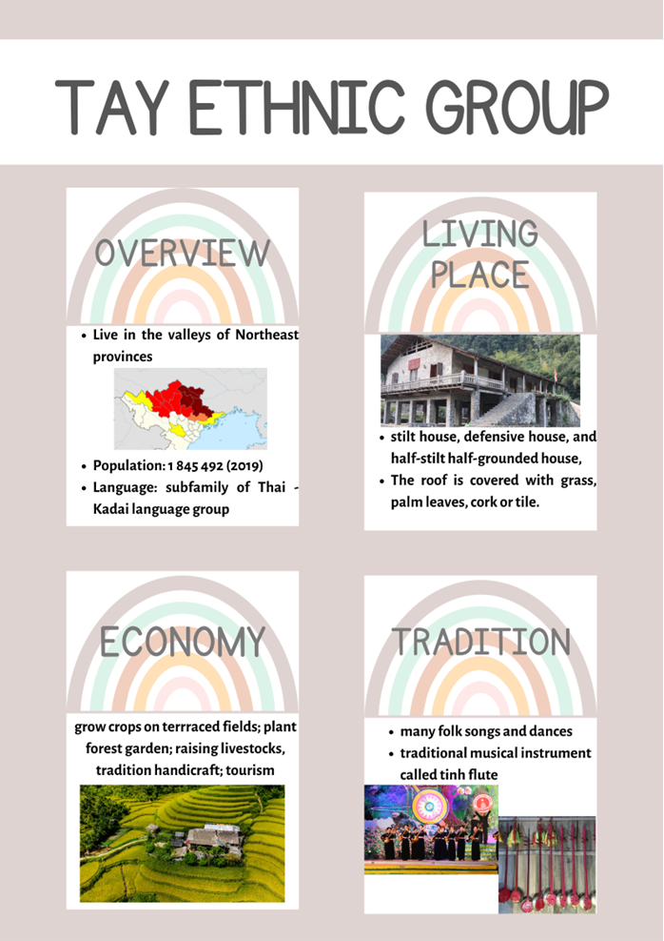
* PROJECT
TAY ETHNIC GROUP
* Make a poster (including pictures and information) to introduce the group.

Slide 18
* PROJECT
* Present your poster to the class.
TAY ETHNIC GROUP
Today, my group will introduce about the Tay people, an ethnic group which has been presented for over three millennium in Vietnam. The Tay people mostly live in valleys of Nothern provinces like Quang Ninh, Bac Giang, Lang Son, Cao Bang, Bac Kan, Thai Nguyen, Ha Giang, Tuyen Quang to Lao Cai and Yen Bai. According to the census on the 53 ethnic minorities as announced on April 1, 2019, the total population of the Tay ethnic group is 1,845,492. The Tay people speak the subfamily of Thai-Kadai people.
Tay people live in three kinds of houses: houses on stilts, half-stilt houses and half-ground houses and defensive houses. But house on stilt is the most common one. And the roof is covered with grass, palm leaves, cork or tile so it’s environmentally friendly.
To earn a living, they exploited the valleys and hills to make fields for crops and forest garden to grow palm anise, and fruit tree. They also raise cattle and poultry and have many handicrafts such as knitting, weaving, dyeing indigo, making tiles, and woodworking.
Tay people have many folk songs such as luon, then, quan lang, vi singing, lullaby, and folk songs. They also have folk dance like then and traditional musical instrument like dan tinh.

Slide 19

* CONSOLIDATION
In this lesson, you have:
revised more vocabulary items in the unit in different context.
revised Yes / No questions and Wh-questions.
revised the use of countable and uncountable nouns.
had an opportunity to research more deeply into an ethnic group you are interested in.

Slide 20

* Homework
Do exercises in the workbook.
Prepare for Unit 5 – Getting started.

