Slide 1

Good morning class !!!

Slide 2
* WARM-UP
Answer the questions:
1. Can you name some of Festivals in Viet Nam?
2. Do you like Mid-Autumn Festival?
3.Do you like Tet holiday?
4. What do you do before Tet holiday?
5. What do you do during Tet holiday?
→ Mid Autumn Festival, Tet holiday, …
→Yes, I do / No, I don’t because ……..
→Yes, I do . Because at Tet, I often eat delicious food and receive lucky money.
→ Clean my house, buy some flowers, decorate my house, cut hair,…
→ Visit my relatives, receive lucky money…

Slide 3

Unit
5
OUR CUSTOMS AND TRADITIONS
LESSON 1: GETTING STARTED
LESSON 1: GETTING STARTED
Tet is coming

Slide 4
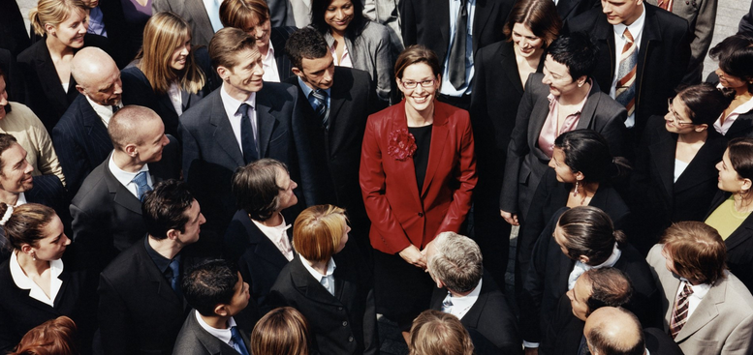

* VOCABULARY
- admire (v):
khâm phục, ngưỡng mộ
/ədˈmaɪr/

Slide 5
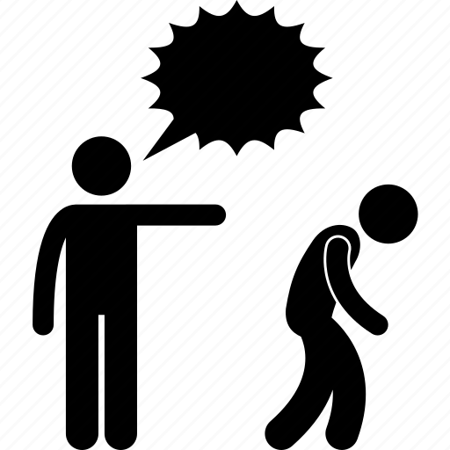
* VOCABULARY
- chase away
/tʃeɪs əˈweɪ/
xua đuổi

Slide 6
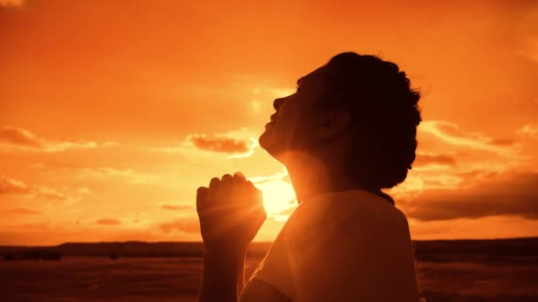
* VOCABULARY
pray (v)
/preɪ/
cầu nguyện

Slide 7
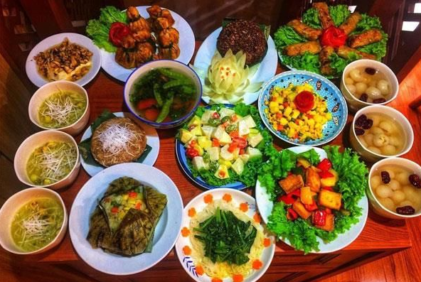
offering (n)
/ˈɒfərɪŋ/
đồ thờ cúng

Slide 8
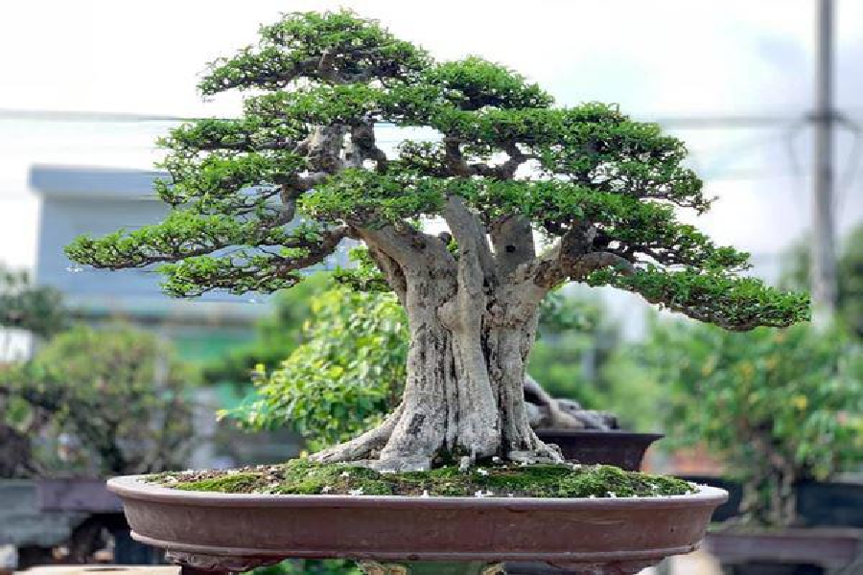
* VOCABULARY
ornamental tree
/ɔːnəˈmentl triː/
cây cảnh

Slide 9
* VOCABULARY
New words | Pronunciation | Meaning
1. admire (v) | /ədˈmaɪr/ | khâm phục
2. chase away | /tʃeɪs/ | xua đuổi
3. pray (v) | /preɪ/ | cầu nguyện
4. offering (n) | /ˈɒfərɪŋ/ | đồ thờ cúng
5. ornamental tree | /ɔːnəˈmentl triː/ | cây cảnh

Slide 10
* Checking vocab
What and Where
admire
chase away
ornamental tree
pray
offering

Slide 11
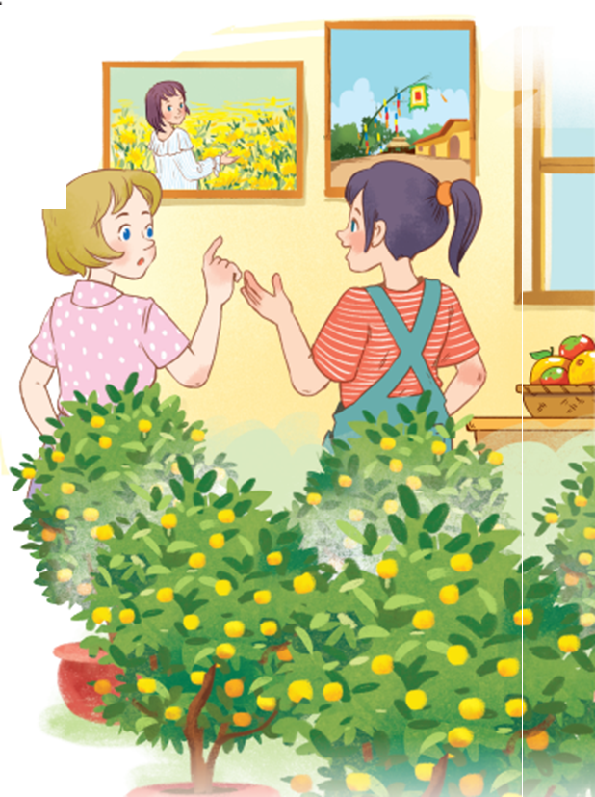
* PRACTICE
1
Listen and read.
What can you see in each picture?
Can you guess the places that the picture show?
A few ornamental plants, bamboo pole, flower village,…
They are Elena and Trang, They are at Trang’house , I guess they are talking about Tet.

Slide 12

* PRACTICE
1
Listen and read.
Elena: Wow, this girl looks so cute.
Trang: Yeah ... She’s my cousin. She’s at Sa Dec flower Village. Tet is coming soon, so many people visit flower villages to take pictures with the blooming flowers.
Elena: Oh, I’m fond of admiring the flowers. Does your family visit places like this too?
Trang: Yes, we do. We usually visit nhat Tan Village to buy kumquat trees and peach blossoms.
Elena: I see flowers and ornamental trees everywhere these days. What are they for?
Trang: We, Vietnamese, use plants and flowers for decorations and for oﬀerings. They are an important part of our Tet tradition.
Elena: And what’s that tall tree in the photo?
Trang: Well, it’s actually a bamboo pole. People place it in the yard of the communal house. They hang decorative items like small bells and lanterns on it. They want to chase away bad luck and pray for a lucky new year.
Elena: Interesting! I didn’t know that.

Slide 13

* PRACTICE
2
Read the conversation again and tick T (True) or F (False).
Sentences | T | F
1. Elena and Trang are at Sa Dec Flower Village.
2. Many people visit ﬂower villages to take photos.
3. Trang’s family usually buys kumquat trees and peach blossoms at Nhat Tan Village.
4. Flowers are not part of any Vietnamese traditions.
5. People decorate bamboo poles with small bells and lanterns for New Years.
Trang’s cousin is at Sa Dec Flower Village
Plants and flowers are an important part of Tet

Slide 14
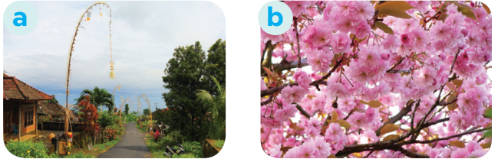
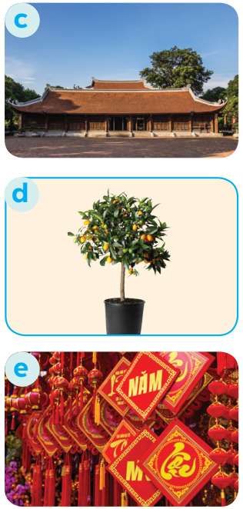
3
Match the phrase with the correct pictures.
1. bamboo pole
2. blooming flowers
3. communal house
4. ornamental tree
5. decorative items

Slide 15
3
Match the phrase with the correct pictures.
1. bamboo pole
2. blooming flowers
3. communal house
4. ornamental tree
5. decorative items

Slide 16
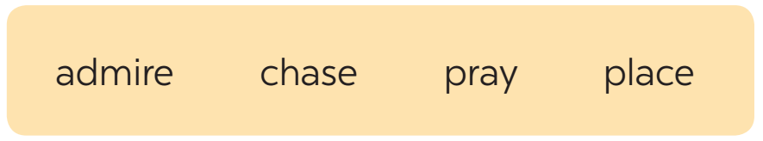
4
Complete the sentences with the verbs from the box.
1. The British decorate their Christmas trees and ______ presents under them.
2. Tom likes to ______ the view from the hill.
3. In many cultures, knocking on wood is a way to ______ away bad spirits.
4. Many Asians go to Buddhist temples to ______ for good luck.

Slide 17


LUCKY NUMBER!
1
2
3
4
5
6
GA
2
4
6
8
10
12
14
GB
2
4
6
8
10
12
14

Slide 18
4
Complete the sentences with the verbs from the box.
1. The British decorate their Christmas trees and ______ presents under them.
place

Slide 19
4
Complete the sentences with the verbs from the box.
2. Tom likes to ______ the view from the hill.
admire

Slide 20
4
Complete the sentences with the verbs from the box.
3. In many cultures, knocking on wood is a way to ______ away bad spirits.
chase

Slide 21
4
Complete the sentences with the verbs from the box.
4. Many Asians go to Buddhist temples to ______ for good luck.
pray

Slide 22



Slide 24
4
Complete the sentences with the verbs from the box.
1. The British decorate their Christmas trees and ______ presents under them.
2. Tom likes to ______ the view from the hill.
3. In many cultures, knocking on wood is a way to ______ away bad spirits.
4. Many Asians go to Buddhist temples to ______ for good luck.
place
admire
chase
pray

Slide 25

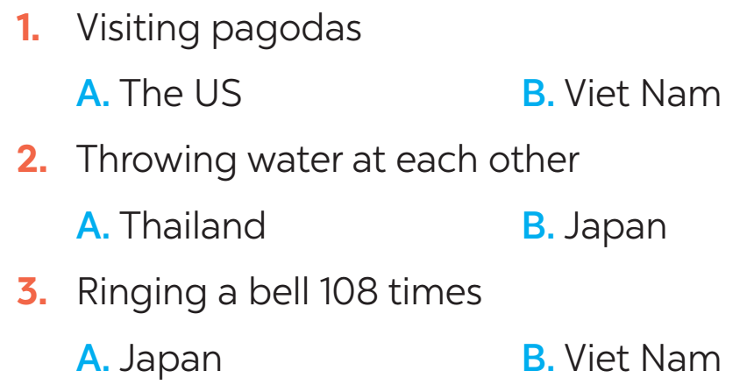
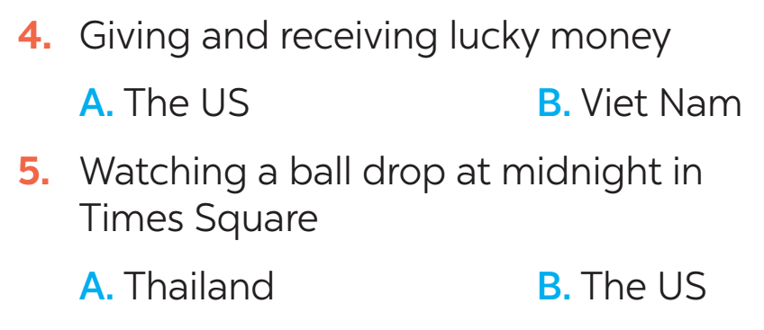
* FURTHER PRACTICE
5
New Years around the world.
People around the world celebrate New Years differently. Choose the tradition below.

Slide 26

* CONSOLIDATION
What have we learnt in this lesson?
identify the topic of the unit
use lexical items related to Tet holiday.
identify the language features that are covered in the lesson.

Slide 27

* Homework
- Learn the new words by heart.
- Practice talking about Tet Holiday.

