Slide 1




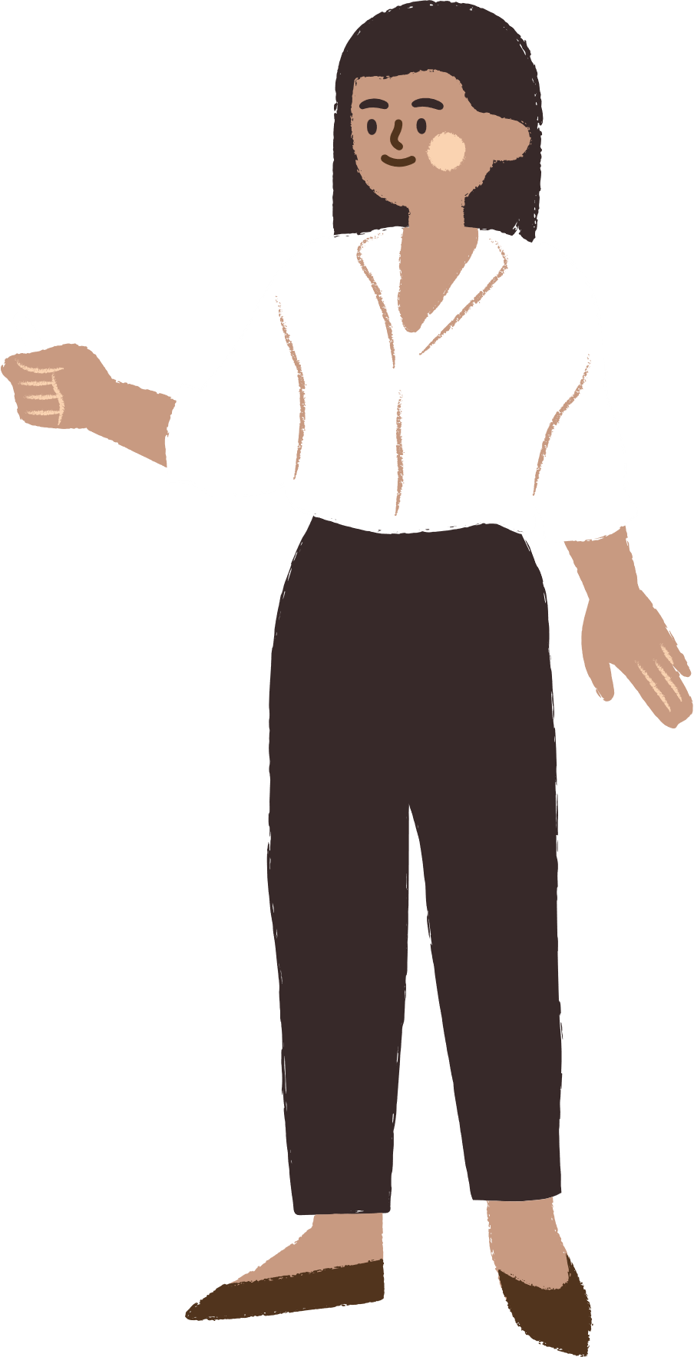
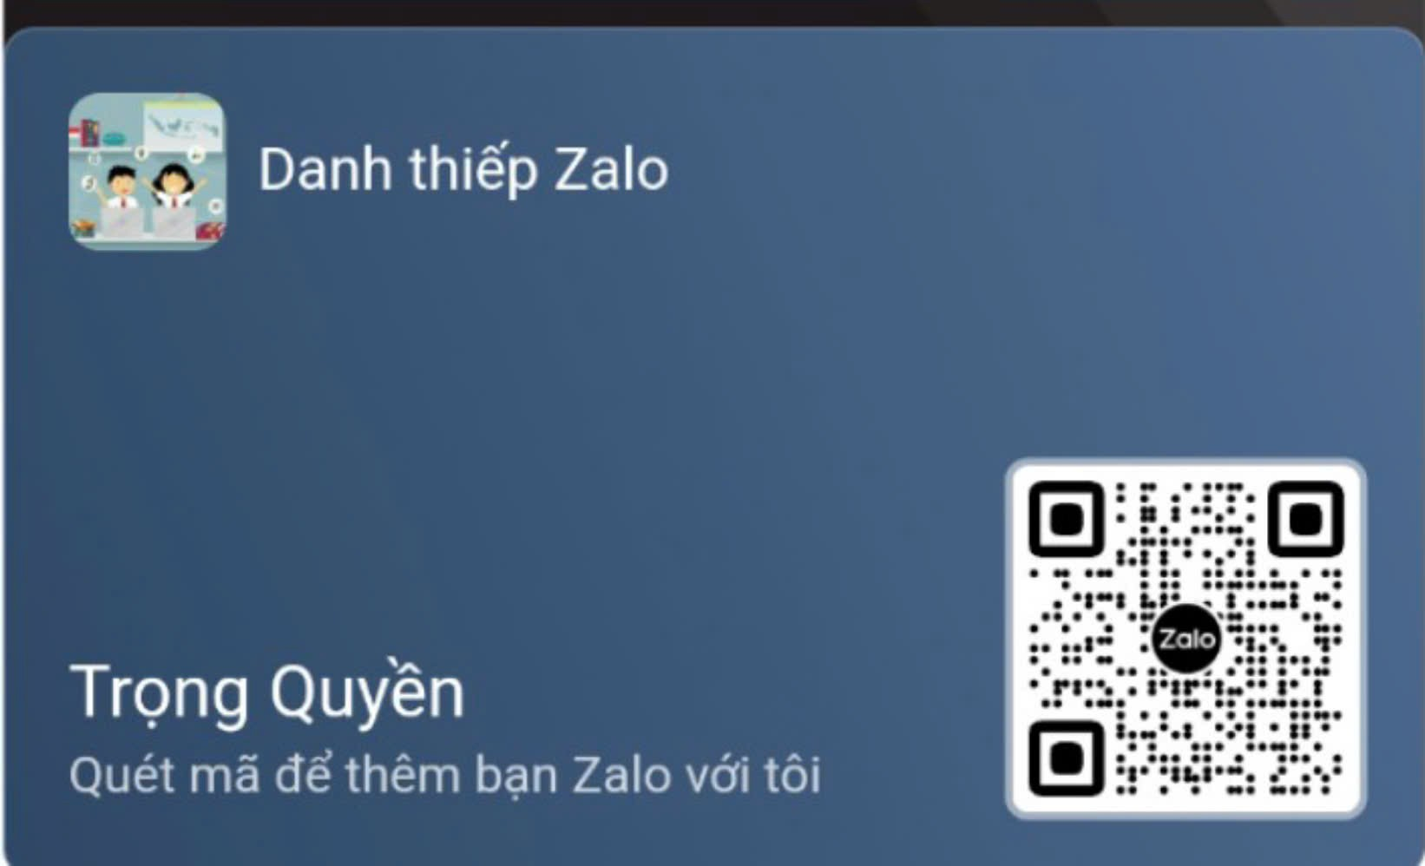




````````````````````````````````````````````````
UNIT 12
Career choices
LESSON 1: GETTING STARTED
Notes:
TRUY CẬP MÃ QR ĐỂ NHẬN QUÀ TẶNG
https://facebook.com/groups/853679022766648/

Slide 2

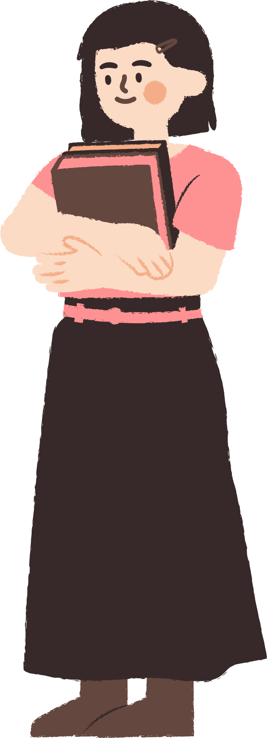




CONTENT
WARM-UP
VOCABULARY
PRACTICE
GAMES

Slide 3

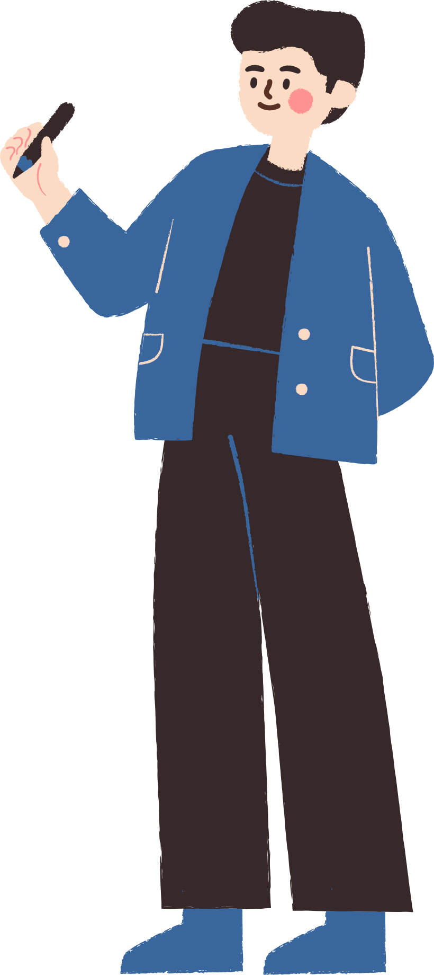



WARM-UP

Slide 4


WARM-UP
OPTION 1
Look at the pictures and name the jobs
THINK

Slide 5
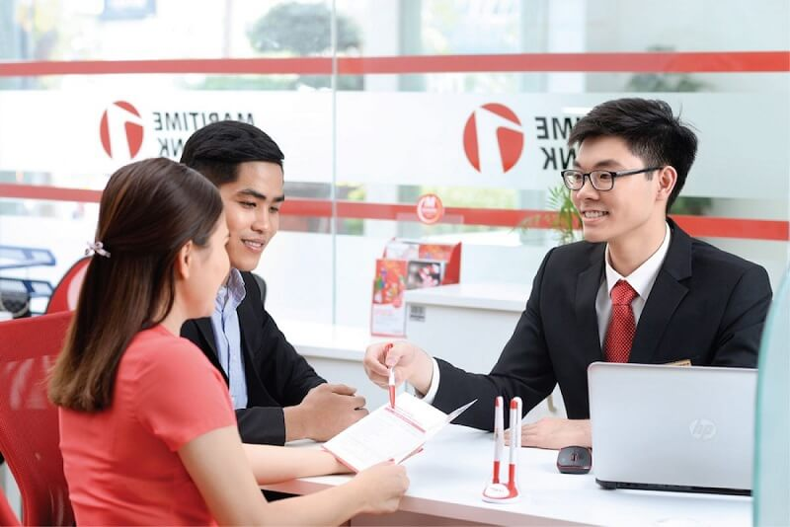
WARM-UP
OPTION 1
HA LONG BAY
IT ENGINEER

Slide 6
WARM-UP
OPTION 1
HA LONG BAY
Banker

Slide 7
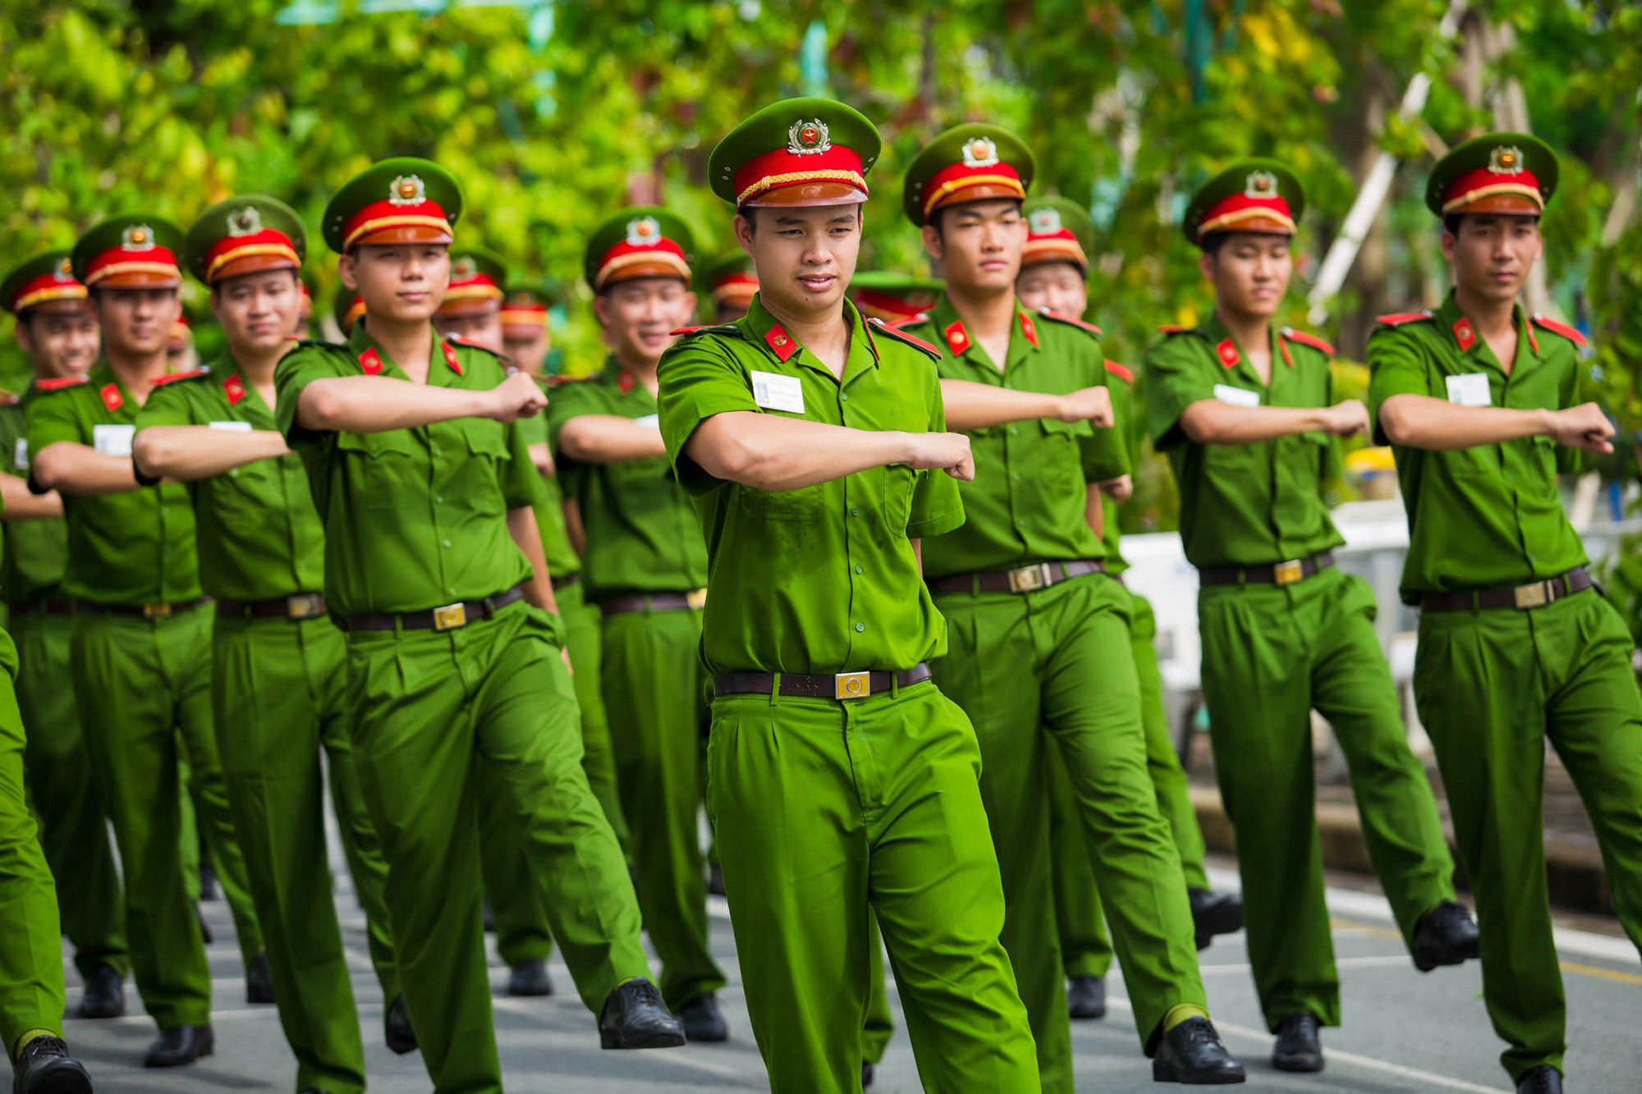
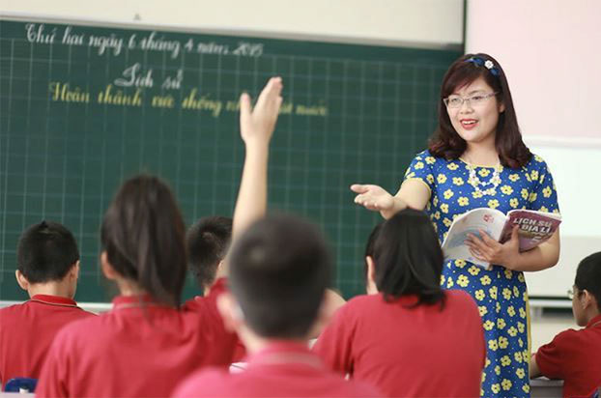
WARM-UP
OPTION 1
HA LONG BAY
Police

Slide 8
WARM-UP
OPTION 1
HA LONG BAY
Teacher

Slide 9

WARM-UP
OPTION 2
Future Vision

Slide 10
VOCABULARY

Slide 11




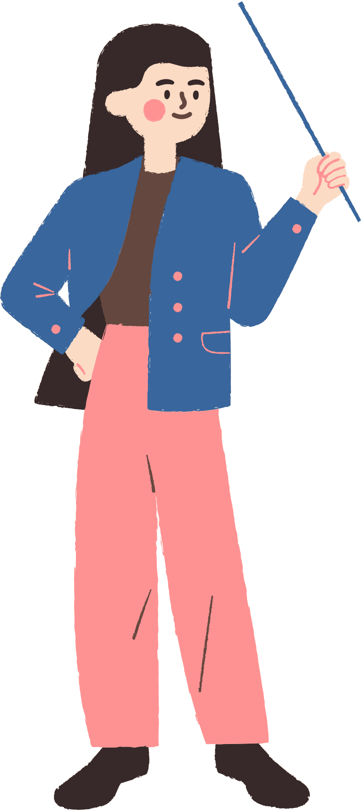





1. career choice /kəˈrɪə ˈʧɔɪsɪ/ (n) lựa chọn nghề nghiệp
Career choices can greatly affect our future lives. (Lựa chọn nghề nghiệp có thể ảnh hưởng lớn đến cuộc sống tương lai của chúng ta.)

Slide 12
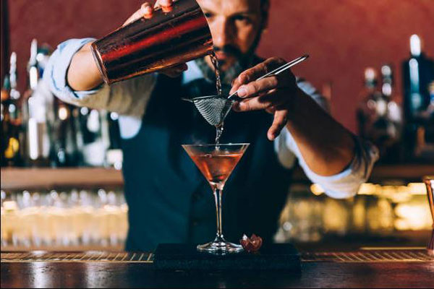
2. bartender /ˈbɑːˌten.dər/ (n) người pha chế
A bartender needs to know how to mix different drinks.(Một người pha chế đồ uống cần biết cách pha trộn các loại đồ uống khác nhau.)

Slide 13
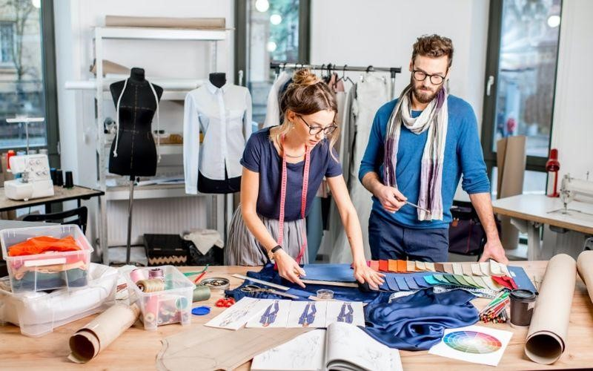
3. fashion designer /ˈfæʃn dɪˈzaɪnə(r)/ (n) nhà thiết kế thời trang
My sister wants to become a fashion designer and create her own clothing line.(Chị gái tôi muốn trở thành nhà thiết kế thời trang và tạo ra dòng quần áo riêng của mình.)

Slide 14
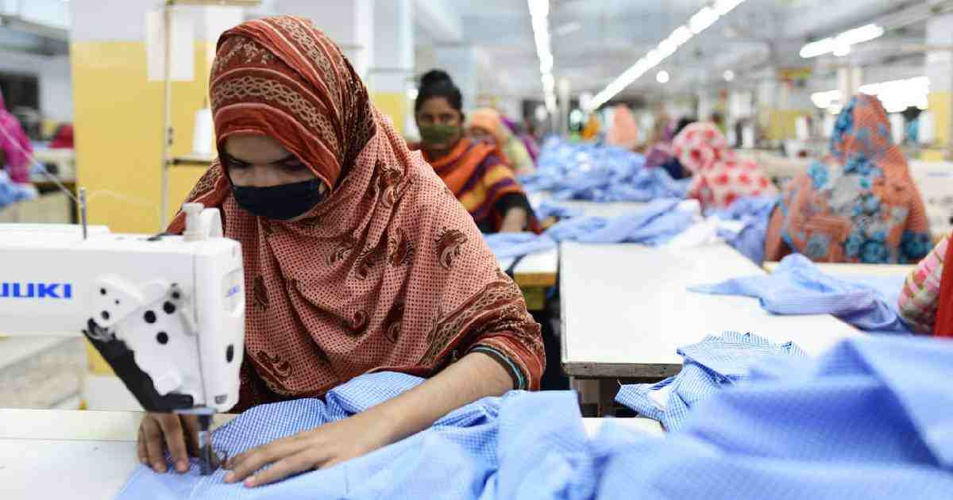
4. garment worker /ˈɡɑːməntˈwɜːkə(r)/ (n) công nhân may mặc
Garment workers play a crucial role in the clothing industry.(Công nhân may mặc đóng vai trò quan trọng trong ngành công nghiệp quần áo.)

Slide 15
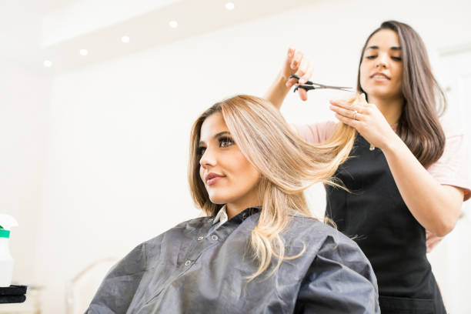
5. hairdresser /ˈheədresə(r)/ (n) thợ làm tóc
A good hairdresser can transform your appearance with a new hairstyle.(Một thợ làm tóc giỏi có thể thay đổi diện mạo của bạn với một kiểu tóc mới.)

Slide 16
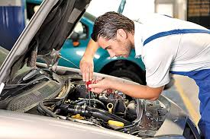
6. mechanic /məˈkænɪk/ (adj) thợ máy
My uncle is a mechanic who can fix all types of cars.(Chú tôi là một thợ máy có thể sửa chữa tất cả các loại xe hơi.)

Slide 17
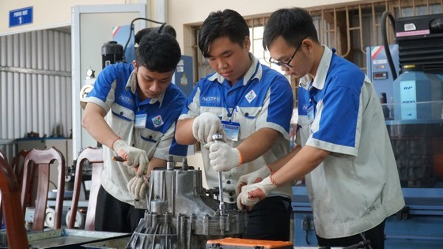
7. vocational college /vəʊˈkeɪʃənlˈkɒlɪdʒ/ (n) trường cao đẳng nghề
Many students attend vocational colleges to learn practical job skills.(Nhiều học sinh theo học các trường dạy nghề để học các kỹ năng công việc thực tế.)

Slide 18

8. training course /ˈtreɪnɪŋ kɔːs/ (n) khóa học đào tạo
The school offers a training course in computer programming for interested students.(Trường cung cấp một khóa đào tạo lập trình máy tính cho học sinh quan tâm.)

Slide 19

9. complete /kəmˈpliːt/ (v) hoàn thành
We need to complete our science project by next week.(Chúng ta cần hoàn thành dự án khoa học vào tuần tới.)

Slide 20

10. informative /ɪnˈfɔːmətɪv/ (adj) có tính thông tin
The career fair was very informative for students choosing their future paths.(Hội chợ việc làm rất bổ ích cho học sinh đang chọn con đường tương lai.)

Slide 21

11. academic subject /ˌækəˈdemɪk ˈsʌbdʒɪkt/ (n) môn học thuật
Math and Science are important academic subjects in our school curriculum.(Toán và Khoa học là những môn học thuộc về học thuật quan trọng trong chương trình học của trường chúng ta.)

Slide 22

12. prepare (for) /prɪˈpeə(r)/ (v) chuẩn bị cho
We need to prepare for our exams by studying regularly.(Chúng ta cần chuẩn bị cho các kỳ thi bằng cách học tập đều đặn.)

Slide 23
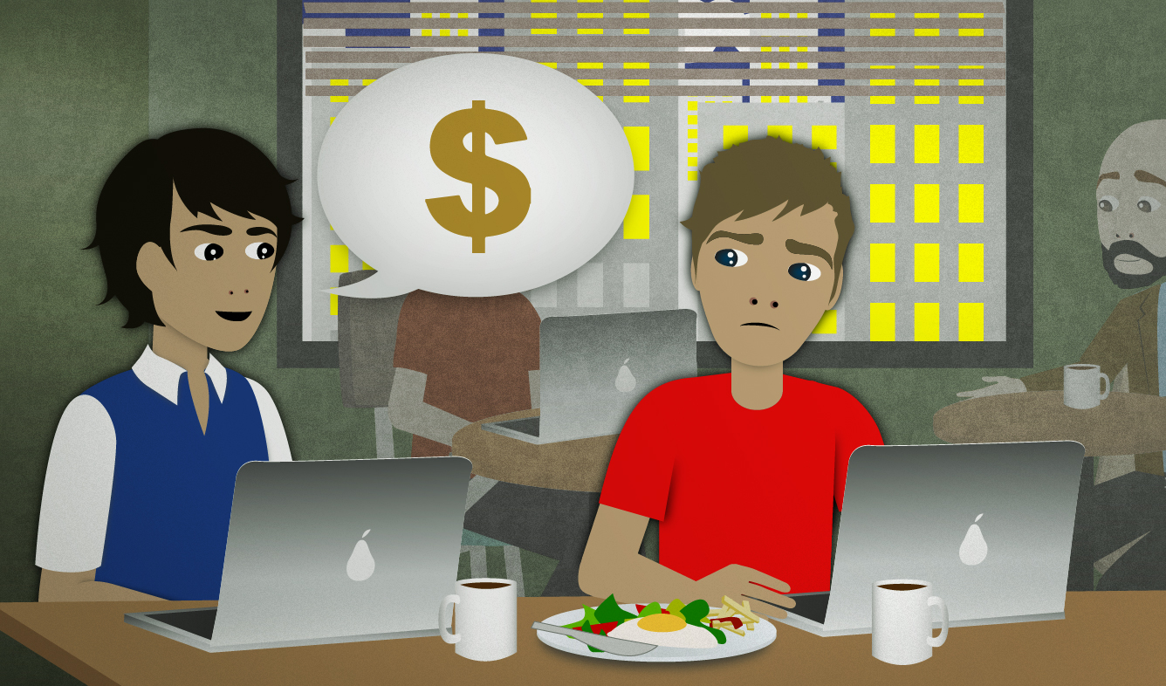
13. earn living /ɜːn ˈlɪvɪŋ/ (v) kiếm sống
After graduation, we'll need to find jobs to earn living.(Sau khi tốt nghiệp, chúng ta sẽ cần tìm việc để kiếm sống.)

Slide 24

14. skillful /ˈskɪlfl/ (adj) có kỹ năng
My friend is very skillful at drawing and wants to become an artist.(Bạn tôi rất khéo léo trong việc vẽ và muốn trở thành một nghệ sĩ.)

Slide 25

15. achieve /əˈtʃiːv/ (v) đạt được
With hard work, you can achieve your career goals.(Với sự chăm chỉ, bạn có thể đạt được mục tiêu nghề nghiệp của mình.)

Slide 26

16. passion /ˈpæʃn/(n) (n) đam mê
It's important to find a career that aligns with your passion.(Việc tìm một nghề nghiệp phù hợp với niềm đam mê của bạn là rất quan trọng.)

Slide 27

17. business management /ˈbɪznəs ˈmænɪdʒmənt/ (n) quản trị kinh doanh
My brother is studying business management at university.(Anh trai tôi đang học quản lý kinh doanh tại trường đại học.)

Slide 28
VOCABULARY
Words | Pronunciation | Meanings
career choice | /kəˈrɪə ˈʧɔɪsɪ/ | (n) lựa chọn nghề nghiệp
bartender | /ˈbɑːˌten.dər/ | (n) người pha chế
fashion designer packed | /ˈfæʃn dɪˈzaɪnə(r)/ | (n) nhà thiết kế thời trang
garment worker | /ˈɡɑːməntˈwɜːkə(r)/ | (n) công nhân may mặc
hairdresser | /ˈheədresə(r)/ | (n) thợ làm tóc
mechanic | /məˈkænɪk/ | (adj) thợ máy
vocational college | /vəʊˈkeɪʃənlˈkɒlɪdʒ/ | (n) trường cao đẳng nghề

Slide 29
VOCABULARY
Words | Pronunciation | Meanings
training course | /ˈtreɪnɪŋ kɔːs/ | (n) khóa học đào tạo
complete | /kəmˈpliːt | (v) hoàn thành
informative | /ɪnˈfɔːmətɪv/ | (adj) có tính thông tin
academic subject | academic subject / | (n) môn học thuật
prepare | /prɪˈpeə(r)/ | (v) chuẩn bị cho
earn living | /ɜːn ˈlɪvɪŋ/ | (v) kiếm sống
skillful | /ˈskɪlfl/ | (adj) có kỹ năng
achieve | /əˈtʃiːv/ | (v) đạt được
passion | /ˈpæʃn/(n) | (n) đam mê
business management | /ˈbɪznəs ˈmænɪdʒmənt/ | (n) quản trị kinh doanh

Slide 30
PRACTICE

Slide 31

1. LISTEN AND READ
Mi: My cousin did that. He learnt bartending after finishing grade 9. Now he's a skilful bartender and makes lots of money.
Nick: And you? What will you be in five years from now?
Mi: Well, I'll be studying at a teachers' college because I want to be a teacher. How about you?
Nick: I'll be a fashion designer.
Mi: You really want to be a fashion designer?
Nick: Yeah. My art teacher says I have such a good sense of style that I should get formal training in fashion design after high school.
Mi: Hope you'll achieve your dream.
Nick: Thanks. I think we should know our passions and abilities to make a good career choice.
Mi : Did you attend the career orientation session yesterday?
Nick: No, I didn't. I had to complete my project. How was it?
Mi : It was really informative. There were three guest speakers from vocational colleges. They introduced their job training courses for lower secondary leavers.
Nick: My teacher told us that if we didn't like academic subjects, we should apply for courses which would prepare us for a job such as mechanic, hairdresser, or garment worker. That way, we could start working and earn a living earlier.

Slide 32
2. Read the conversation again and answer the following question
1. Where did the guest speakers come from?
→The guest speakers came from vocational colleges.
2. According to Nick's teacher, who should apply for vocational courses?
→The students who don’t like academic subjects, should apply for vocational courses.
3. What did Mi's cousin do after finishing grade 9?
→He learnt bartending after finishing grade 9.
4. What quality does a fashion designer need to have?
→A fashion designer needs to have such a good sense of style.
5. What do we need to know to make a good career choice?
We need to know our passions and abilities to make a good career choice.

Slide 33
2. Read the conversation again and decide if the following statements are true (T) or false (F)
T
F
T
1. The bus in Trang's city is slow and crowded.
F
2. The underground system in Ben's city is unreliable.
3. There is a dusty and noisy construction site near Trang's house.
T
F
4. Trang thinks new buildings make the city look ugly.
T
5. Both Trang and Ben find shopping malls expensive.
Notes:
TRUY CẬP MÃ QR ĐỂ NHẬN QUÀ TẶNG
https://facebook.com/groups/853679022766648/

Slide 34
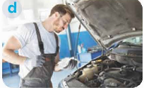



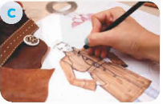
3. Match the words and phrases in the conversation with their pictures.
1. Bartender
3. garment worker
5. Bartender
2. fashion designer
4. hairdresser
Notes:
TRUY CẬP MÃ QR ĐỂ NHẬN QUÀ TẶNG
https://facebook.com/groups/853679022766648/

Slide 35
4. Choose the correct answer A, B, C, or D to complete each sentence.
1. Subjects like maths, physics, English, and literature are called _______ subjects.
Theoretical
art
academic
physical
Notes:
TRUY CẬP MÃ QR ĐỂ NHẬN QUÀ TẶNG
https://facebook.com/groups/853679022766648/

Slide 36
4. Choose the correct answer A, B, C, or D to complete each sentence.
2. She earns a _______ by selling home-made foods.
Life
salary
money
Living
Notes:
TRUY CẬP MÃ QR ĐỂ NHẬN QUÀ TẶNG
https://facebook.com/groups/853679022766648/

Slide 37
4. Choose the correct answer A, B, C, or D to complete each sentence.
3. He went to college to get _______ training in business management.
life-long
informal
formal
online
Notes:
TRUY CẬP MÃ QR ĐỂ NHẬN QUÀ TẶNG
https://facebook.com/groups/853679022766648/

Slide 38
4. Choose the correct answer A, B, C, or D to complete each sentence.
4. Finding a _______ job in big cities is rather difficult.
Teacher
teaching
taught
Teach
Notes:
TRUY CẬP MÃ QR ĐỂ NHẬN QUÀ TẶNG
https://facebook.com/groups/853679022766648/

Slide 39
4. Choose the correct answer A, B, C, or D to complete each sentence.
5. Career _______ programmes are useful because they help students make good decisions about their future jobs.
Orientation
B. pressure
C. Tradition
D. income
Notes:
TRUY CẬP MÃ QR ĐỂ NHẬN QUÀ TẶNG
https://facebook.com/groups/853679022766648/

Slide 40
5. GAME - Guess my job
Work in two groups. Take turns to explain and guess the jobs the teacher shares. The group with more correct answers wins.
Example: (T shows a picture of a mechanic)
Group members: This person works in a garage. He repairs cars or motorbikes.
Student A: A mechanic.
Group members: This person works in a salon or barbershop. They cut and style hair.
Student B: A hairdresser or a barber.
Notes:
TRUY CẬP MÃ QR ĐỂ NHẬN QUÀ TẶNG
https://facebook.com/groups/853679022766648/

Slide 41
5. GAME - Guess my job
Group members: This person works in a restaurant, preparing and cooking food for customers.
Student C: A chef.
Group members: This person works in a classroom, teaching students various subjects.
Student D: A teacher.
Group members: This person works in a hospital or clinic. They diagnose illnesses, prescribe medications and perform surgery.
Student E: A doctor.
Notes:
TRUY CẬP MÃ QR ĐỂ NHẬN QUÀ TẶNG
https://facebook.com/groups/853679022766648/

Slide 42
GAMES

Slide 43







game
Look and answer?
A. career choice
B. bartender
C. hairdresser

Slide 44
game
Look and answer?
A. bartender
B. earn living
C. career choice

Slide 45
game
2. Look and answer?
A .business management
B. fashion designer
C. earn living

Slide 46
game
2. Look and answer?
A. passion
B. garment worker
C. achieve

Slide 47



game
3. look and answer?
A. skillful
B. bartender
C. hairdresser

Slide 48
game
4. Look and answer?
A. mechanic .
B. training course .
C. passion.

Slide 49
game
5. Look and answer?
A. earn living .
B. achieve.
C. vocational college.

Slide 50
game
4. Look and answer?
A. training course .
B. skillful.
C. fashion designer .

Slide 51
game
6. Look and answer?
A. mechanic.
B. informative
C. passion.

Slide 52
game
7. Look and answer?
A. academic subject .
B. earn living .
C. prepare (for) .

Slide 53

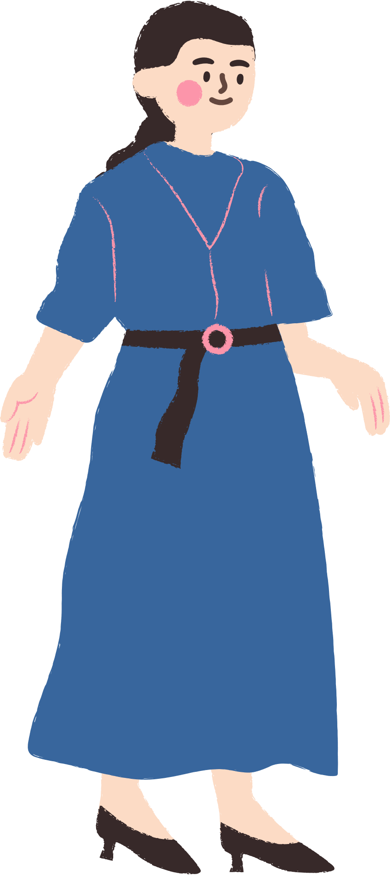

THANK YOU
See you gain!
Notes:
TRUY CẬP MÃ QR ĐỂ NHẬN QUÀ TẶNG
https://facebook.com/groups/853679022766648/

