Slide 1




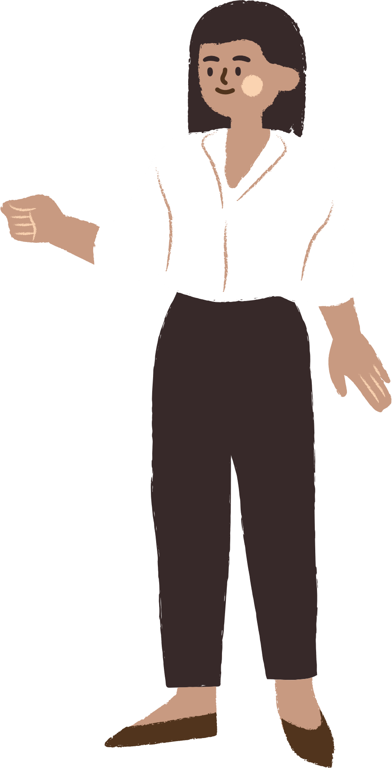
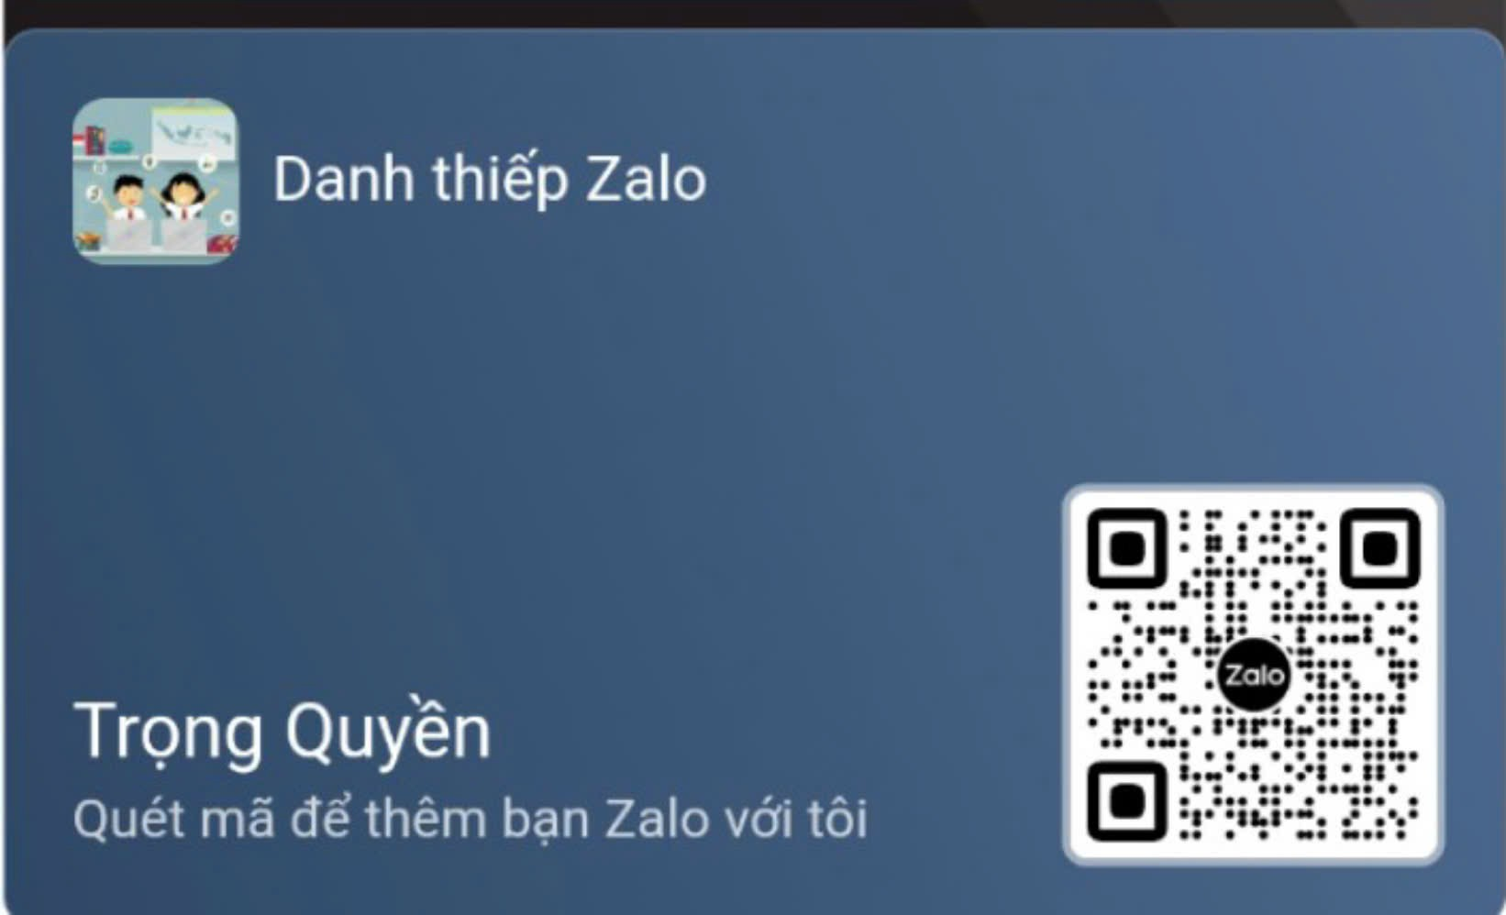




UNIT 12
Career choices
LESSON 2: A CLOSER LOOK 1

Slide 2

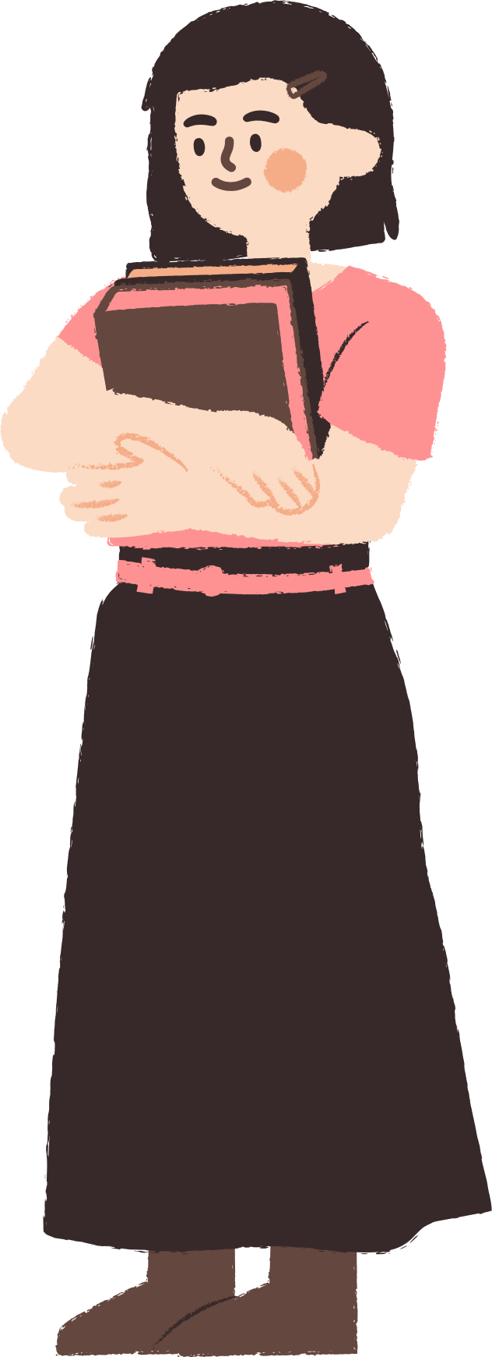




CONTENT
WARM-UP
VOCABULARY
PRACTICE
GAMES

Slide 3

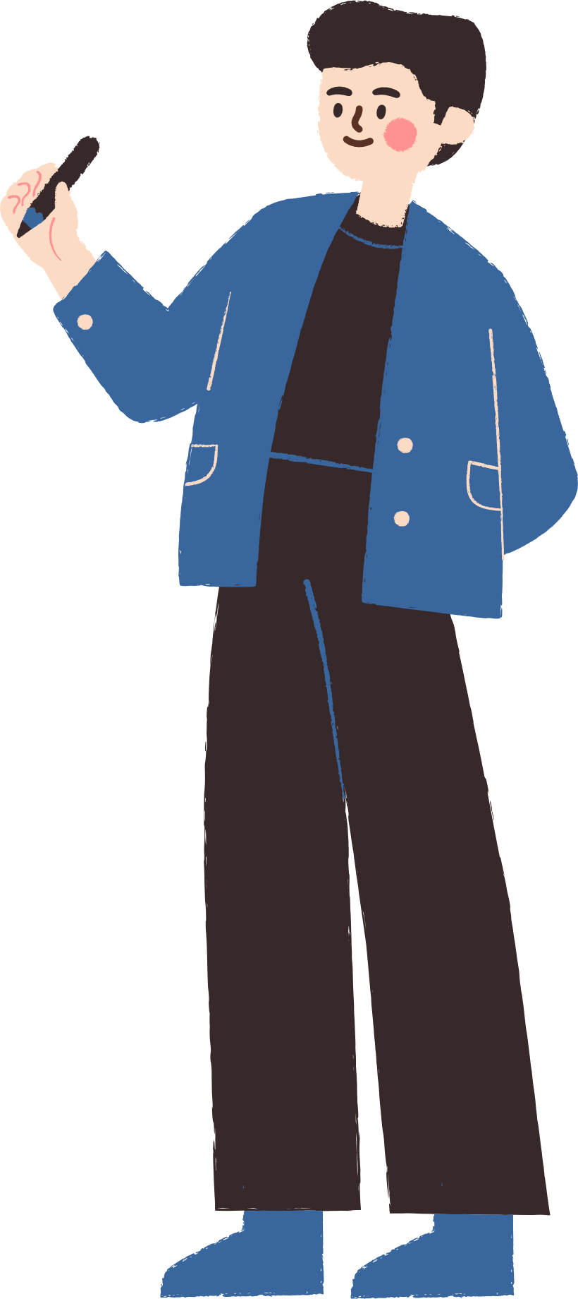



WARM-UP

Slide 4

WARM-UP
OPTION 1
HOW TO PLAY
- There are some JUMBLE WORDS.
              - Work in teams to unscramble them.

Slide 5
WARM-UP
OPTION 1
P | C | L | I | O | E
P | O | L | I | C | E

Slide 6
WARM-UP
OPTION 1
A | C | H | T | E | R | E
T | E | A | C | H | E | R

Slide 7
WARM-UP
OPTION 1
N | R | E | E | N | I | G | E
E | N | G | I | N | E | E | R

Slide 8
WARM-UP
OPTION 1
S | I | H | E | C | A | R
C | A | S | H | I | E | R

Slide 9
WARM-UP
OPTION 1
S | E | E | N | G | I | D
 | A | S | O | N | I | H | F
F | A | S | H | I | O | N | E | D
 | D | E | S | I | G | N | E | R

Slide 10
WARM-UP
OPTION 1
M | N | T | E | R | A | G
 | K | O | R | W | R | E
G | A | R | M | E | N | T | E | D
 | W | O | R | K | E | R

Slide 11
WARM-UP
OPTION 2
One-sentence Job stories

Slide 12
WARM-UP
OPTION 2
One-sentence Job stories
- Write down a one-sentence story about a specific job.
- Read out or have volunteers share their sentences, and try to guess the jobs based on the clues.
Example:
- As a baker, I wake up to the sweet smell of fresh bread.

Slide 13
VOCABULARY

Slide 14



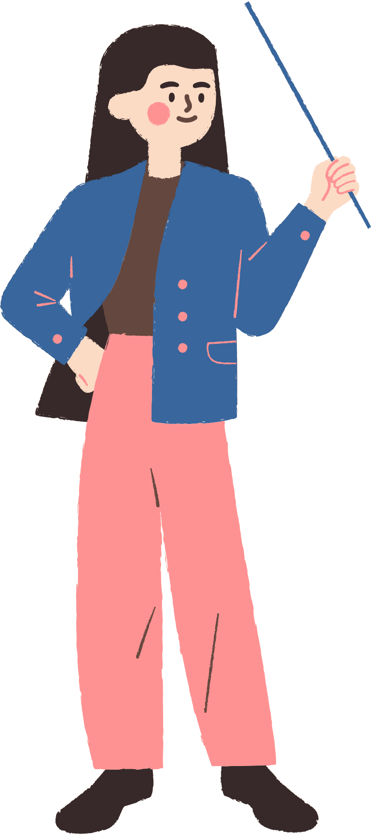


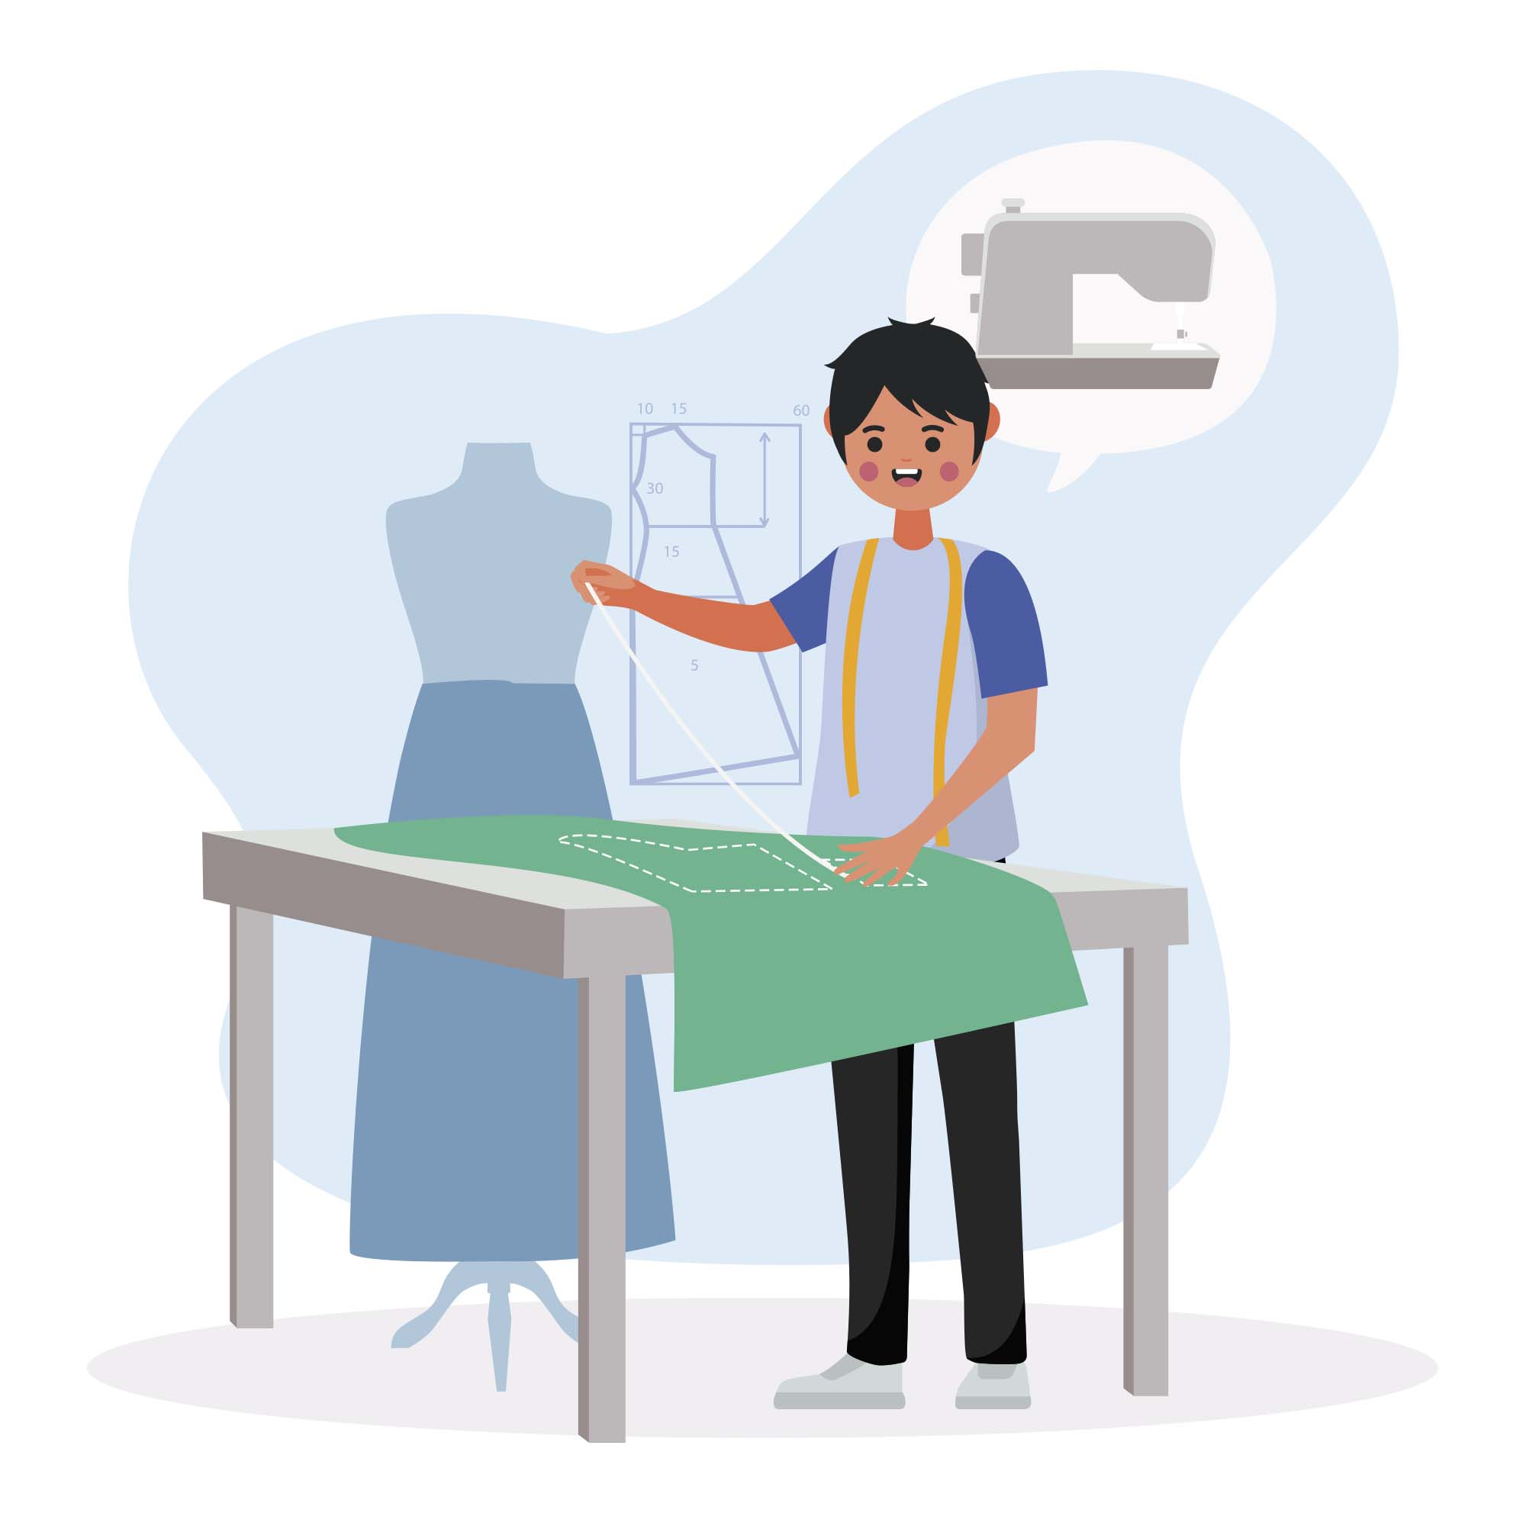



18. tailor /ˈteɪlə(r)/ (n) thợ may
A tailor can adjust clothes to fit you perfectly.(Một thợ may có thể điều chỉnh quần áo để vừa vặn với bạn một cách hoàn hảo.

Slide 15
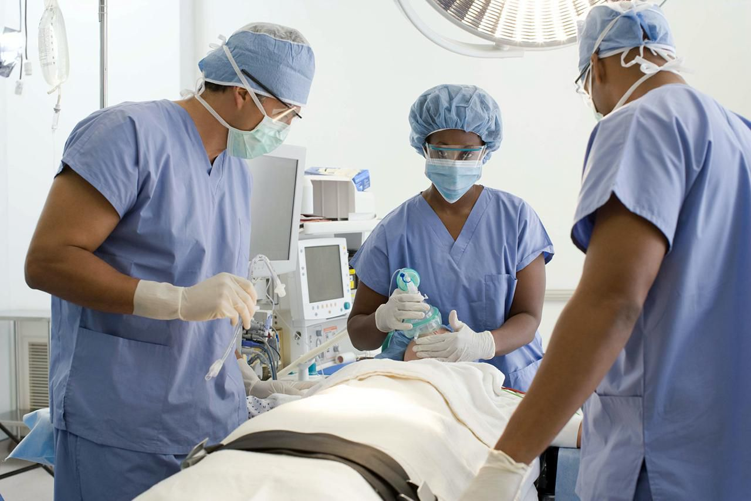
19. surgeon /ˈsɜːdʒən/ (n) bác sĩ phẫu thuật
Becoming a surgeon requires many years of study and training.(Để trở thành bác sĩ phẫu thuật đòi hỏi nhiều năm học tập và đào tạo.

Slide 16

20. dentist /ˈdentɪst/ (n) nha sĩ
We visit the dentist twice a year for check-ups.(Chúng tôi đến gặp nha sĩ hai lần một năm để kiểm tra.

Slide 17
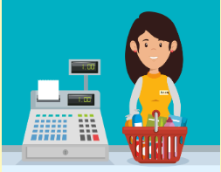
21. cashier /kæˈʃɪə(r)/ (n) nhân viên thu ngân
The cashier helps customers pay for their purchases at the store.(Người thu ngân giúp khách hàng thanh toán cho các mua sắm của họ tại cửa hang.

Slide 18

22. softwareengineer/ˈsɒftweə(r) ˌendʒɪˈnɪə(r)/ (n) kỹ sư phần mềm
Software engineers create the apps we use on our phones.(Các kỹ sư phần mềm tạo ra các ứng dụng chúng ta sử dụng trên điện thoại.

Slide 19

23. demanding /dɪˈmɑːndɪŋ/ (adj) đòi hỏi cao
Being a doctor is a demanding job that requires a lot of study.(Làm bác sĩ là một công việc đòi hỏi cao cần nhiều năm học tập.

Slide 20
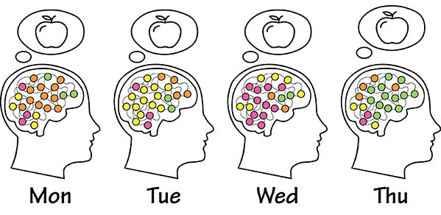
24. repetitive /rɪˈpetətɪv/ (adj) lặp đi lặp lại
Some factory jobs can be repetitive, doing the same task over and over.(Một số công việc trong nhà máy có thể lặp đi lặp lại, thực hiện cùng một nhiệm vụ nhiều lần.

Slide 21

25. well-paid /ˌwel ˈpeɪd/ (adj) có thu nhập cao
Doctors and lawyers are often well-paid professions(Bác sĩ và luật sư thường là những nghề được trả lương cao.

Slide 22

26. successful /səkˈsesfl/ (adj) thành công
Hard work and dedication can help you become successful in your career.(Làm việc chăm chỉ và cống hiến có thể giúp bạn thành công trong sự nghiệp.

Slide 23

27. decisive /dɪˈsaɪsɪv/ (adj) quyết đoán
A good leader needs to be decisive when making important decisions.(Một nhà lãnh đạo tốt cần phải quyết đoán khi đưa ra quyết định quan trọng.

Slide 24

28. creative /kriˈeɪtɪv/(adj) sáng tạo
Artists and designers need to be very creative in their work.(Nghệ sĩ và nhà thiết kế cần phải rất sáng tạo trong công việc của họ.

Slide 25

29. stress-free /stres - friː/(adj) (adj) không căng thẳng
Working in a park might be more stress-free than working in a busy office.

Slide 26

30. difficult /ˈdɪf.ə.kəlt/ (adj) khó khăn
Learning a new language can be difficult but rewarding. (Học một ngôn ngữ mới có thể khó khăn nhưng đáng giá.

Slide 27

31.reasonable/ˈriːznəbl/(adj) hợp lý
It's important to have reasonable expectations about your first job.(Việc có những kỳ vọng hợp lý về công việc đầu tiên của bạn là quan trọng.

Slide 28
VOCABULARY
Words | Pronunciation | Meanings
tailor | /ˈteɪlə(r)/ | (n) thợ may
surgeon | /ˈsɜːdʒən/ | (n) bác sĩ phẫu thuật
dentist | /ˈdentɪst/ | (n) nha sĩ
cashier | /kæˈʃɪə(r)/ | (n) nhân viên thu ngân
Softwareengineer | /sɒftweə(r)ˈ/ | (n) kỹ sư phần mềm
demanding | /dɪˈmɑːndɪŋ/ | (adj) đòi hỏi cao
repetitive | /rɪˈpetətɪv/ | (adj) lặp đi lặp lại

Slide 29
VOCABULARY
Words | Pronunciation | Meanings
well-paid | /ˌwel ˈpeɪd/ | (adj) có thu nhập cao
Successful | /səkˈsesfl/ | (adj) thành công
decisive | /dɪˈsaɪsɪv/ | (adj) quyết đoán
creative | /kriˈeɪtɪv/ | (adj) sáng tạo
stress-free | /stres - friː/(adj) | (adj) không căng thẳng
difficult | /ˈdɪf.ə.kəlt/ | (adj) khó khăn
reasonable | /ˈriːznəbl/ | (adj) hợp lý

Slide 30
PRACTICE

Slide 31
1. Match the jobs in A with their descriptions in B to make complete sentences.
a. receives and pays out money in a shop, bank, restaurant, etc.
1. A tailor
B
c. designs and develops computer software.
2. A surgeon
b. performs a particular task in the
process of making a product in a factory.
3. An assembly worker
4. A cashier
d. performs medical operations.
5. A software engineer
e. makes clothes.
Notes:
TRUY CẬP MÃ QR ĐỂ NHẬN QUÀ TẶNG
https://facebook.com/groups/853679022766648/

Slide 32
2. Choose the correct answer A, B, C, or D to complete each sentence.
1. My brother is applying for a _______ as a customer manager in a supermarket.
      job
      duty
      career
      work
Notes:
TRUY CẬP MÃ QR ĐỂ NHẬN QUÀ TẶNG
https://facebook.com/groups/853679022766648/

Slide 33
2. Choose the correct answer A, B, C, or D to complete each sentence.
2. Mr Hoang was a police officer. He had a successful _______ in the police force.
      work
      job
      career
      task
Notes:
TRUY CẬP MÃ QR ĐỂ NHẬN QUÀ TẶNG
https://facebook.com/groups/853679022766648/

Slide 34
2. Choose the correct answer A, B, C, or D to complete each sentence.
3. A cashier has to do _______ tasks, such as receiving money and printing receipts.
A . Effective
B. Creative
C. Decisive
D. Repetitive
Notes:
TRUY CẬP MÃ QR ĐỂ NHẬN QUÀ TẶNG
https://facebook.com/groups/853679022766648/

Slide 35
2. Choose the correct answer A, B, C, or D to complete each sentence.
4. A tailor can have a _______ job if he/she is creative and knowledgeable about fabric.
A. boring
B. Basic
C. well-paid
D. Difficult
Notes:
TRUY CẬP MÃ QR ĐỂ NHẬN QUÀ TẶNG
https://facebook.com/groups/853679022766648/

Slide 36
2. Choose the correct answer A, B, C, or D to complete each sentence.
5. A surgeon's job is _______. He/She works long hours and occasionally deals with life-and-death situations.
A. easy
B. Demanding
C. Rewarding
D. stress-free
Notes:
TRUY CẬP MÃ QR ĐỂ NHẬN QUÀ TẶNG
https://facebook.com/groups/853679022766648/

Slide 37
3. Complete the texts, using the words from the box. https://loigiaihay.com/tieng-anh-9-unit-12-a-closer-look-1-a163868.html
demanding repetitive well-paid
assembly worker software engineer
Mr Lam: I'm a(n) (1) _____________________. I design and develop programmes for computers. My job is (2)_____________. I work long hours on the computer, especially when deadlines approach. However, it's a (3)_________ job, so I'm happy with it.Ms Nga: I'm a(n) (4)________________ . I'm in charge of sticking labels on the products. Besides basic skills, I must be able to stand for a long time and do (5)___________ tasks at a reasonable speed.
software engineer
demanding
well-paid
assembly worker
repetitive

Slide 38
4. Listen to the conversations. Pay attention to the intonation in the statement questions. Then practise the conversations with a partner.
Remember!
We use a statement question when we want to express our surprise at the previous statement. In some cases, we use it to check if our information is correct. In these cases, we raise our voice at the end of the statement.
Example:
A: I want to be a doctor. ⤵
B: You want to be a doctor? ⤴
Notes:
TRUY CẬP MÃ QR ĐỂ NHẬN QUÀ TẶNG
https://facebook.com/groups/853679022766648/

Slide 39
4. Listen to the conversations. Pay attention to the intonation in the statement questions. Then practise the conversations with a partner.
Answer:
1.
- Minh: It's 4:20 now. I must go.
- Hoa: It's 4:20? Oh dear, I must go, too!
1.
- Minh: It's 4:20 now. I must go.
- Hoa: It's 4:20? Oh dear, I must go, too!
2.
- Mai: Mum, Ms Lan has invited you to a party.
- Mother: She invited me to a party?
Answer:
2.
Mai: Mum, Ms Lan has invited you to a party. ⤵
Mother: She invited me to a party? ⤴
Notes:
TRUY CẬP MÃ QR ĐỂ NHẬN QUÀ TẶNG
https://facebook.com/groups/853679022766648/

Slide 40
5. Complete each conversation with a statement question. Then practise the conversations with a partner. Pay attention to the intonation of each sentence
1. Nick: Minh is very happy with the vocational test.
- Trang: ______________ ? He told me something different.
2. Elena: I want to become a surgeon.
-Tom: __________ ? Do you have skillful hands?
Answer:
1.Nick: Minh is very happy with the vocational test. ⤵
- Trang: He is very happy with the vocational test? ⤴ He told me something different. ⤵
2.Elena: I want to become a surgeon. ⤵
- Tom: You want to become a surgeon? ⤴ Do you have skilful hands? ⤴
Notes:
TRUY CẬP MÃ QR ĐỂ NHẬN QUÀ TẶNG
https://facebook.com/groups/853679022766648/

Slide 41
GAMES

Slide 42







game
Look and answer?
A. tailor
B. reasonable
C. creative

Slide 43
game
2. Look and answer?
A. surgeon
B. creative
C. successful

Slide 44
game
3. Look and answer?
A. leveabale
B. reasonable
C. creative

Slide 45
game
4. Look and answer?
A. demanding
B. cashier
C. tailor

Slide 46



game
5. look and answer?
A. well-paid
B. decisive
C. softwareengineer

Slide 47
game
6. Look and answer?
A. demanding
B. reasonable
C. successful

Slide 48
game
7. Look and answer?
A. demanding
B. reasonable
C. repetitive

Slide 49
game
8. Look and answer?
A. well-paid.
B. successful
C. cashier

Slide 50
game
9. Look and answer?
A. demanding
B. successful
C. reasonable

Slide 51
game
10. Look and answer?
A. decisive.
B. demanding
C. well-paid.

Slide 52

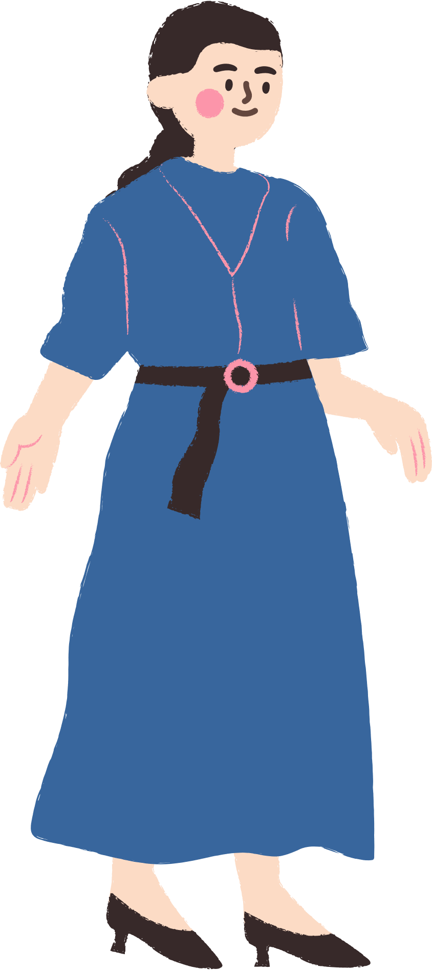

THANK YOU
See you gain!

