Slide 1




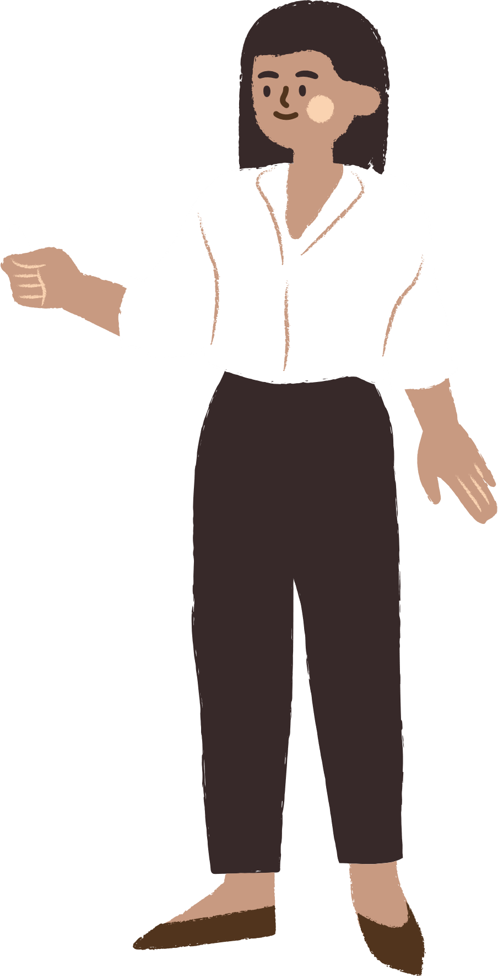
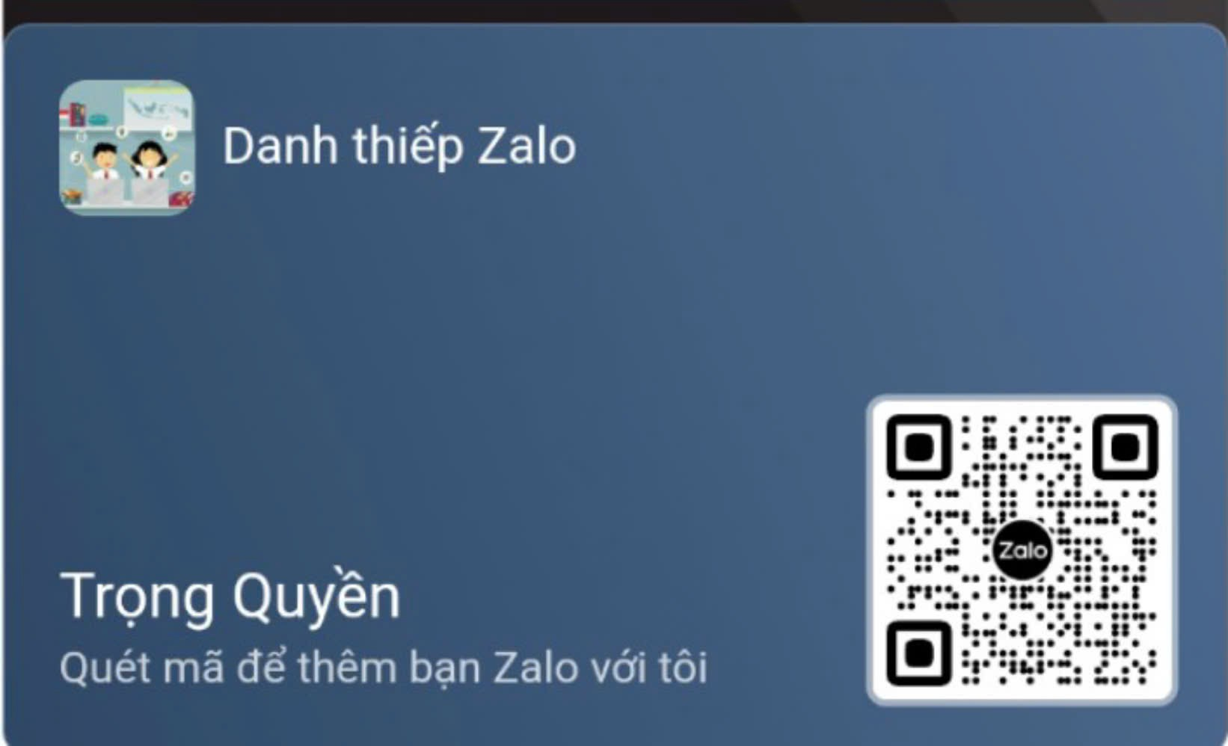




UNIT 12
Career choices
LESSON 6: SKILL 2
Notes:
TRUY CẬP MÃ QR ĐỂ NHẬN QUÀ TẶNG
https://facebook.com/groups/853679022766648/

Slide 2

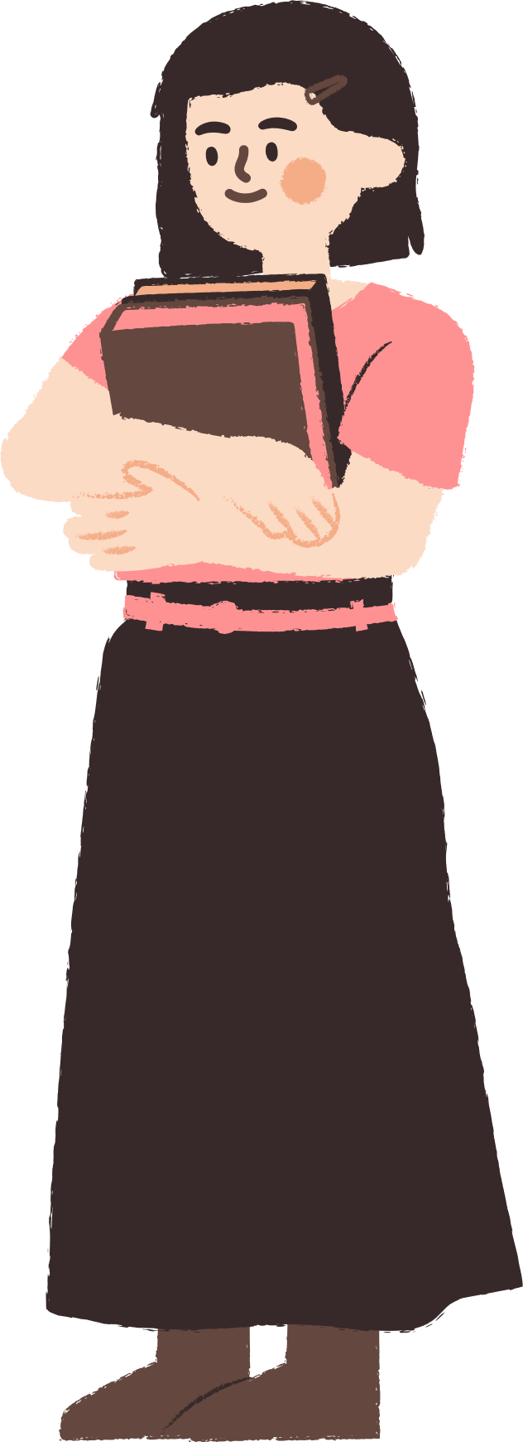




CONTENT
WARM-UP
VOCABULARY
PRACTICE
GAMES

Slide 3

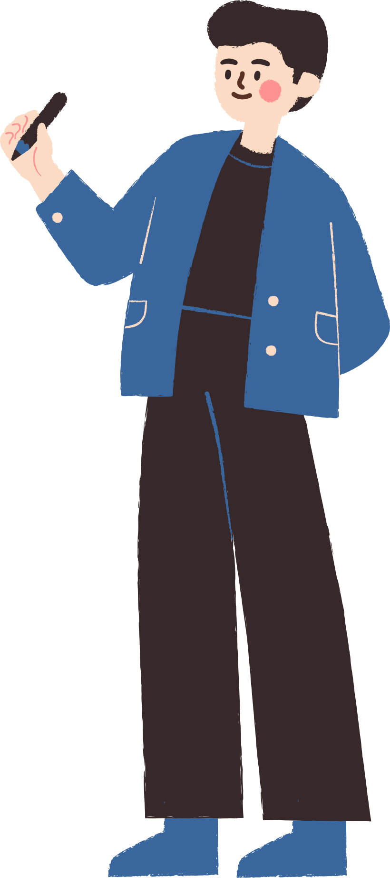



WARM-UP

Slide 4
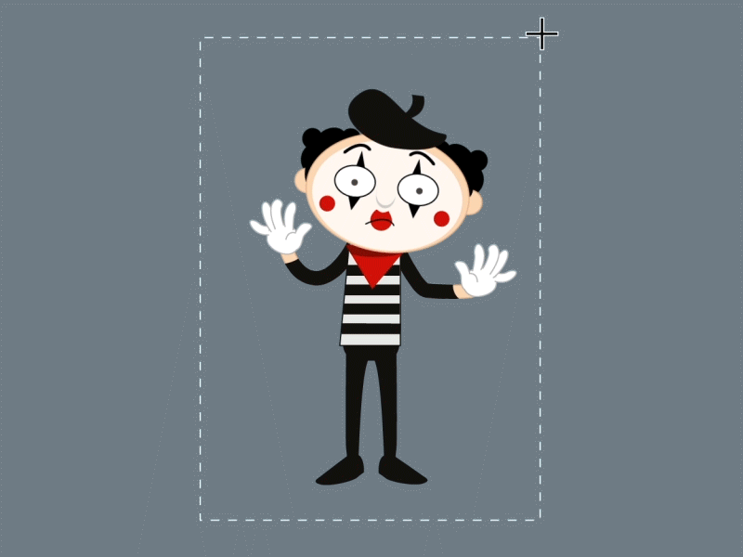
WARM-UP
OPTION 1
MIMING

Slide 5

WARM-UP
OPTION 1
- Go to the board. Mime some jobs. Other Ss to guess the jobs.
MIMING

Slide 6
VOCABULARY

Slide 7




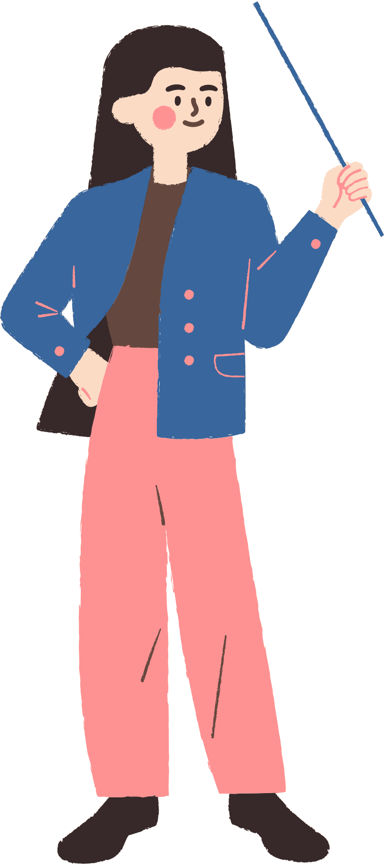

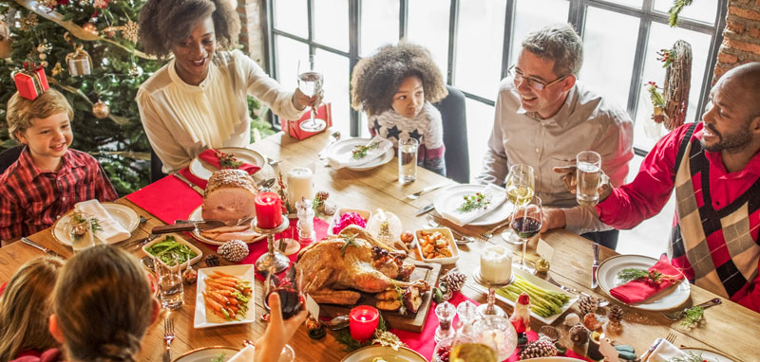



52. family tradition /ˈfæməlitrəˈdɪʃn/ (n) truyền thống gia đình
In some families, becoming a doctor is a family tradition.(Trong một số gia đình, trở thành bác sĩ là một truyền thống gia đình.)

Slide 8
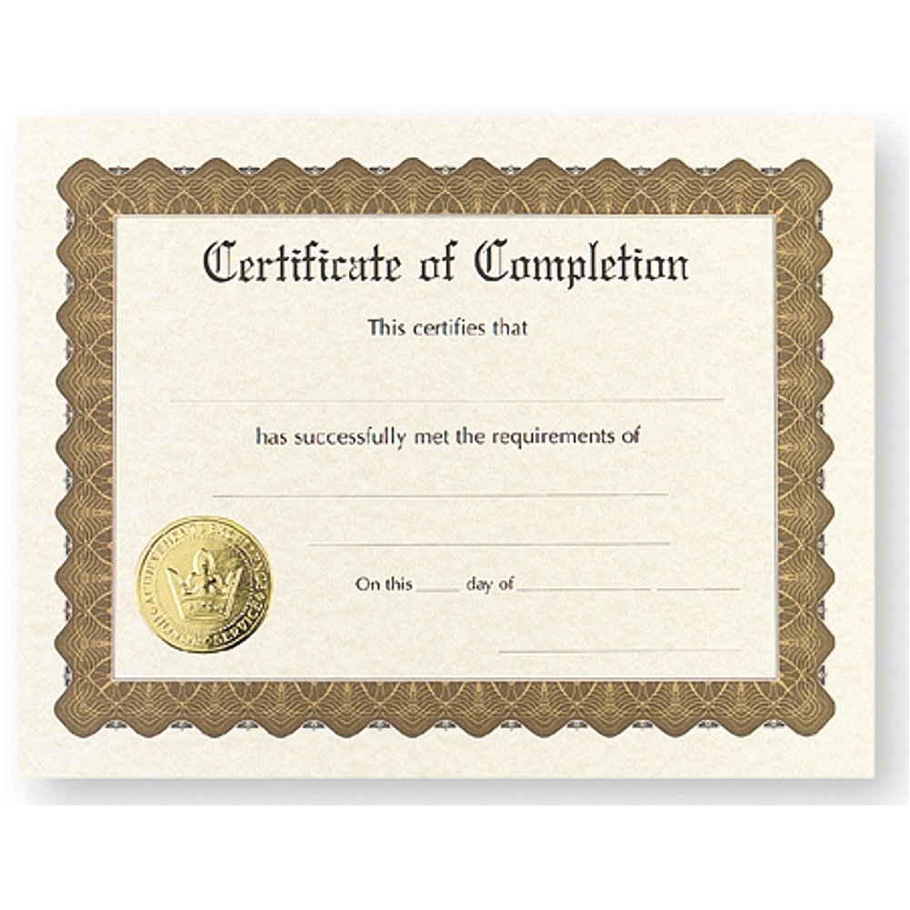
53. certificate /səˈtɪfɪkət/ (n) chứng chỉ
You may need a certificate to prove you have completed a training course.(Bạn có thể cần một chứng chỉ để chứng minh bạn đã hoàn thành một khóa đào tạo.)

Slide 9
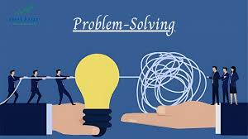
54. solving problem /ˈsɒlvɪŋ ˈprɒbləm/ (n) giải quyết vấn đề
Engineers use their skills in solving problems to create new technologies.(Kỹ sư sử dụng kỹ năng giải quyết vấn đề của họ để tạo ra các công nghệ mới.)

Slide 10
VOCABULARY
Words | Pronunciation | Meanings
family tradition | /ˈfæməlitrəˈdɪʃn/ | (n) truyền thống gia đình
certificate | /səˈtɪfɪkət/ | (n) chứng chỉ
solving problem | /ˈsɒlvɪŋ ˈprɒbləm/ | (n) giải quyết vấn đề

Slide 11
PRACTICE

Slide 12
Listening
1. Work in pairs. Which of the reasons below is the most important to you when choosing a job?
passion
ability
opportunity to travel
family tradition
ability
Answer
The ability and salary are the most important reasons to me when choosing a job. Because the abilities that align with the job will help me utilize my skills and knowledge effectively, thereby completing the job well. Additionally, a good salary ensures that I can support myself and my family, afford the lifestyle I desire, and plan for the future.
Notes:
TRUY CẬP MÃ QR ĐỂ NHẬN QUÀ TẶNG
https://facebook.com/groups/853679022766648/

Slide 13
2. Listen to two people talking about their career paths and tick (✔) T (True) or F (False).
T
F
1. Minh's parents were farmers.
✔
2. Minh is now working for an agricultural company.
✔
3. Ann first learnt cooking from a family member
✔
4. Ann is now a chef in a famous restaurant.
✔
Notes:
TRUY CẬP MÃ QR ĐỂ NHẬN QUÀ TẶNG
https://facebook.com/groups/853679022766648/

Slide 14
3. Listen again. Choose the correct answer A, B, or C.
-[Man]: Hi, I'm Minh. My parents were farmers in a remote village. Though they worked very hard in the fields, they were still poor. I wanted to find ways for farmers like my parents to earn a better living. So I decided to study agriculture engineering at university. Now I'm working for the local agriculture department in my home town. I help farmers grow better crops by using farming technology. I also persuade them to try new farming methods. Though it's a demanding job, I'm glad I'm doing well at it.
-[Woman]: Hi, I'm Ann. When I was a child, my grandmother, who was a chef, taught me how to cook. I liked cooking so much that I attended a vocational college where I earned a cooking certificate. Now I'm a chef in a restaurant in a small hotel. I make tasty and healthy food which my customers love very much. Though it's a well-paid job, I want to develop my career further. I'm learning more about food and new cooking skills. Hopefully, in the next five years, I'll have my own restaurant.
NEXT
Notes:
TRUY CẬP MÃ QR ĐỂ NHẬN QUÀ TẶNG
https://facebook.com/groups/853679022766648/

Slide 15
3. Listen again. Choose the correct answer A, B, or C.
1. Why did Minh decide to learn agriculture engineering?
A. Because he wanted to help the farmers.
B. Because he could get a well-paid job.
C. Because he had no other choice for university.
Notes:
TRUY CẬP MÃ QR ĐỂ NHẬN QUÀ TẶNG
https://facebook.com/groups/853679022766648/

Slide 16
3. Listen again. Choose the correct answer A, B, or C.
2. What does Minh's job involve?
A. Using technology in farming.
B. Solving problems among farmers.
C. Creating new kinds of plants.
Notes:
TRUY CẬP MÃ QR ĐỂ NHẬN QUÀ TẶNG
https://facebook.com/groups/853679022766648/

Slide 17
3. Listen again. Choose the correct answer A, B, or C.
3. How did Ann earn her cooking certificate?
A. By taking a short course in cooking.
B. By attending a vocational college.
C. By enrolling in an online course.
Notes:
TRUY CẬP MÃ QR ĐỂ NHẬN QUÀ TẶNG
https://facebook.com/groups/853679022766648/

Slide 18
3. Listen again. Choose the correct answer A, B, or C.
4. In the future, Ann wants to _______
A. work in a hotel restaurant
B. get another cooking certificate
C. open her own restaurant
Notes:
TRUY CẬP MÃ QR ĐỂ NHẬN QUÀ TẶNG
https://facebook.com/groups/853679022766648/

Slide 19
Writing
4. Work in pairs. Ask and answer the following questions.
1. What is your favourite job?
→My favourite job is being a photographer.
2. What does this job involve?
→ Being a photographer involves capturing images then editing them by using software like Adobe Photoshop or Lightroom. Photographers may specialize in various genres such as portrait, landscape, wildlife, fashion, or photojournalism.
Notes:
TRUY CẬP MÃ QR ĐỂ NHẬN QUÀ TẶNG
https://facebook.com/groups/853679022766648/

Slide 20
Writing
4. Work in pairs. Ask and answer the following questions.
3. What skills does this job need?
→ Photography requires technical skills such as understanding camera settings, composition principles, and lighting techniques. Photographer must also have a good eye for detail, and creativity. Additionally, proficiency in photo editing software is essential for the job.
4. What personal qualities do you need to have for this job?
→ I need patience and perseverance, as capturing the perfect shot may require waiting for the right moment or dealing with challenging conditions. Moreover, a keen sense of observation and effective communication skills are also important.
Notes:
TRUY CẬP MÃ QR ĐỂ NHẬN QUÀ TẶNG
https://facebook.com/groups/853679022766648/

Slide 21
5. Write an email (100-120 words) to your friend telling him/her about your future favourite job. You can use the ideas from 4
Start and end the email as follows:
Dear _____
It's nice to hear from you again. Let me tell you about ______
Write to me soon.
Cheers,
next
Notes:
TRUY CẬP MÃ QR ĐỂ NHẬN QUÀ TẶNG
https://facebook.com/groups/853679022766648/

Slide 22
5. Write an email (100-120 words) to your friend telling him/her about your future favourite job. You can use the ideas from 4
Answer:
Dear Duong
It's nice to hear from you again. Let me tell you about my future favourite job. In the future, I want to become a photographer. As a photographer, I'll get to capture moments and tell stories through my lens to create stunning images. I'll also be honing my skills in using photo editing software like Adobe Photoshop or Lightroom, and learning about camera settings, composition principles, and lighting techniques. I need patience and perseverance, as capturing the perfect shot may require waiting for the right moment or dealing with challenging conditions. Moreover, a keen sense of observation and effective communication skills with models are also important to create beautiful photos.
I'm really excited about this new journey and hope to share my photography adventures with you soon!
Write to me soon.
Cheers,
Quynh
Notes:
TRUY CẬP MÃ QR ĐỂ NHẬN QUÀ TẶNG
https://facebook.com/groups/853679022766648/

Slide 23
GAMES

Slide 24









game
3. look and answer?
A. family tradition
B. solving problem
C. certificate

Slide 25
game
3. look and answer?
A. family tradition
B. certificate
C. solving problem

Slide 26

game
Look and answer?
A. family tradition
B. solving problem
C. certificate

Slide 27

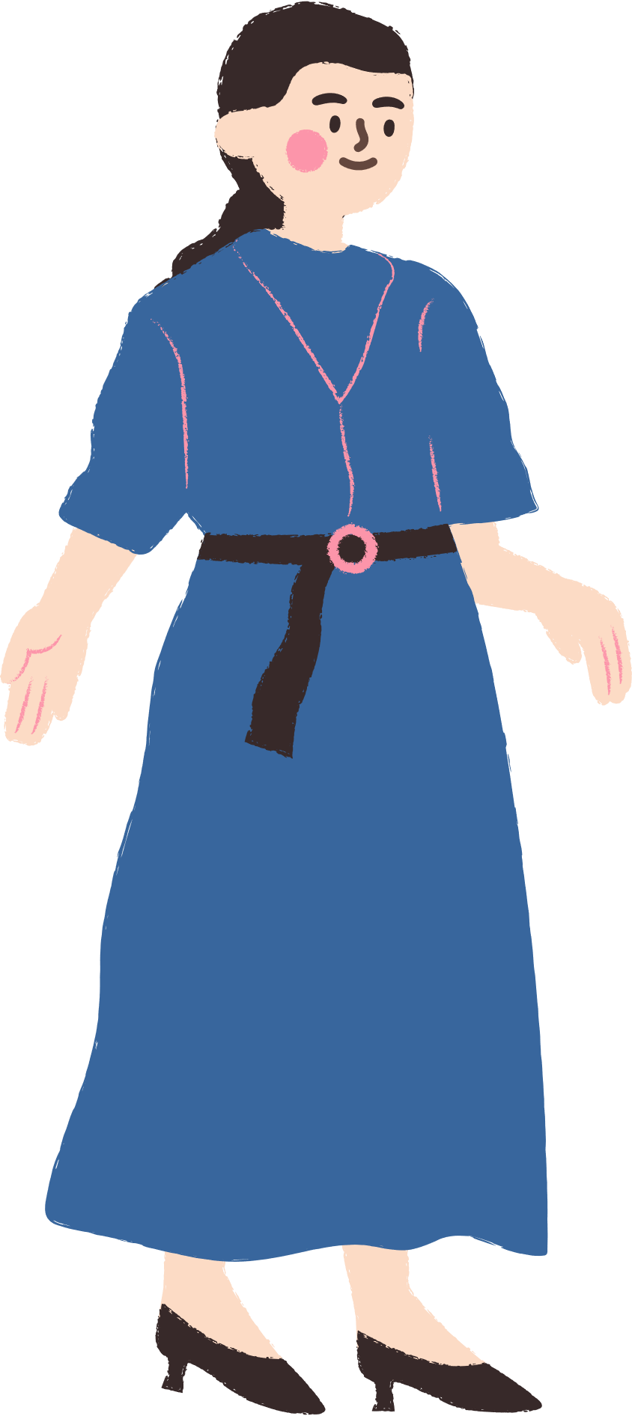

THANK YOU
See you gain!
Notes:
TRUY CẬP MÃ QR ĐỂ NHẬN QUÀ TẶNG
https://facebook.com/groups/853679022766648/

