Slide 1




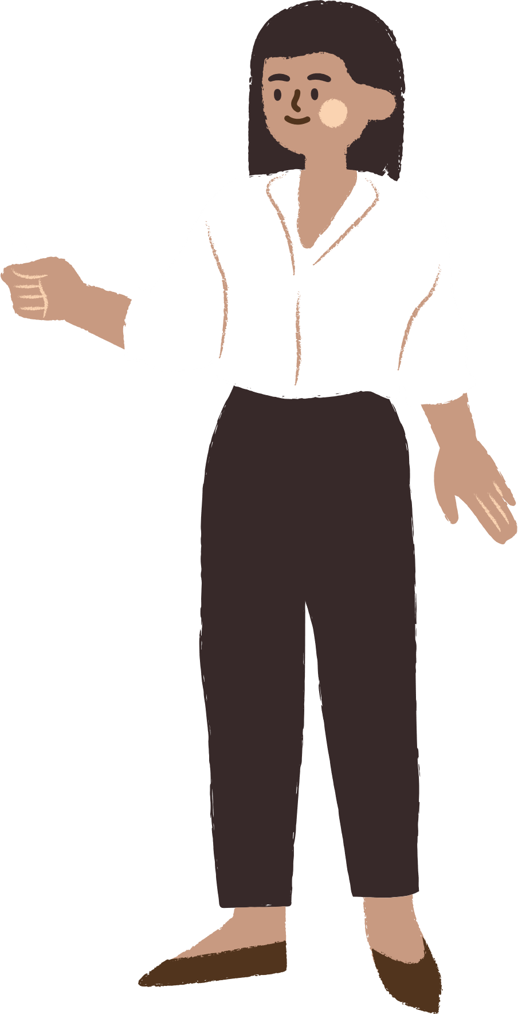





UNIT 12
LOCAL COMMUNITY
LESSON 7: : LOOKING BACK & PROJECT

Slide 2

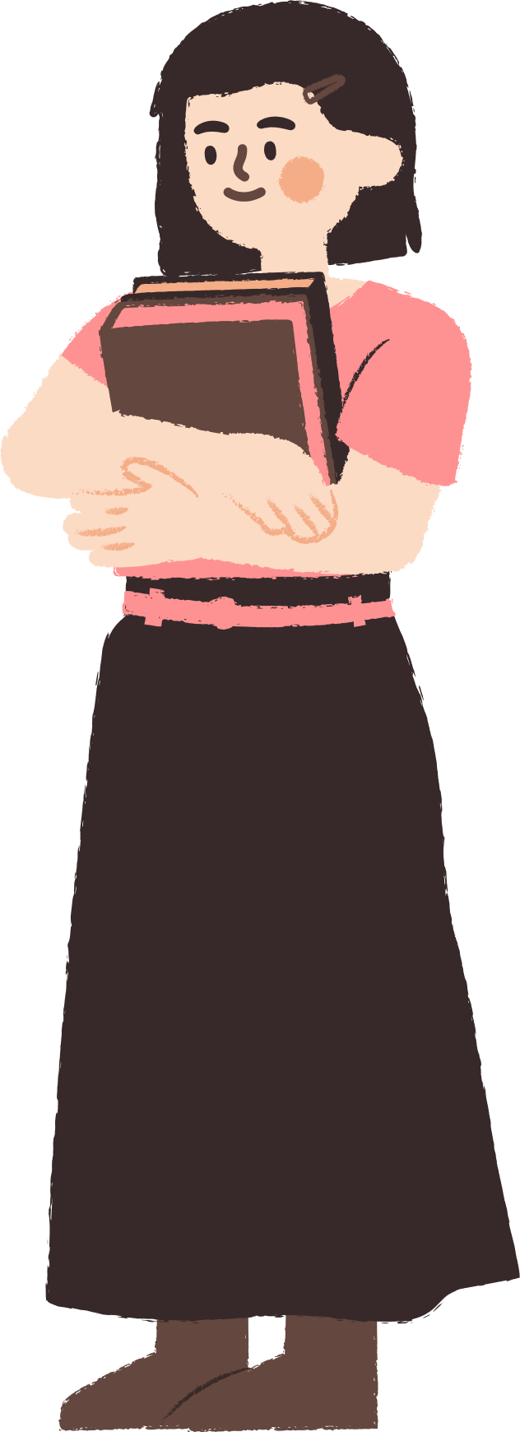




CONTENT
WARM-UP
VOCABULARY
PRACTICE
GAMES

Slide 3

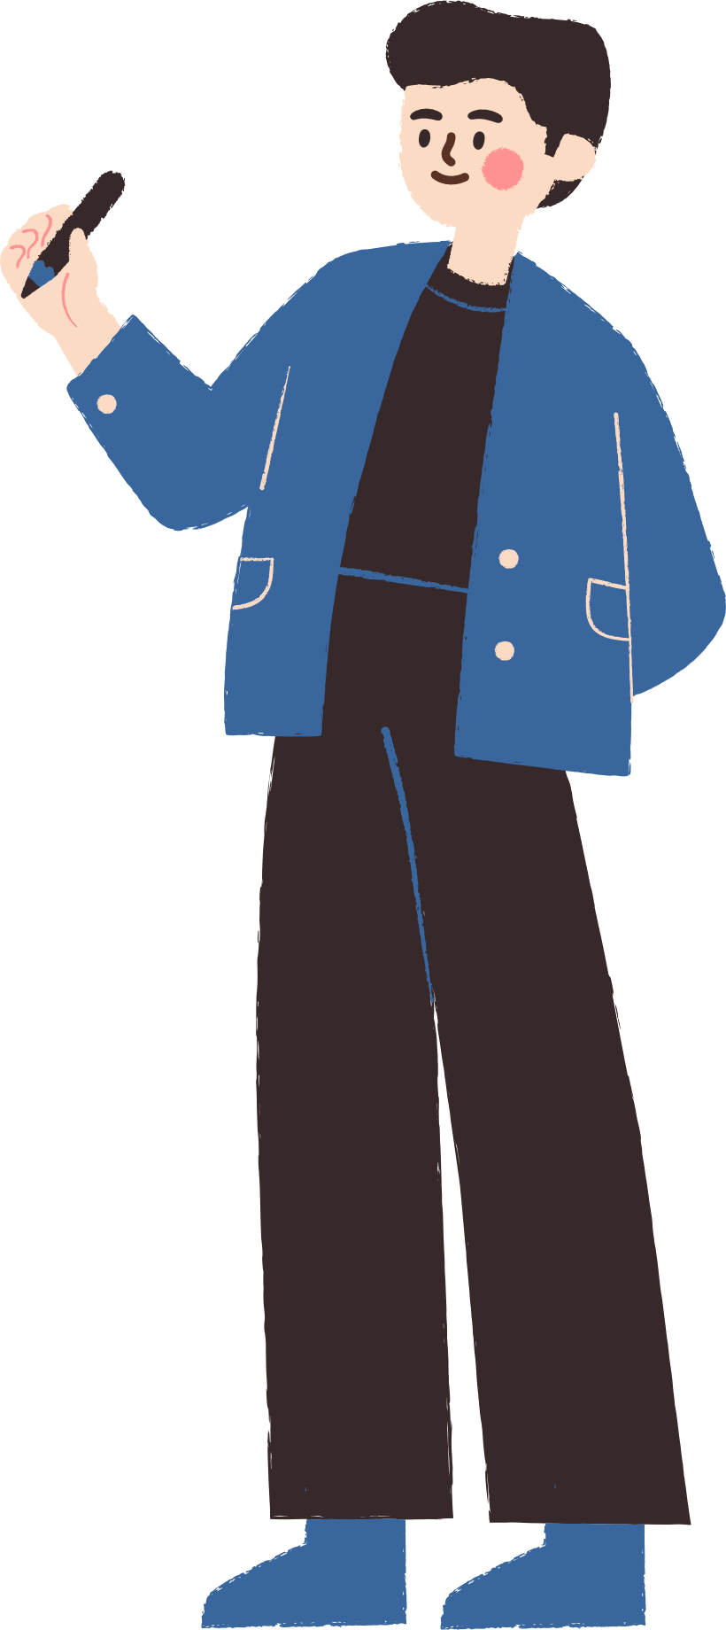



WARM-UP

Slide 4


WARM-UP
BRAINSTORMING
- Work in teams.
- Members of each team take turns and write as many vocabulary about city as possible in ................. minutes.
- The group having more correct answers is the winner.

Slide 5
VOCABULARY

Slide 6




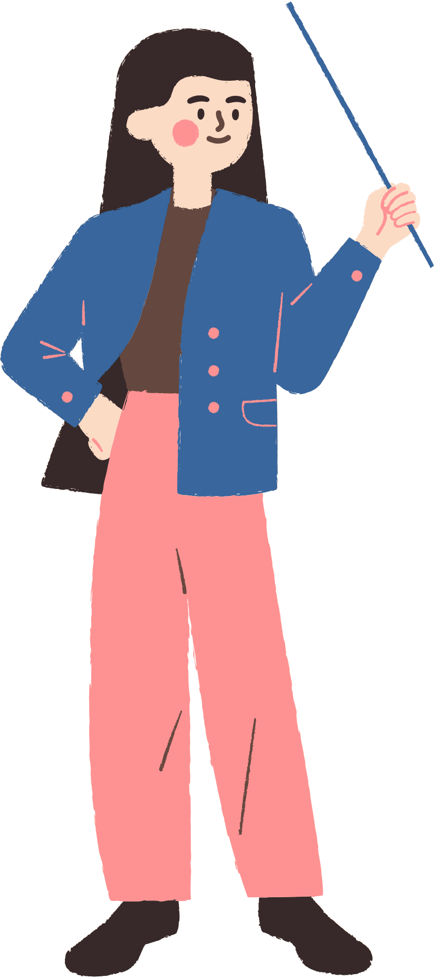





55. theoretical subject /θɪəˈretɪklˈsʌbdʒɪkt/ (n) môn lý thuyết
Physics is a theoretical subject that requires a lot of study.(Vật lý là một môn học lý thuyết đòi hỏi nhiều học tập.)

Slide 7

56. insist /ɪnˈsɪst/ (v) khăng khăng
Some parents insist that their children follow a certain career path.(Một số phụ huynh khăng khăng rằng con cái họ phải theo một con đường sự nghiệp nhất định.)

Slide 8

57. salary /ˈsæləri/ (n) lương
A good salary is important, but job satisfaction matters too.(Một mức lương tốt là quan trọng, nhưng sự hài lòng trong công việc cũng quan trọng.)

Slide 9

58. painful /ˈpeɪnfl/ (adj) đau đớn
Some jobs, like dentistry, may involve dealing with painful procedures.(Một số công việc, như nha khoa, có thể liên quan đến việc xử lý các thủ tục đau đớn.)

Slide 10
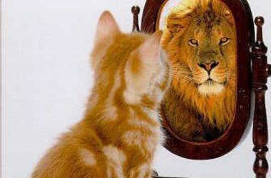
59. overestimate /ˌəʊvərˈestɪmeɪt/ (v) đánh giá cao
It's easy to overestimate how quickly you can learn a new skill.(Thật dễ dàng để đánh giá quá cao về việc bạn có thể học một kỹ năng mới nhanh như thế nào.)

Slide 11

60. future job /ˈfjuːtʃə(r) dʒɒb/ (n) nghề nghiệp tương lai
It's important to think about your future job when choosing what to study.(Việc suy nghĩ về công việc tương lai của bạn khi chọn ngành học là rất quan trọng.)

Slide 12
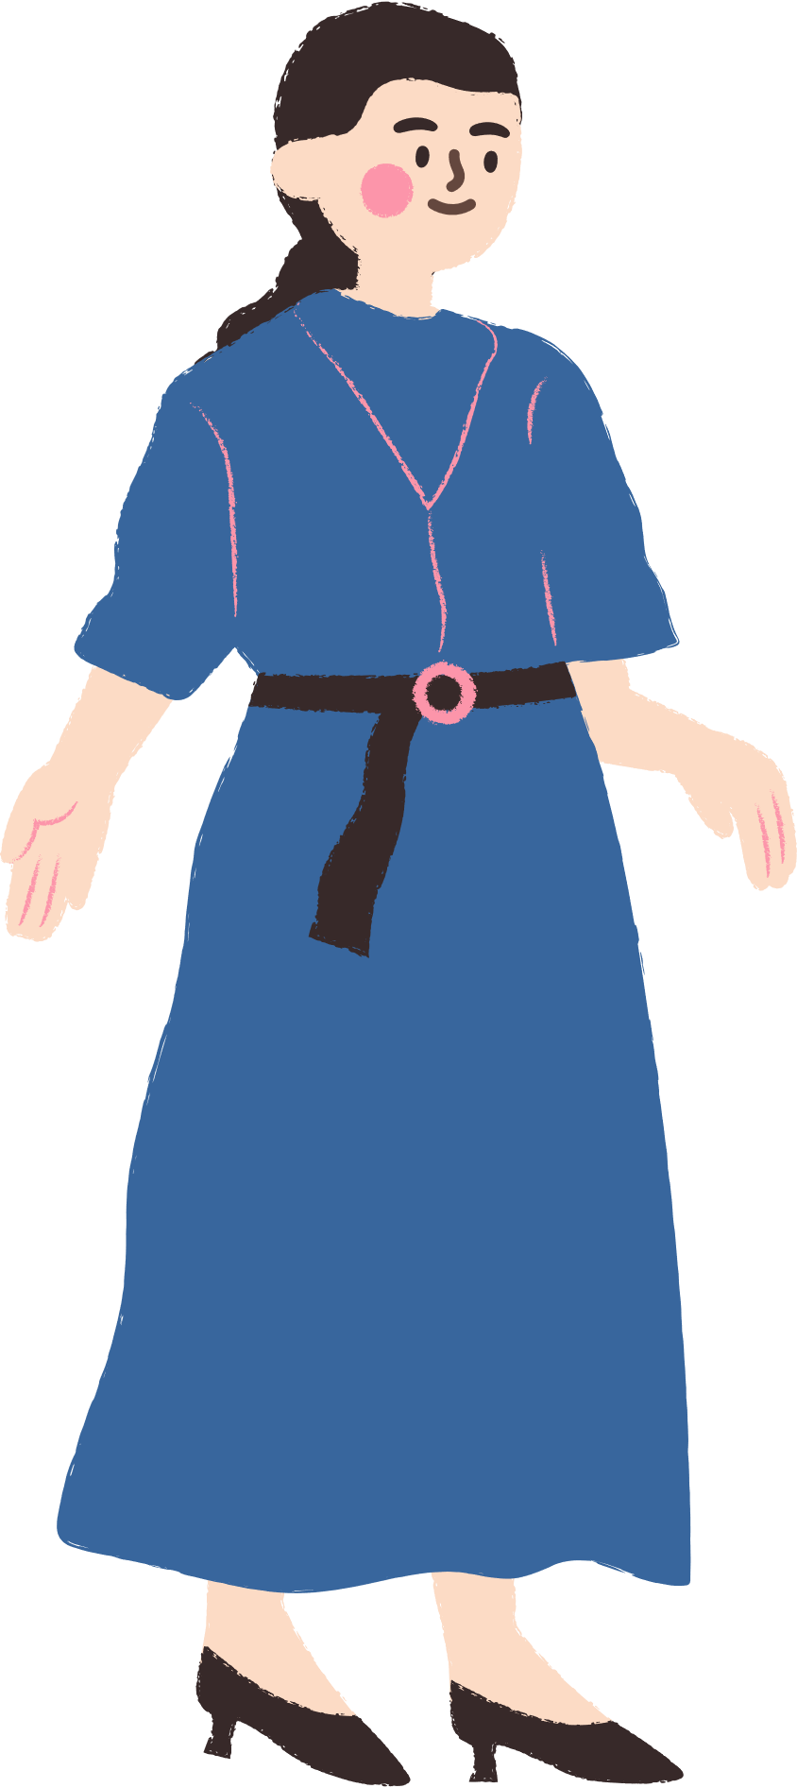
VOCABULARY
Words | Pronunciation | Meanings
theoretical subject | /θɪəˈretɪklˈsʌbdʒɪkt/ | (n) môn lý thuyết
insist | /ɪnˈsɪst/ | (v) khăng khăng
salary | /ˈsæləri/ | (n) lương
painful | /ˈpeɪnfl/ | /ˈpeɪnfl/
overestimate | /ˌəʊvərˈestɪmeɪt/ | (v) đánh giá cao
future job | /ˈfjuːtʃə(r) dʒɒb/ | (n) nghề nghiệp tương lai

Slide 13
PRACTICE

Slide 14
Vocabulary
1. Put the words and phrases in the appropriate column.
Jobs | Job features | Job skills
Surgeon assembly worker software engineer Designing | Demanding Repetitive well-paid | hand-eye coordinationm teamwork
Notes:
TRUY CẬP MÃ QR ĐỂ NHẬN QUÀ TẶNG
https://facebook.com/groups/853679022766648/

Slide 15
2. Complete the text, using words / phrases from the box.
job
createve sewing
s
career
rewarding
Sewing
My mum first learnt (1) ______________ skills from my grandmother. She got her (2) ______________ as a tailor when she was 16. Now she owns a small tailor shop in the village.
She is (3) ____________ and hardworking. She has such an excellent sense of style that many ladies love the clothes she makes. Though sometimes she has to work late at night, she finds her job (4) _____________ because she can satisfy her customers. I think my mum has had a successful (5)____________ in tailoring.
job
creative
rewarding
career
Notes:
TRUY CẬP MÃ QR ĐỂ NHẬN QUÀ TẶNG
https://facebook.com/groups/853679022766648/

Slide 16
Grammar
3. Combine each pair of sentences into one, using the given word in brackets.
1. The salary was low. She accepted the job. (though)
→She accepted the job, though the salary was low.
2. My sister is too shy. She can't be an MC. (such)
→My sister is such a shy person that she can't be an MC.
3. Life in the city was too demanding, so he came back to his village. (because)
→He came back to his village because life in the city was too demanding.
4. Her backache was too painful. She had to stop working in the factory. (so)
→Her backache was so painful that she had to stop working in the factory
5. Clara didn't like academic subjects. Her mum insisted that she go to university. (although)
→Although Clara didn't like academic subjects, Clara's mum insisted that she go to university.
Notes:
TRUY CẬP MÃ QR ĐỂ NHẬN QUÀ TẶNG
https://facebook.com/groups/853679022766648/

Slide 17
4. Fill in each gap in the text with a conjunction from the box.
although because since so such
such
Making career choices is (1) ____________ a difficult process that conflicts happen in many families when they discuss their teenager's future career. (2) __________ some parents consider their child's dream job unrealistic, they try to stop him/her from pursuing it. Sometimes, the parents force their child to study for a job which is (3) ________demanding that he / she feels stressed just (4) ______________ they overestimate their child's ability. (5) ____________parents want to help their children make good career decisions, they really need to understand their teenaged children's passions and abilities.
Since
So
Becausen
Although
Notes:
TRUY CẬP MÃ QR ĐỂ NHẬN QUÀ TẶNG
https://facebook.com/groups/853679022766648/

Slide 18
YOUR FUTURE JOBS
Work in groups.
1. Choose TWO jobs that members of your group would like to do in the future.
Two jobs that members of my group would like to do in the future are hairdresser and photographer.
Notes:
TRUY CẬP MÃ QR ĐỂ NHẬN QUÀ TẶNG
https://facebook.com/groups/853679022766648/

Slide 19
2. Compare the jobs in terms of:
Aspect | Hairdresser | Photographer
What they are | providing hair care services | capturing images using a camera and edit them
Training Required | cosmetology school or vocational | formal education, online couses, vocational training school
Skills Needed | hair styling techniques, knowledge of different hair types, artistry and creative skills, communication, customer service and dexterity. | understanding camera operation, composition principles, and lighting techniques, proficiency in photo editing software, artistry and creative skills, and good communication
next
Notes:
TRUY CẬP MÃ QR ĐỂ NHẬN QUÀ TẶNG
https://facebook.com/groups/853679022766648/

Slide 20
2. Compare the jobs in terms of:
Personal Qualities | Expected to continue growing, especially with the rise of digital content creation and social media
Popularity in the Future | Likely to maintain stability and increase in popularity due to people's increasing interest in beauty and hair care services | Likely to maintain stability and increase in popularity due to people's increasing interest in beauty and hair care services
Notes:
TRUY CẬP MÃ QR ĐỂ NHẬN QUÀ TẶNG
https://facebook.com/groups/853679022766648/

Slide 21
3. Prepare a poster presentation.
Aspect | Hairdresser | Photographer
What the are | Providing hair cave services | Capturing images using a camera and edit them
Training Required | Cosmetology school vocational program | Formal education, online couses , vocation, training school
Skills Needed | Hair styling techniques, knowledge of different hair types, artistry and creative skills, communication, customer service and dexterity | Understanding camera operation, composition principles, and lighting techniques, proficiency in photo editing software, artistry and creative skills, and good communication
Personal Qualities | Patience and perseverance, energy, adaptability and active listening
Popularity in the future | Likely to maintain stability and increase in popularity due to people’s increasing interest in beauty and hair care services. |  | Expected to continue growing, especially with the rise of digital content creation and social media.
Notes:
TRUY CẬP MÃ QR ĐỂ NHẬN QUÀ TẶNG
https://facebook.com/groups/853679022766648/

Slide 22
4. Present your poster to the class.
Today, I want to compare two creative professions: hairdressing and photography. Let's dive in.Let's start by understanding what exactly hairdressing and photography entail. Hairdressing is about caring and styling hair, while photography captures moments through a camera lens.To become a hairdresser, one typically undergoes formal training at a cosmetology school or through a vocational program. In contrast, the path to becoming a photographer can vary widely. While some pursue formal education in photography through university or art school programs, others are self-taught. Workshops, online courses, and apprenticeships also play a significant role in honing photography skills.Both require artistry and creative skills, attention to detail, and communication skills. Hairdressers need to have knowledge of different hair types and styling techniques, while photographers focus on understanding camera operation, composition principles, and lighting techniques, and proficiency in photo editing software.In the future, hairdressing is stable due to ongoing demand in beauty and hair care services, while photography is growing, especially in digital media.In conclusion, both hairdressing and photography offer exciting and rewarding career paths for those with a passion for creativity and artistry.Thank you for your time. Any questions?
Notes:
TRUY CẬP MÃ QR ĐỂ NHẬN QUÀ TẶNG
https://facebook.com/groups/853679022766648/

Slide 23
GAMES

Slide 24








game
Look and answer?
A. theoretical subject
B. insist
C. overestimate

Slide 25

game
2. Look and answer?
A. painful
B. insist
C. overestimate

Slide 26

game
3. Look and answer?
A. painful
B. salary
C. overestimate

Slide 27

game
3. Look and answer?
A. overestimate
B. painful
C. insist

Slide 28

game
3. Look and answer?
A. painful
B. overestimate
C. insist

Slide 29

game
3. Look and answer?
A. painful
B. future job
C. insist

Slide 30


THANK YOU
See you gain!

