Slide 1




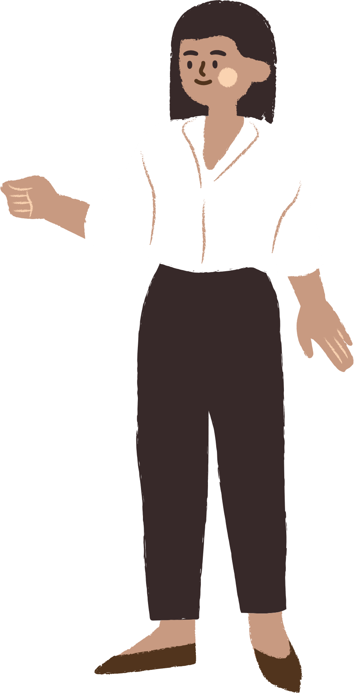
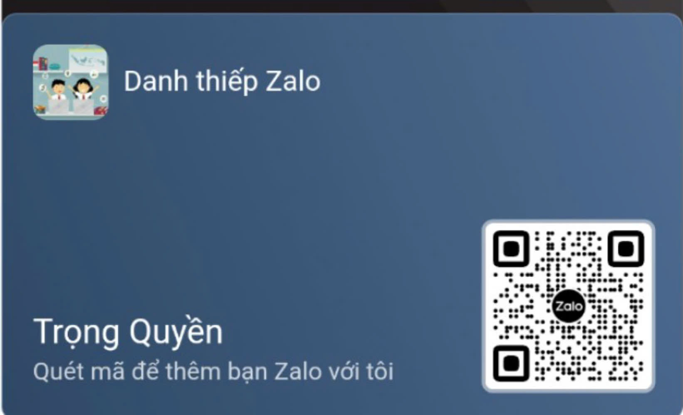




UNIT 12
Career choices
LESSON 3: A CLOSER LOOK 2
Notes:
TRUY CẬP MÃ QR ĐỂ NHẬN QUÀ TẶNG
https://facebook.com/groups/853679022766648/

Slide 2

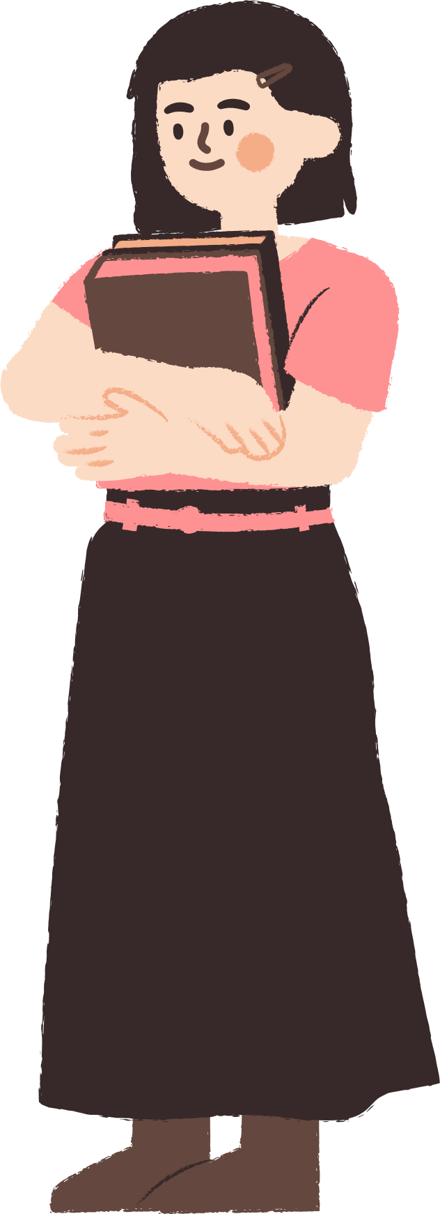




CONTENT
WARM-UP
VOCABULARY
PRACTICE
GAMES

Slide 3

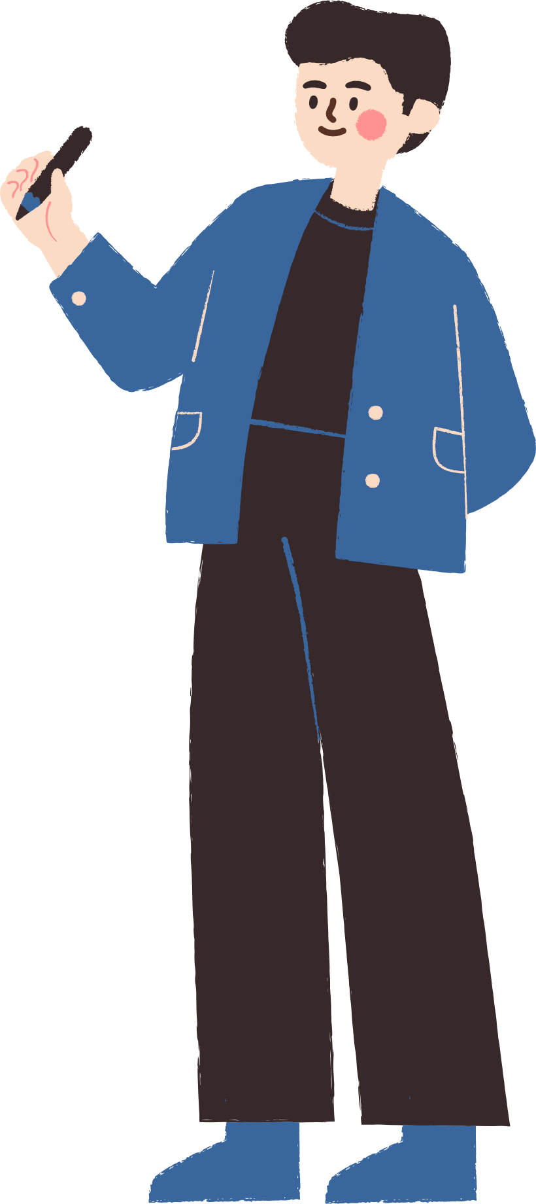



WARM-UP

Slide 4
WARM-UP
OPTION 1
- Look at the sentence:
Although
________ the sun was shining, it was very cold.
- Complete the sentence with one of the following words: “Although, Because, So.”
- We use “although” when we want to express a contrast between two clauses.

Slide 5
WARM-UP
OPTION 2
Conjunction Catch

Slide 6
WARM-UP
OPTION 2
- There are slips of paper with individual conjunctions for each adverb clause type (although, so, because)
- Teacher throws the slips of paper around the class while students stand and move around.
HOW TO PLAY
- When a student catches a slip, they must immediately shout out a sentence that uses the conjunction correctly as part of an adverb clause.

Slide 7
WARM-UP
OPTION 2
LET’S PLAY

Slide 8
VOCABULARY

Slide 9



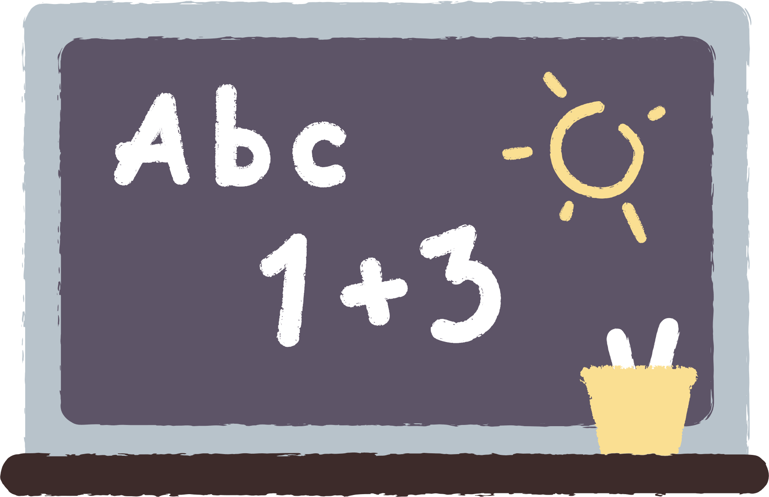
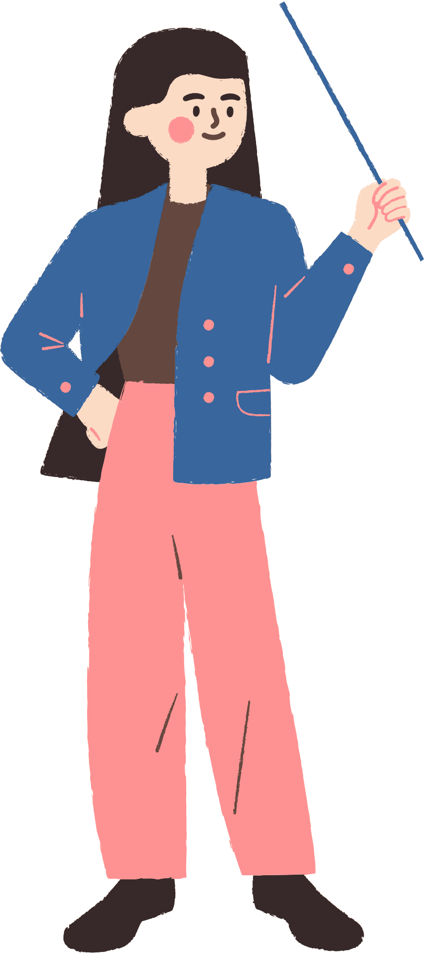

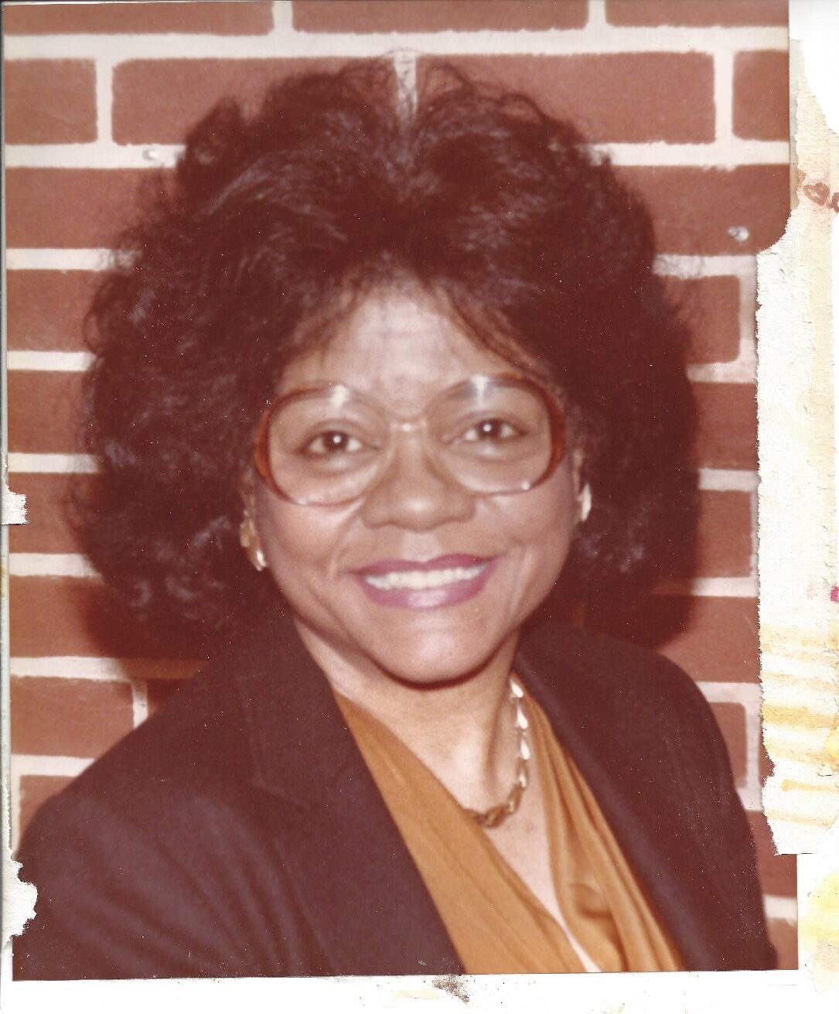

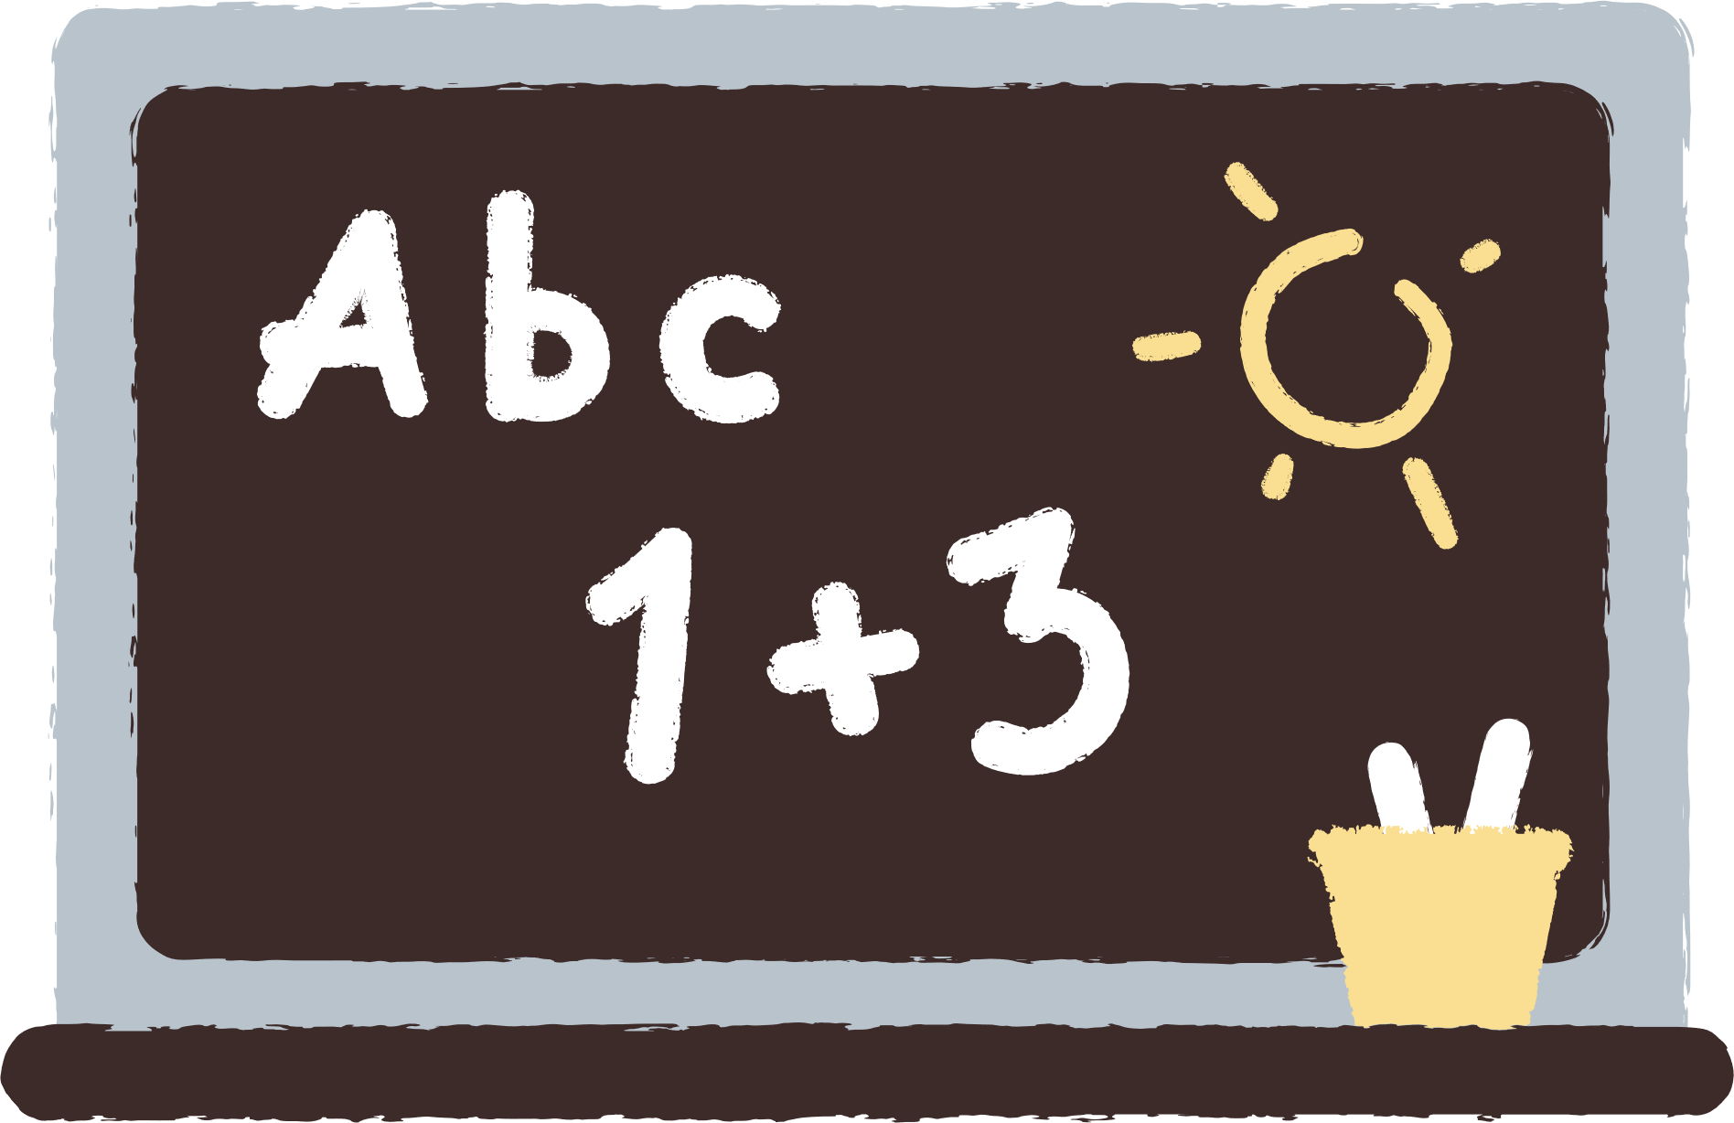

32. mathematician /ˌmæθəməˈtɪʃn/ (n) nhà toán học.
A mathematician might work on complex problems in science or technology (Một nhà toán học có thể làm việc với các vấn đề phức tạp trong khoa học hoặc công nghệ.)

Slide 10

33. put off /pʊt ɒf/ (phr.v) trì hoãn Don't put off studying for your exams until the last minute. (Đừng trì hoãn việc học cho kỳ thi của bạn đến phút cuối.)

Slide 11
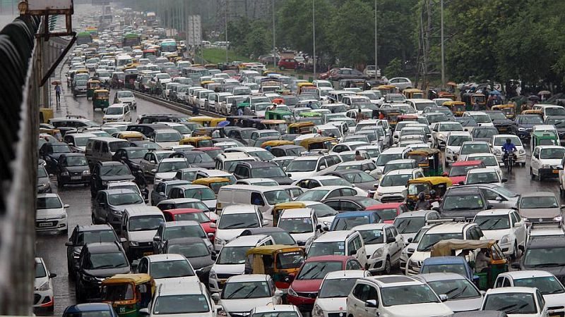
34. traffic jam /'træfɪk dʒæm/ (n) tắc đường.
A traffic jam can make you late for school or work. (Tắc nghẽn giao thông có thể khiến bạn đi học hoặc đi làm muộn.)

Slide 12
VOCABULARY
Words | Pronunciation | Meanings
mathematician | /ˌmæθəməˈtɪʃn/ | (n) nhà toán học.
put off | /pʊt ɒf/ | (phr.v) trì hoãn
traffic jam | /'træfɪk dʒæm/ | (n) tắc đường.

Slide 13
PRACTICE

Slide 14
Choose the correct word to complete each sentence
1. Although / But footballers are well-paid, they have short careers.
→ Although footballers are well-paid, they have short careers.
2. She still applied for the job so / though she had almost no chance to get it.
→ She still applied for the job though she had almost no chance to get it.
3. Although / However she went to the cinema early, she couldn't buy the ticket.
Although she went to the cinema early, she couldn't buy the ticket.
4. She has to do repetitive tasks in her job, although / but she still likes it.
She has to do repetitive tasks in her job, although she still likes it.
5. Though / But Mike felt tired, he managed to finish his homework.
→Though Mike felt tired, he managed to finish his homework.
Notes:
TRUY CẬP MÃ QR ĐỂ NHẬN QUÀ TẶNG
https://facebook.com/groups/853679022766648/

Slide 15
2. Complete the sentences with so or such.
Phương pháp giải:
Remember!
An adverbial clause of result shows the result of an action or event. It is often introduced with so/such... that... We use so + adj + that and such (+ a/an) + adj + noun + that.
Example:
The box was so heavy that the worker couldn't lift it up.
She is such a skilful tailor that all the ladies in the neighbourhood like the clothes she makes.
An adverbial clause of reason explains the reason why an action is done or an event happens. It is often introduced with because and since. Since is often placed at the beginning of a sentence. Because can be placed at the beginning or in the middle of the sentence.
Example:
James wants to become a tour guide because he loves travelling. / Because he loves travelling, James wants to become a tour guide.
Since she was late, she couldn't join the career orientation session.
Notes:
TRUY CẬP MÃ QR ĐỂ NHẬN QUÀ TẶNG
https://facebook.com/groups/853679022766648/

Slide 16
2. Complete the sentences with so or such.
so
1. The factory was _______ far from his home that he couldn't go there to work.
2. Katie was ________ a lazy worker that no manager wanted to hire her.
3. They are _______ creative designers that everyone admires them.
4. Can you speak louder? You voice is _______ soft that I can't hear you.
5. He is _______ a handsome man that many people think he could be an actor.
such
such
so
Such
Notes:
TRUY CẬP MÃ QR ĐỂ NHẬN QUÀ TẶNG
https://facebook.com/groups/853679022766648/

Slide 17
3. Join the sentences, using the given word in brackets.
1. Jenny didn't attend the job fair. She was ill. (because)
→ Jenny didn't attend the job fair because she was ill.
2. Henry is excellent at maths. Everyone thinks he will become a mathematician. (since)
→ Since Henry is excellent at maths, everyone thinks he will become a mathematician.
3. Mai practised speaking English a lot. She wanted to get a high score on the speaking test. (because)
→Mai practised speaking English a lot because she wanted to get a high score on the speaking test.
4. Ms Nga is away this week. We'll put off the next class meeting. (since)
Since Ms Nga is away this week, we'll put off the next class meeting.
5. I couldn't go to the office on time. There was a traffic jam. (because)
→I couldn't go to the office on time because there was a traffic jam.
Notes:
TRUY CẬP MÃ QR ĐỂ NHẬN QUÀ TẶNG
https://facebook.com/groups/853679022766648/

Slide 18
4. Rewrite each sentence. Use the given word in brackets.
1. I forgot to bring money, so I couldn't buy the career guidebook.(because)
I couldn't buy the career guidebook because I forgot to bring money.
2. My navigation skill is very bad. I could never work as a taxi driver. (so)
I'm so bad at navigation that I could never work as a taxi driver.
3. Sally couldn't use the computer. There was a power cut. (since)
→Since there was a power cut, Sally couldn't use the computer.
4. She had a university degree, but she couldn't find a good job. (although)
→ Although she had a university degree, she couldn't find a good job.
5. The florist was very skillful. Her flower shop attracted many customers.(such)
→She was such a skilful florist that her flower shop attracted many customers.
Notes:
TRUY CẬP MÃ QR ĐỂ NHẬN QUÀ TẶNG
https://facebook.com/groups/853679022766648/

Slide 19
5. Complete the sentences with your own ideas. Then exchange them with a partner.
1.Although my sister is a fashion designer, _______________________.
→ Although my sister is a fashion designer, he often struggles to find inspiration for new designs
2. I want to become a pilot because ______________________.
I want to become a pilot because I love flying and seeing the world from above.
3. My father has such a hard job that ___________________.
My father has such a hard job that he often works overtime and rarely takes vacations.
4. Since most vocational courses take a short time to finish, __________________.
Since most vocational courses take a short time to finish, students can start working sooner after completing them.
5. The garment worker felt so bored that ______________________.
→ The garment worker felt so bored that she has started looking for a new job.
Notes:
TRUY CẬP MÃ QR ĐỂ NHẬN QUÀ TẶNG
https://facebook.com/groups/853679022766648/

Slide 20
GAMES

Slide 21







game
Look and answer?
A. mathematician
B. traffic jam
C. suitable

Slide 22
game
2. Look and answer?
A. put off
B. medical university
C. traffic jam

Slide 23
game
3. Look and answer?
A. noise pollution
B. traffic jam
C. suitable

Slide 24

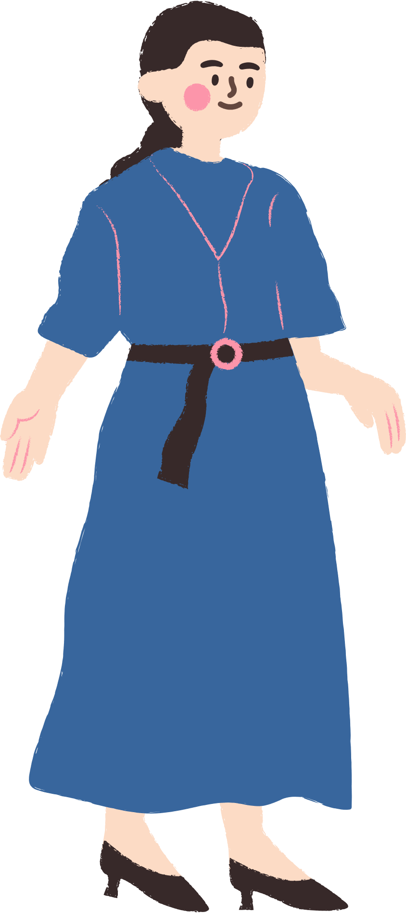

THANK YOU
See you gain!
Notes:
TRUY CẬP MÃ QR ĐỂ NHẬN QUÀ TẶNG
https://facebook.com/groups/853679022766648/

