Slide 2


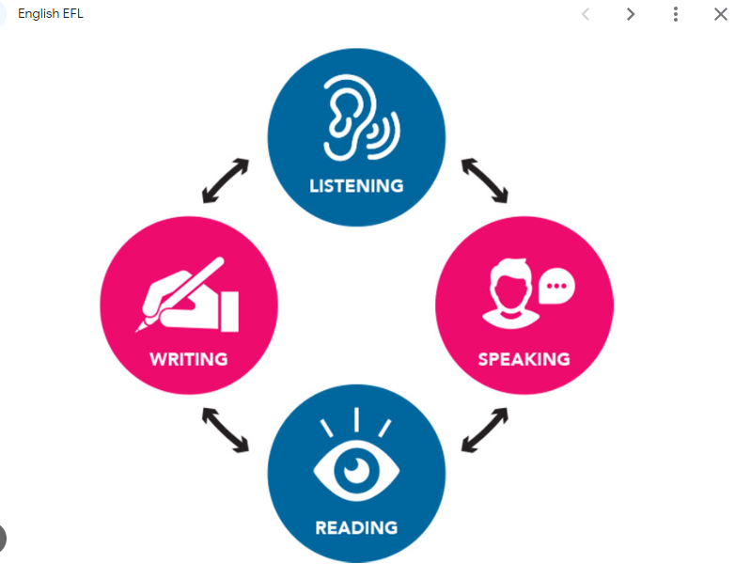
REVIEW
4
LESSON 2: SKILLS
1

Slide 3
LESSON 2: SKILLS
WARM-UP
Keyword guessing
READING
Task 1: Read the article. Choose the best option A, B, C, or D.
SPEAKING
Task 2: Work in groups. Imagine a job that may be popular in the future. Discuss the answers to the questions about the job and report them to the class.
LISTENING
Task 3: Listen to a conversation between Trang and Tom. Fill in each blank with no more than TWO words.
WRITING
Task 4: Write an email (100 – 120 words) to your friend telling him / her about an organisation which protects the ocean. You can use the ideas below.
CONSOLIDATION
Wrap-up
Homework

Slide 4
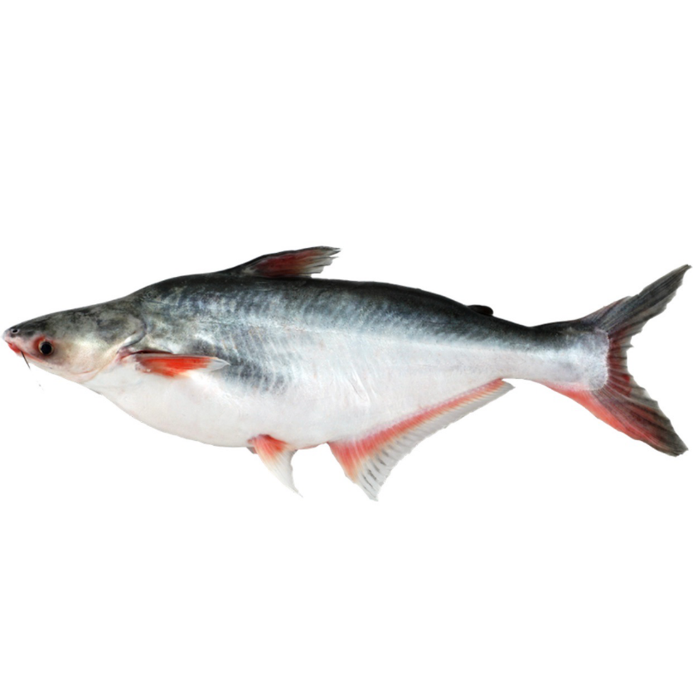
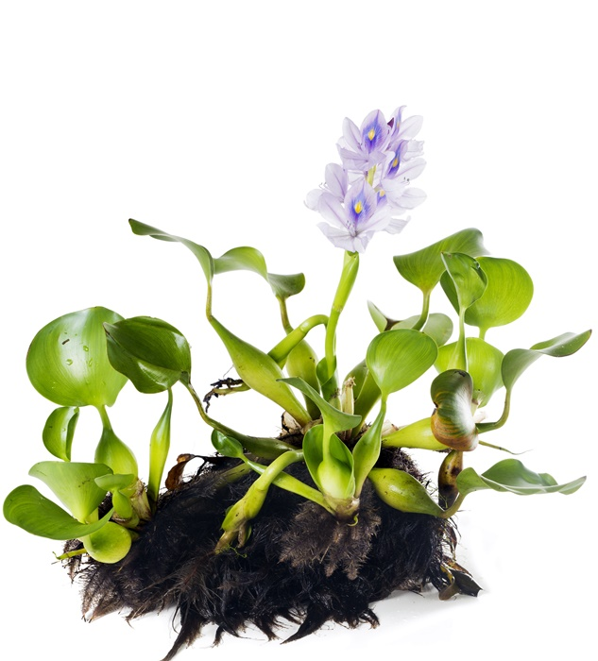
WARM-UP
GUESSING THE KEYWORD FOR THE PICTURES
Can you name this fish and plant in Vietnamese?
SILVER CARP WATER HYACINTH
VI BÈO
CÁ BA SA
Keyword: INVASIVE SPECIES

Slide 5
READING
1
Read the article. Choose the best option A, B, C, or D.
1. What is the article mainly about?
A. Definition of invasive species. B. Some troubles caused by invasive species.
C. How local environments affect new species.
D. The impact of invasive animals on local people.
2. How do silver carp affect paddlefish in the Mississippi River?
A. They eat paddlefish. B. They become food for the paddlefish. C. They use up most of the paddlefish’s food.
D. They make the river water dirty.

Slide 6
READING
1
Read the article. Choose the best option A, B, C, or D.
1
3. People in Africa first used water hyacinth as a type of ______.
A. decorative plant B. herb medicine
C. fish food D. insect killer
4. Which of the following is true about water hyacinth in Lake Victoria?
A. It is poisonous to local people. B. It feeds the paddlefish in the lake. C. It helps clean up the lake water. D. It allows mosquito populations to increase.

Slide 7
READING
1
Read the article. Choose the best option A, B, C, or D.
5. The text suggests preventing the spread of invasive species by ______.
A. introducing stricter laws B. taking animals to a new place
C. raising people’s awareness D. growing new types of plants

Slide 8
SPEAKING
2
Work in groups. Imagine a job that may be popular in the future. Discuss the answers to the questions about the job and report them to the class.
1. What may be a popular job in the future?
2. What type(s) of training does it require?
3. What skill(s) do you need to do it?
4. What personal qualities are necessary to do the job well?

Slide 9
SPEAKING
2
Work in groups. Imagine a job that may be popular in the future. Discuss the answers to the questions about the job and report them to the class.
Sample answer:
We think that computer software engineer will be a popular job in the future. It is because people are using computers for many daily tasks, such as office work, entertainment, and shopping, and they need updated applications and software to do these tasks eﬀectively. The job of a computer software engineer requires college or university training. To do the job well, you need many skills, for example computer programming and coding skills, and problem-solving skills. In addition, you should be patient, hardworking and careful.

Slide 10

LISTENING
3
Listen to a conversation between Trang and Tom. Fill in each blank with no more than TWO words.
1. Trang is reading about newly invented ________________. 2. Trang wants to have a _________. 3. Trang wants the View-me window to show the __________ all day. 4. Tom says that with the blue hat, Trang doesn’t need to carry along a ___________. 5. Trang doesn’t like the blue hat because it’s not _______.
electronic devices
pet robot
ocean view
music player
elegant

Slide 11
WRITING
4
Write an email (100 – 120 words) to your friend telling him / her about an organisation which protects the ocean. You can use the ideas below.
Name of the organisation: Save the Oceans
Importance of ocean habitats: produce half of the earth’s oxygen; adjust the climate; create homes for plants and animals
Current situation: habitat loss due to overfishing and pollution
What the organisation does: promotes smart fishing; encourages people to use fewer plastic bags; organises campaigns to clean up the beach and the sea

Slide 12
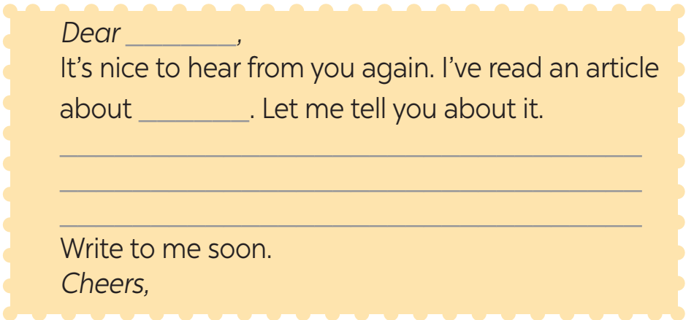
WRITING
4
Write an email (100 – 120 words) to your friend telling him / her about an organisation which protects the ocean. You can use the ideas below.
Start and end the email as follows:

Slide 13
WRITING
4
Write an email (100 – 120 words) to your friend telling him / her about an organisation which protects the ocean. You can use the ideas below.
Sample answer:
Dear Peter,
It’s nice to hear from you again. I’ve read an article about Save the Oceans. Let me tell you about it.
The ocean habitats are very important because they produce half of the earth’s oxygen and create homes for plants and animals. However, there is serious habitat loss due to overfishing and pollution. Save the Oceans is helping oceans in many ways. It promotes smart fishing. It also encourages people to use fewer plastic bags. Besides, it organises campaigns to clean up the beach and the sea.
I admire the actions of Save the Oceans. Hope that I can join them in the future.
Do you know other organisations which help the oceans?
Cheer,

Slide 14

CONSOLIDATION
1
Wrap-up
What have we learnt in this lesson?
review the skills of Unit 10, 11, 12.

Slide 15

CONSOLIDATION
2
Homework
Do the exercises in the workbook.
Prepare for the final test.

Slide 16
Website: hoclieu.vn
Fanpage: facebook.com/tienganhglobalsuccess.vn/

