Slide 2



Unit
1
LOCAL COMMUNITY
LESSON 5: SKILLS 1
1

Slide 3
LESSON 5: SKILLS 1
LESSON 1: GETTING STARTED
WARM-UP
Warm up: Video watching
- Task 1: Work in pairs. Answer the questions.
- Vocabulary teaching
- Task 2: Read the brochure introducing different places with special products. Match each highlighted word with its definition.
- Task 3: Read the brochure again. Decide which place each detail below belongs to.
READING
SPEAKING
- Task 4: Work in pairs. Ask and answer about a speciality in your neighbourhood, your home town, or the area you know. Use the questions below.
- Task 5: Work in groups. Give a short presentation about the speciality you discussed in 4.
CONSOLIDATION
Wrap-up
Homework

Slide 4
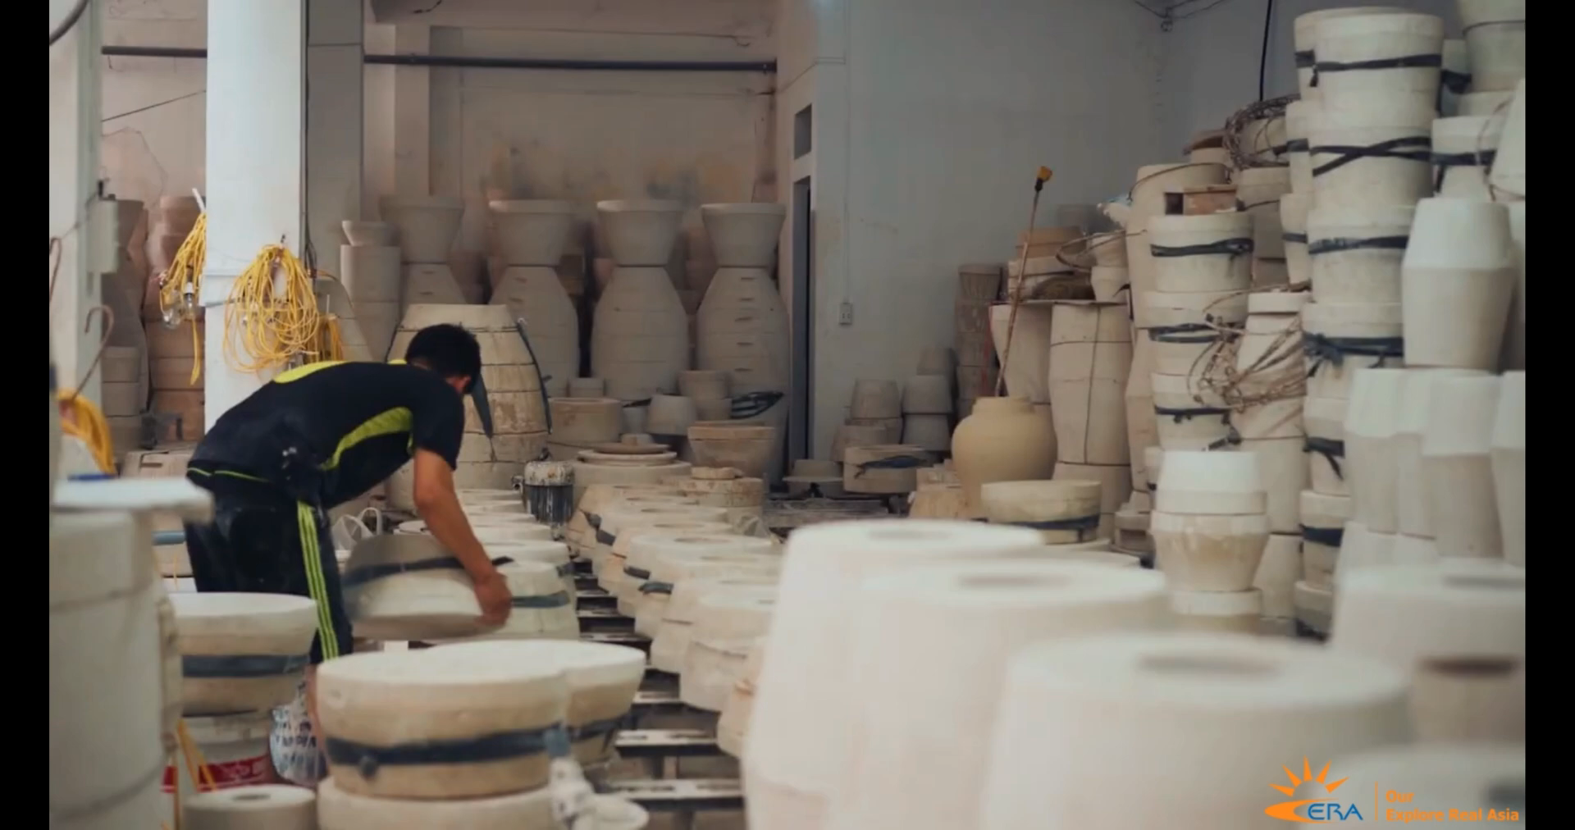
WARM-UP
WATCH THE VIDEO
VIDEO
WATCHING

Slide 5
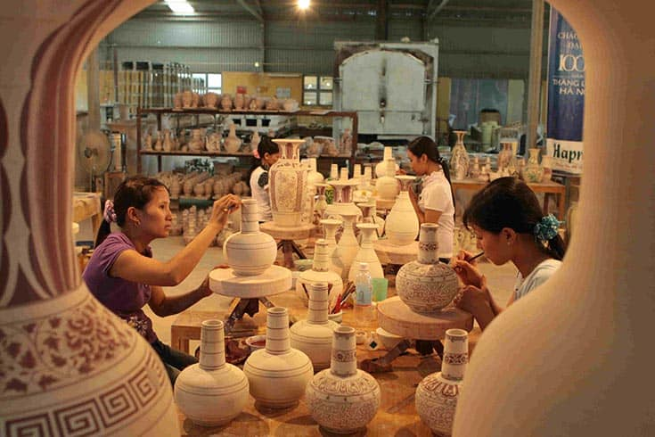
WARM-UP
BAT TRANG POTTERY VILLAGE

Slide 6
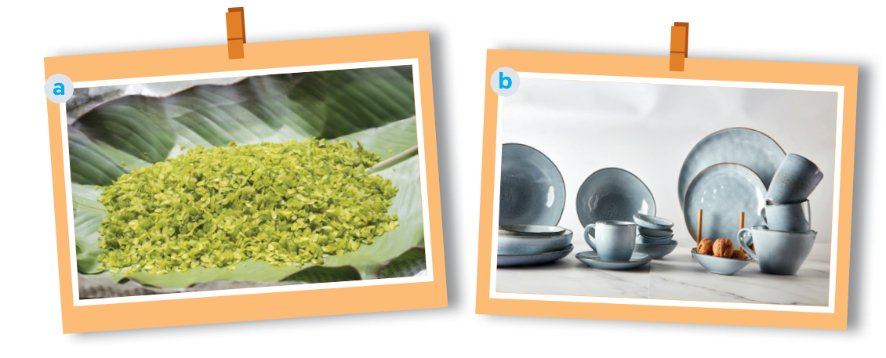
PRE READING
1
Work in pairs. Answer the questions.
1. What can you see in each picture? 2. Do you know any place(s) where people make the thing(s) in each picture?

Slide 7
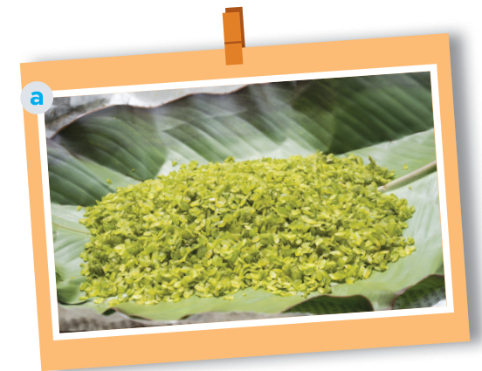
PRE READING
1
Work in pairs. Answer the questions.
Picture a: cốm (young sticky rice)- from Vong Village, Ha Noi
Another place which makes com: Tu Le Commune in Yen Bai Province

Slide 8
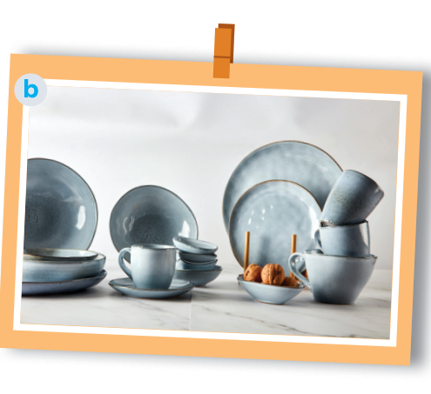
PRE READING
1
Work in pairs. answer the questions.
Picture b: pottery – from Denby, England.
In Viet Nam, there are some pottery villages: Bat Trang, Bau Truc, Phu Lang, …

Slide 9
VOCABULARY
preserve (v)
/prɪˈzɜːv/
bảo tồn
maintain (something) in its original or existing state.

Slide 10
VOCABULARY
fragrance (n)
/ˈfreɪɡrəns/
hương thơm
a sweet or delicate odor

Slide 11
VOCABULARY
New words | Pronunciation | Meaning
1. preserve (v) | /prɪˈzɜːv/ | bảo tồn
2. fragrance (n) | /ˈfreɪɡrəns/ | hương thơm

Slide 12
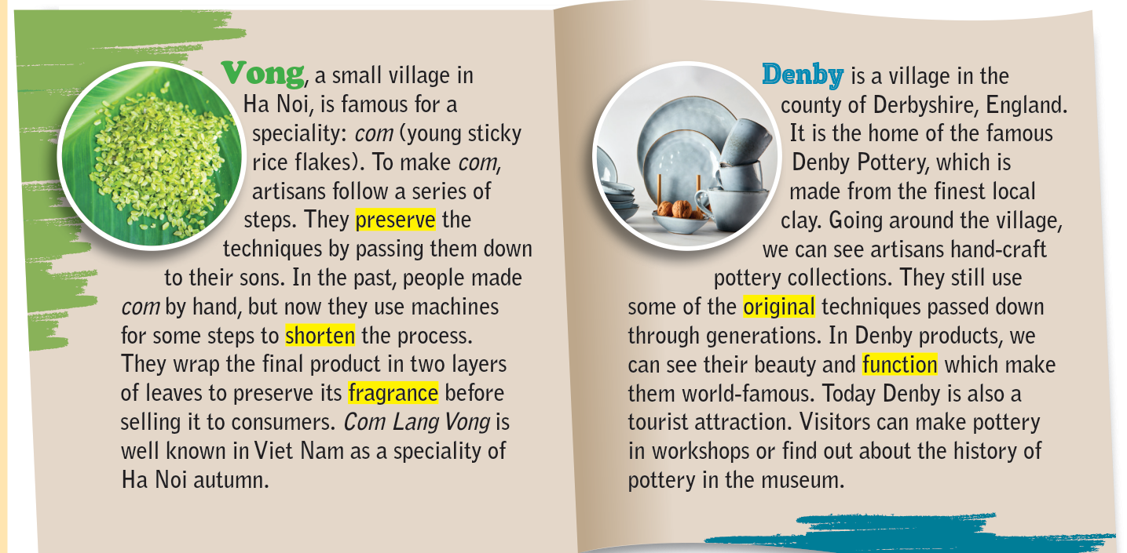
WHILE READING
2
Read the brochure introducing different places with special products. Match each highlighted word with its definition.

Slide 13
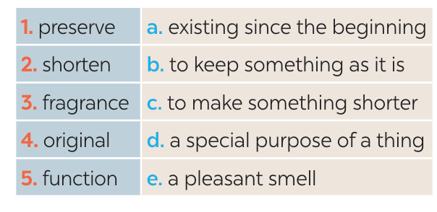
WHILE READING
2
Read the brochure introducing different places with special products. Match each highlighted word with its definition.
1. b
2. c
3. e
4. a
5. d

Slide 14
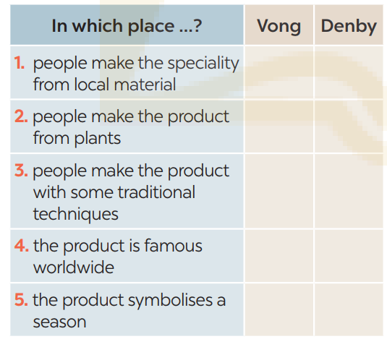
WHILE READING
3
Read the brochure again. Decide which place each detail below belongs to
Vong: 2, 3, 5
Denby: 1, 3, 4

Slide 15
SPEAKING
4
Work in pairs. Ask and answer about a speciality in your neighbourhood, your home town, or the area you know. Use the questions below.
1. What speciality is it? 2. What do people make it from? 3. Do people make it in the traditional way? 4. What can people do with it? 5. Is it well known in only your country or around the world?

Slide 16

SPEAKING
5
Work in groups. Give a short presentation about the speciality you discussed in 4.
I live in Tay Ho Village, 12 kilometres from Hue City. My village is famous for its conical hats. We make conical hats from goi leaves. We still follow 15 traditional steps to make a hat. A conical hat protects us from the sun and the rain as well as makes us more graceful. What is special about our conical hats is that each of them carries a poem. Tay Ho conical hats are not only famous in Hue but all over Viet Nam.

Slide 17

CONSOLIDATION
1
Wrap-up
What have we learnt in this lesson?
Read for specific information about special products in some areas.
Give a short presentation about a speciality.

Slide 18

CONSOLIDATION
2
Homework
- Do exercises in the Workbook.

Slide 19
Website: hoclieu.vn
Fanpage: facebook.com/www.tienganhglobalsuccess.vn/

