Slide 1




WELCOME TO OUR CLASS!
Presented by: ………………….

Slide 2

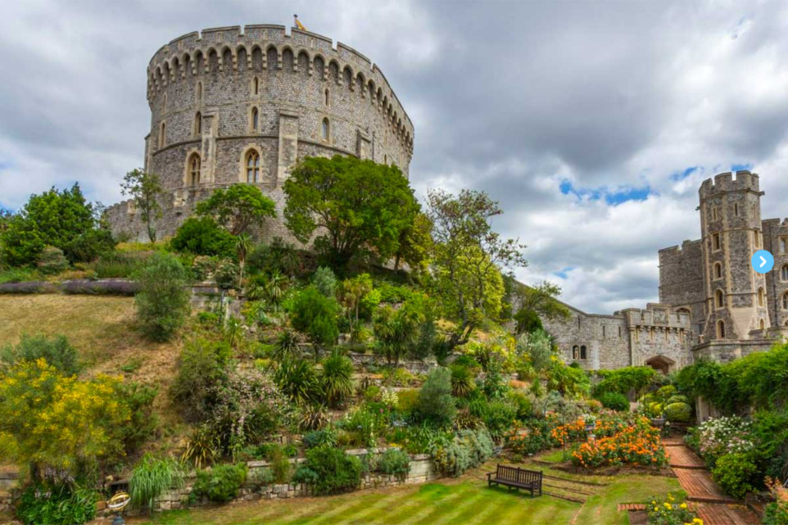
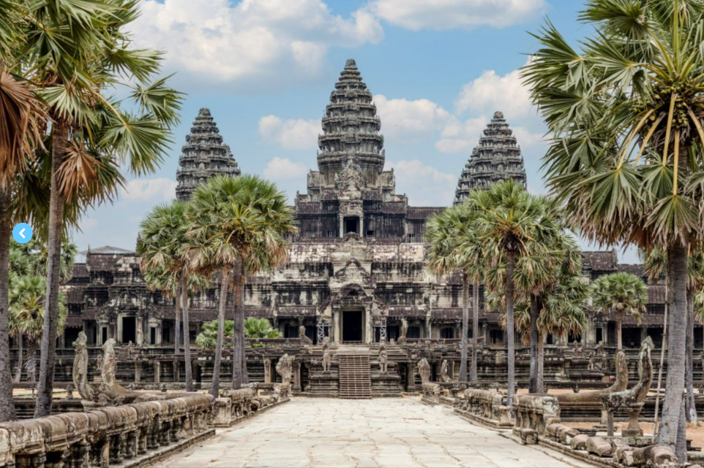
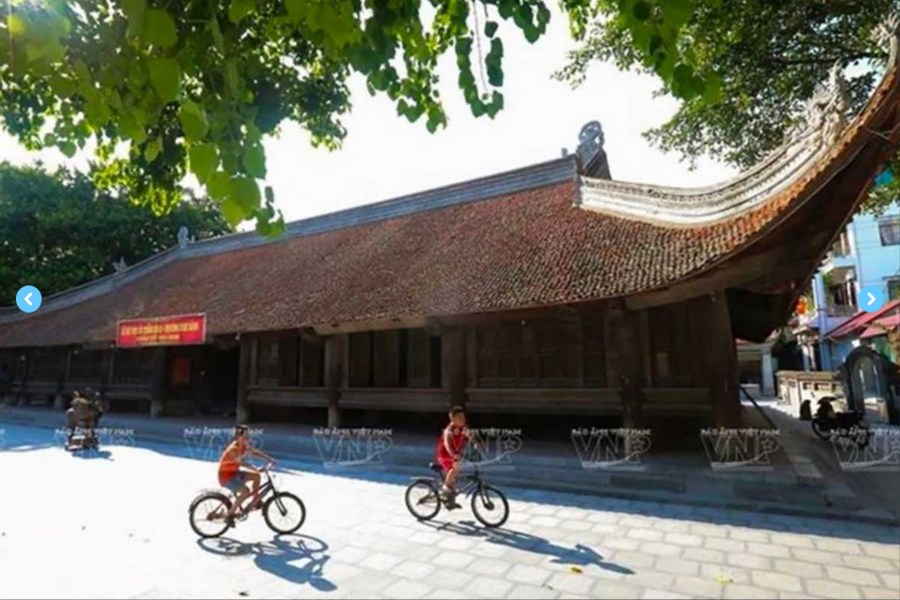
LOOK AND ANSWER
What can you see in the pictures?
Do you know where they are?
What do you know about them?

Slide 3


Unit 4:
REMEMBERING THE PAST
Lesson 1: Getting Started

Slide 4



VOCABULARY
complex (n)
involving a lot of different but related parts
/ˈkɒmpleks/
khu phức hợp, quần thể

Slide 5
VOCABULARY
religious (adj)
relating to, or involved with religion, or living and worshiping according to the beliefs of a particular religion.
/rɪˈlɪdʒəs/
thuộc tôn giáo
Ex: He's deeply religious and goes to church twice a week.

Slide 6
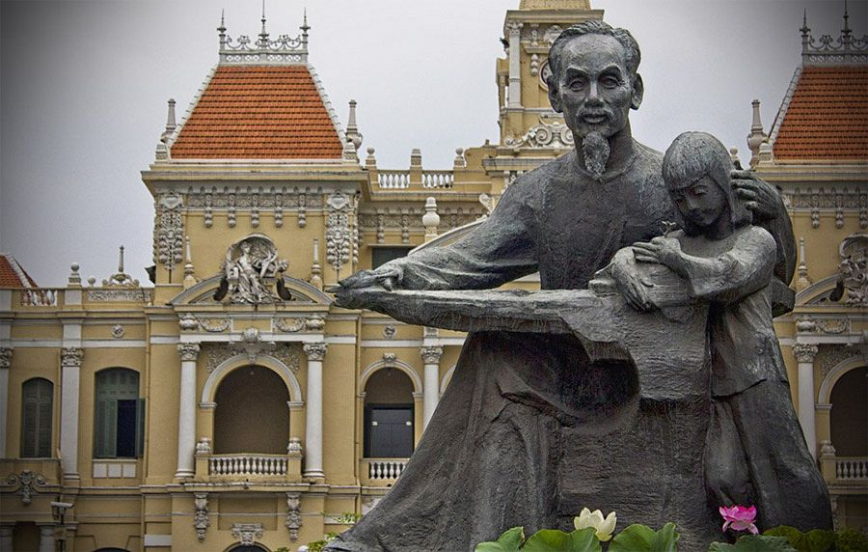
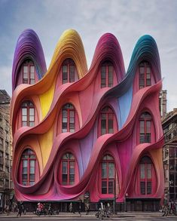
VOCABULARY
monument (n)
a structure or building that is built to honour a special person or event.
/ˈmɒnjumənt/
tượng đài

Slide 7
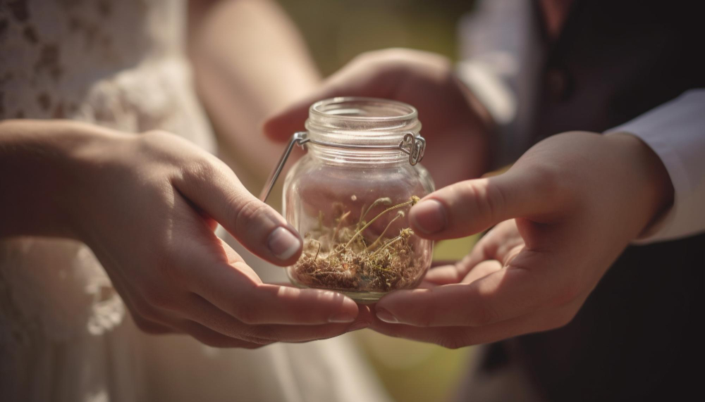
VOCABULARY
magnificent (adj)
very good, beautiful, or deserving to be admired.
/mæɡˈnɪf.ɪ.sənt/
tráng lệ

Slide 8
VOCABULARY
preserve (v)
to keep something as it is.
/prɪˈzɜːv/
bảo tồn

Slide 9
VOCABULARY
heritage (n)
features belonging to the culture of a particular society, such as traditions, languages, or buildings, that were created in the past and still have historical importance.
/ˈher.ɪ.tɪdʒ/
di sản
Ex: The historic building is as much part of our heritage as the paintings.

Slide 10
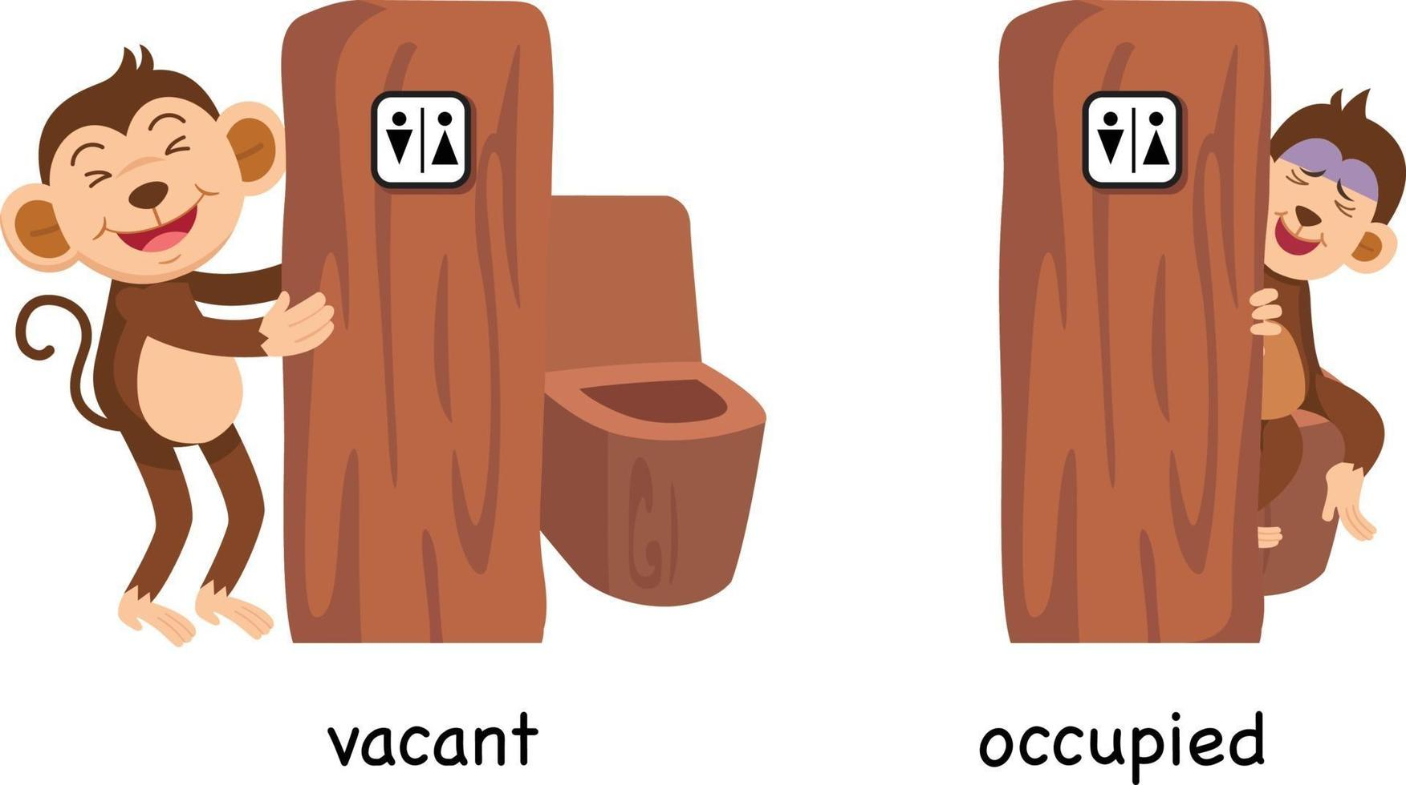
VOCABULARY
occupy (v)
take control
/ˈɒkjupaɪ/
chiếm giữ

Slide 11
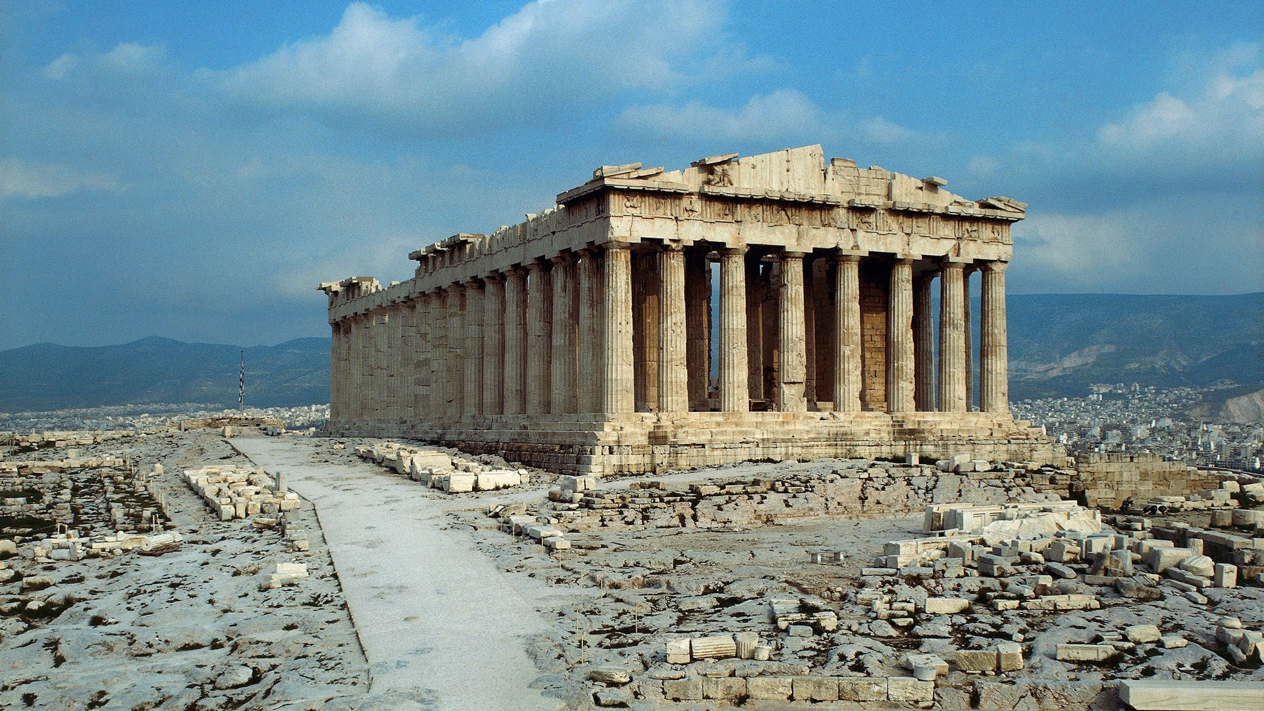
VOCABULARY
occupied (adj)
being used by someone or with someone in it.
/ˈɒkjupaɪd/
có người ở

Slide 12

VOCABULARY
of or from a long time ago, having lasted for a very long time.
ancient (adj)
/ˈeɪnʃənt/
cổ đại, lâu đời

Slide 13
VOCABULARY
all the people of about the same age within a society
generation (n)
/ˌdʒenəˈreɪʃn/
thế hệ

Slide 14
VOCABULARY
to bring something into existence.
found (v)
Ex: Boston was founded in 1630 by Puritan colonists from England.
/faʊnd/
thành lập

Slide 15
VOCABULARY
New words | Pronunciation | Meaning
1. complex (n) | /ˈkɒmpleks/ | khu phức hợp, quần thể
2. religious (adj) | /rɪˈlɪdʒəs/ | (thuộc) tôn giáo
3. monument (n) | /ˈmɒnjumənt/ | tượng đài
4. magnificent (adj) | /mæɡˈnɪf.ɪ.sənt/ | tráng lệ
5. preserve (v) | /prɪˈzɜːv/ | bảo tồn
6. heritage (n) | /ˈher.ɪ.tɪdʒ/ | di sản

Slide 16
VOCABULARY
New words | Pronunciation | Meaning
7. occupy (v) | /ˈɒkjupaɪ/ | chiếm giữ
8. occupied (adj) | /ˈɒkjupaɪd/ | có người ở
9. ancient (adj) | /ˈeɪnʃənt/ | cổ đại, lâu đời.
10. generation (n) | /ˌdʒenəˈreɪʃn/ | thế hệ
11. found (v) | /faʊnd/ | thành lập

Slide 17
At an English lesson
Teacher: Now let’s look at what you’ve done on your projects. Group one first, please.
Mi: OK. This is Angkor Wat in Cambodia. It’s a temple complex, the largest religious monument in the world.
Teacher: Fantastic! When did people build it?
Mi: They built it in the 12th century. It’s a World Heritage Site. Millions of visitors go there every year
Teacher: Thank you. I wish I could go there one day too. And now group two, please.
Nam: Our project is about Dinh Bang Communal House in Bac Ninh Province - a national historic site. People were building it for 36 years, and it’s about 300 years old!
Teacher: Great! It’s quite magnificent! Now group three, please.
Lan: Well, this is Windsor Castle in England. It was built about a thousand years ago. It’s been the home for about 40 English kings and queens.
Teacher: Yeah. It’s the oldest and largest occupied castle in the world.
Mi & Nam: Amazing! So we need to preserve our heritage for future generations.
Teacher: Right. Thanks to preservation efforts, we know a lot about our history and life in the past.

Slide 18


2. Read the conversation again and answer the questions
1. How old is Angkor Wat?
2. What is Dinh Bang Communal House like?
3. Where is Windsor Castle?
4. What helps us know about our history and life in the past?

Slide 19
Check your answers
1. How old is Angkor Wat?
About 900 years old/ Nearly a thousand years old.
Mi: OK. This is Angkor Wat in Cambodia. It’s a temple complex, the largest religious monument in the world.
Teacher: Fantastic! When did people build it?
Mi: They built it in the 12th century. It’s a World Heritage Site.

Slide 20
Check your answers
2. What is Dinh Bang Communal House like?
It’s magnificent.
Nam: Our project is about Dinh Bang Communal House in Bac Ninh Province - a national historic site. People were building it for 36 years, and it’s about 300 years old!
Teacher: Great! It’s quite magnificent!

Slide 21
Check your answers
3. Where is Windsor Castle?
In England.
Lan: Well, this is Windsor Castle in England. It was built about a thousand years ago. It’s been the home for about 40 English kings and queens.

Slide 22
Check your answers
4. What helps us know about our history and life in the past?
Preservation
Teacher: Right. Thanks to preservation efforts, we know a lot about our history and life in the past.

Slide 23
Look at the answers again
1. How old is Angkor Wat?
About 900 years old/ Nearly a thousand years old.
2. What is Dinh Bang Communal House like?
It’s magnificent.
3. Where is Windsor Castle?
In England.
4. What helps us know about our history and life in the past?
Preservation

Slide 24

3. Complete each sentence with a word or a phrase from the box
occupied magnificent thanks to heritage well preserved
1. The best way to preserve our cultural ___________ is to share it with others.
2. Vietnamese people take great pride in their culture which has been ____________________for thousands of years.
3. The foreign tourists gave a ________________performance of the Vietnamese folk songs and dances
4. ___________ your kind contribution, we were able to save the ancient monument.
5. Many beautiful old castles are no longer ____________.

Slide 25




BE A FARMER

Slide 26
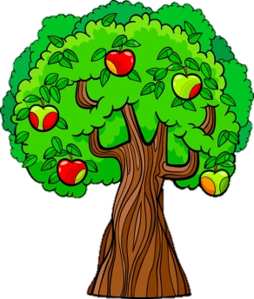















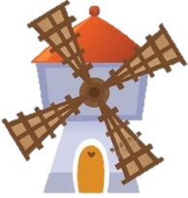










Slide 27


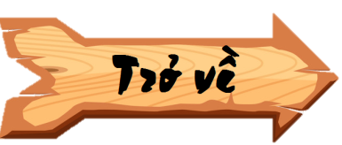
1. The best way to preserve our cultural ___________ is to share it with others.
heritage

Slide 28
2. Vietnamese people take great pride in their culture which has been ___________ for thousands of years.
well preserved

Slide 29
3. The foreign tourists gave a _________ performance of the Vietnamese folk songs and dances.
magnificent

Slide 30
4. ___________ your kind contribution, we were able to save the ancient monument.
Thanks to

Slide 31
5. Many beautiful old castles are no longer ____________.
occupied

Slide 32
LUCKY NUMBER

Slide 33
Look at the answers again
heritage
1. The best way to preserve our cultural ___________ is to share it with others.
2. Vietnamese people take great pride in their culture which has been ____________________for thousands of years.
well preserved
magnificent
3. The foreign tourists gave a ________________performance of the Vietnamese folk songs and dances
Thanks to
4. ___________ your kind contribution, we were able to save the ancient monument.
occupied
5. Many beautiful old castles are no longer ____________.

Slide 34


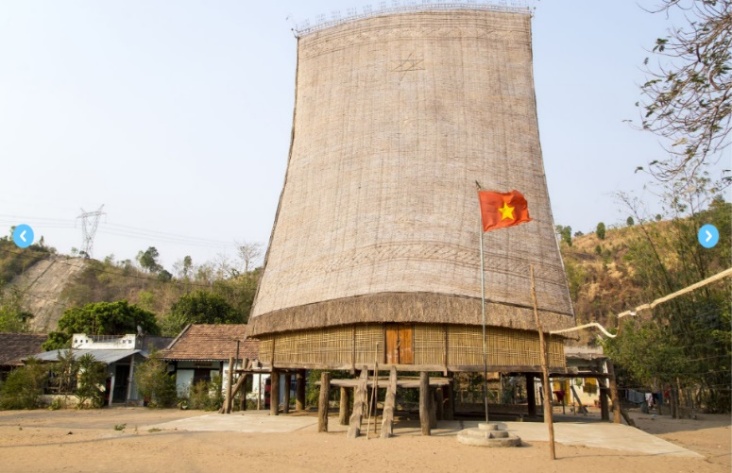
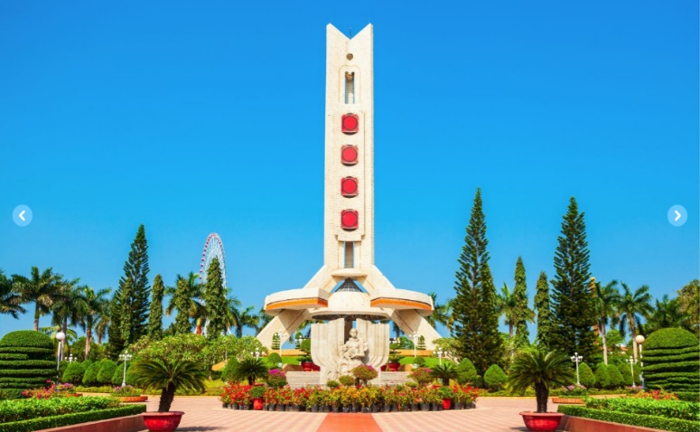
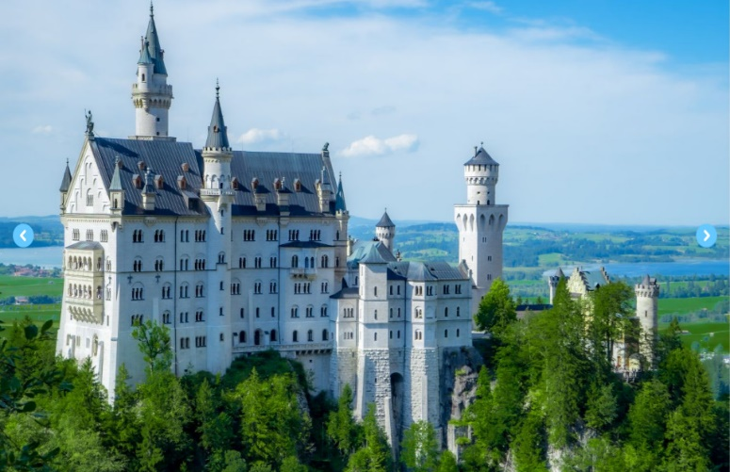
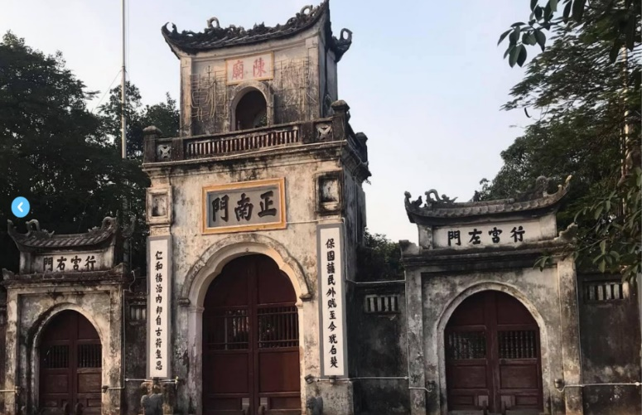
4. Look at the pictures and complete the sentences.
1. This is a standard serving of __________ with a slice of lemon.
2. The ______ house has a significant meaning in the Bahnar community.
1.
2.
3. In the square, there is a ________ dedicated to the people killed in the war.
4. They have decided to rebuild the _______ which was damaged in the disaster
3.
5. In Nam Dinh City, there is a complex of three ______ where people worship the Tran Dynasty’s Kings and royal family members.
4.
5.

Slide 35

Check your answers
fish and chips
1. This is a standard serving of ________________________ with a slice of lemon.

Slide 36

Check your answers
communal
2. The ___________________ house has a significant meaning in the Bahnar community.

Slide 37

Check your answers
monument
3. In the square, there is a _______________ dedicated to the people killed in the war.

Slide 38

Check your answers
castle
4. They have decided to rebuild the _________________ which was damaged in the disaster.

Slide 39

Check your answers
5. In Nam Dinh City, there is a complex of three __________________ where people worship the Tran Dynasty’s Kings and royal family members.
temples

Slide 40
Look at the answers again.
1. This is a standard serving of fish and chips with a slice of lemon.
2. The communal house has a significant meaning in the Bahnar community.
3. In the square, there is a monument dedicated to the people killed in the war.
4. They have decided to rebuild the castle which was damaged in the disaster
5. In Nam Dinh City, there is a complex of three temples where people worship the Tran Dynasty’s Kings and royal family members.

Slide 41
Work in groups. Ask and answer
1. Who decided to move our capital from Hoa Lu to Dai La (Thang Long) in 1010?
King Ly Thai To (Ly Cong Uan)
2. When did Columbus discover the Americas?
In 1492
3. When was the United States founded?
In 1776.
4. When did Nguyen Ai Quoc first go abroad?
In 1911.
World War I started/ broke out.
5. What happened in world history in 1914?
King Bao Dai (1913 – 1997)
6. Who was the last king of Viet Nam?

Slide 42
WRAP-UP
What have we learnt in this lesson?
Use the words related to the topic remembering the past.
Gain vocabulary to talk about some historical places.

Slide 43
HOMEWORK
- Do exercises in the workbook
- Prepare for the Project of the unit
- Open book p.49, look at the picture and say what the topic of the project is
- Work in groups to design a poster.
- You will show and present in Lesson 7 – Looking back and Project.

