Slide 1












WELCOME TO OUR CLASS!
Presented by:…………………………

Slide 2


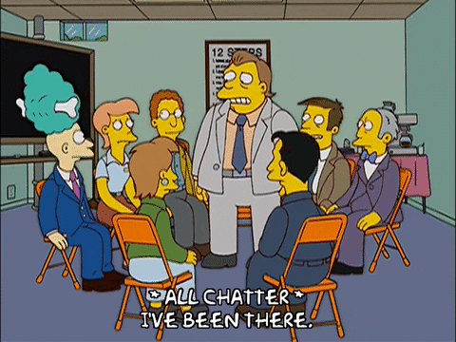



CHATTING
What do you know about schools and school days in the past?

Slide 3
Unit 4:
REMEMBERING THE PAST
Lesson 6: Skills 2

Slide 4




LISTENING

Slide 5
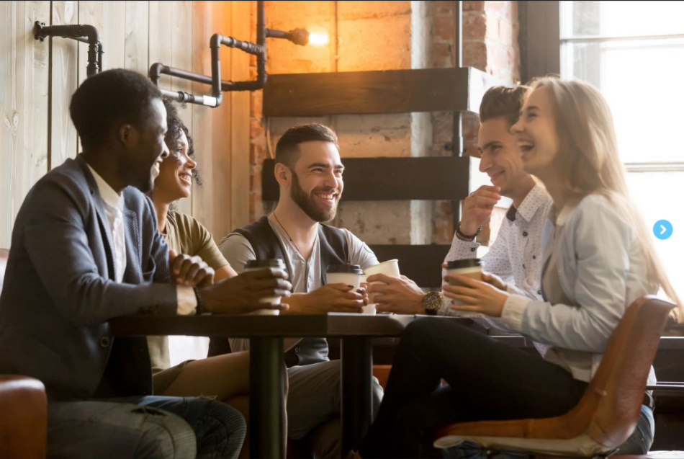
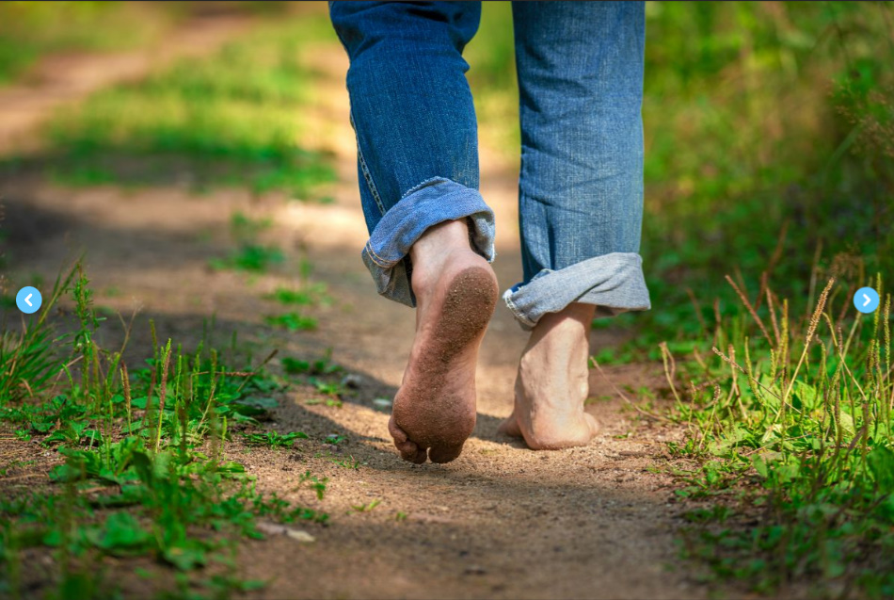
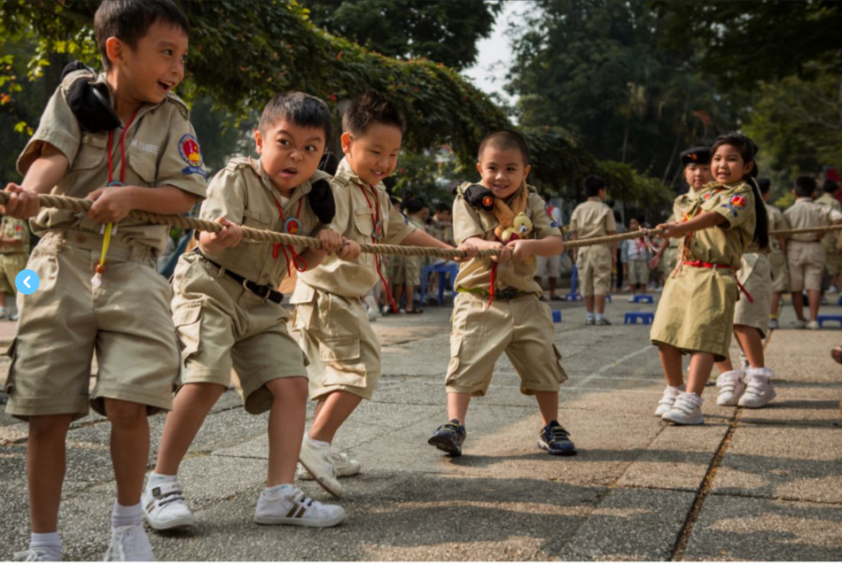


1. Match each phrase with the right picture.
1. walking barefoot
2. talking face to face
3. traditional game

Slide 6



2. Listen to the talk between Thanh and his grandma and tick (√) the things you hear.
1. Three-month summer holiday
2. Lessons in the morning only
3. A lot of extra lessons
4. Walking barefoot
5. Chatting on mobile phones
√
√
√

Slide 7
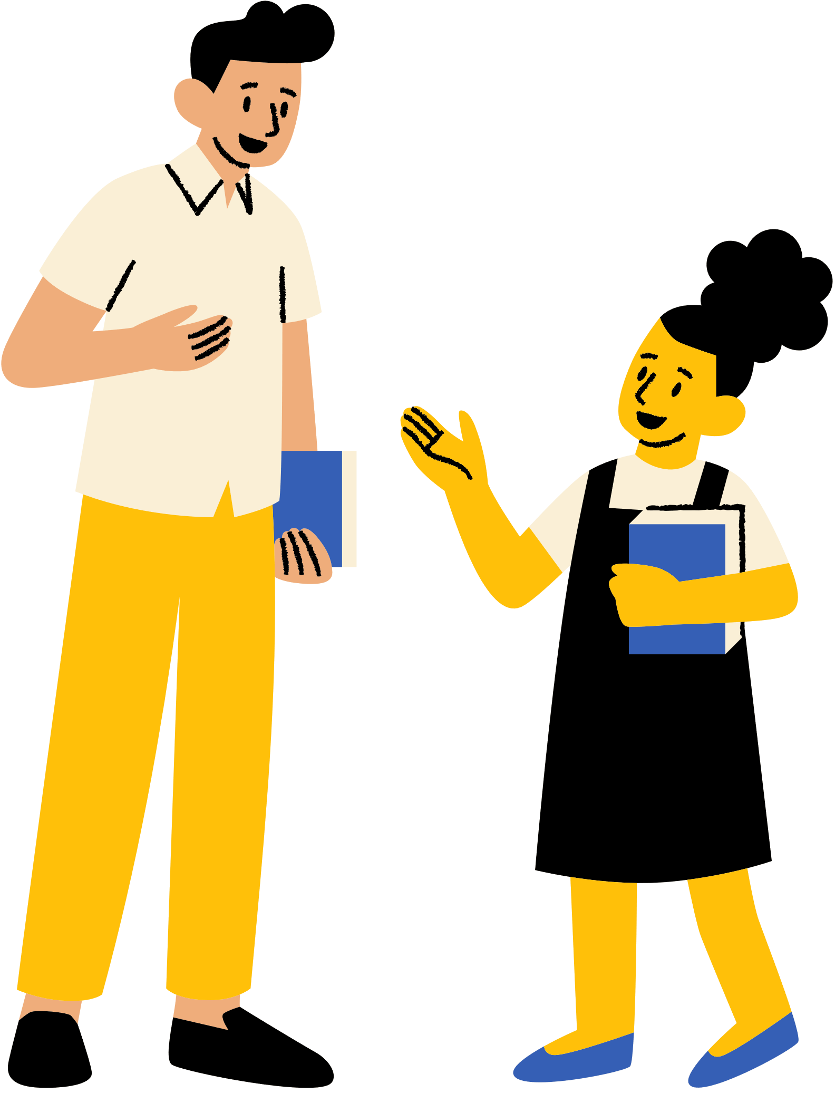

3. Listen again. Choose the correct answer.
1. The conversation is generally about Thanh’s ______.
A. school days
B. grandma’s school days
C. grandma’s life in the past
2. Thanh’s grandma didn’t have a lot of ______.
A. homework B. lessons C. subjects
3. Thanh’s grandma ______ went to school on foot
A. always B. sometimes C. never
4. Students in the past played ______during break time.
A. computer games
B. games on mobile phones
C. traditional games

Slide 8




WRITING
B
O
T
H
/
A
N
D
NOT ONLY/ BUT ALSO

Slide 9
4. Work in pairs. Ask and answer about school days in the past.
- Work in pairs. You can use the cues given to ask and answer about school days in the past.
Your talk may include the following:
– school time (When …)
– school subjects (What …)
– leisure time activities (What …)
– summer holiday (How long …)
– means of transport to school (How …)
in the morning only
maths, language, history, etc.
traditional games
three months
walk
- You can refer to the listening text for your answers.

Slide 10





4. Work in pairs. Ask and answer about school days in the past.
A: When did students go to school in the past?
B: They usually only went to school on weekday mornings.
A: What subjects did they study?
B: They had the usual subjects like Math, Literature, Ethics, History and Geography.
A: What did they do during their leisure time?
B: They read books and played traditional games.
A: How long did their summer holidays use to be?
B: They felt endless! It was about three months.
A: How did they get to school?
B: They used to go to school by foot or by bike.

Slide 11




5. Write a paragraph (100 - 120 words) about school days in the past.
- Use the ideas in Activity 4 for your writing.
In the past, students had lessons in the morning only. ___________________________________________
___________________________________________
___________________________________________
___________________________________________
___________________________________________.
In the past, students had lessons in the morning only. In the afternoon, they stayed home and did other things to help their parents. At school, they learned subjects such as maths, language, history, physics, etc. but they did not have music and arts, or sciences. They did not have extra lessons. In their free time they played traditional games such as hide-and-seek, tug of war, skipping, and so on. Every day they went to school on foot. My grandmother told me that they walked barefoot all the time, as they did not have shoes or sandals. They were lucky in that they had a long summer holiday – about three months!
(111 words)

Slide 12
Sample paragraph:
In the past, students had lessons in the morning only. In the afternoon, they stayed home and did other things to help their parents. At school, they learned subjects such as maths, language, history, physics, etc. but they did not have music and arts, or sciences. They did not have extra lessons. In their free time they played traditional games such as hide-and-seek, tug of war, skipping, and so on. Every day they went to school on foot. My grandmother told me that they walked barefoot all the time, as they did not have shoes or sandals. They were lucky in that they had a long summer holiday – about three months!
(111 words)

Slide 13






WRAP - UP
Listen for general and specific information about old school days.
Write about old school days.

Slide 14




HOMEWORK
Complete the writing task by yourself
Prepare: Looking back

Slide 15







THANK YOU!

Slide 16






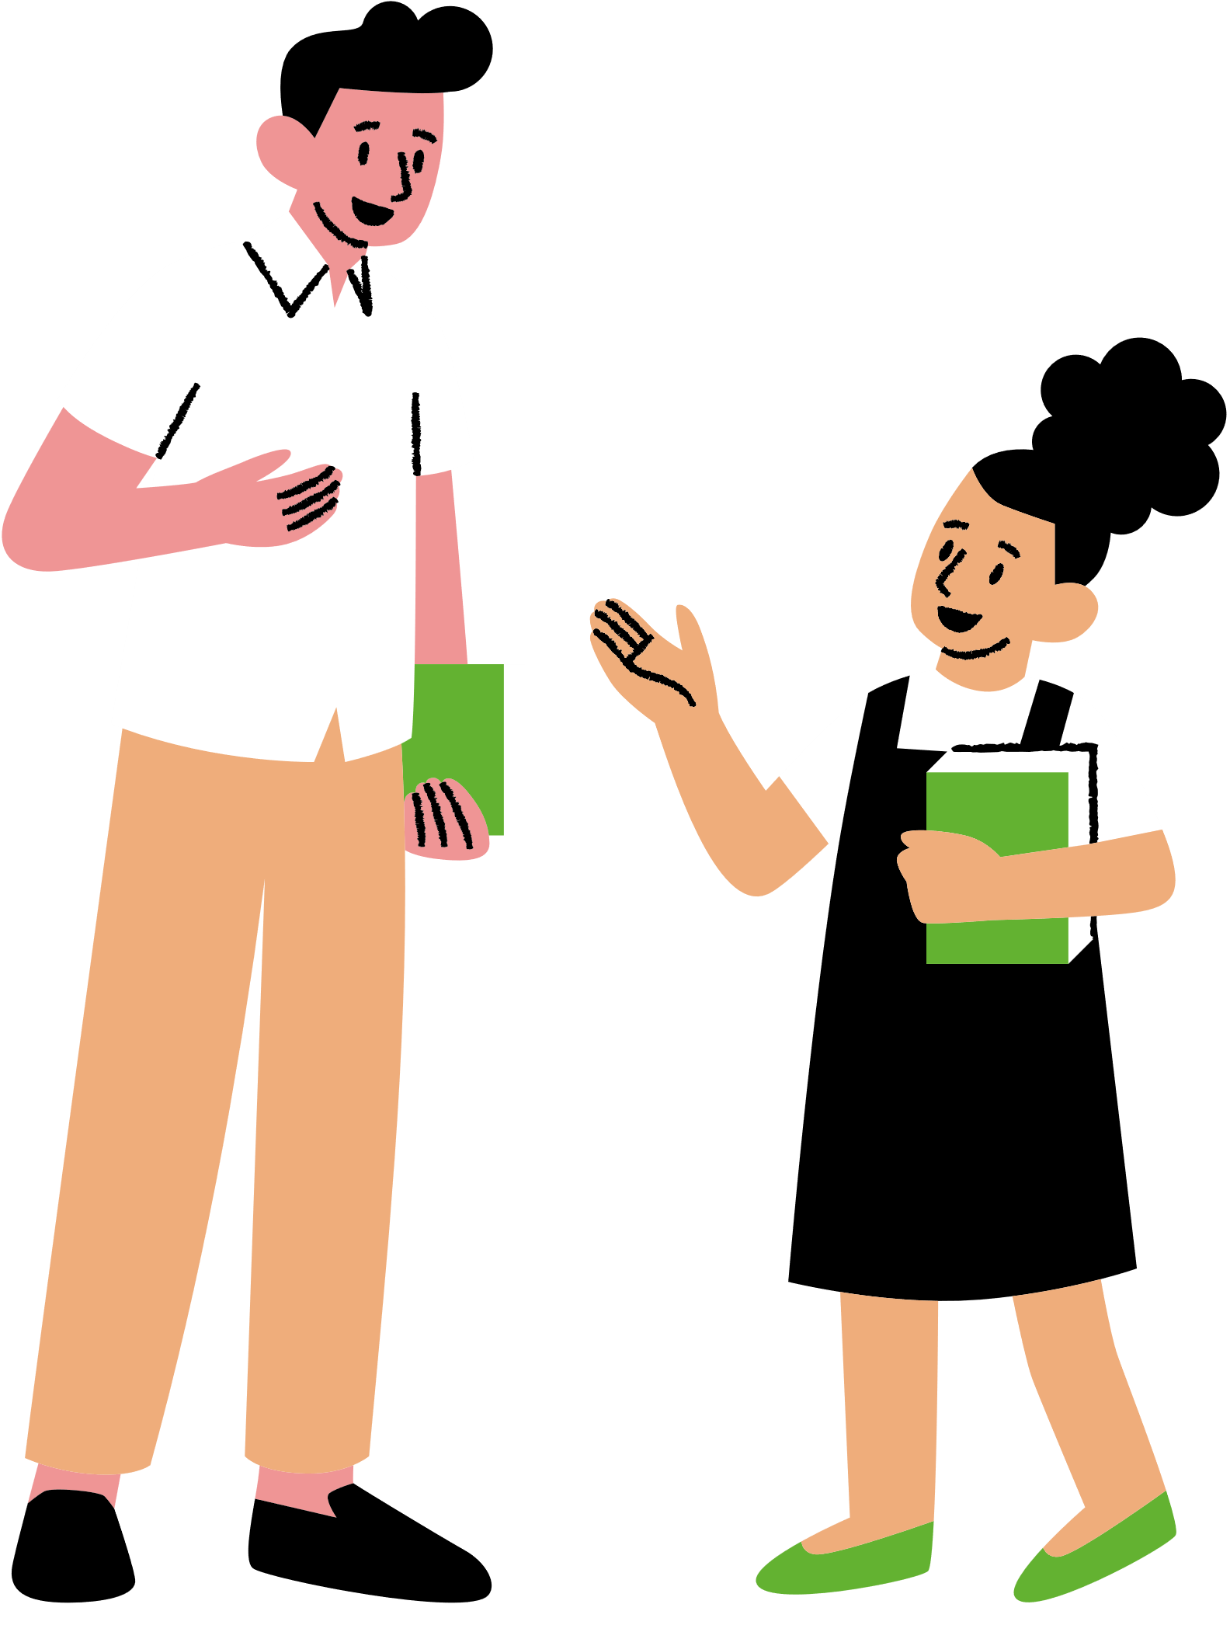







Trang Tài nguyên
Sử dụng các biểu tượng và hình minh họa này trong Bản thuyết trình Canva của bạn.
Chúc bạn thiết kế vui vẻ! Đừng quên xóa
trang này trước khi thuyết trình.

