Slide 1










……. SECONDARY SCHOOL
WELCOME TO
OUR CLASS
PRESENTED BY:……………………………

Slide 2


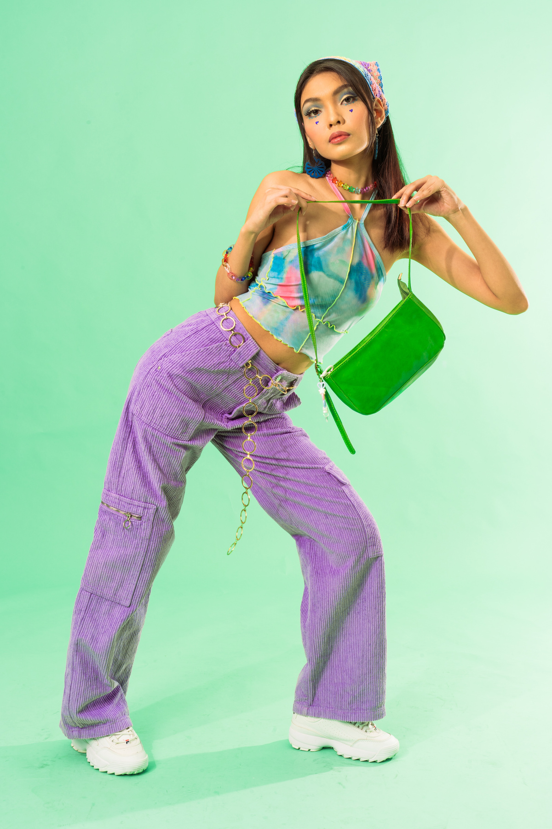


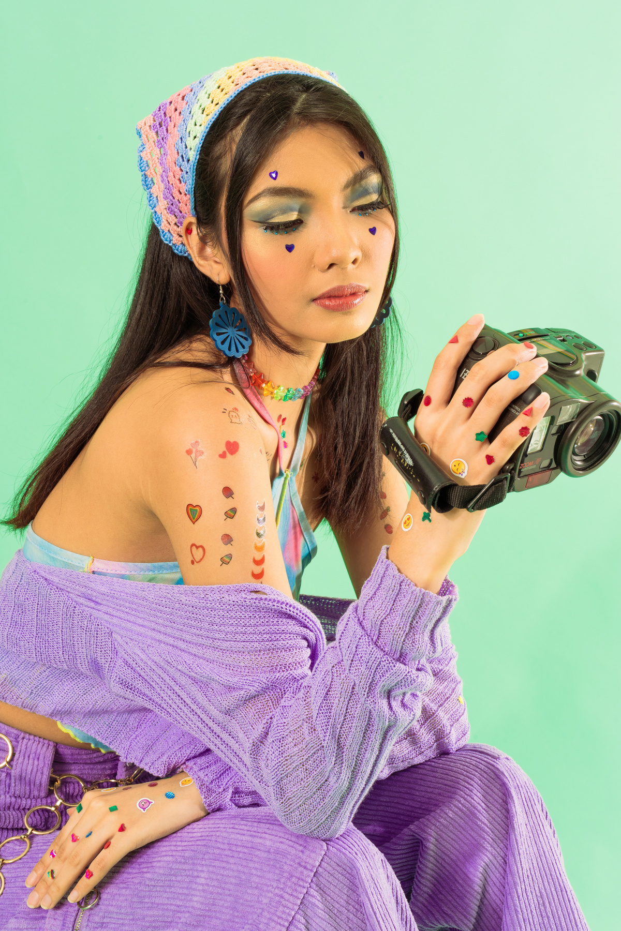







  What were you doing at 7 p.m. last night?

Slide 3


UNIT 4:
REMEMBERING THE PAST
LESSON 3: A CLOSER LOOK 2

Slide 4



PAST CONTINUOUS TENSE

Slide 5
PAST CONTINUOUS TENSE
+
S + was/were + V-ing
-
S + was/were + not + V-ing
?
Was/were + S + V-ing?

Slide 6
1. Put the verbs in brackets in the past continuous
was visiting
1. My dad first met my mum when he (visit) _______________ Hoi An Ancient Town.
was sleeping
2. Tom had a nightmare while he (sleep) ____________ in the camp by the old castle.
was going
3. David hurt his foot while he (go) ___________down the steps of the pagoda.
was looking
4. My brother was just sitting while I (look) _________________ around the weaving workshop.
Were
watching
5. ______ you (watch) __________ TV at 9 p.m. last night? There was a very good programme on Duong Lam Ancient Village preservation.

Slide 7



PAST CONTINUOUS TENSE
We also use the past continuous to emphasise how long an action took and how much time somebody spent doing it. We usually use adverb phrases that explain the length of time such as:
all morning / week / year/ for hours / days / weeks / months / years
Example:
We were cooking all morning because we had our friends coming for lunch.
We use the past continuous to describe an action that was happening at a particular time in the past, or a past action that was happening when another action interrupted it.

Slide 8

2. Complete the sentences, using the past continuous forms of the given verbs.
live make preserve work build
were preserving
1. People ____________________ the monument for years because it had great value.
was / were living
2. When I finished school, my family _____________________in the countryside.
were building
3. People _______________the Taj Mahal – a World Heritage Site while Shah Jahan was emperor.
Were
working
4. “______ you still _____________ on the coffee farm when the war broke out, Grandpa?”
was making
5. I __________________ a presentation when the microphone stopped working.

Slide 9
WISH + PAST SIMPLE
- Look at the Grammar Box p.43
We use wish + past form verb when we want something now or in the future to be different.
Subject + wish + subject + past simple
Example:
I wish I had enough money to travel around the world.
I wish (that) my mother didn’t have to work so hard.

Slide 10

3. Put the verbs in brackets in the correct forms.
got
1. The children wish they (get) ______________more presents every Christmas.
had
2. I wish I (have) _________________ enough money to visit London and Windsor Castle.
had
3. Do you wish we (have) __________a swimming pool in our school?
could spend
4. We wish we (can spend) _______________our summer holiday on the seaside.
could go
5. I wish I (can go) ______________ back to my grandparents’ time.

Slide 11
4. Read the passage and write down five things that Jenny might wish for.
My sister Jane is very untidy. She and I share the same room, but I have to clean it every day. Whenever she’s at home, she lies in bed reading or playing computer games. She often puts her dirty clothes on my bed. I’d like to have my own room, but it’s impossible now.
I hope she can change her way one day.
Jenny, 14
Example:
Jenny wishes (that) her sister Jane was tidier.

Slide 12

4. Read the passage and write down five things that Jenny might wish for.
Possible answers:
1. Jenny wishes (that) she didn’t have to share the room with her sister.
2. Jenny wishes (that) she didn’t have to clean the room every day.
3. She wishes (that) her sister Jane didn’t lie in bed reading or playing computer games.
4. She wishes (that) her sister Jane didn’t put dirty clothes on her bed.
5. She wishes (that) she had her own room.

Slide 13
5. Work in pairs. Tell your partner three wishes.
Work in pairs and exchange your wishes
Example:
I wish I had a dishwasher to do the washing-up for me every day.

Slide 14
Work in groups to talk about your family members wish
Example:
My mum wishes (that) she had a new dishwasher.
My little sister often wishes (that) she became a princess

Slide 15



What have you learnt in this lesson ?
WRAP-UP
past continuous
wish + past simple

Slide 16


HOMEWORK
Do exercises in the workbook
Make 5 sentences with the past continuous and wish
V
V
Prepare: Communication
V

Slide 17

THANK YOU!

