Slide 1


GOOD MORNING
EVERYONE !!!

Slide 2



* MINI GAME
2 groups: Mango & Orange
Listen to the words the teacher says
Members of Mango stand up if the word is countable.
Members of Orange stand up if the word is uncountable.
apple
chicken
carrot
salt
meal
pepper
star
sugar
meat
cucumber

Slide 3


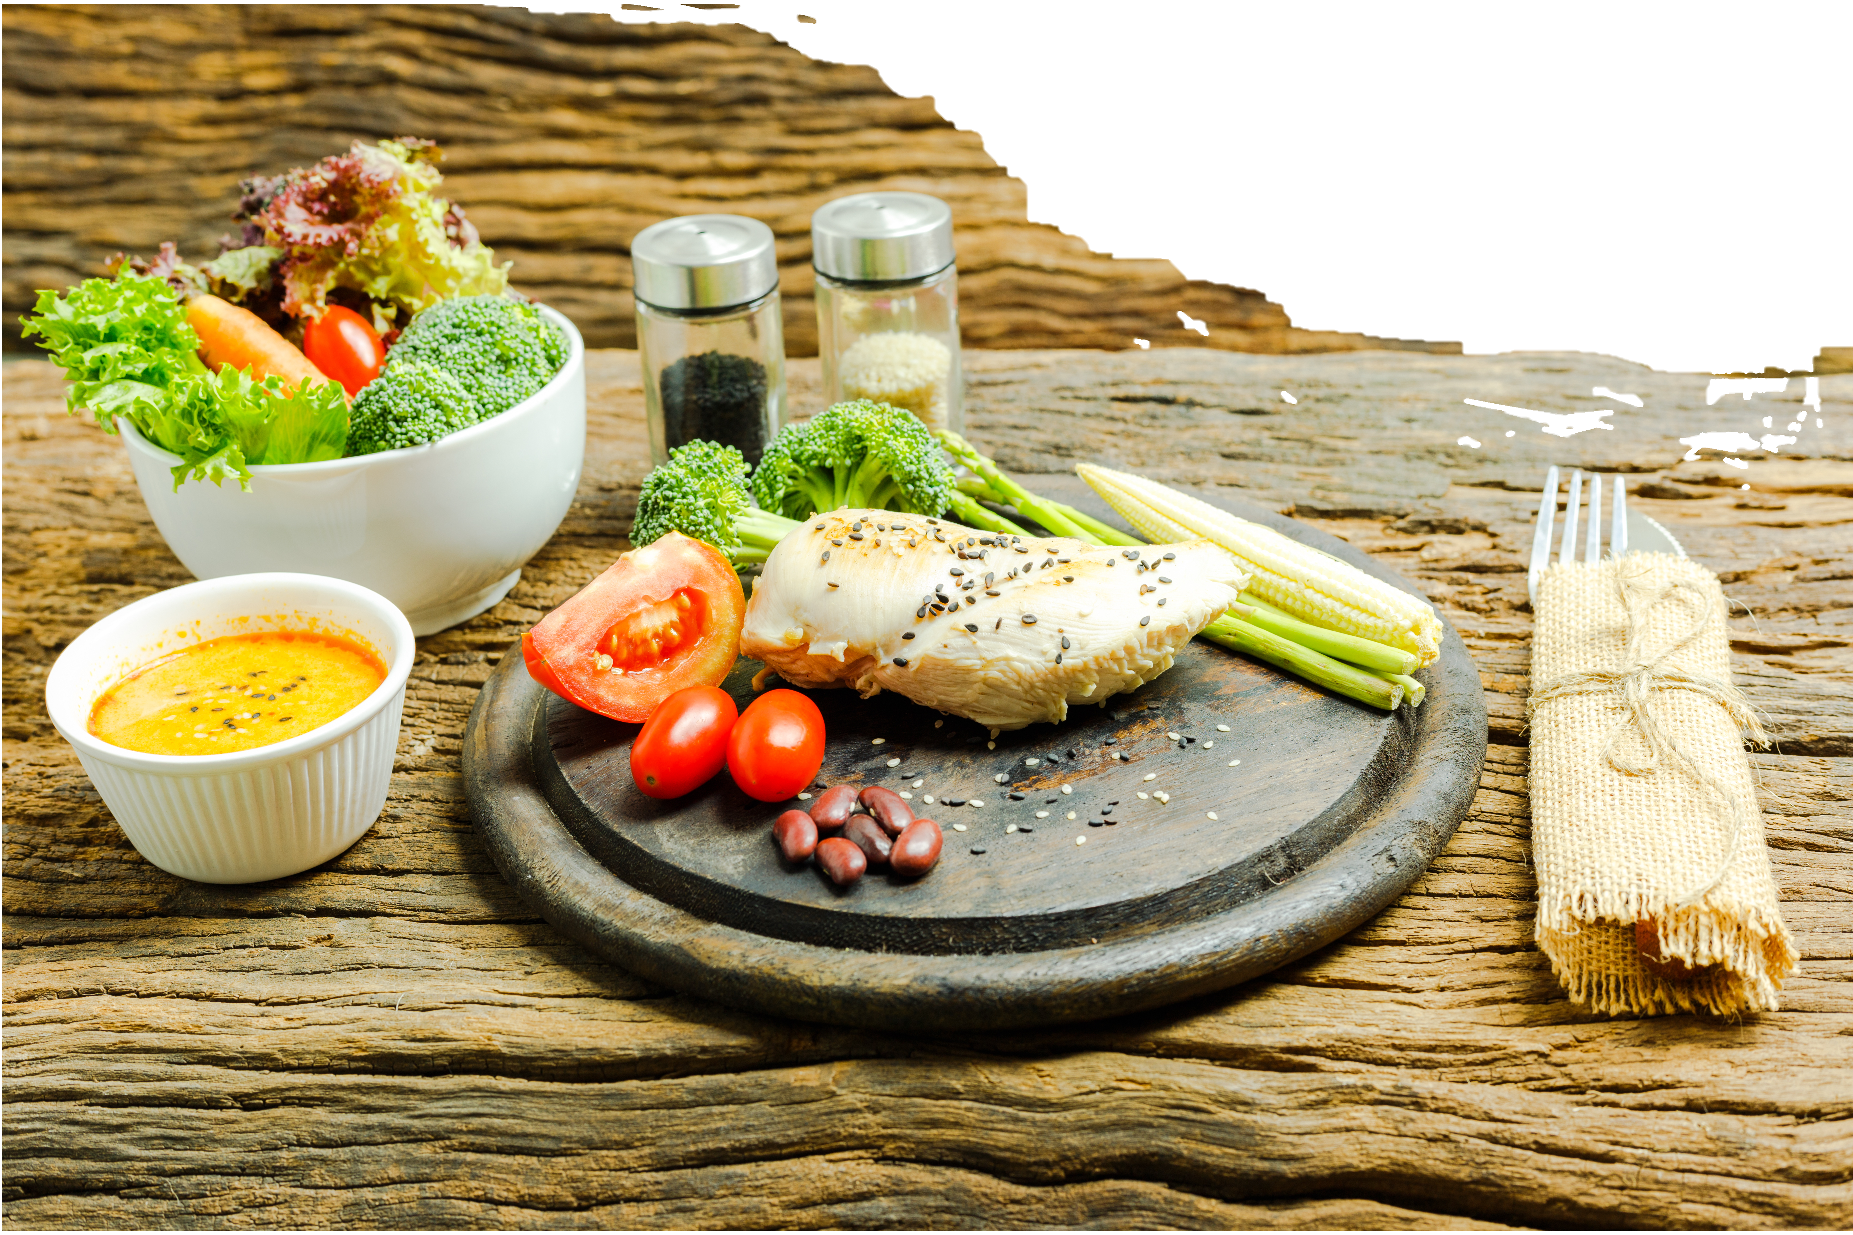

Unit
5
FOOD AND DRINK
LESSON 3: A CLOSER LOOK 2

Slide 4
* VOCABULARY:
* Translate the words into English
1. đếm được:
2. số lượng:
3. miêu tả:
4. được nhiều người biết đến:
5. hoạt hình:
countable /ˈkaʊntəbəl/
quantity /ˈkwɒntəti/
describe /dɪˈskraɪb/
popular /ˈpɒpjələr/
cartoon /kɑːˈtuːn/

Slide 5
* GRAMMAR
Measurement words/phrases: some, a lot of / lots of
Remember!
We use some, a lot of, lots of with both countable nouns and uncountable nouns to describe quantities.
Example:
- I need some apples for this recipe.
- There's some water in the bottle.
- There are a lot of/ lots of people in the room.
- She likes coffee with a lot of / lots of sugar.

Slide 6
1
Circle the correct words or phrases to complete the following sentences.
1. Minh is very popular. He has got some / a lot of friends.
2. Linh is very busy. She has got some / lots of homework.
3. Put some / a lot of sugar in my tea. But not too much.
4. There are some / a lot of cars in our city. Too many. I don't like it.
5. There is some / lots of rice left. Not much but just enough for our breakfast.
a lot of
lots of
some
a lot of
some

Slide 7

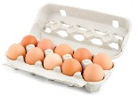

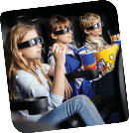

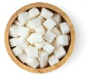
1
2
Look at the pictures and complete each sentence. Write some, any or a lot of/ lots of in the blanks.
Example: There is some orange juice in the glass.
1. There are _____________ eggs in the carton.
2. There aren't _________ biscuits on the plate.
3. Susie went to the cinema with _________ friends.
4. I'd like a pizza with ____________ cheese.
5. There is _____________ sugar in the bowl.
a lot of/ lots of
any
some
a lot of/ lots of
a lot of/ lots of

Slide 8




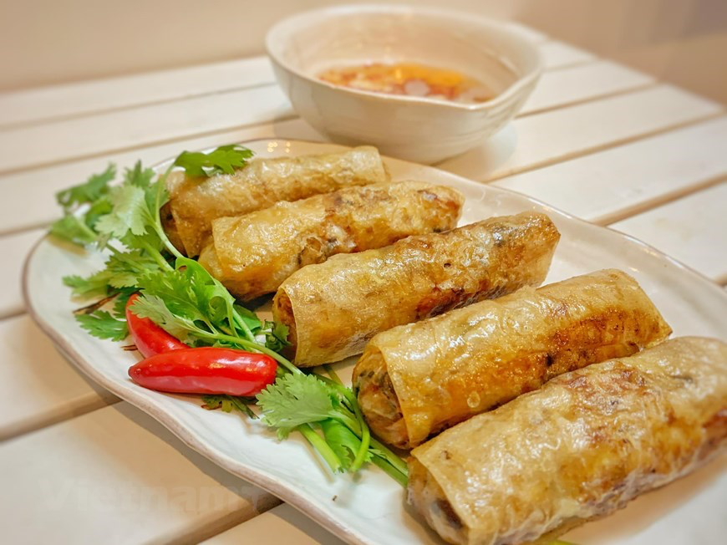
3
Fill in each blank with How many or How much. Answer the questions, using the pictures.
1. __________ water do you drink every day? _________
2. ___________ books did you read last month?_________
3. ___________ films did you watch last year? ________
4. ___________ bananas do you eat every week? ___________
5. ___________ spring rolls did your mother cook last month? _______
2L
Lucky number

Slide 9
LUCKY NUMBER
1
8
2
Team A
Team B
2
7
3
8
4
6
10
2
8
4
6
10
6
4
5
TIẾP

Slide 10


3
Fill in each blank with How many or How much. Answer the questions, using the pictures.
2L
1. _______water do you drink every day? _________
How much
2 litters

Slide 11

3
Fill in each blank with How many or How much. Answer the questions, using the pictures.
2. ___________ books did you read last month?_________
How many
2 books

Slide 12

3
Fill in each blank with How many or How much. Answer the questions, using the pictures.
3. ___________ films did you watch last year? ________
How many
3 films

Slide 13
3
Fill in each blank with How many or How much. Answer the questions, using the pictures.
4. _________bananas do you eat every week? __________
How many
3 bananas

Slide 14
3
Fill in each blank with How many or How much. Answer the questions, using the pictures.
5. ________ spring rolls did your mother cook last month?
______________
How many
5 spring rolls

Slide 15

LUCKY NUMBER!

Slide 16
LUCKY NUMBER!

Slide 17
LUCKY NUMBER!

Slide 18
3
Fill in each blank with How many or How much. Answer the questions, using the pictures.
1. __________ water do you drink every day? _________
2. ___________ books did you read last month?_________
3. ___________ films did you watch last year? ________
4. ___________ bananas do you eat every week? ___________
5. ___________ spring rolls did your mother cook last month? _______
2L
How much
2 litters
How many
2 books
How many
2 films
How many
3 bananas
How many
5 spring rolls

Slide 19
4
Work in pairs. Ask and answer, using the questions in 3.
1. How much water do you drink everyday?
2. How many books did you read last month?
3. How many films did you watch last year?
4. How many bananas do you eat every week?
5. How many spring rolls did your mother cook last month?
…

Slide 20
4
Work in pairs. Ask and answer, using the questions in 3.
Example:
A: How much water do you drink every day?
B: Two litres.
A: How many bananas do you eat every week?
B: I eat two bananas every week.

Slide 21
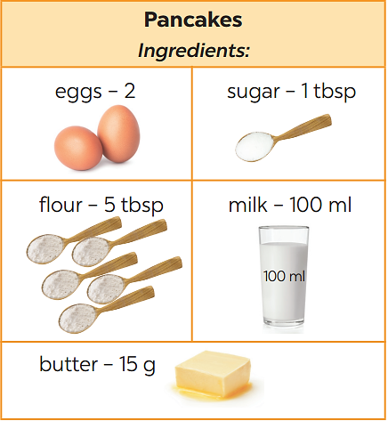
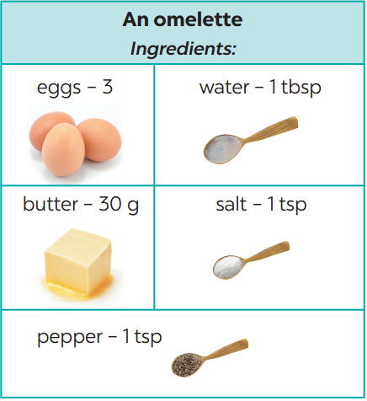
* PRODUCTION
4
Work in pairs. Take turns to ask and answer about the recipes.
1

Slide 22
* PRODUCTION
4
Work in pairs. Take turns to ask and answer about the recipes.
1
* Example:
A:
B:
A:
B:
A: ……
What do we need to make pancakes?
We need eggs, sugar, flour, milk, and butter.
How many eggs do we need?
Two.

Slide 23
* PRODUCTION
4
Work in pairs. Take turns to ask and answer about the recipes.
1
* Example:
A: What do we need to make an omelette?
B: We need eggs, butter, pepper, water, and salt.
A : How many eggs do we need?
B : three
A : How much water do we need?
B: 1tbsp

Slide 24
* CONSOLIDATION
- Review the measurement words and phrases such as some and
a lot of / lots of used with countable and uncountable nouns.
- Understand and use the How many/ How much to ask and answer about quantities.

Slide 25

Homework:
Make questions and sentences about quantities, using some, a lot of / lots of, any, How much and How many.
Prepare for the project (the eating habits, pictures or photos and responsibilities of each member).
Prepare lesson 4 (communication)

Slide 26

Goodbye.
See you again.

Slide 27
