Slide 1





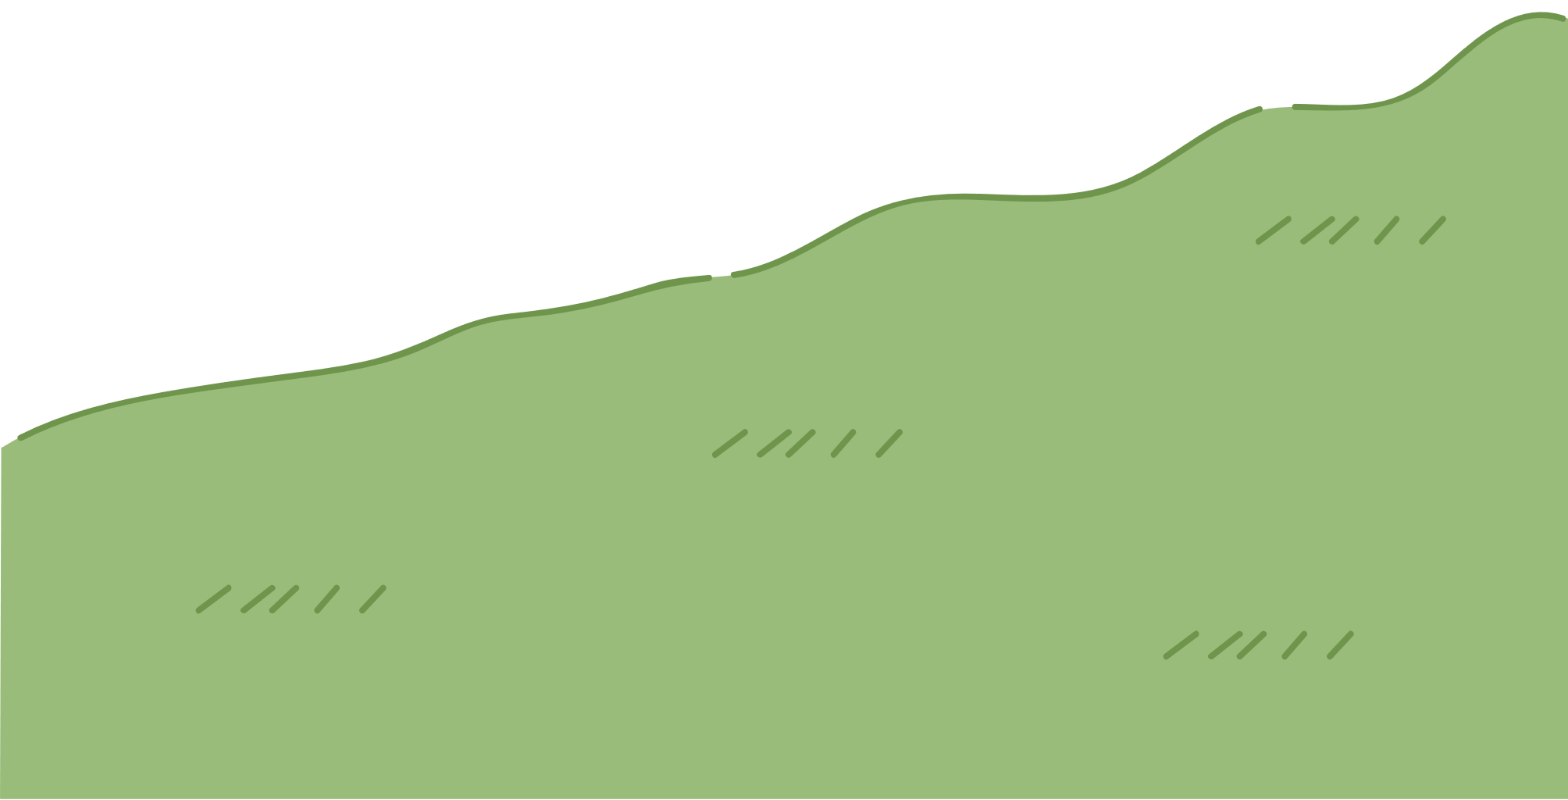
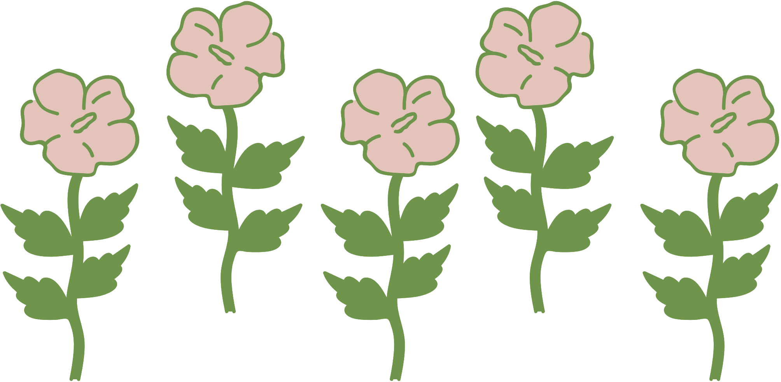
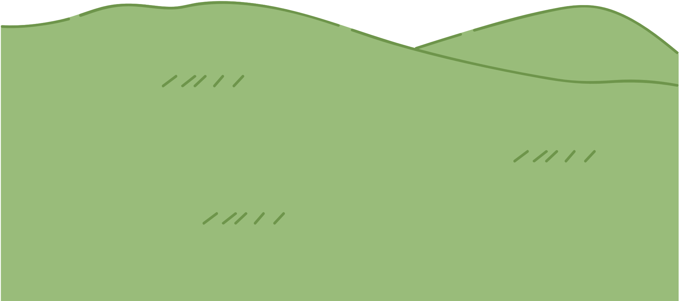
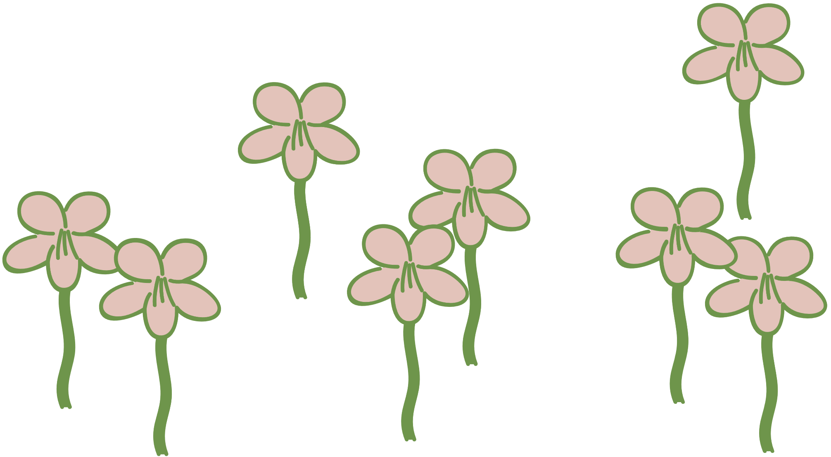

WELCOME TO OUR CLASS!
Presented by: ……………………….

Slide 2

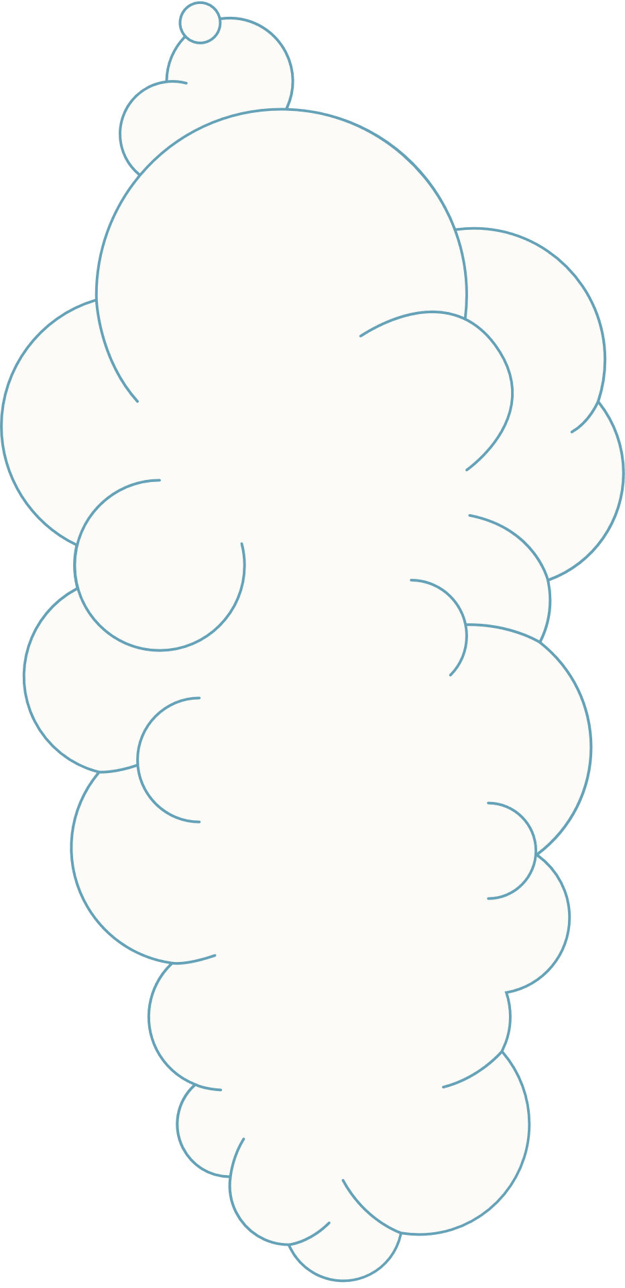

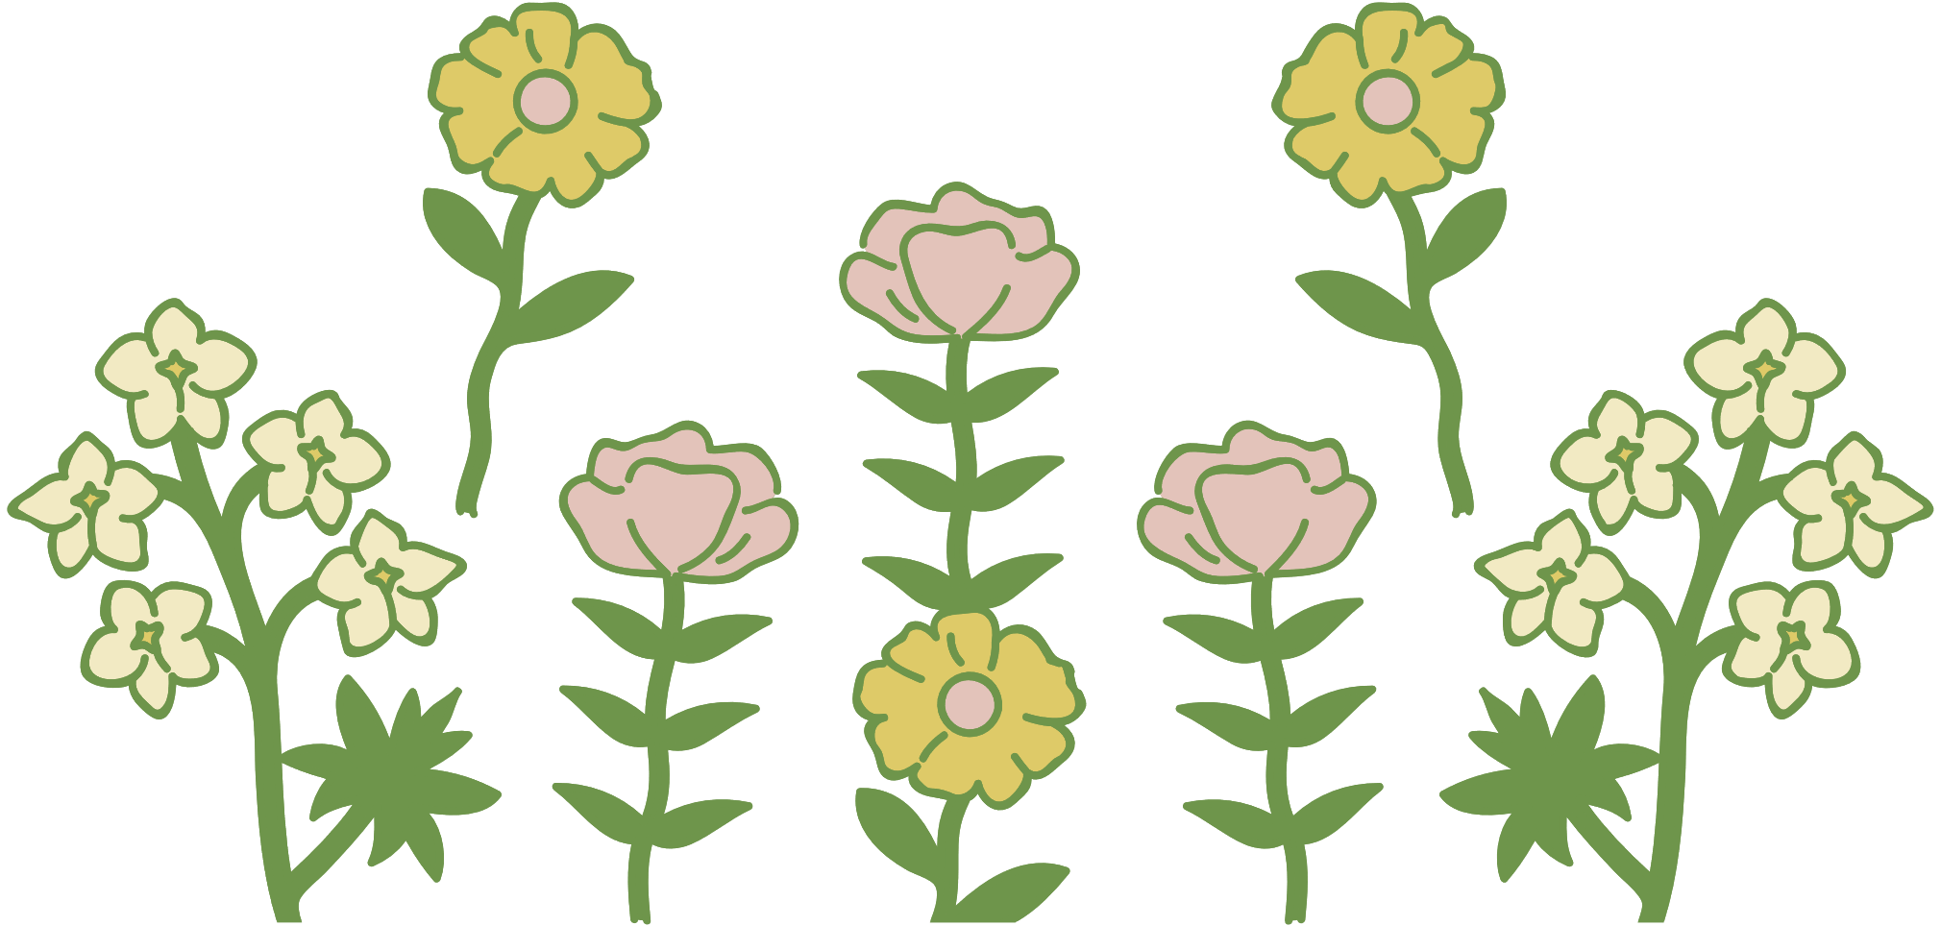
What is the video about?

Slide 3

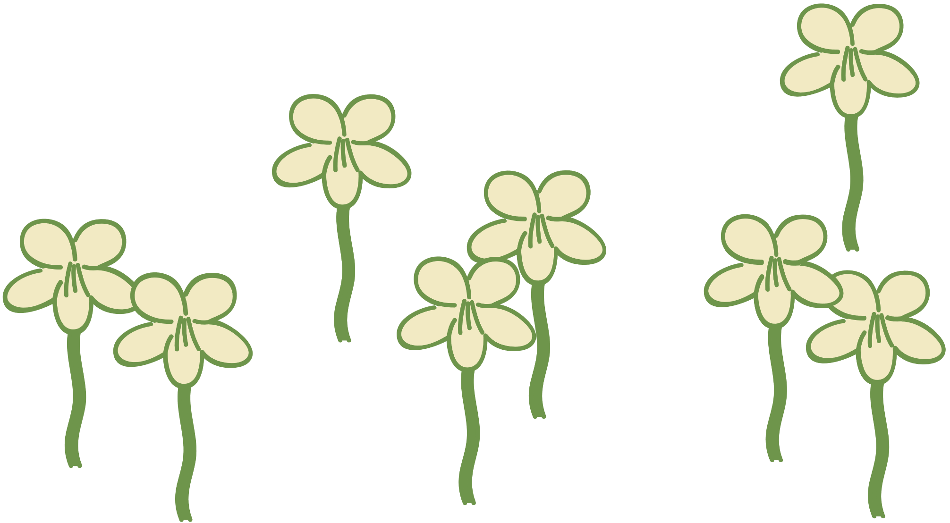

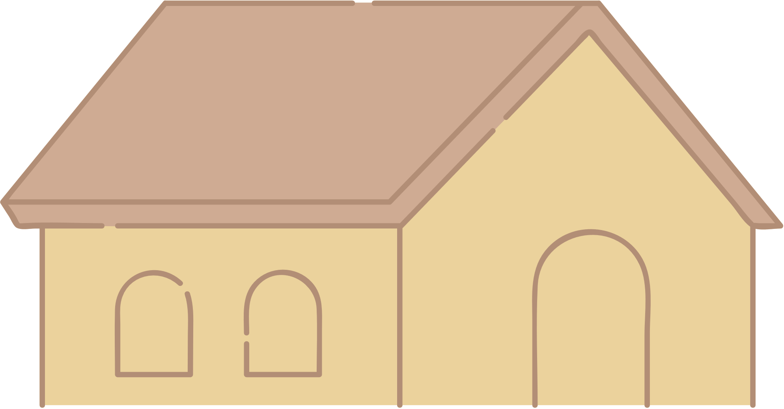

Unit 6:
VIETNAMESE LIFESTYLE: THEN AND NOW
Lesson 1: Getting Started

Slide 4


VOCABULARY

Slide 5

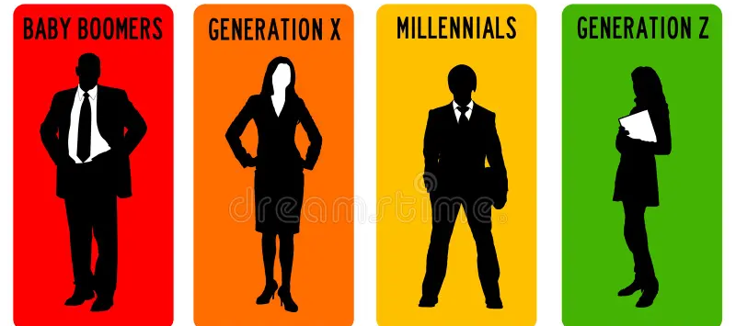
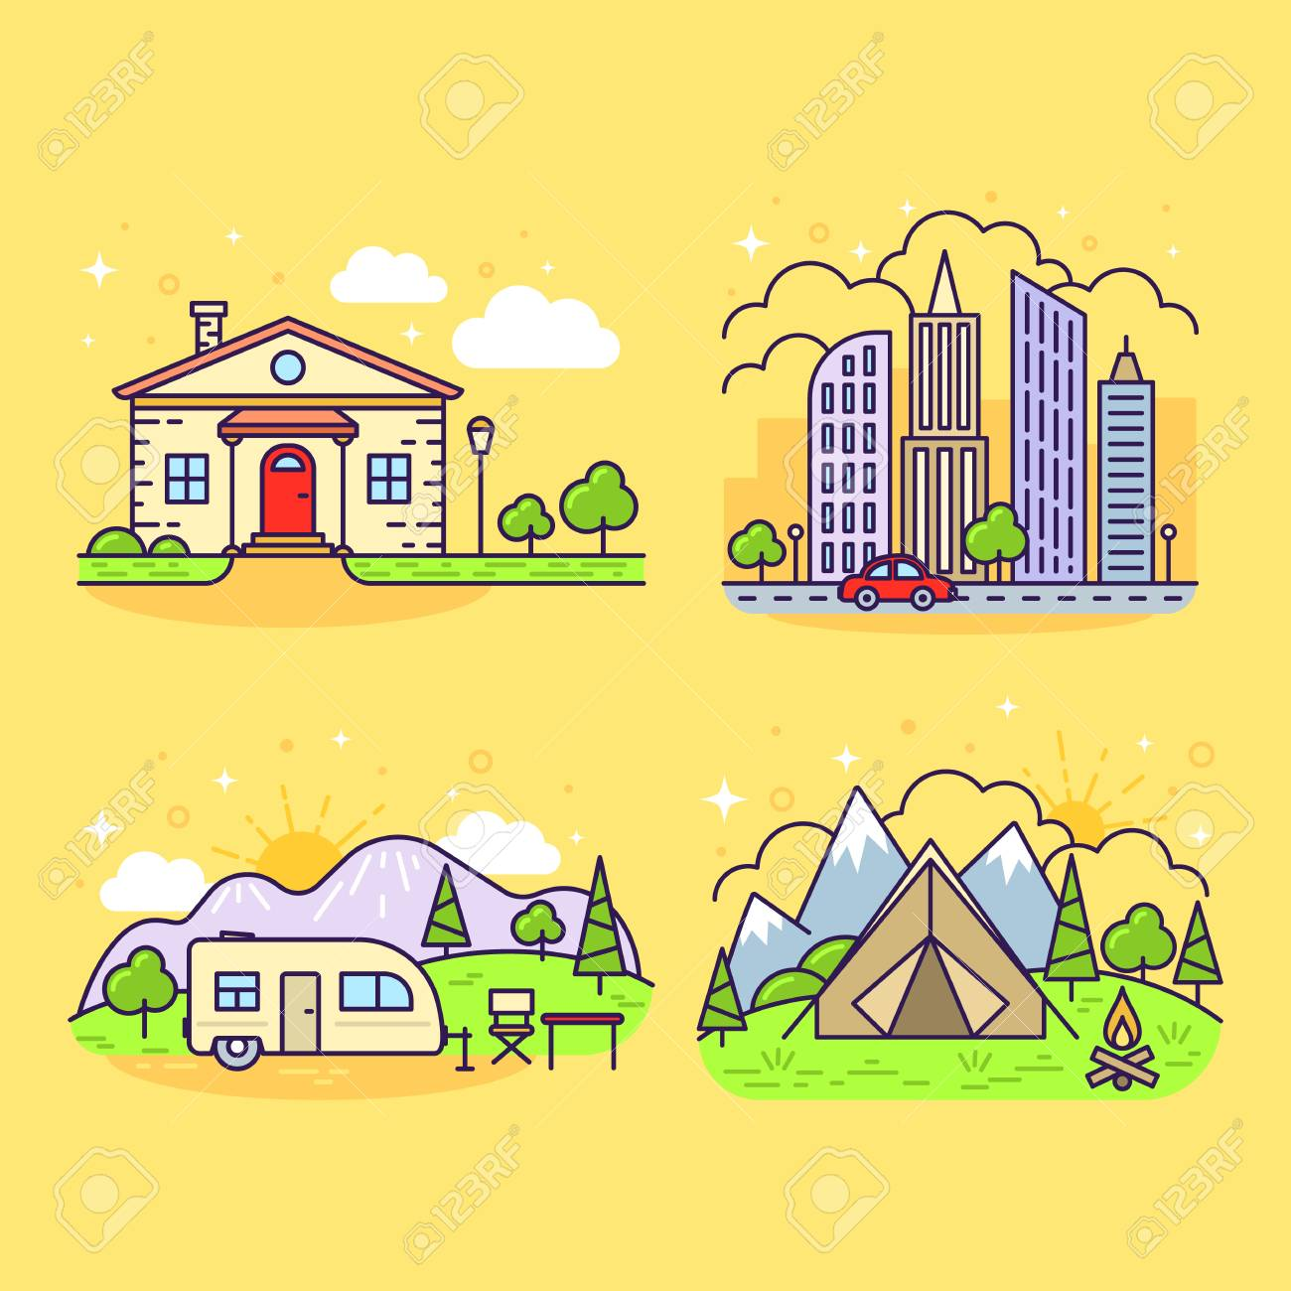
VOCABULARY
all the people of about the same age within a society
generation (n)
/ˌdʒenəˈreɪʃn/
thế hệ

Slide 6

VOCABULARY
living condition
standard of living
/ˈlɪvɪŋ kənˈdɪʃənz/
điều kiện sống

Slide 7
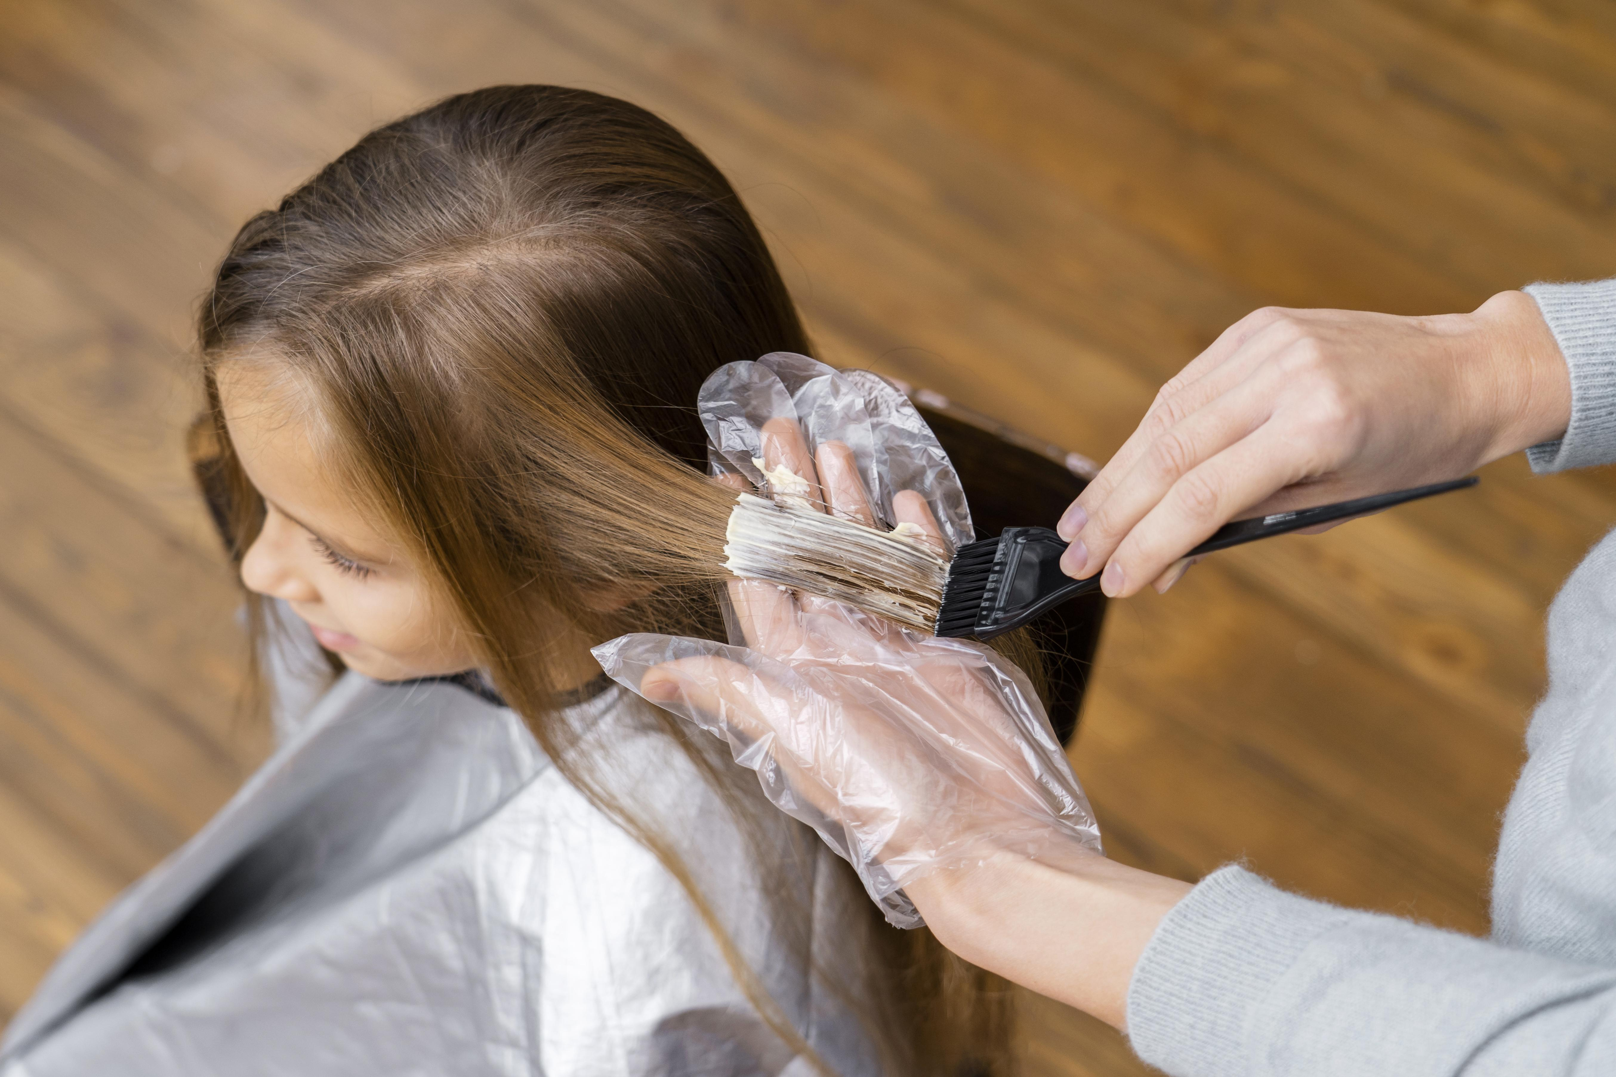
VOCABULARY
chance
opportunity (n)
/ˌɒpəˈtjuːnəti/
cơ hội
Ex: He had a golden opportunity to score in the first half but squandered it.

Slide 8
VOCABULARY
dye (v)
to change the colour of sth using a special liquid.
/daɪ/
nhuộm

Slide 9
VOCABULARY
New words | Pronunciation | Meaning
1. generation (n) | /ˌdʒenəˈreɪʃn/ | thế hệ
2. living condition | /ˈlɪvɪŋ kənˈdɪʃənz/ | điều kiện sống
3. opportunity (n) | /ˌɒpəˈtjuːnəti/ | cơ hội
4. dye (v) | /daɪ/ | nhuộm

Slide 10


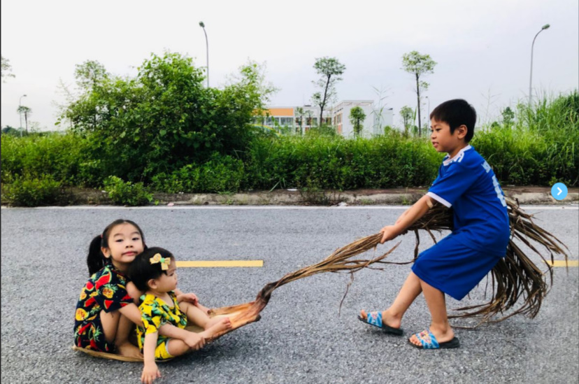
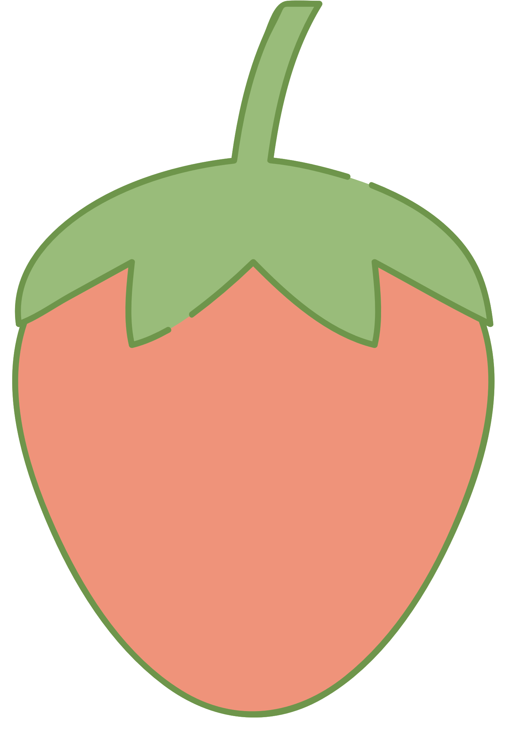

Look and answer
- What do you think the children / teens in each picture are doing?
- Do you think the activity in each picture is popular in the past or present?

Slide 11
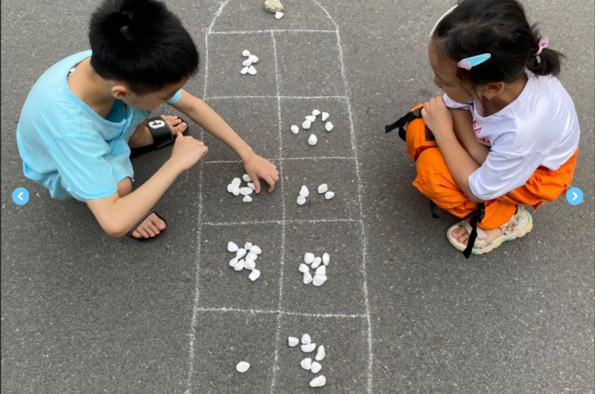
Look and answer
- What do you think the children / teens in each picture are doing?
- Do you think the activity in each picture is popular in the past or present?

Slide 12
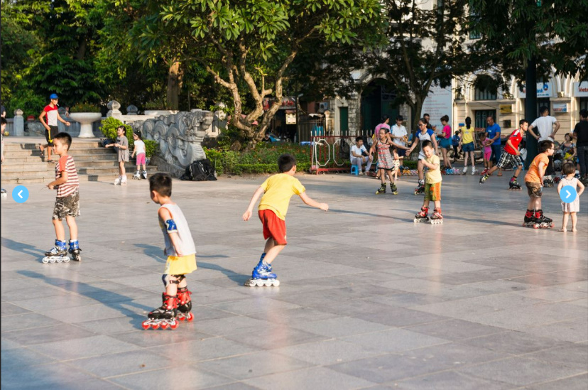
Look and answer
- What do you think the children / teens in each picture are doing?
- Do you think the activity in each picture is popular in the past or present?

Slide 13
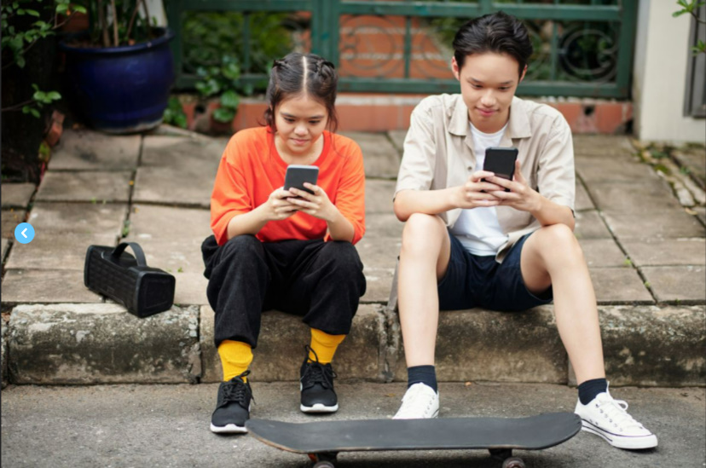
Look and answer
- What do you think the children / teens in each picture are doing?
- Do you think the activity in each picture is popular in the past or present?

Slide 14
We didn’t do it in my day
Phong: Grandpa, do you mind telling me how our lives are different from yours in the past?
Grandpa: Well, there are many differences. In my day, we mostly played outdoors. The games were simple and cost little. We made our own toys from natural materials.
Phong: That sounds interesting. Nowadays, most leisure games depend on electronic devices.
Grandpa: Right, but that is mostly true in the city only. Many children in the countryside still play traditional games.
Phong: I know.
Grandpa: Another thing is that children nowadays have more freedom of choice. They wear short dresses and jeans with holes. They also dye their hair purple and green.
Phong: Ha ha … Not many, Grandpa.
Grandpa: Hm … And many children of my generation left school early to support their families. Moreover, there were not many schools then.
Phong: You mean we have more opportunities to learn now?
Grandpa: That’s right.
Phong: Do you think these changes are for the better?
Grandpa: Yes, they mostly are. They have improved our living conditions.
Phong: Thank you, Grandpa

Slide 15



2. Read the conversation and circle the correct answer
1. Phong and his grandpa are talking about some differences between___________________
A. children in the city and the countryside
B. the living standards in the past and now
C. life in the past and now
D. past and present entertainment
2. Phong’s grandpa mentions _________________differences
A. two B. three C. four D. five
3. Phong’s grandpa sees most of the changes as ______________.
A. positive B. negative C. unnecessary D. necessary

Slide 16
2. Read the conversation and circle the correct answer
1. Phong and his grandpa are talking about some differences between___________________
A. children in the city and the countryside
B. the living standards in the past and now
C. life in the past and now
D. past and present entertainment
Phong: Grandpa, do you mind telling me how our lives are different from yours in the past?
Grandpa: Well, there are many differences.

Slide 17
2. Read the conversation and circle the correct answer
2. Phong’s grandpa mentions _________________differences
A. two B. three C. four D. five
Grandpa: Well, there are many differences. In my day, we mostly played outdoors. The games were simple and cost little. We made our own toys from natural materials….
Grandpa: Another thing is that children nowadays have more freedom of choice. They wear short dresses and jeans with holes. They also dye their hair purple and green.
Grandpa: Hm … And many children of my generation left school early to support their families. Moreover, there were not many schools then.

Slide 18
2. Read the conversation and circle the correct answer
3. Phong’s grandpa sees most of the changes as ______________.
A. positive B. negative C. unnecessary D. necessary
Phong: Do you think these changes are for the better?
Grandpa: Yes, they mostly are. They have improved our living conditions.

Slide 19

3. Write the expressions from the conversation in the correct column.
a. depend on electronic devices
b. leave school early
c. dye their hair
d. have more opportunities to learn
e. make toys from natural materials
THE PAST
THE PRESENT

Slide 20



4. Complete the sentences with the words from the box
opportunity
freedom
dyed
generation
materials
1. A few teenagers in my village have ____________ their hair brown.
2. Young people’s lifestyle today is different from that of the previous ____________.
3. Nowadays, nearly all young people have a(n)______________ to go to school.
4. He wants to live green, so he uses products made from natural ____________ .
5. My parents give me ____________ to pursue my own interests.

Slide 21
5. Work in pairs. Decide if the statements below are TRUE or FALSE about life in Viet Nam 40 years ago. Share your answers with the class.
40 years ago, ______
TRUE
FALSE
1. school children didn’t wear uniforms.
2. no Vietnamese student could go and study abroad.
3. most people wrote letters instead of writing emails or texting messages.
4. bicycles were the main means of transportation.
5. people lit firecrackers at Tet and weddings

Slide 22





HOMEWORK
Learn by heart vocabulary
Do exercises in the workbook
Prepare: A Closer Look 1

Slide 23
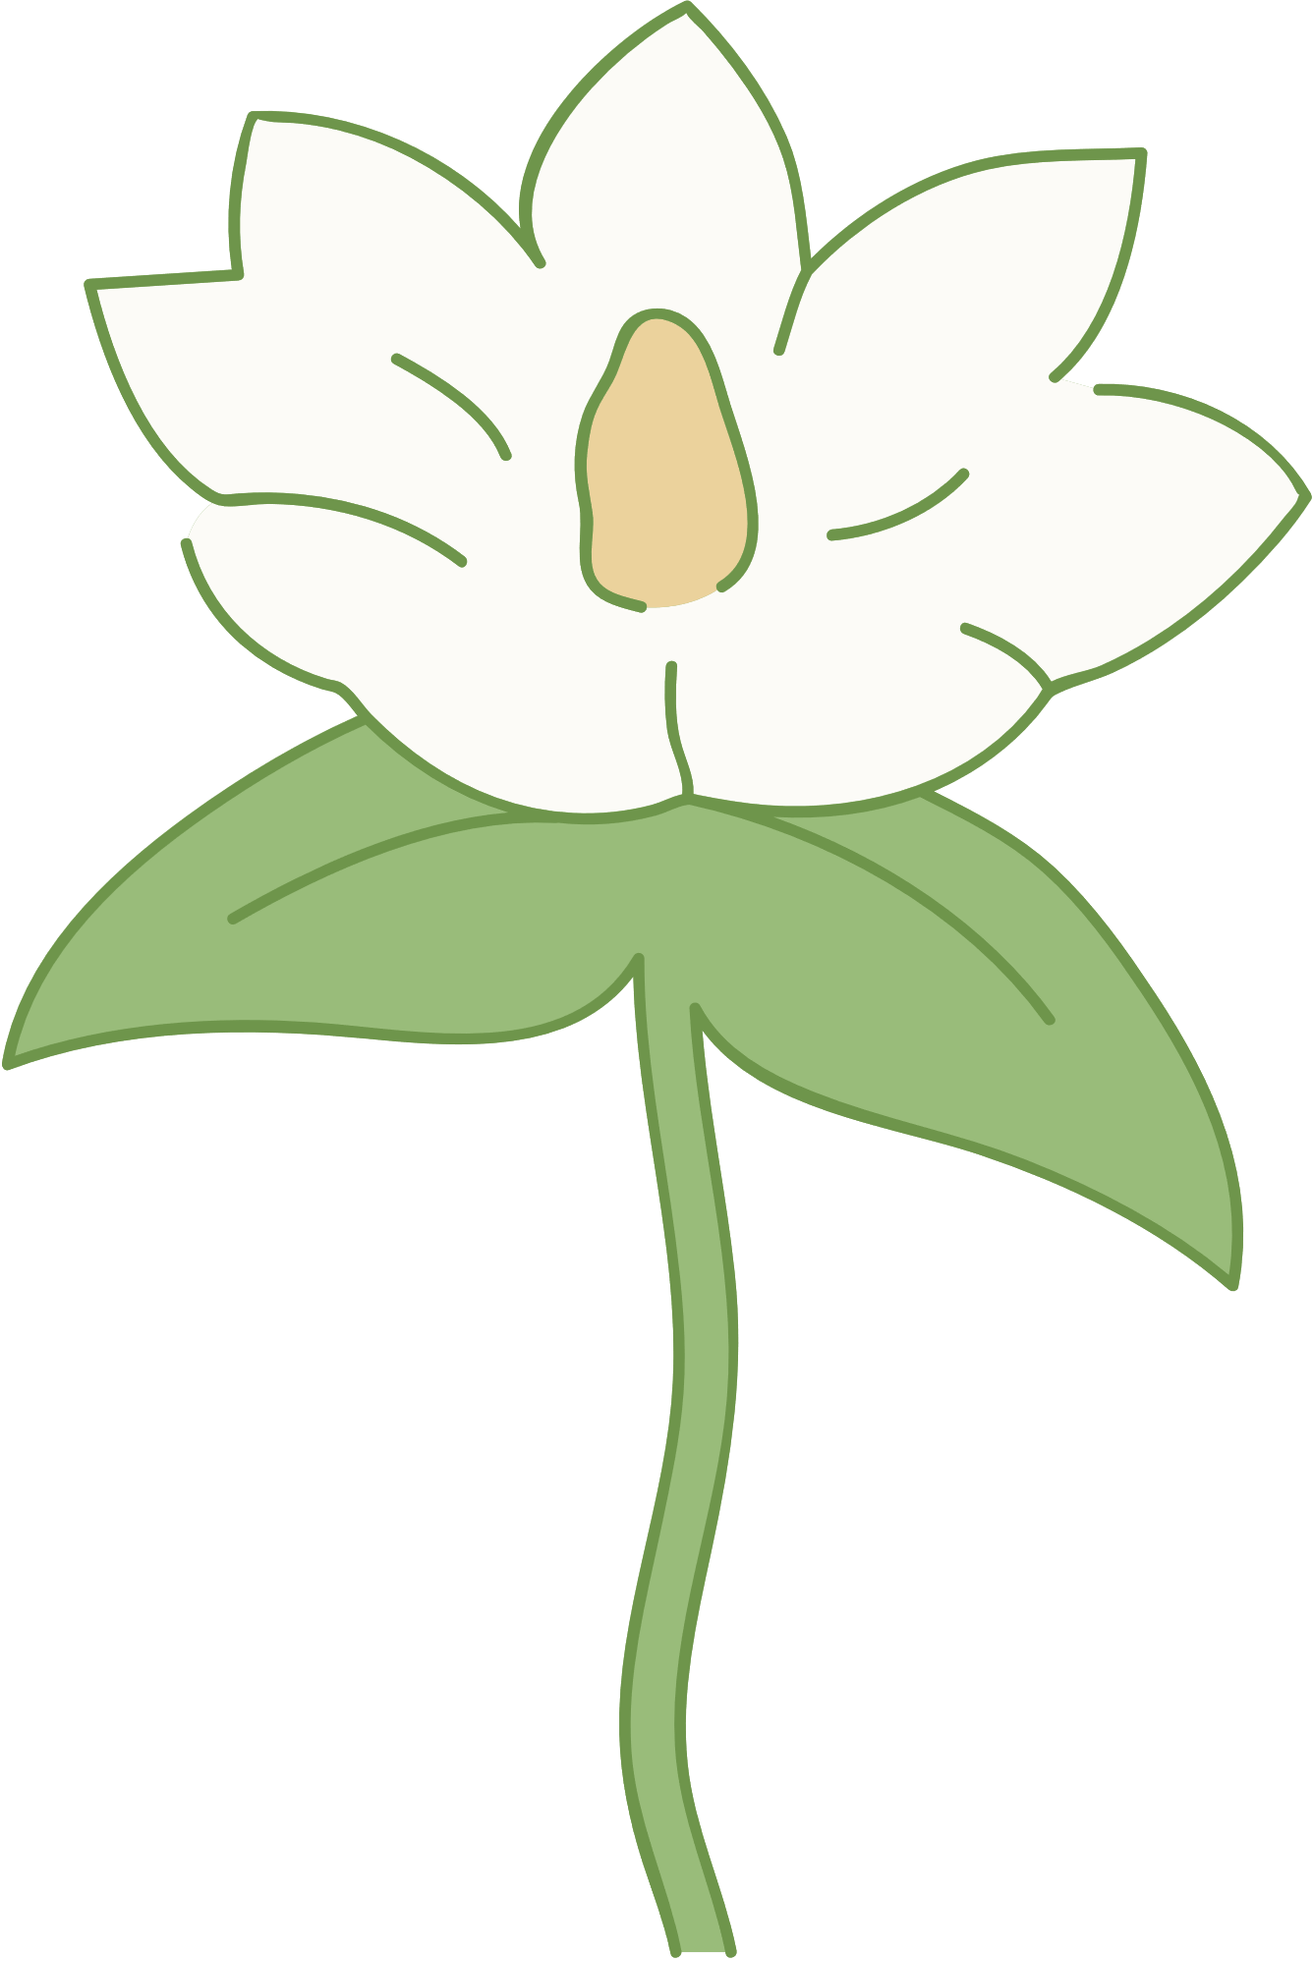
THANK YOU!

