Slide 1
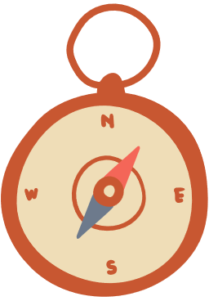
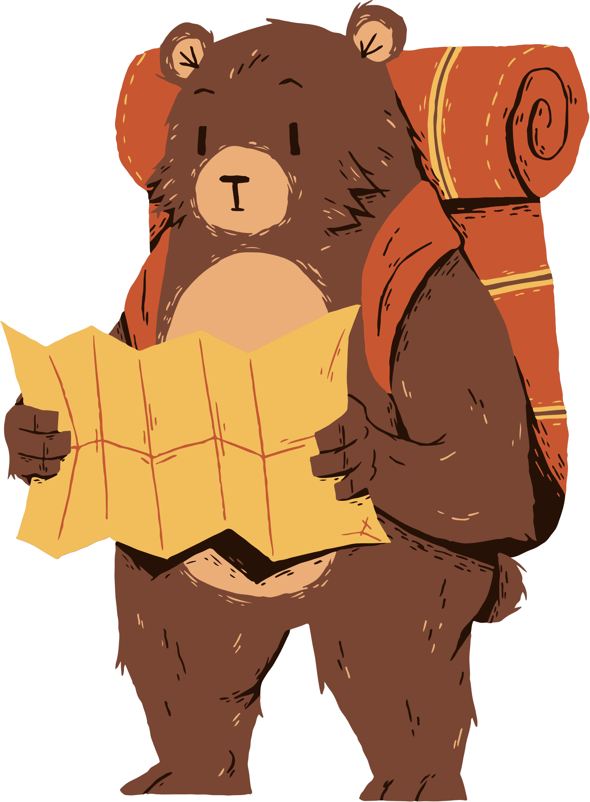


…… Secondary School
WELCOME TO OUR CLASS!

Slide 2
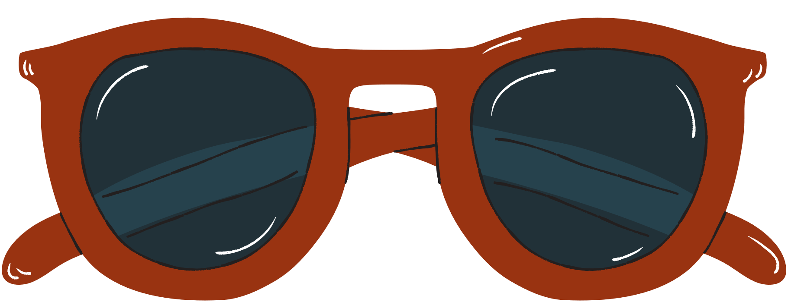




Watch and fill in the blank
to pay
to get
to remember
meaning __________
want __________
trying __________
meeting
spending
suggest ________
love ________
to be
aspire _________
to work
continue _______
getting
risk ___________
to raise
need __________
to live
neglect ________
to spend
get ___________
living
miss __________

Slide 3

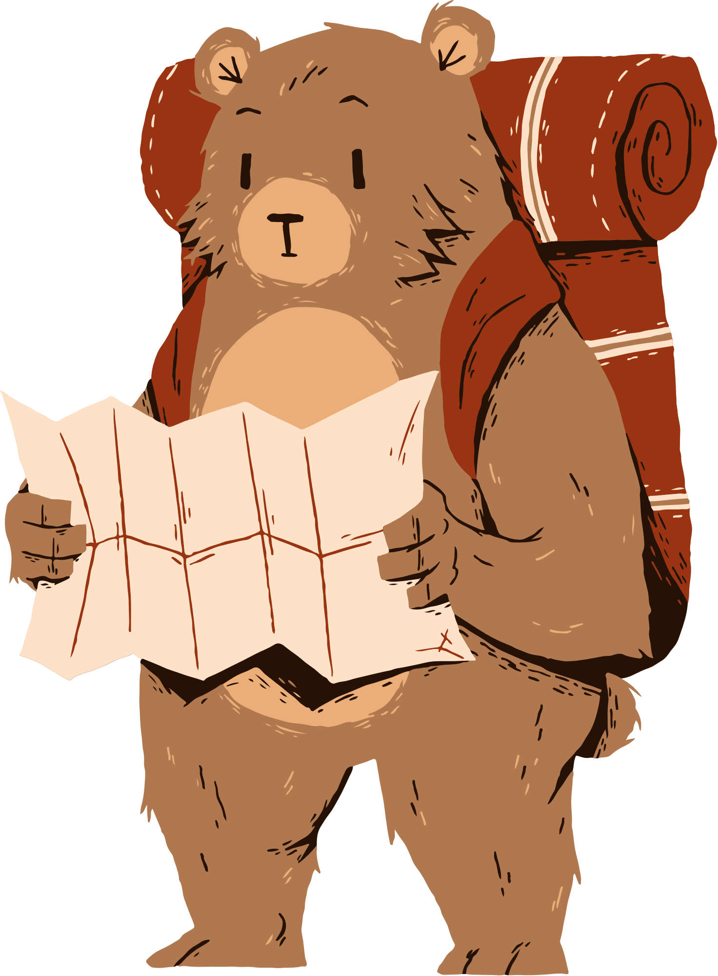

Unit 6:
VIETNAMESE LIFESTYLE: THEN AND NOW
Lesson 3: A Closer Look 2

Slide 4
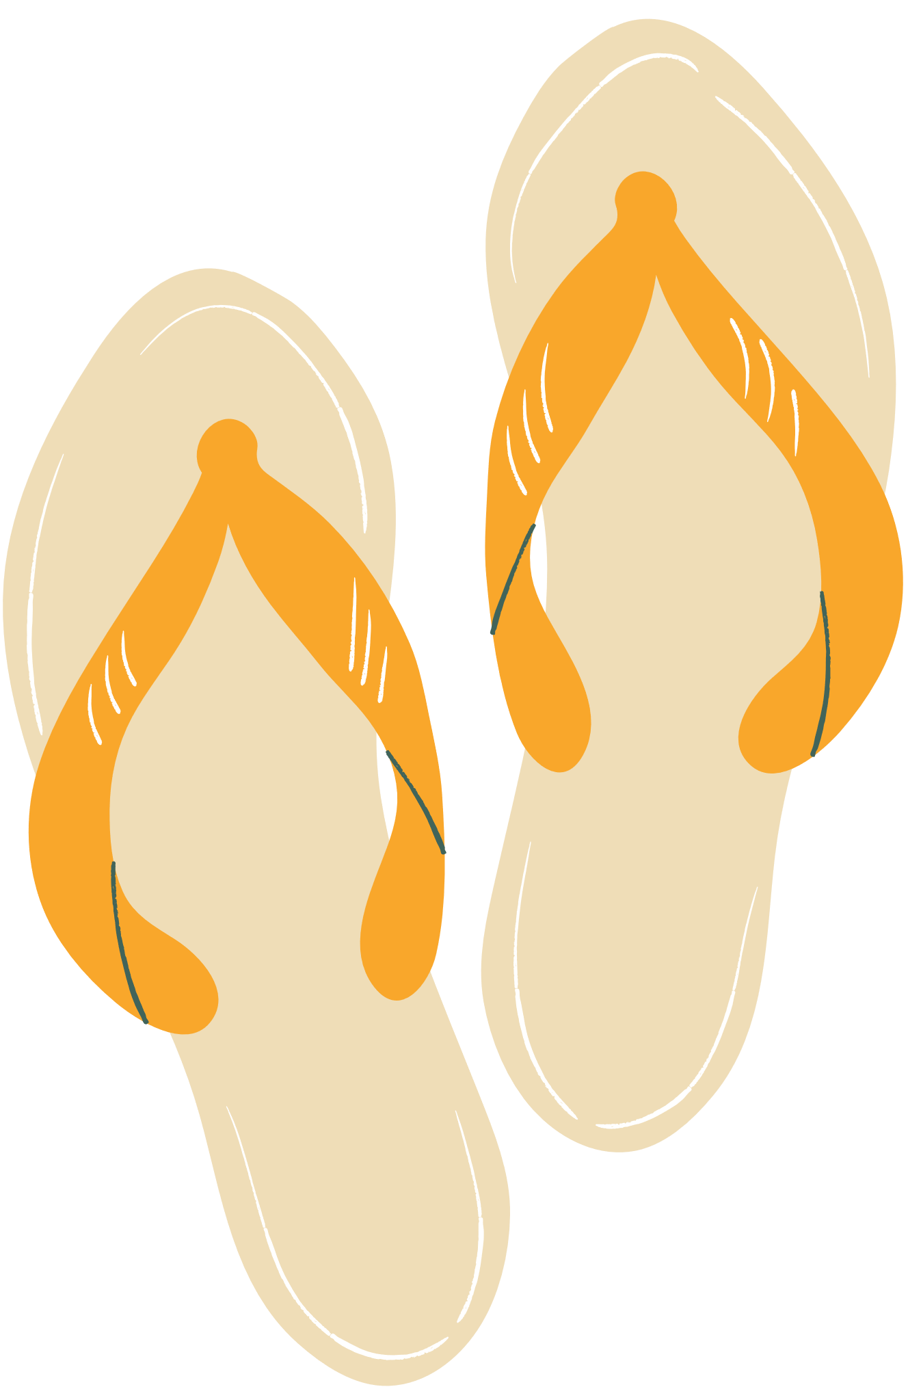
REMEMBER
– The verb after want, promise, decide, agree, learn, plan has the to-infinitive form.
Example:
We decided to do some research on Thai traditional dancing.
– The verb after enjoy, fancy, finish, mind, avoid, suggest has the -ing form.
Example:
I suggested visiting the Viet Nam Museum of Ethnology.

Slide 5


1. Write the correct form of the verbs in bracket
riding
1. fancy (ride) ___________ a buffalo
to use
2. learn (use)___________ traditional farming tools
not touching
3. mind (not touch)______________ the displays
to make
4. decide (make)______________ a kite
playing
5. avoid (play) ______________ on the streets
to learn
6. promise (learn) ______________ more about the history of our village

Slide 6



2. Underline the correct verb form for each sentence
1. I really fancy to wear / wearing this traditional cone hat at our Fashion Show
2. My brother has decided to enter / entering the Back to Our Past Competition.
3. Do you mind to replay / replaying that Folk music? It’s lovely.
4. My uncle always avoids to tell / telling stories about his past.
5. They plan to do / doing research about life in Hue in the 19th century.

Slide 7

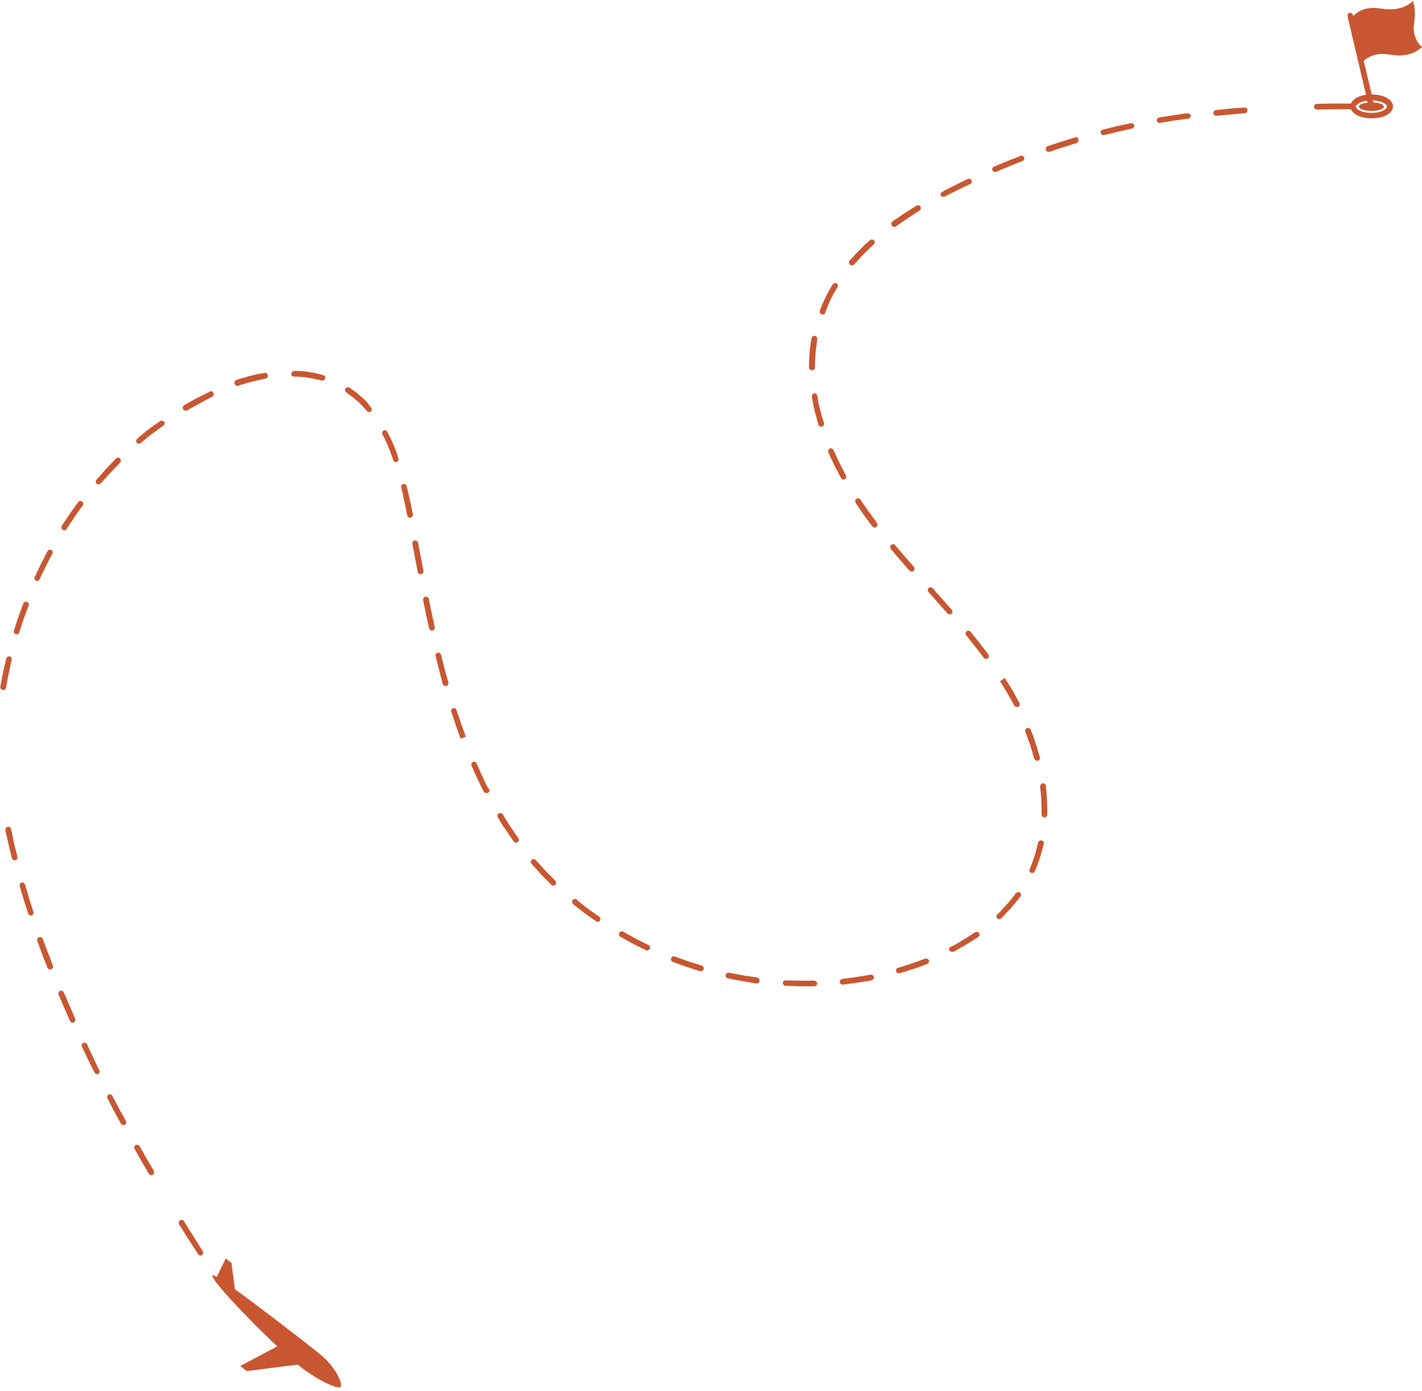
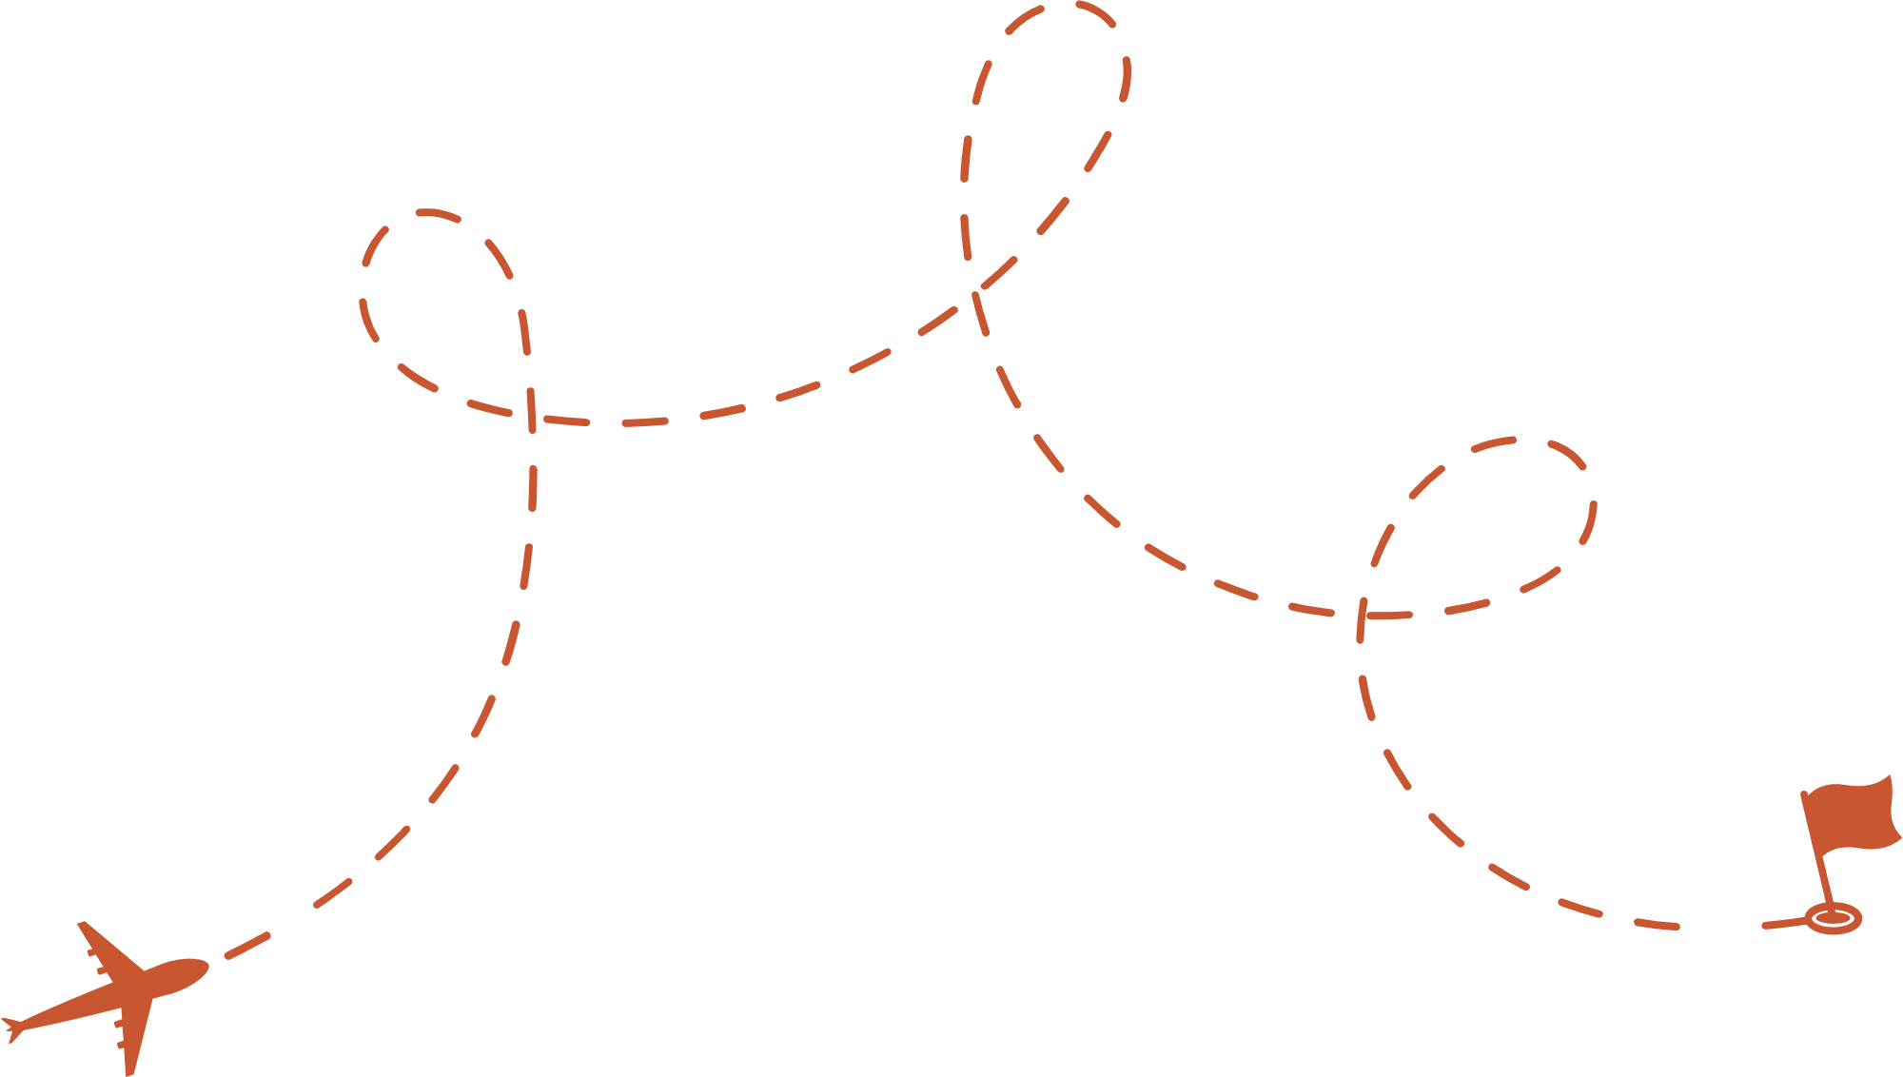
3. Complete each sentence with the correct form of a verb from the box.
make learn give work teach
to learn
1. We want __________________ how to make toys from natural materials.
working
2. Yesterday, we finished __________________ on the poster for our Good Old Days project
to teach
3. I have promised __________________ my grandfather how to find news online.
making
4. My grandmother suggested __________________ a traditional long dress for the wedding
to give
5. Our group agreed __________________ a presentation about school uniforms in the 20th century.

Slide 8


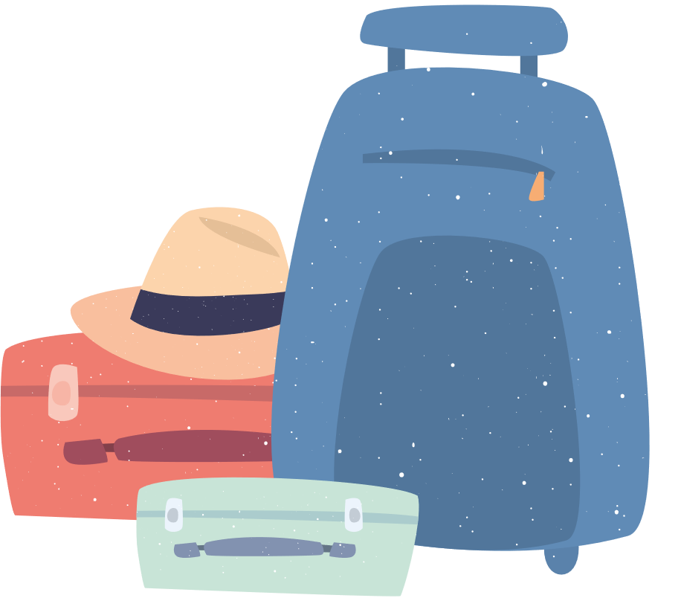
4. Choose the incorrect underlined word or phrase in each sentence
having
1. Just a few years ago, I would never fancy to have a smart TV in my home.
2. Tom promised adding some information about the past to his presentation.
3. I’ve decided learning how ethnic minority people use natural materials to dye cloth.
4. My children plan researching and make our family tree for the past hundred years.
5. Do you mind not to talk about the past in such a negative way?
to add
to learn
to research
talking

Slide 9



5. Work in pairs. Take turns to complete the sentences.
- Work in pairs.
- Take turns to complete the sentences in the way they like
1. For my future career, I want _____________.
2. Do you mind not ______________________?
3. We all agreed ________________________.
4. I have never fancied ___________________.
5. For our two-day holiday, I suggest ________.

Slide 10
Suggested answer:
1. For my future career, I want to work in fashion design.
2. Do you mind not making noise while studying?
3. We all agreed to visit the nursing home in our neighbourhood.
4. I have never fancied travelling alone in the dark.
5. For our two-day holiday, I suggest going camping at Chua Thay.

Slide 11
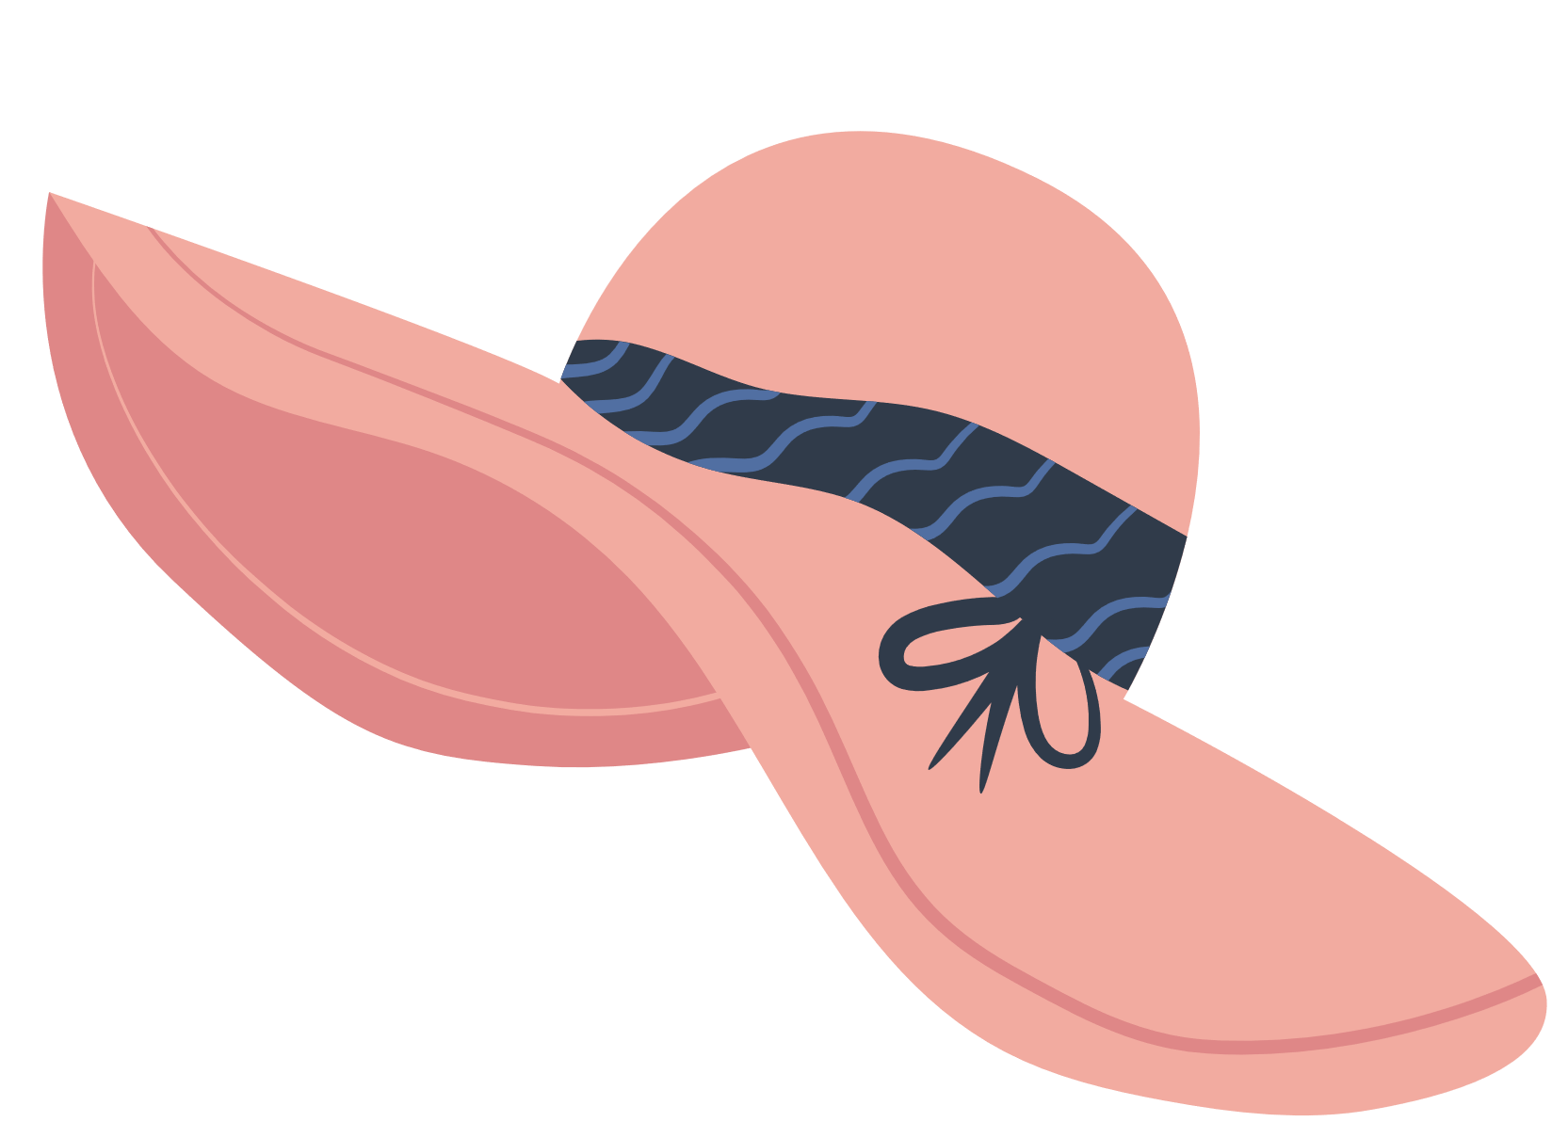

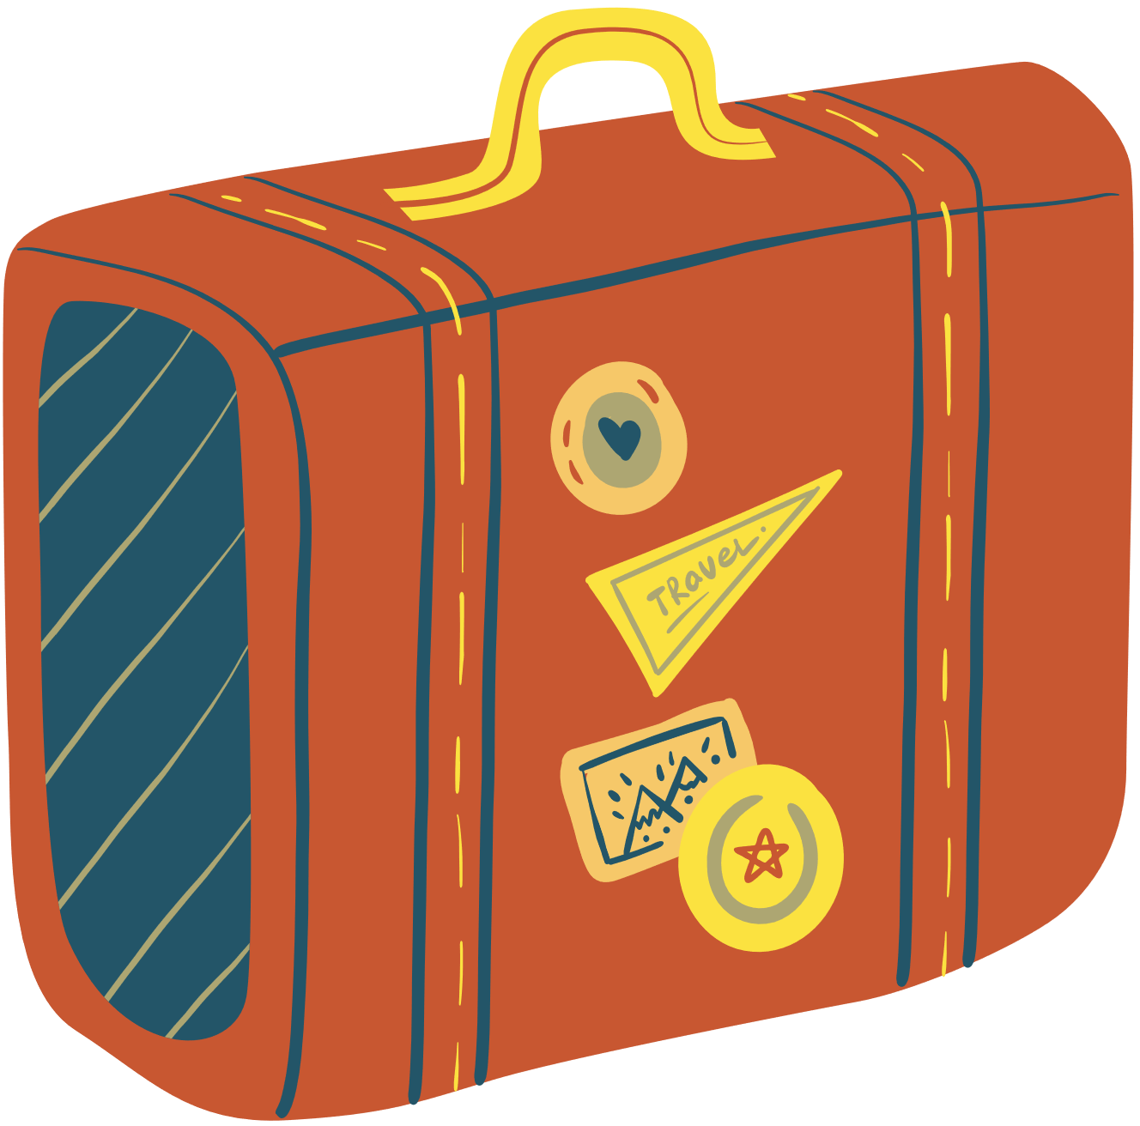
WRAP-UP
What have you learned in this lesson?
Use correctly to-infinitive and V-ing after a verb.

Slide 12
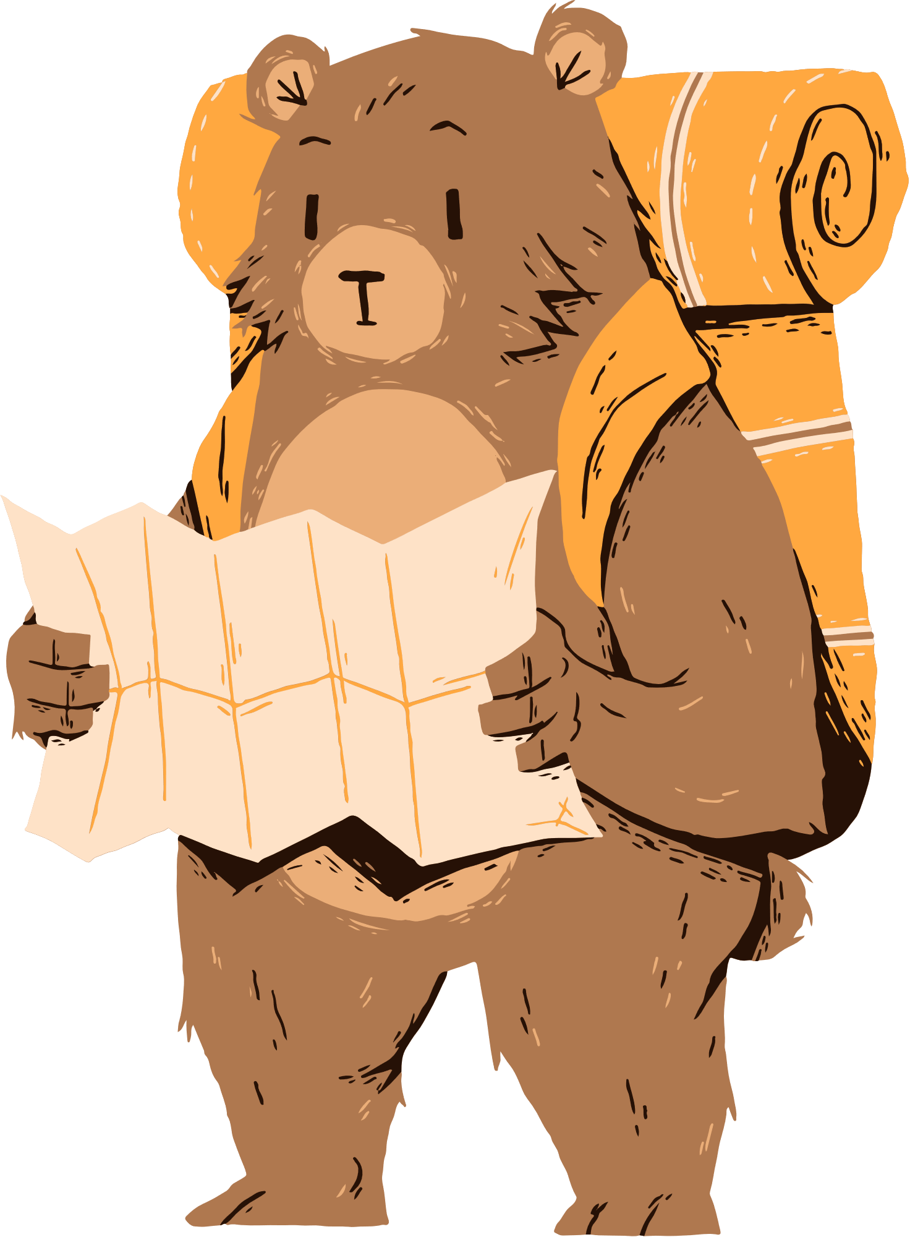
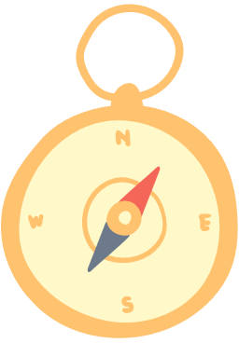

HOMEWORK
Review the grammar point
Do exercises in the workbook
Prepare: Communication

Slide 13
THANK YOU!

