Slide 1





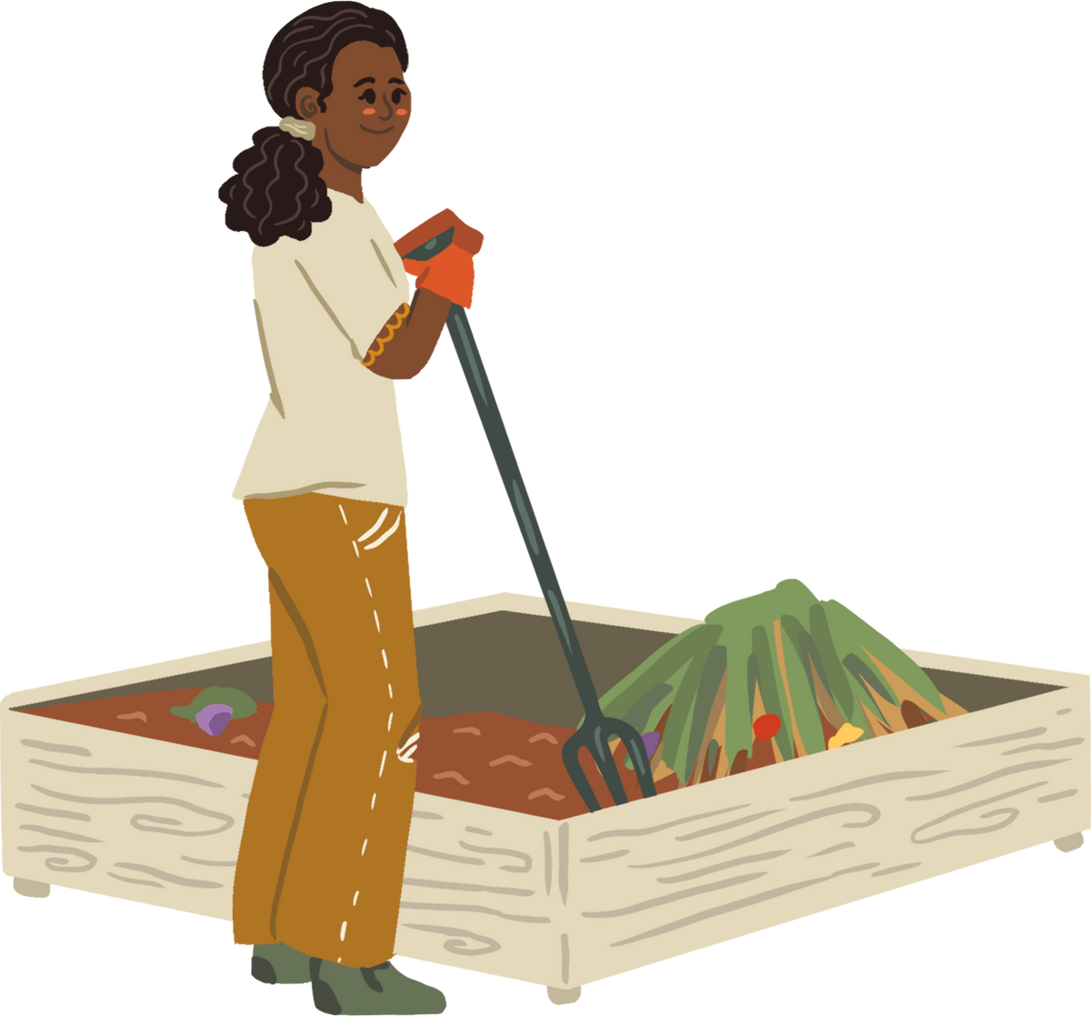


WELCOME TO OUR CLASS!
Presented by: ………

Slide 2
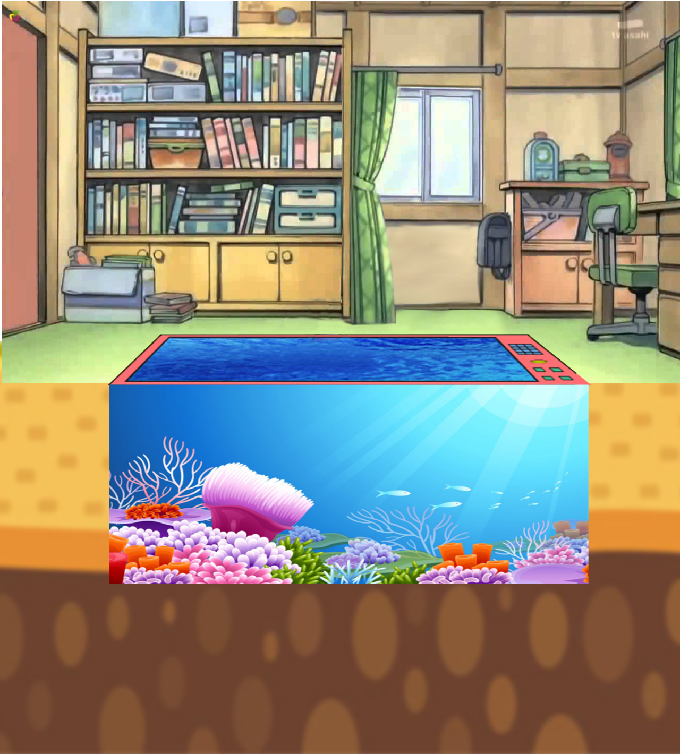



DORAEMON FISHES

Slide 3







GOOD JOB
START
OH, NO
TIMES-UP
My parents enjoy _______ to new places.
A. traveling
B. travel

Slide 4


GOOD JOB
START
OH, NO
TIMES-UP
The teacher avoids ________ too much homework.
A. giving
B. to give

Slide 5
GOOD JOB
START
OH, NO
TIMES-UP
They decided __________ (to rent/renting) an apartment closer to their workplace.
A. to rent
B. renting

Slide 6


GOOD JOB
START
OH, NO
TIMES-UP
She finishes ________ her room before leaving.
A. to clean
B. cleaning

Slide 7
GOOD JOB
START
OH, NO
TIMES-UP
I hope __________ my English skills this year.
A. improving
B. to improve

Slide 8


GOOD JOB
START
OH, NO
TIMES-UP
My parents want __________ more during their retirement.
A. traveling
B. to travel

Slide 9
Unit 6:
VIETNAMESE LIFESTYLE: THEN AND NOW
Lesson 4: Communication

Slide 10


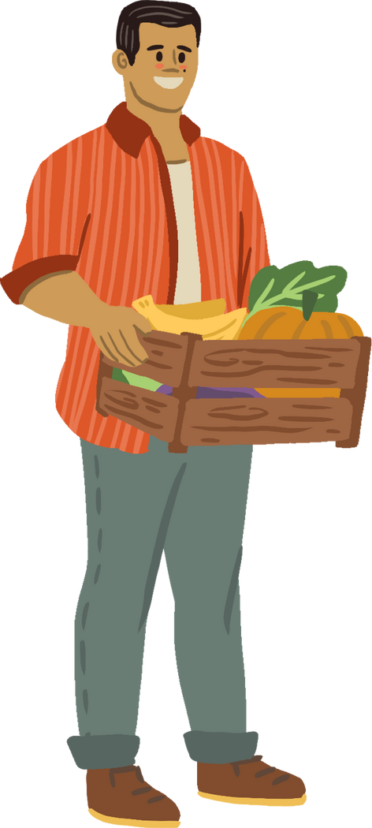
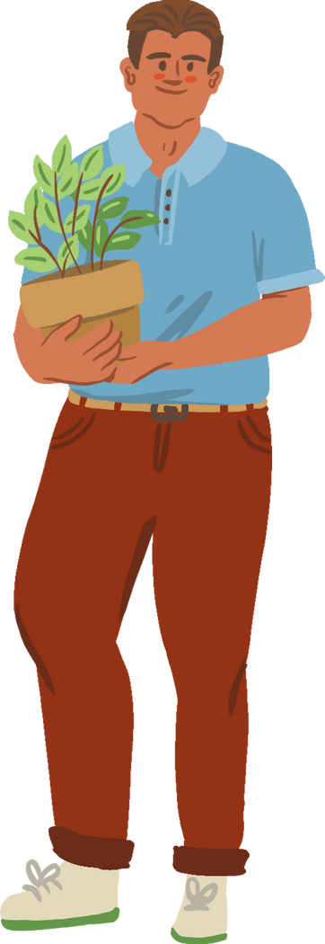

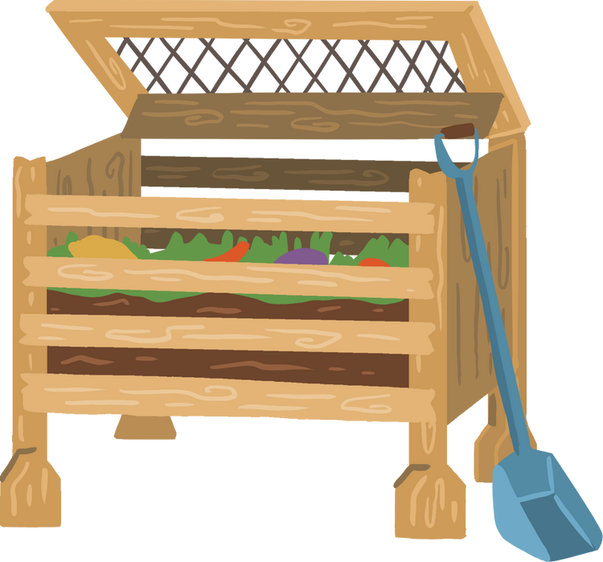
EVERYDAY ENGLISH

Slide 11

1. Listen and read the conversations below. Pay attention to the highlighted parts.
Mike: I will share with you the links about the ancient village of Duong Lam.
Phong: Thank you.
1
Mi: I promise not to bring my dog to the picnic.
Ann: Great! I appreciate it.
2

Slide 12
STRUCTURES:
Making Promises:
I will …
I promise to / not to…
Respond:
Thank you.
I (highly) appreciate it.

Slide 13

2. Work in pairs. Make promises for the following situations.
1. You are going out with friends. Promise your parents to return before 9 p.m.
2. Promise your friend that you will be on time for the performance.

Slide 14
2. Work in pairs. Make promises for the following situations.
1. You are going out with friends. Promise your parents to return before 9 p.m.
I will return / I promise to return before 9 p.m.
I appreciate it.

Slide 15
2. Work in pairs. Make promises for the following situations.
2. Promise your friend that you will be on time for the performance.
I will be / I promise to be on time for the performance.
I highly appreciate it.

Slide 16
CHANGES AROUND YOU

Slide 17
3. Read the passage about changes. Then match the people with the topics they are talking about.
1. Aki from Tokyo | Children used to go to temple schools. Monks, samurai, doctors, and people of other professions served as teachers. Nowadays, children study in modern schools with teachers who get professional training in the subjects they teach.
2. Sanjay from New Delhi | Once, it was easy to say which country a person was from because people wore their own traditional costumes. Now, trends, comfort, and style are more important. More people are wearing western clothes like jeans and T-shirts instead.
3. Asim from Cairo | In the past, people used animals such as horses and camels for travelling. Now, airplanes, ships, and trains have replaced them. Transportation has become faster and easier.

Slide 18
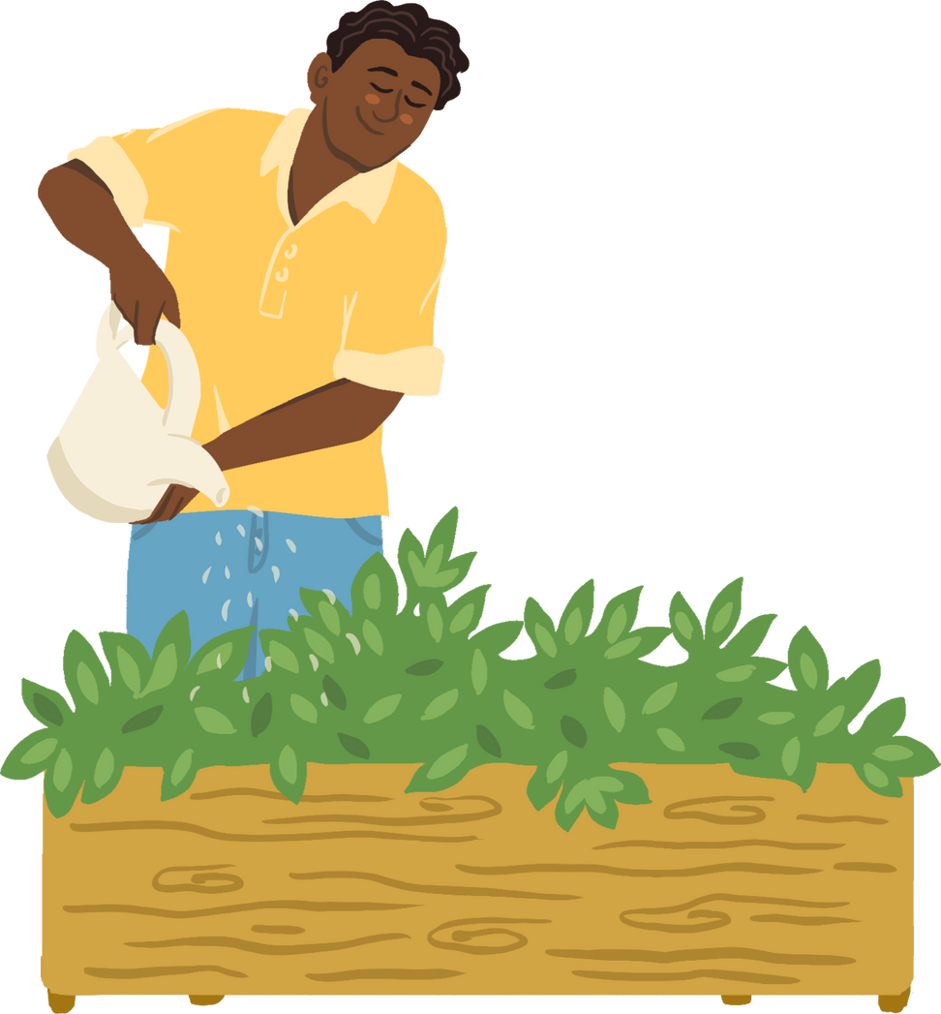
3. Read the passage about changes. Then match the people with the topics they are talking about.
PEOPLE | TOPICS
1. Aki | a. Transportation
2. Sanjay | b. Education
3. Asim | c. Clothes

Slide 19
4. Work in groups. Read the passages in 3 and discuss
What aspects of life in the past you want to experience
What change you think is for the better, and why

Slide 20
5. Work in pairs. Read the list below. Tell your partners which of them has remained the same and which has changed over the past five years. Take notes of your partner’s answers and report them to the class.
– Your style of clothes
– Your eating habits
– Your hobbies
– Your favourite actor / singer / book / movie
There have been some changes in ............ lifestyle. The first change is her/his…. However, her/his … has / have not changed over the past five years.

Slide 21
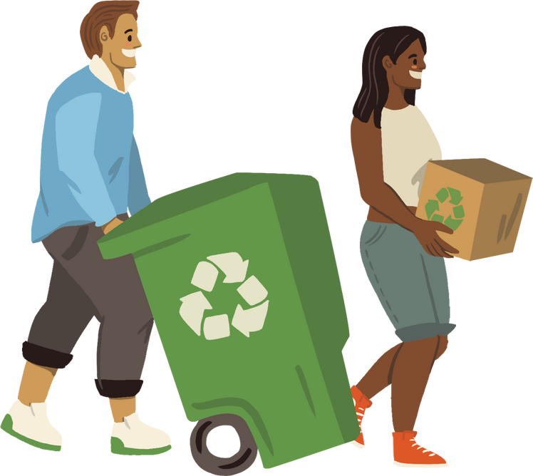
WRAP-UP
What have we learnt in this lesson?
Know how to make promises
Talk about Changes in Lifestyle

Slide 22
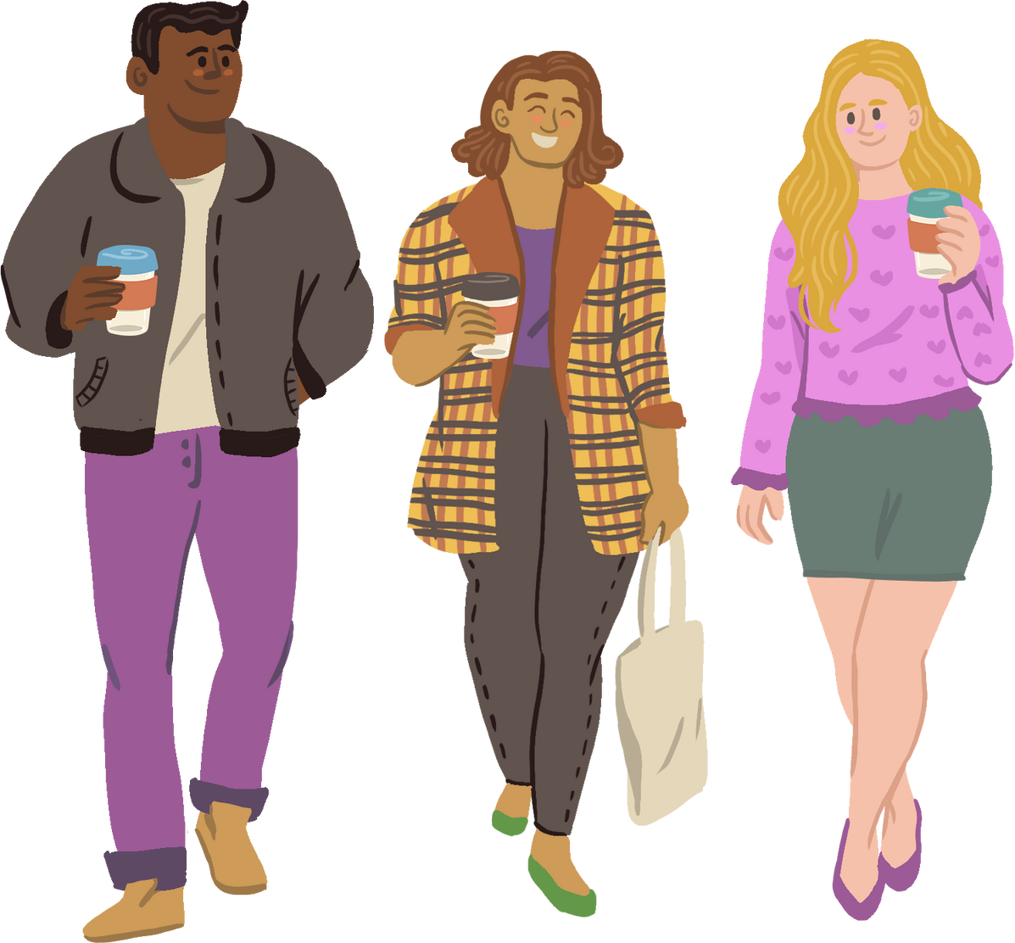
HOMEWORK
- Practice making promises and responding
- Do exercises in the workbook.
- Prepare: Skills 1

Slide 23
THANK YOU!

