Slide 1




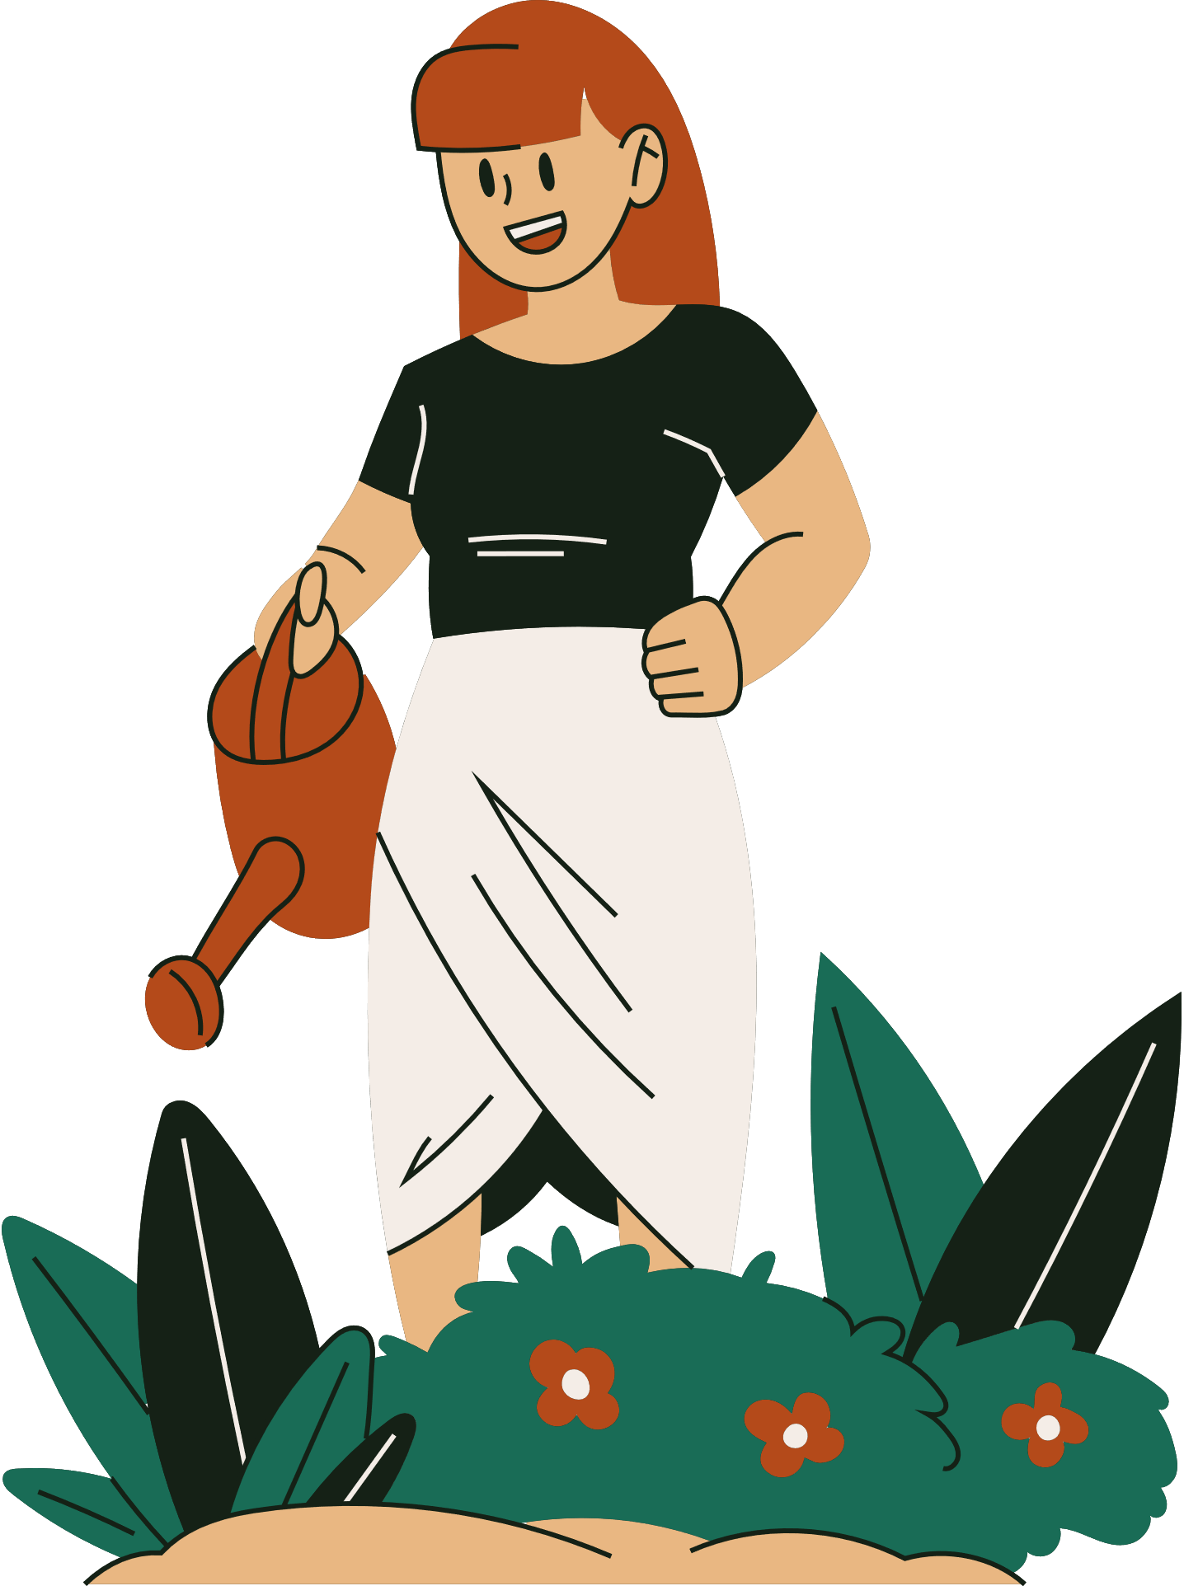
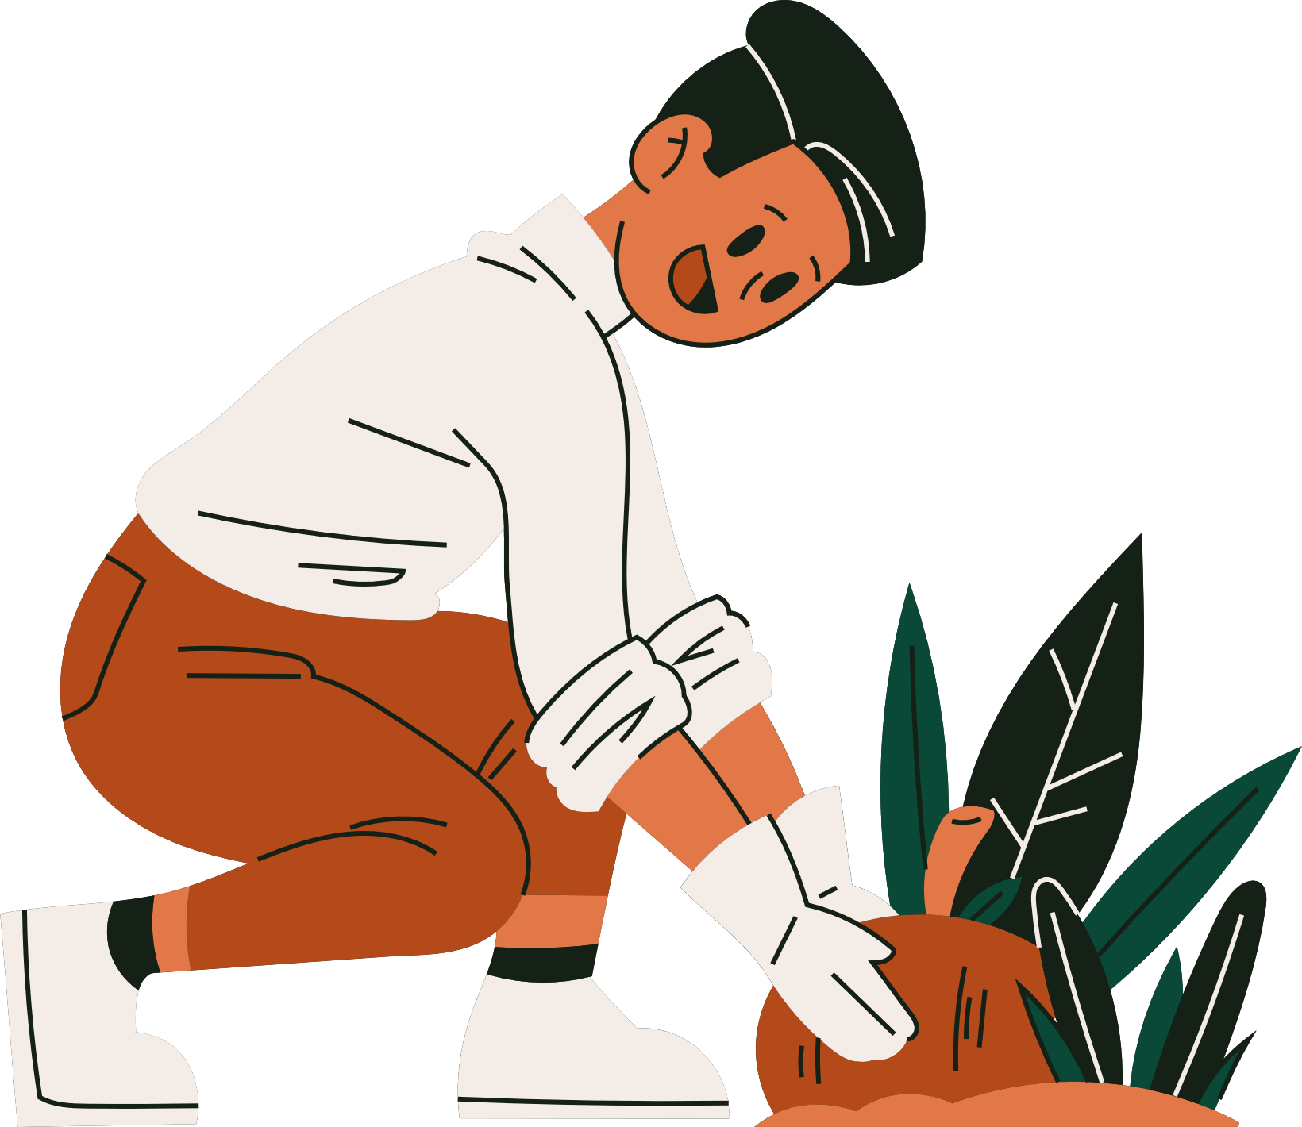



WELCOME TO OUR CLASS

Slide 2
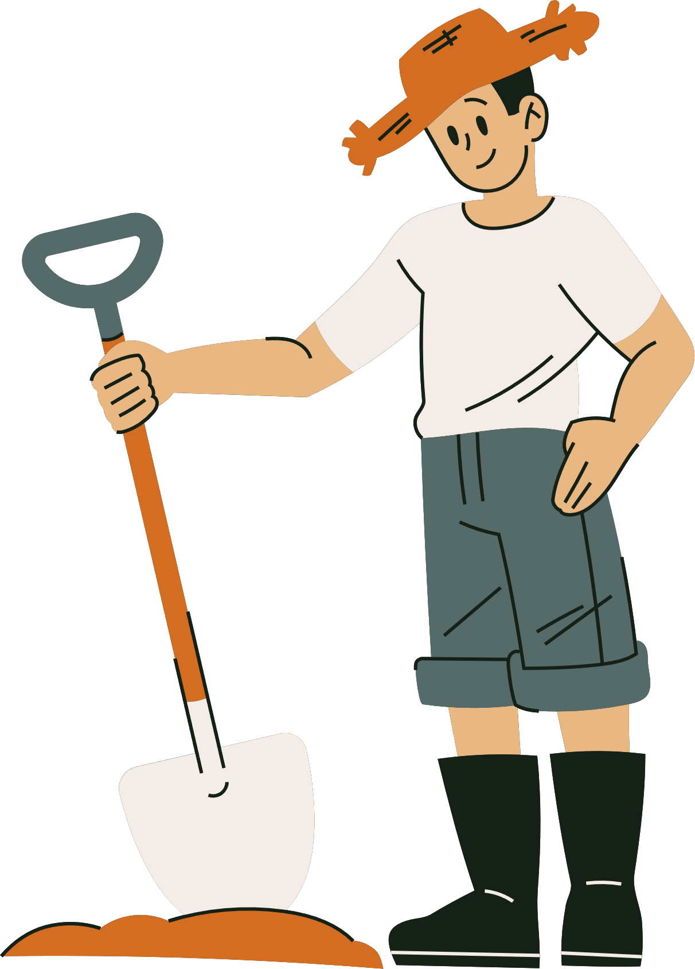

Who knows more?
Name some learning facilities you know

Slide 3
Who knows more?
Bookshop, classroom, laboratories, libraries, Computer labs, online learning platforms,…

Slide 4
Unit 6:
VIETNAMESE LIFESTYLE: THEN AND NOW
Lesson 5: Skills 1

Slide 5
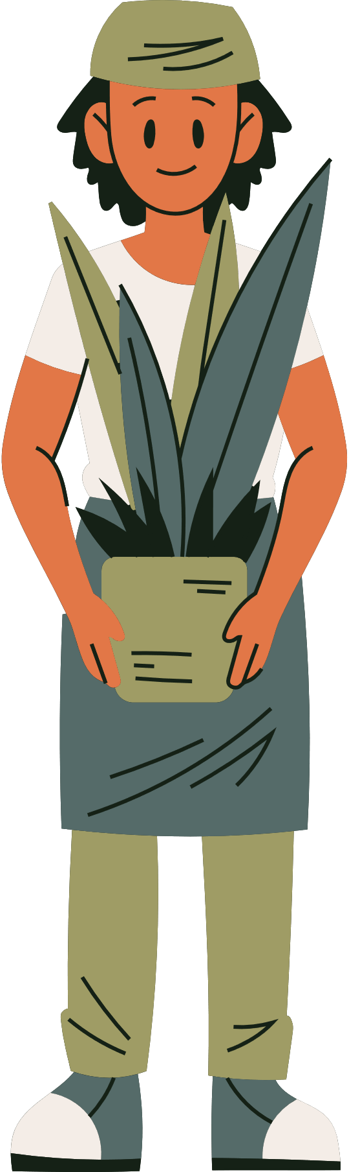
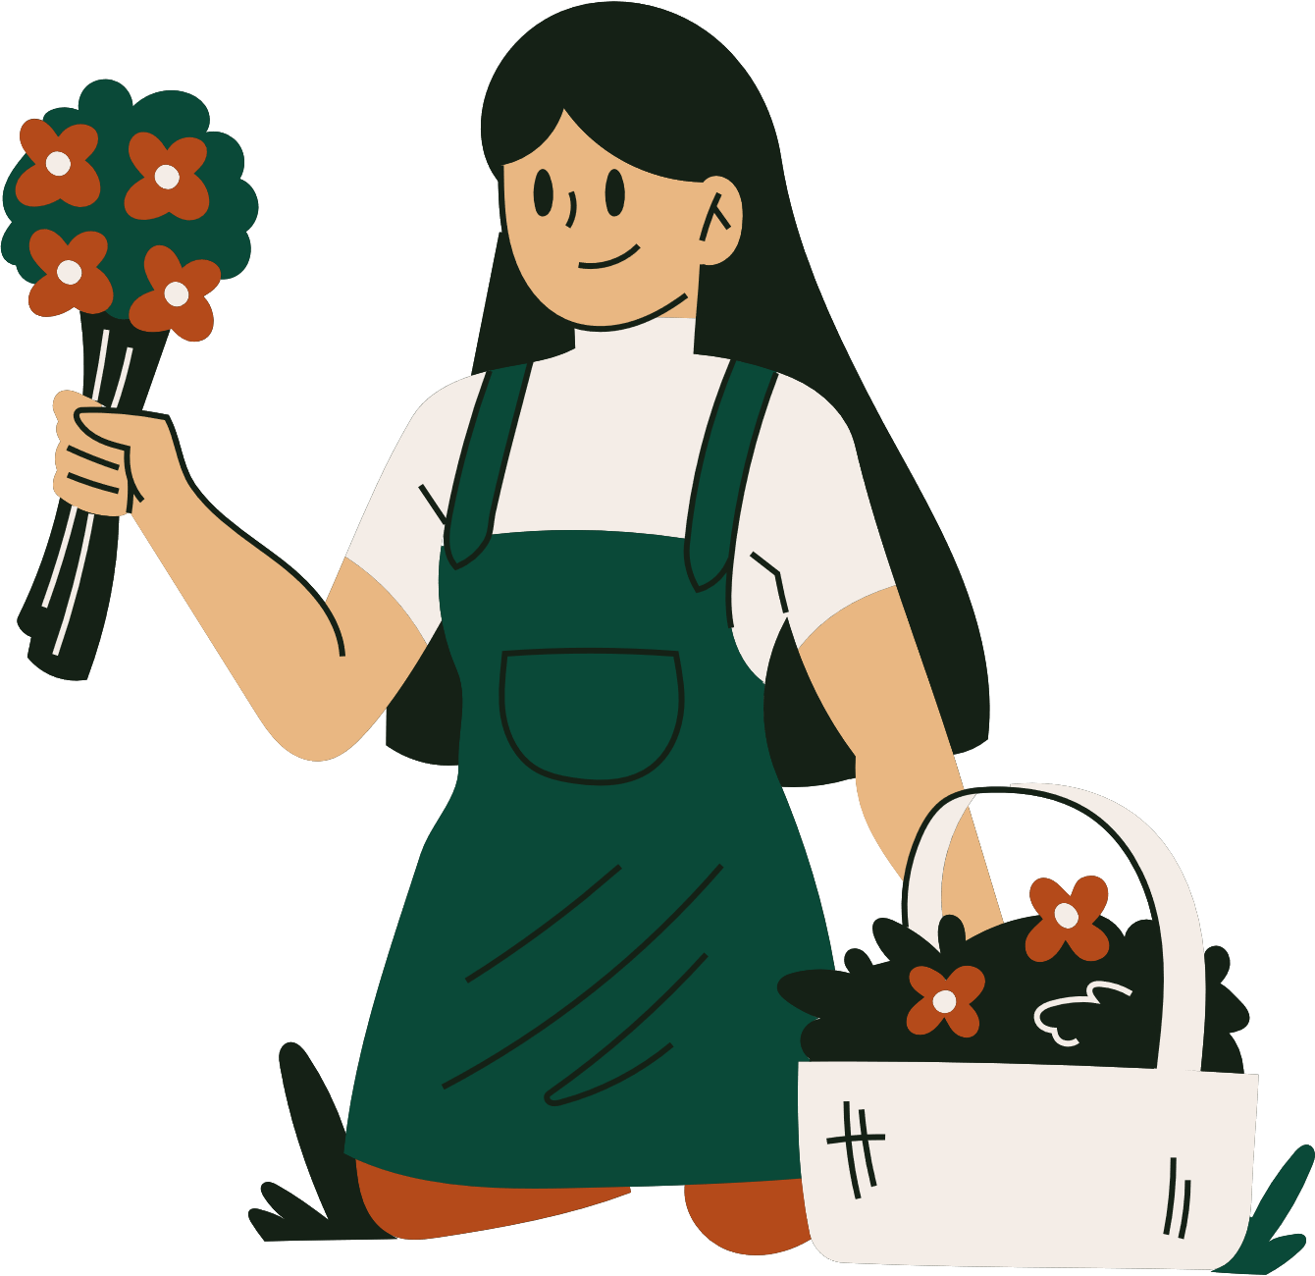
1. Work in groups. Discuss if each of the following phrases describes past or present learning.
 | Past learning | Present learning
1. Depending on textbooks
2. Using the Internet
3. Learning under an oil lamp
4. Being independent and active

Slide 6
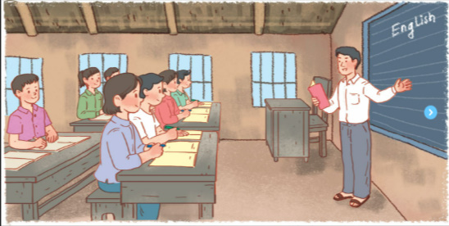
2. Two people of different generations are talking about their learning styles. Read the passages and choose the correct answer a, b, c or d
Mr Nam, grandfather, a 70-year-old farmer
I was one of the few children in my village who was still at school at the age of 15. Every day, I got up early and walked to school. Learning then depended mostly on our teachers and textbooks. We had no library or lab. The nearest bookshop was six kilometres away. I learned simply by taking notes during class, memorizing them, and doing the homework. Life then was simple. We rarely travelled outside our village, so we didn’t know much about the world around us.

Slide 7
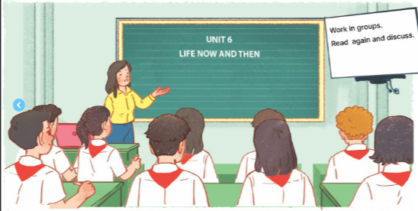
2. Two people of different generations are talking about their learning styles. Read the passages and choose the correct answer a, b, c or d
Mai, granddaughter, a 15-year-old student
Learning today is very different from my grandfather’s time. It is easier and more convenient. Besides learning from teachers and textbooks, we use the Internet. It provides us with various online sources such as documents, clips, and programmes. Google helps us find the answers to almost any questions we have. The Internet also allows us to pursue our own interests. Learning has become more independent. Although most children in my village have fewer private learning facilities than the students in the city, we are still luckier than my grandfather’s generation. We have TVs to watch at home and a library and computers at school.

Slide 8
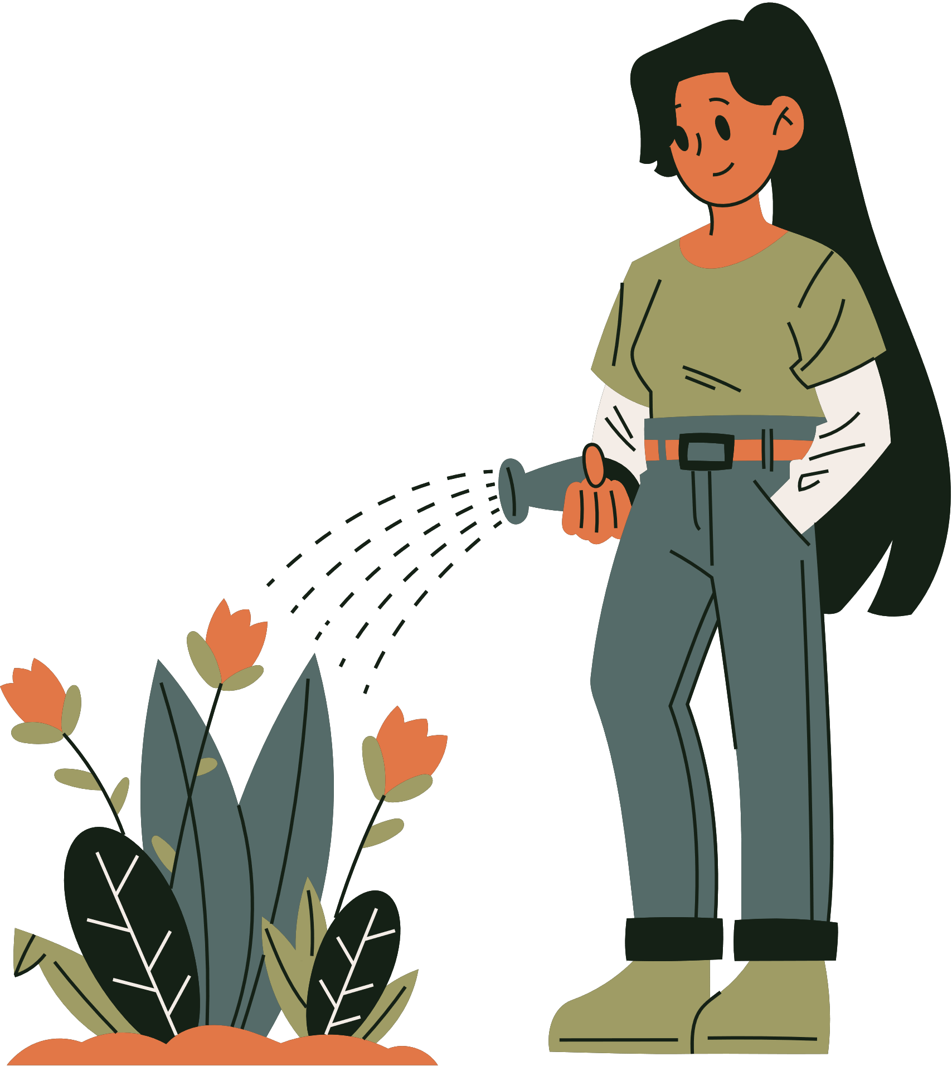
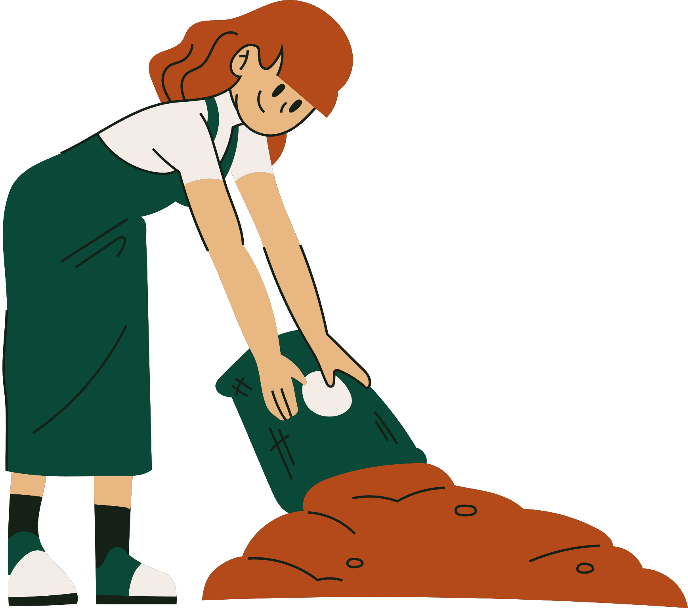
Read the passages and choose the correct answer a, b, c or d
1. In Mr. Nam’s time, ______.
A. teachers played an important role
B. there were no bookshops
C. students did experiments in labs
D. all children stayed on at school until they were 15
2. Few people travelled outside their village, so ______.
A. life in the village was simple
B. his school didn’t have any learning facilities
C. the villagers didn’t know much about the world around
D. none of the villagers knew about city life

Slide 9
Read the passages and choose the correct answer a, b, c or d
3. Learning now ______.
A. does not require textbooks
B. uses some online programmes
C. depends only on the Internet
D. does not require students to take notes
4. The word “It” refers to ______.
A. learning today
B. my grandfather’s time
C. learning facilities
D. the Internet

Slide 10
Read the passages and choose the correct answer a, b, c or d
5. The word “we” refers to__________.
A. learning facilities
B. students at my grandfather’s generation
C. students in the city
D. children in the village

Slide 11
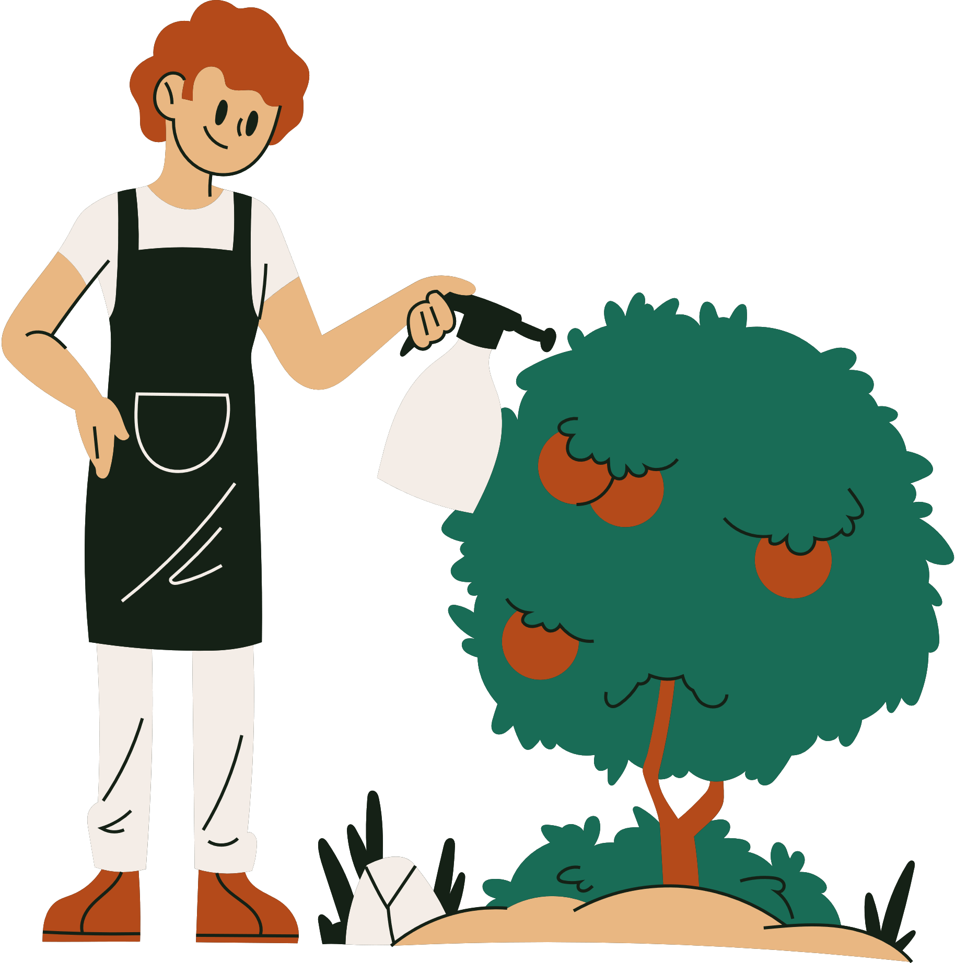
3. FILL IN EACH BLANK WITH ONE WORD FROM THE PASSAGE
textbooks
1. Mr Nam learned mainly from teachers and _________.
2. He learned by___________the information he got in class.
3. Nowadays, students can learn from _________ online sources.
4. An example of an online source is _________________.
5. The Internet helps children _________ their interests.
memorising
various
documents/clips/
programmes
pursue

Slide 12
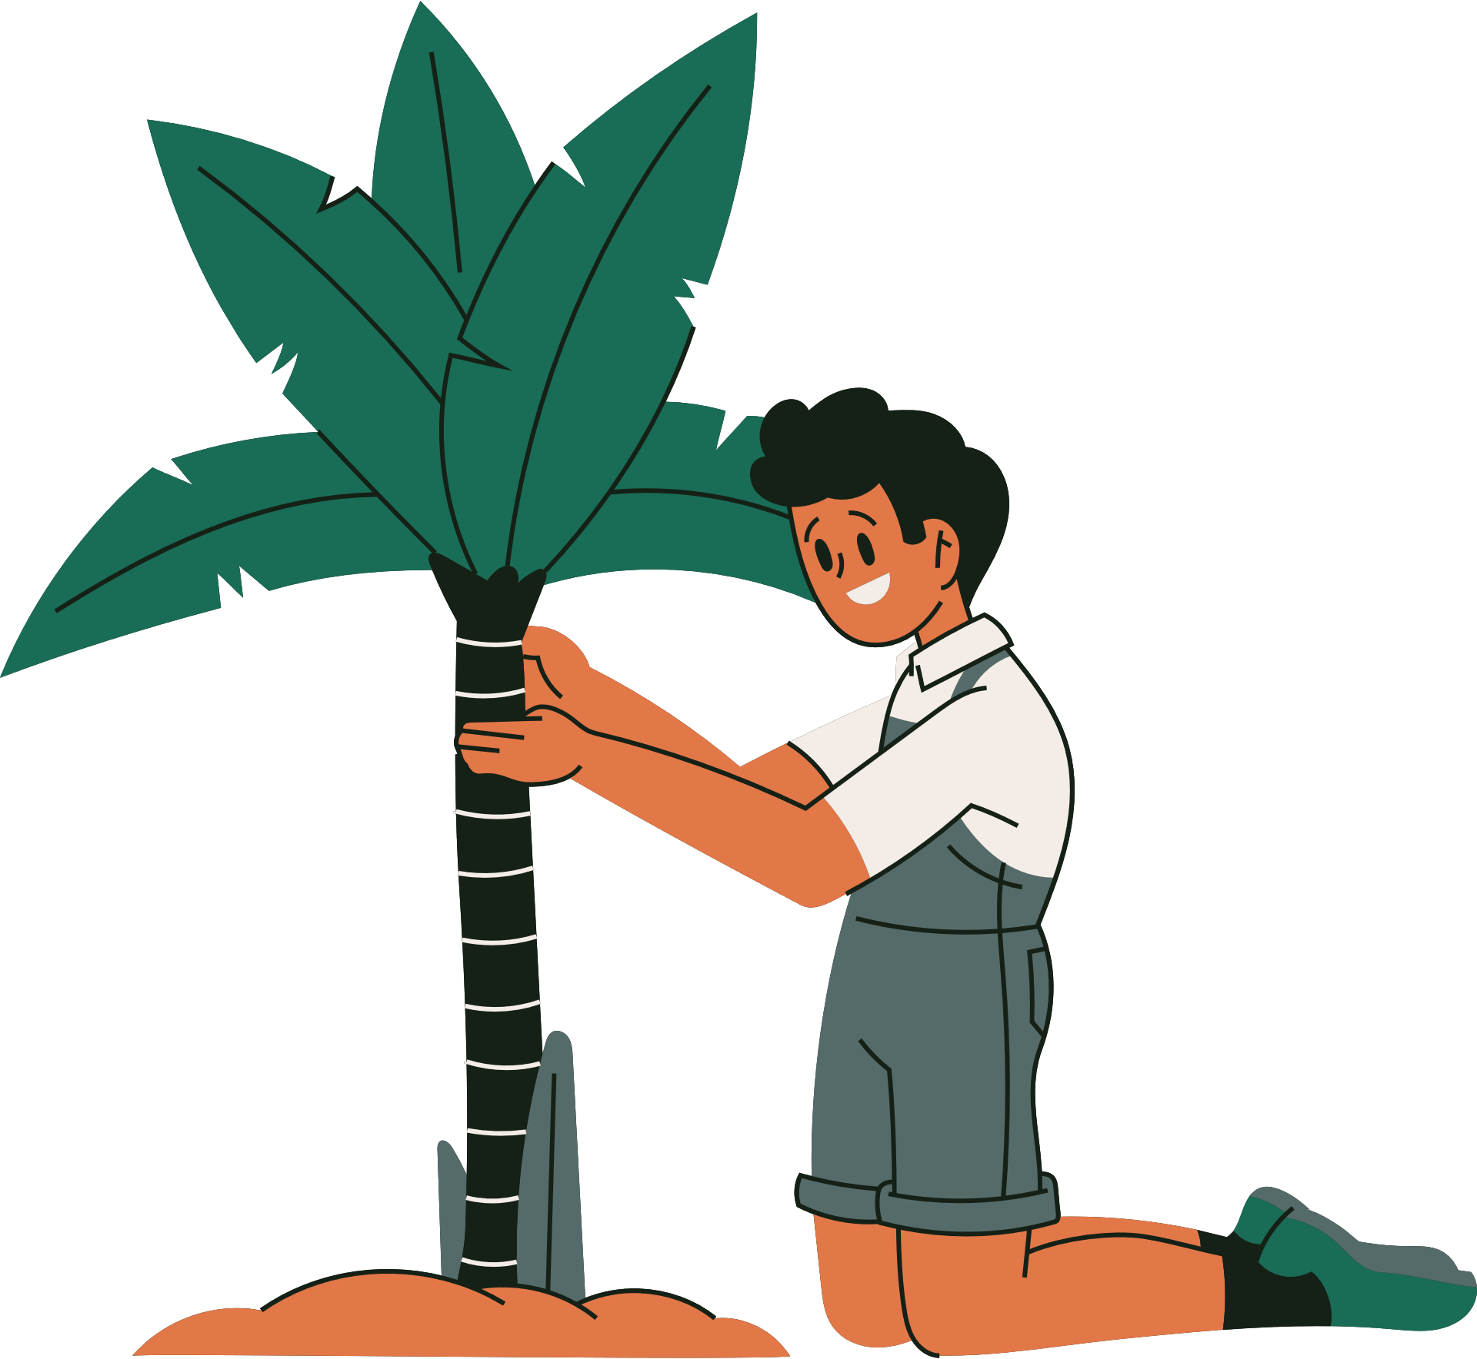
4. WORK IN GROUPS. DISCUSS AND MAKE A LIST OF THE CHANGES IN YOUR LEARNING OVER THE PAST FIVE YEARS.
You can mention:
number of subjects
teachers
learning facilities
learning style (dependent/ independent….)

Slide 13
4. WORK IN GROUPS. DISCUSS AND MAKE A LIST OF THE CHANGES IN YOUR LEARNING OVER THE PAST FIVE YEARS.
Suggested answer:
Teachers: three or four teachers teach all the subjects -> different teachers for different subjects.
Learning Facilities: almost text book -> use textbooks and internet…
Learning style: dependent -> independent

Slide 14
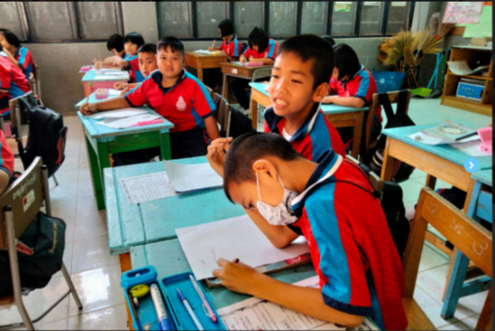
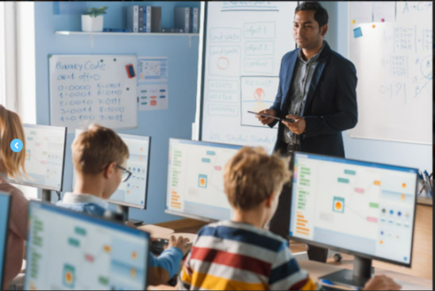
5. Share with the class the list your group has made in 4
- Present the changes that your groups have talked about.
- Listen and give comment or ask questions if you have any.

Slide 15
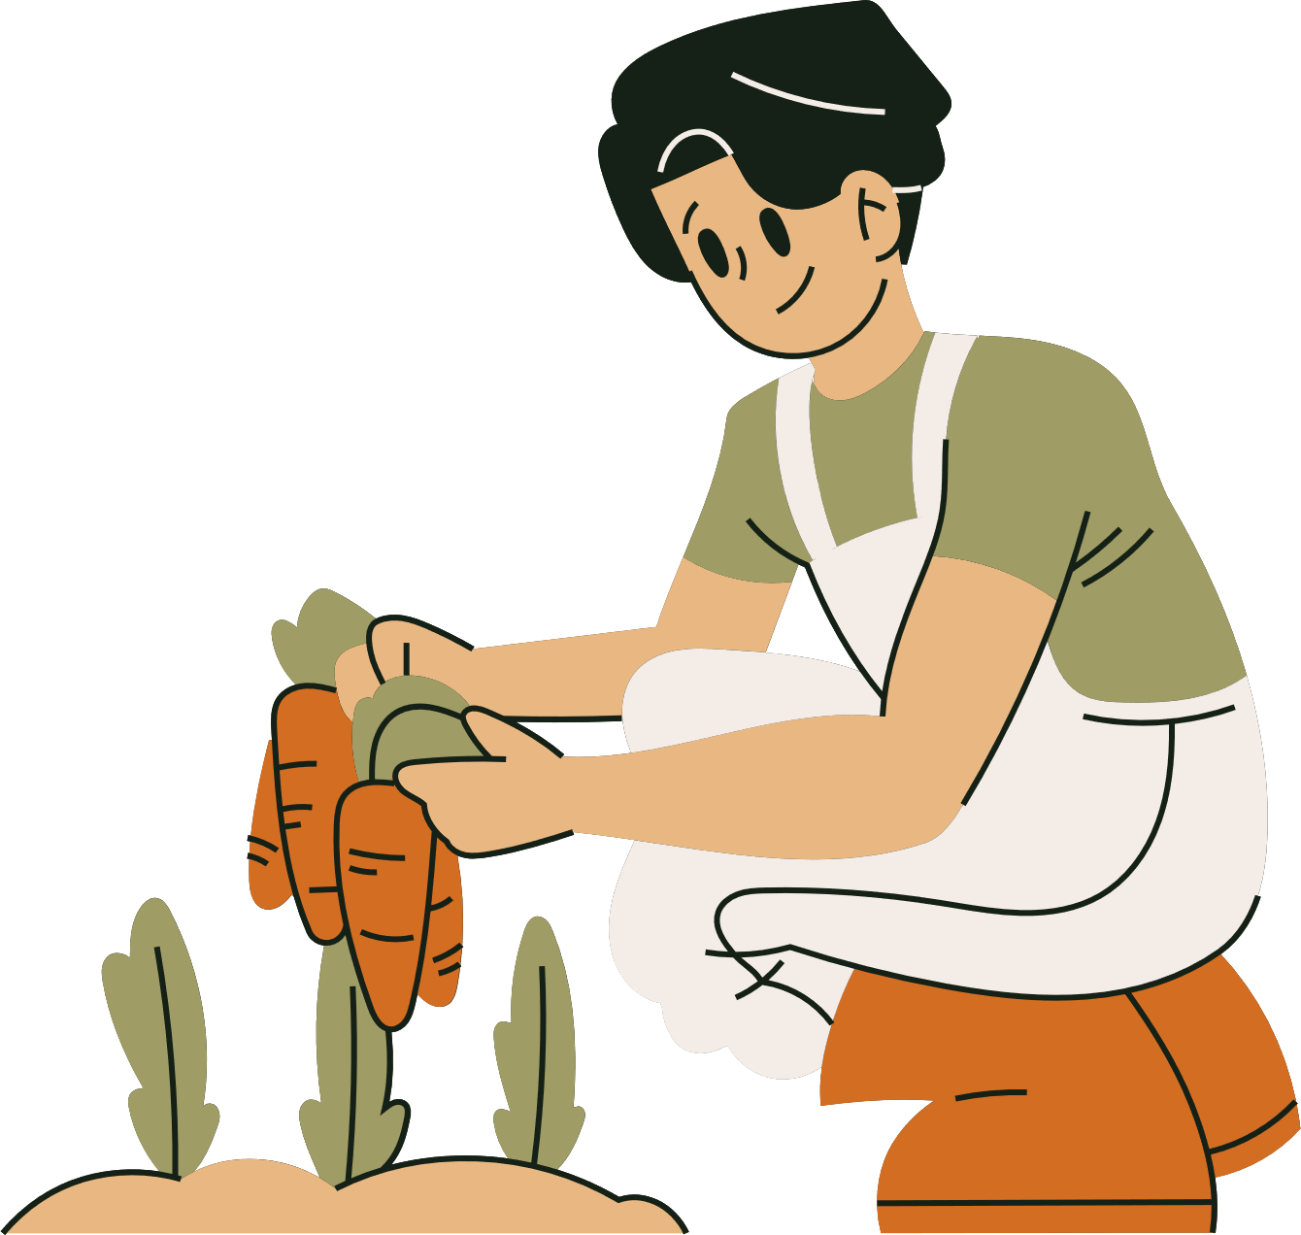
5. Share with the class the list your group has made in 4
Example:
Five years ago, we were at primary school. We had only three or four teachers teaching us all the subjects. We depended on the teachers to tell us everything we needed to do: taking notes in our notebooks, doing homework and preparing for exams. We rarely did anything that the teacher did not request. Now, we have different teachers for different subjects. We have also become more independent and active in our learning. We use the internet to learn about our interests. And it costs little to do it.

Slide 16
WRAP-UP
What have we learnt in this lesson?
Read for specific information about the differences in the learning styles of past and present
Talk about changes in one’s learning style

Slide 17
HOMEWORK
Do exercises in the workbook
Prepare: Skills 2

Slide 18
Thank
You

