Slide 1



WELCOME TO OUR CLASS!
Presented by: …………

Slide 2

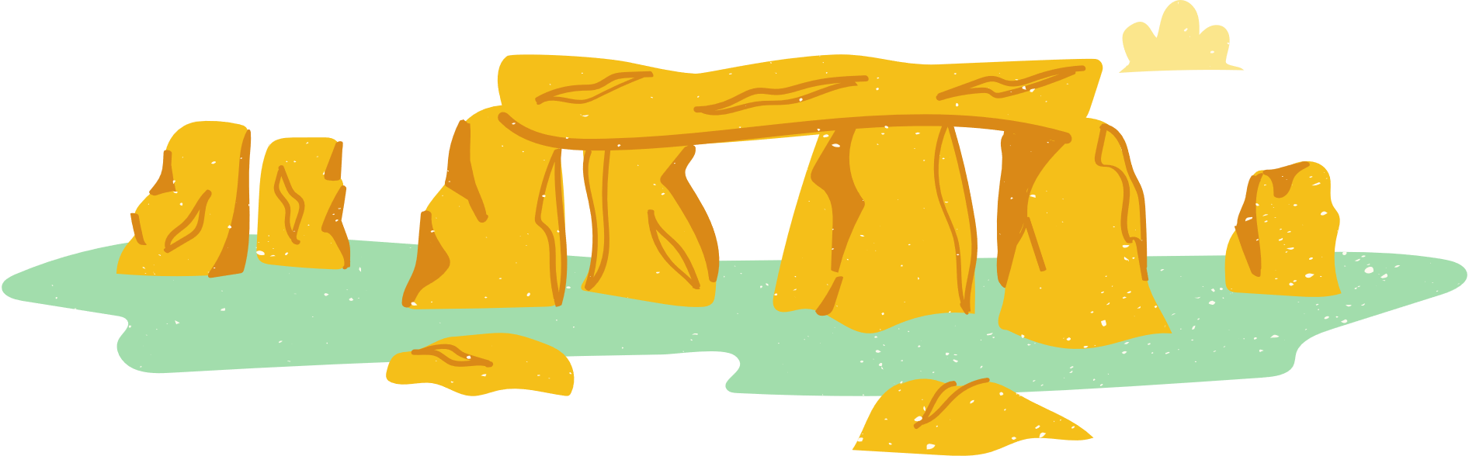
WARM UP

Slide 3
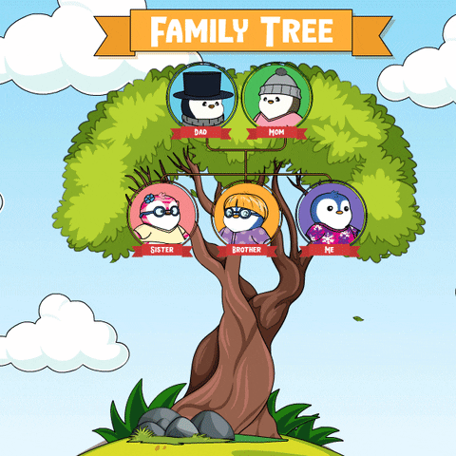
Family Tree Brainstorm
- Create a family tree diagram, starting with yourself as the center and extending outwards to include your parents, grandparents, siblings, …..
- Add details to each branch of their family tree, including names, relationships, occupations, memorable events, and any unique traditions or customs associated with your families

Slide 4


Father: Ben
Age: 50
He has taught me many things
Mother: Mary
Age: 45
She always takes care of me
PETER
Brother:............
Sister:.........
.....................
.....................

Slide 5
LISTENING

Slide 6

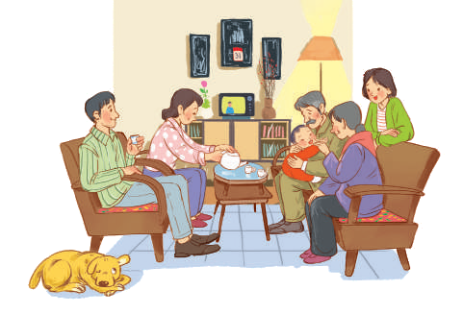

1. You are going to listen to a talk about family life. Work in pairs. Choose the aspect(s) that you think will be mentioned in the talk.
a. Family types
b. Parents’ working places
c. Family holidays
d. Birthday parties
e. Parents-children relations

Slide 7



2. Listen to the talk and tick (√) the correct column.
FACTS | THE PAST | THE PRESENT
1. Popularity of extended families
2. More holidays away from home
3. More time spent doing things together
4. More source to learn from
5. More democratic parent-children relationships
✓
✓
✓
✓
✓

Slide 8

3. Listen again and fill in the blank with one word or number.
two
1. The speaker mentions ____________ types of families.
three
2. In an extended family, there is / are ___________ generation(s) living together.
family-oriented
3. The speaker describes Vietnamese people as _________________.
elders
4. Children in the past usually came to their ___________ to share their experiences.
5. Today’s children want their parents to respect their independence and _______________.
privacy

Slide 9
Changes in their family over the past five years
WRITING

Slide 10
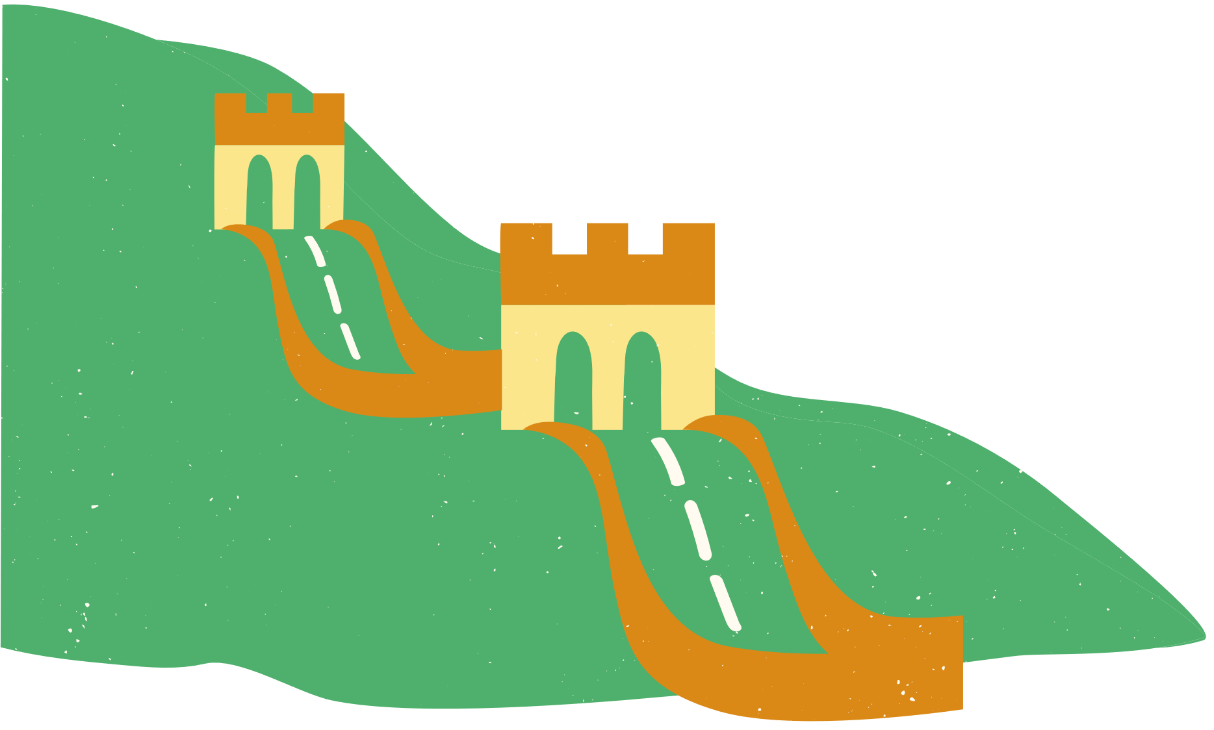
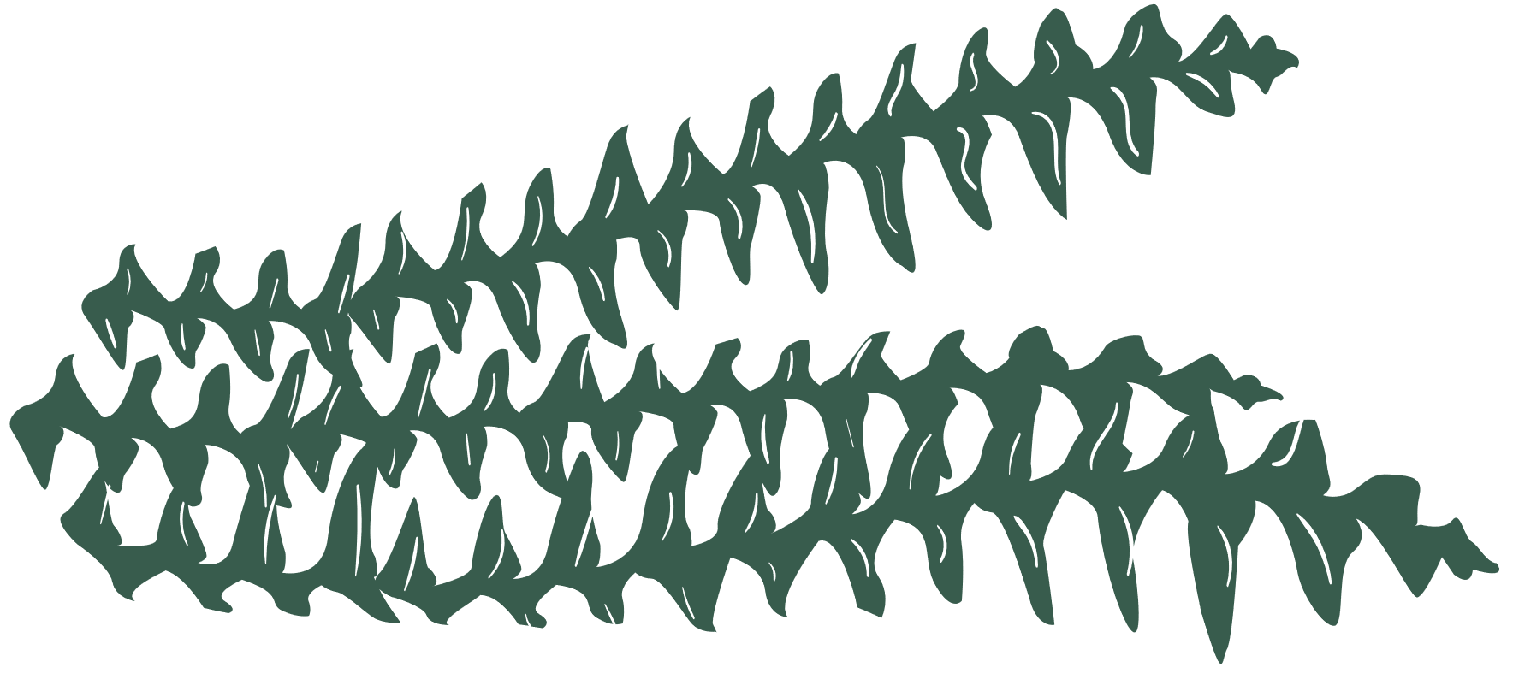
4. Read the list and tick (√) the thing(s) that has/have changed in your family in the past five years. Make notes of those which have changed.
List | Change
1. Family type / members | Still nuclear. One more member: my brother
2. Home facilities
3.Ways of spending free time
4.Relationships among members
√
better, air conditioner, washing machines,…..
eat out, go on holiday, do chores..
respect each other

Slide 11

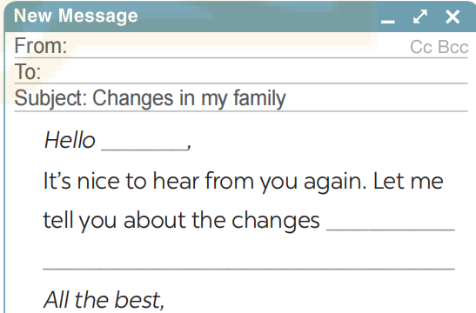

5. Write an email (100 - 120 words) to your penfriend about the changes in your family. Use the ideas in 4.

Slide 12



From: Hoa
To: Tom
Subject: Changes in my family
Hello Tom,
It’s nice to hear from you again. Let me tell you about the changes in my family over the past five years. It’s still a nuclear family with two generations. But our living conditions are much better. Two years ago, my father found another job and he earns more money now. We now have an air conditioner and a washing machine. Sometimes we can eat out or go on holiday. My father also spends more time with my brother and me. He teaches us how to do the chores that adult men should be able to do. We act more like friends. My parents respect our independence and privacy. It’s good news, isn’t it?
All the best,
Hoa

Slide 13


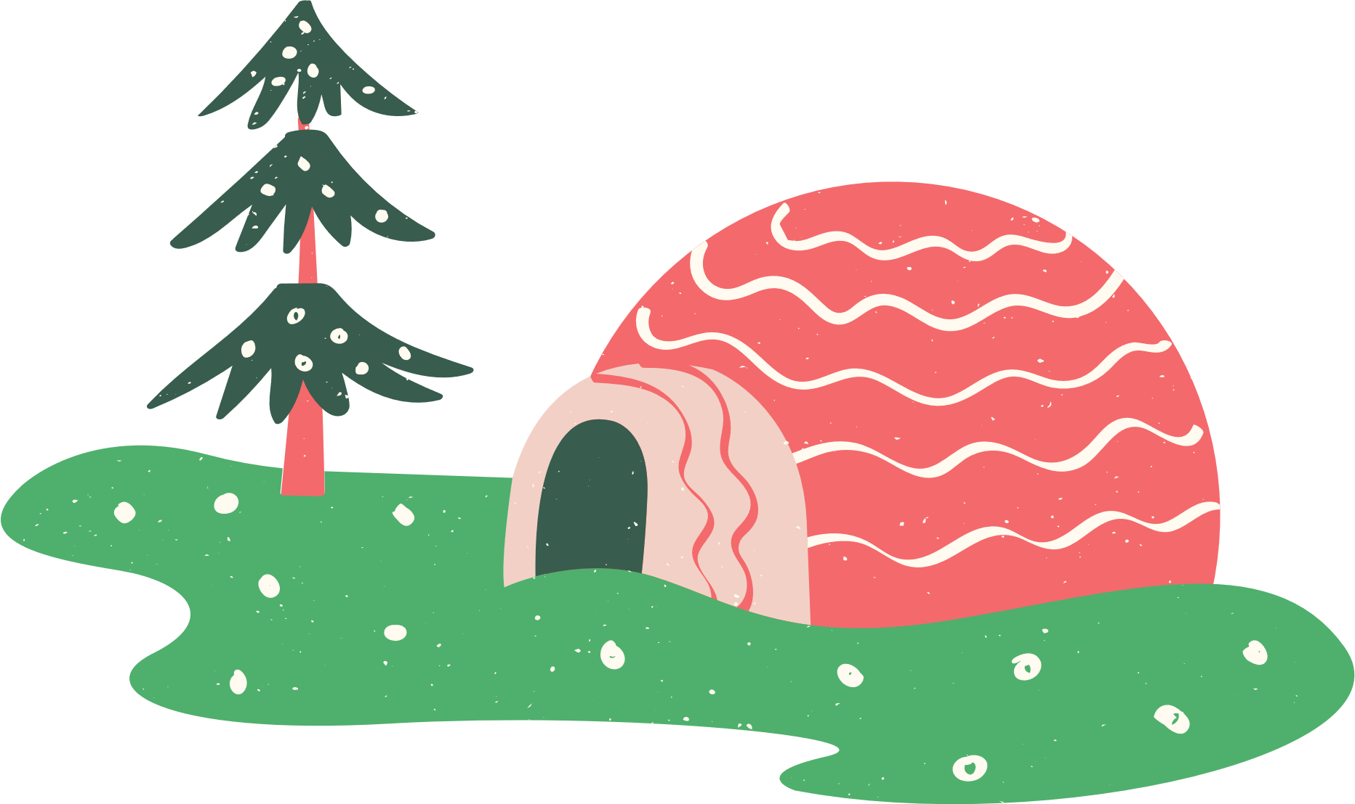
What have you learned in this lesson?
WRAP-UP
Listen for general and specific information to talk about changes in family life
Write about the changes in one’s family. Write about old school days.

Slide 14



- Rewrite the paragraph in the notebooks.
- Do exercises in the workbook.
- Prepare: Looking back.
HOMEWORK

Slide 15


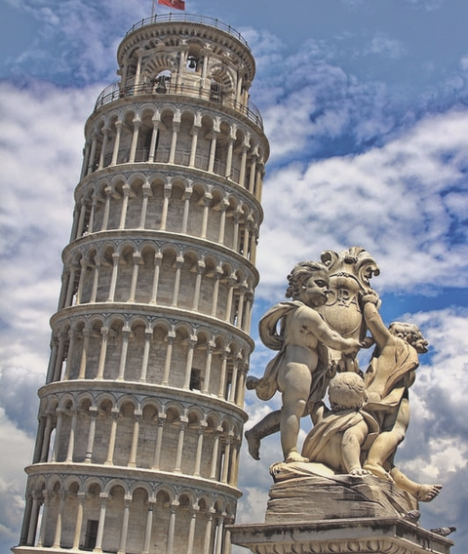


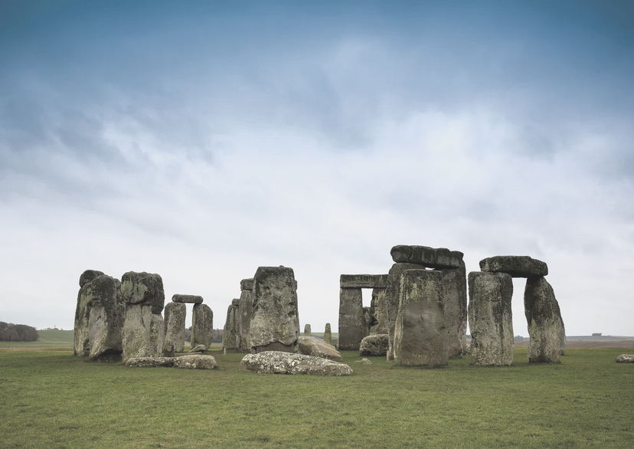


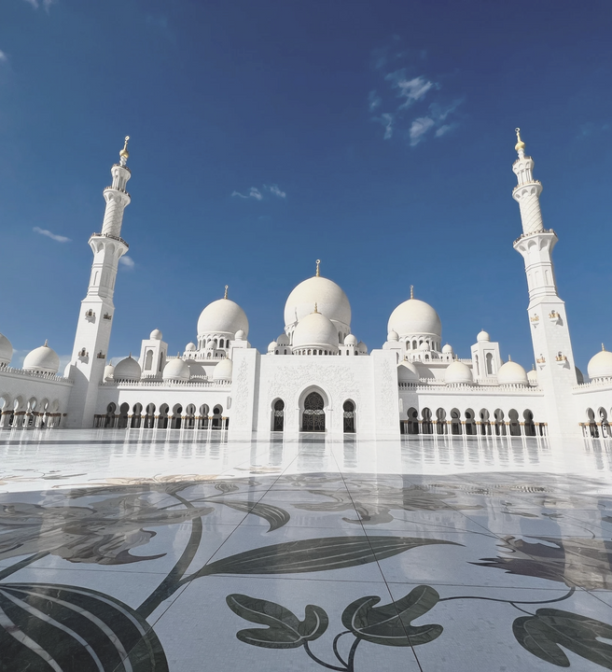

Thank you!

