Slide 1







……… SECONDARY SCHOOL
WELCOME TO OUR CLASS!
Presented by: ………………………….

Slide 2

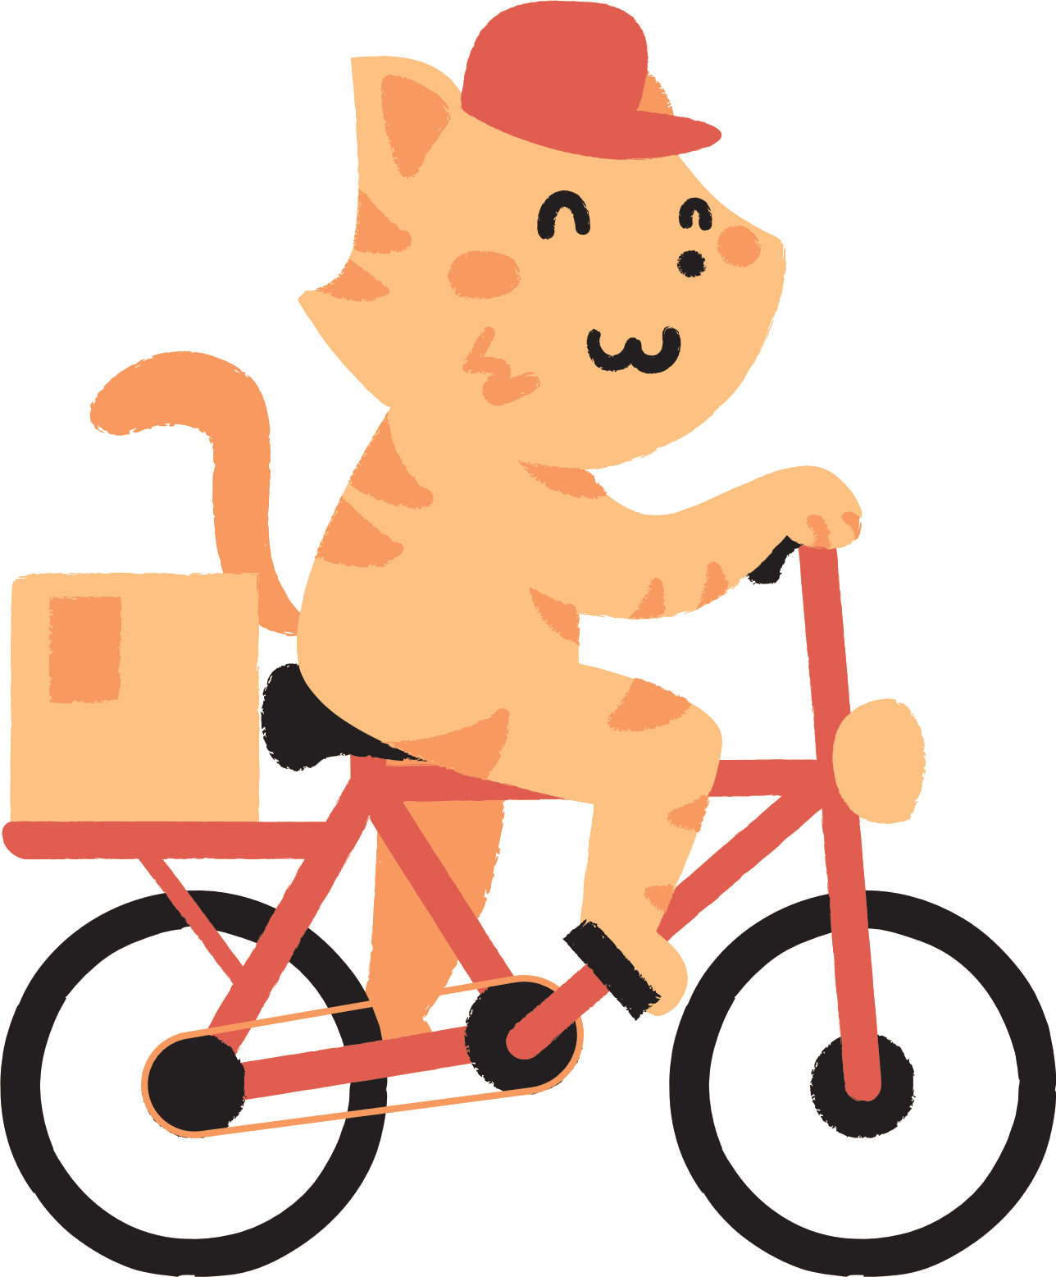

Unit 6:
VIETNAMESE LIFESTYLE: THEN AND NOW
Lesson 7: Looking back

Slide 3
1. Choose the correct answer A, B, C, or D
1. I love animals and I’m determined to ______ my dream of becoming a vet.
A. have B. pursue C. do D. depend on
2. ______ people tend to put the needs of their families ahead of their own.
A. Independent B. Democratic C. Kind D. Family-oriented
3. Rapid changes in society and lifestyle have made the ______ in many families wider.
A. generation gap B. family relation
C. family values D. experiences
4. She has found ______ sources of information about life in Viet Nam a century ago.
A. extended B. alive C. various D. long
5. Like adults, children sometimes want some ______.
A. opportunity B. relations
C. values D. privacy

Slide 4


Finding Nemo

Slide 5











Slide 6






1. I love animals and I’m determined to ______ my dream of becoming a vet.
A. have
B. pursue
C. do
D. depend on

Slide 7
2. ______ people tend to put the needs of their families ahead of their own.
A. Independent
B. Democratic
C. Kind
D. Family-oriented

Slide 8
3. Rapid changes in society and lifestyle have made the ______ in many families wider.
A. generation gap
B. family relation
C. family values
D. experiences

Slide 9
4. She has found ______ sources of information about life in Viet Nam a century ago.
A. extended
B. alive
D. long
C. various

Slide 10
5. Like adults, children sometimes want some ______.
A. opportunity
B. relations
C. values
D. privacy

Slide 11
1. Choose the correct answer A, B, C, or D
1. I love animals and I’m determined to ______ my dream of becoming a vet.
A. have B. pursue C. do D. depend on
2. ______ people tend to put the needs of their families ahead of their own.
A. Independent B. Democratic C. Kind D. Family-oriented
3. Rapid changes in society and lifestyle have made the ______ in many families wider.
A. generation gap B. family relation
C. family values D. experiences
4. She has found ______ sources of information about life in Viet Nam a century ago.
A. extended B. alive C. various D. long
5. Like adults, children sometimes want some ______.
A. opportunity B. relations
C. values D. privacy

Slide 12
2. Complete the sentences with the correct forms of the words in brackets.
1. My parents taught me not to listen to other people’s __________ conversations. (privacy)
2. It’s amazing that the boy can __________ all the information in such a short time. (memory)
3. Living away from home to attend college has made me more ______________(independence).
4. In a modern society, we learn to value a person’s ____________. (free)
5. In a ___________ classroom, every student has the right to speak as well as the responsibility to listen to others. (democracy)
private
memorise
independent
freedom
Hannah
Daniel
Isabel
Aaron
democratic

Slide 13

3. Circle the correct words or phrases to complete the following sentences.
1. Do you mind turning / to turn the volume down? I’m studying.
2. We decided spending / to spend this whole week learning to cook traditional foods
3. If you want seeing / to see the differences between the past and the present of a city, visit its museum.
4. He stayed in his room to avoid meeting / to meet his parents’ guests.
5. My brother promised taking / to take me to the exhibition of traditional farming tools.
Daniel

Slide 14

4. Make complete sentences from the clues. Make any changes and add more words if necessary.
1. we / plan / visit / historical places / Cao Bang.
2. we / hope / have / bus station / near / village / soon.
3. even / grandmother / enjoy / use / Facebook / communicate / her friends.
4. last year / I / learn / make cakes / watch / cooking videos / Internet.
5. this morning / I / suggest / do a survey / northern women’s traditional costumes.

Slide 15

4. Make complete sentences from the clues. Make any changes and add more words if necessary.
1. we / plan / visit / historical places / Cao Bang.
☞ We plan / are planning to visit some historical places in Cao Bang.
Shout "Bingo" if you get five in a row!

Slide 16
4. Make complete sentences from the clues. Make any changes and add more words if necessary.
2. we / hope / have / bus station / near / village / soon.
☞ We hope to have a bus station near our village soon.
Shout "Bingo" if you get five in a row!

Slide 17
4. Make complete sentences from the clues. Make any changes and add more words if necessary.
3. even / grandmother / enjoy / use / Facebook / communicate / her friends.
☞ Even my grandmother enjoys using Facebook to communicate with her
Shout "Bingo" if you get five in a row!

Slide 18
4. Make complete sentences from the clues. Make any changes and add more words if necessary.
4. last year / I / learn / make cakes / watch / cooking videos / Internet.
☞ Last year, I learned to make cakes by watching the cooking videos on the Internet.
Shout "Bingo" if you get five in a row!

Slide 19
4. Make complete sentences from the clues. Make any changes and add more words if necessary.
5. this morning / I / suggest / do a survey / northern women’s traditional costumes.
☞ This morning, I suggested doing a survey on traditional northern women’s costumes.
Shout "Bingo" if you get five in a row!

Slide 20
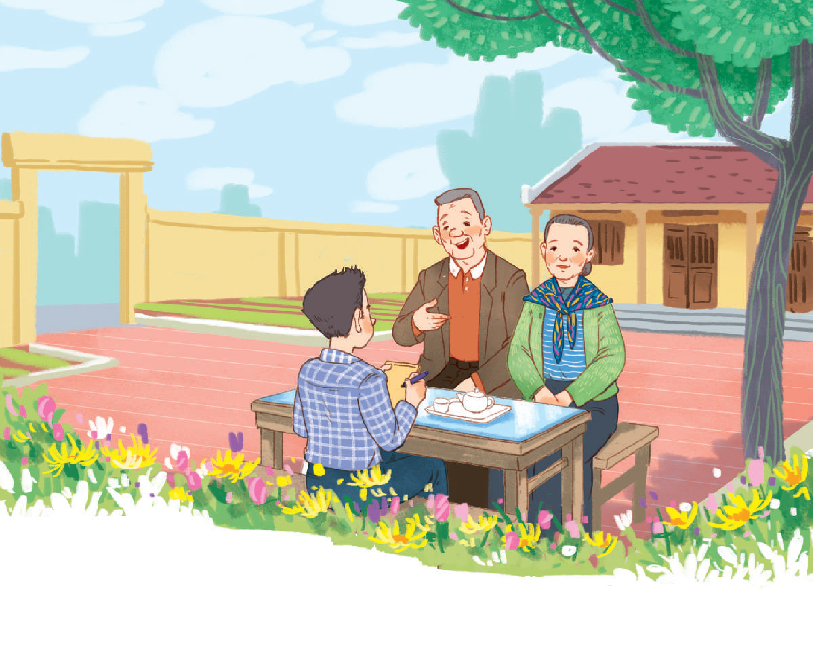
I KNOW MY ______ WELL!

Slide 21


WRAP - UP
What have we learnt in this lesson?
Review the vocabulary and grammar of Unit 6
Apply what they have learnt (vocabulary and grammar) into practice through a project.
Aaron

Slide 22
HOMEWORK
Review the vocabulary and grammar of Unit 6
Prepare for the next unit
Aaron

Slide 23
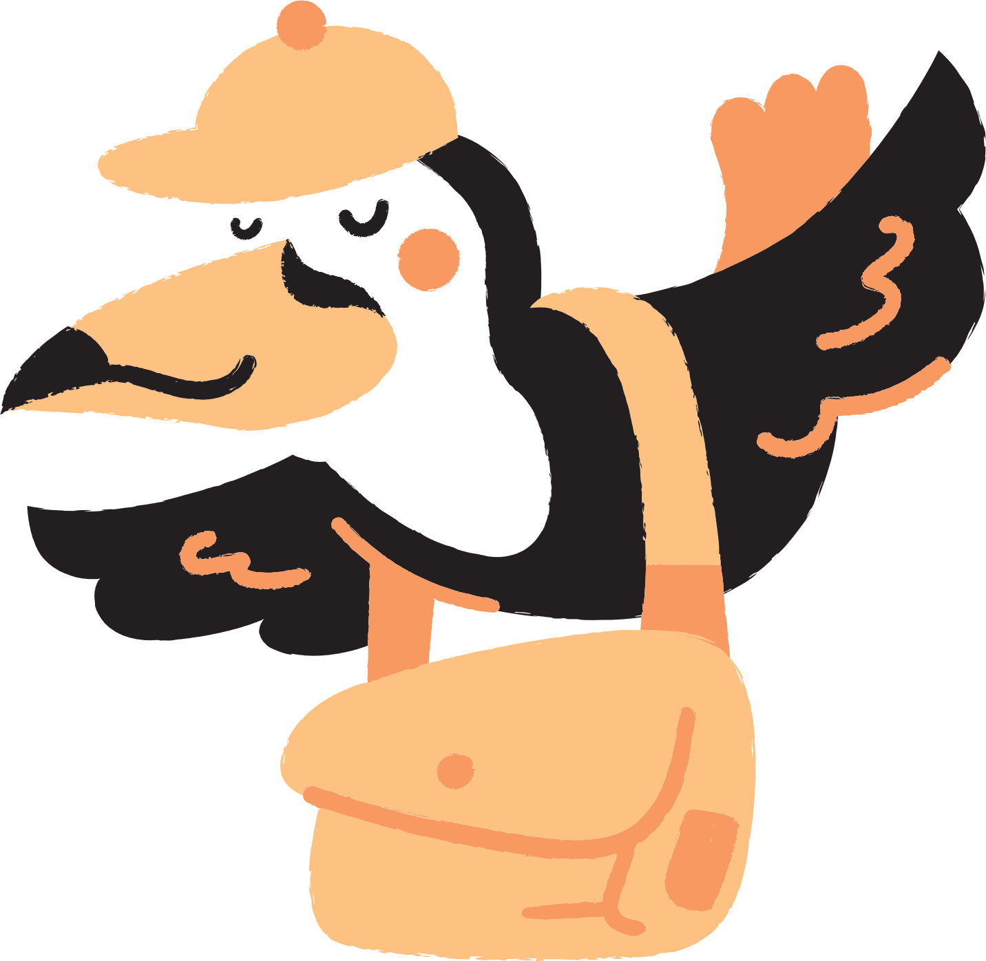
Thank you!

